Slide 1

Alameda County Behavioral Health Department (ACBHD)
Opioid Settlement Listening Session
(2025)
Presenters
Dr. Kathleen Clanon (Agency Medical Director, Alameda County Health)
James Wagner (Deputy Director of Clinical Operations, ACBHD)
Dr. Joshua Kayman (Medical Director of Substance Use Continuum of Care, ACBHD)
Dr. Anna Phillips (Director of Substance Use Continuum of Care, ACBHD)
Jill Louie (Budget Director, ACBHD)

Slide 2
Purpose Statement
The purpose of the opioid settlement listening sessions is to give stakeholders opportunity on an annual basis to provide feedback to Alameda County regarding the usage and expenditure of the opioid settlement dollars. In addition, the County will give an overview of the current opioid crisis in Alameda County and the expenditures that have been implemented. The listening sessions are open to any Alameda County resident to attend.

Slide 3
What is an opioid listening session?
The listening sessions will serve as a venue for Alameda County Behavioral Health Department (ACBHD) to provide an update to the stakeholders and to gather their input:
Opioid Settlement dollars from the national lawsuit that Alameda County signed on to.
Stakeholders to hear about what ACBHD has done thus far with the settlement money.
To provide opportunity for input on opioid settlement dollars and on how to make the best use of the dollars.
To assist the County in dreaming big and how to abate the opioid crisis in Alameda County.

Slide 4

Why am I here? Who is attending the listening sessions?
Participants have been identified as having a stake or vested interest in the opioid crisis.
Attendance is made up of individuals impacted directly by the crisis, family members of impacted individuals, and organizations that provide services to the impacted population.
Any resident of Alameda County who is interested in this topic and want to be a positive force in addressing the opioid crisis in our community.

Slide 5
Alameda County Opioid Overdose & Poisoning
Dr. Kathleen Clanon (Agency Medical Director)
Dr. Joshua Kayman (Medical Director of Substance Use Continuum of Care, ACBHD)

Slide 6
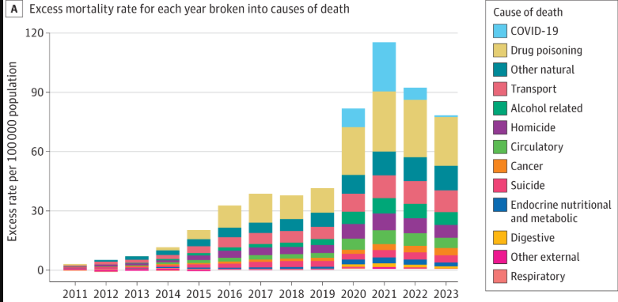
Drug Overdoses Continue To Be a Public Health Crisis
Drug poisoning is the number one cause of death among adults ages 18-45.
Notes:
The 5 causes of death that collectively accounted for almost three-quarters of the early adult excess mortality in 2023 were drug poisoning (31.8% of excess mortality), the residual natural-cause category (16.0%), transport-related deaths (14.1%), alcohol-related deaths (8.5%), and homicide (8.2%). Additionally, the combined contribution of cardiometabolic conditions, including circulatory and endocrine, metabolic, and nutritional, was substantial (9.2%).

Slide 7
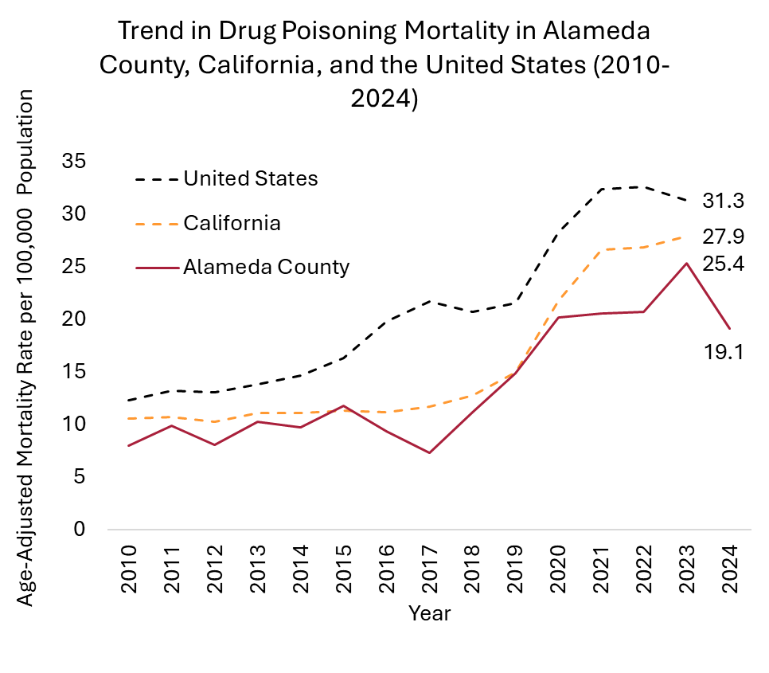
Overdose deaths in Alameda County
Source: Alameda County vital statistics files, 2010-2024; CDC Wonder, 2010-2023 (CA & US).
Note: Alameda County 2024 data is preliminary.
Notes:
Although rates of death due to drug overdose in Alameda County remain much lower than in California as a whole, the continued upward trajectory is alarming and the human cost of each of these unnecessary deaths goes beyond the individual who is lost.
Data from the CA Overdose Dashboard. Uses deaths among AC residents, not AC occurrences, so includes AC residents who died elsewhere but does not include non-AC residents who died in AC. CAPE data through 2022 will be available later this year for 2022 and will have better geocoding.
2022 overdose deaths, totals:
CA, all drugs: 11,002 (rate/100,000: 27.11)
AlCo, all drugs: 327 (rate/100,000: 18.45)
CA, opioids: 7,385 (rate/100,000: 18.66)
AlCo, opioids: 229 (rate/100,000: 13.24)
2021 overdose deaths, totals:
CA, all drugs: 10,898
AlCo, all drugs: 325
CA, opioids: 7,175
AlCo, opioids: 203
2020 overdose deaths, totals:
CA, all drugs: 8,894
AlCo, all drugs: 316
CA, opioids: 5,502
AlCo, opioids: 144
Local Impact as reported by 911/EMS:
AlCo Drug Overdoses (any drug)
1/1/2023-12/31/2023
3,688 Total / 336 Fatal / 1,662 Naloxone
Oakland Drug Overdoses (any drug)
1/1/2023-12/31/2023
1,924 Total / 218 Fatal / 936 Naloxone
California Drug Overdoses (any drug)
1/1/2023-12/31/2023
73,101 Total / 4,522 Fatal / 25,255 Naloxone

Slide 8
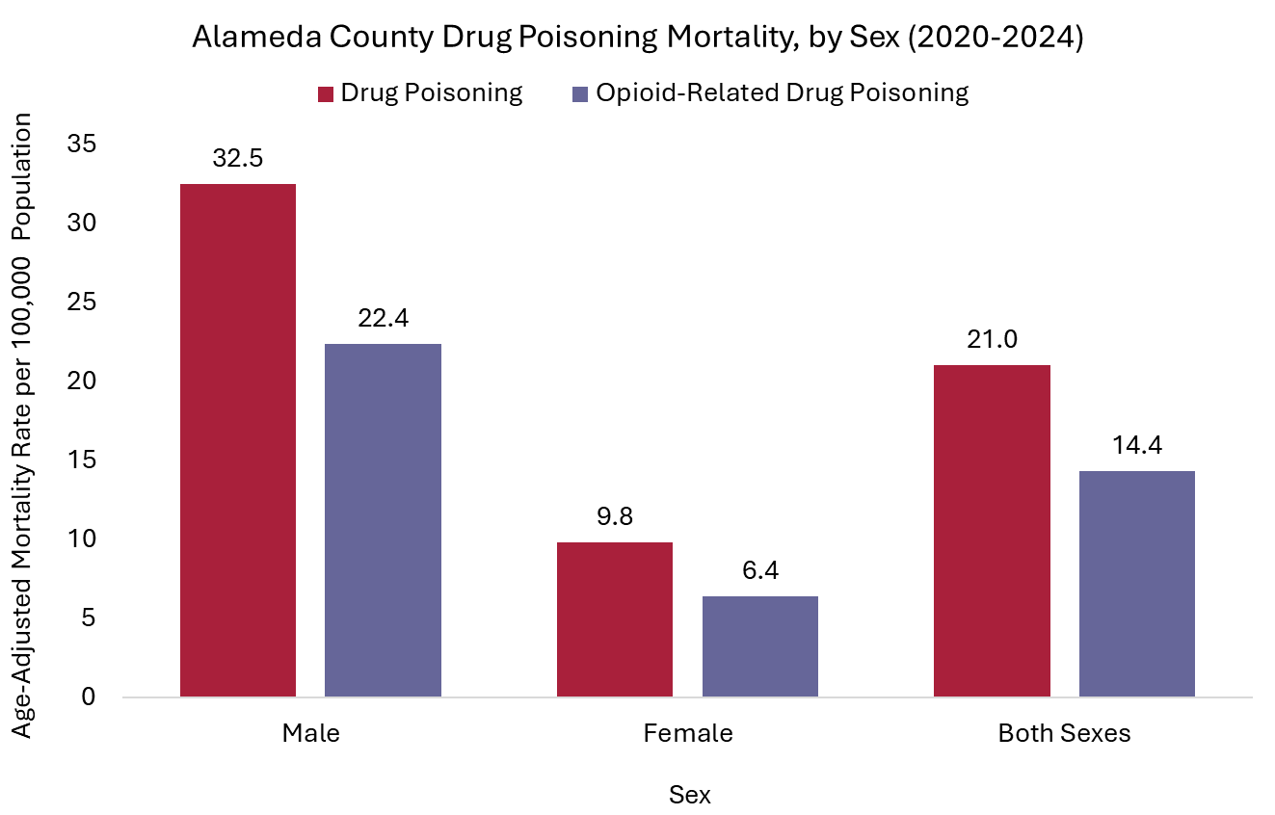
Who is At Higher Risk: Opioid deaths higher among men
Source: Alameda County vital statistics files, 2020-2024.
Note: Alameda County 2024 data is preliminary.

Slide 9
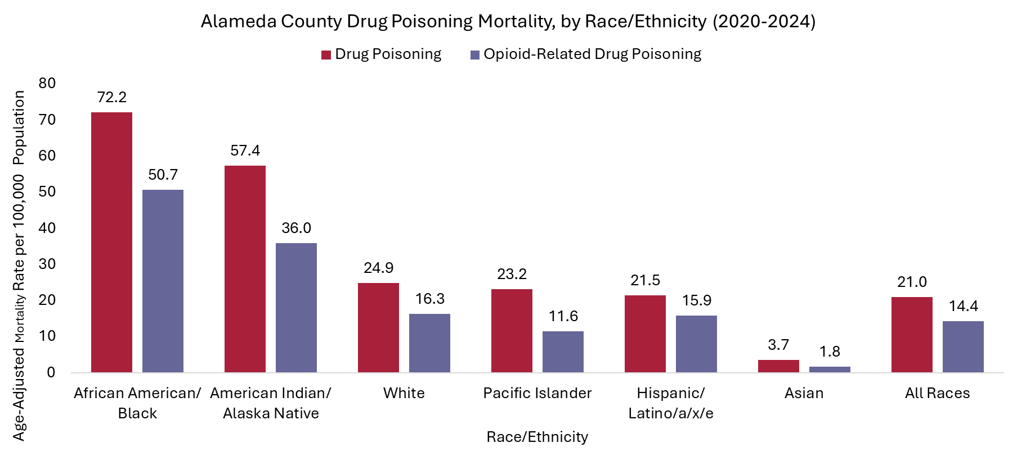
Higher rates of overdose death among Black residents
Source: Alameda County vital statistics files, 2020-2024; except for American Indian/Alaska Native and Pacific Islander, CDC Wonder for CA, 2019-2023.
Note: Alameda County 2024 data is preliminary.
Notes:
Too few deaths in the “other” category to allow for breakout​

Slide 10

Why do we see higher levels of overdose in some groups?
For all races and ethnicities, men are more likely …
To use drugs
To use illegal drugs
To be socially isolated. Addiction is a disease of isolation. Women tend to stay connected to family and friends more than men.

Slide 11

Why do we see higher levels of overdose in some groups (continued…)?
Fentanyl has made drug use in the US far deadlier for all Americans…however, for African Americans there are additional challenges due to systematic inequities, which include:
  Over-criminalization of drug use
  Less access to health care
  Implicit Bias
  Racism
  Worse outcomes when residents live in counties with high income inequity
Notes:
Resources for this slide (1) Overdose deaths among Black Americans rising faster than those among other races : Shots - Health News : NPR (2) More Black Americans are now dying from drug overdoses than whites : NPR​
​
NOTE: These resources are from NPR referencing a peer reviewed article

Slide 12
How is Alameda County Health (ACH) addressing
Overdoses & Poisonings

Slide 13

Interventions To Reduce Overdose Deaths
Supported by ACBH Substance Use Continuum of Care
Medications for Opioid Use Disorder
    Buprenorphine
    Methadone
Residential Programs
    Treatment
    Recovery Residences
Outpatient Treatment
Sobering and Detox services
    Referrals and linkages to care

Slide 14
Medication for Opioid Use Disorder Saves Lives
Methadone and Buprenorphine
Activate the opioid receptor
Maintain high tolerance → 59% reduction in mortality¹
Retains people in treatment
Lower relapse rates²
Reduced HIV and Hep C infection³
Improved quality of life (incarceration, employment, housing)⁴
Larochelle MR, et al. Ann Intern Med. PMID: 29913516
Mattick RP, et al. Cochrane Database of Systematic Reviews, 2014.
Edelman EJ, et al. Drug Alcohol Depend, 2014. PMID: 24726429
Malta M, et al. PLoS Med, 2019. PMID: 31891578

Slide 15

Before I started Suboxone, every day was about finding and using. Now I wake up without that constant panic. I'm working and I can think more than one day ahead. But the best part is I can see my kids again.
-Steven L.

Slide 16

Resources Providing Medications for Opioid Use Disorder
Bridge Clinic
  Low-barrier addiction medicine clinic at Highland Hospital
  1,300 unique patients served per month
  Both telemedicine and in person
  Staffed by prescribers, Social Workers, Community Health Workers, and Substance Use Navigators
Methadone Clinics
  9 clinics serving disparate geographic areas
  Serving over 2,000 unique patients
Other medication providers
  Clinics/FQHCs
  TRUST Clinic

Slide 17
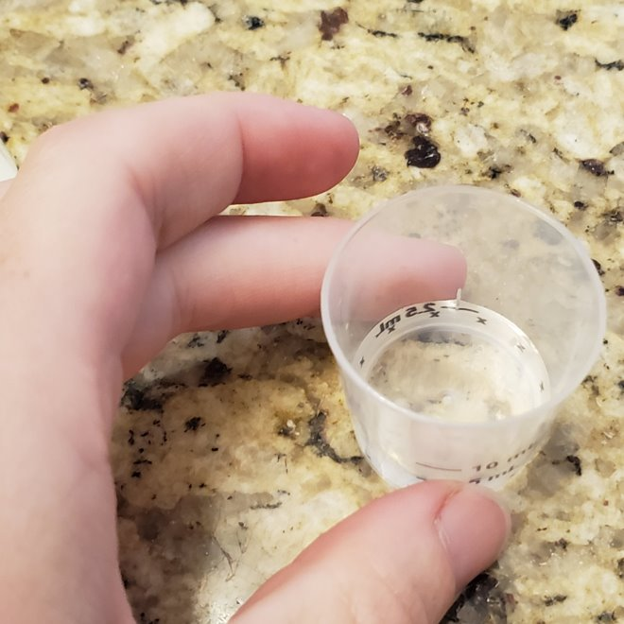
Cross-Agency Overdose Response
MAT Expansion & Linkages to Care
Expanding the use of medications for Opioid Use Disorder at Santa Rita Jail
  Initiating treatment for individuals arriving to the jail who are already on Buprenorphine or Methadone
  Identifying new individuals who may benefit from these medications through screening
  In person meeting before release and linkage with community-based resources
  Long-acting Injectable Buprenorphine now available
EMS Prehospital Buprenorphine Initiative
  Allows paramedics to administer buprenorphine in the field when responding to an overdose
  Addresses the underlying addiction by starting treatment and encouraging transport to an ED that can continue care
Notes:
Resources for this slide (1) Overdose deaths among Black Americans rising faster than those among other races : Shots - Health News : NPR (2) More Black Americans are now dying from drug overdoses than whites : NPR​
​
NOTE: These resources are from NPR referencing a peer reviewed article

Slide 18
ACBH Foundational Addiction Treatment Programs
Sobering and Detox
Residential Treatment
    173 Adult beds
    46 Perinatal beds
Recovery Residence
    145 Adult beds
    9 Perinatal beds
Outpatient Treatment Programs
  5 Adult programs providing Intensive Outpatient care
  3 Adolescent programs

Slide 19
Other Strategies
Dr. Kathleen Clanon (Agency Medical Director, Alameda County Health)

Slide 20
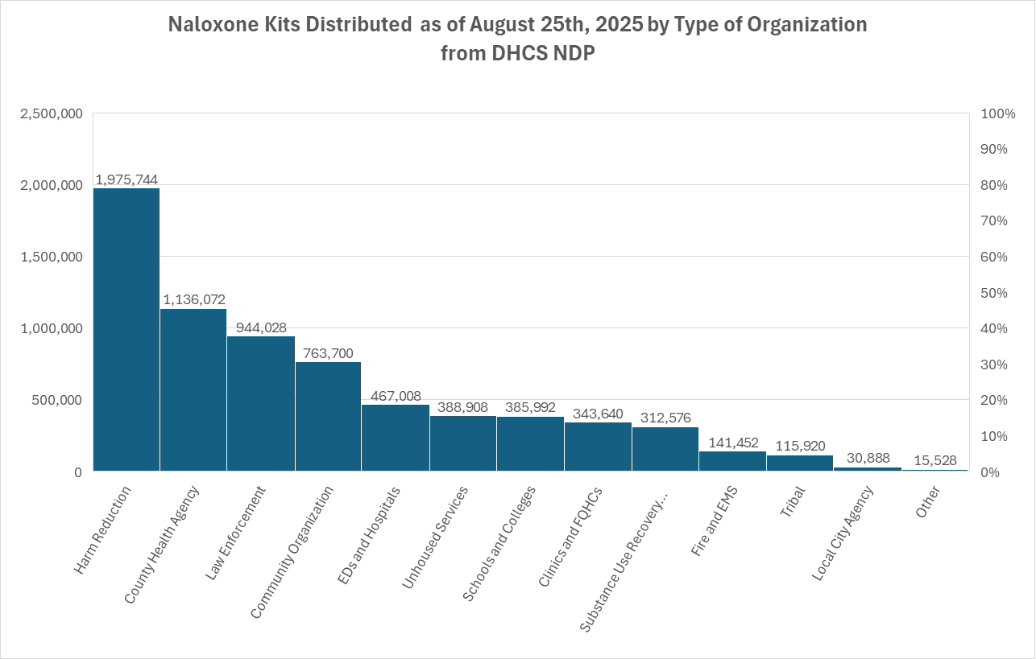
Rescue Strategy: Helping Local Organizations Acquire and Utilize Naloxone
Notes:
*2024 Jan- March:
33 trainings​
1,780 training attendees
435 naloxone kits distributed​
One unit = two 4mg nasal spray devices
California’s Department of Health Care Services (DHCS) administers the Naloxone Distribution Project (NDP), through which qualified entities can request free naloxone and have it shipped to their address.

Slide 21
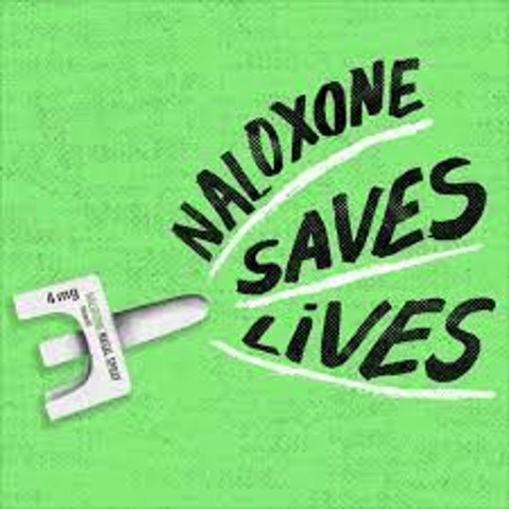

How is ACH supporting Community Members
YOU CAN SAVE A LIFE!
Be Prepared. Get Training. Carry Naloxone.
Sign up for a Naloxone Overdose Rescue Training:
  Get a free naloxone kit
  Request resources for your team
  Ask about in-person training, presentations, or tabling
  Ask your doctor (it is also available over-the-counter without a prescription)
Notes:
This slide drew information from the original presentation and this article: More Black Americans are now dying from drug overdoses than whites : NPR​
​
NOTE: Alexis to find another visual

Slide 22
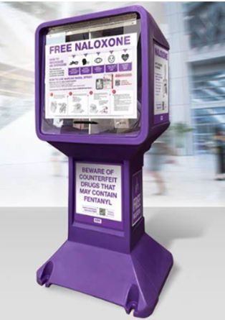
Naloxone Distribution in Alameda County
Opioid Settlement Funds have supported placement of NSBs in the community
    ACBH Providers and Clinics
    Libraries, Schools, & Santa Rita Jail
Naloxone paid for by the California Naloxone Distribution Project
As of September 1, 2025, over 2,000 Boxes of Naloxone have been distributed from NSBs
Online map showing NSB locations: Alameda County NSB Map
Notes:
How many NSBs currently in place: 38
12 being Behavioral Health sites
12 more due to arrive today!

Slide 23
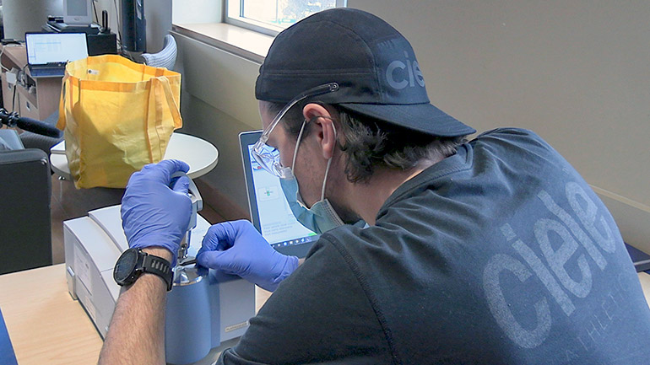
Harm Reduction Strategy: Drug Checking
Testing of substances purchased on the street by people who use the needle exchanges.
    Uses a portable lab device that gives a result in 15 mins
    Counseling available to help client decide how to use the info
    Results checked later by a reference lab
Pilot in Alameda County funded by CDC and by Measure A funds
    3 weekly sessions
    5 site locations between Oakland and Berkeley
    Flyers are available at harm reduction sites for participating community members and members of the drug checking collaborative
    300+ samples tested through 2024
Main partners: HIV Education and Prevention Project of Alameda County (HEPPAC), Health Care for Homeless (HCH), Punks with Lunch, and Needle Exchange Emergency Distribution (NEED)

Slide 24
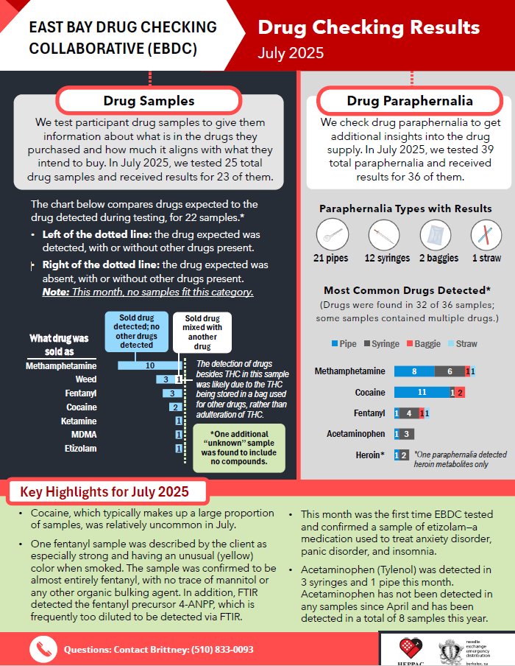
Sharing Results with Community
East Bay Drug Checking and Alameda County are trying different types of “dashboard reports” to disseminate test results to community.

Slide 25
Opioid Settlement
Planning Update
Dr. Anna Phillips, Director of Substance Use Continuum of Care, ACBHD

Slide 26
State Required Target Population
Target Population
Homeless
Chronic Substance-Dependent
People of color
Incarcerated, and
Notes:
These are the 4 as identified by DHCS during the Opioid Settlement

Slide 27
Planning Framework: Short-Term Service Level Goals Reminder
Increase number of residential treatment beds and recovery residences – Completed
Create a substance use outreach team to actively engage people into treatment – In process
Medical Detox Facility Beds – Will be part of Alameda Health System Hospital based services
Increase access to medication for Opioid Use Disorder– Completed
Notes:
Here are areas of our system of care that we have been able to positively impact due to the Opioid settlement dollars and through listening to the community! (highlight MAT in the jail and its effectiveness on reducing OD post release)

Slide 28
Planning Framework: Long-Term System & Stakeholder Input
Goals Reminder (Ongoing)
Planning, Location/Districts
Long-Term Sustainability
Community Input
Board of Supervisors Priorities
System, Program, CBO, Agency Integration
Implementation
Notes:
This slide demonstrates our process of implementing the $$ we have been seeking community input through venues such as this one we are now. And then that feedback is carried forward all the way through implementation as we discussed in the previous slide.

Slide 29
Crosswalk from Prior Opioid Settlement Listening Sessions
Feedback received in prior listening sessions | What has been implemented?
Increase MAT availability (incarcerated, homeless, teens and other vulnerable population) | Maxor - MAT at Santa Rita Jail (SRJ)
Expand and enhance SUD system of care | Recovery Residence and Residential Treatment Bed Expansion
Fund more Community Based Organizations who can support with opioid abatement​ | Mini-grants to Community Organizations
Increase detox beds | Alameda Health Systems – BHCIP award, San Leandro hospital
Expand and enhance SUD system of care | SUD Outreach Teams
Education Media Campaign | Public Media Campaign
Expand and enhance SUD system of care | Capital Projects – La Familia, El Chante
Naloxone Stand Boxes | Free Distribution of Naloxone Stand Boxes
Notes:
In this slide we would like to highlight what we have been doing in the community based on the feedback we have been hearing during these listening sessions. *Highlight the Naloxone stand boxes. A great example in September last year we heard we need to get more Narcan to the community and in January we started a process for the community to request distribution boxes like those shown earlier by Dr. Clanon. We are committed to doing this on going and look forward to providing 40 boxes a year free refills through the state.

Slide 30
  Opioid Settlement Mini-Grants: Fund Recipient Agencies Overview

Slide 31
Opioid Mini-Grants Funding Recipients –Round 1
Organization | Award $Amount | Project Description
Bay Area One Health Coalition | $62,327.00 | One Health Micro Clinic: Naloxone, Harm Reduction, and Diversion from Justice System for unhoused and justice involved in Central and North Alameda.
Black Girls Mental Health Collective Foundation | $299,000.00 | The Birth Network: Diversion from Justice System to Treatment, Preventing Addiction among Youth, Naloxone, and Harm Reduction in North and Central Alameda. Incarcerated women, perinatal and youths.
(CAL-PEP) California Prevention and Education Project | $250,000.00 | Project MOST (Mobile Outreach, Services, and Treatment): Naloxone, and Harm Reduction in Unhoused Populations & Other Communities of Color in North Alameda.
City of Fremont Human Services | $128,669.00 | Fremont Mobile Evaluation Team (MET): Naloxone, and Harm Reduction in unhoused population in South Alameda.
(HEPPAC) HIV Education and Prevention Project of Alameda County | $299,150.00 | HEPPAC-Santa Rita Jail Medically-Assisted Treatment Linkage and Overdose Prevention Program: Countywide Substance Use Disorder Treatment, and Diversion from Justice System to Treatment
National Prevention Science Coalition to Improve Lives | $250,000.00 | Alameda County Innovative Prevention (ACIP) project: Development and dissemination of a parenting intervention aimed at reducing substance use outcomes in children of parents with addiction Countywide.
Roots Community Health | $250,000.00 | East Oakland Opioid Response Initiative: Substance Use Disorder Treatment for Unhoused Populations, Black Men, and Other Communities of Color through the launch of a Mobile MAT Unit.

Slide 32
Opioid Mini-Grants Funding Recipients –Round 1 Continued
Organization | Award $ Amount | Project Description
Tha Town | $194,400.00 | Junior Journalist Opioid Outreach for Alameda County project: Countywide initiative to prevent addiction among vulnerable , at-risk youth using peer-to-peer education through a Junior Journalist internship, where youth create articles, podcasts, and videos to raise awareness.
Tri-Valley Haven | $179,299.00 | This project will integrate harm reduction into its current program which offers safe shelter to primarily women and children escaping domestic violence and abuse countywide. One-on-one and group counseling and staff training on Narcan administration/overdose response.
Trybe, Inc. | $300,000.00 | Trybe Safe Spaces: Addresses preventing addiction among vulnerable and at-risk youth by offering comprehensive, community-based prevention programming in Oakland and Central Alameda.
West Oakland Punks With Lunch | $189,482.00 | HEAL Oakland: Harm reduction, Education and Access to naloxone for safer Lives in Central Alameda targeting unhoused, justice involved and other communities of color.
Youth Uprising | $300,000.00 | A Push Forward: Innovative and youth-centered initiative designed to combat the opioid epidemic in Alameda County through a multifaceted approach focusing on Prevention, Intervention, and Awareness strategies.
Total | $2,702,327.00

Slide 33
Opioid Mini-Grants Funding Recipients –Round 2
Organization | Award $Amount | Project Description
Bay Area Community Health | $250,000.00 | Project Generations includes syringe exchange, HIV/HCV testing, fentanyl detection kits, overdose prevention education to directly reduce opioid-related deaths, especially in unhoused populations in Central and South Alameda.
Building Opportunities for Self-Sufficiency (BOSS) | $250,000.00 | BOSS Opioid Overdose Prevention Project focuses on tackling opioid crisis in marginalized areas by distributing Naloxone and providing peer-based support and harm reduction training in unhoused populations and justice-involved individuals in East Oakland, especially Black and Brown communities.
Carnales Unidos Reformando Adictos / C.U.R.A., Inc. | $154,904.00 | The Aftercare Project provides structured transition from residential treatment to sober living environments incorporating culturally competent case management and job training support to reduce recidivism and foster stability county-wide.
Castro Valley Unified School District | $181,230.00 | CVUSD Project DASH (Drug Abuse Stops Here) is an expansion of Familia Adelante, a school-based drug prevention program. The expansion will target vulnerable / at-risk youth in Central Alameda, particularly those experiencing academic or emotional challenges that may increase their risk of substance use.
Livermore Lab Foundation | $300,000.00 | FAST (Fentanyl Alert Substance Testing) New Technology for Rapid & Accessible Opioid Detection: The technology supports a broader harm reduction strategy by helping identify fentanyl exposure, that could enhance response efforts to opioid overdoses. County-wide focus serving the unhoused and other vulnerable populations.

Slide 34
Opioid Mini-Grants Funding Recipients –Round 2 Continued
Organization | Award $Amount | Project Description
LifeLong Medical Care | $250,000.00 | Partnership to address SUD/OUD among Unhoused Populations in Alameda County: Street medicine teams distribute naloxone, provide overdose prevention education, and connect clients to MAT services across North and Central Alameda County. Partnership with Samaritan and use of innovative engagement tools—such as the Samaritan digital platform and practical incentives to improve linkage to care.
Magnolia Women's Recovery Program | $298,142.00 | Magnolia Opioid Prevention, Education, and Outreach Project focus on naloxone distribution and harm reduction activities; integrates stigma-reducing MAT education for pregnant and parenting women in Hayward and Oakland.
NAACP Hayward Branch | $250,000.00 | Reboot Program ‘s focus is in reducing opioid misuse, supporting diversion efforts, providing access to treatment, and recovery housing in Hayward and surrounding areas.
National Coalition Against Prescription Drug Abuse | $203,224.00 | Alameda County Overdose Prevention Project (ACOPP): Project focus is on preventing substance use disorder and fatal overdoses among Alameda youths and adults of all ages. Innovative use of 50+ News Stand Box units for naloxone distribution, translation tools for immigrant communities, and virtual MAT counseling integration.
Women of Color on the Move | $150,000.00 | Hope & Healing: Addressing Opioid Use Among Marginalized Populations in Alameda County provides Mobile MAT service delivery, comprehensive harm reduction services (fentanyl test strips, sterile syringes) for unhoused individuals / vulnerable, high-risk women in Alameda County
Total | $2,287,500.00
Notes:
We have already awarded 5.5 mil in mini grant funding highlight projects are aligned with our focus populations

Slide 35
Opioid Settlement
Finance Update
Jill Louie
Budget Director, ACBHD

Slide 36
Opioid Settlement Funds: Fiscal Update (May 2025)
FUNDING
Total Settlement Funds: Up to $80M*
Total Received to Date: $28.5M
    Abatement Allocation: $21.8M
    Reallocated from Cities: $1.3M
    (Alameda, Albany, Hayward, Livermore, Newark, Piedmont, Pleasanton)
    Subdivision Allocation (legal fees): $5.4M
Expended to date: $9.7M
Programs planned: $54.0M
*Payments are subject to change and depend upon distributions set at non-regular intervals. Spending and implementation planning impacted accordingly.
**Additional settlements pending.
Notes:
Opioid funding consist of settlements with several different companies with each having its own terms such as:
Timeline to pay
Incentives based on prohibiting future lawsuits
Incentives if no additional lawsuits occur by a certain time
Payments received include these incentives with the assumption they will be achieved but will later be recouped if not met
Incentives to prepay
County Counsel analyzed each settlement and based the estimate on current conditions and made educated guesses about whether incentives will be achieved.
The initial estimate of $46M is now revised to $80M which includes new settlements with additional companies.
For every payment and for every settlement, cities can decide whether to accept the funds or redirect to the county.
Planned expenditures total $53M.

Slide 37
Implementation Update: Expenditures to Date & Beyond*
Activities (in Millions of Dollars) | FY 2023-24 | FY 2024-25 | FY 2025-26 | FY 2026-27 | FY 2027-28
Maxor - MAT at Santa Rita Jail (SRJ) | $0.5 | $1.0 | $1.5 | $1.5 | $1.5
Recovery Residence and Residential Treatment Expansion | $0.5 | $2.1 | $2.8 | $3.0 | $3.1
Innovative Grants to Community Organizations | $0 | $3.0 | $2.5 | $0 | $0
Alameda Health Systems - Bridge Clinic | $0 | $0.4 | $0.4 | $0.4 | $0.4
SUD Outreach Teams | $0 | $0 | $1.3 | $1.4 | $1.4
Public Media Campaign | $0 | $0.5 | $0.5 | $0.5 | $0.5
Options – Counseling at SRJ | $0 | $0.3 | $0.5 | $0.5 | $0.5
Capital Projects | $0 | $0.5 | $0.0 | $0 | $0
Public Health Epidemiology Positions | $0 | $0 | $0.4 | $0.4 | $0.5
Naloxone Distribution | $0 | $0.03 | $0.03 | $0.03 | $0.03
Public Defender – Holistic Defense Mitigation Specialists | $0 | $0 | $0.9 | $0.9 | $0.9
Outside Council (estimated 15% of Ala Co allocation) | $0.3 | $0.3 | $0.3 | $0.1 | $0.2
TOTAL Planned | $1.3 | $8.1 | $11.1 | $8.7 | $9.0
NOTE: *Planned Expenditures (“Beyond”) representing future fiscal years have been included here and are subject to ongoing review that is informed by the Alameda County budgeting process. As ACBHD receives additional Opioid Settlement Dollars, additional projects may be programmed/implemented.
Notes:
We appreciate your continued input to plan how the funds are expended and already implemented some of the program towards the middle of last year. Medication-Assisted Treatment spending half a million dollars or $500,000…
For current year (FY 24/25)…

Slide 38
Estimated Funding and Planned Expenditures
Notes:
Highlights:
Moving to the horizontal axis at the bottom. You’ll see payments began in FY 22/23 and will possibly continue through FY 38/39. For those who noticed this is only 16 years and we said 18 years of payments in the earlier slide, the variance is caused by some settlement years getting paid in a single FY. The important part of the timeline is that most payments will be received in the near-term years with current year by far the highest.
Shift to the legend at the right which identifies companies paying so far. Teva through Walgreens payments started this year and included year 1 and 2. Walmart also started this year and paid nearly their full amount. Mallinkrodt was a bankruptcy settlement already paid in full. The first settlements were Janssen and the Distributors which includes 4 companies. The Distributors is by far the largest and expected to continue the longest although three of the companies have already used the prepayment incentive.
Add’l settlements pending.
Finally, the black line shows planned expenditures. The next slide provides detail for the first 5 years. Beyond that, the line is flat since only outside council fees and substance use disorder outreach teams are include.

Slide 39
Questions and Input!

Slide 40


