Slide 1
Alameda County Behavioral Health (ACBH) Opioid Settlement- Listening Session [September 26, 2023]
Presenters
Dr. Kathleen Clanon (Medical Director, Alameda County Health Care Services Agency)
Stephanie Montgomery (Health Equity Division Director/Health Equity Officer)

Slide 2
Definition: Opioid
Opioids are a broad class of drugs, natural and man-made, that act on body and brain to reduce the signals and feelings of pain. At higher doses, they can also cause sleep and can cause people to stop breathing.
Norco OxyContin Morphine Methadone Fentanyl Oxycodone Tramadol Carfentanyl | Percocet Hydrocodone Vicodin Oxymorphone Codeine Dilaudid Hydromorphone Heroin

Slide 3
Medication-assisted treatment (MAT)
MAT, sometimes referred to as Medication for Addiction Treatment, is a treatment for opioid use disorder combining the use of medications such as methadone and buprenorphine (AKA Suboxone) with counseling and behavioral treatments.
MAT is used to decrease withdrawal symptoms and cravings, to reduce the chances of relapse, and help people stay in a treatment program. If relapse does happen, people on buprenorphine MAT have lower rates of fatal overdose because their body is still used to having opioids on board.

Slide 4
Current Data

Slide 5
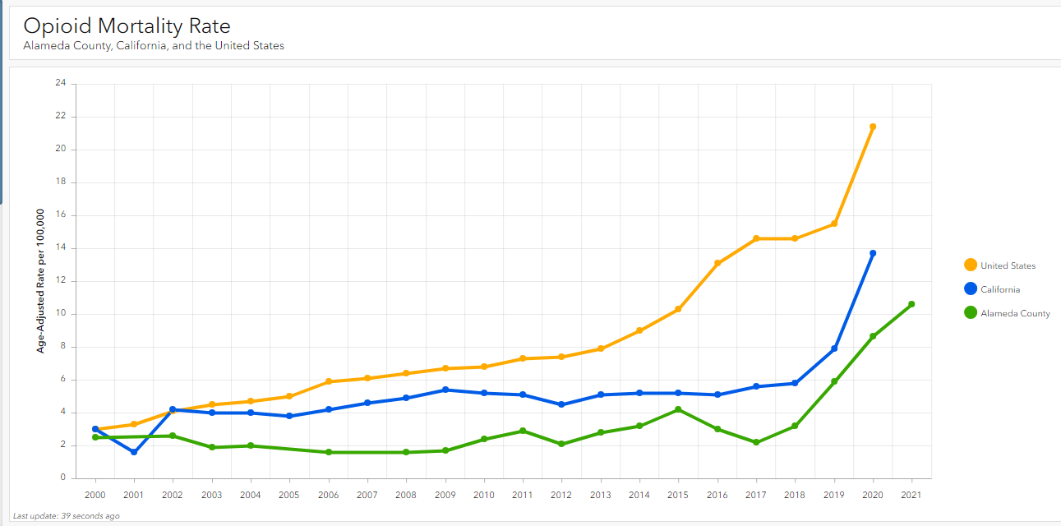

Slide 6
All overdose deaths are increasing – driven by opioids
Overdose deaths are increasing each year.
Opioid deaths are increasing as a proportion of overall overdoses.
Polydrug overdoses that include opioids and stimulants are the fastest growing segment.

Slide 7
Rapid increase in overdose deaths starting in 2017
Notes: (1) Deaths of Alameda County residents, no matter where they occurred. (2) An overdose is a fatal poisoning.

Slide 8
Opioid Poisoning deaths higher among Men

Slide 9
Opioid Poisoning deaths affect adults of all ages

Slide 10
Overdose deaths disproportionately high among Black residents
Notes: (1) All other races includes Asian, Native American, Pacific Islander, and Multi-race.
(2) Deaths of Alameda County residents, no matter where they occurred.
Source: ACPHD CAPE, with data from VRBIS, CA’s Vital Records Business Information System.
Notes:
Too few deaths in the “other” category to allow for breakout

Slide 11
Opioid-related ER visits also disproportionately high among Black residents
Notes: (1) The race/ethnicity coding changed in 2019, so the data shown for race/ethnicity span only two years.
(2) Hospital visits of Alameda County residents, no matter where they occurred.
Source: ACPHD CAPE, with data from HCAI.

Slide 12
Opioids driving overdose deaths among PEH
Overdose deaths are increasing each year with People Experiencing homelessness (PEH) accounting for about 30% of all overdose deaths.
Polydrug overdoses including opiates have sharply increased between 2020 and 2021.

Slide 13
Conclusions from the data
Opioid poisoning deaths in Alameda County are continuing to rise
Opioids alone and in combination are driving that increase.
Overdose deaths disproportionately impact African Americans, men, and people experiencing homelessness.
People experiencing homelessness account for about 30% of all overdose deaths.

Slide 14
Overview of Approach

Slide 15
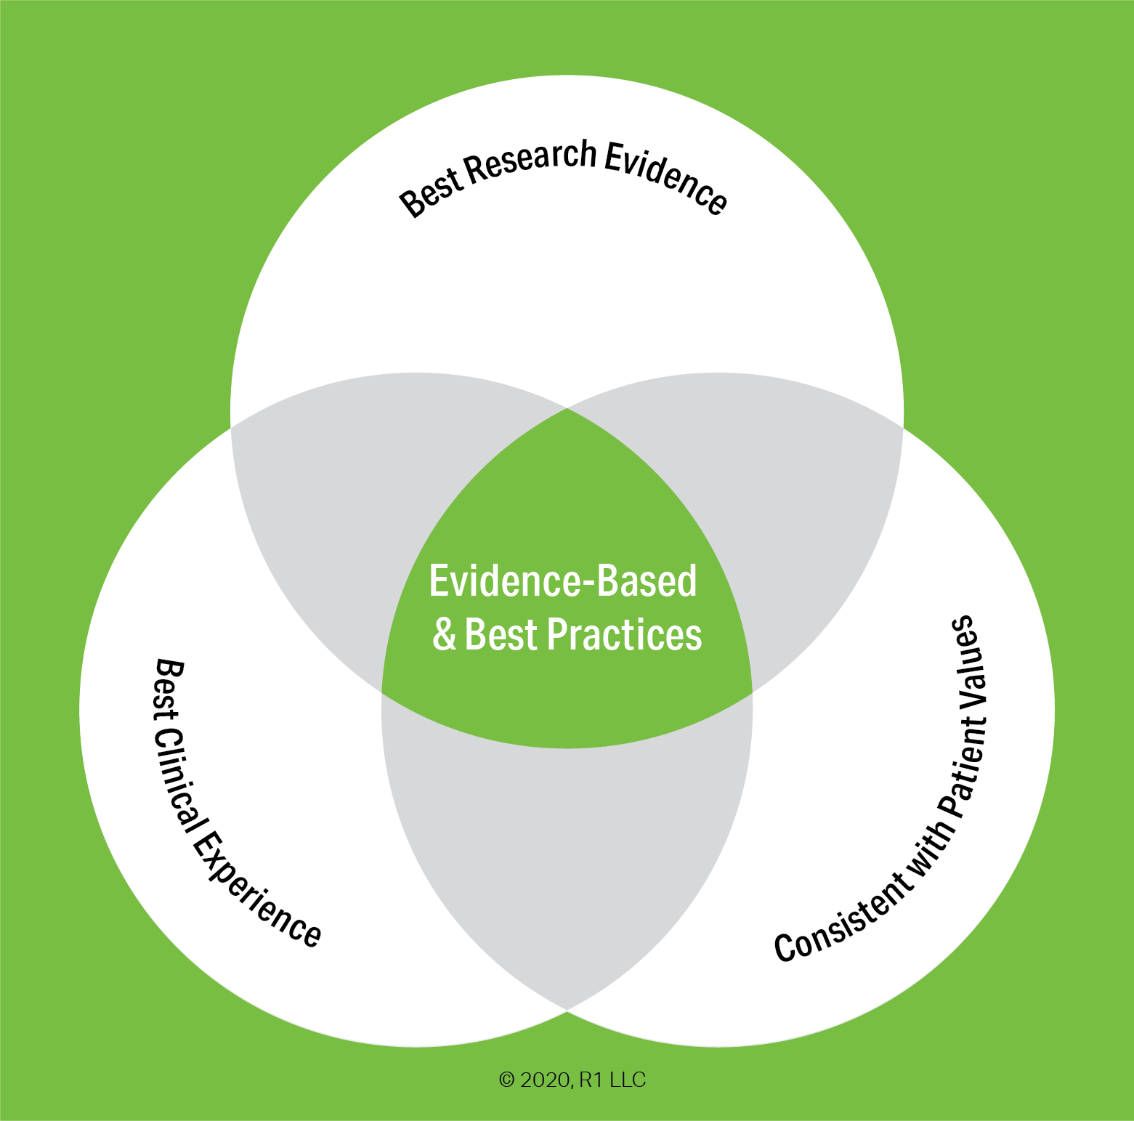
Evidence-based interventions to reduce opioid overdose deaths
Targeted Naloxone distribution e.g., transitional housing, treatment centers, and in criminal justice settings
Medication-Assisted Treatment (MAT)
Healthcare provider education on screening for and diagnosing Substance Use Disorder and connecting people to treatment.
Eliminating insurance barriers for medications for opioid use disorder
Screening for fentanyl in routine lab tests
911 ‘Good Samaritan’ laws
MAT in criminal justice settings and on release
Starting suboxone/buprenorphine-based MAT in Emergency Departments
Syringe services programs

Slide 16
Opioid Overdose Intervention Points
REDUCE OPIOID EXPOSURE
TREAT OPIOID ADDICTION
Recovery Housing
Detox facilities
Long-acting injectable MAT
Medication Assisted Treatment (MAT)
RESCUE
Public education
Collect unwanted meds
Stigma reduction
Naloxone use training
Naloxone distribution
Supply
Harm
Reduction
Exposure
Treatment
Rescue
REDUCE OPIOID SUPPLY
REDUCE HARM
Public protection partners
Prescriber education
Prescriber accountability
Drug checking
Supervised use
Test strips
Syringe Service Programs
Notes:
Unmet demand in each of these areas.
Each has its part to play, given the continuum of readiness that people experience when suffering from an addiction.

Slide 17
Opioid Litigation Settlement Update

Slide 18
Key National Settlement Terms
More than 3,000 state and local governments have targeted opioid makers and distributors in hopes of recouping billions in tax dollars spent dealing with the opioid epidemic [Opioids - National Association of Attorneys General (naag.org)]. In 2018, the County of Alameda and several cities also decided to join.
In 2021 and late 2022 nationwide settlements were reached to resolve all opioid litigation against the three largest pharmaceutical distributors, a major producer, and three pharmacy chains.
Funds will be paid overtime, from 6 to 18 years, depending on the settlement.
At least 85% of the funds must be used for opioid abatement, for the County almost all funds being received are restricted to funding future abatement efforts.
Notes:
In addition to providing billions of dollars for abatement, the settlements also impose changes in the way the settling defendants conduct their business. For example:
The Distributors are required to account not only for their own shipments, but also the shipments of the other distributors, in order to detect, stop, and report suspicious opioids orders;
J&J (which ceased marketing Opioids in 2015 and ceased selling Opioids in 2020) will not market, sell or lobby for any opioid products in the next ten years.
Teva and Allergan have agreed to strict limitations on their marketing, promotion, sale, and distribution of opioids, including a ban on: (1) promotion and lobbying; (2) rewarding or disciplining employees based on volume of opioid sale
Walmart, CVS, and Walgreens are required to address opioid diversion prevention, suspicious order monitoring, and reporting on red-flag processes, as well as blocked and potentially problematic prescribers.

Slide 19
CA Opioid Abatement Priority Areas
Creating new or expanded Substance Use Disorder (SUD) treatment infrastructure.
Matching existing funds for SUD within the Behavioral Health Continuum Infrastructure
Addressing the needs of communities of color and vulnerable populations (including sheltered and unsheltered homeless populations) that are disproportionately impacted by SUD.
Diversion of people with SUD from the justice system into treatment, including by providing training and resources to first and early responders and implementing best practices for outreach, diversion and deflection, employability, restorative justice, and harm reduction.
Interventions to prevent drug addiction in vulnerable youth.
Notes:
In addition to providing billions of dollars for abatement, the settlements also impose changes in the way the settling defendants conduct their business. For example:
The Distributors are required to account not only for their own shipments, but also the shipments of the other distributors, in order to detect, stop, and report suspicious opioids orders;
J&J (which ceased marketing Opioids in 2015 and ceased selling Opioids in 2020) will not market, sell or lobby for any opioid products in the next ten years.
Teva and Allergan have agreed to strict limitations on their marketing, promotion, sale, and distribution of opioids, including a ban on: (1) promotion and lobbying; (2) rewarding or disciplining employees based on volume of opioid sale
Walmart, CVS, and Walgreens are required to address opioid diversion prevention, suspicious order monitoring, and reporting on red-flag processes, as well as blocked and potentially problematic prescribers.

Slide 20
ACBH Opioid Settlement Program Planning

Slide 21
Goals
Expenditure of Opioid Settlement funds to address opioid crises in Alameda County.
Expand and enhance Substance Use System of Care with targeted investment from the opioid settlement.
Periodic Stakeholder process to inform, educate and update on ACBH’s settlement funding planning and to receive community feedback and input.
Expend settlement funding on prevention efforts such as public media campaign to address opioid misuse and to educate on Substance Use Services in Alameda County.

Slide 22
Opioid Settlement Planning
An Integrated Approach

Slide 23
Process
Communities Most Impacted
People Experiencing Homelessness;
Stakeholder Process
Chronic Substance-Dependent individuals;
Incarcerated; and
Black/African American
Periodic Public Updates Overtime

Slide 24
Opioid Settlement Planning
BOS Priorities
Planning, Location/ Districts
Long-Term Sustainability
Community Input
System, Program, CBO, and Agency Integration
Implementation

Slide 25
ACBH Plans for Opioid Settlement Dollars
Public media campaign regarding the opioid crisis
Fund more Medication Assisted Treatment (MAT) services.
Establish hospital based medical detoxification beds.
Mini grants to community organizations to address opioid crisis.
Notes:
Even with the above planning there is still more money to allocate from the settlement for other activities

Slide 26
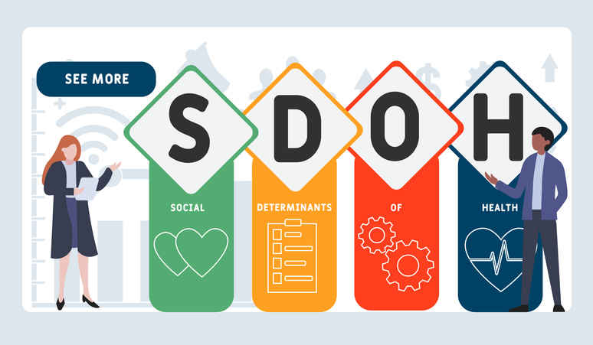
Social Determinants of Health
Our own data clearly indicates that African American males are disproportionately represented compared to other demographics.
Understanding SDOH can support strategies that will support and
pave the way for better outcomes for those most impacted within our system of care.

Slide 27
Education
Race
Gender
Health Care System
Social Support
Neighborhood & Built Environment
Social & Community Context
Social Determinants of Health

Slide 28
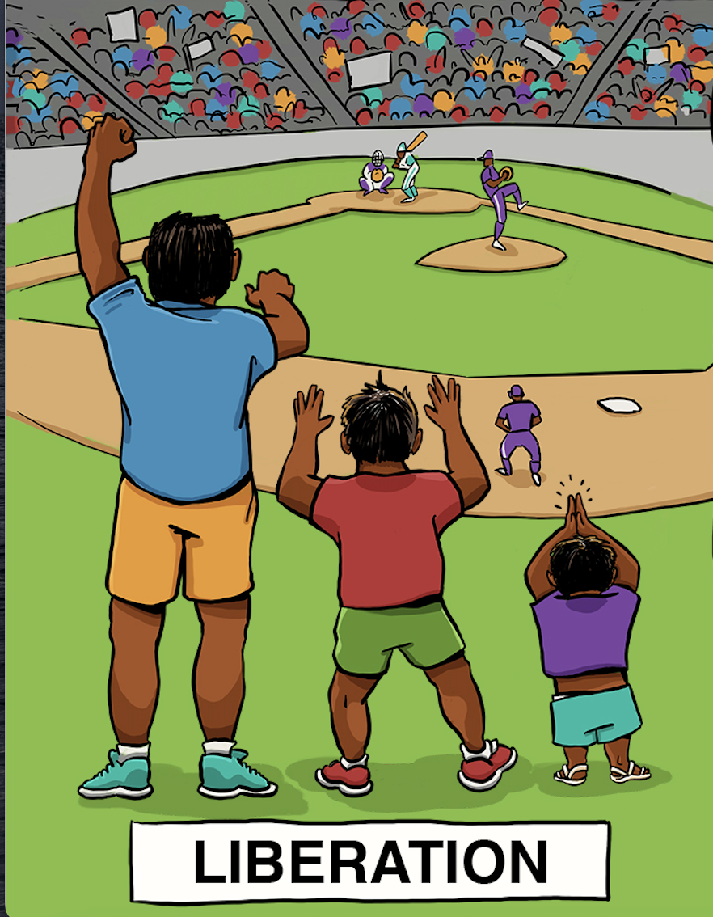
Health Equity
It's important to acknowledge how institutional and structural racism affect the care and support of individuals most affected by opioid use. We need to actively strive to break down these barriers and develop a new, culturally sensitive approach to care that is inclusive and supportive for those who need it.
Image Credit: A collaboration between Center for Story-based Strategy & Interaction Institute for Social Change.

Slide 29
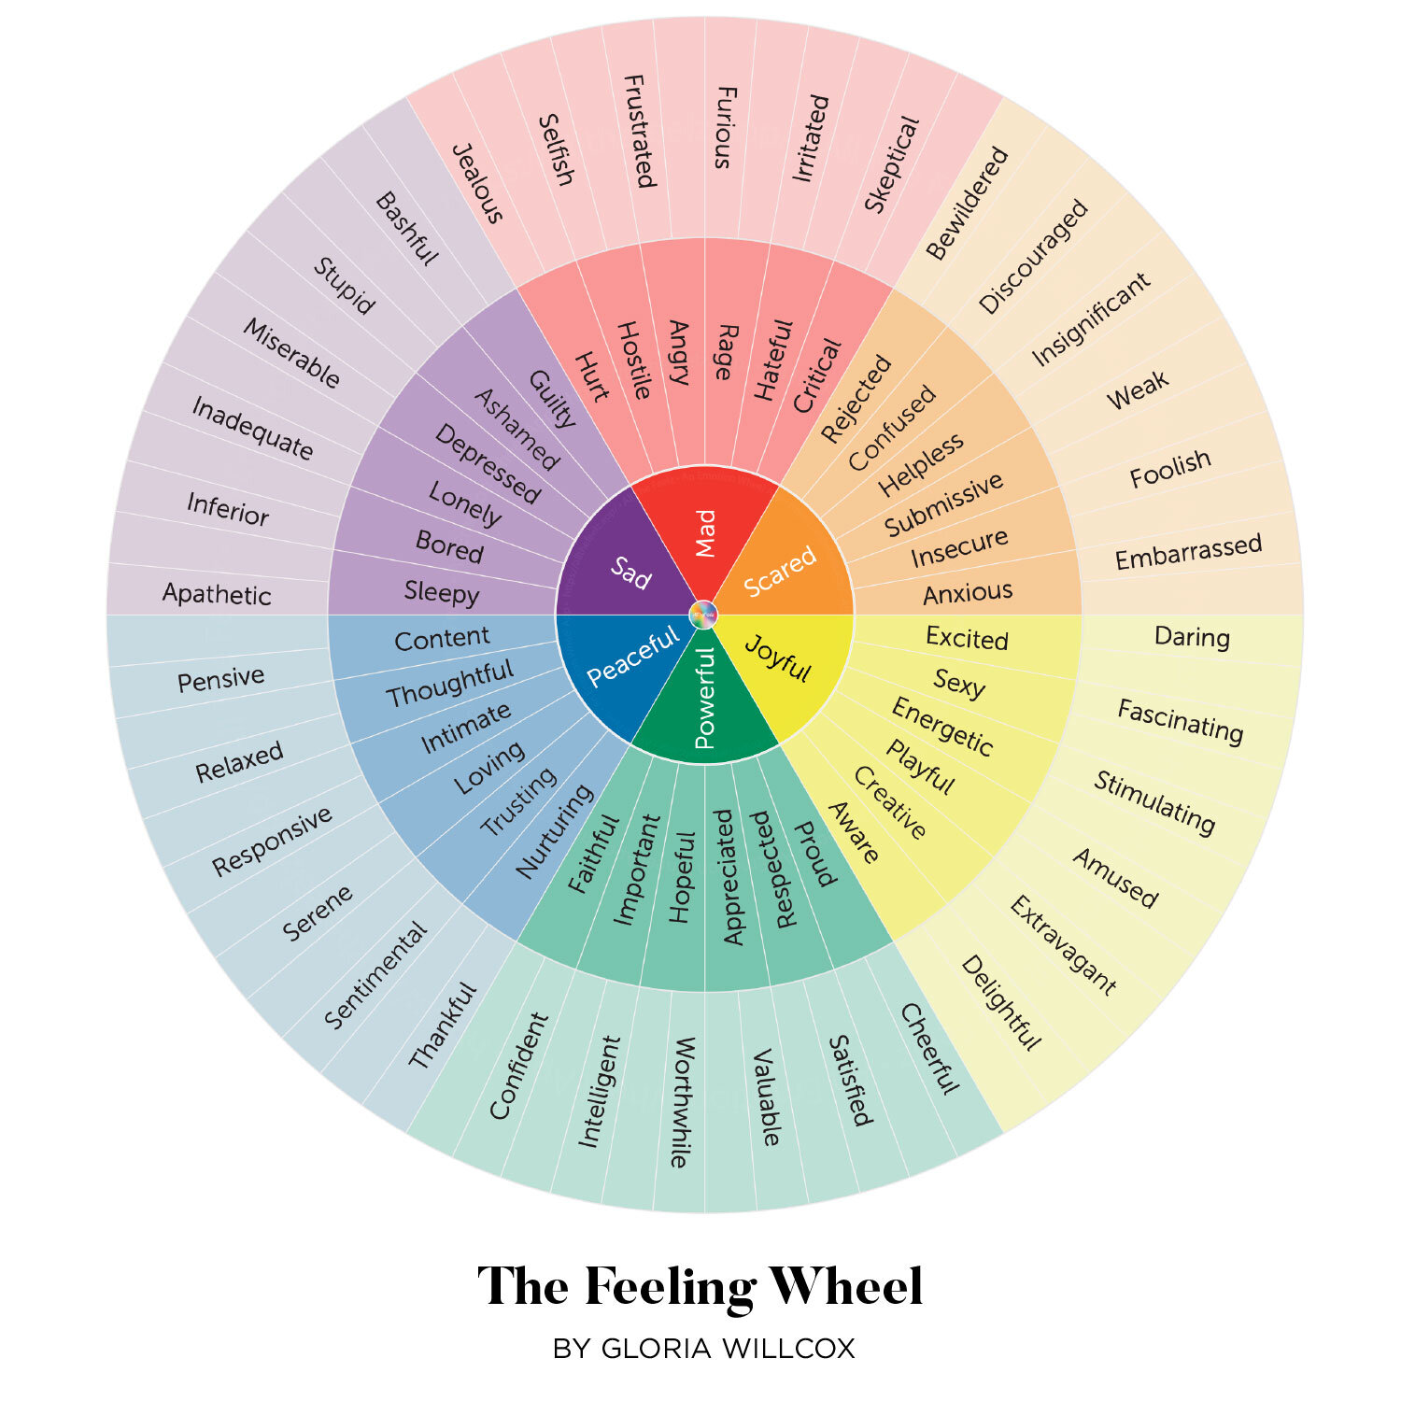

Slide 30
Community Input & Feedback
This Photo by Unknown Author is licensed under CC BY-NC-ND

