Slide 1
The Yellow/Dusky Peril and Anti-Asian Hate
Professor Russell Jeung
San Francisco State University Asian American Studies

Slide 2
Litany of Lament
Roommate told me that the Chinese are filthy people who all deserve to die of COVID-19, and said it is no wonder all plagues spread from China. Said that the Chinese were selfish and horribly overpopulated, and they should have issued a 0-child policy so they could not proliferate.
A man right outside of the main Massachusetts General Hospital entrance yelled at me, “Why are you Chinese people killing everyone? What is wrong with you? Why the f**k are you killing us?”
Notes:
Angie

Slide 3
Litany of Lament
While I was at the grocery store, another patron referred to me as "another one of those damn Chinese trying to infect everyone into communism."
I received the following voicemail message: "I just wanted to let you know that China has lost their best customer, America. Everybody in America is not going to buy Chinese anymore, so I hope that your country struggles and everybody has no money. I think it's pretty ignorant for your government not to protect that virus; to let that virus come out and ruin the world. Thanks, China."
Notes:
Angie

Slide 4
Litany of Lament
“I was in line at the pharmacy when a woman approached me and sprayed Lysol all over me. She was yelling out, “You’re the infection! Go home! We don’t want you here!” I was in shock and cried as I left the building. No one came to my help.”
Notes:
Angie

Slide 5
Conclusion
Flocking as a Protective and Healing Mechanism¹
Lu, Y., & Wang, C. (2022). Asian Americans’ racial discrimination experiences during COVID-19: Social support and locus of control as moderators. Asian American Journal of Psychology, 13(3), 283–294. https://doi.org/10.1037/aap0000247
Zhuo Chen, Grace X. Ma, Xinzhi Zhang, and Monica R. McLemore. Community Engagement Is Key to Promoting Asian American, Native Hawaiian, and Pacific Islander Health. Health Equity. Dec 2022.681-683
Kormendi, N. M., & Brown, A. D. (2021). Asian American mental health during COVID-19: a call for task-sharing interventions. SSM-Mental Health, 1, 100006.

Slide 6
Recommendations
Learning from and Integrating Asian Healing and Well-being Practices²
Raghavan, S. S., & Sandanapitchai, P. (2019). Cultural predictors of resilience in a multinational sample of trauma survivors. Frontiers in Psychology, 10, 131.
Lehmann, C., & Steele, E. (2020). Going beyond positive and negative: Clarifying relationships of specific religious coping styles with posttraumatic outcomes. Psychology of Religion and Spirituality, 12(3), 345.
Litam, S. D. A., & Oh, S. (2022). Ethnic identity and coping strategies as moderators of COVID-19 racial discrimination experiences among Chinese Americans. Counseling Outcome Research and Evaluation, 13(2), 101-115.

Slide 7
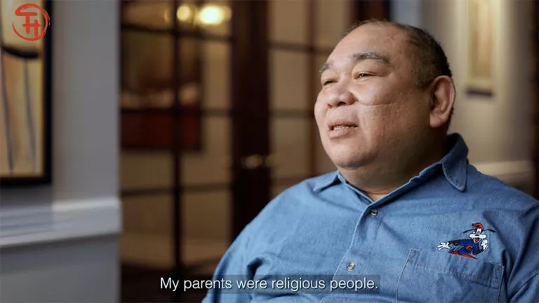
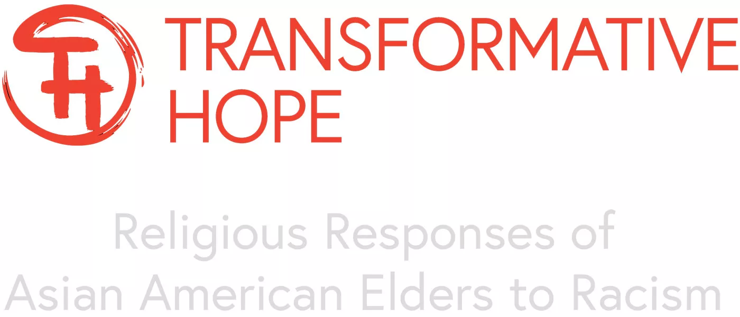
Recommendations
Healed People Heal People; Restored People Restore People³
Hyun, S., Wong, G. T. F., Levy-Carrick, N. C., Charmaraman, L., Cozier, Y., Yip, T., & Liu, C. H. (2021). Psychosocial correlates of posttraumatic growth among US young adults during the COVID-19 pandemic. Psychiatry Research, 302, 114035.
Oh, S., Litam, S. D. A., & Chang, C. Y. (2022). Racism and Stress-Related Growth Among Asian Internationals: Ethnic Identity, Resilience, and Coping During COVID-19. International Journal for the Advancement of Counselling, 1-23.

