Slide 1
Alameda County
BHCS – Substance Use Disorder (SUD)
Documentation Training
March 8, 2017

Slide 2
BHCS QA Contacts
SUD Technical Assistance
Sharon Loveseth, LAADC
Sharon.Loveseth@acbhcs.org
Medical Records Review Questions
Tony Sanders, PhD, Clin Psychologist, MFT, LAADC
Tony.Sanders@acbhcs.org
ACBHCS Clinical Review Specialists
Brion Phipps, LCSW Jeffery Sammis, Psy.D
Brion.Phipps@acgov.org Jeffery.Sammis@acgov.org

Slide 3
Today’s Agenda
9:00-9:45a | Introductions
9:45-10:15a | SUD Regulations
10:15-11:15a | Intake &Admission
11:00-11:15a | Morning Break
11:15-12:00p | Assessment & Establishing Criteria For Medical Necessity
12:00p-12:30p | Lunch Break
12:30-1:45p | Treatment Plans
1:45p-2:00p | Afternoon Break
2:00p-3:00p | Progress Notes
3:00p-3:30p | Group Notes & Requirements
3:30p-4:00p | Discharge Plans & Summaries

Slide 4
Introduction & Auditing Plan-FY 16-17
Annual & Quarterly; ACBHCS SUD System Of Care Medical Records Review
Expected to begin 5/2017
Minimum 2 charts from ALL SUD programs
Technical Assistance Feedback
DHCS monitoring Unit is providing on-site technical assistance independent of BHCS
Please let Sharon know if DHCS contacts your agency to conduct a chart review
This will assist us in providing accurate technical assistance to all of our providers

Slide 5
DMC Provider Responsibilities
It is you and your staffs’ responsibility to know and follow ALL applicable regulations
Title 22 § CCR 51341.1 can be found here: https://govt.westlaw.com/
Employ qualified staff and make sure staff stay within their scope of practice!
Develop and document procedures for admission
Establish an individual record for every DMC beneficiary. Maintain record for a minimum of 3 years (or as required by law)
Ensure medical necessity is documented in beneficiary records
Complete a personal, medical, and substance use history upon admission
Ensure that client’s challenges identified are addressed in treatment plan and progress notes.
Complete discharge plan OR discharge summary upon discharge
SUD Treatment MUST be provided under the direction of a licensed physician

Slide 6
Role of the SUD Medical Director
Each DMC provider must have a Medical Director who has medical responsibility for ALL CLIENTS and MUST be available on a regularly scheduled basis. Duties of a Medical Director may vary, but at a minimum, DMC certified treatment provider medical directors are responsible for:
Establishing, reviewing, & maintaining medical policies and standards - source: 22 CCR §51341.1 (b)(28)(A)
Ensuring the quality of medical services provided to all clients - source: 22 CCR §51341.1 (b)(28)(A)(i)(a)
Ensuring that a physician has assumed medical responsibility for all clients treated by the provider – source: 9 CCR § 10110
SUD Medical Director must obtain 5 hrs. continuing education in Addiction Medicine Annually. - source: 22 CCR §51341.1 (b)(28)(A)(iii)

Slide 7
Alameda County SUD Providers’ Admission/Pre-Admission Process

Slide 8
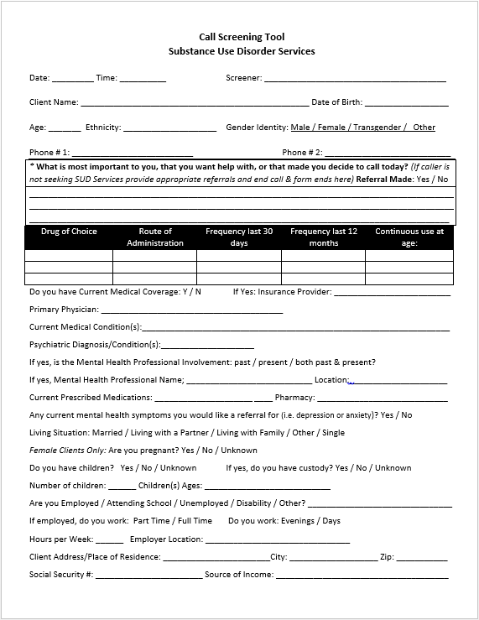
COMING SOON!!
Call Screening Tool --Form Highly Recommended—
Three (3) page form that will comply with upcoming pre-admission screening requirements.
This form is included with the handouts

Slide 9
Health Screening / Questionnaire -DHCS Form 5103 highly recommended-
REQUIRED be completed during admission process, PRIOR TO INTAKE
AOD-Certified programs' Health Questionnaire MUST contain at minimum the information in the DHCS 5103
Client should complete on their own unless they require assistance
Must be reviewed and signed by staff
Used to help determine if client has immediate medical needs that would impact their ability to safely participate in SUD Treatment
Health Questionnaire requirement is NOT a substitute for medical history in screening/assessment

Slide 10
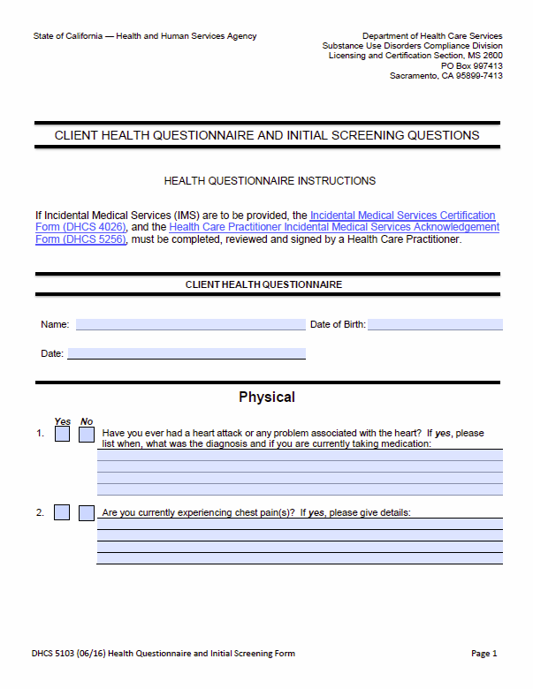
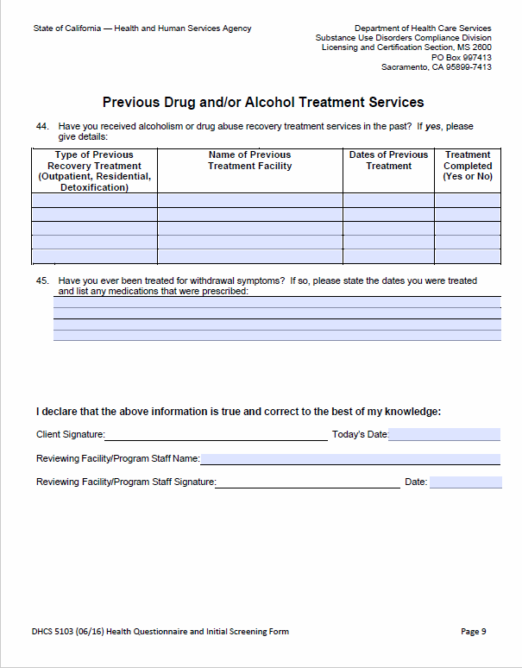
DHCS Form 5103: Health Screening Questionnaire
Meets requirements of Title 22 CCR §51341.1 (h)(1)(A)(ii)&(iii) and AOD Alcohol And Drug Certification Standards Section 12020
DHCS Form 5103, Version (06/16) this is a 10 page form:
http://www.dhcs.ca.gov/provgovpart/Documents/DHCS_5103.pdf
Available in handout section!

Slide 11
Intake and Assessment of Substance Use Disorders under DMC

Slide 12
Intake Assessment --AC BHCS Form Highly Recommended--
Providers must complete a personal, medical, and substance use history for each beneficiary at admission
Physician must review within 30 days of episode opening date - source: 22 CCR §51341.1 (h)(1)(A)(iii)
Required components of admission/intake - source: 22 CCR §51341.1 (b)(13)
Social, economic, family, education, employment, criminal, and medical history
Legal status and previous treatment history
Client substance use history
Evaluation or analysis of the cause or nature of mental , emotional, psychological, behavioral, and substance use disorder(s), the diagnosis of substance use disorders, and the assessment of treatment needs
Perinatal programs (DMC or non-DMC) have additional requirements (see Perinatal slide)
ACBHCS has created a 12 page AOD/SUD Intake and Assessment Form that fulfills DMC requirements.
This form is available in the included documents—is highly recommended for compliance
and on the ACBHCS provider website (coming soon!)

Slide 13
AOD/SUD Intake Assessment
Instructions and regulations included in the form
Emergency contact information included in the form
12 page form available in handouts

Slide 14
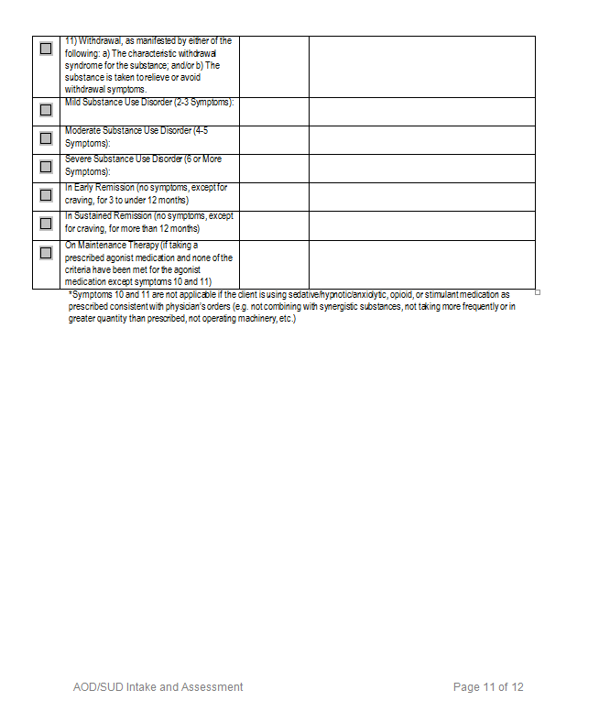
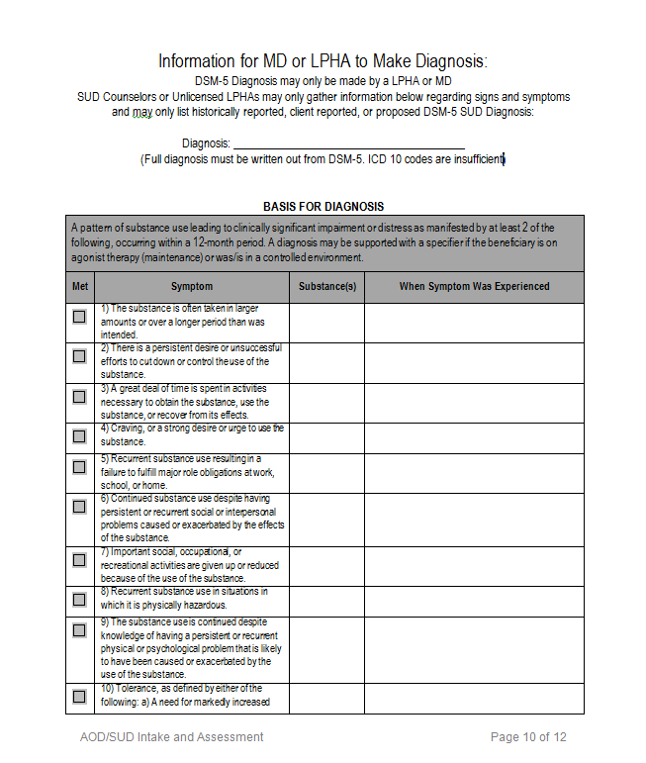
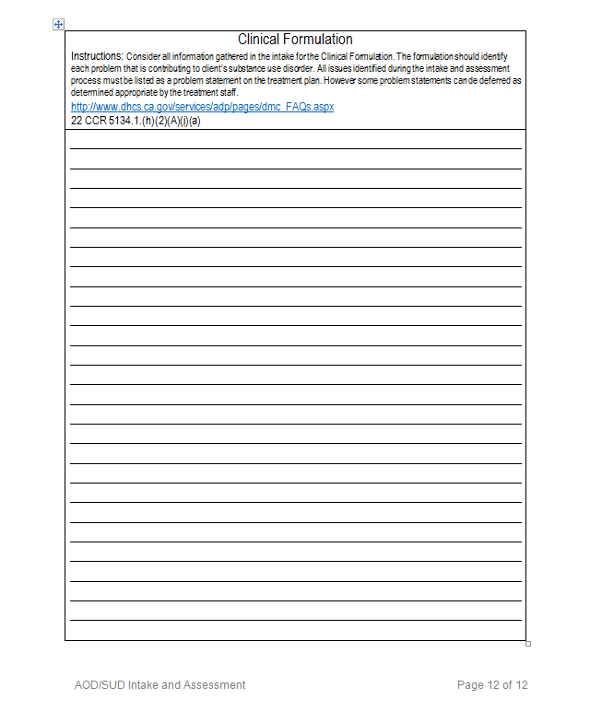
AOD/SUD Intake Assessment
Space to write the clinical formulation for diagnosis
Form includes space for reported/ proposed/ historical DSM-5 diagnosis and code
To complete basis for diagnosis, simply check the appropriate check boxes and corresponding fields
Severity can be determined by following the instructions in this section

Slide 15
Consent to Treat
Written consent for treatment IS a requirement of ACBHCS
If missing/not completed at the time of admission will result in a fully non-compliant chart.
Consent to treat MUST be signed by the client, demonstrating informed consent has been reviewed

Slide 16
Perinatal Residential Assessment
Additional specific DMC requirements for Perinatal Residential treatment plans apply to both Drug Medi-Cal and Non-Drug Medi-Cal Perinatal programs.
Was a need for mother/child habilitative services assessed in the Intake?
Does the mother need assistance in accessing ancillary services (dental, social, community, educational/vocational, and other services that are medically necessary to prevent risk to the fetus)?
Prenatal exposure to substances harms developing fetuses. Was this assessed in the Intake?
Were sexual or physical abuse issues assessed in the Intake?
Were service access needs (i.e. transportation, financial, other barriers) assessed in the Intake?
Source: 22 CCR § 51341.1 (c)(4)

Slide 17
Establishing Medical Necessity for SUD under DMC

Slide 18
Relevance of Medical Necessity for Documentation – GOLDEN THREAD
Initial assessment documentation identifies problems to be addressed in SUD treatment. The Physician establishes Medical Necessity by reviewing all information and making the diagnosis, complete with a written basis for the diagnosis (see exceptions for completing written basis).
Initial client plans are based on the Initial Assessment and must indicate all identified problems that were identified unless counter indicated. These may be prioritized for work during the Tx Plan period.
Client/Treatment plan updates document the ongoing Medical Necessity and progress towards completion of the program.
Progress Notes must contain evidence that the services claimed for reimbursement are helping client achieve their treatment plan.

Slide 19
Switch to &
On or before, April 1, 2017 DHCS and ACBHCS are switching from DSM-IV to DSM-5/ICD-10 for diagnosis and coding
DSM-5 codes are ICD-10 codes; however they are not always identical in their description (name)
ACBHCS has developed tools to assist in this transition
Any approved SUD diagnosis must be BOTH on the approved list AND in the DSM-5
SUD DSM-5 DHCS included lists are available on BHCS provider website
http://www.acbhcs.org/providers/QA/memos.htm

Slide 20
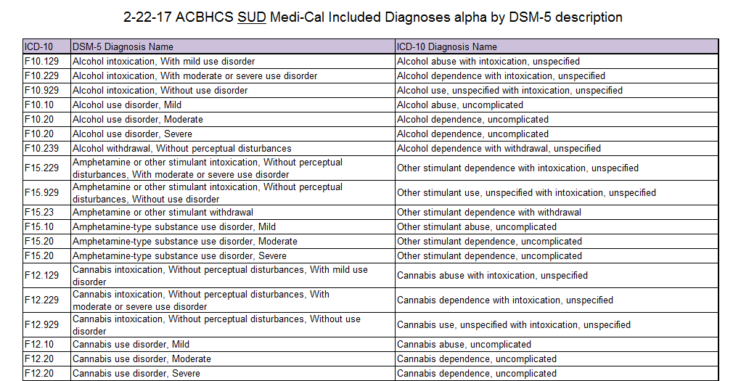
approved ICD-10 codes*
*ICD-10 diagnoses crossed out are not found in DSM-5 & can not be basis for SUD treatment.

Slide 21
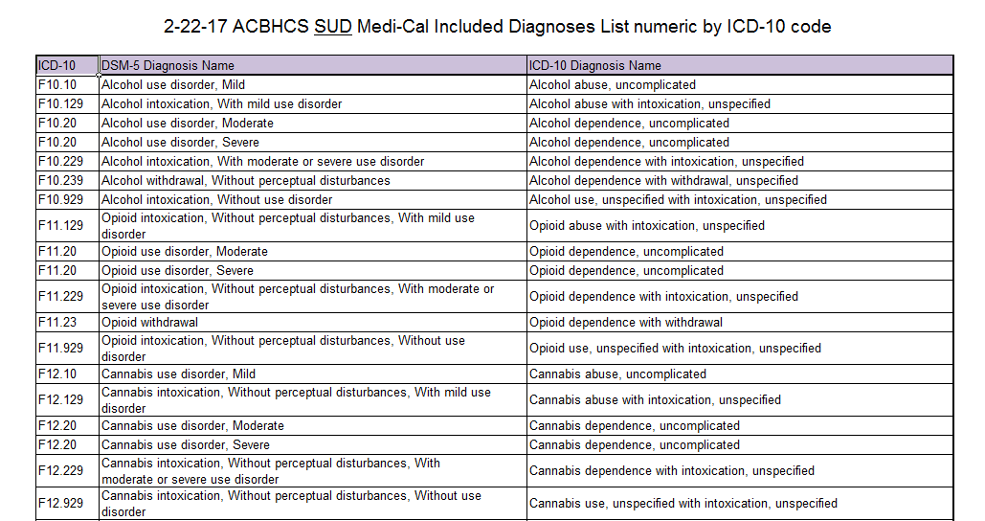
approved ICD-10 codes*
*ICD-10 diagnoses crossed out are not found in DSM-5 & can not be basis for SUD treatment.

Slide 22
DMC Physical Examination Requirements Physical Examinations are an integral part of DMC Treatment
Scenario A:
If the beneficiary has had a physical exam in the12 months prior to the date of admission, then the physician must review documentation of this exam. If the physician is unable to obtain documentation of this exam, then efforts to obtain should be documented.
Scenario B:
If beneficiary has not had a physical exam in the 12 months before admission, a physician, registered nurse practitioner, or physician’s assistant may perform a physical examination within 30 days of admission. The physician MUST review documentation of this exam within 30 days of episode opening
Scenario C:
If a physical examination has not been completed within the last 12 months OR the physician does not review the exam record AND/OR new exam is not completed, then the initial treatment plan MUST have a goal of obtaining a physical exam.
Source: 22 CCR § 51341.1 (h)(1)(A)(iv)
It is not acceptable to roll this (or any other) goal over from one Plan to the next, without revisiting the current obstacles and what modified action steps will allow for the goal to be met in the new Plan time period. (Reason for chart non-compliance from that Plan date and onward.)

Slide 23
Physician Responsibilities
“For a provider to receive reimbursement for Drug Medi-Cal substance use disorder services, those services shall be provided by or under the direction of a physician” - 22 CCR § 51341.1 (h)
DMC physician MUST be licensed by the Medical Board Of California or the Osteopathic Medical Board of California - 22 CCR § 51341.1 (b)(21)
That treatment provided is known to be effective in improving health outcomes and in accordance with generally accepted standards.
Ensure physical exam requirements are met
Specific information on ‘DMC Physical Examination Requirements” slide
Review, approve, and sign Treatment Plan and updates within accepted timelines
For specific information see Treatment Plan section
For specific physician responsibilities for Naltrexone Treatment Services see Naltrexone Treatment Services Section

Slide 24
Physician Responsibilities & Medical Necessity
The DMC physician MUST determine and document whether SUD services are medically necessary:
SUD Services are “…reasonable and necessary to protect life, to prevent significant illness or significant disability, or to alleviate severe pain through the diagnosis or treatment of the disease, illness or injury covered by the Medi-Cal program.”
Physician must indicate that they reviewed each client’s personal, medical, and substance abuse history – Source: 22 CCR § 51341.1(h)(1)(A)(iii)
Document the basis for SUD diagnosis in the client’s individual patient record—the MD must specify the DSM criteria that is met for the Dx (unless Licensed or Registered LPHA specifies and then MD co-signs); Chart out of compliance if incomplete - Source: 22 CCR § 51341.1 (h)(1)(A)(v)

Slide 25
Medical Necessity & Assessment Review Cont. All are reasons for full chart non-compliance from the date of non-compliance until completed.
What is the timeline for establishing medical necessity and on-going treatment for AOD Medi-Cal programs?
Within 30 days (NTP = 28 days, Residential = 14 days) of the Episode Opening Date (EOD);
90 Days from therapist signing of the previous plan for Plan Update (Narcotic Treatment Programs at “least once every quarter --aka every three months)--from EOD”); and
Between 5 and 6 months (from the Initial Medical Necessity or Last Justification for Continuing Treatment) the Justification for Continuing Tx must be established by the Physician with determination of Medical Necessity and with a recommendation from the counselor or therapist to continue treatment (except NTP).

Slide 26
Non-Drug Medi-Cal Medical Necessity Requirements
For AOD Residential with non Drug Medi-Cal (DMC) Claiming—Medical Necessity is not required to be signed by the MD.
A “Therapist” (Licensed or Registered with Board of Psychology or California Board of Behavioral Sciences) may sign.
If no such staff work for the agency indicate “Non DMC program” on signature line.

Slide 27
Initial Medical Necessity Form
INITIAL MEDICAL NECESSITY FORM IS REQUIRED BY BHCS
Physician MUST indicate they have reviewed each client’s personal, medical, and substance abuse history
Document the basis for SUD diagnosis in the client’s individual patient record—the MD must specify the DSM criteria that is met for the Dx (unless Licensed or Registered LPHA specifies and then MD co-signs); Chart out of compliance if incomplete
Determine and document whether SUD services are medically necessary:
SUD Services are “…reasonable and necessary to protect life, to prevent significant illness or significant disability, or to alleviate severe pain through the diagnosis or treatment of the disease, illness or injury covered by the Medi-Cal program.”
MUST be completed within 30 days of the date of admission
MUST be signed by physician
Source: 22 CCR § 51341.1 (h)(1)(A)(v)

Slide 28
Use the ACBHCS Medical Necessity Form(s) and always be in compliance!
DMC requires ‘basis for diagnosis’ to be completed. This section can contain details that supports the SUD dx for the client—if NOT WRITTEN OUT full chart non-compliance!
DNF to complete this section too
Make sure ALL signatures are in compliance: legibly printed name, signature, and date MUST be included—if all three req’s not met; full chart non-compliance!

Slide 29
Justification For Continuing Services Form
*FORM REQUIRED BY BHCS*
JCS Form MUST be signed by a physician no sooner than 5 months and no later than 6 months from date of admission or previous medical necessity form
Physician MUST indicate that they reviewed each client’s personal, medical, and substance abuse history
Document the basis for SUD diagnosis in the client’s individual patient record—the MD must specify the DSM criteria that is met for the Dx; if not complete chart non-compliance. (Note, there is no exception to the written basis of the Dx by the MD if the Therapist does it as in the Initial Medical Necessity Form)
Used to determine and document whether continuing SUD services are medically necessary:
SUD Services are “…reasonable and necessary to protect life, to prevent significant illness or significant disability, or to alleviate severe pain through the diagnosis or treatment of the disease, illness or injury covered by the Medi-Cal program.”
Signing of Treatment Plan Update by the physician DOES NOT meet requirement of Justification for Continuing Services
Source: 22 CCR § 51341.1 (h)(5)(A)

Slide 30
Naltrexone Treatment Services (NTS) --additional requirements of Medical Necessity Form--
Provider shall document / confirm that the client has a documented history of opiate addition.
Is at least 18 years of age
Has been opiate free for a period of time to be determined by physician based on physician’s clinical judgment
Provider shall administer a body specimen to confirm client is opiate free
The physician shall certify the beneficiary’s fitness for Naltrexone treatment based on medical history, physical examination, and laboratory results
The physician shall advise the beneficiary of the overdose risk of using opiates while taking Naltrexone and ineffectiveness of opiate pain relievers
Source: 22 CCR § 51341.1 (h)(1)(B)(i)

Slide 31
Perinatal / Pregnancy Residential
Women in Perinatal Residential Treatment must be pregnant or less than 2 months postpartum—to claim AOD Medi-Cal.
What COUNTS as proof of pregnancy or last date of pregnancy?
Hospital discharge paperwork
Forms signed by a medical professional
What does NOT count?
Birth Certificates
Home Pregnancy Tests
Both would result in full chart non-compliance.
Source: 22 CCR § 51341.1 (g)(1)(A)(iii)
DMC regulations ONLY permit these as proofs of pregnancy.

Slide 32
Residential Treatment Programs Non-Perinatal, Non-DMC
Similar charting requirements and documentation timelines as DMC perinatal residential
Justification For Continuing Services and Medical Necessity is required:
May be signed by LPHA or physician/MD
MD signature not required if no medications are being prescribed
BHCS is seeking clarification regarding treatment plan requirements for non-perinatal residential programs.

Slide 33
Medical Necessity & Assessment Review Questions
What are the three (3) requirements for Medical Necessity?
A DHCS included SUD diagnosis which is the Primary Focus of Treatment
SUD Services are “…reasonable and necessary to protect life, to prevent significant illness or significant disability, or to alleviate severe pain through the diagnosis or treatment of the disease, illness or injury covered by the Medi-Cal program.?
Treatment provided is known to be effective in improving health outcomes and in accordance with generally accepted standards.
Who is the ONLY final authorized signer for Initial Medical Necessity?
The Physician or Medical Director
For the Initial Medical Necessity documentation ONLY ( not continuing justification) the Physician or Medical Director may co-sign the Therapist (Licensed or Registered: Psychologist, Clinical Social Worker, Professional Clinical Counselor or Married and Family Therapist), PA, or NP’s Medical Necessity and Diagnosis (who must have described the basis for Dx).
Who MAY NOT formulate a diagnosis?
Certified SUD Counselor and/or Registered SUD Counselor

Slide 34
Medical Record Requirements

Slide 35
Charting Requirements Individual Client Record
Each client must have an individual record that meets HIPAA compliance for confidentiality
NO other identifying information is allowed in another client’s record
In past audits, charts were fully disallowed because they contained multiple client information, often in the form of combined group notes
As a result, the patient record was not considered unique
References to other clients should happen only when absolutely necessary and done anonymously (e.g. “another client”)
Never use other clients’ initials, names,
nicknames, etc.
Source: 22 CCR § 51341.1 (g)(1)(A)

Slide 36
Individual Client Record
Client record MUST include:
A unique identifier
Client’s InSyst number
Client’s DOB
Client’s gender (aka sex), gender identity, sexual orientation and other cultural factors
Client’s race or ethnicity
Client’s address or indicate “homeless” for address
Client’s telephone number or again indicate “homeless” for no telephone
Client’s record and InSyst record must include emergency contact information with Release of Information (or reason why this was not provided)
Source: 22 CCR § 51341.1 (g)(1)(A)
Without-will result in the entire chart being non-compliant

Slide 37
How to Update Emergency Contact Information

Slide 38
How to Update Emergency Contact Information

Slide 39
How to Update Emergency Contact Information

Slide 40
Inserting Significant Other Info if None was Entered at Episode Opening.

Slide 41
Updating Significant Other Information that has already been entered.

Slide 42
How to Update Emergency Contact Information

Slide 43
Face Sheet with Emergency Contact Info

Slide 44
We are so in sync
Treatment Plans & Documentation

Slide 45
“We are so *NSync”
Treatment Plans & Documentation

Slide 46
DMC (And Non DMC Programs): Required Parts of a Treatment Plan --BHCS Treatment Plan Form Highly Recommended--
A statement of problems to be addressed
Attainable goals of the client that focuses upon their personal vision of recovery, wellness, and the life they envision for themselves
Include strengths
Challenges from reaching the goals which may include specific symptoms and impairments of the Approved Dx
Indicate Area(s) of Difficulty: Alcohol and-or Drugs / Family & Social Skills / Legal / Employment & Support / Recovery Environment / Emotional, Behavioral and/or Cognitive Conditions & Complications
Indicate Level of Difficulty: Mild, Moderate, Severe
Source: 22 CCR § 51341.1 (h)(2)

Slide 47
DMC (And Non DMC Programs) Required Parts of a Treatment Plan Cont.
Assignment of a primary therapist or counselor
A description of services
Frequency-per week or per month
Type of Service-group, individual (intake, crisis and only scheduled-treatment planning), collateral
If a beneficiary has not had a physical examination within the twelve month period prior to beneficiary‘s admission to treatment date, a goal that the beneficiary have a physical examination—if goal is carried over to the following Tx Plan, the current Barriers and needed Action Steps must be indicated.
DSM/ICD Dx
Source: 22 CCR § 51341.1 (h)(2)

Slide 48
DMC (And DMC Programs) Required Parts of a Treatment Plan Cont.
Action Steps (by Client, family, significant other) with target dates for accomplishment (aka objectives)
Providers assist the client in developing the short-term action steps to his/her identified goal(s)
Includes Measurable Change in helping the client achieve his/her treatment goals;
Can address symptoms, behaviors and impairments (problems) identified in the assessment
Strength based SUD objectives replace problematic symptoms with positive coping skills/behaviors/ etc.
SMART is ideal (but not required): Specific, Measurable, Attainable, Realistic, and Time Bound
Source: 22 CCR § 51341.1 (h)(2)

Slide 49
DMC (And DMC Programs) Required Parts of a Treatment Plan Cont.
Action Steps Continued—Provider’s Action Steps (aka Interventions)
Provider Action Steps must focus upon and Problems identified in the Assessment and Intake process.
Interventions for Collateral (see prior slides) should include listing significant others by their names and roles (professional relationships do not qualify for Collateral services) for whom contact is planned and indicating “others as needed”
Source: 22 CCR § 51341.1 (h)(2)

Slide 50
Initial Treatment Plan Signatures
Which providers can sign SUD Initial Treatment Plans?
Non-MD (with MD co-signature, see upcoming slides with timelines--and exception for Plan Updates or Non-DMC programs).
Therapist
Psychologist licensed by CA Board of Psychology
LCSW or MFT licensed by CA BBS
Intern registered by the CA BBS or CA Board of Psychology
Counselor
Certified AOD Counselor or Registrant
Or physician may be the sole Provider signer
Non AOD Medi-Cal Programs require no Tx Plan signature by Physician or LPHA—SUD Counselor adequate.
If the beneficiary is unable or unwilling to sign the plan, the provider shall document the reason for refusal and the provider's strategy to engage the beneficiary to participate in treatment-if not full chart non-compliance.
Source: 22 CCR § 51341.1 (h)(2)(A)(i)(h)(ii)

Slide 51
All Treatment Plan Signatures
Per Title 22 Reg. Treatment Plan signatures must include ALL of the following parts for each individual, including the beneficiary, signing the plan:
Typed or legibly written name
Signature
Date - Note that beneficiaries MUST write in the date themselves
Professional Credentials Recommended
Source: 22 CCR § 51341.1 (h)(2)(A)(i)(h)(ii)(a),(b),&(c)
One of the most common causes of non-compliance is due to incomplete signatures that did not contain all three above requirements—if not on Plan, full chart non-compliance.

Slide 52
Initial Treatment Plans: Physician Responsibilities
Physician MUST review the treatment plan and determine if treatment outline in the plan is medically necessary.
It is not required that the physician meet face to face with the client to develop the treatment plan.
If the physician determines the services in the initial treatment plan are medically necessary, the physician shall type or legibly print their name and sign and date the treatment plan within 15 days of signature by the therapist or counselor (but no more than 30 days from EOD,)—if not full chart non-compliance.
Source: 22 CCR § 51341.1 (h)(2)(A)(i)(h)(ii)(c)
Initial Narcotic Treatment Programs Treatment Plan is due within 28 calendar days and has an additional Plan Update due within 14 days of any confirmed pregnancy. MD has a full 14 days after the Counselor or Therapist’s signature to sign the Plans.
AOD Residential—non AOD M/C Claiming, Tx Plan is due within 14 days (of long-term programs 31 days or longer), and Updates no longer 90 days after prior Tx Plan. (No MD co-signatures required).

Slide 53
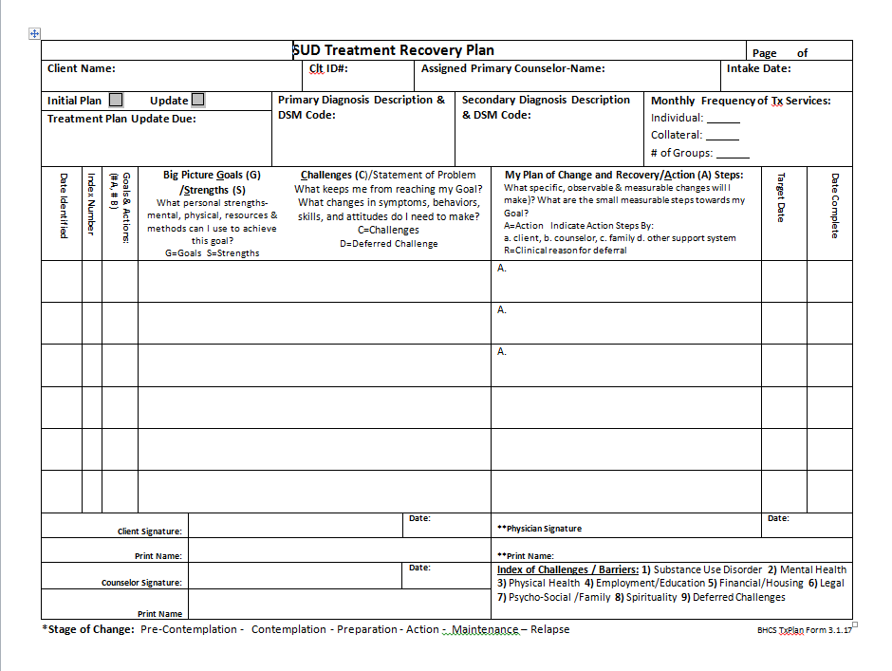
Treatment Plan Template --Form Highly Recommended--
This treatment plan template is available as a handout in the binder and online at the BHCS Provider site—highly recommended to ensure compliance and avoid non-compliance. Address every field and instructions.

Slide 54
Treatment Plan Example: Using BHCS Template
Primary dx must be on the plan
Put challenge code in this column
Primary counselor must be identified on the plan
Client goals for treatment AND strengths to facilitate goals.
Index of challenge codes

Slide 55
Treatment Plan Example: Using BHCS Template
Plan must include frequency of services
Indicate initial or update. Must have plan fully completed and signed by due date.
Indicate initial or update. Must have plan fully completed and signed by due date.
What are the problems that require SUD treatment
Make sure modality is specified. Auditors can not assume if missing
Steps identified in order for client to accomplish plan goals

Slide 56
Treatment Plan Example: Using BHCS Template
Primary dx must be on the plan
Primary counselor must be identified on the plan
Challenge code goes this column
Client goals for treatment AND strengths to facilitate goals.
Index of challenge codes

Slide 57
Treatment Plan Example: Deferring Challenges
Challenges identified in the assessment but not being addressed in the plan MUST be deferred. Include a clinical rationale what the challenge is and why it is being deferred.
Pro Tip: Include if any additional steps (referrals, plan for review at next plan update, etc.) will be taken.
Description of the identified challenge
Clinical rationale why challenge is being deferred
Challenge code goes this column
Deferred challenges index code

Slide 58
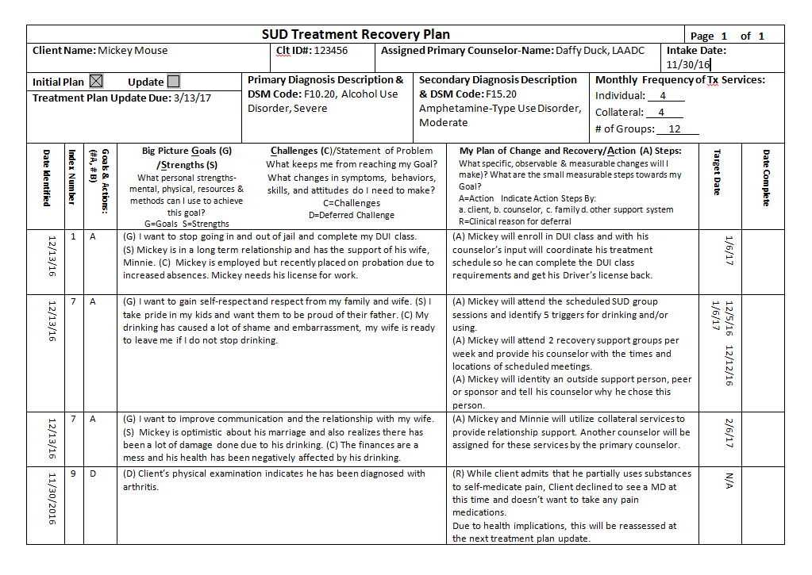
Treatment Plan Example: Using BHCS Template
Due date for next treatment plan update.
Plan updates are due 90 days from the date the counselor signed the previous plan
Intake date field for reference
Must put deferred treatment plan goals in the treatment plan. Identify deferred goals with Item #9 and provide a description
Put the clinical reason for not addressing an identified need here

Slide 59
Treatment Plan Example: Using BHCS Template
Date client signed must be handwritten by client
Physician reviewed/signed within 15 days of counselor signature AND within 30 days Intake/EOD
Complete, with legibly printed name, signature, and date.
Date of treatment plan = Date signed by counselor
Client MUST sign initial plan within 30 days of admission
And for plan update MUST sign within 30 days of counselor and no more than 90 days from previous plan counselor signature

Slide 60
Important Treatment Plan Update Timeline Requirements All result in non-compliance if not met
Treatment Plan Updates
Treatment Plans must be updated as client’s functioning changes; at a minimum every 90 days (pregnant NTP clients have an additional Tx Plan due within 14 days of established pregnancy)
Therapist MUST complete the treatment plan update no later than 90 days after the signing of the previous treatment plan
The client must review and approve the update treatment plans within 30 days of the therapist or counselor signing the treatment plan AND within the required 90 day timeline
Remember per DMC All Signatures: must include not only a signature, but also: date signed, and legibly printed or typed name. Client must write-in the date of their signature themselves.
Source: 22 CCR § 51341.1 (h)(2)(A)(i)(h)(iii)

Slide 61
Important Treatment Plan Update Timeline Requirements Cont. All result in non-compliance if not met
The physician must review, sign, date, and legibly print their name within 15 days of the therapist or counselor’s completed signature.
Non AOD M/C Programs do not require Physician signature—SUD Counselor is adequate.
If the MD has not prescribed medications, a CA state board licensed psychologist may sign the treatment plan update - Source: 22 CCR § 51341.1 (h)(2)(A)(i)(h)(iii)(c)
MUST review, sign, date, and legibly print their name within 15 days of the therapist or counselor’s completed signature

Slide 62
Narcotic Treatment Programs (NTP) - Treatment Plans
Two key differences
Initial treatment plan must be completed within 28 days after initiation of maintenance treatment
Pregnant NTP clients have an additional Tx Plan due within 14 days of established pregnancy
Treatment plan updates are to be completed whenever necessary – due to changes in the client’s functioning – or AT LEAST every 3 months
The effective date is based on the primary counselor’s signature on the plan
NTP Treatment Plans are governed by Title 9, CCR §10305

Slide 63
Potential Treatment Plan non-compliance
All services will be disallowed for the entire chart when:
Treatment Plan signatures (MUST INCLUDE date signed & printed/typed names) are missing or incomplete
The criteria for the diagnosis with physician’s complete signature is not present (see limited exceptions on prior slides)
The additional Perinatal Assessment & Plan items were not assessed and addressed. (See Perinatal Slides)
What are some common reasons for treatment plan non-compliance?
Primary counselor not identified in the treatment plan
Frequency, Duration and Type of Services (modalities) not specified
Goals, Objectives and Measurable Action Steps are missing or vague

Slide 64
Perinatal Residential Treatment Plans
Additional specific DMC requirements for Perinatal Residential treatment plans apply to both Drug Medi-Cal and Drug Non-Medi-Cal Perinatal programs.
Was a need for mother/child habilitative services identified in the assessment?
If yes, the treatment plan must include a goal, action steps, and target date to accomplish this goal
Does the mother need assistance in accessing ancillary services (dental, social, community, educational/vocational, and other services that are medically necessary to prevent risk to the fetus)?
If yes, the treatment plan must include a goal, action steps, and target date to accomplish this goal

Slide 65
Perinatal Residential Treatment Plans Cont.
Prenatal exposure to substances harms developing fetuses. If this is identified as a need in the assessment there must be a goal to provide education to the mother, action steps, and target date must be included in the treatment plan to address this problem.
Were sexual or physical abuse issues identified in the assessment?
If yes, the treatment plan must include a goal, action steps, and target date to accomplish this goal
Are there service access needs (i.e. transportation, financial, other barriers) identified in the assessment?
If yes, the treatment plan must include a goal, action steps, and target date to accomplish this goal

Slide 66
Continuing SUD Services

Slide 67
Justification for Continuing SUD Treatment — BHCS FORM REQUIRED --
Must occur no sooner than five (5) months and no later than six (6) months from the date of admission / episode opening date—if not full chart non-compliance after six months of EOD.
Required for Narcotic Treatment Program Medical Director shall discontinue within 2 years of beginning of Tx unless completes the following: Evaluates progress of lack of progress of Tx Goals, and Determines in his/her clinical judgement that such treatment should be continued. Source: 9 CCR § Article 5, 10410
Therapist or counselor must review client’s progress and eligibility to continue treatment and document recommendations - Source: 22 CCR § 51341.1 (h)(5)(A)(i)

Slide 68
Justification for Continuing SUD Treatment Cont.
The physician must determine whether continued services are medically necessary (consistent with Title 22 CCR § 51303) and documented by the physician that the following has been considered:
Client’s personal, medical, and substance use history
Documentation of the client’s most recent physical exam
Client’s progress notes and treatment plan goals
Therapist or counselor’s recommendation
Client’s progress
Source: 22 CCR § 51341.1 (h)(5)(A)(ii)

Slide 69
Justification for Continuing SUD Treatment Cont.
ACBHCS has created a form to assist with compliance for continued treatment. This form is available as a handout and on the BHCS provider website—required for compliance and to prevent non-compliance.

Slide 70
Progress Notes

Slide 71
Progress Notes - ODF and Naltrexone Treatment Services(and Non-DMC non-residential programs) All reasons for non-compliance.
For each claimed service, there must be an individual progress note documenting that service
Group counseling notes must be completed for each session and specific to the individual client
No other client information is allowed in another client’s chart/record
Notes must be completed and signed within seven (7) calendar days—and dated with date of signature (not just service date)— if not out of compliance
Alameda County BHCS documentation requirement

Slide 72
Progress Notes - ODF and Naltrexone Treatment Services(and Non-DMC non-residential programs) Cont. All reasons for non-compliance.
Each note must contain:
The topic of the session (Relapse Prevention, Relationships, etc.)
A complete signature of the therapist or counselor
If multiple notes are combined on a single page, each note must have all of the required parts
The type of counseling format (i.e. individual, group, collateral, crisis)
A description of the client’s progress towards treatment plan challenges, goals, action steps, objectives, and or referrals
Information about the client’s attendance in the group and individual counseling sessions—including Start and End Times (not just total minutes).
Source: 22 CCR § 51341.1 (h)(3)(A)

Slide 73
Progress Notes – IOT & Perinatal Residential Programs (and-DMC Residential) All reasons for non-compliance.
Must have at least one (1) progress note per calendar week (recommend short note for each service to inform the weekly note), containing:
A description of the client’s progress towards treatment plan challenges, goals, action steps, objectives, and or referrals
Information about client’s attendance at each session, including the date, start and end time, and topic of the session
Each note must have the complete provider signature
Notes must be completed and signed within the following calendar week of the services
22 CCR § 51341.1 (h)(3)(B)

Slide 74
Progress Notes – IOT Only All reasons for non-compliance.
The record must document a minimum of three (3) hours per day for three (3) days per week of individual or group sessions
Or structured therapeutic activities were offered & available (per schedule) AND one of the three
1. Document the one-time occurrence as to why they didn’t attend or attended less than 3 hours—specific to any given day or week--with proof such as scheduling slip for MD appt conflict, etc.
2. If difficulty engaging, assess nature of difficulties and update Treatment Plan (within 1 – 2 weeks) with new action steps. If Plan is not updated by end of week 2—step down to ODF.
3. If Plan is modified and client does not respond (by the end of 3rd week) then step down to ODF or consider other referrals such as co-occurring IOT.
If IOT no longer clinically indicated, step down to ODF
See attached SUD-IOT Services document
and see 22 CCR § 51341.1 (h)(4)(A)(i),(ii)

Slide 75
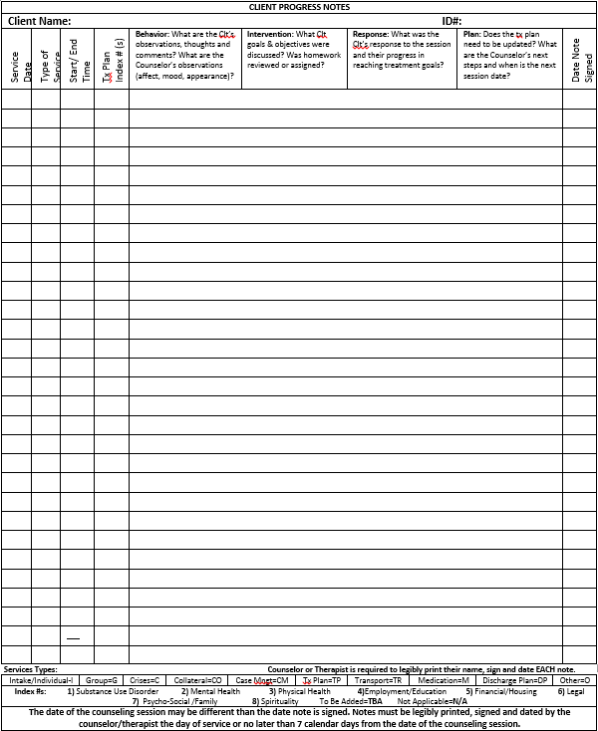
Progress Notes --Recommended form--
ACBHCS has developed a progress note form for providers that is available on the BHCS Provider website

Slide 76
Sample Progress Notes
Available as a handout in the rear of your binder

Slide 77
DMC Minimum Contact Requirements All reasons for non-compliance.
For ODF and Naltrexone Treatment Services, the record must document at least two face to face sessions per 30 day period
If client does not meet this requirement, document close of services
There are two exceptions to this regulation if documented:
Fewer contacts are deemed clinically appropriate
Client is progressing toward treatment plan goals
Source: 22 CCR § 51341.1 (h)(4)(A)
For IOT attendance requirements see prior slides & SUD-IOT Requirements Doc.
Source: 22 CCR § 51341.1 (b)(8)
Narcotic Treatment Programs
Client shall receive a minimum of 50 minutes of counseling per month
The Medical Director may adjust or waive this requirement and document the clinical rationale behind the waiver
Source: 22 CCR § 51341.1 (h)(4)(B)

Slide 78
Collateral Services
Are face to face sessions with the SUD therapists (or SUD counselor) and any significant persons in the life of a beneficiary, focusing on the treatment needs of the beneficiary in terms or supporting the achievement of the beneficiary’s treatment goals.
Significant persons are individuals that have a personal relationship(family member, non-paid advocate, sponsor, etc.), AND not an official or professional relationship (CWW, Probation Office, Teacher, etc.) with the beneficiary.
Must be indicated in Tx Plan with frequency (2x/month).

Slide 79
SUD Group Treatment

Slide 80
SUD Groups
SUD groups must be between 2 and 12 participants — reason for non-compliance
Groups larger than 12 participants must be broken into two separate groups with different SUD Counselors.
Group size updated by: CA State Plan Amendment (SPA) 15-012 Substance Use Disorder Services Expansion and Definition Changes
A client that is 17 years of age or younger can not participate in group counseling with any participants who are 18 years of age or older—reason for non-compliance
However, a client who is 17 years of age or younger may participate in group counseling with participants who are 18 years of age or older when the counseling is at a provider's certified school site
Source: 22 CCR § 51341.1 (b)(11)

Slide 81
Group Sign-In Sheets All reasons for non-compliance.
Improper handling of group sign-in sheets was a frequent cause of non-compliance during prior SUD audits
Required parts of group sign-in sheets include (22 CCR § 51341.1 (g)(2)):
Date of the group session
Topic of the group
Start and End Times of the group
Typed or legibly printed names of the participants (this can be pre-typed)
Signature of each participant (must be clear that it matches the name—if not legible due to client’s writing inability, counselor must indicate.)
Group sign-In sheets should be kept separate from the chart as it contains multiple clients’ PHI and provided to BHCS whenever a chart is audited

Slide 82
Group Sign-In and signatures
Facilitators must enter date of group and start/end times to be in compliance. (Recommend they also type, legibly print names of clients.)
Make sure members print their names legibly and sign their names.
DMC SUD groups must be between 2 and 12 members
Keep sign-in sheets separately in order to maintain HIPAA compliance and confidentiality
When charts are requested for audit, remember to provide all corresponding sign-in sheets, otherwise the auditor is unable to confirm group compliance.

Slide 83
Discharge Summary
&
Discharge Plan

Slide 84
Discharge: Summary v. Plan --see highly recommended compliant forms--
A discharge plan is a plan to support client’s discharge from the program
A plan is developed in conjunction with the client and is intended to transition client from treatment services
Can be claimed when completed face-to-face with client
Discharge plans should be prepared (discussed and signed with client) within 30 days prior to the last face-to-face treatment with client in order to be claimed
A discharge summary is a summary of treatment services, progress, and prognosis—this is required when contact is lost with the client.
Must be completed within 30 days of last face-to-face service
Can be claimed if completed with the client face-to-face
Otherwise, should be non-billable
Source: 22 CCR § 51341.1 (h)(6)

Slide 85
Discharge Plans
Recent SUD Audit indicated that client discharges are not being documented or completed according to DMC requirements
When provider has lost contact with client, a discharge plan is not required, but the circumstances should be documented in a non-billable note & Discharge Summary.
Must document that client was provided (or offered and reason for refusal) a copy of their discharge plan at the last face-to-face. - Source: 22 CCR § 51341.1 (h)(6)(A)(iii)
“Client discharged from the program” Is not a discharge plan!

Slide 86
Discharge Plans --Form Highly Recommended--
Discharge plans MUST include:
Description of each client’s triggers and a plan to assist the client to avoid relapse when confronted with triggers
A support plan
Complete signature of therapist or counselor
Client’s legibly printed name, date, and signature
Source: 22 CCR § 51341.1 (h)(6)(A)(i)

Slide 87
Discharge Summary Required when Client Contact Lost --Form Highly Recommended--
Discharge Summary MUST include:
Duration of treatment (admission date to date of last service)
Reason for discharge and if discharge was involuntary or successful completion of SUD services
Client prognosis
If the discharge summary was not completed face-to-face with client, it must be disallowed
Source: 22 CCR § 51341.1 (h)(6)(B)

Slide 88
Drug Medi-Cal Eligibility
Check Medi-Cal Eligibility the first week of each month (if any services are being claimed to Medi-Cal).
If client loses Medi-Cal for a given month, or no longer meets Medi-Cal criteria (such as for Perinatal IOT in Residential).
Close case to Medi-Cal with D/C Summary and provide client with Fair Hear Notification. Continue to serve client as if Medi-Cal is being claimed.
If Medi-Cal is regained—provide note in client’s chart that Medi-Cal case is reopened.
Alameda County BHCS requirement

Slide 89
Sources / Resources
CA CCR Title 22: http://bit.ly/2hwel56
https://www.sfdph.org/dph/files/CBHSdocs/SUD-Treatment-Provider-Manual.pdf
http://www.dhcs.ca.gov/formsandpubs/Documents/Info%20Notice%202015/Enclosure%204_15_30.pdf

