Slide 1
NO WRONG DOOR & SCREENING &
TRANSITION TOOLS PRESENTATION

Slide 2
Karen Capece
Karen Capece
Juliene Schrick
Charles Edwards
Kate Jones
Welcome &Introductions
CalAIM Overview
No Wrong Door Overview
Standardized Screening & Transition Tools
No Wrong Door in Practice
PRESENTATION
OVERVIEW

Slide 3
WHAT IS CalAIM?

Slide 4
California Advancing and Innovating Medi-Cal (CalAIM)
CalAIM is a long-term commitment to transform Medi-Cal, making the program more equitable, coordinated, and person-centered to help people maximize their health and life trajectory. The success of CalAIM will be a model for transformation of the entire health care sector
~ Department of Health Care Services

Slide 5
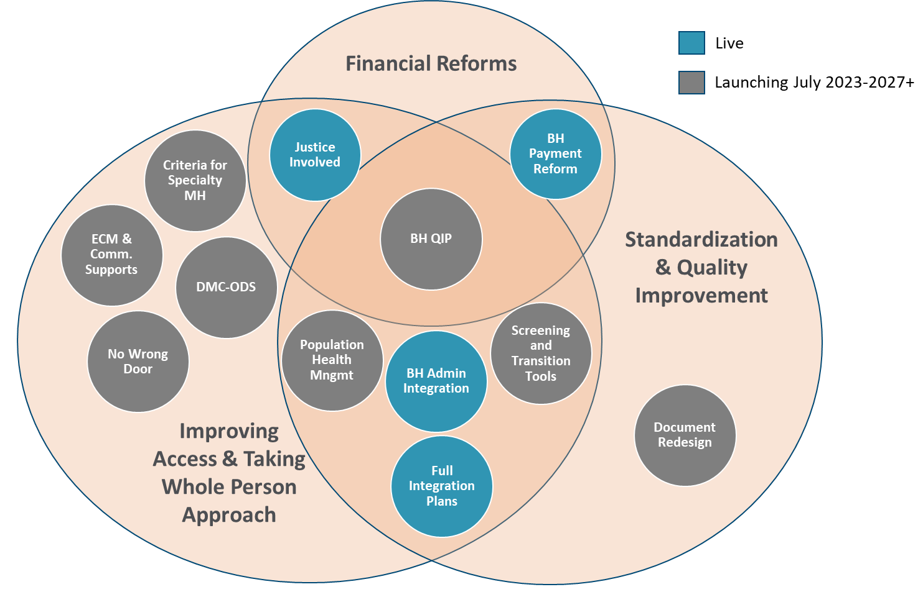
The Journey
Journey to Transform Medi-Cal Delivery System
Payment Reforms
Greatest impact on Alameda County Medi-Cal Beneficiaries at the County and State level.

Slide 6
No Wrong Door

Slide 7
What is No Wrong Door?
On March 31, 2022, the Department of Health Care Services (DHCS) published Behavioral Health Information Notice: 22-011 No Wrong Door for Mental Health Services Policy.
The No Wrong Door Policy is a CalAIM initiative that went live on July 1, 2022

Slide 8
Before diving into the No Wrong Door policy, let’s review the landscape of Medi-Cal Mental Health

Slide 9

No Wrong Door Goals
  Members can access mental health services when they need them, no matter what Medi-Cal service delivery system they first go to (Managed Care Plan or Mental Health Plan)
  Members can maintain treatment relationships with trusted providers without interruption

Slide 10
Managed Care Plans
Are responsible for providing Medi-Cal members physical health care services and Non-Specialty Mental Health Services who meet access to care criteria
There are Two Primary Types of
Medi-Cal Delivery Systems for Mental Health Services:
Mental Health Plan
Are responsible for providing Medi-Cal members Specialty Mental Health Services who meet access to care criteria

Slide 11
Non-Specialty Mental Health Services Provided by the Managed Care Plans (MCPs)
Mental health evaluation and treatment, including individual, group and family psychotherapy
Psychological and neuropsychological testing, when clinically indicated to evaluate a mental health condition
Outpatient services for purposes of monitoring drug therapy
Psychiatric consultation
Outpatient laboratory, drugs, supplies and supplements

Slide 12
Specialty Mental Health Services Provided by the Mental Health Plan (MHP)
Mental health Services
Medication Support Services
Day Treatment Intensive
Day Rehabilitation
Crisis Intervention
Crisis Stabilization
Adult Residential Treatment Services
Crisis Residential Treatment Services
Psychiatric Health Facility Services
Intensive Care Coordination (for beneficiaries under the age of 21)
Intensive Home Based Services (for beneficiaries under the age of 21)
Therapeutic Behavioral Services (for beneficiaries under the age of 21)
Therapeutic Foster Care (for beneficiaries under the age of 21)
Psychiatric Inpatient Hospital Services
Targeted Case Management
Peer Support Services (If the MHP opted in)
For beneficiaries under the age of 21, the Contractor shall provide all medically necessary SMHS required under federal Medicaid law for EPSDT

Slide 13
Who are the Managed Care Plans and the Mental Health Plan in Alameda County?
Mental Health Plan:
Alameda County Behavioral Health
Managed Care Plans:
Alameda Alliance for Health MCP
Kaiser MCP
Anthem MCP (will no longer be an MCP in January 2024)

Slide 14

Now let’s dive into No Wrong Door

Slide 15

There are Three Elements to the No Wrong Door Policy

Slide 16
Now with No Wrong Door:
During the Assessment phase, you can provide treatment to a person before a diagnosis is determined
AND
before it is clear whether the person should get Non- Specialty Mental Health Services from the Managed Care Plan or Specialty Mental Health Services from the Mental Health Plan.
Prior to No Wrong Door/CalAIM:
You had to ensure the person met Specialty Mental Health access criteria and you had to complete the Assessment and Treatment Plan before you could start providing treatment.
#1:
Treatment Services Can Be Provided Promptly

Slide 17
#2:
We can treat substance use disorders, but there is a caveat
Now with No Wrong Door:
You can discuss, document, and bill for time spent treating a person’s co-occurring substance use disorder, if the session primarily addresses the person’s mental health need.
Prior to No Wrong Door:
Specialty Mental Health Providers could not directly treat a substance use disorder when working with a person who has a co-occurring mental health need and substance use problem.

Slide 18
#3:
A person can receive services from the MCP and the MHP concurrently
Now with No Wrong Door:
A person can receive Non-Specialty Mental Health Services through the Managed Care Plan AND Specialty Mental Health Services through the Mental Health Plan at the same time.
The services must be coordinated and not duplicated.
Prior to No Wrong Door:
A person received all their mental health services through the MCP or all their mental health services through the MHP.

Slide 19
So How Does No Wrong Door Relate to Standardized Screening and Transition Tools?
The No Wrong Door Policy defines three new scenarios when Specialty Mental Health Services are covered and reimbursable.
The Screening Tool and the Transition of Care Tool are the instruments used to operationalize No Wrong Door across all counties.

Slide 20
Screening & Transition of Care Tools for Medi-Cal Mental Health Services

Slide 21
Screening & Transition of Care Tools for Medi-Cal Mental Health Services
Beginning January 1, 2023, the Department of Health Care Services (DHCS) mandated use of the new Screening & Transition of Care Tools for Medi-Cal Mental Health Services.
Adult Screening Tool for Medi-Cal Mental Health Services
Youth Screening Tool for Medi-Cal Mental Health Services
Transition of Care Tool for Medi-Cal Mental Health Services

Slide 22
Screening & Transition of Care Tools for Medi-Cal Mental Health Services
Prior to January 2023, multiple tools were used across the different counties in the state, contributing to inconsistencies about who was seen in the various Medi-Cal Managed Care Plans (MCPs) and County Mental Health Plans (MHPs).
One of CalAIM’s Behavioral Health Initiatives is to standardize entry into, and transitions between the MCPs and the MHPs. With use of the tools, CalAIM is also attempting to ensure access to the right care, in the right place, at the right time.
ACCESS began using and receiving the tools on the first day of business January 2023.

Slide 23
Screening & Transition of Care Tools for Medi-Cal Mental Health Services​
Screening Tools​
Adult Screening Tool for Medi-Cal Mental Health Services (to be used for beneficiaries ages 21 and over)
​Youth Screening Tool for Medi-Cal Mental Health Services (to be used for beneficiaries under age 21 )
The Screening Tools are required for use by MCPs and MHPs when individuals contact the MCP or MHP (ACCESS) seeking mental health services.​
​
The Screening Tools are NOT required for use:​
With beneficiaries who are currently receiving mental health services in the MCP or MHP.​
When individuals contact providers directly seeking mental health services.

Slide 24
Screening & Transition of Care Tools for Medi-Cal Mental Health Services
Screening Tools​
Adult Screening Tool for Medi-Cal Mental Health Services (to be used for beneficiaries ages 21 and over)​
Youth Screening Tool for Medi-Cal Mental Health Services (to be used for beneficiaries under age 21 )
After administering a screening tool, the individual must be referred to either the MCP or the MHP, based on their score.​
0 –5 MCP​
6 and above MHP ​
The screening tools are not replacing assessments. Rather they're being used to identify key indicators of mental health needs and where someone should be referred for an assessment, in the MCP or the MHP.

Slide 25
Screening & Transition of Care Tools for Medi-Cal Mental Health Services
Transition of Care Tool​
Transition of Care Tool for Medi-Cal Mental Health Services (one tool to be used for all Adult and Youth beneficiaries)
Required to be used when a beneficiary needs their care transitioned (entirely or partially) from one mental health system (MCP or MHP) to the other.​
​
A clinician must make the decision (with consulting the beneficiary) to transition and/or add a service from one mental health system to the other.​
​
MCP and MHP must coordinate to facilitate transitions of care or additions of services to the other mental health system and continue to provide care until the beneficiary is connected to the other system.

Slide 26
Screening & Transition of Care Tools for Medi-Cal Mental Health Services
Transition of Care Tool​
Transition of Care Tool for Medi-Cal Mental Health Services (one tool to be used for all Adult and Youth beneficiaries)
ACBH and the MCPs (Alameda Alliance for Health, Kaiser and Anthen Blue Cross) have made an agreement to include the following documents when sending Transition of Care Tools to the other plan. ​
​
Assessment ​
Service History ​
Medication List​
Statement regarding the client's knowledge of the referral and willingness to receive services in the other plan.

Slide 27
Screening & Transition of Care Tools for Medi-Cal Mental Health Services
Transition of Care Tool​
Transition of Care Tool for Medi-Cal Mental Health Services (one tool to be used for all Adult and Youth beneficiaries)
Where to send Transition of Care Tools​
Alameda Alliance for Health: email to deptbhmentalhealth@alamedaalliance.org​
Kaiser Oakland: email to jenica.x.babbitt-pearce@kp.org​
Kaiser Fremont / Union City / San Leandro: email to radawn.l.alcorn@kp.org​
Anthem Blue Cross: email to bhcmreferrals@anthem.com

Slide 28
Screening & Transition of Care Tools for Medi-Cal Mental Health Services
Resources
Adult Screening Tool for Medi-Cal Mental Health Services ​
Youth Screening Tool for Medi-Cal Mental Health Services ​
Transition of Care Tool for Medi-Cal Mental Health Services ​
Screening and Transition of Care Tools for Medi-Cal Mental Health Services​
Screening-and-Transition-of-Care-Tools-FAQ​
Screening & Transition of Care Tools Technical Assistance Webinar
Managed Care Plans
Alameda Alliance: 1-855-856-0577
Kaiser Oakland: (510) 752-1075
Kaiser San Leandro: (510) 626-2800
Kaiser Union City: (510) 675-3080
Kaiser Fremont: (510) 248-5050
Anthem Blue Cross: 1-800-407-4627
Managed Care Plan Clinical Contacts
Alameda Alliance for Health | Alameda Alliance Behavioral Health deptbhmentalhealth@alamedaalliance.org
Kaiser Oakland | Jenica Babbitt-Pearce jenica.x.babbitt-pearce@kp.org
Kaiser San Leandro/Union City/Fremont | Radawn Alcorn radawn.l.alcorn@kp.org
Anthem Blue Cross | Fargol Riahi Fargol.Riahi@anthem.com or Maribeth Capen Maribeth.Capen@anthem.com
Notes:
Charles to tranistion to Kate

Slide 29
CalAIM
No Wrong Door in Practice

Slide 30
Seeking Services Directly from a Provider
Bantu walks into CHANGES FSP front door at Eastmont Mall asking for medications and therapy.
CHANGES warmly greets Bantu and explains that there are two or even three ways they can help him right now:
  Conduct an immediate crisis assessment to determine if Bantu needs immediate crisis intervention (all providers are expected to do this when someone walks in or calls requesting services).
  No crisis, Next steps:
    Explain to Bantu that you can assist him in contacting the ACCESS line to get a screening and referral to a service and do this with him immediately.
    Take Bantu down to Oakland Community Support Clinic to the Urgent Medication clinic and do a warm handoff to the Urgent Meds staff.
    Either immediately begin an assessment or schedule an assessment with Bantu within 14 days of walking in.

Slide 31
Directly Seeking Services- Bantu Continued …
A provider can immediately begin to assess an individual and bill for that assessment period for up to 60 days in the Adult/Older Adult Services System of Care. Either:
  Contact ACCESS and open the client up to the FSP because he meets criteria
  Contact ACCESS to refer him to a medication clinic and therapy
  Fill out the transition of care tool and send it to the Managed Care Plan and request medication and therapy because you assessed his mental health needs are mild-to-moderate.

Slide 32

Filling out a Transition of Care Tool
Transition fully to the Managed Care Plan and out of Specialty Mental Health Services
Add a service that our Mental Health Plan does not have available

Slide 33
Service Team Example
You have a beneficiary that needs therapy and psych testing. ​ You do not provide therapy or psych testing on your team​
There are 2 possibilities: ​
- Through a discussion with the beneficiary, client wants therapy through the MCP or​
- Contact ACCESS to request the services on behalf of the beneficiary and they are not currently available
​
  Fill out the Transition of Care Tool and click “Add a Service”​
  Fill in all relevant information including supporting documentation​
  Request the services of therapy and psych testing (MCPs are required to provide these services)​
  Send to MCP and document in the chart

Slide 34
Stepping Someone Down from the MHP
A Medication Clinic in our system believes a beneficiary is stable enough to be followed by his/her/their Primary Care Physician (PCP)
The Medication Clinic fills out the Transition of Care Tool (TOCT) and attaches supporting documentation to the tool
The Clinic emails the completed TOCT to the beneficiary’s MCP
The Medication Clinic continues to serve the individual until it can be verified that the beneficiary has had their first appointment with the newly assigned provider/PCP within the MCP

Slide 35

Questions?

