Slide 1
Unusual Occurrence: Policy, Reporting and Investigation
Ray Carlson, LCSW Dee Dee Terry, LMFT Quality Assurance, Clinical Review Specialist Quality Assurance, Clinical Review Specialist
May 19, 2022

Slide 2
Learning Objectives
Understand what constitutes an Unusual Occurrence
Learn how to report an Unusual Occurrence
Understand ACBH Quality Assurance team’s process for investigating reported Unusual Occurrences

Slide 3
What is an Unusual Occurrence (UO)?
All ACBH County Clinics and Contractors (MH and SUD programs) are required to submit UO Notifications to ACBH.
Unexpected incidents involving death or serious physical and/or psychological injury, or the risk thereof, including those for which a recurrence would carry a significant risk of an adverse outcome, or adversely affect the quality of behavioral health care service or operations.
Can be witnessed by staff or reported by others.
The client must have received mental health or substance use disorder services through Alameda County within 12 months of the occurrence.
This Photo by Unknown Author is licensed under CC BY-SA-NC

Slide 4
Examples of UOs
Deaths:
Unusual Occurrences Not Resulting in Death:
Suicides
Homicides
Accidental deaths
Unexpected deaths
Serious injuries
Acts of self-harm resulting in injury
Physical assault of a client or involving a client
Problem involving seclusion and/or restraint of client
Professional conduct allegations
Medication prescription or administration errors
Allegations of abuse, accidents, injuries, elopements
Physical facility issues, property damage
Epidemic outbreaks, poisonings, fires, major accidents
High-profile events

Slide 5
Applying the UO Definition To Your Agency
UO Definition
Unexpected incidents involving death or serious physical and/or psychological injury, or the risk thereof, including those for which a recurrence would carry a significant risk of an adverse outcome, or adversely affect the quality of behavioral health care service or operations.
The client must have received mental health or substance use disorder services through Alameda County within 12 months of the occurrence.
Toddlers fall down a lot. A toddler falling would not be an unusual occurrence unless it results in a severe injury.
All occurrences involving death or serious injury should be reported. The QA team will review and close the case if the client’s death was determined to be due to natural causes and the client was receiving appropriate services.
A physical altercation not resulting in serious injury would be an Unusual Occurrence in a residential program or Board and Care setting but may not be unusual at Santa Rita Jail or John George Psychiatric Hospital.
Medication errors should always be reported, even if they don’t result in serious injury.
What would be an Unusual Occurrence, that does not result in serious injury or death, within your agency?
This Photo by Unknown Author is licensed under CC BY-SA

Slide 6
Value of the UO Investigation process
The goal of reviewing an unusual occurrence is:
To minimize the possibility of something similar happening in the future by identifying and addressing process improvement opportunities.
To ensure consistent application of the following best practices to support quality of care:
Coordination of care
Continuity of care
Containment of emergent situations
Adequate reporting
Consistent application of Policy and Procedure
This Photo by Unknown Author is licensed under CC BY-NC-ND

Slide 7
Internal Reviews vs. ACBH UO Process
Internal Reviews are a best practice. They allow for oversight and implementation of positive changes at the agency level to address and minimize adverse occurrences. These are strongly recommended by ACBH.
Internal Reviews are to UOs as CQRT is to audits (policy/practice improvements).
Providers may also be required to report UOs to certifying or licensing bodies, the state or federal government, Joint Commission on Accreditation of Healthcare Organizations (JCAHO), Alameda County Risk Management, etc.
Submission of UO Notification forms to ACBH is required, even if an agency has their own internal review process or is required to submit reports to other external bodies.

Slide 8
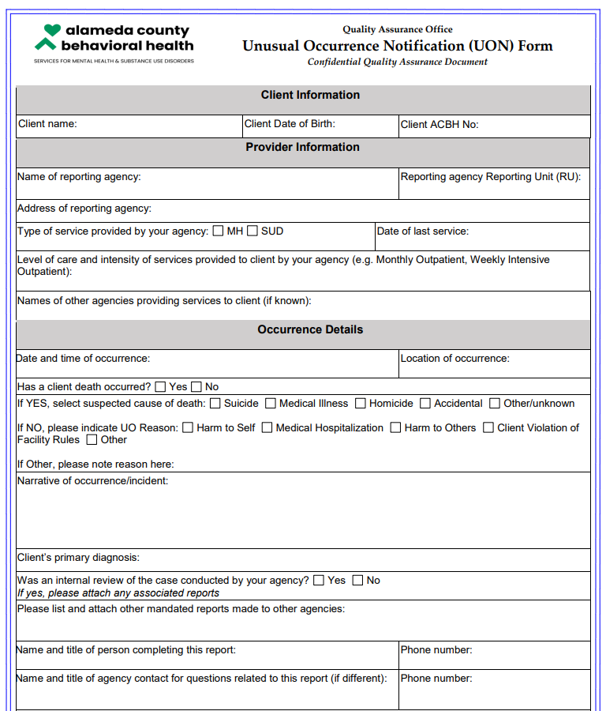
Updated Process with Simplified Form
Changes to the UO Process became effective on July 1, 2021.
The updated UO process allows for:
Collaboration and consensus-building
Wider spectrum of available expertise
Faster processing for appropriately handling of issues
Targeting outliers and identifying trends
Link to the UO Policy:
6-2_1603-4-1 Unusual Occurrence and Death Reporting P&P.pdf (acbhcs.org)
Link to the UO form: UO Form

Slide 9
ACBH QA Investigation Process
The QA Office gathers relevant information to understand the details related to the event:
Agency records, policies, etc.
Additional materials may include: Police Department (PD) reports, Community Care Licensing (CCL) reports and Coroner’s reports.
Additional records from secondary agencies
QA staff reviews the documents and may reach out to providers directly to discuss and better understand the issues.
QA staff determines whether there were potential gaps in care or service that could, if addressed, minimize the risk of a future similar occurrence.
Depending on the level of potential gaps identified, the investigation is either completed by the QA team or referred to the UO Committee for review by a multi-disciplinary team.

Slide 10
ACBH QA Investigation Process
In cases where the issues identified may represent a system-wide, agency, and/or provider trend, a Formalized Trend Review may be recommended by the QA team or the UO Committee.
The role of the Formalized Trend Review committee is to review patterns and trends that may be impacting the quality of services provided to beneficiaries and make recommendations for addressing the identified issues.
At the conclusion of the UO investigation, providers will receive a letter from the QA office noting whether there were any potential gaps identified. If so, the letter will include recommendations for improvement or a request for a Corrective Action Plan to address those gaps.

Slide 11
Let’s Follow The Life of An Unusual Occurrence
Provider Example:
UO: Overdose in a residential facility
Agency did their own internal review
Took lessons learned to apply to other agencies within their umbrella
Helped to facilitate process implementation at additional facilities
QA able to generalize to support changes in system of care
This example demonstrates the value of a collaborative process in addressing Unusual Occurrences.
Notes:
Had an emergency that was potential overdose
Had NarCan and someone on staff that is supposed to administer it
They called 911
One person conveyed the instructions from the telephone to the team.
The person that was assigned to do the NarCan got pulled into a different task
The person conveying instructions became anxious
The paramedics arrived, administered NarCan and then asked why someone had not already done it.
Internal review was done and determined to use the speakerphone instead of the instruction conveyor and to have the NarCan administered prior to paramedics arriving

Slide 12
Discussion/Questions

Slide 13
Contact QATA @acgov.org for more information

