Slide 1
Substance Use Disorder (SUD) Care Coordination
Performance Improvement Project (PIP)
QI & UM
November 2022
Rashad Eady Quality Improvement, Program Specialist
Lori Shallcross LCSW Utilization Management, Clinical Review Specialist

Slide 2
WHAT ARE PIPs?
Program Improvement Projects (PIP):
  As a Medi-Cal funded Mental Health Plan (MHP) and Drug Medi-Cal Organized Delivery System (DMC-ODS), we are required by Federal regulation and State contract to have various active PIPs at any given time.
  A PIP is a project designed to address an identified problem and achieve significant improvement, sustained over time, in health outcomes and client satisfaction.
  A PIP may be designed to change behavior at a client, provider, and/or system level.

Slide 3
SUD Treatment Outcomes
Definition of Progress
  Made Progress
    Comp Tx/Rcvr Plan Goals/No Ref
    Comp Tx/Rcvr Plan Goals/Ref
    Left w/Satis Prog/No Ref
    Left w/Satis Prog/Ref
  No Progress
    Left w/Unsatis Prog/No Ref
    Left w/Unsatis Prog/Ref
Excludes Death & Incarceration

Slide 4
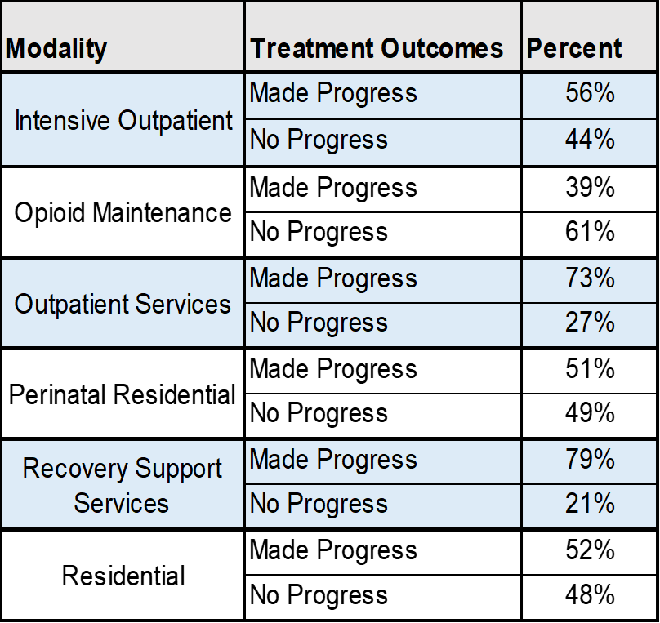
SUD Treatment Outcomes— Discharge Status by Modality
Almost 50% of the clients receiving services in Residential settings are discharged without making any progress.

Slide 5
SUD Treatment Outcomes— Discharge Status by Modality
Clients discharging from Residential services only successfully transition to the next level of care 27% of the time.

Slide 6
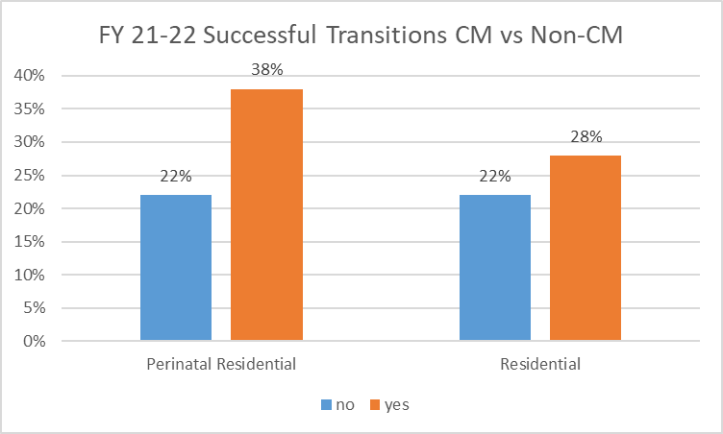
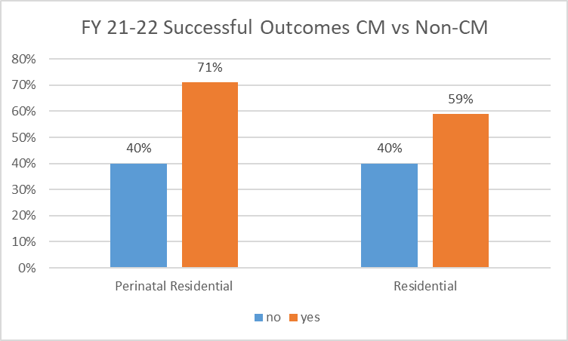
Care Coordination/ Case Management Improves Outcomes
NOTE: Care coordination and case management will be used synonymously throughout this presentation.

Slide 7
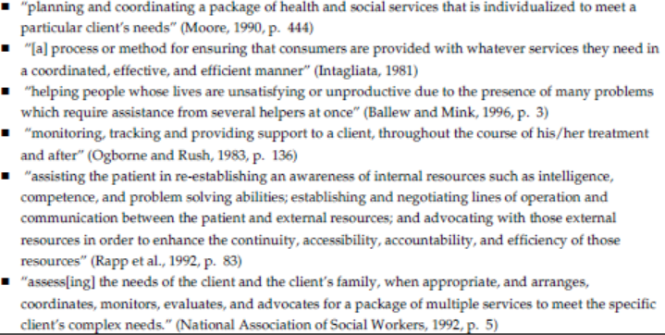
Substance Abuse & Mental Health Services Administration (SAMSHA) Definition of Case Management
SAMSHA General Definition: Coordinated, individualized approach that links clients with appropriate services to address their specific needs and help them achieve their stated goals.

Slide 8
SUD Care Coordination PIP Overview
GOAL: Improve SUD outcomes in Alameda County residential treatment programs by increasing care coordination services for beneficiaries.
SAMHSA/Multi-County Best Practices and Areas of Focus for Improving Care Coordination:
    Family and support
    Social connection/concerns
    Frequency of Care Coordination contacts
    Transitions in level of care
    Physical health concerns
Notes:
SUD Care Coordination (Case Management) PIP Overview

Slide 9

The Nuts and Bolts –
Billing for
Case Management Services

Slide 10
ACBH BILLING CODES FOR CASE MANAGEMENT SERVICES
Level of Care | Billing Code | Service Provided
3.1 | 112 | CM Care Coordination
 | 113 | Service Coordination
3.3 | 142 | CM Care Coordination
 | 143 | Service Coordination
3.5 | 172 | CM Care Coordination
 | 173 | Service Coordination
CM Service |  | Description of Service
CM-Care Coordination |  | Coordination of care for clients in DMC-ODS without disruptions to services; this would include any care coordination to transition to a lower level of SUD care.
Service Coordination |  | Services provided to assist clients to access needed medical, educational, social, prevocational, vocational, rehabilitative, or other community services
NOTE: Residential Providers cannot bill the daily rate on the client's date of discharge. However, services provided in transitioning the client to a lower level of SUD care or other service coordination activities can be billed on the discharge date.

Slide 11
Case Management Activities
The following reference table may be used as a tool to ensure that core functions of case management and their respective activities are being performed. This table offers some examples of activities that could be covered in sessions, when applicable and are billable. The examples should not be considered an exhaustive list of case management activities.
NOTE: Case management services must be provided by either registered/certified Counselors or LPHAs in order to be billable.

Slide 12
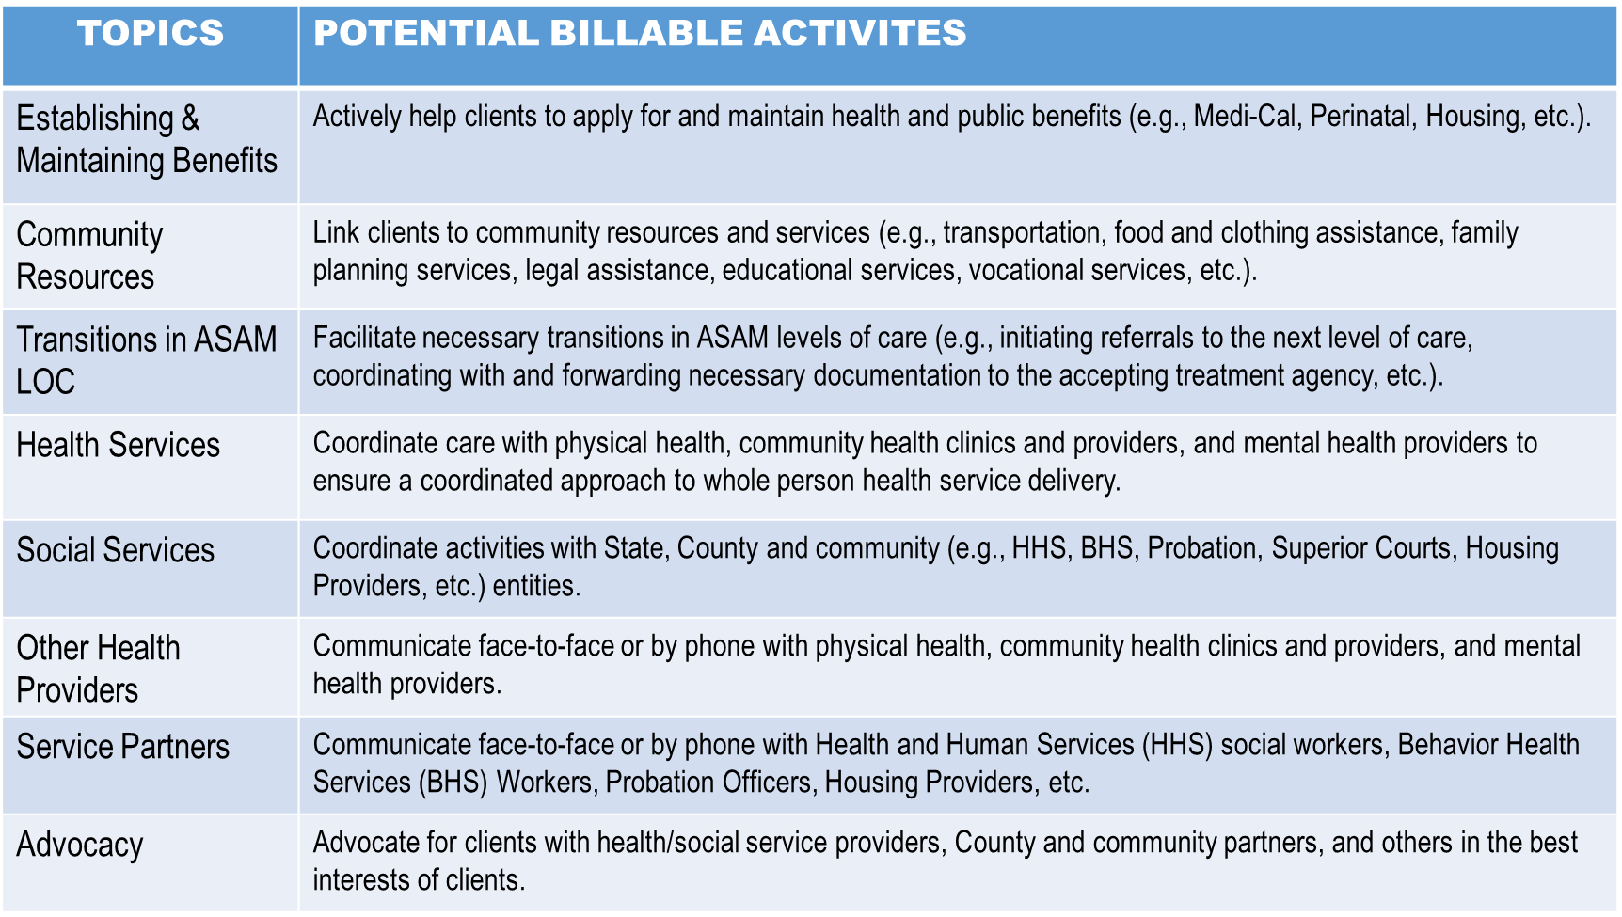
Connection
Coordination
Communication

Slide 13
CASE MANAGEMENT ACTIVITY SCENARIOS
The following reference table may be used as a tool to ensure that core functions of case management and their respective activities are being performed. This table offers some examples of activities that could be covered in sessions, when applicable and are billable. The examples should not be considered an exhaustive list of case management activities.
NOTE: Case management services must be provided by either registered/certified Counselors or LPHAs in order to be billable.
BILLABLE
NOT BILLABLE
Linking Clients to housing resources.
Assisting clients with applying for Medi-Cal.
Transferring Medi-Cal benefits for clients
Linking clients to community resources such as food and clothing assistance
Providing warm hand-offs to new LOC.
Providing transportation for clients to scheduled appointments (not considered medically necessary treatment) such as driving client to and from DMV to obtain ID card.
Helping a client move residences.
Driving around looking for a client who went AWOL from the program.
Driving to visit a client in the community and waiting for the client, but the client is a no-show for the appointment.
Waiting for a client in the lobby during a client’s doctor appointment.
Identifying a referral agency and scheduling an appointment for a level of care transition (e.g. from IOP or ASAM 2.1.)
Coordinating care to physical and mental health providers to ensure clients are provided appropriate services.
Documenting case mgt activities outside of a progress note for services, including information regarding recent primary care and specialist visits, ED visits, auxiliary treatment services (e.g. dialysis) and any community resources received. Although providers are expected to conduct these activities, time spent documenting these activities are not billable if not a part of a direct documented service.
Time spent communicating with service providers, county workers, judges, etc. either face-to-face or by phone (e.g. meeting with patient and doctor during a primary care visit) or discussing treatment progress with county partners (e.g. Child, Youth and Family Services, Probation Department.
Following up with other agencies regarding scheduled services and/or services received by clients.
Entering data into InSyst/Clinician’s Gateway; submitting authorizations, progress notes, etc.
Attempting but not successfully contacting service providers either by phone or face-to-face (e.g., leaving a voice mail message). Providers should only bill for CM if they are successful in communicating with other services providers on the client’s behalf.
Providing written reports or communicating via email to health and mental health providers, and county partners (e.g. Child, Youth and Family services, Probation).

Slide 14
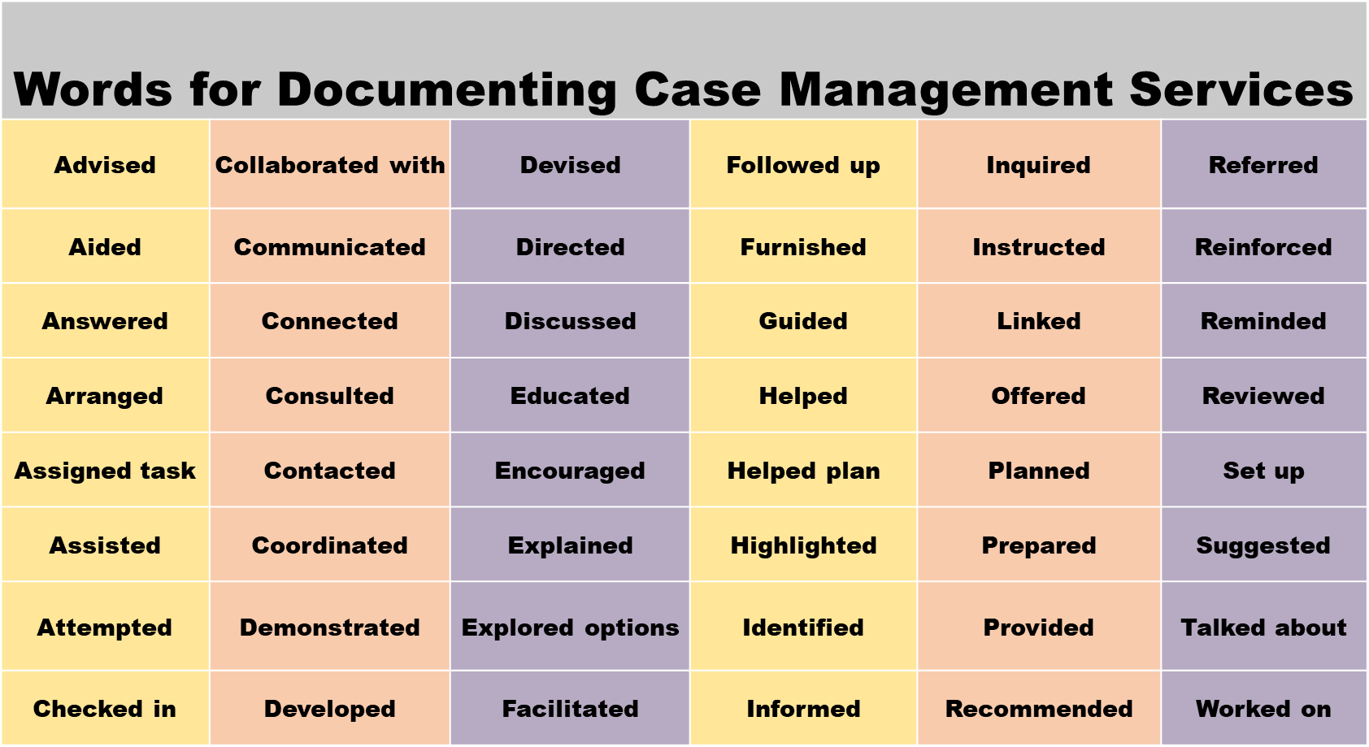

Slide 15
Care Coordination Best Practices & Tips
Substance abuse clients often arrive in treatment programs with numerous social problems and addressing them in a respectful and timely way makes a difference.
  Supporting clients in reconnecting with family & friends
  Assisting in goal planning and following up with the client’s progress and future plans
  Finding and making referrals to other needed services and monitoring the subsequent engagement of the referrals
    Physical health concerns are one of the number one needed referral.
  Engaging in advocacy on behalf of individuals to secure additional resources including:
    Income - GA, CalWorks, employment services
    Food including CalFresh benefits
    Phone
Always come first with a strength based perspective.

Slide 16
SUD PIP Next Steps
Set up on-going meetings with care coordination staff to:
  Track success
  Identify areas that need improvement
  Remove any barriers encountered
Provide on-going support for:
  Case notes
  Data input
  Care coordination strategies
Resources
  COMPREHENSIVE CASE MANAGEMENT FOR SUBSTANCE USE DISORDEER TREATMENT (samhsa.gov)
  TIP 27: Comprehensive Case Management for Substance Abuse Treatment (samhsa.gov)

Slide 17
Questions and or Feedback?
Rashad.Eady@acgov.org
Lori.Shallcross@acgov.org

