Slide 1
Clinical Quality Review Team (CQRT) Process and Forms
Outpatient Specialty Mental Health Services
Quality Assurance Team (QA)
Alameda County Behavioral Health Services (ACBH)
January 2023
Presented by: Amy Saucier, Clinical Review Specialist Supervisor
Danielle Pence, Clinical Review Specialist

Slide 2
Learning Objectives
Provide an overview of the
  Outpatient CQRT process for new and existing ACBH agencies and Fee for Service providers
  Required and optional CQRT forms

Slide 3

Overview and Purpose of CQRT
The contract between Alameda County Behavioral Health (ACBH) and the Department of HealthCare Services (DHCS) requires ACBH to certify that claims made to Medi-Cal meet Federal and State requirements for medical necessity and documentation.
The CQRT process was created to perform this required function and involves review of clinical documentation during specific review cycles to certify that it meets Medi-Cal requirements.
The CQRT process starts with the ACBH Quality Assurance (QA) team, then transitions to a required monthly agency expectation.
New programs and Fee for Service providers must participate in the ACBH CQRT process within the first 3 months of their contract start date.

Slide 4
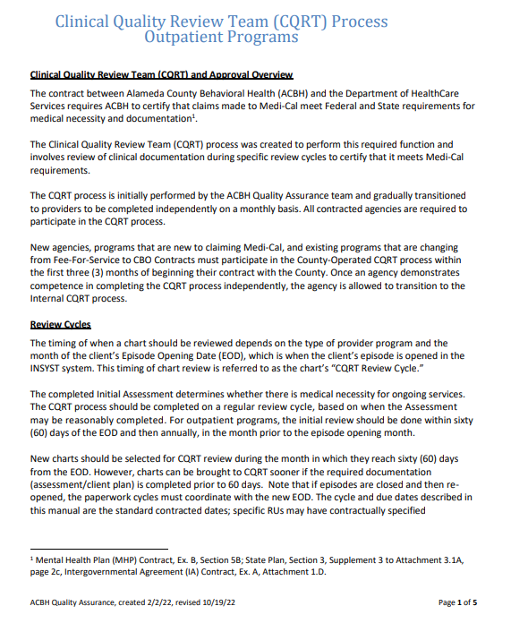
CQRT Documents and Resources
The following CQRT documents and resources can be found on the ACBH provider website, in section 8 of the QA Manual:
  CQRT Procedures Post CalAim
  CQRT Checklist
  CQRT Glossary
  CQRT Electronic Record Attestation form
  CQRT Tracking Tool
  CQRT Comments Sheet
Most of the information presented in this training is included in the CQRT Procedures Post CalAIM document.

Slide 5

New Agency CQRT Process
CQRT begins as a collaborative process during which the ACBH QA team partners with agencies/providers to train and support them in using the CQRT tools to review their agency’s documentation and certify that they meet Medi-Cal requirements.
After demonstrating understanding of the CQRT review process, the agency/provider transitions to CQRT independence.

Slide 6
CQRT Process and Roles
The CQRT process involves agency/provider review of a designated number of open charts each month using the ACBH CQRT Checklist, certifying that claims made to Medi-Cal meet Federal and State requirements for medical necessity and documentation.
In addition to identifying a CQRT Reviewer, agencies should select a CQRT Chairperson to provide oversight of the process.
CQRT reviewers and chairpersons must be trained on the clinical documentation requirements.
Fee for Service providers can review their own charts and do not require oversight of a CQRT Chairperson.
Below are more details regarding the role of the Chart Reviewer and Chairperson.
CQRT Chart Reviewer: Must be licensed, waivered, or registered as Licensed Practitioners of the Healing Arts (LPHA) or graduate student interns.
  Using the CQRT Checklist and Glossary, reviews charts each month
  Makes a determination regarding the status of the chart
  Makes recommendations and follows through with needed training, coaching or other actions
CQRT Chairperson: Must be a Licensed Practitioner of the Healing Arts (LPHA)
  Signs off on the completed CQRT Checklists
  Ensures that reviews were completed timely and effectively
  Confirms recommended corrections are appropriate to address any identified issues

Slide 7

CQRT Review Cycles
The CQRT process should be completed on a regular review cycle, based on when an assessment may be reasonably completed.
Open charts should be selected for CQRT review,
  During the month in which they reach sixty (60) days from the episode opening date (EOD). Note that if episodes are closed and then re-opened, the paperwork cycles must coordinate with the new EOD.
  Annually, in the month prior to the episode opening month
Some programs have accelerated dates, in which case, the documentation must follow the dates specified in the contract.
With the roll out of CalAIM, there is no longer an expectation for an initial completed assessment and/or an updated assessment within a specific timeframe.
Assessments should be completed and updated according to clinical best practices and the particular details and needs of the case.
If an initial assessment is not completed within 60 days, the notes should clearly indicate barriers to completion and efforts being made to remove those barriers. For example, that the patient is not a reliable historian and that records have been requested from past providers and will be used to inform the assessment.

Slide 8
Frequency of CQRT Review
Agencies are responsible for reviewing a reasonable percentage of all open charts each month to obtain a general understanding of training issues and needs.
At minimum, 5% of the total number of new and annual charts combined must be reviewed each month.
This will allow providers the flexibility to determine whether to choose a higher percentage of new or annual charts based on their census.
For agencies with multiple treatment programs (a single RU or a grouping of RUs), reviewers should ensure that all programs that have charts up for review, have at least one of those charts reviewed each month.
Fee for Service providers are expected to review at least one Medi-Cal chart per month.
  Example:
    Agency A has a total of five hundred (500) open charts.
    Sixty (60) have passed day sixty (60) and are up for initial review.
    One hundred (100) are up for annual review (i.e., this is the CQRT in the month before their episode opening month).
    That is a total of one hundred sixty (160) initial and annual charts.
    Under this model, a minimum of eight (8) of these charts would need to be reviewed. Agencies may decide how many of each chart type (initial or annual) to choose. Agencies also have the discretion to choose more than eight (8) charts for review.

Slide 9

Sampling Methodology
Each agency can choose the sampling methodology that works best for their system from the list below and document the sampling methodology utilized in their Policy and Procedures.
Sampling options include the following:
  Random Sampling: Pick a number and pull randomly
  Sampling based on clinician strength/competence: Review fewer charts by more seasoned staff and more by staff who are newer and/or who have had difficulty with their documentation
  Sampling based on the type of case: For example, high billing, long duration, etc.

Slide 10
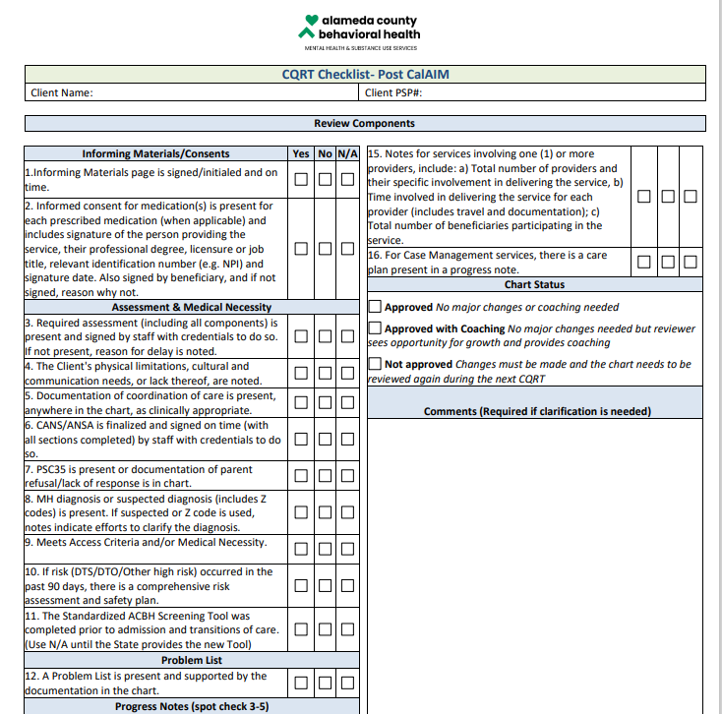
CQRT Checklist
The CQRT Checklist-Post CalAIM document should be utilized for all reviews.
The checklist was modified in partnership with the Behavioral Health Collaborative, to include items that lead to disallowances, as well as others identified by the group as critical documentation elements.
The Checklist should not be edited and/or items removed without prior written consent from the ACBH QA department.
Additional items can be added to the checklist if an agency feels that they would like that item reviewed during the process.
Agencies can utilize the WORD version of the CQRT Checklist or incorporate the Checklist into their Electronic Health Records to help streamline the process.
The former CQRT Authorization Form is no longer required.

Slide 11
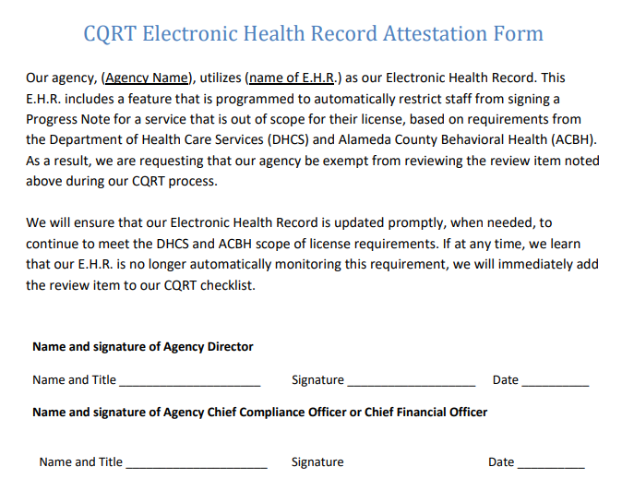
Electronic Health Record Attestation
The CQRT checklist contains some questions that can be removed through an Attestation process.
These questions are those that can be validated by the provider’s Electronic Health Record (EHR) behind the scenes. For example, some EHRs are set up to ensure that providers are not claiming for services outside their scope of practice.
The CQRT Checklist Glossary provides details of which questions may be removed through this attestation process.
The ACBH Attestation form must be submitted to QATA@acgov.org and permission received from ACBH QA prior to removal of the questions from the Checklist.
A copy of the form should be maintained by the agency and will be requested during ACBH audits.

Slide 12
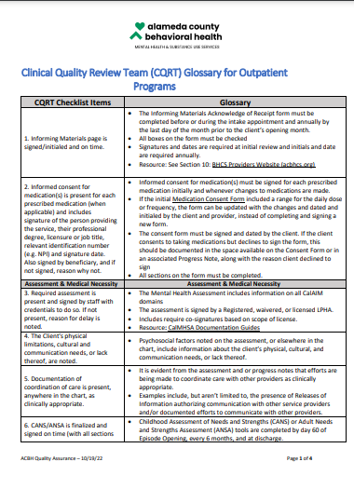
CQRT Checklist Glossary
The CQRT Checklist Glossary provides details of what is required for each of the sections being reviewed.
The Glossary should be utilized by the CQRT Reviewer and CQRT Chairperson to ensure that each section is reviewed appropriately and consistent with all of the requirements.

Slide 13
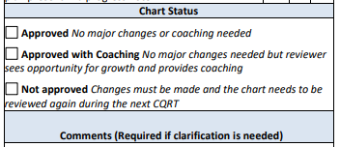
Chart Status
For each chart that is reviewed, the reviewer selects a Status based on their findings:
Approved: This status implies that no major changes are needed. The chart is found to be compliant with all requirements.
Approved with Coaching: This status can be used in cases where the reviewer does not identify any major concerns or changes needed to the documentation but notices a potential area of growth or improvement that could benefit from individual feedback. In these cases, feedback is provided to the staff member but the chart is not required to be brought back to CQRT the following month.
Not approved: This status implies that changes must be made to the chart to make it compliant with requirements. The staff member and/or the staff member’s supervisor are notified of the issues and coaching is provided regarding the items that need correction.
The chart is reviewed again during the next CQRT month. Charts that are re-reviewed, are only checked for items that were missed during the initial review. The deficient items are checked and a new review Status is provided based on the findings.
If opportunities for improvement are found with a chart, further clarification of the issues can be noted in the Comments section of the CQRT Checklist and on the separate CQRT Comments Sheet.
Notes:
Only review again for the items that were missing.

Slide 14

Best Practices For Follow Up
Given that a sample of charts are reviewed, reviewers should follow the principle of one chart stands for all other charts.
The following best practices should be utilized to maximize the efficacy of the CQRT process:
  The list of charts being reviewed should not be released in advance of the review.
  If a problem is identified, additional actions are taken by the agency which could include the following:
    Review of deficiencies with staff member or staff member’s supervisor
    Review of additional charts
    Identification of themes and areas of concern to be addressed through re-training of staff, email communication, Reference Guides, coaching, etc.
    Other steps identified by the agency
Actions taken following the review should be clearly documented in the Comments and/or Tracking Tool and provided to ACBH when CQRT documentation is requested.

Slide 15
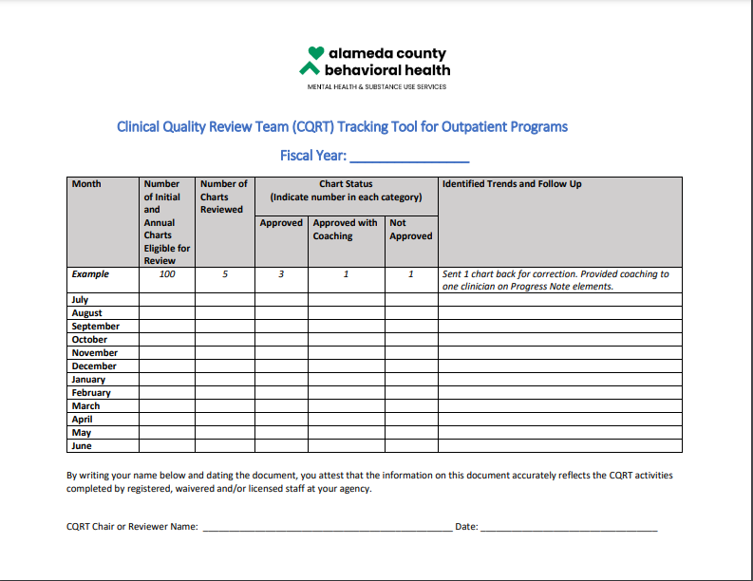
CQRT Tracking Tool
Once final sign off is received from the CQRT Chairperson, the CQRT Reviewer should complete the CQRT Tracking Tool.
The Tracking Tool is required for use by agencies to demonstrate compliance with the CQRT review expectations.
It also tracks the number of charts reviewed and can help identify any documentation trends.
The completed Tracking Tool should be provided to ACBH at the time of a scheduled chart audit or at any time, as requested by ACBH.
CQRT Checklists and Tracking Tools must be retained for ten years.
Fee for Service Providers:
Annually, the QA team will randomly select five percent of FFS providers across our system for a CQRT review.
During this review, providers will be asked to share their completed CQRT forms and Tracking Sheets with QA staff and will be provided with feedback and coaching.

Slide 16

What if we don’t get it all right?
The goal is for the agency/provider to recognize issues and resolve them promptly and appropriately, improving future compliance with standards and regulations.

Slide 17
Frequently Asked Question
Question | Answer
What if we don’t have enough people at our agency to review charts? | Please contact QATA@acgov.org. The solution for this issue will not always be the same. The QA team will review your agency’s circumstances and discuss an individualized solution.
Are we still required to enter in the CQRT date into INSYST? | No. The CQRT date in InSYST assists with the generation of the weekly OPS485 report that was previously used to monitor annual treatment plan completion. Since this is no longer a requirement post CalAIM, providers do not need to enter the CQRT date into InSYST. Some providers have chosen to continue to use the weekly OPS485 report so the feature has not been turned off. However, if you wish to no longer receive this weekly report, please contact Billing & Benefits Support (BBS) Unit at 510.567.8032 to request that the feature be turned off.
Item 15 on the CQRT checklist is confusing. Does it only apply to group sessions? It says “Notes for services involving one (1) or more providers include: a) Total number of providers and their specific involvement in delivering the service, b) Time involved in delivering the service for each provider (includes travel and documentation); c) Total number of beneficiaries participating in the service.” | The language comes directly from the State’s Reason for Recoupment document and applies to all Progress Notes. Non compliance with this item can lead to a disallowance. All Progress Notes need to clearly break out the time involved in delivery of the individual service, travel, and documentation time. If more than one provider is delivering a service or more than one beneficiary is participating in the service, the required details as noted in the requirement must also be clearly documented.
Are we still expected to complete the CQRT Authorization Form? | No, that form is no longer required.
How long do we need to keep the CQRT documents? | CQRT documents should be kept for a period of 10 years.

Slide 18

Special Acknowledgements
ACBH would like to acknowledge the Behavioral Health Collaborative of Alameda County Steering Committee and workgroups for their partnership in developing revisions to the CQRT process and forms.
For questions and support, contact the ACBH Quality Assurance team at QATA@acgov.org.

