Slide 1
ACBH SMHS Adult Residential Treatment
Authorization and Documentation Requirements
Specialty Mental Health Services
Deanna Kolda, LCSW, Clinical Review Specialist Supervisor
Amy Saucier, LMFT, Clinical Review Specialist Supervisor

Slide 2
Adult Residential Treatment (ART)
Rehabilitative services, provided in a non-institutional, residential setting.
For beneficiaries who would be at risk of hospitalization or other institutional placement if they were not in the residential treatment program.

Slide 3

ART Services
A range of activities and services that support beneficiaries in their efforts to restore, maintain and apply interpersonal and independent living skills and to access community support systems.
Available 24 hours a day, 7 days a week.
May include but are not limited to assessment, plan development, therapy, rehabilitation and collateral.

Slide 4
Levels of residential treatment
Transitional Residential
Has a planned length of stay in accordance with the client’s assessed needs.
Not to exceed one year or what’s listed in your contract.
Long Term Residential
Has a planned length of stay in accordance with the client’s assessed needs.
Not to exceed eighteen months.

Slide 5

Authorization
BHIN 22-016 states that Mental Health Plans must utilize referral and/or concurrent review and authorization for all Crisis Residential Treatment Services (CRTS) and Adult Residential Treatment Services (ARTS).
This Information Notice further states that Mental Health Plans may not require prior authorization.

Slide 6
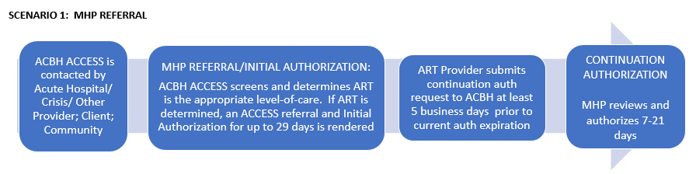
Authorization: MHP Referral
NOTE: ACBH is currently not using this process but plans to implement this scenario in the future.

Slide 7
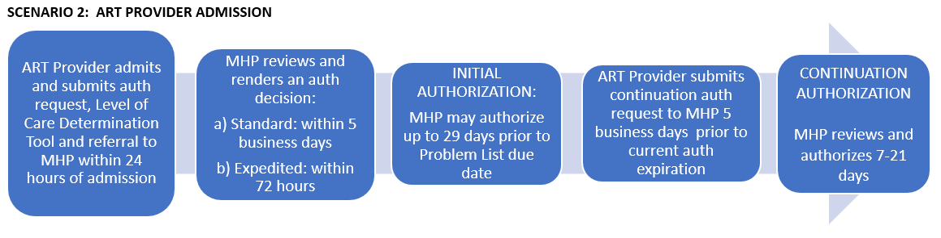
Authorization: ART Provider Admission

Slide 8
Initial Authorization

Slide 9
Requesting Initial Authorization
There are a number of forms that are used by providers to request initial or concurrent authorizations. These include the following:
  Admission Notification/Service Authorization Request (SAR)
  Level of Care Determination tool
  Completed referral form
Additionally, the MHP uses the Authorization Decision Form to render an authorization decision

Slide 10
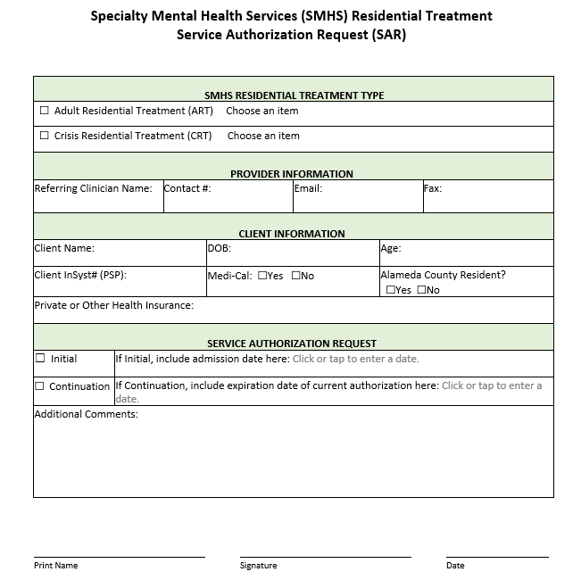
Admission Notification/SAR
Within one business day of admission, providers should submit the following information to ACBH:
  Admission notification using the Service Authorization Request (SAR) form
  Completed Referral Form used by program
  Level of Care Determination Tool to support medical necessity
Initial authorization requests for Residential services should be sent to your program’s county liaison for review using secure email delivery.

Slide 11
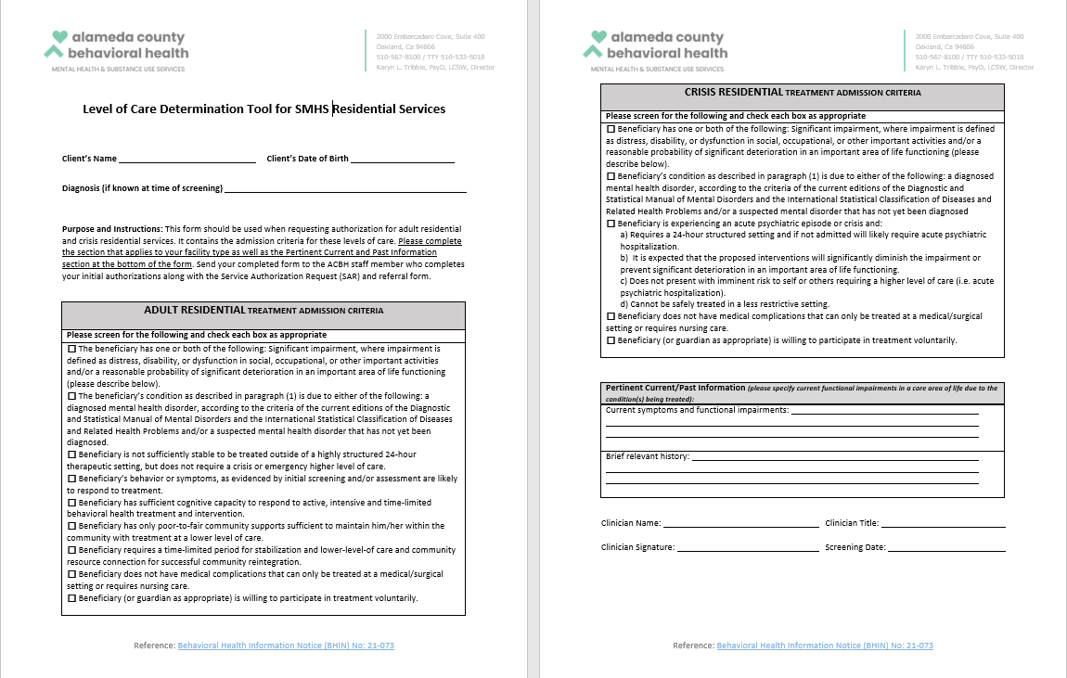
Level of Care Determination Tool
This tool was created to replace the Brief Screening Tool.
It includes two sections:
  Adult Residential
  Crisis Residential
Complete the section that applies to your program type.
The bottom section labeled “Pertinent Current/Past Information” should be completed by everyone.

Slide 12
County Contacts for Initial Authorization
Bonita House (please email initial SARs securely (ENCRYPT) to the following email addresses)
Michael Kessler – Michael.Kessler@acgov.org
Vanessa Baker – Vanessa.Baker@acgov.org
REFUGE Kimbilio (please email initial SARs securely (ENCRYPT) to the following email addresses)
Sun Hyung Lee – SunHyung.Lee@acgov.org
Christine Mukai – Christine.Mukai@acgov.org

Slide 13
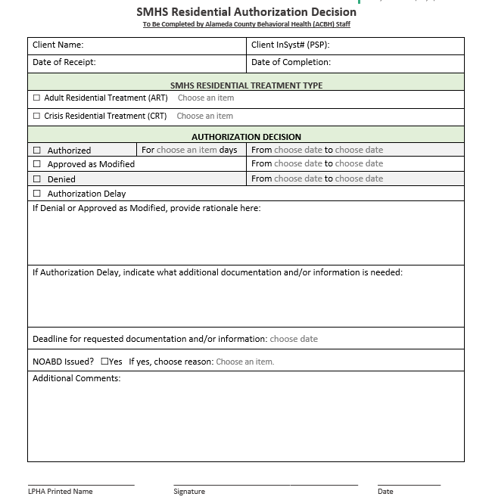
ACBH Review
Upon receipt of the initial SAR and related paperwork, the appointed MHP delegate(s) will review this paperwork and make a medical necessity determination.
Within 5 business days, the MHP delegate will render a decision and send the program this decision in writing via the Authorization Decision Form.
Initial Authorization will be up to 29 days.

Slide 14
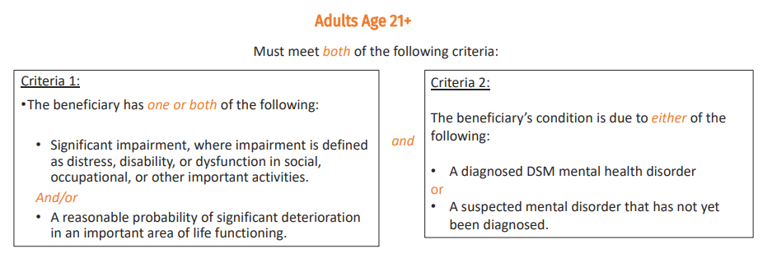
SMHS Access Criteria

Slide 15
SMHS Access Criteria
Youth Under Age 21
Must meet either of the following criteria:
The beneficiary meets both of the following requirements
The beneficiary has at least one of the following:
A significant impairment
A reasonable probability of significant deterioration in an important area of life functioning
A reasonable probability of not progressing developmentally as appropriate.
A need for specialty mental health services, regardless of presence of impairment, that are not included within the mental health benefits that a Medi-Cal managed care plan is required to provide.
and
The beneficiary’s condition is due to one of the following:
A diagnosed mental health disorder
A suspected mental health disorder that has not yet been diagnosed.
Significant trauma placing the beneficiary at risk of a future mental health condition, based on the assessment of a licensed mental health professional.
The beneficiary has a condition placing them at high risk for a mental health disorder due to experience of trauma as evidenced by any of the following:
Scoring in the high-risk range under a trauma screening tool approved by the department
Involvement in the child welfare system
Juvenile justice involvement
Experiencing homelessness

Slide 16
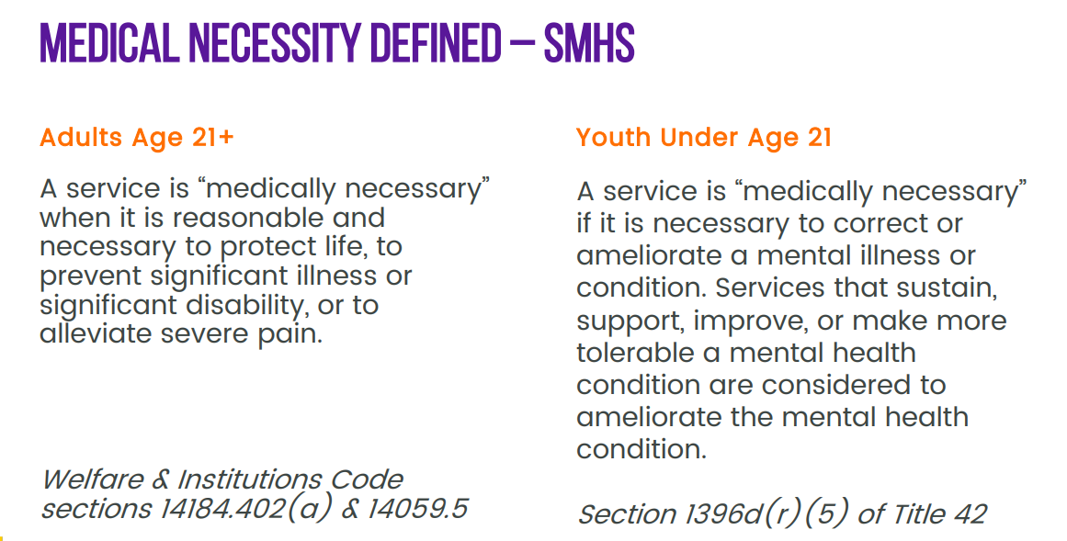
Medical Necessity Criteria

Slide 17
Continuation Authorization

Slide 18
Requesting Authorization for Continued Services
Five (5) business days before the current authorization expires, the program is expected to submit a new SAR along with the following:
  Progress notes documenting services since the last authorization cycle
  Problem List (only if updated since last authorization cycle)
  Assessment (only if updated since last authorization cycle)

Slide 19
Medical Necessity Criteria for Continued Residential Services
All of the following criteria must be met:
  Beneficiary continues to meet admission criteria.
  A less restrictive level of care would not be adequate to safely and effectively treat the beneficiary’s current condition.
  Treatment is still necessary to reduce symptoms and improve functioning, so that beneficiary may be treated in a less restrictive level of care.
  There is evidence of progress towards resolution of the symptoms that are preventing treatment from continuing in a less restrictive level of care.
  Beneficiary progress is monitored regularly, and the treatment plan is modified if the beneficiary is not making substantial progress toward a set of clearly defined and measurable goals.

Slide 20
Medical Necessity Criteria for Continued Residential Services (Cont’d)
  Beneficiary is engaged in treatment and amenable to goals/interventions set forth by the treatment team.
  Family/guardian/caregiver/significant others are participating in treatment as clinically indicated and appropriate, or engagement is underway.
  Medication assessment has been completed, when appropriate, and medication trials have been initiated or ruled out.
  There is evidence of coordination of care and active discharge planning to a less intensive level of care, with beneficiary’s active involvement, beginning from admission.
  Coordination of care and discharge planning activities involve provider referral/linkage, teaching/coaching, development and connection to appropriate aftercare and non-mental health community supports.

Slide 21
Discharge

Slide 22
Medical Necessity Discharge Criteria
Any one of the following criteria must be met for discharge to occur:
  Beneficiary no longer meets admission criteria and/or meets criteria for another level of care, either more or less intensive.
  Beneficiary or parent/guardian withdraws consent for treatment and the beneficiary does not meet criteria for involuntary/mandated treatment.
  Beneficiary does not appear to be participating in the treatment plan.
  Beneficiary is not making progress toward goals, nor is there expectation of any progress.
  Beneficiary’s individual treatment plan and goals have been met, and when indicated, beneficiary’s support systems are in agreement with the aftercare treatment plan.
  Note – Discharge Criteria listed above are limited to Medical Necessity scenarios only. There may be additional reasons for discharge unrelated to medical necessity criteria.

Slide 23
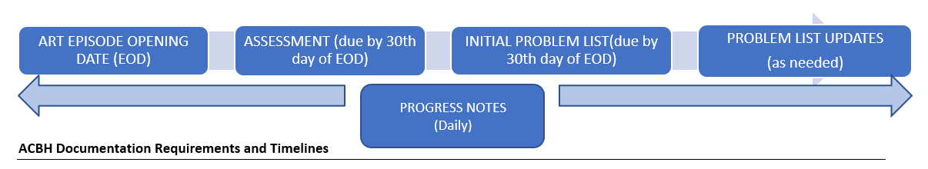
Documentation Requirements and Timelines

Slide 24
Documentation Standards

Slide 25

Service components for Transitional and Long-Term Residential Programs
  Individual and group counseling
  Crisis intervention
  Planned activities
  Counseling, with available members of the client’s family, when indicated in the client’s treatment/care plan
  The development of community support systems for clients to maximize their utilization of non-mental health community resources
  Pre-vocational or vocational counseling
  Client advocacy, including assisting clients to develop their own advocacy skills
  An activity program that encourages socialization within the program and general community, and which links the client to resources which are available after leaving the program
  Use of the residential environment to assist clients in the acquisition, testing, and/or refinement of community living and interpersonal skills

Slide 26
Additional Service Requirements by Program
Transitional Residential
Long Term Residential
Must provide services that emphasize the development of vocational skills, and linkages to services offering transitional employment or job placement.
Must provide pre-vocational and vocational services.
Including volunteer activities, supported employment, transitional employment and job placement.
When any of these vocational services are provided by outside agencies or programs, written agreements or documented treatment plans must be developed consistent with the treatment goals and orientation of the program.
Must also include provisions for special education services and learning disability assessment and remediation.

Slide 27
Documents Required During ACBH and DHCS Chart Audits
ACBH and DHCS perform periodic audits of programs, involving service and documentation review.
Chart audits typically involve review of daily progress notes, documentation of monthly contact with support person(s), documentation of total number of minutes or hours of program attendance, as well as other required documentation details.
In addition to the above, the following documents are required from residential programs during audits:
  Assessments
  Problem Lists
  Progress Notes
  Discharge Summaries
  Policies and Procedures
  CQRT Checklists/Tracking Tool
The following slides provide additional information regarding these requirements.
Notes:
If you haven’t already, every program needs to develop these documents and be able to provide them to auditors for review during audits.

Slide 28
Assessment
The assessment template was updated with 7 Domains to match CalMHSA documentation guidance.
At this time, there is no new assessment template in Clinician’s Gateway.
It is highly recommended that providers use the ACBH Assessment template provided in WORD and PDF formats.
Templates are fillable and available on the ACBH Provider website.
If using an Electronic Health Record, you may add, but not remove items from the assessment template.

Slide 29
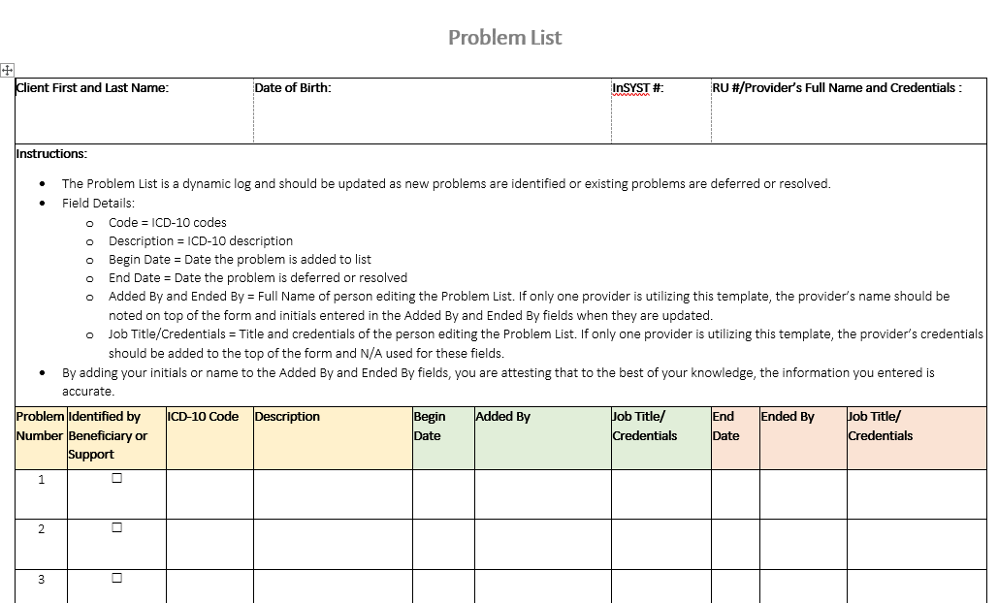
Problem List
The Problem List is a dynamic log and should be updated initially when the client is admitted, and as new problems are identified, or existing problems are deferred or resolved.
By adding your initials or name to the Added By and Ended By fields, you are attesting that to the best of your knowledge, the information you entered is accurate.

Slide 30

Progress Notes
Date services are provided
Type of services (assessment, therapy, groups, collateral) provided throughout the day
ICD 10 code
Current procedural terminology (CPT) code or Healthcare Common Procedure Coding System (HCPCS) code
The service provider’s typed or legibly printed name, Medi-Cal credential, signature and date of signature
Narrative sections to include the following information:
  Description of services provided throughout the day, including how the services addressed the person’s behavioral health needs (e.g. symptom, condition, diagnosis and/or risk factors).
  Treatment plan changes or progress made towards achieving treatment goals.
  Groups attended, significant information shared during groups, concerns about participation, insights or progress made during groups.
  Next steps, including but not limited to planned action steps by the provider or client, collaboration with the client, other providers, family or significant others and any updates to the problem list, as appropriate.
Residential programs are required to create treatment plans based on Community Care Licensing regulations.
ACBH does not review treatment plans from residential treatment programs during provider audits.

Slide 31
Discharge Notes and Discharge Summaries
Discharge Notes and Discharge Summaries are two distinct note types.
Only one is required in a chart.
Discharge Summaries are primarily used to transition a beneficiary from one program to another and include relevant information that will be useful in the transition.

Slide 32
Discharge Note
A Discharge Note must contain the following:
Reason for discharge/transfer
Date of discharge/transfer
Referrals made, if applicable
Follow-up care plan

Slide 33
Discharge Summary
A Discharge Summary must include all the components of a Discharge Note, as well as a summary of the following:
Treatment provided.
Overall efficacy of interventions (including medications, their side effects/sensitivities and dosage schedules).
Progress made toward the mental health goals/objectives.
Clinical decisions/interventions: Treatment planning recommendations for future services relevant to the final Client Plan; and or Referral(s) for aftercare services/community support services.

Slide 34

Policies and Procedures
    Providers must
      Have written policies defining the purpose, goals, and services of the program.
      Establish and maintain financial records in accordance with generally accepted accounting principles and an annual budget.
  Each program must
    Be directed by a designated individual who is responsible for its overall administration and management.
    Have an individual(s) designated as the administrator of the facility.
    Identify the qualifications, experience, skills, and knowledge required of an individual who is designated the facility administrator. These requirements must at least satisfy the minimum requirements established by the Community Care Licensing Division of the Department of Social Services for this position.
    Have a financial plan of operation that is consistent with the goals and purpose of the organization and in accordance with generally accepted accounting practices and legal requirements.

Slide 35
Clinical Quality Review Team
Department of Health Care Services requires ACBH to certify that all services billed to Medi-Cal meet the State’s requirements.
To meet this expectation, ACBH requires providers to participate in the County’s CQRT program.
The CQRT process involves monthly chart review by providers to ensure compliance with the State’s requirements.
All new Residential programs participate in the ACBH supervised CQRT process until training is completed and the agency is released to begin the CQRT process independently.
See Section 8 of the provider manual for more details regarding the CQRT process and expectations: BHCS Providers Website (acbhcs.org).

Slide 36
Community Care Licensing Requirements
NOTE: ACBH does not audit for these requirements, but they should be followed to comply with CCL regulations.

Slide 37
Client Involvement Requirements
Clients must be involved in the development and implementation of their treatment/care plan.
Clients must be involved, depending on capability, in the operation of the household. This includes participation in the formulation and monitoring of house rules, as well as in the daily operation of the facility, including but not limited to cooking, cleaning, menu planning and activity planning.
Clients must be encouraged to participate in program evaluations and reviews.

Slide 38
Medical Requirements
Providers are required to maintain up-to-date written medical and psychiatric policies and practices for their programs. These policies must include, but are not be limited to:
  A plan for monitoring of medications by a person licensed to prescribe or dispense prescription drugs, which will include, but not be limited to, the name and qualifications of the person(s) who will conduct the monitoring, its frequency and procedures.
  Screening for medical complications which may contribute to disability, conducted by a physician, nurse practitioner or physician's assistant and a plan for follow-up. The screening for medical complications must occur within 30 calendar days prior to, or after admission. If a client refuses a screening, the program must document the refusal in the client case record.
  Client education, provided by program staff or consultants, about the role of medications and their potential side effects, with the goal of enabling the client to become responsible for their own medication.
  Entries in client case records indicating all prescribed and non-prescribed medications.
  Provisions for program staff to discuss medication issues with a person licensed to prescribe or dispense prescription drugs.
  Provisions for central storage of medication when necessary.
  Encouragement to clients, when part of the treatment/rehabilitation plan, to be personally responsible for holding, managing and safeguarding all of their medications.

Slide 39
Staffing Requirements
The program must document the use of multi-disciplinary professional consultation and staff when necessary to meet the specific diagnostic and treatment needs of the clients.
Paraprofessionals and persons who have been consumers of mental health services must be utilized in the program when consistent with the program design and services provided.
All direct care staff must have graduated from high school or possess a GED and have a minimum of one (1) year of full-time experience, or its part-time equivalent, working in a program serving persons with mental disabilities. Such experience must be in the direct provision of services to clients. If the employee does not have the required experience, the program must document a specific plan of supervision and in-service training for the employee which will guarantee the ongoing qualification of the employee to perform the job. The plan must include, but not be limited to, the frequency and number of hours of training, the subjects to be covered, and a description of the supervision to be provided, written by the Program Director.
All social rehabilitation facilities must have a program director.
The program director must be on the premises the number of hours necessary to manage and administer the program component of the facility, in compliance with applicable laws and regulations.

Slide 40
Program Director Requirements
A Bachelor’s Degree in Psychology, Social Work, or any other major which includes at least 24 semester college units in one (1) or more of the following subject areas: Psychology, Social Work, Sociology, Behavioral Sciences, or Psychiatric Nursing;
and
One (1) year of full-time work experience in a community program that serves clients who have a mental illness. Such experience must be in the direct provision of services to clients, of which four (4) months must be in the position of supervising direct care staff
OR
As an alternative to the Bachelor Degree and experience required above, possession of a GED or high-school diploma and a total of three (3) years of experience in a community program providing direct services to persons with mental disabilities, of which six (6) months must be in a position of supervising direct care staff.

Slide 41
Staffing Requirements -Long-Term Residential
Scheduling of staff which provides for the maximum number of staff to be present during times when clients are engaged in structured activities.
At least one direct service staff must be on the premises 24-hours a day, seven (7) days per week. Additional staff, including part-time or consulting services staff, must be on duty during program hours to provide specialized services and structured evening services.
When only one staff member is on the premises, there must be staff on call who can be contacted by telephone if an additional staff person is needed and can be at the facility and on duty within 60 minutes after being contacted.
Staffing ratio of at least one (1) full-time equivalent direct service staff member for each 2.8 clients served.

Slide 42

Staffing Requirements –Transitional Services
  A greater number of staff must be present during times when there are greater numbers of clients in programmed activities.
  Staff schedules must be determined by the program based on the number of clients in the program during specific hours of the day, level of care provided by the program, and the range of services provided within the facility.
  At least one staff member must be present any time there are clients at the facility.
  There must be a staffing ratio of at least one (1) full-time equivalent direct service staff for each 2.5 clients served.
  All scheduled hours in the facility must be considered part of this required full-time equivalent staffing ratio.
Notes:
This seems to support that it is total staff rather than staff on each shift. 2 full time staff if 5 clients or 4 full time staff if there are 10.

Slide 43

Admission Agreement
Each program must have an admission agreement.
The admission agreement must be signed on entry by the client or an authorized representative, and program representative.
The agreement must describe the
  Services to be provided
  Expectations and rights of the client regarding house rules
  Expectations of client involvement in the program
  Program fees
The client must receive a copy of the signed admission agreement.

Slide 44
Admission/Discharge Criteria
Admission and discharge criteria of all programs must be written and consistent with program goals.
The program's exclusionary criteria must also be written and clearly defined.
The program must have written policies and procedures for orienting new clients to the service.
The range of services provided must be discussed with the prospective client or an authorized representative, prior to admission, so that the program's services are clearly understood.
A written discharge summary must be prepared by staff and client, which includes an outline of services provided, goals accomplished, reason and plan for discharge, and referral follow-up plans.

Slide 45
Documentation Training Requirements
The admission assessment, treatment/care plan, and discharge summary must be prepared by staff who have received training in the development and preparation of these documents.
    A minimum of one hour of instruction on the development and preparation of the admission assessment.
    A minimum of one hour of instruction on the development and preparation of the treatment/care plan.
    A minimum of one hour of instruction on the development and preparation of the discharge summary.
    This training must include guidance regarding the expected content of documentation, methods used to prepare the document, timeframes for completion of documentation, and resources to be consulted in preparing the document.
    Presentation Methods
    Formal classroom instruction
    Oral presentation
    Videotape, film, or audiovisual presentation
    Audiotape presentation; or
    Performing the duties, on the job, under the direct supervision of the instructor.
Notes:
Care plan = rehabilitation plan

Slide 46
References
BHIN-22-016 Authorization of Outpatient Specialty Mental Health Services
BHIN 22-019 SMHS Documentation Requirements
DMH Information Notice No: 01-04
SMHS-Billing-Manual-v-1-4
CDSS Community Care Licensing Manual
BHIN 21-031 Notification of Change of Program Director
California Summary -- State Residential Treatment for Behavioral Health Conditions: Regulation and Policy (hhs.gov)
Supplement 2 to Attachment 3.1-B Rehabilitative Mental Health Services (Medically Needy)

Slide 47

For questions, contact QATA@acgov.org

