Slide 1
Alameda County Behavioral Health (ACBH) Clinical Documentation Training: Module 2 – Treatment Plans

Slide 2
Introduction to Client Plans
Client Plans are plans for the provision of mental health services to clients who meet medical necessity.
They are an outline of the goals and objectives of treatment aimed to reduce functional impairments caused by the symptoms/behaviors of a client’s diagnosis.
The mental health services identified within the plan must address identified mental health needs, consistent with the diagnosis, that are the focus of the mental health treatment.
The plan itself acts as a progress report of the client’s measure of medical necessity for services as part of the golden thread.
Notes:
Ultimately in non Medi-Cal language, the client plan is the contract between the client and provider as to the goals they will work on and how they will get there.

Slide 3
Scope of Practice for Client Plans
All staff with appropriate training and experience may complete the Client Plan.
Trainee, Mental Health Rehabilitation Specialist (MHRS) & Adjunct Staff require co-signatures by a Licensed LPHA. (Physician, Psychologist, LCSW, LMFT, RN, NP, and clinical nurse specialists, and a Waivered / Registered Professional when supervised by a licensed mental health professional in accordance with laws and regulations governing the registration or waiver.)
If a medical provider prescribes to the client, it is best practice to obtain their co-signature.
Clinical pharmacists may not sign the Client Plan without a co-signature by a Licensed LPHA (non-pharmacist).

Slide 4
The Foundation Before Writing The Client Plan
Established medical necessity
Completed CANS/ANSA
Completed PSC-35 if applicable
Documented the need for case management in the assessment if considering providing case management services.
Completed a safety plan if you have assessed any risk factors within the past 90 days and include an objective related to containment.
Documented any cultural, linguistic, physical limitations in the Assessment
Completed Assessment with required co-signatures
Notes:
The assessment process lays the foundation for the development of the Client Plan.

Slide 5
Planned Services
An approved Client Plan must be in place prior to service delivery for the following Specialty Mental Health Services (SMHS):
Individual, Group, and Family Psychotherapy; Individual and Group Rehabilitation; Collateral; and Medication Services
Intensive Home Based Services (IHBS)
Monitoring activities of Intensive Care Coordination (ICC)
Monitoring activities of Targeted Case Management/Brokerage
Therapeutic Foster Care (TFC)
Therapeutic Behavioral Services (TBS)
Notes:
Monitoring and follow up activities of TCM include ensuring that the client plan is being implemented and addresses the client's individual needs. Monitoring activities differ from referral and linkage, which may be provided before the plan is in place until the client has successfully engaged with the desired community resource (e.g. medical provider, drug and alcohol tx, education or vocational services). An example may include meeting with the client to discuss how they are adapting to their current housing situation after one month, identifying barriers to maintaining the current placement, and exploring additional services to help stabilize the placement.
An example of an ICC monitoring activity may include meeting with the CFT to discuss the client’s participation/progress in a job training program, identifying areas of strength/challenge (e.g. feelings of anxiety around peers, low motivation, or other barriers), and discussing strategies to support the client in continuing to attend the program.

Slide 6
Initial Client Plan
The initial Client Plan is due within 60 calendar days of episode opening date (EOD) is day 1.
The Client Plan is effective the date of the provider’s signature. After this date, all planned services as outlined on the plan may be billed.
Every subsequent Plan is due on a 12 month cycle, completed within the 30 day period prior to the first day of the month of EOD.
Example: EOD 8/18/20
The initial plan is due by 10/17/20
The second treatment can be completed anytime between 7/1/21 and 8/1/21 but no later than 8/1/21.
This Photo by Unknown Author is licensed under CC BY-SA-NC
Notes:
(CAP) Due to NACT Timely Access Standards we are expecting most plans to be completed well before the 60 day mark. 60 days should be reserved for the hard to assess, difficult to reach, etc.
(CAP) Barriers that prevent timely completion of Treatment Plans should be documented. If a Treatment Plan is completed late, the reason for this should be indicated in the record along with efforts made to address those barriers.

Slide 7
Client Plans – Additional Timeline Requirements
The Client Plan must be updated annually prior to the first day of the month of EOD.
The Client Plan must also be updated whenever there is an event of clinical significance.
Events of clinical significance can include but are not limited to:
- Client has made significant progress and reached their target goal
- Client has increased suicidal/homicidal ideation
- Client is hospitalized for psychiatric reasons (especially if this is a new bx)
- Client is sanctioned for behaviors (school expulsion, legally detained).

Slide 8
Interim Assessments to Allow Earlier Development of Treatment Plans
If staff/programs do not have enough time to complete a full mental health assessment (with all required elements) before completing a treatment plan, an Interim Assessment can be completed.
An Interim Assessment must include the essential medical necessity components:
A current included (“covered”) diagnosis
Signs and symptoms of the diagnosis that meet DSM5 criteria
Functional impairments as a result of that diagnosis
Level of impairment
Client’s ability to benefit from treatment.
An Interim Assessment does not meet Medi-Cal requirements for a full completed Assessment. A full Assessment with all required elements must be completed by the due date.

Slide 9
Interim Assessments and Client Plans
Programs that determine it is clinically indicated to provide certain planned services before completion of a full Assessment (example: want to get client into a group therapy session within the first week), may complete both an Interim Assessment and Client Plan to allow for those planned services.
Any Client Plan must always have the required Medi-Cal documentation components.
Any Client Plan that is informed/created by an Interim Assessment must be reviewed once the full assessment is completed, and updated as clinically appropriate.
Notes:
An initial Client Plan that is written based upon an Interim Assessment is usually considered an “Interim” Plan and will need to be rewritten within 30 – 90 days of the Episode Opening Date (EOD).

Slide 10
Client Plan - Goals
The client goals are the long-term hopes of the client and/or caregiver/parent, stated in their own words.
Goals should focus on their personal vision of recovery, wellness, and the life they envision for themselves.
It is invaluable for client engagement to services that they are able to verbalize their own treatment goals.
You may include optional long term mental health goals which support the client’s life goals by linking them to the specific mental health objectives.
Providers assist the client in developing the short term mental health objectives that link to the client’s long term goals and are the target of interventions.
This Photo by Unknown Author is licensed under CC BY-NC
Notes:
The objectives developed should relate back to the client’s long-term mental health goals or life goals. The objectives are the steps that will help the client accomplish their long term goals. In their words is ok. Give an example of in a client’s own words (see next slide).

Slide 11
Examples of Goals
“I want to continue my education and finish my diploma.”
“I want to find a job and be able to support myself.”
“I would like my child to do better in school.”

Slide 12
Impairments/ Area of Challenges
Indicate area(s) of challenges: Community Life, Family Life, Safety, School/Education, Vocational, Independent Living (ADL’s), Health, Housing, Legal, SUD, Food/Clothing/Shelter, etc.
Indicate level of challenges.
Moderate or Severe (remember to rate accordingly if documenting to a significant impairment in an important area of life functioning for medical necessity).
Describe specific functional impairments related to the signs and symptoms of the primary mental health diagnosis.
For Case Management (C/M), must indicate need for C/M service, i.e. client is unhoused. Also, must indicate (1) which severe symptoms/impairments resulting from the mental health diagnosis prevent client from accessing/maintaining needed services, or (2) for child/youth, that the lack of such services (caretaker not providing) exacerbates child’s mental health symptoms/impairments.
Notes:
Goals relate to the functional impairments identified in the mental health assessment and the functioning domains (areas of impairment) of the CANS/ANSA. The plan objectives then target the symptoms/Bx’s that are contributing to those impairments and by reduction/management increase the functioning. The baselines are what help indicate the level of challenges.

Slide 13
Client Plan – Mental Health Objectives
Apply SMART (Specific, Measurable, Attainable, Realistic and Time-Bound) to all Client Plan objectives
Must be mental health focused (not housing, employment, SUD treatment, etc.)
Address symptoms, behaviors, or impairments identified in the assessment
Strength-based objectives replace problematic symptoms with positive coping skills/behaviors/etc.
Notes:
(CAP)Treatment plan objectives must follow the SMART format: specific (what will the client be doing), measurable or observable (numeric), attainable, realistic, and time bound (target dates). Objectives should tie back to the client’s mental health symptoms and impairments. For example, obtaining housing is not a mental health goal; however, if mental health symptoms are contributing to housing instability, an objective could be written that addresses the underlying mental health symptoms. Plan objectives are linked to the mental health needs, diagnosis, and functional impairments identified in the Assessment, and should also be reflective of the functional impairments identified in the CANS/ANSA. Objectives may be problem-focused (e.g. reduction of problematic symptoms/Bx) or strengths-based (increase in positive Bxs to improve functioning)

Slide 14
CANS/ANSA and Treatment Planning
Designed to guide treatment planning and develop Treatment Plan goals and objectives. -
Need items rated a “2” or “3” should be addressed in the Treatment Plan.
Strength items rated “0” or “1” may be used for strength-based planning.
Used to monitor treatment progress and redevelop the Plan as necessary.
Notes:
The CANS/ANSA is used to gather information about a client’s needs and strengths, and identify areas of need that are used to develop long-term goals and short-term objectives. Items related to MH symptoms and functioning that are rated a “2” or “3” are areas that require intervention. If there are numerous Need items identified on the CANS/ANSA, it is not necessary to include an objective for each one. Discuss with the client which areas they would like to prioritize, which areas have the greatest need for intervention, and any risk areas that are present. Strength items rated “0” or “1” indicate areas that may support the client in achieving their goals/objectives, and may be listed in the corresponding section of the Treatment Plan. When monitoring treatment progress, an updated CANS/ANSA (e.g. every 6 months) helps to identify if Treatment Plan objectives have been met, or if the Plan needs to be revised to reflect new needs.

Slide 15
Creating a Mental Health Objective
Consider the client’s diagnosis.
Example: Bipolar II F31.81
Target the client’s stated long term goal (consider the client’s CANS/ANSA).
Example: Improve ability to pay attention at work and finish job- related tasks.
Identify with the client which symptoms/behaviors/impairments associated with the client’s primary diagnosis they would like to work on.
Example: “Diminished ability to think or concentrate nearly every day.” Note: It helps to use the criteria from the DSM 5.
Ask the client to estimate the number of times that symptoms and/or behaviors happen on a daily, weekly, or monthly basis?
Example: Client reports experiencing difficulty concentrating on tasks on a daily basis because they worry that they are going to start a depressive episode or not be able to manage mood swings.

Slide 16
Creating a Mental Health Objective
Ask the client how many times they want the symptoms/behaviors/impairments to decrease.
Encourage the client to set realistic numbers.
Example: Client will reduce the number of times that they experience difficulty concentrating on tasks from 7 days a week to 4 days or less.
Develop a way to measure the change.
Example: . . .as evidenced by client report.
Develop a time frame.
Example: . . .within the next 12 months.
This Photo by Unknown Author is licensed under CC BY-SA

Slide 17
Examples of Good Mental Health Objectives
Example of an objective to reduce an impairment/symptom:
In the next 12 months, client will reduce the number of times that they experience difficulty concentrating on tasks from 7 days a week to 4 days or less as evidenced by client’s self report.
Example of a strength-based objective to increase positive behavior:
In the next 12 months, client will increase the number of times that they use positive coping skills when they have difficulty concentrating from 1 out of 10 times to 8 out of 10 to times as evidenced by client’s daily journal.

Slide 18
Types of service intervention
Identify the proposed type(s) of interventions to be provided along with a proposed frequency and duration.
If a planned service intervention is not in the client plan it may not be claimed and will be disallowed.
Example:
Individual Psychotherapy 1x per week, and as needed, for 12 months
Case Management 1x per month, and as needed, for 12 months
Group Therapy 1x per week, for 12 months
Collateral 1x per month, and as needed, for 12 months.
Adding “AND as needed” to the frequency of the service intervention allows flexibility in the scheduling—however “as needed” alone will not suffice for frequency of intervention and “or as needed” is not allowed. Both would result in disallowances.
Unplanned service interventions do not need to be listed in the plan.
Note that monitoring activities of ICC and Case Management / Brokerage are considered planned services and must be listed in the plan.
Notes:
(CAP) Service interventions described in the treatment plan should be provided to the client at a frequency that is consistent with what is documented in the Client Plan and services should be sufficient to reasonably achieve the purpose and goals documented on the Plan. The service frequencies listed are examples only, and should be individualized to the client. If a client requires additional services to achieve their tx plan goals, these may be claimed provided that medical necessity is documented in the PN. However, if the client requires an ongoing increase in services in order to meet their MH needs, then the Client Plan should be written to incorporate the increase in proposed frequency.

Slide 19
Types of service intervention
Types of interventions to be listed in the Client Plan with common frequencies and timeframes:
Collateral (Includes: Collateral and Collateral-Caregiver) – Weekly and as needed, for 12 months
Case Management (Planned F/U Services) – Weekly and as needed, for 3 – 12 months
Medication Services (non-urgent)– Monthly and as needed, for 12 months
Individual Therapy – Weekly and as needed, for 12 months
Individual Rehabilitation – Weekly and as needed, for 12 months
Group Psychotherapy – Weekly for 12 months
Group Rehabilitation – Weekly for 12 months
Family Therapy – Weekly for 12 months
Collateral Family Counseling – 2x month and as needed for 12 months
Notes:
(CAP) An approved Client Plan must be in place prior to service delivery for the Specialty Mental Health Services listed. Service frequencies and timeframes should be individualized to the client, taking into consideration the client’s specific needs and the type of service intervention.

Slide 20
Service interventions Continued
Multi-Family Group Therapy – Weekly for 12 months
Collateral Family Group – Weekly for 12 months
TBS – Weekly and as needed, for 3 – 12 months
ICC – Weekly and as needed, for 3 – 12 months
IHBS – Weekly and as needed, for 3 – 12 months
Therapeutic Foster Care (TFC) – Daily, for 3 – 12 months
Psychological Testing (Includes Psych Test, Developmental & Neuropsych) – Weekly and as needed, for 3 months

Slide 21
Detailed Interventions
For each intervention it is best practice to include a detailed description.
Must focus upon and address the identified functional impairments as a result of the mental disorder.
Must be consistent with the client plan mental health objectives and the qualifying diagnoses.
For Collateral it should include listing significant others (by names and/or roles) for whom contact is planned and indicating “and others as needed.”
Notes:
For Collateral, best practice is to list the individual’s name and or role. In most circumstances, this will also require obtaining a ROI.
Providers should be aware that Collateral is claimed only when interacting with a client’s support person (family, friend, board and care operator), but not another treatment provider. If a provider needs to talk with another provider to discuss a client’s symptoms and impairments and how best to meet a client’s current needs, this should be claimed as plan development.

Slide 22
Detailed Interventions
General enough to be inclusive, but specific enough to be illustrative.
Examples:
Individual Rehab
“Assist the client in re-engaging in pleasant social activities through the use of an activities chart and role-play to manage symptoms of anhedonia due to Major Depression.”
Collateral
“Contact with significant support persons of client including parents, teacher and school counselor (others as needed) to assist client in meeting their mental health goals and objectives.”
Medication Services
“Medication Management strategies to engage client in collaboration to find, and optimize the dosage for effective anti-depressive medications.”

Slide 23
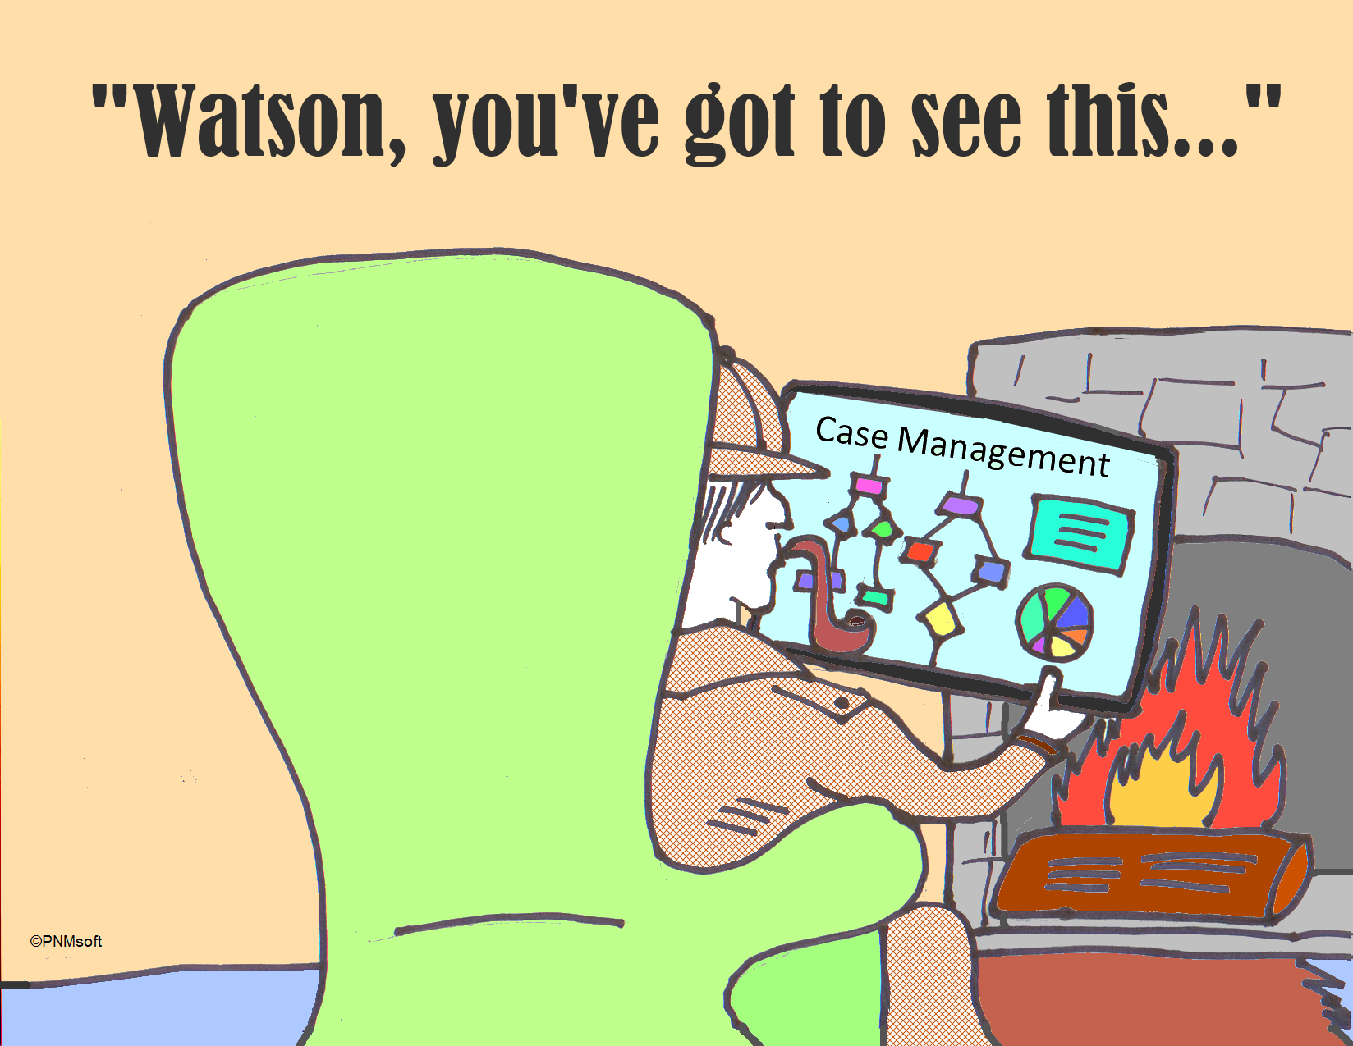
Developing Client Plans to Include Case Management Services
If Case Management Services (Brokerage/ICC) will be provided, the detailed interventions section of the plan should document the following:
Successful case management (linkage and monitoring) is expected to result in the client’s mental health symptoms being reduced and client’s mental health objectives being achieved.
Specific community resources that client will be linked to should be identified and documented.

Slide 24
Client Plan Required Signatures
Client Plans are signed (or electronic equivalent) by:
a) The person providing the service(s) or,
b) A person representing a team or program providing the service(s) or,
c) A person representing the MHP providing service(s).
Client plan signatures must include the date of service, the signature of the person providing the service (or electronic equivalent); the person’s type of professional degree, licensure or job title, relevant identification number (e.g., NPI number), if applicable, and the date the documentation was entered in the medical record.
Client Plans must be finalized (unable to be further edited) and signed by all required clinical staff (including supervisor) before considered effective.
Notes:
(CAP) The signature of the staff that provides the service and their credentials should be included on the Treatment Plan. Staff signatures should include the provider’s professional degree, licensure, or job title.

Slide 25
Client Plan Required Signatures
All Client Plans must also be signed by the client and/or guardian.
Clinical judgment should be used to determine if it is appropriate to review treatment plans with young children. If appropriate, obtain a client’s signature. If not appropriate, obtain a client’s guardian’s signature.
Client plans do not require a date to indicate when it was signed.
If a client does not date their signature, a provider may add the date and include their initials.

Slide 26
Client Plan Required Signatures
If the client does not sign or refuses to sign the Client Plan, regular efforts must be attempted to obtain the client’s approval.
Note the issue on the client signature line in the Client Plan with a reference to a progress note. Elaborate in the Progress Note the rationale or reason why a signature was not obtained, and when the next attempt will occur.
If the client’s mental health symptoms (such as paranoia caused by schizophrenia) prevent client from reviewing and signing the treatment plan and it is determined that ongoing attempts are not clinically appropriate, this must be documented in a progress note. The unsigned treatment plan should reference this note.
If a client does not sign a Client Plan due to unavailability (such as client no-showing to an appointment) future attempts must be made to obtain the client’s signature. Unavailability (without other mitigating mental health factors) is not a reason to stop attempts to obtain a client signature.

Slide 27
Exceptions to Signature Requirements
A client’s signature on the Treatment Plan is not required when:
The client is not expected to be in treatment beyond
60 days.
Is only receiving one Specialty Mental Health Service (intervention)
Currently, the only ACBH programs claiming one intervention are Medication Services and TBS.
Remember that Collateral is considered a intervention.
All other requirements remain. For example, provider must document that client participated in the development, agreed to it, and was offered a copy.
Note that even if one of these exceptions is met, it is highly recommended that the client sign their plan.

Slide 28
Signature Requirements during COVID-19
Will late signatures (Informing Materials, Consents, Client Plan and Medication Consents) be accepted as compliant for claiming purposes if verbal consent is provided?
Yes, for certain documents. Document as follows: In the PN, explain what information was shared with the client, that the client verbally consented to the information provided, and that they will sign the forms at the next in-person meeting as they cannot currently meet in-person due to the COVID-19 emergency.
Releases of Information require an actual client signature.
DHCS has indicated that if a COVID-19 situation has caused the client to be unavailable to sign a Client Plan, this can be documented and there is no need to seek a signature after the shelter in place is lifted. For this reason, a Client Plan lacking a wet signature can be approved in CQRT and there is no need to wait on review or approval of a chart.

Slide 29
Participation in the Creation of the Client Plan
The clinical record must document the client’s participation in the development of the Plan, agreement with the client’s Plan, and that the client was offered a copy of their Plan.
The client’s signature on the Plan alone does not meet these
requirements
This information may be documented in progress notes and/or in the body of the Client Plan itself.

Slide 30
Discharge Plan
Discharge planning should be started at the time of admission and discussed regularly over the course of treatment.
The Client Plan must contain a tentative discharge plan, which includes an anticipated timeframe, readiness indicators, and/or possible referrals at discharge.
Notes:
Example 1: “Client will be discharged to family after they have met and maintained their treatment goals for 3 months, and client is able to successfully use coping skills to manage feelings of anxiety with teachers and peers for the full school day. Referrals to school based support groups will be offered upon discharge.
Example 2: Client’s discharge to a lower level of care will be considered when client’s mental health symptoms (e.g. depressed thoughts, suicidal ideation) have improved and they have had at least one year without hospitalization or inpatient admissions. Client will be reevaluated within the next 12 months to determine progress.

Slide 31
Discharge Plan
Questions to consider with the client:
What is getting in the way of the client meeting their goals/objectives?
What will the client be doing differently as a result of treatment?
How would you or the client know that they were ready to move on from treatment?
Who is in the client's support system, and how can they support client in discharge planning?
What services are available to the client after they leave this program?
What referrals need to be made (if any) to make services available to the client upon termination?
What life/coping skills need to be learned/taught during treatment in order for the client to maintain their treatment objectives?
What triggers might the client face after leaving and how will they deal with these without the support of the current provider?

Slide 32
Updating Client Plans
Providers must be attentive to the need to update changes in the treatment plan through-out the year. Department of Health Care Services and ACBH Quality Assurance will disallow notes if the Client Plan has not been updated to reflect new client goals, mental health objectives, and events in the client’s life.
Examples of events requiring a change to the Treatment Plan include, but are not limited to: hospitalization, new thoughts or behaviors of self-harm or dangerousness to others, additions of new service interventions (i.e. medication services, case management, group rehab, individual therapy, etc.)

Slide 33
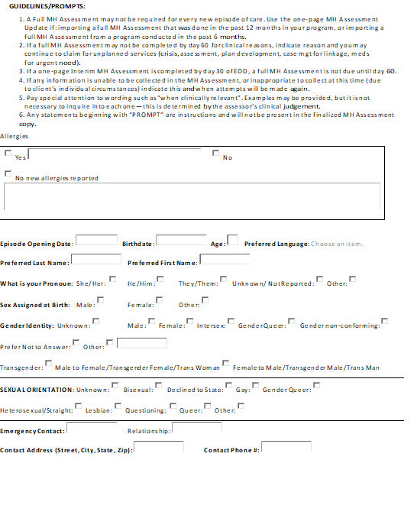
Medi-Cal Compliant Client Plan Form Templates
ACBH/Forms/
Clinical/Adult or Child/
Plan
http://www.acbhcs.org/
providers/Forms/Adult
Form.htm

Slide 34
Example of a Non-Billable Client Plan
Mental Health Objective: Client will obtain stable housing within 6 months; temporarily living with a friend. [Not a MH Objective]
Service intervention : Case management 1x/week and as needed for 1 year
Detailed Interventions: Case management - Case manager will work with client to apply for housing and assist client in filling out necessary forms. [Case mgt is not acting as a housing support specialist—but is linking to and monitoring client’s participation in such services.]
This Photo by Unknown Author is licensed under CC BY-SA
Notes:
Non-billable examples are indicated in red.

Slide 35
Sharing Assessments and Treatment Plans
Agencies with multiple Reporting Units (RUs) that share a medical record are allowed to share one mental health Assessment and Treatment Plan for concurrent services.
Example: If a client is receiving therapy services in one RU, and begins to receive medication services in a different RU, both RUs/providers may share the Assessment and Treatment Plan.
Open each RU with the date the client was first opened at the agency.
Any documentation that is in need of updating must be addressed within the agency.
For example, informed consent must be completed when new interventions are added to the plan.
Multiple RUs within an agency may decide to share a plan or create a new Treatment Plan.
Adding an additional intervention will always require a new plan.
This Photo by Unknown Author is licensed under CC BY-SA-NC

Slide 36
Sharing Assessments and Treatment Plans
If multiple RUs (in one agency) do not share a chart, all shared documentation must be copied into each chart. This includes documents from the initial episode opening date such as:
Screening Form (with associated progress notes)
Informing Materials (with associated progress notes)
Mental Health Assessments (with associated progress notes)
CANS/ANSA (with associated progress notes)
Client Treatment Plan (with associated progress notes)
Release of Information (with associated progress notes)
For ACBH county clinics, “one agency” is considered one program which has a unique folder in the Laserfiche database.

Slide 37
Sharing Assessments and Treatment Plans
For Initial Assessments Only
If a full Assessment has been completed for a client it is possible for providers to use this Assessment and update it under the following circumstances:
Full Assessment completed within the same agency in the last 12 months.
Full Assessment completed by another agency in the last 6 months.

Slide 38
Sharing Assessments and Treatment Plans
To use a previously completed Assessment, the following should occur:
A copy of the Assessment should be placed into the chart.
The Assessment content should be reviewed with the client to assure accuracy.
An Assessment Addendum must be completed that includes:
Interim History
Any changes in all of the areas of the MH Assessment previously collected
A current included diagnosis
Signs and symptoms of the diagnosis that meet DSM 5 criteria
Functional impairments as a result of the diagnosis
Level of impairment
Client’s ability to benefit from treatment

Slide 39
Client Plan Review
May Collateral services be claimed before completion of the Client Plan?
No
Name three reasons that all planned services may be disallowed in a chart:
Assessment not done initially and annually
Client Plan not done initially and annually and when clinically indicated—or not signed by provider and client/representative
Service intervention for a planned service is not listed in Client Plan

Slide 40
Client Plan Review
When must the CANS/ANSA be completed?
As part of the assessment process and before completion of the Client Plan
Every 6 months (based on episode opening)
At discharge.
What is the Treatment Plan Cycle for a case that is opened on August 23rd?
August 1st – July 31st each year.
When a Case Management need arises before completion of the MH Assessment and/or Client Plan, may it be claimed as such?
Only if it for the purposes of referral and linkage
When must all services of a certain type (i.e. Ind Rehab) be disallowed across the whole chart (episode of care)?
When the service intervention is not listed in the Client Plan.

Slide 41
Keep In Touch with QA
Follow up Documentation Questions QATA@acgov.org
•Privacy Incidents should be reported via BreachNotification@acgov.org
•Unusual Occurrences should be sent to QAOffice@acgov.org
•Professional Licensing Waivers should be sent to QAOffice@acgov.org or eFAX (510) 639-1346
•Whistleblower reports should be received via ProgIntegrity@acgov.org
•Grievance and Appeal Requests should be sent by mail or to QAOffice@acgov.org
•Training inquiries should be received via QAOffice@acgov.org
•NOABDs should be received via eFAX (510) 639-1346

