Slide 1
Alameda County Behavioral Health (ACBH)
Clinical Documentation Training
Module 1- Assessment
Amy Saucier, LMFT Cammie Duval, LMFT Danielle Pence, LMFT LPCC
Clinical Review Specialist Supervisor Clinical Review Specialist Clinical Review Specialist
Quality Assurance Department

Slide 2
Learning Objectives
Identify all required elements of a Medi-Cal compliant assessment
Understand the requirements when using an existing assessment
State the timelines to complete: Brief Screening Tool, Informing Materials, Mental Health(MH) Assessment, Child/Adolescent Needs and Strengths (CANS)/Adult Needs and Strengths Assessment (ANSA)
Identify key components of establishing medical necessity
Collect Sexual Orientation and Gender Identity Expression (SOGIE) data during the MH assessment process in a sensitive manner

Slide 3
Agenda
Review documentation standards for initial paperwork and assessment
Discuss special assessment considerations
Understand the processes by which documentation standards are monitored

Slide 4

Network Adequacy-Timely Access
Who: All outpatient ACBH county-operated programs and individuals under a contract or subcontract with ACBH who bill Medi-Cal for services. (inpatient, Santa Rita, outreach programs do not)
What: Date of first contact to request services, type of service requested, assessment start/end, treatment start/end, medical necessity,
When: New or New Returning client who has Medi-Cal or is Medi-Cal eligible.
Providers are required to offer an appointment within:
Psychiatry-15 business days (urgent 48 hours)
Outpatient prior authorization not required-10 days (48 hours)
Outpatient prior authorization is required-10 days (96 hours)
This Photo by Unknown Author is licensed under CC BY-NC

Slide 5

Initial Required Forms
Brief Screening Tool
Informing Materials
Release of Information

Slide 6
Brief Screening Tool
Alameda County is required to provide the appropriate type of mental health services to Medi-Cal beneficiaries.
Alameda County’s Screening Tool (or the algorithm embedded into the assessment) is used to determine if a client meets medical necessity for Specialty Mental Health Services (clients with Moderate-to-Severe symptoms) or Mental Health Services from a Primary Care Provider (clients with Mild-to-Moderate symptoms.)
Use appropriate form based on age (0-5, 6-17, Adult)
  http://www.acbhcs.org/providers/Forms/docs/Access/Adult_BH_Screening_Form.pdf
  http://www.acbhcs.org/providers/Forms/docs/Access/Child_6-17_BH_Screening.pdf
  http://www.acbhcs.org/providers/Forms/docs/Access/Child_0-5_BH_Screening.pdf

Slide 7
Brief Screening Tool Continued
The Screening tool may be used prior to opening a case to determine if a client is appropriate for specialty mental health services.
    Using the screening form prior to opening a case can help assure that clients are referred to the correct mental health provider as soon as possible.
    Completing the screening from prior to opening a case is a non-billable activity.
The Screening tool must be completed before or by the assessment completion.
  Exceptions for: Out of County, TBS Workers, Crisis, Conservatorship, Guidance Clinic, & STAT program.

Slide 8

Who May Complete the Brief Screening Tool
May be completed by a Licensed/Waivered/Registered LPHA/ and 2nd year Graduate Trainee with the proper training and experience to diagnose (with attestation of this by clinical supervisor).
  Waivered or Registered LPHA require a Licensed LPHA co-signature.
  2nd Year Trainees and greater also require a Licensed LPHA co-signature.
This Photo by Unknown Author is licensed under CC BY-NC

Slide 9
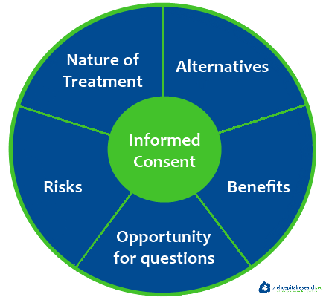
Informing Materials
Informing Materials are required at Initial and Annual Assessments.
  Recommended at first visit as it includes consent to treatment.
  Reviewing and obtaining signatures may be claimed as part of an assessment service.
If a client’s primary, preferred language is not English, you must review informing materials in the client’s primary preferred language.
  Alameda County provides translated Informing materials for all threshold languages. These forms must be provided to the client and the signature page present in the client’s medical record.
  If a client does not speak a threshold language, you can verbally interpret an English packet to the client and place an English signature page in the medical record and indicate that it was verbally reviewed with them in a language they understand.
This Photo by Unknown Author is licensed under CC BY-SA-NC

Slide 10
Informing Materials Continued
All elements present in ACBH’s Informing Materials Packet are required.
  http://www.acbhcs.org/providers/QA/General/informing.htm
ACBH’s Informing Materials signature page is highly recommended to be used and must be maintained in client record.
ACBH audits are assessing that all elements of the informing materials have been covered (all boxes checked) completed signature page, and initials that the materials were reviewed annually.
Providers may add additional agency/program consents and forms.
  If an agency form is used—all county form elements must be present and readily identifiable.
  Note all boxes must be checked and must be signed.
  May utilize form by client initial for four additional occurrences.

Slide 11
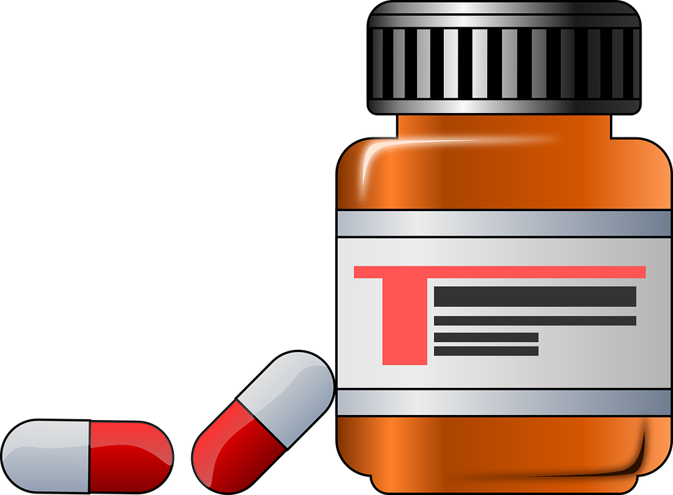
Medication Consents
Must include: Date of service, signature of person providing service, professional degree license or job title, relevant NPI, date the document was entered into the medical record. It is highly recommended to use the ACBH Medication Consent forms found here: http://www.acbhcs.org/meddir/MedConsent/English/medconsent.pdf
Must contain all 10 of the following:
1. Reason for taking medications
2. Reasonable alternatives
3. Type of medication
4. Range of frequency of administration
5. Dosage
6. Method of administration
7. Duration of taking medication
8. Probable side effects
9. Possible side effects if taken more than 3 months
10. Consent once given can be withdrawn at any time
*The provider will obtain and retain a current written medication consent form signed by the beneficiary agreeing to the administration of each prescribed psychiatric medication.

Slide 12

Release of Information (ROI)
  Must be signed by client or legal representative
  Clients may limit data that will be shared including dates that information can be shared
  Not required for Alameda Health Care Services Providers—but recommended
  Not required to simply facilitate treatment referral to other MH Providers—but highly recommended
  Releases are valid for as long as the client indicates, if no date indicated, default is 12 months
  For a date to be valid, it must be an actual date; “until the end of treatment” is not a valid date
  Allows for the coordination of care with other providers which is expected to ensure proper assessment and treatment
*To avoid gaps in consent, obtain signatures on relevant ROIs annually during update of the assessment & treatment plan so that they fall in-sync with annual updates

Slide 13

Establishing Medical Necessity
  The “Golden Thread” is the sequence of documentation that supports the demonstration of ongoing medical necessity and ensures all provided services are reimbursable.
  The sequence of documentation on which medical necessity requirements converge is:
        Brief Screening Tool
        The Assessment
        The Client Plan
        The Progress Note
This Photo by Unknown Author is licensed under CC BY-NC

Slide 14

Key Documentation for Medical Necessity
Medical Necessity is documented throughout the client’s chart.
The mental health assessment and treatment plan must establish medical necessity for all planned services.
Progress notes must contain evidence that the services claimed for reimbursement meet medical necessity by linking to a specific current MH Objective.

Slide 15

Medical Necessity Criteria
Must meet the following three criteria:
Criteria #1: An included diagnosis (See included diagnosis list)
  All Dx must indicate:
  1) The ICD-10 Code
  2) The DSM-5** Description (name) WITH all specifiers
  **for included diagnoses not in DSM-5, such as F84.5, F84.9, F84.2, F84.3 & F84, list the ICD-10 Descriptor (Dx Name)
  3) DHCS also recommends indicating the ICD-10 Descriptor (Dx Name)— but this is not required by ACBH at this time.
A client may also have a non-included diagnosis identified in the assessment as long as the focus of treatment is to address the signs and symptoms of the included (primary) diagnosis.
  The Primary Diagnosis in the clinical record must match the Primary Diagnosis in INSYST to ensure an accurate clinical snapshot.
  If the either diagnosis is revised you must update INSYST.
This Photo by Unknown Author is licensed under CC BY-SA

Slide 16
Medical Necessity Criteria
Criteria #2: A qualifying impairment (meets one of the following)
    A significant impairment in an important area of life functioning
    A reasonable probability of significant deterioration in an important area of life functioning without treatment
    For EPSDT with full scope Medi-Cal (FSMcal) (children < 21 yrs.): a reasonable probability that a child will not progress developmentally as individually appropriate

Slide 17

Medical Necessity Criteria
Criteria #3: A qualifying intervention (meets all three of the following)
  1. The focus of the intervention is to address the condition of the impairment resulting from the included diagnosis.
  2. The expectation is that the proposed intervention will meet one of the following (which corelate with Criteria #2 a – c):
    Significantly diminish the impairment
    Prevent significant deterioration
    Allow the child to progress developmentally as individually appropriate
  3. And the condition would not be responsive to physical healthcare treatment alone.

Slide 18
Pathways To Medical Necessity
DSM 5 Diagnosis
Significant Impairment in Life Functioning
Significantly Diminish Impairment In Life Functioning
Has Full Scope Medical & Is Under The Age of 21 And Has a Mental Health Disorder That SMHS Can Correct Or Ameliorate
Has Full Scope Medical & Is Under The Age of 21 And Can Correct or Ameliorate The Condition
Required Element #1
Included Diagnosis
Required Element #2
Impairment As A Result
of Mental Disorder
Required Element #3
Intervention Criteria
Probability A Child Will Not Progress Developmentally As Individually Appropriate
Probability of Significant Deterioration in Life Functioning
Prevent Significant Deterioration in Life Functioning
Allow Child To Progress Developmentally As Individually Appropriate
Required Element #4
Not Responsive To Physical Healthcare Alone
Not Responsive To Physical Health Care Alone
Not Responsive To Physical Health Care Alone
Not Responsive To Physical Health Care Alone
Not Responsive To Physical Health Care Alone

Slide 19
Establishing a Diagnosis
For MH Clients the diagnosis is maintained in the MH Assessment.
See Medi-Cal Included Diagnosis Lists for:
  Outpatient MH Services Medi-Cal Included Dx Lists (by ICD-10 Code and DSM Name)
It is not recommended to use the DHCS Medi-Cal Included Lists on DHCS’ website as they include more diagnoses than may actually be utilized.

Slide 20
Crosswalk for Outpatient MH Services
  DHCS releases the SMHS Included list as ICD-10 diagnoses, however ICD-10 does not include criteria for diagnoses. DSM-5 uses ICD-10 codes and adds specific criteria.
  Codes and diagnoses between the manuals are not always the same because they are updated independently.
  ACBH has developed a crosswalk to help navigate these concerns.

Slide 21
Diagnosis Continued
The primary diagnosis and focus of treatment can not be a historical diagnosis. The primary diagnosis must be made during the current episode.
  For example, diagnoses made during recent psychiatric hospitalizations may be used to inform the current diagnosis but may not simply be referenced.
Any additional diagnoses that the client has received in the past may be documented without indicating the full criteria. Indicate “by history” and the source of the data.

Slide 22
Discrepant Diagnosis
When there is a discrepant diagnoses within an agency, it must be resolved and if it can not be resolved, the client record should indicate:
  What attempts were made to align them?
  How the decision was reached to keep discrepant diagnoses?
It is best practice for providers to coordinate care and collaborate across agencies regarding conflicting diagnoses.
Each contracted agency is required to have a policy and procedure to resolve discrepant diagnoses.

Slide 23

Information Systems Help Desk
If a diagnosis code is on the M/C Included list and cannot be entered into InSyst please contact the Information Systems Help Desk @ 510.567.8181 or HIS@acgov.org

Slide 24

Mental Health Assessment
Step One of the Golden Thread
This Photo by Unknown Author is licensed under CC BY-SA-NC

Slide 25
Purpose of the assessment
    Assessments are a collection of information and clinical analysis that are designed to evaluate the current status of a client’s mental, emotional, or behavioral health.
What is the purpose?
  To learn about the client’s story that brought them to treatment
  Gather information about the client in order to formulate a diagnosis, develop a conceptualization, and collaboratively create a treatment plan
  Determine if the client meets medical necessity:
    Do they have an included diagnosis and an impairment in life functioning due to their mental health symptoms?
    To ensure that all beneficiaries have a plan of treatment that addresses all symptoms and impairments to functioning and that those services are provided to the beneficiary.

Slide 26
Assessment-Scope of Practice
  A Licensed LPHA may: 1) Conduct Mental Status Exam (MSE) and establish a diagnosis and 2) May complete and sign the mental health assessment form.
  A Waivered/Registered LPHA: 1) Conduct MSE and establish a diagnosis (must have a licensed LPHA co-signature ) and 2) May complete a mental health assessment form.
  A Second Year FTE MH Graduate Student/Trainee with written attestation (placed in personnel file by the current Licensed Clinical Supervisor that the student trainee has sufficient education, training and experience to diagnose independently with the licensed supervisor’s on-going full record review, supervision and co-signature) 1) May conduct a MSE and establish diagnosis (with licensed LPHA co-signature) and 2) May complete mental health assessment form (with a licensed LPHA co-signature).
  A First Year Graduate Students: 1) May not establish a diagnosis, 2) May complete and sign a MH Assessment form (with a Licensed LPHA co-signature).
    When a first year graduate student completes an assessment, they may not complete the diagnosis section of the assessment form. Only a clinician with the proper scope of practice may meet with a client to conduct a MSE and establish a diagnosis. That clinician must complete and sign (with required co-signatures) the diagnosis section of the assessment, and have an accompanying PN establishing they met with the client f-f and provided this service.

Slide 27

Mental Health Rehab Specialist (MHRS) Assessment Activities
If the agency determines it is within their scope of ability, training, and experience MHRS & Adjunct Staff may collect self-report information in the areas of:
Mental health and medical history
Substance exposure and use
Identifying strengths, risks, and barriers to achieving goals
Demographic information
CANS/ANSA
MHRS & Adjunct Staff may not enter information into the Assessment form. This information must be documented in progress notes.
Progress Notes will generally indicate:
        “Client/Family Member/Other reports ____.”

Slide 28
Clinical Pharmacist Scope of Practice
Advance Practice Clinical Pharmacists have the full scope of Licensed Practitioners of the Healing Arts (LPHA) with the following exceptions:
1) Clinical Pharmacists may not diagnosis
2) Clinical Pharmacists may not conduct the Mental Status Exam (MSE) that is required for the formulation of the diagnosis (they may conduct a MSE for treatment purposes).
Clinical Pharmacists may not sign the Client Plan without a co-signature by a Licensed LPHA (non-pharmacist.)
The MH Assessment must indicate which licensed LPHA conducted the MSE and formulated the diagnosis and on what date. Additionally, there must be a corresponding Progress Note (PN) in the medical record by the non-pharmacist Licensed LPHA that indicates this was done face to face with the client.

Slide 29

Assessment Due Dates
The Initial Mental Health assessment is due within 60 days of the Episode Opening Date (EOD).
Annual Assessments after that are due within the 30 day period prior to the first day of the Episode Opening Month (EOM).
  Example:
    (EOD) 8/28/19 and Assessment due by 10/26/19 (actual 60 day count) before claiming for planned services.
    Annual Assessment is due in July 2020 and all required signatures must be obtained no later then 7/31/2020 (in order to claim planned services).

Slide 30

Incomplete Assessment
If it is not possible to address all required elements of the assessment due to issues of client participation or inability to obtain a full history, but medical necessity has been established, the assessment should be completed within the required deadlines, with notations of when addendums with missing information are expected.
If medical necessity can not be established (due to clinical reasons) do not complete the assessment until this information can be obtained.
  You may continue to bill for assessment and other unplanned services until you complete an assessment.
  During this extended assessment period, the record should continue to be reviewed by CQRT (or similar agency activities) every 30 days until completed.
This Photo by Unknown Author is licensed under CC BY

Slide 31

Required items for Assessment
Identifying Information
Communication Needs
Medical History
  Indicate the client’s primary care provider with contact information. If none, make referral and follow-up to ensure client is linked with physical health care
Presenting Problem(s) / Referral Reason
Relevant Conditions & Psychosocial Factors
Risks
Client / Family Strengths
Medications
This Photo by Unknown Author is licensed under CC BY-SA

Slide 32
Requirements Continued
Allergies / Adverse Reactions / Sensitivities
Substance Exposure/Use
Mental Health History
Other History (Employment, living situation, etc.)
For Clients Under Age 18
  Prenatal/Perinatal Events and Complete Developmental History
Mental Status Exam (MSE)
Complete Diagnosis with required signatures
Complete Signature of Individual Completing the Assessment (with required co-signatures)
For Examples of Medi-Cal Compliant Assessment Forms see the ACBH Provider Website at BHCS Providers Website (acbhcs.org)

Slide 33

Assuring Form Compliance
It remains the responsibility of each agency to follow the current Specialty Mental Health Services documentation standards by including the required information into the narrative fields and assuring that all required information is present in a client’s assessment.
Therefore, unless the field header indicates “optional” or “if known”, etc., then the field may not be left blank.
This Photo by Unknown Author is licensed under CC BY

Slide 34

Cultural Considerations
Identified during the assessment process and addressed in the plan if appropriate
    Language
    Physical limitation
    Race
    Ethnicity
    Socio-Economic Status
    Class, Religion
    Immigration status/Citizenship
    Geography
    Sexual Orientation, and Gender Identity Expression (SOGIE)
This Photo by Unknown Author is licensed under CC BY-SA

Slide 35

Documenting the Need for Interpreter Services
Medi-Cal requires that the language needs of a client be assessed and documented in a client’s chart.
The best place to document this information is in the initial assessment.
This Photo by Unknown Author is licensed under CC BY

Slide 36
Specifics of Documenting Interpretation Use
If the clients primary language is English, one may document this in the Assessment and indicate all services will be provided in English.
If the client’s primary language is something other than English, document this in the Assessment AND document in every PN what language the service was provided in.
If an interpreter was utilized, indicate that in the PN and the client’s relationship to the interpreter.
If a family member is utilized, the clinician should first provide psychoeducation about the contraindications to such an arrangement. Their preference and discussion should be documented.

Slide 37
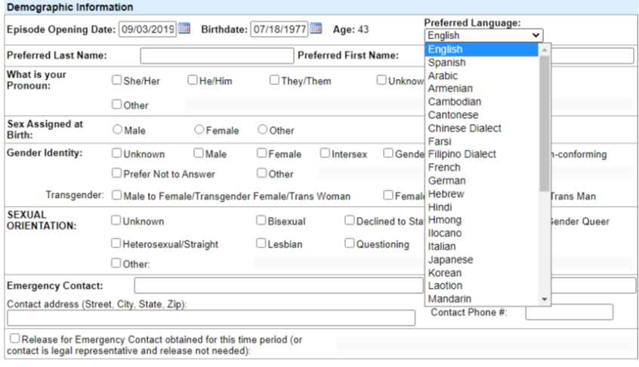
Documenting Interpretation Needs
If you use Clinician’s Gateway Electronic Health Record (EHR) System, this is done in the demographic information section.
If you use a different EHR or a paper chart, make sure there is a location to document the client’s preferred language. This will be looked for if a chart is audited.

Slide 38

Documenting Complex Language Needs
If a client’s Language needs are complicated (Example: a client’s preferred language is English but their parent/guardian who participates in treatment has a different preferred language) this should be documented in the assessment as well.
This Photo by Unknown Author is licensed under CC BY-NC-ND

Slide 39
Documenting Complex Language Needs
In Clinician’s Gateway, a good place to document complex language or cultural needs would be in the cultural formulation section.
However, providers may document such information in any portion of the assessment if they think the information belongs in a different location.

Slide 40
Documenting Language Needs in Progress Notes
Each time an intervention is provided to a client the PN must document the language the service was provided in unless, the Assessment indicates that the primary language is English and all services will be provided in English.
Examples:
“For this session Alameda County’s language interpreter line was used by phone to translate Farsi.”
“Client’s Mother participated in treatment today and since she primarily speaks Spanish, this therapist had our agency’s Spanish interpreter attend session to help with translation.”
“Therapy was conducted in Mandarin as this is client’s preferred language.”

Slide 41

How NOT To Meet Language Needs
Family members or friends present in a session may not act as interpreters.
  The exception would be in a crisis while attempts to get an interpreter are being made and have not been obtained yet.
A clinician that has some language proficiency but is not fluent enough to talk about complex mental health needs in the preferred language may not act as an interpreter.
Interpreters used should convey to the client or to the clinician as accurately as possible exactly what is said. Interpreters should not engage in assessment or therapeutic interventions unless they themselves are the clinician.

Slide 42

SOGIE Data
Recommended at time of MH Assessment.
The ACBH EHR (CG) has been modified to include Sexual Orientation and Gender Identity (SOGIE) data collection.
The Data collection will serve to identify LGBTQ+ populations which have historically been underserved as well as to assist the provider in providing culturally sensitive & responsive services.
Gathering such data in clinical settings will allow providers to better understand and treat their clients, and to compare their clients’ health outcomes with national samples of LGBTQ+ people from health surveys.
This Photo by Unknown Author is licensed under CC BY-NC

Slide 43
Why Is SOGIE Data Collection Important?
Lesbian, gay, bisexual, transgender, queer/questioning (LGBTQ+) clients have unique health needs and experience numerous health disparities.
Shift from LGBTQ+ language to SOGIE.
Everyone has a SOGIE and identity does not always equal behavior.
Routine and standardized collection of Sexual Orientation and Gender Identity Expression (SOGIE) information in medical and EHRs will help assess satisfaction, quality of care and inform the delivery of appropriate health services to address health disparities.

Slide 44
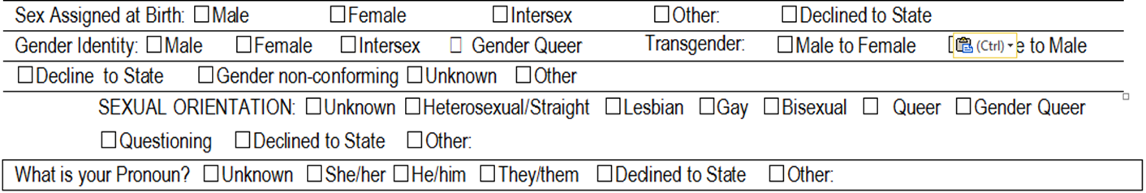
SOGIE Assessment Options
Not limited to one option. Choose all that apply.
When collecting “caretaker/guardian” information—use that label rather than mother/father (may be same-sex household), parent (may be extended family members), etc. Only exception would be biological parents if genetic information is needed.

Slide 45

Helpful tips
Explain upfront that SOGIE questions are asked of all clients, and that the information is used to ensure that everyone is treated equally and gets their individual needs met. This introduction can also explain how to decline to answer the questions.
Sexual orientation information can usually be collected in a single question. Different questions are recommended for children/youth and adults, in part for developmental reasons and in part because of generational differences in how people talk about gender and sexual orientation. Usually developmentally appropriate by age 12.
Explain two part Gender Identity Question. Usually appropriate as early as child can express if they are a “boy” or “girl”.
This Photo by Unknown Author is licensed under CC BY-NC

Slide 46
Helpful Tips
Ask each client what name and pronoun they would like you to use.
If you are uncomfortable with using they or them pronouns due to grammar, consider practicing using different pronouns and names outside of the therapeutic relationship.
If someone does not disclose their sexual orientation or gender identity, continue to assess by asking more general questions. (e.g.: is there anywhere that you feel like you can be yourself?)
If a client does not want their sexual orientation or gender identity documented in the record, you must note that as well as proof of assessing for these items.
  Example: Client reports that they do not want their sexual orientation or gender identity documented in their record at this time and agree to discuss as treatment continues.

Slide 47
SOGIE Statistics
LGBTQ+ youth are 2 to 3 times more likely to attempt suicide. For those from rejecting homes, their risk is up to 8 times greater than other LGBTQ+ youth (Family Acceptance Project).
LGBTQ+ youth are more likely to be homeless.
Transgender individuals have a high prevalence of HIV/STDs, victimization, mental health issues, suicide and are less likely to have health insurance than heterosexual or LGBTQ+ individuals.
70% report being harassed at school.
90% report feeling unsafe at school
Elderly LGBTQ+ individuals face additional barriers to health because of isolation and a lack of social services and culturally competent providers.
LGBTQ+ populations have the highest rates of tobacco, alcohol, and other drug use.
National Resource Ctr for Youth Development: Fact Sheet & Healthy People 2020 http://www.healthypeople.gov/2020/topicsobjectives2020/overview.aspx?topicid=25

Slide 48

Changing Language

Slide 49
Barriers to SOGIE data collection
During provider-client interaction there are several potential barriers to gathering this information:
  Microaggressions
  Internalized oppression
  Prejudice
  Stereotypes
  Not all LGBTQ+ clients will disclose their sexual or gender identity

Slide 50
SOGIE Summary
Assessing for and Collecting SOGIE information is recommended
If a client does not wish to disclose such information, or a comprehensive collection of this information is not possible due to time constraints or extenuating circumstances, or it is clinically counter indicated to do so, you must document the reasons the information was not collected and what plan you have to collect this information in the future.
  Explain to the client:
    They are not required to disclose this information,
    That if they wish to disclose it, you do not have to record it in record unless they consent to that,
    If they do consent to it being collected:
      Indicate how it will help improve our services to LGBTQ+ and that the data will only be used in aggregate form, unless
      If the Assessment is released to someone it could be discovered (may ask for it to be redacted).
        Ramifications for minors whose guardians may have access to records, or to any age client’s whose records are subpoenaed.
All providers should seek ongoing continuing education and consultation to gain skills and knowledge to serve this population.

Slide 51
Assessment Basics
Medical Necessity is established in the assessment by documenting the:
Presenting problems (symptoms/behaviors):
Document the intensity, frequency, duration and onset of current symptoms/behaviors.
Impairments in life functioning:
Document the connection between impairments and their relationship to MH symptoms/behaviors of the primary (and other) included diagnoses.
e.g. Community life, family life, safety school/education, vocational, independent living (adult daily living skills), health, housing, legal, SUD, food/clothing/shelter, etc.
Best practice to document both the client’s activity level both prior to and at the onset of symptoms.

Slide 52
Assessing Substance Use
Must assess for substance use in 7 Areas:
Tobacco, Alcohol (ETOH), Caffeine, Complimentary Alternative Medicines (CAM), Prescription (Rx), Over the Counter (OTC) & Illicit Drugs
Document past and current use in record.
For children/adolescents also document the caregivers’ use and impact upon the client.
If clinically indicated refer client to SUD treatment/provider and document.
If appropriate establish SUD diagnosis
Cannot be primary diagnosis
May only be addressed in the client plan by addressing the underlying MH diagnosis signs, symptoms, and behaviors through the MH objectives and through claimable case management linkage and monitoring of SUD services.

Slide 53

Assessing for Case Management Services
Successful Case management is expected to decrease a client’s MH symptoms and impairments and is usually in the client plan and must document the following:
Indicate areas of need regarding community supports (housing, vocational, educational, medical, SUD, etc.)
MH Impairments
  Link that the adult client’s inability to access and utilize needed community supports (in the area of need such as housing) is due to the specific (state which and how impacts) severe MH Impairments of Included Dx. Or
  Link that the child’s lack of housing, medical, educational, etc. services exacerbates their MH Sx’s of x, y, & z and MH impairments of a, b, & c.
Alternatively, all of the above three items may be in each progress note.
This Photo by Unknown Author is licensed under CC BY

Slide 54
Therapeutic Behavioral Services
A short-term service to provide tools that reduce severe behavior problems for youth in crisis.
An intensive, individualized, one-to-one behavioral mental health service.
A therapeutic intervention used in addition to primary specialty mental health services.
Available for youth under 21 who are being considered for out of home placement or who are at risk of hospitalization in an acute care psychiatric facility.
Designed to help youth and their parents/caregivers manage these behaviors utilizing short-term, measurable goals, based on the needs of the child and family.
If your agency does not provide this service, utilize billable case management services for linkage and monitoring of TBS services—see referral process on next slide.

Slide 55
Referral process for Therapeutic Behavioral Services
The clinician would reach out to the ACBH TBS coordinator Andrea Kiefer for questions at andrea.kiefer@acgov.org or 510-383-5128.
Follow the guidance on the ACBH TBS referral form.
Utilize assessment and plan development codes.
ACBH is requiring TBS be added to the tx plan upon referral. However it does not necessarily have to be in the intervention section though that’s where it often seems to fit on Providers’ tx plan templates. TBS may be included as the target of case management services in order to meet this requirement.
Issue of including a service you are not providing
state that a “referral for TBS will be made to address the ct’s behaviors of …(list the specific bxs that you have identified elsewhere in the Plan) that are putting the client at risk of…(use language from the TBS referral form.)”
Complete the ACBH TBS referral form, document referral in progress notes.

Slide 56

Intensive Care Coordination (ICC)
ICC is an intensive form of care coordination that identifies ancillary supports and systems to assist with client stabilization. ICC ensures that the client’s complex behavioral health needs are met through active, integrated, and collaborative participation by provider(s), family, and natural supports.
ICC requires a designated mental health coordinator whose role is to work within the Child & Family Team (CFT) to ensure that plans from the system partners are integrated to comprehensively address goals and objectives.
ICC is available through the Early and Periodic Screening, Diagnostic and Treatment (EPSDT) benefit to all children, youth, and young adults under the age of 21 who: are eligible for full scope Medi-Cal; meet medical necessity for specialty mental health services.
ICC services will be assigned by the ACBH ICC Administrator. The ICC provider will reassess every 6 months to a year.
If your agency does not provide this service, utilize billable case management services for linkage and monitoring of ICC services.

Slide 57

Intensive Home Based Services (IHBS)
IHBS are mental health rehabilitative services that are available to clients under 21 who are receiving ICC. IHBS are individualized, strength-based interventions designed to improve mental health conditions that interfere with a child, youth, or young adult’s functioning and are aimed at helping the client build skills necessary for successful functioning in the home and community.
The difference between IHBS and more traditional outpatient Specialty Mental Health Services (SMHS) is that the service is expected to be of significant intensity to address the mental health needs of the child or youth, consistent with the plan, and will be predominantly delivered outside an office setting and in the home, school, or community.
If your agency does not provide this service, utilize billable case management services for linkage and monitoring of IHBS services.
This Photo by Unknown Author is licensed under CC BY-NC

Slide 58
Intensive Care Coordination (ICC) and In Home Based Services (IHBS)
Child/Youth/Young Adult (under 21) must meet ALL of the following criteria:
Primary Mental Health clinician in place and is currently receiving services; and
Involved in more than one child-serving system in addition to Mental Health (e.g. Probation, Special Education, Drug & Alcohol, Regional Center, crisis shelter, California Children’s Services) or has multiple mental health providers; and
Intensive level of care coordination is needed and cannot be adequately provided under standard mental health case management services.
Please utilize the following referral form
http://www.acbhcs.org/href_files/ICC-IHBS_Referral_Form_062917.pdf

Slide 59

Therapeutic Foster Care (TFC)
A service for children and youth under the age of 21, who meet medical necessity for specialty mental health services (SMHS) and are at risk of entering a higher level of care, or are stepping down from a higher level of care.
Short-term, intensive, highly coordinated, trauma informed, and individualized treatment to children and youth, up to age 21, who have complex emotional and behavioral needs.
Children and youth are placed with trained, intensely supervised, and supported TFC parents.
If your agency does not provide this service, utilize billable case management services for linkage and monitoring of TFC services—see referral process.

Slide 60
Referral Process for TFC
For youth placed by Child Welfare or Probation:
The Child Family Team (CFT) makes a recommendation for TFC Services.
The placing agency then completes a referral and submits to the IPRC interagency placement review committee (IPRC).
If approved by the IPRC, the client’s outpatient mental health provider will update the client’s assessment and treatment plan to include TFC as a modality. If a client is not already connected to outpatient MH services, the contracted TFC provider Alternative Family Services (AFS) will complete the assessment and treatment plan.
The referral, assessment, and plan will be sent to UM for authorization.
If authorized, AFS will develop a TFC specific client plan or collaborate with the outpatient clinician to redevelop the treatment plan to reflect the client’s specific TFC needs.
The client can be placed with a TFC parent for TFC services.

Slide 61
Referral for TFC Continued
For youth who are not CW or Probation involved:
The client’s outpatient MH clinician and CFT recommend TFC services. (If the client is not already receiving ICC, a referral is made to the ICC coordinator to initiate ICC services. From there, the CFT can recommend TFC services.)
The client’s outpatient MH clinician updates the assessment and treatment plan to contain TFC as a modality and sends referral to the IPRC.
The referral, assessment, and plan will be sent to UM for authorization.
If authorized, AFS will develop a TFC specific client plan or collaborate with the outpatient clinician to redevelop the treatment plan to reflect the client’s specific TFC needs.
The client can be placed with a TFC parent for TFC services.

Slide 62
What to document in the progress note vs mental health assessment form
The following would be documented using the non F2F code as the service time for meeting with the client for the purpose of assessment would be in a F2F note on the date of that service.
If all information for the Initial Assessment is gathered in one assessment contact and assessment is completed without client present.
  Reference Initial Assessment completed in the Progress Note
  “Completed Initial Assessment (see Initial Assessment dated xx/xx/xx in clinical record)”
  Sign/date the Assessment as of the date of the assessment contact

Slide 63
What to document in the progress note vs mental health assessment form
If information for the Initial Assessment is gathered in multiple assessment contacts and assessment is completed without the client present,
  Reference the sections of the initial assessment completed in full for each progress note written to capture that time.
  If section was not completed in full—the data collected must be present in the PN.
  Sign/date the assessment as of the date of the last assessment activity.

Slide 64
What to document in the PN v MH Assessment Form
If all information was gathered in the assessment session and written collaboratively with the client present, use the Face to Face code.
  Reference initial assessment completed with client in the progress note.
  Include your interventions utilized to gather the information from the client to complete the assessment together.
  Reference the assessment document (see initial assessment dated xx/xx/xx in clinical record.)
  Sign/date the assessment as of the date of the assessment contact.

Slide 65
Assessment Addendum
If assessment information is gathered AFTER the initial assessment has been completed, an Assessment addendum may be created. The original Assessment, once signed may not be altered in any way.
The additional information MUST BE added via a formal Addendum (including required signatures) to the Assessment, and then incorporated into the next Annual Assessment.
Recommended components of the MH Assessment Addendum may include:
  The interim history
  Any changes in all of the areas of the MH Assessment previously collected
  A current included (aka "Covered") diagnosis, with concurrent MSE
  Signs and symptoms of the Diagnosis that meet DSM criteria
  Functional impairments as a result of that Diagnosis
  Level of impairment
  Client’s ability to benefit from treatment
  Date of Completed MH Assessment of which this Addendum is addressing

Slide 66

Unplanned Services
Only unplanned services may be claimed prior to the completion of the mental health assessment
Unplanned services include:
Assessment (includes CANS/ANSA)
Plan Development
Interactive Complexity (as an add on code to assessment and Plan Development)
Crisis Psychotherapy
Intensive Care Coordination (ICC) (referral and linkage only, once client is receiving such services—ongoing monitoring may not be provided until the Assessment and Plan are completed.)
Case Management / Brokerage (referral and linkage only, once client is receiving such services—ongoing monitoring may not be provided until the Assessment and Plan are completed.)
Urgent Medication Services only*
*Record must clearly document services are “urgent” in order to be claimed
This Photo by Unknown Author is licensed under CC BY-SA

Slide 67

Assessing Risk
Each of these areas must be assessed, however only those categories identified as risk to the client need to be documented in the assessment. If there was high risk in the past 90 days, a Comprehensive Risk Assessment and Client Safety Plan must also be completed
History of Danger to Self (DTS) or Danger to Others (DTO)
Previous inpatient hospitalizations for DTS or DTO
Prior suicide attempts
Lack of family/other support
This Photo by Unknown Author is licensed under CC BY

Slide 68
Assessing Risk Continued
Arrest history, if any
Probation status
History of alcohol/drug abuse
History of trauma or victimization
History of self-harm behaviors (e.g., cutting)
History of assaultive behavior
Physical impairments (e.g. limited vision, deaf, wheelchair bound) which makes the beneficiary vulnerable to others
Psychological or intellectual vulnerabilities [e.g., intellectual disability (low IQ), traumatic brain injury, dependent personality]
Risk of Exploitation

Slide 69

Documenting Risk
When these categories exist for the client, they should be addressed in the MH Assessment.
If in the past 90 days there has been suicidal or homicidal ideation or any other significant risk (including above examples) BOTH a written Comprehensive Risk Assessment AND a formal written Safety Plan must be created and documented in the medical record.
Example can be found here: http://www.acbhcs.org/providers/QA/docs/2013/TR_Suicide-Homicide_Risk_Assesment.pdf

Slide 70

Documenting Medication and Medication History
List medications prescribed by a Medical Provider (MD, DO, PA, NP) employed by the provider, including: dose/frequency of each, date of initial prescriptions & refills. Documentation of informed consent for medications is required and may be located in a different section of the record.
Medications prescribed by an outside Medical Provider must be listed as above, per client or Medical Provider’s report; provide the Medical Provider’s name and contact information (address and telephone) and as known: dose/frequency of each, date of initial prescriptions, & refills.
Document the history of prescribed medications (for physical and mental health) as above (each element as known), per client or Medical Provider’s report; provide Medical Provider’s name and contact information (address and telephone).

Slide 71

Assessment Signatures
All Signatures must include:
Date of service
Signature of the person providing services/electronic signature
M/C Scope of Practice (MSW, AMFT, MHRS, NP, MD, MHRS, etc.) See Scope of Practice table with required designations http://www.acbhcs.org/providers/QA/docs/training/MH%20Scope%20of%20Practice%20Credentialing.pdf
Type of degree/licensure/job title
Relevant NPI (if applicable)
Date documentation entered into the medical record

Slide 72
Child Adolescent Needs Strengths (CANS)/Adult Needs Strengths Assessment (ANSA)
The CANS/ANSA is a performance outcome assessment tool. It is used for identifying and prioritizing individual youth and family actionable needs and useful strengths to inform treatment plans. It provides a framework for developing and communicating about a shared vision and uses youth and family information to inform planning, support decisions, and monitor outcomes.
CANS/ANSA assessments are required at initial intake ( by the completion of the assessment, on-going 6 months and at discharge.
The CANS/ANSA must be included in the client’s official Medical Record. Completion of this form in the CANS/ANSA monitoring database Objective Arts does not meet this requirement.
Some programs are exempt from having to complete the CANS/ANSA. The best place to find out is through reviewing your contract or reaching out to your contract manager.
See current ACBH P&P for most recent requirements.

Slide 73

CANS Birth to 24
The new CANS Birth to 24 went live on July 6, 2020. The 3rd edition of Alameda County’s CANS integrated the Early Childhood Birth to 5 version, Child and Youth Ages 6-17 version and the Transitional Age Youth ages18-24 version into one.
CANS/ANSA certification: www.tcomtraining.com
ACBHCS Provider Website/ CANS/ANSA http://www.acbhcs.org/providers/CANS/cans.htm
This Photo by Unknown Author is licensed under CC BY-NC-ND

Slide 74
CANS/ANSA Scope of Practice
The CANS and ANSA are Assessment Tools which may only be completed by the following CANS/ANSA certified individuals:
  Licensed LPHA
  Waivered or registered LPHA
  Graduate student/trainee in a recognized MH Master’s or PhD program
  Mental Health Rehab Specialist

Slide 75
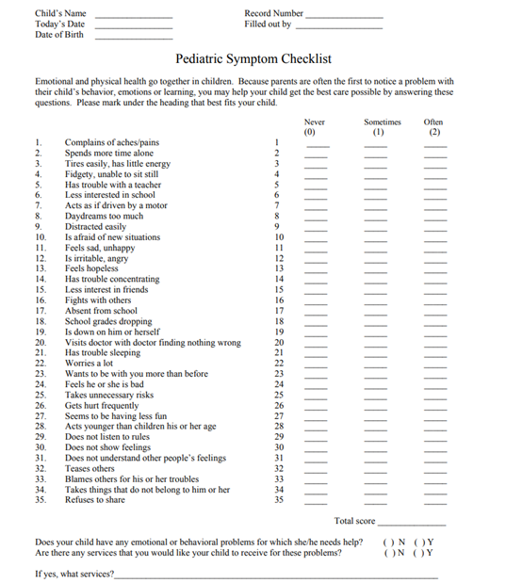
Pediatric Symptom Checklist-35
The PSC-35 is a psychosocial screening tool designed to facilitate the recognition of cognitive, emotional, and behavioral problems so appropriate interventions can be initiated as early as possible. Parents/caregivers will complete PSC-35 (parent/caregiver version) for children and youth ages three (3) up to age eighteen (18).
The PSC-35 should be offered and completed by 60 days from EO, every 6 months, and at discharge.
The PSC-35 does not require training because it is completed by the parent/caregiver.
For more information about the tool, including implementation, scoring and clinical utility, please visit the Pediatric Symptoms Checklist webpage at:
http://www.massgeneral.org/psychiatry/services/psc_home.aspx

Slide 76
PSC-35 Continued
Once the PSC-35 has been completed by parents/caregivers, the results should be entered into Objective Arts and a copy of the form must be included in the Medical Record.
Time spent inputting the PSC-35 into Objective Arts is not a billable activity.
Time spent reviewing the PSC-35 for the first time is a billable assessment activity or as medically necessary.
If client’s caregivers need help completing the PCS-35, time spent reviewing and completing the questions with the client’s caregivers is a billable assessment activity.
Indicate in the progress note what barrier prevented the caregivers from completing the PSC-35 on their own and what interventions you did.
There is also a youth version of the PSC-35.

Slide 77
Clinical Quality Review Team (CQRT)
All agencies must conduct CQRT.
CQRT consists of record review to assure clinical documentation meets Medi-Cal requirements.
Licensed, waivered, or registered LPHAs (Licensed Practitioner of the Healing Arts), and 2nd year Graduate Trainees with the proper training and experience to Diagnose can participate in chart reviews.
Charts are reviewed based on the date of the case episode opening
  Initial CQRT – Charts undergo CQRT review when the complete full MH Assessment and Plan are initially due (for outpatient this is 60 days.)
  Annual CQRT – Prior to treatment plan due date (1st day of month of opening.)

Slide 78

Medical Necessity and Assessment Review
What are the only MH services that may be provided before completion of the MH Assessment and Client Plan?
MH Assessment (with & w/o medical component, & behavioral eval)
Plan Development
Crisis Intervention
Crisis Stabilization (in CSU only)
Case Management and ICC (linkage and referral only)
Urgent medication services
When must an agency’s chart go to CQRT for Quality Review purposes?
Initially and Annually. We recommend that CQRT happen after the Assessment and Plan are completed, but before their due dates. This gives the clinician time to address any concerns identified in the assessment or plan before the CQRT due date. This helps to preserve billing.
All charts must be reviewed before 60 days, and before the annual due date.
This Photo by Unknown Author is licensed under CC BY-NC-ND

Slide 79
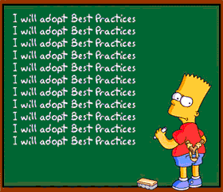
Review Continued
What are the three requirements for Medical Necessity?
An Included Dx which is the Primary Focus of Tx
A Qualifying Impairment (a-c)
A Qualifying Intervention (a-c)
What are the usual due dates for the MH Assessment and Client Plan?
Before 60 days
  It is best practice to complete before 60 days and as soon as possible to ensure timely access to planned services.
  Agencies may create internal policies requiring earlier due dates such as the assessment at 30 days to ensure standards of documentation are met and clients receive timely access to services.
This Photo by Unknown Author is licensed under CC BY-SA

Slide 80

Review Continued
Who may complete (and sign a MH Assessment) and formulate a Dx, but requires co-signature for the Dx?
Waivered or Registered LPHA, qualified 2nd year MH graduate students, and certain nursing staff (see Guidelines for Scope of Practice Credentialing for requirements).
Who may not formulate a Dx and also require a licensed co-signature on the assessment?
1st year Graduate trainee/students
This Photo by Unknown Author is licensed under CC BY

Slide 81

QA Updates
See provider website: http://www.acbhcs.org/providers/Main/Index.htm
COVID-19 Updates:
http://www.acbhcs.org/providers/COVID-19/index.htm
QA Home Page:
http://www.acbhcs.org/providers/QA/QA.htm
  Audits Notices
  Grievance System
  Informing Materials
  Memos and Notices
  QA Manual
  SUD Treatment and Recovery Services
  Trainings

Slide 82

Keep In Touch with QA
•Follow up Documentation Questions QATA@acgov.org
•Privacy Incidents should be reported via BreachNotification@acgov.org
•Unusual Occurrences should be sent to QAOffice@acgov.org
•Professional Licensing Waivers should be sent to QAOffice@acgov.org or eFax (510) 639-1346
•Whistleblower reports should be received via ProgIntegrity@acgov.org
•Grievance and Appeal Requests should be sent by mail or to QAOffice@acgov.org
•Training inquiries should be received via QAOffice@acgov.org
•NOABDs should be received via eFax (510) 639-1346

Slide 83


