Slide 1
Alameda County Behavioral Health: Office Based Evaluation and Management (E/M) Training for Qualified Health Professionals (QHP), QA Coordinators, & Billers

Slide 2
Recorded February, 11, 2021 9:00am –12:00pm
Presenters:
Sheryl Diedrick, Information Systems Analyst;
Lisa Moore, Billing & Benefits Support Unit Director;
Camille Peterson, Information Systems Analyst;
Tony Sanders, PhD, Interim QA Associate Administrator;
and Amy Saucier, LCSW, QA CRS Supervisor
Additional Question and Answer Panel Members:
Aaron Chapman, MD, Chief Medical Director; and
Charles Raynor, PharmD, Director of Pharmacy Services
Administrative Support
Tiffany Lynch, QA Administrative Specialist II; and
Laneisha Whitfield, QA Administrative Assistant
PLEASE NOTE, THIS TRAINING UTILIZES THE AMA CPT MANUAL LANGUAGE OF “PATIENT” FOR CPT CODING PURPOSES, RATHER THAN THE MORE PERSON-CENTERED LANGUAGE OF CLIENT, CONSUMER OR BENEFICIARY UTILIZED BY ACBH.

Slide 3
UPDATES TO POWER POINT SINCE BROADCAST OF TRAINING
Additional Slides have been added to address a data field in Clinician’s Gateway that was not illustrated in the training.
The E/M service time that is used to determine the Primary Code selection will be entered into the “Primary FF/Contact/E-M Time” field in the “Instructions and Pre-existing Diagnosis” section of the note.
See slide #69 (revised) and news slides: 68, 71 73, 75, 78, 80, 84 & 86.
Rather than using New Patient E/M Office Codes it is Recommended to Instead Use Psychiatric Diagnostic Evaluation—with Medical Component, 565-90792.
See slide #17

Slide 4
Important Focus of this Training
The focus of this training is on the selection and claiming of the: E/M Office, or Other, Outpatient Services codes.
For those who attended the prior E/M training:
Please note that information has been added (and examples updated) to distinguish the code selection, and claiming processes, differences when documentation of a rendered service occurs either on the same day, or on a later date.
In particular, take note of changes to slides 17 – 20 and the later examples provided.

Slide 5
Slide Symbols Key
The type of E/M code being discussed on each slide will be indicated by:
Only E/M Office, or Other, Outpatient Services slides:
All E/M Codes slides:
Only E/M Services Provided in the Home, Board & Care (B&C), Skilled Nursing Facility (SNF), and SNF Sub-Acute Settings.
It is recommended for the first Visit to use Psych Diag Eval
565-90792 rather than E/M New Patient codes.
E/M Office Services
All E/M Codes
E/M Home, B&C & SNF
FOR FIRST VISIT USE “PSYCH DIAG EVAL 565-90792” RATHER THAN “E/M NEW PATIENT”

Slide 6
Objectives
E/M Office Services
Discuss CPT code changes for 2021 | Review changes in documentation | Review and understand the changes to Clinician Gateway (CG) and InSyst

Slide 7
Key Changes for 2021
E/M Office Services
DELETION
99201 deleted by American Medical Association (AMA), recognized by Center for Medicare & Medi-Cal Services (CMS)
CREATION
New add-on code for extended visits (99417)
ELIMINATION
History and/or physical exam in determining billable code level
FOUNDATION
Coding based on Time for Medi-Cal (M/C) and Medicare with Medi-Cal (Medi-Medi), or Medical Decision Making (MDM) for Medicare Only (not recommended)

Slide 8
WHO | Qualified Health Providers (“QHP”) Physicians (MD, DO) Advanced Practice Nurses (NP, CNS) Physician Assistant (PA) Note: Clinical Pharmacists (CP) have their own Medication Therapy Management Service (MTMS) codes. See MTMS Power Point training at end of presentation.
WHAT | CPT (E/M) Setting/Service Location E/M Office or Other Outpatient Services
WHEN | Effective March 1, 2021 for ACBH claiming
IMPORTANT | Changes below are for providers submitting claims to Medi-Cal either through Clinician’s Gateway (CG) or InSyst.
E/M Office Services
Overview:

Slide 9
Evaluation and Management (E/M), Office, or Other Outpatient, Services: Overview
E/M Office Services
Effective January 1, 2021 the American Medical Association’s (AMA) CPT® Professional Manual is changing the requirements for selecting the “E/M Office, or Other Outpatient, Services” (CPT® Codes 99201 – 99205, and 99211 - 99215).
ACBH effective date for changes to E/M Office Codes for Medi-Cal claiming is March 1, 2021.
This training does not apply to other E/M services such as:
E/M Home (New or Established Patient)—at client’s home
SNF E/M—at skilled nursing facility (SNF)
SNF SUB E/M—at skilled nursing facility designated sub-acute MH
E/M Board & Care (New or Established)—at Board and Care (B&C)
The new documentation and claiming rules do not apply to the above codes.
E/M Home, B&C & SNF

Slide 10
E/M Office, Other Outpatient, Services vs. E/M Home/SNF/B&C Services
E/M Office Services
Note, the new E/M rules and codes apply only to E/M Office, and Other Outpatient, services.
Those E/M services provided in the Client’s Home, B&C, SNF, or SNF sub-acute utilize the prior E/M codes and rules.
If slides apply to these codes, it will be so designated on the slides.
E/M Home, B&C & SNF

Slide 11
Evaluation and Management (E/M), Office, or Other Outpatient, Services: Overview Continued
E/M Office Services
This will impact Alameda County Behavioral Health (ACBH) Qualified Health Providers (QHP), which include Physicians (MD, DO), Advanced Practice Nurses (NP, CNS) and Physician Assistants (PA) who claim for medication management services with these CPT® E/M codes.
Note: Clinical Pharmacists (CP) have their own Medication Therapy Management Service (MTMS) codes.
Below is a summary of the changes. Note: Changes below are for providers submitting claims to Medi-Cal either through Clinician’s Gateway (CG) or InSyst.

Slide 12
Immediate Attention Required: Changes to Mental Health Subcontractor’s Electronic Health Records (EHR) for E/M Office, Outpt, Services
E/M Office Services
Required implementation date of March 1, 2021;
Deletion of CPT® Code 99201;
Addition of the add-on prolonged service Code 544-99417; and
Duration time-frame changes to CPT® Codes 99202 – 99205 and 99211 – 99215.

Slide 13
Questions

Slide 14
Medi-Cal vs. Medicare Claiming for E/M Office, Outpt, Services:
E/M Office Services
Providers who claim directly to Medicare will need to follow Medicare compliant guidelines. The provider is responsible for submitting Medicare claims according to Medicare requirements. This training addresses only Medi-Cal (and Medi-Medi) compliant claiming.
For Medi-Medi claims, providers must follow Medi-Cal requirements as described herein.
When Medicare is claimed first, the claim as-is may then simply roll-over to Medi-Cal without requiring changes in the claiming process.
Otherwise, it did not meet Medi-Cal requirements (even if it met Medicare requirements) and would be disallowed.

Slide 15
E/M Code Selection for Office, Other Outpt Services:
E/M Office Services
Starting on March 1, 2021, QHPs will select the level of Office, or Other Outpatient, Evaluation and Management (E&M) services based solely on Time [rather than Medical Decision Making (MDM)].*
This is due to a current InSyst claiming limitation, it may change in the future when InSyst is replaced with another claiming database.
Note: Each CPT® Code indicates a specific level of service:
Simple (99211)
Expanded (99202/99212)
Detail (99203/99213)
Complex (99204/99214)
Comprehensive (99205/99215)
*For County and Subcontractors who claim to Medicare, they may select the CPT® Code based on MDM for Medicare only claiming-although not recommended. Because, if it is a Medi-Medi claim, when the claim rolls over to Medi-Cal (after Medicare payment or denial) the Code must be chosen based on time in order to be paid.

Slide 16
Prior E/M Code Selection for Office, Other Outpatient (Outpt), Services:
E/M Office Services
Leading up to 2021, the definition of time associated with CPT® Codes 99201 - 99205 and 99211 - 99215 had been based ONLY on the typical face-to-face (f-f) time the physician/qualified health care professional (QHP) spent on the day of the encounter if Counseling and Coordination of Care was greater than 50% of the f-f time. This had to be documented in detail.
The time-related rule requirement that 50% of the visit be spent on counseling and/or coordination of care to report the service based on time will no longer be applicable as of March 1, 2021.
Note, the prior E/M rules apply when the client is served in the home, SNF, or B&C.
E/M Home, B&C & SNF

Slide 17
“New Patients” vs. “Established Patients” **Rather than using New Patient E/M Codes it is Recommended to Instead Use Psychiatric Diagnostic Evaluation—with Medical Component, 565-90792**
All E/M Codes
FOR FIRST VISIT USE “PSYCH DIAG EVAL 565-90792” RATHER THAN “E/M NEW PATIENT”
New Patients are defined as clients who have not been served by the agency (same Tax ID #) for medication services in the past three years (by any provider). These include codes 99201 (now deleted, instead use 99202) and 99202 – 99205.*
Established Patients are defined as clients who have been served by the same agency (same Tax ID #) for medication services in the past three years (by any provider). These include codes 99211 - 99215.
*Note, County Owned and Operated programs may not utilize New Patient codes if the client was served in any County Programs, in the past three years, as they all have the same tax ID# (check face sheet or always use Established Patient codes).

Slide 18
Time Will Now Be The Sole Determinant Of The Level Of Care Provided for E/M Office, Outpt, Services: per Medi-Cal Claiming Requirements
E/M Office Services
THIS IS THE MOST SIGNIFICANT CHANGE TO E/M CODING FOR MEDICATION SERVICES EFFECTIVE 3/1/21.
The E/M code selection is based on Service Time (exclusive of travel time—which is not allowed for Office based services—and exclusive of documentation time if done on a later date). Service Time now has a NEW definition.
Note, the prior documentation requirements for “Counseling and Coordination of Care” do not apply to E/M Office, Outpt, Services—rather Total Service Time is utilized.
For Medi-Cal (M/C) claiming purposes Documentation time done on a later date is added to Total Time, not Total Service Time**.
** For County and Subcontractors who claim to Medicare, documentation time may not be claimed to Medicare if not done on the same date of service. However, if the claim rolls over to Medi-Cal, documentation time may then be included in Total Time for Medi-Cal claiming. It is always recommended to always chart to M/C requirements.

Slide 19
Service Time Defined for E/M Office, Outpt, Services
E/M Office Services
The definition of Service Time will include both face-to-face (for client and/or significant other) and non-face-to-face activities performed by the provider on the same date of the encounter as described below (excluding any services done on a separate date such as documentation time).
It does not, however, include time in activities that are normally performed by clinical staff*** (RN, LVN, Psychiatric Technician, Medical Assistant, etc.).
For example, if a nurse is taking vitals—that time cannot be included in the E/M visit. The nurse must claim their time separately (and write their own Progress Note).
This is a significant departure from prior E/M guidelines, which ONLY allowed for face-to-face time to be counted.
***Medicare-only claiming allows two qualified health care providers to “bundle” their services into one progress note and claim. Medi-Cal does not allow this, and if a provider rolls a Medicare Claim over to Medi-Cal they may not bundle multiple providers into one service/progress note/claim.

Slide 20
Service Time, Activities for E/M Office, Outpt, Services
E/M Office Services
Service Time for E/M Code selection will now include pre-service, intra-service and post-service activities performed on the same day of the client/family member f-f service. Examples include:
Preparing to see the patient (e.g. review of tests);
Obtaining and/or reviewing separately obtained history;
Ordering medications, tests, and procedures;
Referring and communicating with other health care professionals (interagency, or intraagency only when an urgent or emergent condition requires in person communication asap);
Documenting clinical information in the electronic or other health record;
Independently interpreting results (not separately reported/claimed) and communicating results to the patient/family/caregiver; and
Care Coordination.

Slide 21
Service Time, Activities, cont. For E/M Office, Outpt, Services
E/M Office Services
Service activities cannot happen on separate dates and be counted toward the total Service Time for Code Selection purposes.
For example, to include documentation time into total service time—the write-up
must occur on the same date as the encounter. (Regardless, M/C always reimburses all time claimed.)
Example 1 New Patient:
1/1/20: 25 minutes f-f time with client, and on the same day
1/1/20: 10 minutes documentation time—on same day
In this case, 35 minutes is the total Service time, which is utilized to select the code 99203 (30-44”).
Example 2 New Patient:
1/1/20: 25 minutes f-f time with client
1/2/20: 10 minutes documentation time—on separate day
In this case, only 25 minutes service time is utilized to select the code 99202 (15-29”), and the documentation time is added to the total time (35”) so that all time claimed is paid.

Slide 22
Questions

Slide 23
New Patient E/M Office, Other Outpt, Service Time Intervals:
FOR FIRST VISIT USE “PSYCH DIAG EVAL 565-90792” RATHER THAN “E/M NEW PATIENT”
E/M Office Services
New Patient Office E/M Code Time Intervals
The CPT® Code selected is based on the Service Times as outlined:
InSyst Code | CPT® Code | Description—New Patient Codes | Total Time
546 | 99202 | E/M New OFC Expanded | 15-29 minutes
547 | 99203 | E/M New OFC Detail | 30-44 minutes
548 | 99204 | E/M New OFC Comprehensive | 45-59 minutes
549 | 99205 | E/M New OFC Complex | 60-74 minutes
544 | 99417 | For 75 minutes or longer, drop 99205 to 60 minutes and for each additional full 15 minutes beyond 60 minutes, add one each of the code 99417. Add any additional minutes, that are 14 or less, to the last add-on code . | Full 15 minutes
New Patient E/M Code Time Intervals
The CPT® Code selected is based on the Service Times as outlined:

Slide 24
Established Patient E/M Office, Outpt, Service Time Intervals Continued:
E/M Office Services
Established Patient Office E/M Code Time Intervals
The CPT® Code selected is based on the Service Times as outlined:
InSyst Code | CPT® Code | Description—Established Patient Codes | Total Time
641 | 99211 | E/M EST OFC Simple | <10 minutes
643 | 99212 | E/M EST OFC Expanded | 10-19 minutes
644 | 99213 | E/M EST OFC Detail | 20-29 minutes
645 | 99214 | E/M EST OFC Comprehensive | 30-39 minutes
646 | 99215 | E/M EST OFC Complex | 40-54 minutes
544 | 99417 | For 55 minutes or longer, drop 99215 to 40 minutes and for each additional full 15 minutes beyond 40 minutes, add one each of the code 99215. Add any additional minutes, that are 14 or less, to the last add-on code. | Full 15 minutes

Slide 25
E/M Office, Outpt, Prolonged Service: 544-99417
E/M Office Services
A major component of the 2021 Evaluation and Management (E&M) changes is the introduction of CPT® Code 99417.
The Code reflects a “Prolonged” office, or other, outpatient evaluation and management service that requires at least a full 15 minutes or more of total service time (does not include services done on a different date, such as documentation time after the date of service) either with OR without direct patient contact on the date of the primary E&M service (applicable to either CPT® Code 99205 or 99215).
CPT® 99417 may only be reported in conjunction with 99205 and 99215 if the codes were selected based on the time alone, and not on MDM (ACBH only selects these codes based on time).
A service of less than 15 minutes MAY NOT be reported on an additional Prolonged Service code.

Slide 26
New Patient, E/M Office, Outpt, Services: Prolonged Minutes Code Selection
FOR FIRST VISIT USE “PSYCH DIAG EVAL 565-90792” RATHER THAN “E/M NEW PATIENT”
E/M Office Services
Note this is the methodology for code selection. See the distinct CG
and InSyst claiming processes described in later sections.
Prolonged Minutes Examples for New Patient
New Patient: Service Time of 75 minutes (or 75 – 89”) = (1) 549-99205 (60”) + (1) 544-99417 (15”)
New Patient: Service Time of 90 minutes (or 90 – 104”) = (1) 549-99205 (60”) + (2) 544-99417 (30”);
New Patient: Service Time of 105 minutes (or 105 – 119” minutes) = (1) 549-99205 (60”) + (3) 544-99417 (45”);
New Patient: Service Time of 120 minutes (or 120 – 134” minutes) = (1) 549-99205 (60”) + (4) 544-99417 (60”);
and so on…

Slide 27
Established Patient, E/M Office, Outpt, Service Prolonged Minutes Code Selection
E/M Office Services
Note this is the methodology for code selection.
See the distinct CG and InSyst claiming processes described in later sections.
Prolonged Minutes Examples for Established Patients
Established Patient: Service Time of 55 minutes (or 55 - 69 minutes) = (1) 646-99215 (40”) + (1) 544-99417 (15”)
Established Patient: Service Time of 70 minutes (or 70 -84 minutes) = (1) 646-99215 (40”) + (2) 544-99417 (30”);
Established Patient: Service Time of 85 minutes (or 85 – 99 minutes) = (1) 646-99215 (40”) + (3) 544-99417 (45”);
Established Patient: Service Time of 100 minutes (or 100 - 114 minutes) = (1) 646-99215 (40”) + (4) 544-99417 (60”);
and so on…

Slide 28
Questions

Slide 29
E/M Services Prolonged Minutes: When Allowed and Not Allowed (Due to CG EHR Restrictions).
All E/M Codes
Alert for County and Other Clinician Gateway (CG) Users:
If Prolonged Service Time is utilized—the E/M add-on of “+ Psychotherapy” (465, 467, 468) may not also be claimed. This is due to CG claiming restrictions.
Likewise, if the E/M add-on of + Psychotherapy is utilized—Prolonged Service Time may not also be claimed.
Non-CG, InSyst providers may claim for E/M + Prolonged Service + Psychotherapy IF ALL CRITERIA IS MET (VERY UNUSUAL)

Slide 30
E/M add-on of “+ Psychotherapy” CAUTION—Claiming Risk!
All E/M Codes
Caution: It is not advised to claim add-on + Psychotherapy with E/M codes.
Psychotherapy is often confused with counseling services as described by the AMA CPT Manual® :
“Counseling is a discussion with a client, or the client’s family, concerning one or more of the following issues: Diagnostic results, prior studies, need for further testing, impressions, clinical course, prognosis, treatment options, medication issues/risks/benefits, instructions for management and/or follow-up, importance of compliance with chosen management options, risk factor reduction and client education.”
If the QHP is separately providing psychotherapy to treat the client’s diagnosis (such as providing weekly CBT for addressing depressive symptoms), they will claim for Psychotherapy.
For those sessions where medication is also addressed (usually once monthly) an E/M code + the add-on code of Psychotherapy may be claimed instead.

Slide 31
Documenting E/M Services Provided in a Progress Note (PN)
All E/M Codes
Required for Medicare (and Medi-Medi) documentation, and appropriate for Medi-Cal Claiming:
Per the AMA CPT Manual® document to the seven components of E/M services:
History, Examination, Medical Decision Making, Counseling, Coordination of Care, Nature of Presenting Problem & Time
For Medi-Cal Purposes, the QHP may document:
Any of the relevant 7 components above and a Progress Note (PN) outline such as PIRP. Regardless of the template chosen the elements below must be included per DHCS:
Presentation or Problem (P): That day’s presentation or progress.
Intervention (I): That day’s psychiatric intervention in detail.
Response (R): That day’s detailed client (or collateral) responses to the intervention(s).
Plan (P): Next steps determined from that day’s service provision.

Slide 32
E/M PN Interventions
All E/M Codes
Why would PN entries with the following interventions be disallowed in an Audit?
• “I had a lengthy discussion with the patient.”
• “I spent 20 minutes in supportive counseling.”
• “I spent 15 minutes talking about the treatment options.”
• “I spent 30 minutes with the patient.”
They are not a detailed description of the interventions provided that day, rather a generic comment that could be applied to any case.
They are not thorough enough to represent the time claimed.
Along with the detailed intervention, the PN must also include that day’s presentation/problem, the client’s specific response(s) to the stated provider’s intervention(s), and the plan following this encounter in order to be allowed.

Slide 33
Timeliness of Progress Notes (PN)
All E/M Codes
DHCS has had an increased focus on timely documentation.
Audit feedback has been that it is best practice to write the PN the same day, and if service is at the end of the day—by next day.
Schedule time at the end of the day for documentation.
ACBH Timeliness of PN’s:
It is best practice to write the Progress Notes on the same/next day of the date of service. Progress Notes must be entered in to the clinical record within five (5) business days of the date of service (DOS) with all required signatures or they will be considered a “late note”. Approval by the supervisor and clinician finalization of the Progress Note must be completed within five (5) business days.
If an entry is late, the beginning of the Progress Note must clearly identify the note as a late entry for the DOS with “Late Entry for Month/day/year” at the beginning of the Progress Note.

Slide 34
Questions

Slide 35
InSyst Data Code Selection and Time Entry for E/M Office, or Other Outpatient, Service Codes
E/M Office Services

Slide 36
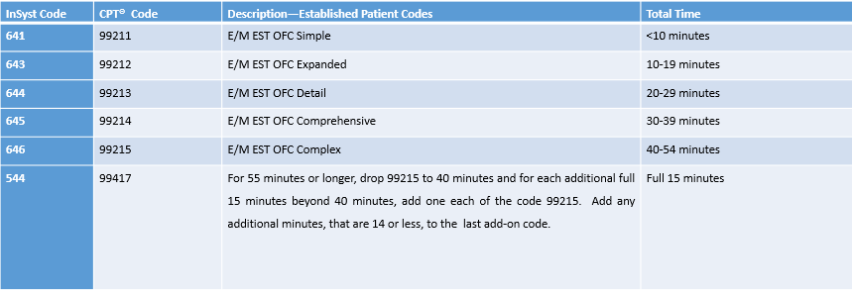
InSyst E/M Office, Outpt, Services Code Selection and Time Entry Directions: No Prolonged Service for Established Patient:
E/M Office Services
Established Patient: If the calculated Service Time (including same-day documentation time) is within the time range of the primary service codes 641-99211 to 646-99215, No Prolonged service code 544-99417 is added.
Any add’l time (i.e. documentation time (done on a different day than service) gets added to the primary service code.
The Primary E/M code selection allows InSyst to correctly claim to Medicare (However, the minutes associated with the code will claim to M/Cal.)

Slide 37
InSyst Example: E/M Office, Outpt, Services Established Patient w/calculated Service Time 40-54 minutes - No Prolonged Time—Same Day Documentation
E/M Office Services
Established Patient Example: 35 min. service + 10 min. documentation time (done on the same day of service) = 45 min. Total Time
Calculate the Service Time to determine the code selection. Service Time = 35 min. service + 10 min. documentation (only if done on the same day of service) = 45 min or (1) 646-99215 (40-54 minutes).
For InSyst entry of minutes: Enter (1) 646 proc code for 45 min. Total time in the Staff Duration field.

Slide 38
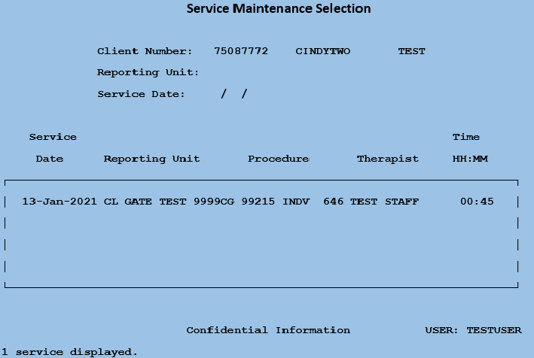
InSyst Example: Established Patient E/M Office, Outpt, Services w/calculated Service Time 40-54 minutes - No Prolonged Time
E/M Office Services

Slide 39
InSyst Example: Established Patient, E/M Office, Outpt, Services w/calculated Service Time 30-39 mins + additional minute(s) for proc code 645-99214
E/M Office Services
Established Patient Example: 35 min. service + 10 min. documentation time (done on a different day) = 45 min. Total Time
Calculate the Service Time to determine the code selection. Service Time = 35 min. service or (1) 645-99214 (30-39 minutes).
For InSyst entry of minutes: Enter (1) 645 proc code for 35 min’s Service Time + 10 min. documentation time (done on a different day) = 45 Total Time in the Staff Duration field.

Slide 40
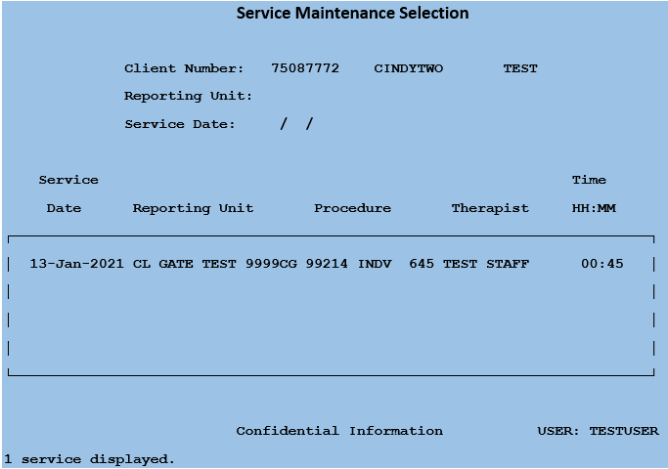
InSyst Example: Service Time 30-39 minutes for 645-99214, E/M Office, Outpt, Service Established Patient - No Prolonged Time
E/M Office Services

Slide 41
InSyst Code Selection and Time Entry Directions: E/M Office, Outpt, Prolonged Service for Established Patient:
E/M Office Services
Established Patient: If 646-99215 is 55 minutes or greater, the Service Time reverts to 40 minutes, and the excess service time rolls over to the Prolonged Service if it is a FULL 15 minutes or greater (see below if 14 minutes or less)
For each FULL 15-minute increment, one 544-99417 Prolonged Service Code is entered.
When the balance is 14 minutes or less, these minutes are added on to the last 544-99417 Prolonged Service Code.

Slide 42
InSyst Example: Established Patient w/calculated Service Time over 54 minutes (incl’ Prolonged minutes for proc code 544-99417—Same Day Doc.)
E/M Office Services
Established Patient: 45 min. service + 10 min. documentation time (done on the same day of service) = 55 min. Total Time
Calculate the Service Time to determine the code selection. Service Time = 45 min. service + 10 min. documentation time = 55 minutes or (1) 646-99215 (40”) + (1) 544-99417 (15”).
For InSyst entry of minutes:
Enter (1) 646-99215 proc code for the first 40 min. Service Time in the Staff Duration field.
Enter (1) 544-99417 proc code for the additional 15 minutes of Service Time.
The Total Time entered in InSyst should be 40 min. under proc code 646 and 15 min. under proc code 544 for a Total Time of 55 min.

Slide 43
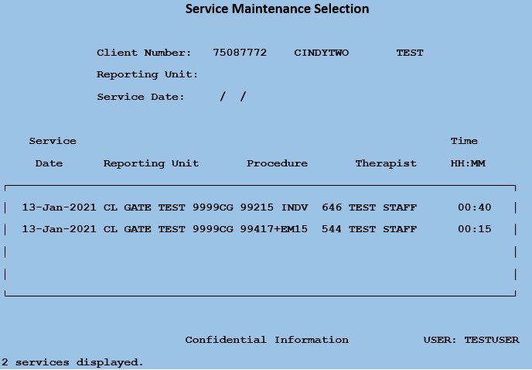
InSyst Example: Established Patient w/calculated Service Time over 54 minutes (incl’ Prolonged minutes for proc code 544-99417—Same Day Documentation)
E/M Office Services

Slide 44
InSyst Example: Established Patient w/calculated Service Time 40-54 min. + (incl’ Prolonged proc code 646-99215—Doc on Different Day)
E/M Office Services
Established Patient: 45 min. service + 10 min. documentation time (done on a different day) = 55 min. Total Time
Calculate the Service Time to determine the code selection. Service Time = 45 min. service or (1) 646-99215 (40-54 minutes).
For InSyst entry of minutes: Enter (1) 646 proc code for 45 minutes Service Time + 10 min. documentation time (done on a different day) = 55 min. Total Time in the Staff Duration field.
Different day documentation is always added to the Primary Code.

Slide 45
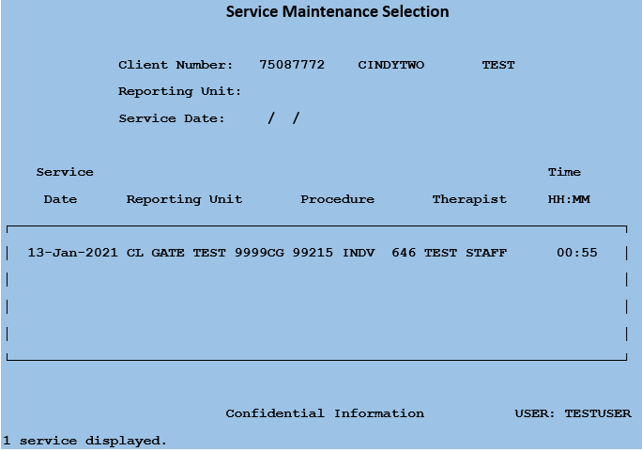
InSyst Example: Established Patient w/calculated Service Time 40-54 min. + Prolonged Time for proc code 646-99215—Different Day Documentation
E/M Office Services

Slide 46
InSyst Example: Established Patient w/calculated Service Time over 54 minutes (incl’ Prolonged minutes w/multiple proc code 544-99417—Same Day Documentation)
E/M Office Services
Established Patient: 60 min. service time + 30 min. documentation time (done on the same day of service) = 90 min. Total Time
For code selection Service Time = 60 minutes service time + 30 min. documentation time (if done on same day of service) = 90 minutes or (1) 646-99215 (40 minutes) + (3) 544-99417 (50 minutes).
For InSyst entry of minutes:
Enter (1) 646 proc code for the first 40 min. Service Time in the Staff Duration field.
Enter (2) 544 proc codes for 15 min. each = 30 min. and (1) 544 proc code for the remaining balance of 20 min. in the Staff Duration field. (Remember to add any additional minutes, that are 14 or less, to the last add on code.)
The Total Time entered in InSyst should be 40 min. under (proc code (646) and 50 min. total under (proc code 544) for a Total time of 90 min.

Slide 47
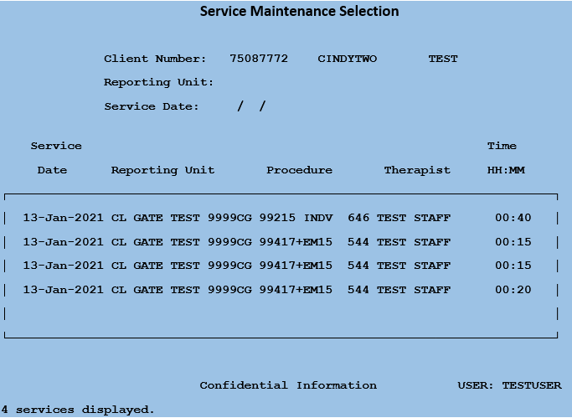
InSyst Example: Established Patient w/calculated Service Time over 54 minutes (incl’ Prolonged minutes w/multiple proc code 544-99417—Same Day Documentation)
E/M Office Services
InSyst override code requires duplicate or multiple 544 codes with same duration.

Slide 48
InSyst Example: Established Patient w/calculated Service Time over 54 minutes (incl’ Prolonged minutes + additional minute(s) for proc code 646-99215—Documentation on Different Day)
E/M Office Services
Established Patient: 60 minutes Service time + 30 min. documentation time (done on a different day) = 90 min. Total Time
For code selection Service Time = 60 minutes Service time reverts to (1) 646-99215 (40 minutes)
For InSyst entry of minutes:
Enter (1) 646 proc code for the first 40 min. Service Time + 30 min. documentation time (done on a different day) = 70 min. in the Staff Duration field.
Enter (1) 544 proc codes for the remaining Service Time balance of 20 min. in the Staff Duration field. (Add on code = Full 15min., plus remember to add any add’l minutes to the last add-on-code.)
The Total Time entered in InSyst should be 70 min. under (proc code (646) and 20 min. total under (proc code 544) for a Total time of 90 min.
Documentation Time added to Primary Code.

Slide 49
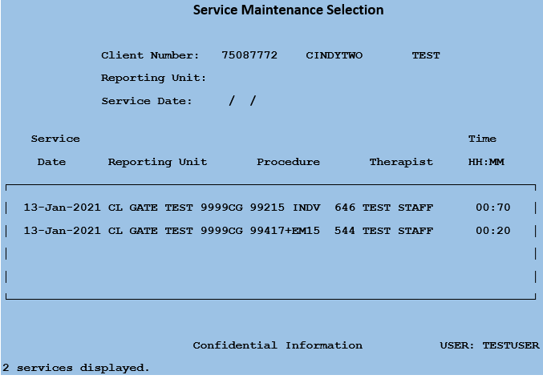
InSyst Example: Established Patient w/calculated Service Time over 54 minutes (incl’ Prolonged minutes + additional minute(s) for proc code 646-99215—Documentation on Different Day)
E/M Office Services

Slide 50
Questions

Slide 51
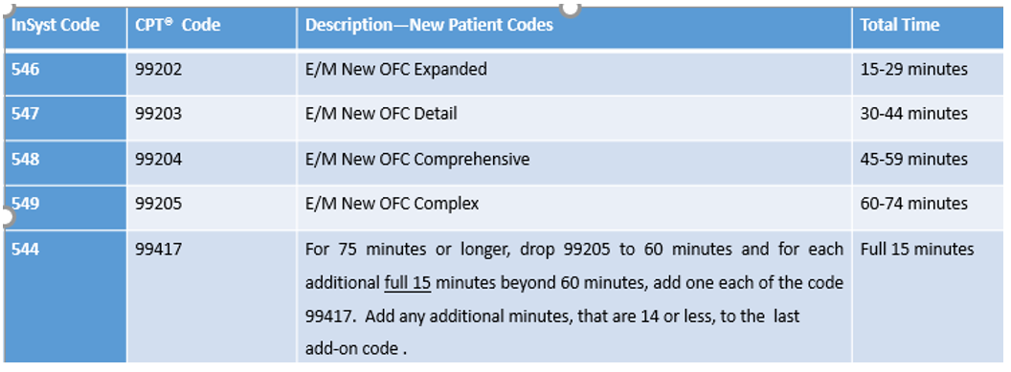
InSyst Code Selection and Time Entry Directions: No Prolonged Service for New Patient:
E/M Office Services
FOR FIRST VISIT USE “PSYCH DIAG EVAL 565-90792” RATHER THAN “E/M NEW PATIENT”
New Patient: If the calculated Service Time is within the time range of the primary service codes 546-99202 to 549-99205, No Prolonged service code 544-99417 is added.
Any add’l time (i.e. documentation time (done on a different day than service) gets added to the primary service code.
When the balance is 14 minutes or less, these minutes are added on to the last 544-99417 Prolonged Service Code.
The Primary E/M code selection allows InSyst to correctly claim to Medicare (However, the minutes associated with the code will claim to M/Cal.)

Slide 52
InSyst Example: New Patient w/calculated Service Time 45-59 minutes – No Prolonged Time
FOR FIRST VISIT USE “PSYCH DIAG EVAL 565-90792” RATHER THAN “E/M NEW PATIENT”
E/M Office Services
New Patient: 35 min. service + 10 min. documentation time (done on the same day of service) = 45 min. Total Time
Calculate the Service Time to determine the code selection. Service Time = 35 min. service + 10 min. documentation (done on the same day of service) = 45 min or (1) 548-99204 (45-59 minutes).
For InSyst entry of minutes: Enter (1) 548 proc code for 45 min. Total time in the Staff Duration field.

Slide 53
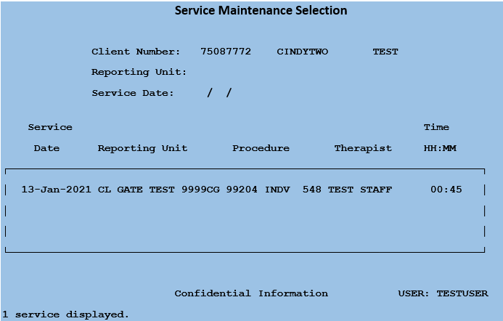
InSyst Example: New Patient w/calculated Service Time 45-59 minutes – No Prolonged Time
FOR FIRST VISIT USE “PSYCH DIAG EVAL 565-90792” RATHER THAN “E/M NEW PATIENT”
E/M Office Services

Slide 54
InSyst Example: New Patient w/calculated Service Time 30-44 minutes – No Prolonged Time
FOR FIRST VISIT USE “PSYCH DIAG EVAL 565-90792” RATHER THAN “E/M NEW PATIENT”
E/M Office Services
New Patient: 35 min. service + 10 min. documentation time (done on a different day) = 45 min. Total Time
Calculate the Service Time to determine the code selection. Service Time = 35 min. service or (1) 547-99203(30-44 minutes).
For InSyst entry of minutes: Enter (1) 547 proc code for 35 min. Service Time + 10 min. documentation time (done on a different day) = 45 Total Time in the Staff Duration field.

Slide 55
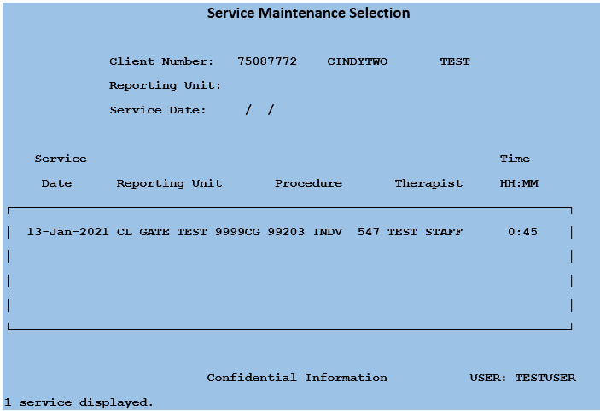
InSyst Example: Service Time 30-44 minutes for 547-99203, New Patient - No Prolonged Time
FOR FIRST VISIT USE “PSYCH DIAG EVAL 565-90792” RATHER THAN “E/M NEW PATIENT”
E/M Office Services

Slide 56
InSyst Code Selection and Time Entry Directions: Prolonged Service for New Patient:
FOR FIRST VISIT USE “PSYCH DIAG EVAL 565-90792” RATHER THAN “E/M NEW PATIENT”
E/M Office Services
New Patient: If 549-99205 is 75 minutes or greater, the Service Time reverts to 60 minutes, and the excess service time rolls over to the Prolonged Service if it is a FULL 15 minutes or greater (see below if 14 minutes or less)
For each FULL 15-minute increment, one 544-99417 Prolonged Service Code is entered.
When the balance is 14 minutes or less, these minutes are added on to the last 544-99417 Prolonged Service Code.

Slide 57
InSyst Example: New Patient w/calculated Service Time over 74 minutes (incl’ Prolonged minutes for proc code 544-99417—Same Day Documentation)
FOR FIRST VISIT USE “PSYCH DIAG EVAL 565-90792” RATHER THAN “E/M NEW PATIENT”
E/M Office Services
New Patient: 65 min. service + 10 min. documentation time (done on the same day of service) = 75 min. Total Time
Calculate the Service Time to determine the code selection. Service Time = 65 min. service + 10 min. documentation time (only if done on the same day of service) = 75 minutes or (1) 549-99205 (60-74 minutes) + (1) 544-99417.
For InSyst entry of minutes:
Enter (1) 549-99205 proc code for the first 60 min. Service Time in the Staff Duration field.
Enter (1) 544-99417 proc code for the additional 15 min. of Service Time.
The Total Time entered in InSyst should be 60 min. under proc code 549 and 15 min. under proc code 544 for a Total Time of 75 min.

Slide 58
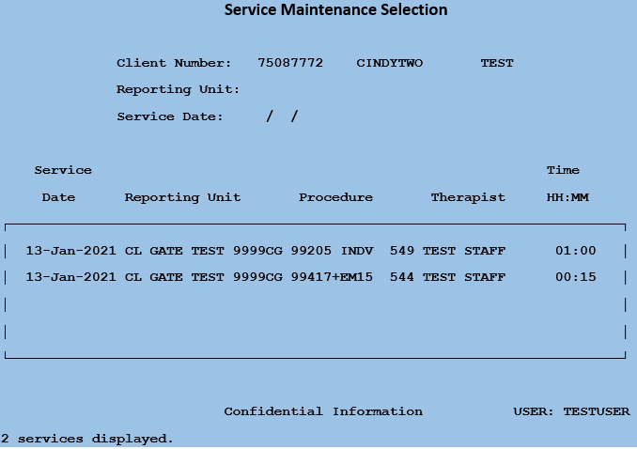
InSyst Example: New Patient w/calculated Service Time over 74 minutes (incl’ Prolonged minutes for proc code 544-99417--Same Day Documentation)
E/M Office Services
FOR FIRST VISIT USE “PSYCH DIAG EVAL 565-90792” RATHER THAN “E/M NEW PATIENT”

Slide 59
InSyst Example: New Patient w/calculated Service Time 60-74 min. + Different Day Documentation Time
FOR FIRST VISIT USE “PSYCH DIAG EVAL 565-90792” RATHER THAN “E/M NEW PATIENT”
E/M Office Services
New Patient: 65 min. service + 10 min. documentation time (done on a different day) = 75 min. Total Time
Calculate the Service Time to determine the code selection. Service Time = 65 min. service or (1) 549-99205 (60-74 minutes).
For InSyst entry of minutes: Enter (1) 549 proc code for 65 min. Service Time + 10 min. documentation time (done on a different day) = 75 min. Total Time in the Staff Duration field.

Slide 60
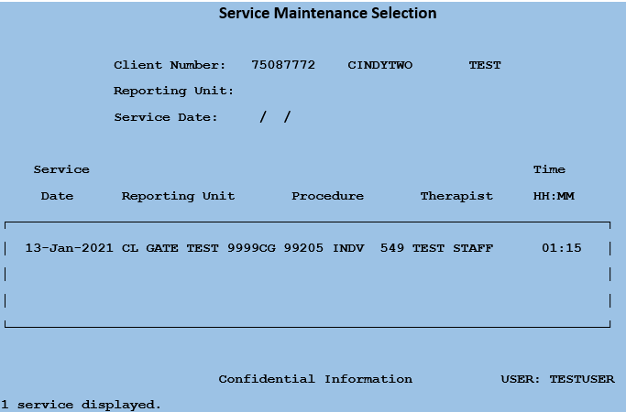
InSyst Example: New Patient w/calculated Service Time 60-74 min. + Different Day Documentation time
FOR FIRST VISIT USE “PSYCH DIAG EVAL 565-90792” RATHER THAN “E/M NEW PATIENT”
E/M Office Services

Slide 61
InSyst Example: New Patient w/calculated Service Time over 74 minutes (incl’ Prolonged minutes w/multiple proc code 544-99417—Same Day Doc)
FOR FIRST VISIT USE “PSYCH DIAG EVAL 565-90792” RATHER THAN “E/M NEW PATIENT”
E/M Office Services
New Patient: 80 min. service time + 30 min
documentation time (done on same day of service)
= 110 min. Total Time
For code selection Service Time = 80 minutes service time + 30 min. documentation time (if done on same day of service) = 110 minutes or (1) 549-99205+ (3) 544-99417.
For InSyst entry of minutes:
Enter (1) 549 proc code for the first 60 min. Service Time in the Staff Duration field.
Enter (2) 544 proc codes for 15 min. each = 30 min. and (1) 544 proc code for the remaining balance of 20 min. in the Staff Duration field. (Remember to add any additional minutes, that are 14 or less, to the last add on code.)
The Total Time entered in InSyst should be 60 min. under (proc code (549) and 50 min. total under (proc code 544) for a Total time of 110 min.

Slide 62
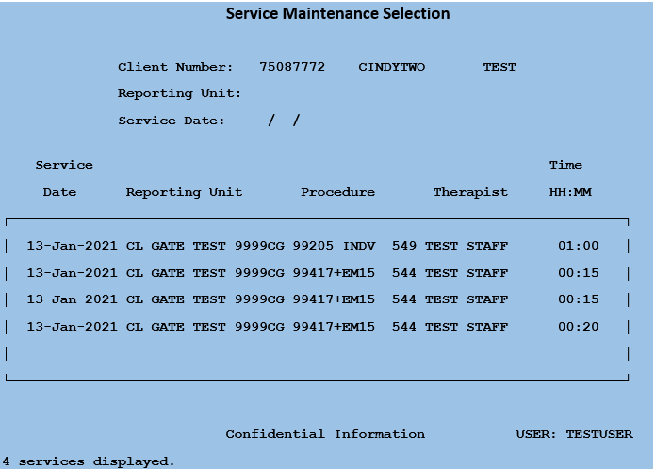
InSyst Code Selection and Time Entry Directions Prolonged Service New Patient Examples, Service Time-110 Minutes—Same Day Documentation
FOR FIRST VISIT USE “PSYCH DIAG EVAL 565-90792” RATHER THAN “E/M NEW PATIENT”
E/M Office Services
InSyst requires duplicate override code for multiple 544 codes with same duration.

Slide 63
InSyst Example: New Patient w/calculated Service Time over 74 minutes (incl’ Prolonged minutes + additional min(s) for proc code 549-99205—Different Day Documentation)
FOR FIRST VISIT USE “PSYCH DIAG EVAL 565-90792” RATHER THAN “E/M NEW PATIENT”
E/M Office Services
New Patient: 80min. service time + 30 min
documentation time (done on a different day) = 110 min. Total Time
For code selection Service Time = 80 minutes service time or (1) 549-99205 (60-74 minutes)
For InSyst entry of minutes:
Enter (1) 549 proc code for the first 60 min. Service Time + 30 min. documentation time (done on a different day) = 90 min. in the Staff Duration field.
Enter (1) 544 proc codes for the remaining Service Time balance of 20 min. in the Staff Duration field. (Add on code = Full 15min., plus remember to add any add’l minutes to the last add-on-code.)
The Total Time entered in InSyst should be 90 min. under (proc code (549) and 20 min. total under (proc code 544) for a Total time of 110 min.

Slide 64
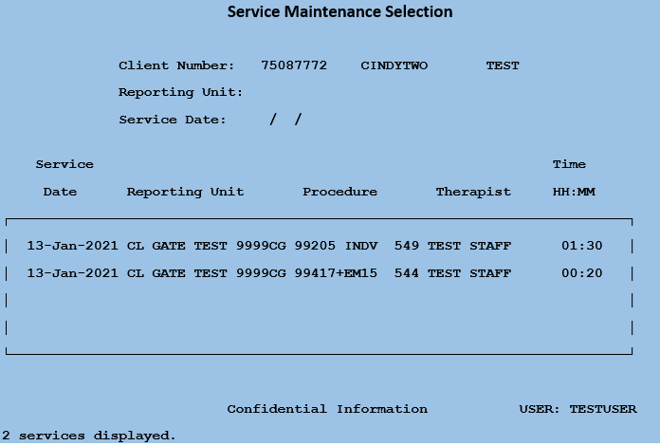
InSyst Example: New Patient w/calculated Service Time over 74 minutes (incl’ Prolonged minutes + additional minute(s) for proc code 549-99205—Different Day Documentation)
FOR FIRST VISIT USE “PSYCH DIAG EVAL 565-90792” RATHER THAN “E/M NEW PATIENT”
E/M Office Services

Slide 65
Questions

Slide 66
Clinician's Gateway EHR Code Selection and Time Entry for E/M Office, or Other Outpatient, Service Codes
E/M Office Services

Slide 67
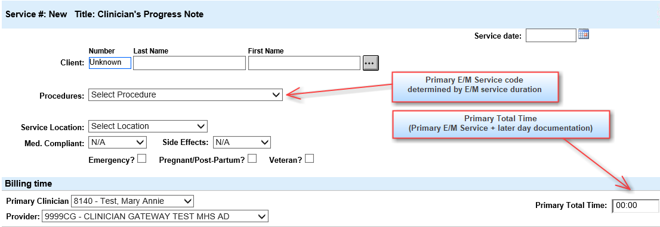
Clinicians Gateway Primary & Secondary Codes
E/M Office Services
E/M services are reported using Primary and Secondary Code and Time Fields

Slide 68
Clinicians Gateway Primary & Secondary Codes
E/M Office Services
The E/M service time that is used to determine the Primary Code selection will be entered into the “Primary FF/Contact/E-M Time” field in the “Instructions and Pre-existing Diagnosis” section of the note.

Slide 69
CG Code Selection and Time Entry Directions
E/M Office Services
Primary E/M Service Time field (equivalent to Service Time above):
Calculate the sum of all types of E/M service time on the date of the encounter
Use these minutes to select the Primary E/M code
Do not include documentation done after the date of service
The Primary E/M code selection allows InSyst to correctly claim to Medicare
(However, the minutes associated with the code will claim to M/Cal.)
Enter these minutes into the Primary FF/Contact/E-M Time field
After the Primary E/M code is selected, then add documentation time done on a different date to calculate the Primary Total Time (field name)
Primary Total Time field:
Once the Primary E/M Service Time is determined, add service time done on a later date to calculate the Primary Total Time.
(The minutes associated with Primary Total Time will claim to M/Cal so no dollars are lost with the lower E/M code selection.)

Slide 70
CG: Primary Total Time and Secondary FF/Contact/E-M Time
E/M Office Services
Secondary Code and FF/Contact/E-M Time field (PKA as Secondary Total Time)
544-99417: Use for Prolonged E/M time beyond the Primary code’s base duration:
If 646-99215 (40 -54 min) Established Client service time is 55 minutes or greater, the E/M Primary Service Time reverts to 40 minutes base duration.
If 549-99205 (60-74 min) New Client service time is 75 minutes or greater, the E/M Primary Service Time reverts to 60 minutes base duration.
All the excess service time rolls over to Secondary Service Time of 544-99417
All minutes roll-over to claim to Medi-Cal.

Slide 71
Clinicians Gateway Primary FF/Contact/E-M Time
E/M Office Services
E/M service time used for Primary Code selection is entered in the Instructions and Pre-Existing Diagnoses section in the FF/Contact/E-M Time field.

Slide 72
CG Example: Service Time 40-54 Minutes for 646-99215, Established Patient, No Prolonged Time Same Tame Documentation
E/M Office Services
Established Patient-with same day documentation time
Determine service time: 35 min service + 10 min documentation = 45 min (Total E/M Service time which includes same day documentation in the service time).
Use Service Time to choose the E/M code
E/M service 40-54 minutes uses only Primary code
Enter Total E/M Service time into Primary Total Time field

Slide 73
CG Example: Service Time 40-54 Minutes for 646-99215, Established Patient, No Prolonged Time Same Day Documentation
E/M Office Services
Total E/M service time for Primary Code selection is placed in the “Primary FF/Contact/E-M Time” field.

Slide 74
CG Example: Total Time 40-54 Minutes, Established Patient, Non-Same Day Documentation, No Prolonged Time
Determine the service time, not including later day documentation time
Choose a lower duration E/M code if service time for encounter day is less than 40 minutes
Add later documentation time to service time for Primary Total Time

Slide 75
CG Example: Total Time 40-54 Minutes, Established Patient, Non-Same Day Documentation, No Prolonged Time
E/M Office Services
Total E/M service time for Primary Code selection is placed in the “Primary FF/Contact/E-M Time” field.

Slide 76
CG: Established Patient Prolonged Service Time Calculation
E/M Office Services
Established Patient, Outpatient-Prolonged Service
If 646-99215 exceeds 54 minutes, the primary E/M service time reverts to 40 minutes base duration and all the excess rolls over to the Additional E/M Minutes (field). CG will do secondary code math in the background.
Same day documentation is included in the service time calculation for code selection:
Non-same day documentation is not included in the Service Time determination, but is added into the Primary Total Time later.
Examples:
If Same Day E/M Service Time is 69 minutes, record: 40 minutes for 646-99215 and 29 minutes 544-99417
If Same Day E/M Service Time is 84 minutes, record: 40 minutes for 646-99215 and 44 minutes 544-99417
If Same Day E/M Service Time is 99 minutes, record: 40 minutes for 646-99215 and 59 minutes 544-99417
and so on

Slide 77
CG Example: Established Patient, Prolonged E/M Service Time with 646-99215 Same Day Documentation
E/M Office Services

Slide 78
CG Example: Established Patient, Prolonged E/M Service Time with 646-99215 Same Day Documentation
E/M Office Services
Total E/M service time for Primary Code selection is placed in the “Primary FF/Contact/E-M Time” field.

Slide 79
CG Example: Established Patient, Prolonged E/M Time with 646-99215 Later Documentation
E/M Office Services

Slide 80
CG Example: Established Patient, Prolonged E/M Time with 646-99215 Later Documentation
E/M Office Services
Total E/M service time for Primary Code selection is placed in the “Primary FF/Contact/E-M Time” field.

Slide 81
Questions

Slide 82
CG: New Patient Prolonged Service Time Calculation
FOR FIRST VISIT USE “PSYCH DIAG EVAL 565-90792” RATHER THAN “E/M NEW PATIENT”
E/M Office Services
New Patient, Office-Prolonged Service
If 549-99205 exceeds 74 minutes, the primary time reverts to 60 minutes base duration and all the excess rolls over to the secondary code. CG will do secondary code math in the background.
Same day documentation is included in the service time calculation and thus code selection:
Non-same day documentation is not included in the Service Time determination, but is added into the Primary Total Time later.
Examples
If Same Day E/M Service Time is 89 minutes, record: 60 minutes for 549-99205 and 29 minutes 544-99417
If Same Day E/M Service Time is 104 minutes, record: 60 minutes for 549-99205 and 44 minutes 544-99417
If Same Day E/M Service Time is 105 minutes, record: 60 minutes for 549-99205 and 45 minutes 544-99417
and so on

Slide 83
CG Example: New Patient, Prolonged Service Time with 549-99205 Same Day Documentation
FOR FIRST VISIT USE “PSYCH DIAG EVAL 565-90792” RATHER THAN “E/M NEW PATIENT”
E/M Office Services

Slide 84
CG Example: New Patient, Prolonged Service Time with 549-99205 Same Day Documentation
E/M Office Services
Total E/M service time for Primary Code selection is placed in the “Primary FF/Contact/E-M Time” field.

Slide 85
CG Example: New Patient, Prolonged Service Time with 549-99205, Later Documentation
FOR FIRST VISIT USE “PSYCH DIAG EVAL 565-90792” RATHER THAN “E/M NEW PATIENT”
E/M Office Services

Slide 86
CG Example: New Patient, Prolonged Service Time with 549-99205, Later Documentation
E/M Office Services
Total E/M service time for Primary Code selection is placed in the “Primary FF/Contact/E-M Time” field.

Slide 87
Questions

Slide 88
Clinical Pharmacists Medication Services Claiming
See ACBHCS Training Slides:
Alameda County Behavioral Health (ACBH): Medication Therapy Management Services (MTMS) by Clinical Pharmacists (CP)

Slide 89
E/M Services Codes and Procedures: When Provided in the Home, B&C, SNF or SNF Sub-Acute Settings Trainings and Resources
E/M Home, B&C & SNF
These NEW E/M rules (in training) are NOT TO BE USED with the following E/M codes:
E/M Home (New or Established Patient)—at client’s home:
471-99341 through 474-99344
475-99345, and]
476-99347 through 479-99350
SNF E/M—at skilled nursing facility (SNF) or SNF SUB E/M
650-99306,
653-99307 through 656-99310
657-99304 through 658-99305
SNF SUB E/M—at skilled nursing facility designated sub-acute MH
E/M Board & Care (New or Established)—at Board and Care (B&C)
660-99324,
661-99325 through 664-99328,
665-99334 through 668-99337

Slide 90
E/M Services Codes and Procedures: When Provided in the Home, B&C, SNF or SNF Sub-Acute Settings Trainings and Resources--Continued
E/M Home, B&C & SNF
Watch for updated Trainings and Resources for these
E/M Codes on the Provider Website / QA / Training page.
http://www.acbhcs.org/providers/QA/Training.htm

Slide 91
Questions

Slide 92
Technical Assistance
MH QA Coordinators may contact the QA Office for Technical Assistance at:
QAta@ACgov.org

