Slide 1
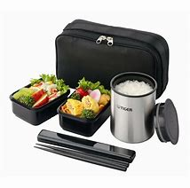


ACBH QA Mental Health Brown bag
ACBH providers, Quality Assurance Lead Staff, Directors, Managers and Supervisors are welcome to join QA for a question and answer session!
Technical Assistance for Mental Health Providers
Open lunch forum to discuss billing and clinical documentation technical questions related to Medi-Cal
QA Brown Bag Question 2020 Schedule
January 10th, 2020 | July 3rd, 2020
February 7th, 2020 | August 7th, 2020
March 6th, 2020 | September 4th, 2020
April 3rd, 2020 | October 2nd, 2020
May 1st, 2020 | November 6th, 2020
June 5th, 2020 | December 4th, 2020
All sessions occur 12-1 pm on the respective Friday
Join in person: 2000 Embarcadero Cove Suite 305 in our Joaquin Miller Conference Room
or
Join by phone: 877-336-1828/Passcode:8298628

