Slide 1
Specialty Mental Health Services Clinical Documentation Training for Clinician Gateway - Electronic Health Record
Users
JEFF SAMMIS, PSY.D
Clinical Review Specialist Supervisor
Clinical Review Specialists:
Phuong Lai, Psy.D
Amy SaucIer, LMFT
Deanna Kolda, LCSW

Slide 2
Welcome
Logistics
Safety
If you were a guest on Check Please Bay Area, what restaurant would you recommend?

Slide 3
Agenda
9:00 am – 4:00 pm
Welcome
System of Care Highlights and Auditing
CQRT
10:30 – 10:45 Break
Timely Access/NOABD
MH Assessment Requirements, including SOGIE Data Collection
Client Plan Requirements
12:00 – 12:30 Lunch
Client Plan Requirements
Progress Notes
Lock-outs, Claims Disallowances, Minor Consent, Emergency Contact
2:00 – 2:15 Break
Procedure Codes - Procedure Code Switching and Bingo
Post Test/Evaluation
Questions

Slide 4
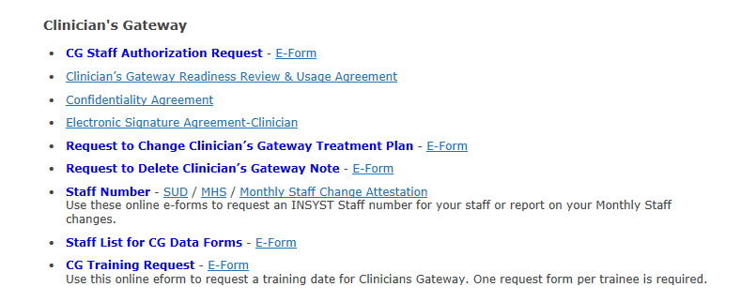
Clinician’s Gateway Is Alameda County’s Electronic Health Record System
This Training will focus on Documentation Requirements.
For Training on how to use Clinician’s Gateway your agency can request a training from Information Systems.
http://achcsa.org/behavioral-health/forms.aspx

Slide 5
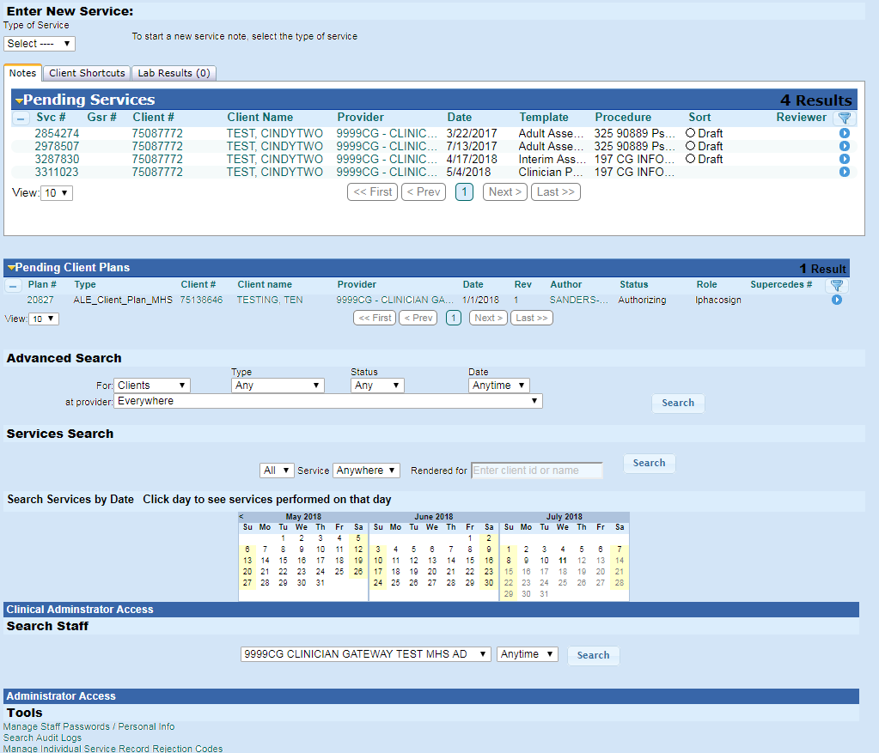
Clinician’s Gateway Is Alameda County’s Electronic Health Record System
Clinician’s Gateway is ACBH Electronic Health Record.
CG Manual can be found at:
http://www.acbhcs.org/providers/CG/index.htm

Slide 6
Training Objectives
After this training participants will be able to:
State the timelines to complete: Brief Screening Tool, Informing Materials, MH Assessment, CANS/ANSA, Client Plan & Progress Note documentation
Identify and document key components of establishing Medical Necessity for the provision of Specialty Mental Health Services (SMHS)
Identify and document key components of the Mental Health (MH) Assessment

Slide 7
Training Objectives Continued
Collect Sexual Orientation and Gender Identity (SOGIE) data during the MH Assessment process in a sensitive manner
Identify and document key components of the Client Plan
Identify and document the key requirements of Progress Notes and frequently used Mental Health Service & Procedure Codes

Slide 8
How to Get into Compliance
Please use the information in this presentation to train your staff on proper Medi-Cal Documentation requirements.
Please review Alameda County’s new and updated Documentation Manual.
  http://www.acbhcs.org/providers/QA/docs/qa_manual/7-1_CLINICAL_DOCUMENTATION_STANDARDS.pdf
If your agency has not recently been audited in Alameda County’s System of Care audit, consider running an internal audit using the same audit tools that ACBH uses.
Conduct regular CQRT (Clinical Quality Review Team) chart reviews and back out claims that were claimed in error.
  Backing out a claim that does not meet medical necessity and would be disallowed in an audit is a requirement of agencies once they are aware of the claims/errors and can save your agency (and the whole County Mental Health Program) money in the long run.

Slide 9
CQRT
All agencies must conduct CQRT
CQRT consists of two essential components
  Record review to assure clinical documentation meets Medi-Cal requirements
  Authorization of SMHS services
    Initial
    Annual

Slide 10
Eligible staff for CQRT
For Agency CQRT meetings
  Licensed, waivered, or registered LPHAs (Licensed Practitioner of the Healing Arts), and 2nd year Graduate Trainees with the proper training and experience to Diagnose can participate in chart reviews.
  Only Licensed LPHAs (Licensed Practitioner of the Healing Arts) may authorize treatment services.

Slide 11
AGENCY CQRT REVIEW CYCLE
Charts are reviewed based on the date of the case episode opening
  Initial CQRT – Charts undergo CQRT review and authorization when the complete full MH Assessment and Plan are initially due (for outpatient this is 60 days)
  Annual CQRT – Prior to treatment plan due date (1st day of month of opening)
  *Some other program types may have different CQRT timeline requirements*
Month Episode is Opened | Cycle | Bring the Chart to Initial CQRT before the due date. | Bring the Chart to annual CQRT during the month | With a new annual TX plan to cover services beginning | And Treatment plans should not be signed/finalized before this date
January (e.g. 1/15) | Jan 1-Dec 31 | Review Before March 15 | December | 1/1 | 12/1
February (e.g.2/2) | Feb 1-Jan 31 | Review Before April 2nd | January | 2/1 | 1/1
March (e.g. 3/30) | Mar 1-Feb 28 | Review Before May 30th | February | 3/1 | 2/1

Slide 12
Additional INFO for CQRT Review
Providers that receive low claims compliance scores in system of care audits will be required (per their Plans of Correction) to submit CQRT forms for the next 6 months.
The QA department will randomly select cases and request a copy of the chart and conduct a 2nd review of the chart.
This process will be used as ACBH evidence that our county is monitoring that Plans of Corrections are being followed and changes made in our system and that we are providing Technical Assistance to Providers.

Slide 13
Timely Access to Services Summary
DHCS wants to know does the MHP provide timely appointment offers and ultimately timely access to assessment? And does the MHP provide timely access to treatment?
DHCS wants to determine the number of days from a beneficiary’s request for specialty mental health services to an initial assessment, and the number of days from the initial assessment to the first treatment appointment.
Info. Notice dated March 22, 2019 indicates that MHP’s must begin collecting the timelines data June 20, 2019.

Slide 14
Timely Access Tracking
Who- All outpatient ACBH county-operated programs and individuals under a contract or subcontract with ACBH who bill Medi-cal for services. (inpatient, Santa Rita, outreach programs do not)
What-Date of first contract to request services, type of service requested, assessment start/end, treatment start/end, medical necessity,
When-New or New returning client who has medi-cal or is medical eligible.
Providers are required to offer an appointment within
Psychiatry 15 business days (urgent 48 hours)
Outpatient prior authorization not required 10 days (48 hours)
Outpatient prior authorization is required 10 days (96 hours)

Slide 15
Timely Access Forms
1. Timeliness Reporting Data Collection (Interim)
2. Timeliness Data Collection Instructions (updating)
3. Timeliness Data Entry eForm (IS web portal)
http://achcsa.org/behavioral-health/forms.aspx
The Timeliness Data should be submitted when the assessment end date and treatment start date is successfully completed or when the client does not complete the assessment process and the case is closed
Complete them on the same cycle as billing

Slide 16
Notices Of Adverse Benefit Determination
(NOABD)
A NOABD is written notification of when an adverse benefit determination is made, and the BHP is required to issue to Medi-Cal beneficiaries.
Purpose: Provide Medicaid (Medi-Cal) beneficiaries timely and understandable written notification when an adverse benefit determination for specialty mental health (SMHS) or substance use disorder (SUD) services is made; notification inclusive of beneficiary rights, such as the right to appeal.
The denial or limited authorization of a requested service, including determinations based on the type or level of service, medical necessity, appropriateness, setting, or effectiveness of a covered benefit;
The reduction, suspension, or termination of a previously authorized service;
The denial, in whole or in part, of payment for a service;
The failure to provide services in a timely manner;
The failure to act within the required timeframes for standard resolution of grievances and appeals; or
The denial of a beneficiary’s request to dispute financial liability.
Notes:
Highlighted sections are the NOABD templates typically issued by ACBH and ACBH contracted SMHS providers.

Slide 17
Initial Required Forms
Brief Screening Tool (non-billable service)
Informing Materials (Reviewing informing materials and obtaining consents with clients as part of the assessment is a billable service.)
Release of Information- when necessary (Discussing release of information with client as part of the assessment is a billable service.)

Slide 18
Brief Screening Tool
All clients must be screened for Mild-to-Moderate (referred to Beacon for MH Services) vs. Moderate-to-Severe (seen by ACBH Providers) criteria.
  Screening is done upon referral and before Annual Assessment.
  Only Exceptions: Out of County, TBS Workers, Crisis, Conservatorship, & Guidance Clinic, STAT
Administration of the Brief Screening Tool is NOT A billable service.
May be completed by a Licensed/Waivered/Registered LPHA/ and 2nd year Graduate Trainee with the proper training and experience to Diagnose (with attestation of this by clinical supervisor).
  Waivered or Registered LPHA require a Licensed LPHA co-signature.
  2nd Year Trainees and greater also require a Licensed LPHA co-signature.
Use appropriate form based on age (0-5, 6-17, Adult)
  http://www.acbhcs.org/providers/Forms/Forms.htm

Slide 19
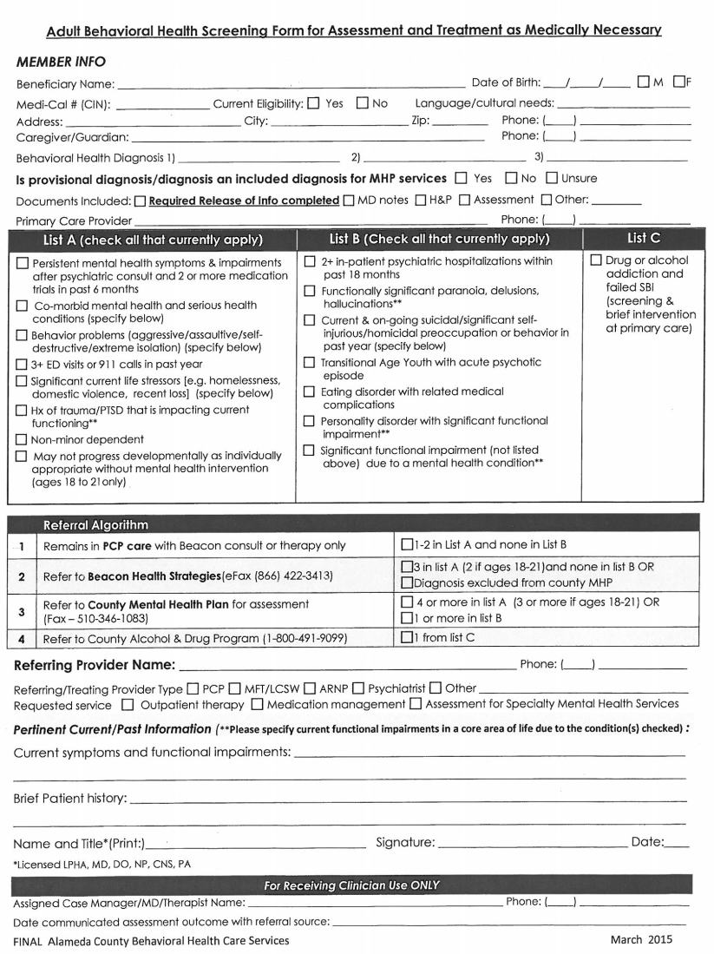
Note that this form does not have co-signature line, however if a co-signature is required, please ensure co-signature is present.

Slide 20
Informing Materials
Informing Materials required at Initial and Annual Assessments.
  Recommended at first visit as includes Consent to Treatment
  May be claimed as part of the MH Assessment
If a client’s primary language is not English, you must review informing materials in the client’s primary language.
  Alameda County provides translated Informing materials for all threshold languages. These forms must be provided to the client and the signature page present in the client’s medical record.
  If a client does not speak a threshold language, you can verbally interpret an English packet to the client and place an English signature page in the medical record and indicate that it was verbally reviewed with them in a language they understand.
All elements present in ACBH’s Informing Materials Packet are required.
  http://www.acbhcs.org/providers/QA/General/informing.htm
  Provider may add additional forms as needed.
ACBH’s Informing Materials Signature Page is highly recommended to be used and must be maintained in client record.
  If agency form is used—all county form elements must be present and readily identifiable.
  Note all boxes must be checked (as addressed) and signed.
  May utilize form by client initial for four additional occurrences.

Slide 21
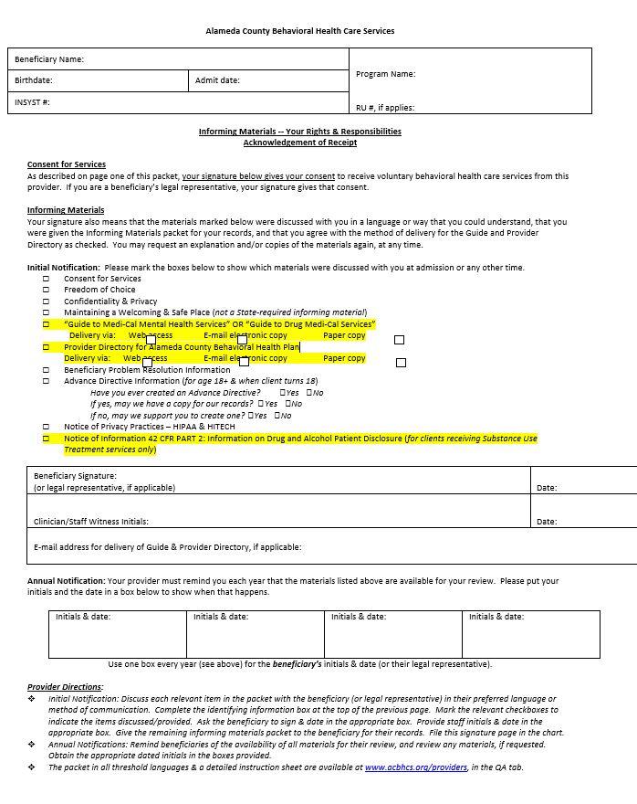

Informing Materials Signature Page
All items with a check box on the left must be reviewed with client and checked once reviewed.
Yellow highlight indicates changes to the form. Check the appropriate box to indicate the manner of delivery for those items.

Slide 22
Release of Information
Informed Releases of Information (ROI)
  Must be signed by client or legal representative.
  Client’s may limit data that will be shared including dates that information can be shared.
  Not required for Alameda Health Care Services Providers—but recommended
  Not required to simply facilitate treatment referral to other MH Providers—but highly recommended
  Releases are valid for as long as the client indicates, if no date indicated, default is 12 months.
  For a date to be valid, it must be an actual date; “until the end of treatment” is not a valid date.
To avoid gaps in consent, obtain signatures on relevant ROIs annually during re-authorization of Assessment & Plan so that they fall in-sync with authorization cycle

Slide 23
Establishing Medical Necessity
The golden Thread

Slide 24
The Golden Thread
Definition:
  The “Golden Thread” is the sequence of documentation that supports the demonstration of ongoing medical necessity and ensures all provided services are reimbursable.
  The sequence of documentation on which medical necessity requirements converge is:
        Brief Screening Tool
        The Assessment
        The Client Plan
        The Progress Note

Slide 25
Medical Necessity
Must meet the following three criteria:
Criteria #1: An included diagnosis (See Medical Necessity for Specialty Mental Health Services handout)
  All Dx must indicate:
  1) The ICD-10 Code
  2) The DSM-5** Description (name) WITH all specifiers
  **for included diagnoses not in DSM-5, such as F84.5, F84.9, F84.2, F84.3 & F84, list the ICD-10 Descriptor (Dx Name)
  3) DHCS also recommends indicating the ICD-10 Descriptor (Dx Name)—
  but not required by ACBH at this time
A client may also have a non-included diagnosis as long as the focus of treatment is to address the signs and symptoms of the included (primary) diagnosis.
  The Primary Diagnosis in the clinical record must match the Primary Diagnosis in INSYST to ensure an accurate clinical snapshot
  If the Diagnosis is revised you must update INSYST

Slide 26
Medical Necessity
Criteria #2: A qualifying impairment (meets one of the following)
    A significant impairment in an important area of life functioning
    A reasonable probability of significant deterioration in an important area of life functioning (without treatment)
    For EPSDT (children < 21 yrs): a reasonable probability that a child will not progress developmentally as individually appropriate

Slide 27
Medical Necessity
Criteria #3: A qualifying intervention (meets all three of the following)
  1. The focus of the intervention is to address the condition of the impairment resulting from the included diagnosis
  2. The expectation is that the proposed intervention will meet one of the following:
    Significantly diminish the impairment, or
    Prevent significant deterioration, or
    Allow the child to progress developmentally as individually appropriate;
  3. And the conditions would not be responsive to physical healthcare treatment alone.

Slide 28
Medical Necessity
Medical necessity is documented throughout the client’s chart.
The mental health assessment and client plan must establish medical necessity for all planned services.
Progress notes must contain evidence that the services claimed for reimbursement meet medical necessity by linking to a specific current MH Objective.

Slide 29
Medical Records Dx Documentation
The diagnosis is maintained in the Assessment.
See Medi-Cal Included Dx Lists for:
  Outpatient MH Services M/C Included Dx Lists (by ICD-10 Code and DSM Name) and Cross-Walk
It is not recommended to use the DHCS Medi-Cal Included Lists on their website as they include more diagnoses than may actually be utilized.
County Clinics and Clinician Gateway Users will not have the option of using the DHCS lists of Included Dx.

Slide 30
Medical Records Dx Documentation Cont.
Crosswalk for Outpatient MH Services: DHCS ICD-10 to DSM
  DHCS releases the SMHS Included list as ICD-10 diagnoses, however ICD-10 does not include criteria for diagnoses. DSM-5 uses ICD-10 codes and adds specific criteria. Codes and diagnoses between the manuals are not always the same because they are updated independently. ACBH has developed a crosswalk to help navigate these concerns.

Slide 31
Medical Records Dx. Documentation Cont.
The primary diagnosis and focus of treatment can not be a historical diagnosis. The primary diagnosis must be made during the current episode.
  For example, diagnoses made during recent psychiatric hospitalizations may be used to inform the current diagnosis, but may not simply be referenced
Any additional diagnoses that the client has received in the past may be documented without indicating the full criteria. Indicate “by history” and the source of the data.

Slide 32
Medical Records Dx Documentation Cont.
Each contracted agency is required to have a policy and procedure to resolve discrepant diagnoses.
It is best practice to align diagnoses within an agency.
  When there is a discrepant diagnosis and it can not be resolved, the client record should indicate what attempts were made to align them and how the decision was reached to keep discrepant diagnoses.
It is best practice for providers to collaborate across agencies regarding conflicting diagnoses.

Slide 33
Diagnosing for CG Users
The Assessment template in Clinician’s Gateway separates diagnoses into the following categories:
Mental Health Diagnoses
Substance Use Disorder Diagnoses
General Medical Codes
Psychosocial

Slide 34
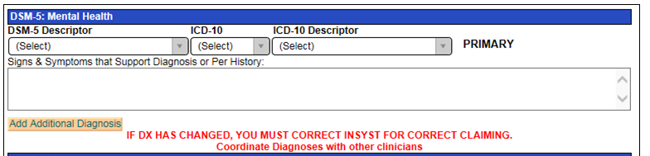
Clinician’s Gateway
All of these fields must be completed.

Slide 35
IS Help Desk Contact
For assistance with entering ICD-10 codes into InSyst, please contact the Information Systems Help Desk @ 510.567.8181 or HIS@acgov.org

Slide 36
Mental Health Assessment
Step 1 Of The Golden Thread

Slide 37
Assessment
    Assessments are a collection of information and clinical analysis that are designed to evaluate the current status of a client’s mental, emotional, or behavioral health.
What is the purpose?
  To learn about client’s story
  Gather information about the client in order to formulate a diagnosis, develop a conceptualization, and collaboratively create a treatment plan (acknowledged by client’s signature).
  Determine if the client meets medical necessity:
    Do they have an “included” diagnosis and an impairment in life functioning due to their mental health symptoms?

Slide 38
Scope of Practice for mental health assessment
  A Licensed LPHA may: 1) Conduct MSE and establish a diagnosis and 2) May complete and sign the mental health assessment form.
  A Waivered/Registered LPHA may: 1) Conduct MSE and establish a diagnosis (must have a licensed LPHA co-signature ) and 2) May complete a mental health assessment form.
  A Second Year FTE MH Graduate Student/Trainee with written attestation (placed in personnel file by the current Licensed Clinical Supervisor that the student trainee has sufficient education, training and experience to diagnose independently with the Licensed Supervisor’s on-going full record review, supervision and co-signature) may 1) Conduct a MSE and establish diagnosis (with licensed LPHA co-signature) and 2) Complete mental health assessment form (with a licensed LPHA co-signature).
  A First Year Graduate Students: 1) May not establish a diagnosis, 2) May complete and sign a MH Assessment form (with a Licensed LPHA co-signature).
    When a first year graduate student completes an assessment, they may not complete the diagnosis section of the assessment form. Only a clinician with the proper scope of practice may meet with a client to conduct a MSE and establish a diagnosis. That clinician must complete and sign (with required co-signatures) the diagnosis section of the assessment.

Slide 39
MHRS Activities
If the agency determines it is within their scope of ability, training, and experience MHRS & Adjunct Staff may collect self-report information in the areas of:
Mental health and medical history
Substance exposure and use
Identifying strengths, risks, and barriers to achieving goals
Demographic information
MHRS & Adjunct Staff may not enter information into the Assessment form. This information must be documented in progress notes.
Progress Notes will generally indicate:
        “Client/Family Member/Other reports ____.”

Slide 40
Assessment Dates
The Initial Mental Health Assessment is due within 60 days of the Episode Opening Date (EOD).
Annual Assessments after that are due within the 30 day period prior to the first day of the Episode Opening Month (EOM).
  Example:
    Episode Opening Date (EOD) 8/28/18 and Assessment due by 10/26/18 (actual 60 day count) before claiming for planned services.
    Annual Assessment is due in July 2019 and all required signatures must be obtained no later then 7/31/2019.
Programs with earlier assessment due dates:
  DTI, DR, Adult Residential, Crisis Residential by day seven (7)
  Psychiatric Health Facility Services - 72 hours (actual count)
  Psychiatric Inpatient Services - 72 hours (excluding Sat. & Sun)
  TBS Services – Prior to any TBS claiming

Slide 41
Incomplete Assessment
If it is not possible to address all required elements of the assessment due to issues of client participation or inability to obtain a full history, but medical necessity has been established, the Assessment should be completed within the required deadlines, with notations of when addendums with missing information are expected.
If medical necessity can not be established (due to clinical reasons) do not complete the assessment until this information can be obtained.
  You may continue to bill for assessment (and other unplanned services) until you complete an assessment.

Slide 42
Required Items of an Assessment
Identifying Information (now includes SOGIE)
Communication Needs
Medical History
Presenting Problem(s) / Referral Reason
Relevant Conditions & Psychosocial Factors
Risks
Client / Family Strengths
Medications
Allergies / Adverse Reactions / Sensitivities
Substance Exposure/Use
Mental Health History
Other History (Employment, living situation, etc.)
For Clients Under Age 18
  Prenatal/Perinatal Events and Complete Developmental History
Mental Status Exam (MSE)
Complete Diagnosis with required signatures
Complete Signature of Individual Completing the Assessment (with required co-signatures)
*BHCS SMHS Documentation Manual provides specific information about the minimum required elements for each of these items*

Slide 43
Assuring Form Compliance
It is the provider’s responsibility to keep their forms and EHR up to date with all Medi-Cal documentation requirements.
Clinician’s Gateway is in the process of being updated and it is the responsibility of each agency to follow the current SMHS documentation standards by including the required information into the narrative fields.

Slide 44
Cultural Considerations
Identified during the Assessment Process and addressed in the plan if appropriate
    Language & Physical Limitations
    Race, Ethnicity, Socio-Economic Status, Class, Religion, Immigration status/Citizenship, Geography,
    CG now includes SOGIE (Sexual Orientation/Gender Identity)

Slide 45
SOGIE Data Collection
Required at time of MH Assessment
CG has been modified to include Sexual Orientation and Gender Identity (SOGIE) data collection.
The Data collection will serve to identify LGBPTQQI2-S populations which have historically been underserved.
Gathering this data will allow providers to better understand and treat their clients, and to compare their clients’ health outcomes with national samples of LGBPT people from health surveys.

Slide 46
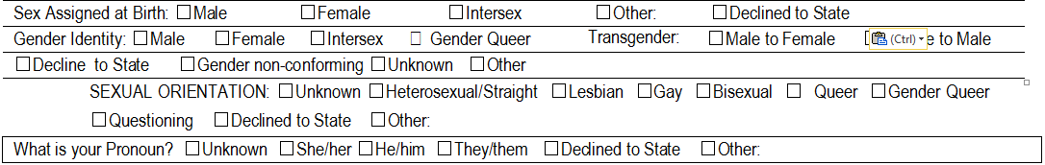
SOGIE Data Collection
You are not limited to one option. Choose all that apply.
When collecting “caretaker/guardian” information—use that label rather than mother/father (may be same-sex household), parent (may be extended family members), etc. Only exception would be biological parents if genetic information is needed.
If spouse is being requested: indicate “spouse or significant-other”.
Notes:
All options in the above section were added after feedback was gathered from a focus group. The purpose of discussing SOGIE in this way is to ensure we separate gender identity/expression from sexual orientation.

Slide 47
Why Collect SOGIE Data?
Lesbian, gay, bisexual, pansexual and transgender (LGBPT) clients have unique health needs and experience numerous health disparities
Routine and standardized collection of Sexual Orientation and Gender Identity Expression (SOGIE) information in medical and EHRs will help assess satisfaction, quality of care and inform the delivery of appropriate health services to address health disparities.

Slide 48
Why Collect SOGIE Data?
Use of national data, if local does not exist, to identify health inequities:
  Example HEALTHY PEOPLE 2020: http://www.healthypeople.gov/2020/topicsobjectives2020/overview.aspx?topicid=25
LGBPT youth are 2 to 3 times more likely to attempt suicide.
LGBPT youth are more likely to be homeless.
Transgender individuals have a high prevalence of HIV/STDs, victimization, mental health issues, suicide and are less likely to have health insurance than heterosexual or LGBPT individuals.
  70% report being harassed at school.
  90% report feeling unsafe at school
Elderly LGBPT individuals face additional barriers to health because of isolation and a lack of social services and culturally competent providers.
LGBPT populations have the highest rates of tobacco, alcohol, and other drug use.
National Resource Ctr for Youth Development: Fact Sheet & Healthy People 2020

Slide 49
Why Collect SOGIE Data?
Statewide data: Building Partnerships: Conversations with LGBPTQ Youth About MH Needs and Community Strengths: UC Davis Center for Reducing Health Disparities, 3/2009, cont:
LGBPTQ youth reported being harassed and bullied in their schools, homes, and neighborhoods on an almost-daily basis.
Many youth shared that they had received death threats.
LGBPTQ youth identified social factors as major causes of mental illness in their communities including challenging economic and physical living conditions.
LGBPTQ youth described their struggles with rejection by their families and peers and harassment at school by students, teachers, and administrators, and how it often leads to feelings of isolation, hopelessness, despair, self-destructive behaviors, suicidal thoughts, attempts, and completed suicides.

Slide 50

Changing Language

Slide 51
Communication Barriers
During provider-client interaction there are several potential barriers to gathering this information:
  Microaggressions
  Internalized oppression
  Prejudice
  Stereotypes
Not all LGBPT clients will disclose their sexual or gender identity
Notes:
Discuss microaggressions, intersectionality

Slide 52
Helpful Tips
  Ask each client what name and pronoun they would prefer you use
  If you are uncomfortable with using they or them pronouns due to grammar, consider practicing using different pronouns and names outside of the therapeutic relationship
  If someone does not disclose their sexual orientation or gender identity, continue to assess by asking more general questions (e.g.: is there anywhere that you feel like you can be yourself?)
  Ongoing training
Notes:
- please note, that is privilege

Slide 53
Assessment
Medical Necessity is established in the assessment by documenting the:
Presenting Problems (symptoms/behaviors):
  Document the intensity, frequency, duration and onset of current symptoms/behaviors
Impairments in Life Functioning:
  Document the connection between impairments and their relationship to MH symptoms/behaviors of the diagnosis
    e.g. Community Life, Family Life, Safety School/Education, Vocational, Independent Living (ADL’s), Health, Housing, Legal, SUD, Food/Clothing/Shelter, etc.
  It is best practice to document the client’s level of functioning prior to and at the onset of symptoms.

Slide 54
Assessment
Must Assess for Substance Use in 7 Areas:
  Tobacco, ETOH, Caffeine, CAM, Rx, OTC & Illicit Drugs
Assess for Substance Use Disorders (SUD):
  Document past and current use in record.
  For children/adolescents also document the caregivers’ use and impact upon the client.
  If clinically indicated refer client to SUD treatment/provider.
If appropriate, establish an SUD Diagnosis
  Cannot be primary diagnosis
  May only be addressed in the client plan by addressing the underlying MH Dx’s signs, Sx, and behaviors through the MH Objectives.

Slide 55
What to Include in the Assessment for
Case Management Services
  Successful Case Management is expected to decrease a client’s MH symptoms and impairments and is usually in the Client Plan.
  Indicate areas of need regarding community supports (housing, vocational, educational, medical, SUD, etc.)
  MH Impairments
    Link that the adult client’s inability to access and utilize needed community supports (in the area of need such as housing) is due to the specific (state which and how impacts) severe MH Impairments of Included Dx. or
    Link that the child’s lack of housing, medical, educational, etc. services exacerbates their MH Sx’s of a, b, & c and MH impairments of x, y, & z.
  Alternatively, all of the above three items may be in each PN.

Slide 56
Assessment
  What to document in the PN vs within the MH Assessment Form:
    If all information for the Initial Assessment is gathered in one assessment contact
      Reference Initial Assessment completed in the Progress Note
        “Completed Initial Assessment (see Initial Assessment dated xx/xx/xx in clinical record)”
        Sign/date the Assessment as of the date of the assessment contact
    If information for the Initial Assessment is gathered in multiple assessment contacts,
        Reference sections of the Initial Assessment completed in each Progress Note
        Sign/date the Assessment as of the date of the last assessment activity

Slide 57
Assessment
If assessment information is gathered AFTER the initial assessment has been completed, an assessment addendum may be created. The original assessment, once signed may not be altered in any way.
      The additional information MUST BE added via a formal Addendum (including required signatures) to the Assessment, and then incorporated into the next Annual Assessment.
      Recommended components of the MH Assessment Addendum include:
      The interim history,
      Any changes in all of the areas of the MH Assessment previously collected,
      A current included (aka "Covered") diagnosis,
      Signs and symptoms of the Diagnosis that meet DSM criteria,
      Functional impairments as a result of that Diagnosis,
      Level of impairment, and
      Client’s ability to benefit from treatment.
      Date of Completed MH Assessment of which this Addendum is addressing

Slide 58
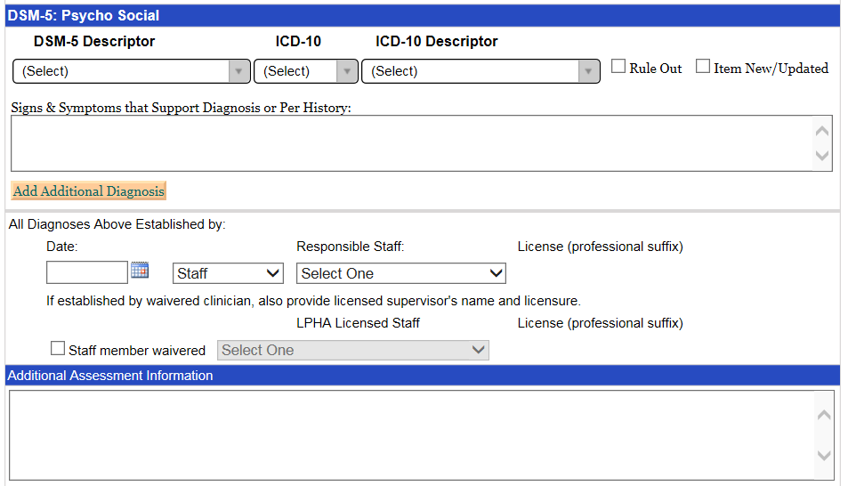
MH Assessment Addendum in Clinician’s Gateway

Slide 59
Mental Health Assessment
Only unplanned services may be claimed prior to the completion of the mental health assessment
Unplanned services include:
  Assessment (includes CANS/ANSA)
  Plan Development
  Interactive Complexity
  Crisis Psychotherapy
  Intensive Care Coordination (ICC) (referral and linkage only)
  Case Management / Brokerage (referral and linkage only)
  Urgent Medication Services only*
  *Record must clearly document services are urgent in order to be claimed

Slide 60
Risk Categories as Identified by DHCS
Each of these areas must be assessed, however only those categories identified as risk to the client need to be documented in the assessment
History of Danger to Self (DTS) or Danger to Others (DTO)
Previous inpatient hospitalizations for DTS or DTO
Prior suicide attempts
Lack of family or other support systems
Arrest history, if any
Probation status
History of alcohol/drug abuse
History of trauma or victimization
History of self-harm behaviors (e.g., cutting)
History of assaultive behavior
Physical impairments (e.g. limited vision, deaf, wheelchair bound) which makes the beneficiary vulnerable to others
Psychological or intellectual vulnerabilities [e.g., intellectual disability (low IQ), traumatic brain injury, dependent personality]

Slide 61
Documenting Risk in the Assessment
When these categories exist for the client, they should be addressed in the MH Assessment
If in the past 90 days there has been suicidal or homicidal ideation or any other significant risk (including above examples) BOTH a Comprehensive Risk Assessment AND a Formal Written Safety Plan must be created and documented in the medical record

Slide 62
CANS / ANSA
The CANS/ANSA is a performance outcome assessment tool.
The CANS/ANSA must be included in the client’s official Medical Record. Completion of this form in the CANS/ANSA monitoring database does not meet this requirement.
The CANS is used for identifying and prioritizing youth and family actionable needs and useful strengths to inform treatment plans. It provides a framework for developing and communicating about a shared vision and uses youth and family information to inform planning, support decisions, and monitor outcomes.

Slide 63
CANS / ANSA
The current ACBH CANS (96 items) has been modified to come in alignment with the CANS 50 required by the state (areas added but not removed). The changes to the CANS have be made within Objective Arts.
All the CANS/ANSA have been updated to come in alignment with all CANS/ANSA manuals, rating sheets except for the 0-5 version
The 0-5 version of the CANS is in the process of getting updated to come in alignment with all CANS/ANSA manuals, rating sheets

Slide 64
CANS / ANSA
The CANS (0-5, 6-17) ANSA (T, 25+) is completed after the MH Assessment and before (informs) the Client Plan.
  Required timeframes (all based on Episode Opening Date): by 60 days, every 6 months, and at discharge.
For Adults, ANSA
  Required timeframes (all based on Episode Opening Date): by 60 days, every 6 months, and at discharge.
ACBHCS Provider Website/ CANS/ANSA
http://www.acbhcs.org/providers/CANS/cans.htm

Slide 65
CANS / ANSA
The CANS and ANSA are Assessment Tools which may only be completed by the following CANS/ANSA certified individuals:
  Licensed LPHA
  Waivered or registered LPHA
    (if not diagnosing—diagnosis requires Licensed LPHA co-signature).
  Graduate student/trainee in a recognized MH Master’s or PhD program
    (if not diagnosing—may only reference Dx established by a Licensed LPHA, unless meets Scope of Practice requirements for diagnosing).
Please note that MHRS and Adjunct staff may not complete the CANS/ANSA.

Slide 66
CANS / ANSA
The only programs which will be exempt from administering the CANS are those providing ancillary services (such as Medication Clinics, Katie A services, and TBS services) where the child has another SMHS provider who is administering the CANS (usually the psychotherapist).
Several Program Types are exempt from administering the ANSA.
Contact ACBH QA department if you have questions about whether your agency/program is exempt from completing the CANS/ANSA.

Slide 67
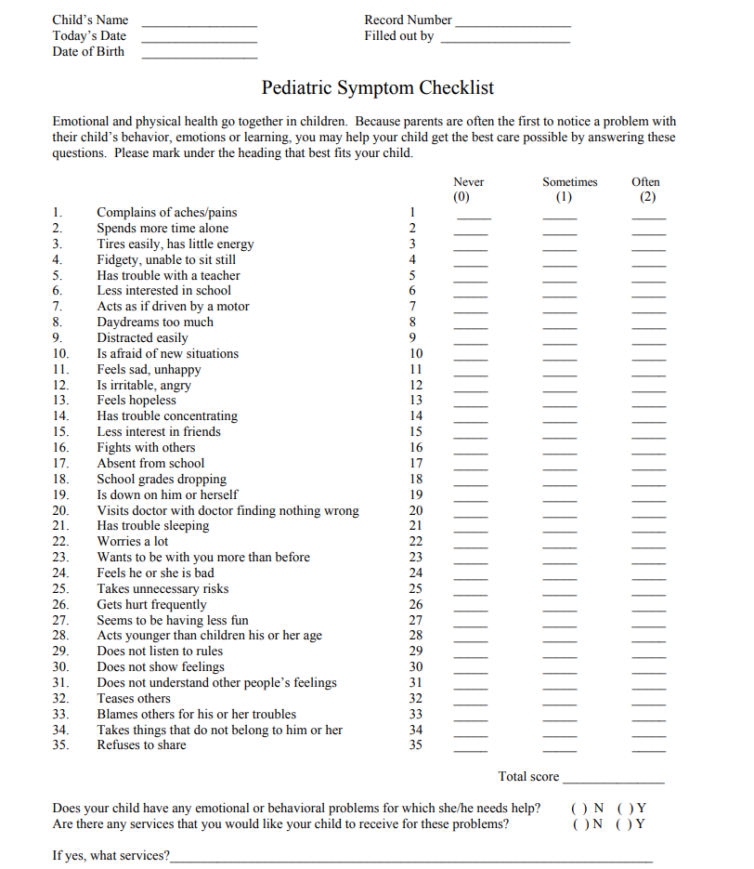
Pediatric Symptom Checklist (PSC-35)
The PSC-35 is a psychosocial screening tool designed to facilitate the recognition of cognitive, emotional, and behavioral problems so appropriate interventions can be initiated as early as possible. Parents/caregivers will complete PSC-35 (parent/caregiver version) for children and youth ages three up to age eighteen.
Implementation Date: July 1, 2018
The PSC-35 should be offered and completed by 60
days, every 6 months, and at discharge.

Slide 68
PSC-35
The PSC-35 does not require training because it is
completed by the parent/caregiver. For more
information about the tool, including implementation, scoring and clinical utility, please visit the Pediatric Symptoms Checklist webpage at:
http://www.massgeneral.org/psychiatry/services/psc_home.aspx

Slide 69
PSC-35
Once the PSC-35 has been completed by parents/caregivers, the results should be entered into Objective Arts and a copy of the form must be included in the Medical Record.
Time spent inputting the PSC-35 into OA is not a billable activity.
Time spent reviewing the PSC-35 for the first time is a billable assessment activity or as medically necessary.
If client’s caregivers need help completing the PCS-35, time spent reviewing and completing the questions with the client’s caregivers is a billable assessment activity.
  Indicate in the progress note what barrier prevented the caregivers from completing the PSC-35 on their own and what interventions you did.

Slide 70
Medical Necessity & Assessment Review
What are the only services that may be provided before completion of the Assessment and Client Plan?
  Assessment (with & w/o medical component, & behavioral eval)
  Plan Development
  Crisis Intervention
  Crisis Stabilization (in CSU only)
  Case Management and ICC (linkage and referral only)
  Urgent medication services
When must an agency’s chart go to CQRT for authorization and Quality Review purposes?
  Initially and Annually. We recommend that CQRT happen after the Assessment and Plan are completed, but before their due dates. This gives the clinician time to address any concerns identified in the assessment or plan before the authorization due date. This helps to preserve billings.
  All Charts must be reviewed for authorization before 60 days, and before the annual due date.

Slide 71
Medical Necessity & Assessment Review Cont.
What are the three requirements for Medical Necessity?
  An Included Dx which is the Primary Focus of Tx
  A Qualifying Impairment
  A Qualifying Intervention
When must a client be screened with the Brief Screening Tool
  Before starting treatment and annually
What are the usual due dates for the MH Assessment and Client Plan?
  60 days
Who may complete (and sign a MH Assessment) and formulate a Dx, but requires co-signature for the Dx?
  Waivered or Registered LPHA, qualified 2nd year MH graduate students, and certain nursing staff (see Guidelines for Scope of Practice Credentialing for requirements)
Who may not formulate a Dx and as well requires a Licensed co-signature on the Assessment?
  1st year Graduate trainee/students

Slide 72
Client Plans
Step 2 of the Golden Thread

Slide 73
Introduction to Client Plans
Client Plans outline the goals and objectives of treatment based upon the diagnosis, areas of functioning, and medical necessity
Selected services address identified mental health needs, consistent with the diagnosis that are the focus of the mental health treatment.

Slide 74
Getting Ready to Write Plan with Client
Established Medical Necessity
Completed Assessment with required co-signatures
Completed CANS/ANSA
Completed PSC 35
Documented the need for case management in the Assessment if considering providing case management services
Consider completing a comprehensive risk assessment and safety Plan if you have assessed any risk factors within the past 90 days and including an objective related to containment
Consider addressing any cultural, linguistic, physical limitations in Plan

Slide 75
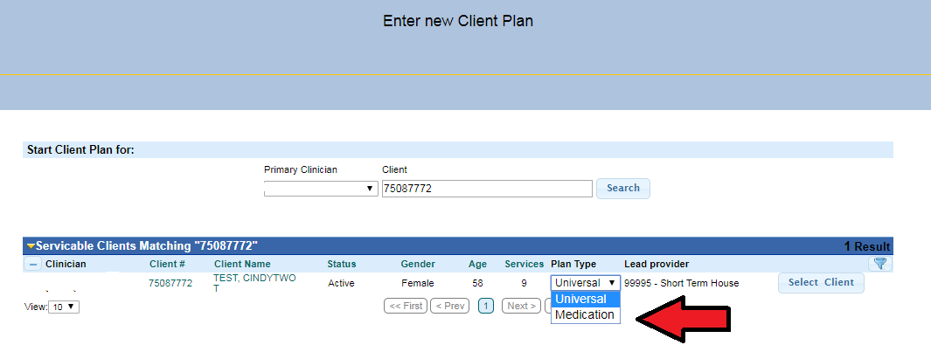
Client Plans
CG currently has two Treatment Plan Templates, “Universal” and “Medication”

Slide 76
Medication Client Plans
“Medication” Treatment Plans Automatically Complete The Modality and Intervention Section of the Treatment Plan and should be used by Medication providers providing Medication only Services;
Or when Medication providers wish to have a separate treatment plan in addition to the “Universal” treatment plan.

Slide 77
Scope of practice for plans
All staff with appropriate training and experience may complete plans.
Trainee, MHRS & Adjunct Staff require Licensed co-signatures.
If medical provider prescribes to the client, they must co-sign.

Slide 78
Planned Services
An approved Client Plan must be in place prior to service delivery for the following Specialty Mental Health Services:
  Planned Mental Health Services: Individual, Group, and Family Psychotherapy; Individual and Group Rehabilitation; Collateral; and Medication Services.
  Intensive Home Based Services (IHBS)
  Monitoring activities of Intensive Care Coordination (ICC)
  Monitoring activities of Targeted Case Management/Brokerage
  Therapeutic Foster Care
  Therapeutic Behavioral Services (TBS)
  Day treatment intensive
  Day rehabilitation
  Adult residential treatment services
  Crisis residential treatment services
  Psychiatric Health Facilities
  Psychiatric Inpatient Services

Slide 79
Client Plan - Cycles
Treatment Plans are due initially (within 60 calendar days of episode opening date—EOD is day 1) and on an annual basis. The cycle must be in sync with the Episode Opening Date (EOD).
Every subsequent Treatment Plan is due on a 12 month cycle, completed within the 30 day period prior to the first day of the EOD month.
      Example: EOD 8/18/18, then the Initial Plan is due: 10/16/18
      The 2nd treatment plan is due by 8/1/19 and to be completed no earlier than 7/1/19.

Slide 80
Programs with Earlier Plan Due Dates
  Day Treatment Intensive / Day Rehab - first billed day, signed (or co-signed) by LPHA and client (or reason client refused)
  Adult Residential / Crisis Residential / Psychiatric Health Facility Services – 72 hours (actual count) signed (or co-signed) by LPHA and client (or reason client refused)
  Psychiatric Inpatient Services - 72 hours (excluding Sat. & Sun) signed by MD and client (or reason client refused)
  TBS Services – Prior to any TBS claiming

Slide 81
Interim Assessments to Allow Earlier Development of Treatment Plans
If staff/programs do not have enough time to complete full Mental Health Assessments (with all required elements) before completing a treatment plan, an Interim Assessment can be completed.
An Interim Assessment must include the essential medical necessity components:
  A current included (“covered”) diagnosis
  Signs and symptoms of the Diagnosis that meet DSM criteria
  Functional impairments as a result of that diagnosis
  Level of impairment
  Client’s ability to benefit from treatment
An Interim Assessment does not meet Medi-Cal requirements for a full completed assessment. A Full assessment with all required elements must be completed by the due date.

Slide 82
Interim Assessments and Treatment Plans
Programs that determine it is clinically indicated to provide certain planned services before they are able to complete a full assessment (Example: Want to get client into a group therapy session within the first week), may complete both an interim assessment and treatment plan to allow for those planned services.
  Any treatment plan must always have the required Medi-Cal documentation components.
  Any treatment plan that is informed/created by an Interim Assessment will usually need to be rewritten after the full assessment is complete.

Slide 83
Programs with Different Time Requirements
Type of Program | Interim Assessment Due Date | Treatment Plan Due Date (a full or Interim Assessment must be completed before TP is completed) | Full Mental Health Assessment (With All components)
Day Treatment Intensive | 1st Day | 1st Day | By Day 7
Day Rehabilitation | 1st Day | 1st Day | By Day 7
Adult Residential Treatment Services | 72 Hours | 72 Hours | By Day 7
Crisis Residential Treatment Services | 72 Hours | 72 Hours | By Day 7
Psychiatric Health Facility Services | 72 Hours | 72 Hours | 72 Hours – Actual Count
(Acute) Psychiatric Inpatient Services | 72 Hours | 72 Hours | 72 Hours – excluding Saturday and Sunday

Slide 84
Client Plan - Goals
The Client Goals are the long-term hopes of the consumer and/or caregiver/parent. Goals should focus on their personal vision of recovery, wellness, and the life they envision for themselves.
You may include optional Long Term Mental Health Goals which support the Client Life Goals by linking them to the specific MH Objectives.
Invaluable for client engagement and buy-in to services.
Providers assist the client in developing the short term Mental Health objectives to the client’s long term goal which are targets of interventions.
Notes:
The objectives developed should relate back to the client’s long-term mental health goals or life goals. The objectives will help the client accomplish their long term goals. In their words is ok. Give an example of in a client’s own words.

Slide 85
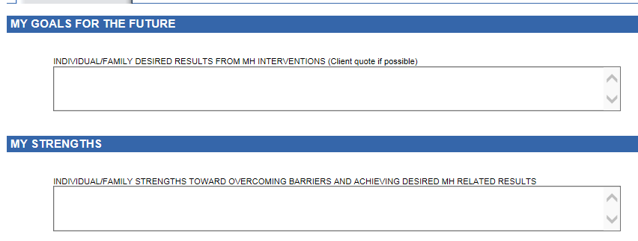
Client Goals in CG

Slide 86
Impairments/ Area of Challenges
Impairments of Functioning in Daily Life
Indicate Area of Challenges: Community Life, Family Life, Safety School/Education, Vocational, Independent Living (ADL’s), Health, Housing, Legal, SUD, Food/Clothing/Shelter, etc.
Indicate Level of Challenges
  Moderate or Severe (remember to rate accordingly if documenting to a Significant Impairment in an Important Area of Life Functioning for Medical Necessity).
Describe Specific Functional Impairments related to MH Diagnosis’s Signs & Symptoms.
  For Case Mgt, must indicate need for C/M service, i.e. ct. is homeless. Also, must indicate (1) which severe Symptoms/Impairments resulting from MH Diagnosis that prevent client from accessing/maintaining needed services, or (2) for child that the lack of such services (caretaker not providing) exacerbates child’s MH symptoms/impairments.

Slide 87
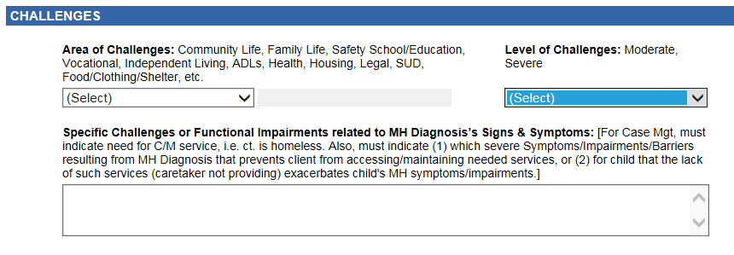
Impairment / Area of Challenges in CG

Slide 88
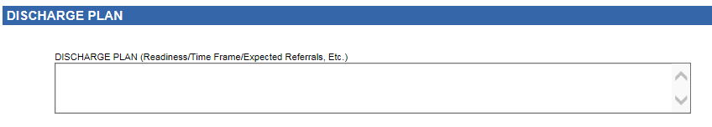
Discharge Plan
If unknown treatment duration, describe criteria (readiness) that would indicate client could successfully transition to a lower level of care with possible referrals and discharge plan.
“Long Term Client w/o Discharge Expected”
Is never a discharge plan

Slide 89
Client Plan – Mental Health Objectives
  SMART (Specific, Measurable, Attainable, Realistic and Time-Bound)
  All Plan Objectives Must Be Mental Health Focused (not housing, employment, SUD tx, etc.)
  Address symptoms, behaviors or impairments identified in the assessment
  Strength based objectives replace problematic Sx with positive coping skills/behaviors/etc.

Slide 90
Creating a Mental Health Objective
  Consider the client’s Diagnosis.
    Example: Bipolar II F31.81
  Identify with client which symptoms/behaviors/impairments that are associated with the client’s primary diagnosis they would like to work on.
    Example: “Diminished ability to think or concentrate nearly every day.” Note: It helps to use the criteria from the DSM 5.
  Ask the client to estimate the number of times that symptoms and/or behaviors happen on a daily, weekly, or monthly basis?
    Example: Client reports that client experiences difficulty concentrating on tasks on a daily basis because they worry that they are going to start a depressive episode or not be able to manage mood swings.
  Ask the client how many times they want the symptoms/behaviors/impairments to decrease. Encourage the client to set realistic numbers.
    Example: Client will reduce the number of times that they experience difficulty concentrating on tasks from 7 days a week to 4 days or less.
  Develop a way to measure the change.
    Example: …as evidenced by client report.
  Develop a time frame.
    Example: … in the next 12 months.

Slide 91
Examples of Mental Health Objectives
Example of an objective to reduce an impairment/symptom:
  In the next 12 months, client will reduce the number of times that they experience difficulty concentrating on tasks from 7 days a week to 4 days or less as evidenced by client’s self report.
  Example of a strength based objective to increase positive behavior:
  In the next 12 months, client will increase the number of times that they use positive coping skills when they have difficulty concentrating from 1 out of 10 times to 8 out of 10 to times as evidenced by clients daily journal.

Slide 92
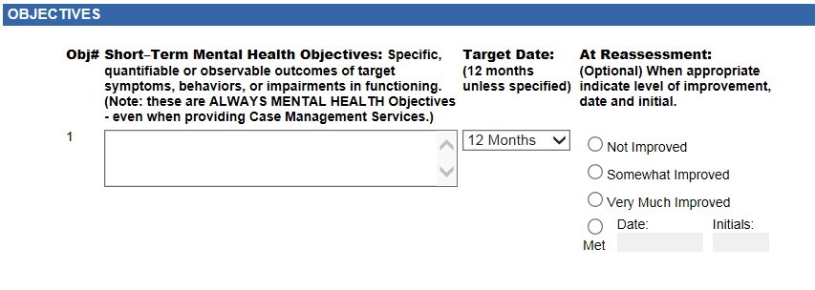
Objectives in CG
CG default is 12 month timeframe

Slide 93
Client Plan – Service Modalities
  Identify the proposed type(s) of service modalities to be provided along with a proposed frequency and duration.
  If a planned service modality is not in the client plan it MAY NOT BE CLAIMED and will be disallowed.
      Example:
      Individual Psychotherapy 1x per week, and as needed, for 12 months
      Case Management 1x per month, and as needed, for 12 months
      Group Therapy 1x per week , for 12 months
      Collateral 1x per month, and as needed, for 12 months.
      Adding “AND as needed” to the frequency of the service modality allows flexibility in the scheduling—however “as needed” alone will not suffice for frequency of modality and “or as needed” IS NOT ALLOWED. Both would result in Disallowances.
  Unplanned services do not need to be listed in the plan.
    Note that monitoring activities of ICC and Case Management / Brokerage are considered planned services and must be listed in the plan

Slide 94
Services Modalities
Service Modalities to be listed in the Client Plan with Common Frequencies and Timeframes:
Collateral (Includes: Collateral, Collateral-Caregiver, & Collateral-Health Care Provider) – Weekly and as needed, for 12 months
Case Management (Planned F/U Services) – Weekly and as needed, for 3 – 12 months
Medication Services (NON-URGENT)– Monthly and as needed, for 12 months
Individual Therapy – Weekly and as needed, for 12 months
Individual Rehabilitation – Weekly and as needed, for 12 months
Group Psychotherapy – Weekly for 12 months
Group Rehabilitation – Weekly for 12 months
Family Therapy – Weekly for 12 months
Collateral Family Counseling – 2x month and as needed for 12 months
Multi-Family Group Therapy – Weekly for 12 months
Collateral Family Group – Weekly for 12 months
TBS – Weekly and as needed, for 3 – 12 months
ICC – Weekly and as needed, for 3 – 12 months
IHBS – Weekly and as needed, for 3 – 12 months
Child Family Team (Katie A. Coordinators only) - Weekly and as needed, for 3 – 12 months
Day Rehabilitation (1/2 or Full Day) – Daily, for 6 months
Day Treatment Intensive (1/2 or Full Day) – Daily, for 6 months
Psychological Testing (Includes Psych Test, Developmental & Neuropsych) – Weekly and as needed, for 3 months
Adult Residential – Daily for 6 – 12 months
Crisis Residential – Daily for 3 – 12 months
Crisis Stabilization – Daily for 3 months

Slide 95
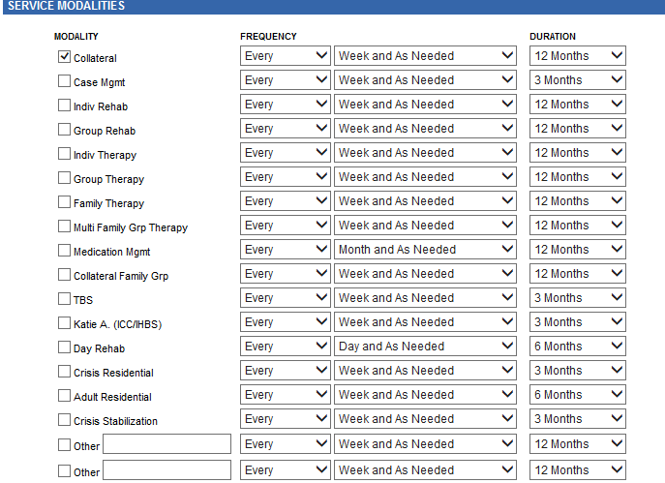
Service Modalities
Select all service modalities to be provided. Any additional service modalities require a Plan Update (along with client’s signature).
Frequency & Duration are pre-populated in CG, but use the drop down menu to adjust to client’s specific needs.

Slide 96
Detailed Interventions
For each service modality it is best practice to include a detailed description of interventions to be provided.
    must focus upon and address the identified functional impairments as a result of the mental disorder.
    must be consistent with the client plan mental health objectives and the qualifying diagnoses.
    For Collateral they should include listing significant others (by names and/or roles) for whom contact is planned and indicating “and others as needed”.
Notes:
For collateral best practices is to list the individuals name and or role. May also need to get an ROI.

Slide 97
Detailed Interventions
General enough to be inclusive, but specific enough to be illustrative
Examples:
  Individual Rehab:
    “Assist the client in re-engaging in pleasant social activities through the use of an activities chart in order to address the impairment of having lost all interest in previous enjoyable social activities as a direct result of her symptom of anhedonia of her Major Depression.”
    “Teach and reinforce active problem-solving skills in order to increase client’s self-efficacy in order to address the impairment of poor self-esteem which is a direct result of her Major Depression.”
    “Help the client to identify early warning signs of relapse, review skills learned, and develop a plan for managing challenges (WRAP tools) in order to help prevent the relapse of depressive symptoms.”
  Collateral:
    Contact with significant support persons of client including parents, teacher and school counselor (others as needed) to assist client in meeting his/her MH Goals and Objectives.
  Med Services:
    Med Mgt. strategies to engage client in collaboration to find, and optimize the dosage for effective anti-depressive medications.

Slide 98
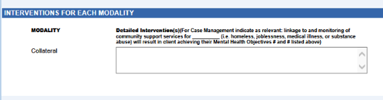
Detailed Intervention in CG
Detailed Interventions are required for each Modality

Slide 99
Developing Client Plans to Include Case Management Services
  If Case Management Services (Brokerage/ICC) will be provided, the Detailed Interventions section of the plan, should document the following:
  Successful case management (linkage and monitoring) is expected to result in the client’s mental health symptoms being reduced and client’s mental health objectives being achieved.
    Specific community resources that client will be linked to should be identified and documented.

Slide 100
Treatment Plan Required Signatures
Once a treatment plan is signed by all required clinical staff (including supervisor), it is considered finalized and cannot be changed.
All Treatment Plans must also be signed by the client and/or guardian.
  Clinical judgment should be used to determine if it is appropriate to review treatment plans with young children. If appropriate obtain a client’s signature. If not appropriate obtain a client’s guardian’s signature.

Slide 101
Treatment Plan Required Signatures
If the client does not sign or refuses to sign the Client Plan, regular efforts must be attempted to obtain the client’s approval.
  Note the issue on the client signature line in the Client Plan with a reference to a Progress Note. Then elaborate in the Progress Note the rationale or reason why a signature was not obtained, and when the next attempt will occur.
If the client’s mental health symptoms (such as paranoia caused by schizophrenia) prevent client from reviewing and signing the treatment plan and it is determined that ongoing attempts are not clinically appropriate, this must be documented in a progress note and the unsigned treatment plan should reference this note.
If a client does not sign a treatment plan due to unavailability (such as client no-showing to an appointment) future attempts must be made to obtain the client’s signature. Unavailability (without other mental health mitigating factors) is not a reason to stop attempts at obtaining signatures on treatment plans.

Slide 102
Required Signature Dates on Treatment Plans
All required staff signatures on Treatment plans require dates of signatures.
  Treatment plans are considered effective once a form is finalized (and can not be altered) and the required staff signatures are present on the document.
Client signatures do not require a date to indicate when it was signed.
  It is best practice to have clients date their signature
  If a client does not date their signature, a provider may add the date and include their initials.

Slide 103
Exceptions to Signature Requirements
A beneficiary’s signature on the treatment plan is not required when:
  The client is not expected to be in long term treatment (beyond 60 days)
  Is only receiving one Specialty Mental Health Service (modality)
    Currently, the only ACBH programs claiming one modality are Medication Services and TBS
    Remember that Collateral is considered a modality
    Note that even if one these exceptions is met, it is highly recommended that the client sign their plan.

Slide 104
Participation in Creation of Treatment Plan
The clinical record must document the client’s participation in the development of the plan, agreement with the client’s plan, and that the client was offered a copy of their plan.
  The client’s signature on the plan alone DOES NOT meet these requirements
This information may be documented in progress notes and/or in the body of the treatment plan itself.

Slide 105
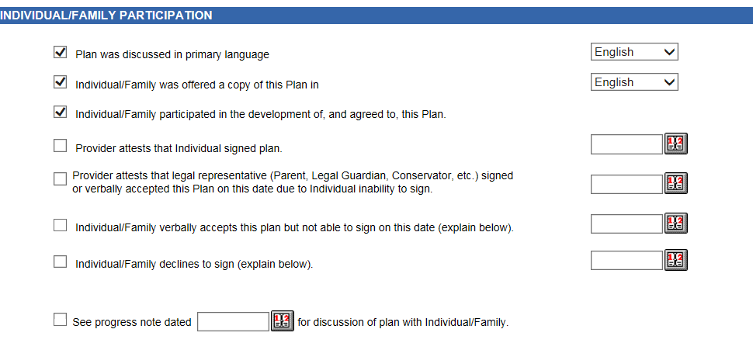
Plan Participation
  Individual/Family Participation attestations self-populate in CG. Please check and uncheck as appropriate.

Slide 106
All Client Plans—Signatory Requirements
On the CG Plan these comments are above the Client Signature Line. If client refuses to sign that must be indicated and all that apply below are addressed in the PN.

Slide 107
Updating Client Plans
Providers MUST be attentive to the need to update changes in the treatment plan through-out the year. DHCS (and QA) will disallow notes if the treatment plan has not been updated to reflect new client goals, mental health objectives, and events in the client’s life.
    Examples of events requiring a change to the Treatment Plan include, but are not limited to: hospitalization, new thoughts or behaviors of self-harm or dangerousness to others, additions of new service modalities (i.e. medication services, case management, group rehab, individual therapy, etc.)

Slide 108
MH Plan Example #1:
Impairment: Inability to maintain housing/placement
Billable example:
Dx: Major Depressive DO (lack of interest in all areas of life, low energy, insomnia, indecisiveness, feelings of worthlessness, and poor self-care)
Impairments include Client’s inability to participate in daily activities and to complete tasks including securing and maintaining housing due to: his severe symptoms of Major Depression of diminished interest and pleasure in daily activities, low energy, insomnia, indecisiveness, feelings of worthlessness and poor self-care.
Goals: Client states: “I want my own place to live”.
Long Term MH Goal: Decrease depression symptomology, and increase coping, so that client’s depressive signs and symptoms do not negatively impact his ability to meet his life goals.

Slide 109
MH Plan Example #1:
Impairment: Inability to maintain housing/placement cont.
Billable example cont.:
Mental Health Objective(s):
1) Client currently experiences overwhelming feelings of depression (feelings of worthlessness and low energy) all day 6 days per week. The number of days that client gets overwhelmed by depression will decrease from 6 days per week to 3 days or less in the next 12 months.
2) Client’s depressive symptoms are reduced as evidenced by an increase in sleep from 2-3 hours per night to 6-8 hours per night by 6 months;
3) Client reports being overwhelmed (due to low energy, disorganized planning, depressed mood) and reports that they only complete weekly living activities/tasks 25% of the time. Client will increase completion rate of daily living activities to 50% or more for the next 3 – 12 months. Client will keep a journal or task list to help measure their success.

Slide 110
MH Plan Example #1:
Impairment: Inability to maintain housing/placement cont.
Billable example cont.:
Service Modality:
  Psychotherapy 1x/week, and as needed, for 1 year;
  Case Management 1x/week, and as needed, 6 – 12 months;
  Group Rehab 1x/week for 6 months
Detailed Interventions:
  Psychotherapy – CBT to help client link feelings of worthlessness to depressive symptoms, to explore roots of low self-esteem and areas of competence.
  Group Rehab – build client’s awareness to track and manage depressive symptoms, teach coping skills such as relaxation techniques, and build client’s skills to successfully overcome low energy and complete tasks.
  Case Management – Successful linkage and monitoring/providing support to client to maintain needed housing community support services will decrease client’s depressive symptoms. Client is currently very sad and depressed about their living situation and linking client to housing support services should significantly improve clients symptoms.

Slide 111
MH Plan Example #1: Impairment: Inability to maintain housing/placement cont.
Non-billable example:
Mental Health Objective: Client will obtain stable housing within 6 months; temporarily living with a friend. (Not a MH Objective)
Service Modality: Case management 1x/week and as needed for 1 year
Detailed Interventions: Case management - Case manager will work with client to apply for housing and assist client in filling out necessary forms. Case mgt is not acting as a housing support specialist—but is linking to and monitoring client’s participation in such services.

Slide 112
Client Plan Review
May Collateral services be claimed before completion of the Client Plan?
  No
Name three reasons that all PLANNED services may be disallowed in a chart:
  Assessment not done Initially and Annually
  Client Plan not done Initially and Annually and when Clinically Indicated—or not signed by Provider and Client/Representative
  Service Modality not listed in Client Plan (Case Management, Collateral, etc.)

Slide 113
Review Questions
When must the CANS/ANSA be completed?
  After completion of the MH Assessment and before completion of the Client Plan
  At initial 6 months (based on episode opening)
  Every Annual authorization
  At discharge.
What is the Authorization Cycle for a case that is opened on August 23rd?
  August 1st – July 31st each year.
When a Case Management need arises before completion of the MH Assessment and/or Client Plan may it be claimed as such?
  Only if it for the purposes of Referral and Linkage
When must all services of a certain type (i.e. Ind Rehab) be disallowed across the whole chart (episode of care)?
  When the service modality is not listed in the Client Plan.
Notes:
For

Slide 114
Sharing Assessments and Treatment Plans
Agencies with multiple RUs that share a medical record are allowed to share one mental health assessment and treatment plan for concurrent services.
  Example: If a client is receiving therapy services in one RU, and begins to receive medication services in a different RU, both RUs/providers may share the Assessment and Treatment Plan.
  Open each RU with the date the client was first opened at the agency
Any documentation that is in need of updating must be addressed within the agency
  For example, informed consent must be completed when new modalities are added to the plan
  Multiple RUs within an agency may decide to share a plan or create separate plans. Adding an additional modality will always require an update to the treatment plan.

Slide 115
Sharing Assessments and Treatment Plans
If multiple RUs (in one agency) do not share a chart, all shared documentation must be copied into each chart. This includes documents from the initial Episode Opening Date Such as:
  Screening Form (with associated progress notes.)
  Informing Materials (with associate progress notes.)
  Mental Health Assessments (with associate progress notes.)
  CANS/ANSA (with associate progress notes.)
  Client Treatment Plan (with associate progress notes.)
  Release of Information (with associate progress notes.)
For BHCS county owned and operated programs, “one agency” is considered one program which has a unique folder in the Laserfiche database.

Slide 116
Sharing Assessments and Treatment Plans
For Initial Assessments Only
If a full assessment has been completed for a client it is possible for providers to use this assessment and update it under the following circumstances:
Full Assessment Completed within the same agency in last 12 months.
Full Assessment Completed by another agency in the last 6 months.

Slide 117
Sharing Assessments and Treatment Plans
To use a previously completed Assessment, the following should occur:
  A Copy of the Assessment should be placed into the chart
  The Assessment should be reviewed with the client to assure accuracy
  An Assessment Addendum must be completed that includes:
    Interim History
    Any changes in all of the areas of the MH Assessment Previously collected
    A current included diagnosis
    Signs and symptoms of the Diagnosis that meet DSM criteria
    Functional impairments as a result of the diagnosis
    Level of impairment
    Client’s ability to benefit from treatment.

Slide 118
Progress Notes
Step 3 Of The Golden Thread
Notes:
Fix this slide

Slide 119
Progress Notes
Describe how services provided address the:
  Reduction of the impairment(s)
  Restoration of functioning, and/or
  Prevention of significant deterioration in an important area of life functioning as outlined in the client plan.
Document both direct services (therapy) provided to clients as well as indirect (completing an assessment form or treatment plan).
Must be done prior to submission of a claim
  Best practice to complete same day/within one working day, and must be designated as “late note” after 5 working days.
May combine different types of services e.g., combining individual rehab and collateral in a single note (indicate service code for the predominant service).
    Claim to the lowest paid service (i.e.. Case Management when combined with any other service), or if all services are claimed at the same rate—claim to the predominant service.

Slide 120
Progress Notes
InSyst 3 digit and/or CPT Procedure Code (or exact name per ACBH) claimed.
Date of Service
FF/Contact Time and Total Time
Telephone contact with a client can be entered into the FF/Contact Time field of CG. You must have the location be phone if you provide services over the phone. Failure to do this can result in disallowance.
Which objective is being addressed.
It is strongly recommended to include travel and documentation time. This helps support the amount of time claimed.
Indicates what language the service was provided in (unless Assessment indicates “client is English speaking and all services will be provided in English”).
Legible Provider Signature with M/C credential and date signed.
  Completion requires finalization of all required signatures.

Slide 121
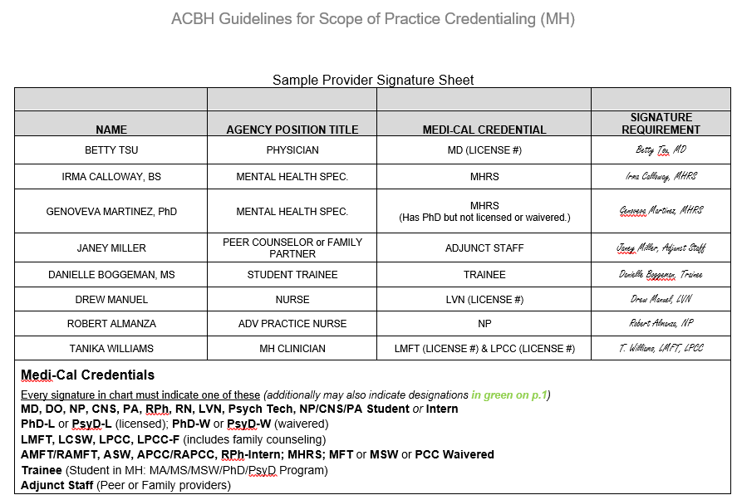

Slide 122
Progress Notes
Quality progress notes are:
  Concise
  Clear
  Cohesive
  Reader-centered
  Written in language anyone can understand
Only use ACBH abbreviations
Always keep in mind that the Clinical Record
belongs to, and is about, the client

Slide 123
P/BIRP Format
  Purpose/Problem/Behavior/Assessment
    Describe the client’s current presentation and reported functioning since last encounter especially in terms of progress towards goals and objectives.
    Identify the purpose of the contact (e.g., to link, assess, plan, provide skill building, provide therapy, etc)
    Illustrate narrative description of the contact – who, what, when, where, and why, and the purpose of the service and/or situation requiring the service.
  Intervention by Staff
    Identify what specific intervention was provided toward the mental health objectives – interventions, and/or linkage to services consistent with achieving client objectives
  Response of Client to Intervention
    Identify client’s response today toward the interventions and impact/progress toward their objectives
  Plan for future services
    Can include collaterals, coordination of care, continue with CBT techniques or any follow up by the provider or client.

Slide 124
Modifying Progress Notes for Case Management Services
In addition to identifying which objective that the Case Management service is targeting for improvement, it is best to also include some version of the following statement:
  “case management service will result in a decrease in MH symptoms of a, b, & c and an increase in adaptive functioning of x, y, & z”
Modifying the P/BIRP Format for Case Management
  “P/B” = Client reported that he believes the government has been monitoring his phone calls and is scared to call the housing authority to put in an application for support. Client has not been able to access housing support services in spite of desire to do so. It is expected that successful case management service to link client to housing support will result in a decrease in paranoid symptoms and an increase in adaptive functioning per objective #2 on the client plan.
  “I” = Called housing provider to initiate referral and provide linkage to needed housing support services. Appointment made and provided to client.
  “R” = Client agreed to make scheduled housing intake appointment and to report back to this provider at our next scheduled appointment.
  P = Client will attend housing intake appointment and will follow up with this writer at next meeting to monitor the appropriateness of the referral.

Slide 125
A Word About Cloning
“This practice involves copying and pasting previously recorded information from a prior note into a new note, and it is a problem in health care institutions that is not broadly addressed …
The medical record must contain documentation showing the differences and the needs of the patient for each visit or encounter …
The U.S. Department of Health and Human Services, Office of Inspector General (HHS-OIG) indicated that due to the growing problem of cloning, its staff would be paying close attention to EHR cloning.”
For more words of caution about EHRs check out this link:
  www.cms.gov/Medicare-Medicaid-Coordination/Fraud-Prevention/Medicaid-Integrity-Education/Downloads/docmatters-ehr-providerfactsheet.pdf

Slide 126

No, not this kind of cloning

Slide 127
Example Progress Note
Procedure Code/Name: 442 Psychotherapy 45 minutes Date of Service: 2/1/17
Location: Office Face to Face Time: 45 Minutes
Total Time: 55 Minutes This service was provided in English
Mental Health Objective # | Objective #3 from the Client Plan
Behavior/Purpose or Problem | Client presents today for individual therapy. Client continues to have sleep problems and negative thoughts due to depression. Client reports sleeping about 3-4 hours per night since our last session. Today client appears tired, flat affect, and depressed mood.
Intervention | Practiced Cognitive Behavioral relaxation techniques with client – visualized tranquil places relaxing to client. Practiced breathing techniques. Replaced negative thought of “I am constantly screwing things up and making mistakes” to “I sometimes make mistakes but it is not all the time and I often do things right.”
Response | Client was able to identify negative thoughts and replace with alternative thoughts. Client had some anxiety but was eventually able to relax and practice breathing techniques and visualization.
Plan | During the next week client will practice new skills before bed and keep track of hours slept per night. Therapist will evaluate success at next session.

Slide 128
Progress Note Review Questions
What are the five components of a Progress Note?
  Linked to a specific MH Objective (state or indicate #).
  Today’s Problem/Behavior/Assessment/Evaluation
  Today’s Staff Intervention
  Today’s Client’s Response to Intervention
  Plan for f/u, homework, additional services, etc.
Would an auditor allow a PN that repeated the Staff’s MH Intervention almost verbatim from the previous encounter?
  No
What are the M/C Credentials that must always be used when signing a PN or other document in the Medical Record?
  Medical Providers:
    MD, DO, NP
  Licensed LPHA Clinicians:
    PhD-L, PsyD-L, LCSW, MFT, LPCC, LPCC-F
  Waivered/Registered LPHA Clinicians
    PhD-W, PsyD-W, ASW, APCC, AMFT, MSW-W (out of state), PCC-W (out of state)
  Practicum Students in MH approved programs:
    Trainee
  Others:
    MHRS, OR Adjunct Staff

Slide 129
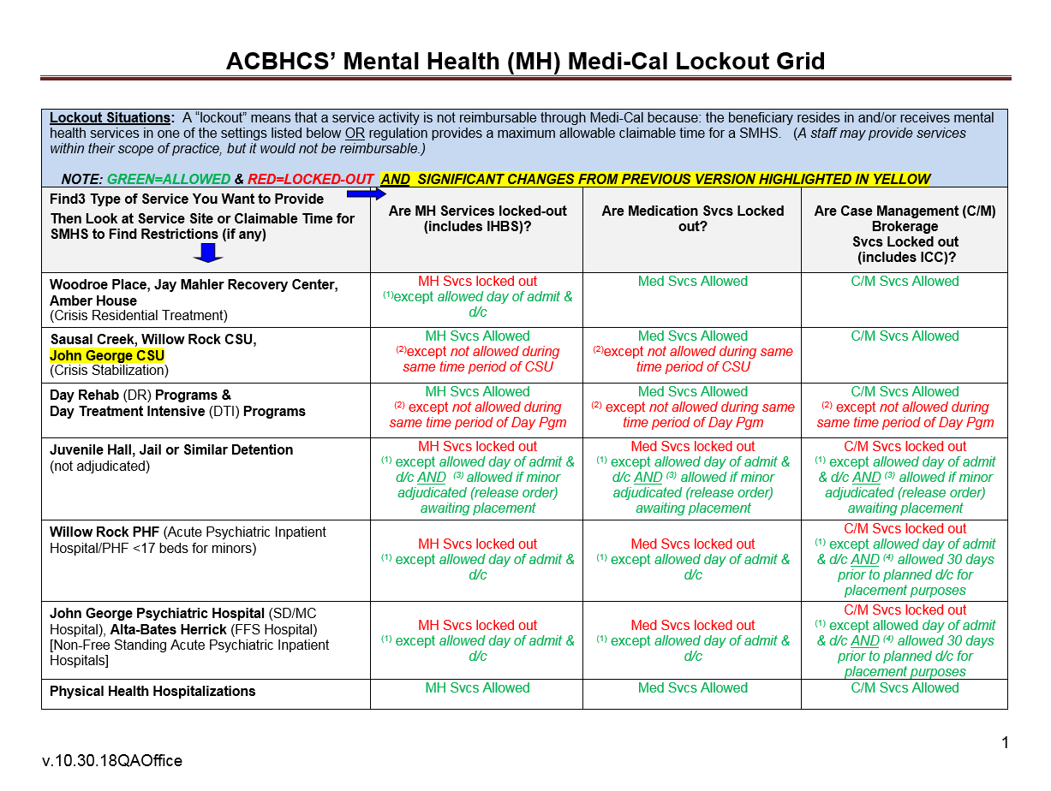
MH Service Lockouts
Lockouts are services that cannot be reimbursed or claimed due to the potential duplication of claim (double billing)
or ineligible billing site.

Slide 130
Non-Reimbursable Services/Activities
No service provided: Missed appointment
Solely transportation of an individual to or from a service
Services provided which included payee related activities (Indicate payee portion of visit in a separate—non-billable service note.)
Services provided which included clerical activities
  Leaving or listening to voice mail, or email, or texting, etc.
Socialization Group
  which consists of generalized group activities that do not provide systematic individualized feedback to the specific targeted behaviors of the clients involved
Translation and/or interpretive services
Activities or interventions that included vocational training, academic education or recreational activities
Calling in/Completing CPS/APS reports.
Writing SSI disability report
Services provided after client’s death.

Slide 131
Record Retention
For all clients, records (paper and electronic) must be maintained for a minimum of: ten (10) years after the last service OR ten (10) years after their eighteenth (18) birthday, whichever is later. (DMH02) As well:
If later, records must also be retained until DHCS does a final cost settlement with ACBH for the FY in which the last date of service occurred. The last cost settlement which has been finalized occurred for FY 07/01/08-6/30/09. The most recent cost settlement will always be found here.
On the date of the ten year anniversary (after no services, or the client’s 18th birthday—whichever is later), the record shall be retained until the then current DHCS contract with ACBH expires. The current contract terminates 6/30/23. The most recent contract termination date will always be found here.
Audit situations: Records shall be retained beyond the ten (10) year period if an audit involving those records is pending, until the audit findings are resolved. The obligation to maintain the records beyond the ten (10) year period exists only if the MHP notifies the Contractor of the commencement of an audit prior to the expiration of the ten (10) year period.
*Given the above extensions beyond the 10 year period it is highly recommended that all providers simply maintain their client’s records for fifteen (15) years after the last service OR fifteen (15) years after their eighteenth (18) birthday, whichever is later.*

Slide 132
Minor Consent, ages 12 – 17 yrs.
Minors aged 12 – 17 yrs of age may consent to their own treatment under Family Code 6924 or Health & Safety Code 124260.
If minor is consenting under Health & Safety Code 124260 – the provider must seek authorization from their QA technical contact to provide the service and thereby ensure that Medi-Cal is not claimed.
If minor is consenting under Family Code 6924– the provider may document as such and serve the client without any additional authorization (if meets necessary requirements).
  However, if the possibility of the caretaker being informed by Medi-Cal that services are being provided is a risk for the client—call QA and explain this so client may be authorized under 124260 instead without risk of the caretaker being alerted to treatment.
For more information:
  www.youthlaw.org
    Search in their website for “Minor Consent”

Slide 133
Updating or Inserting New Emergency Contact Information in INSYST
A Client’s emergency contact information must be entered, and kept updated in Insyst.
------------------
it is recommended each provider have a designated location in their medical record for emergency contacts.

Slide 134
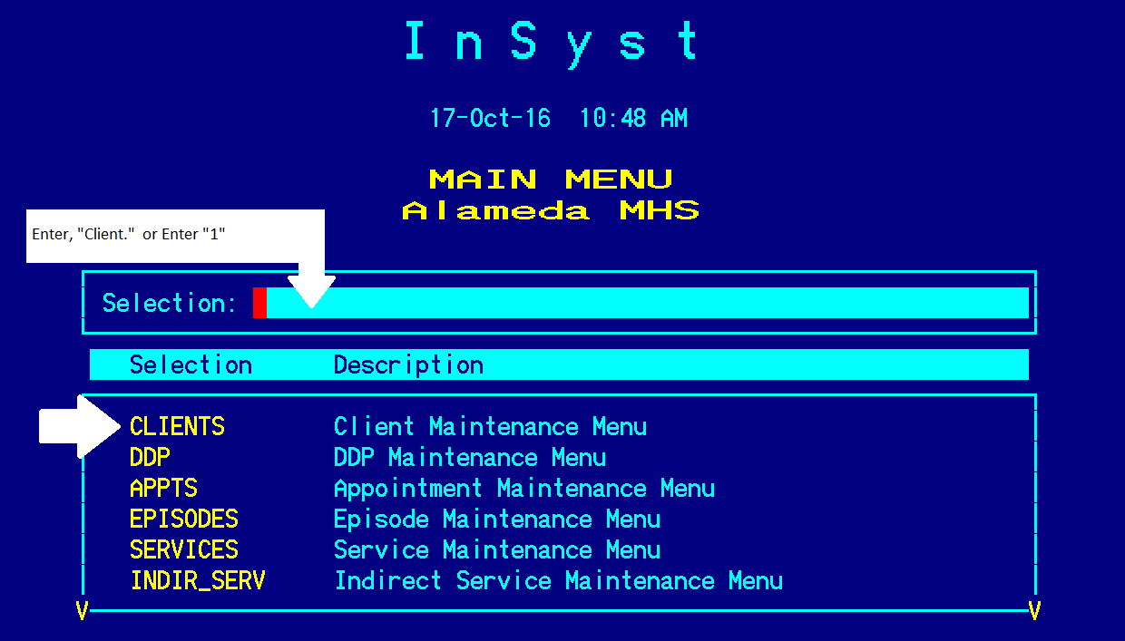
How to Update Emergency Contact Information

Slide 135
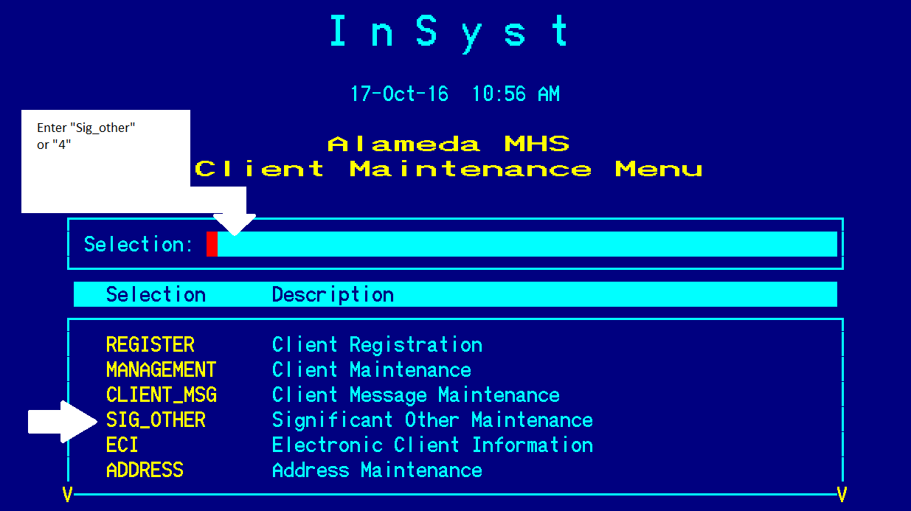
How to Update Emergency Contact Information

Slide 136
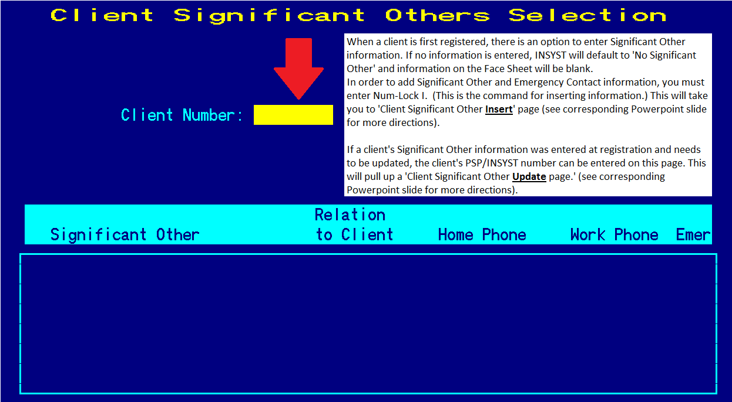
How to Update Emergency Contact Information

Slide 137
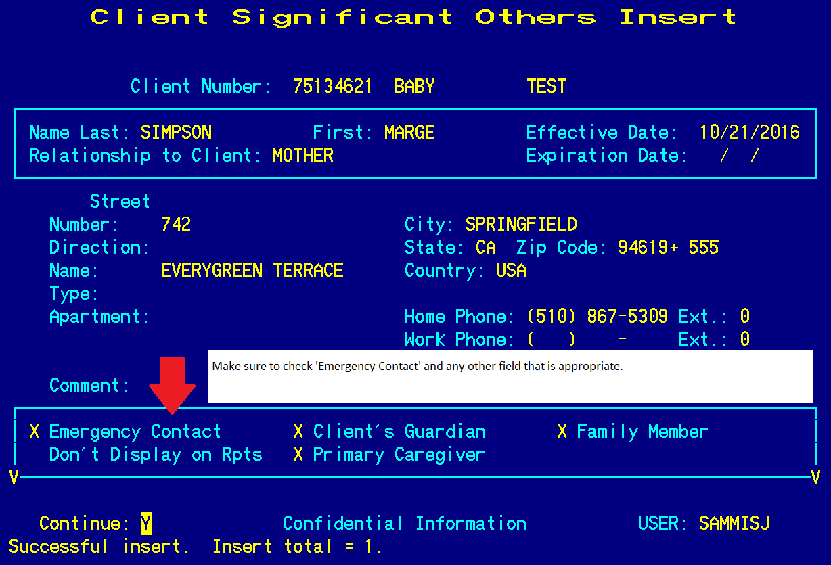
Inserting Significant Other Info if None was Entered at Episode Opening.

Slide 138
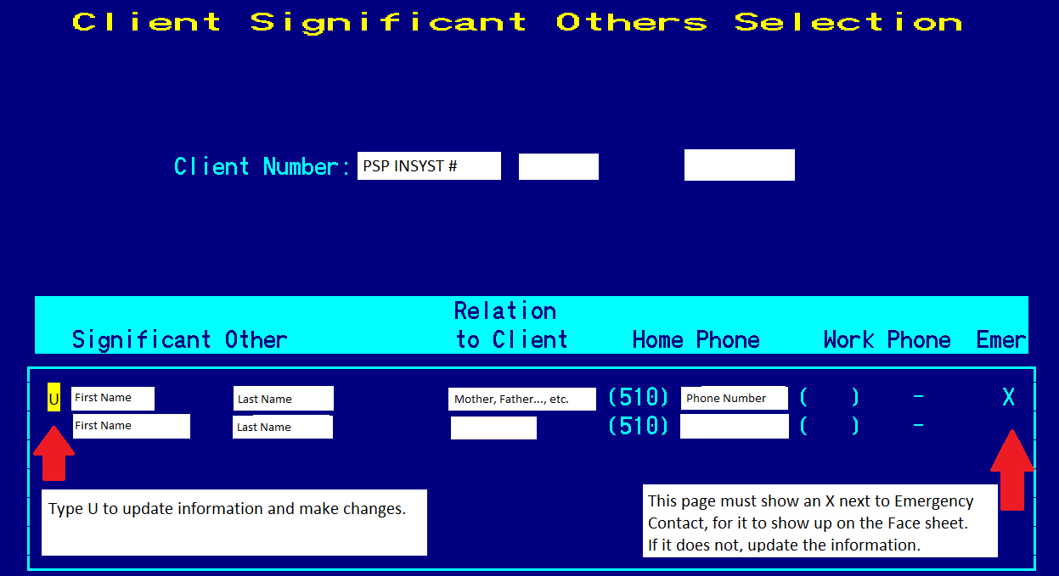
Updating Significant Other Information that has already been entered.

Slide 139
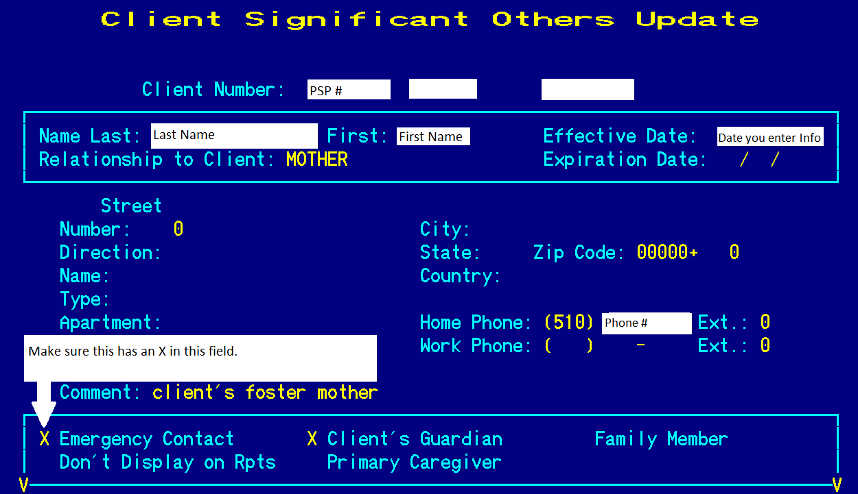
How to Update Emergency Contact Information

Slide 140
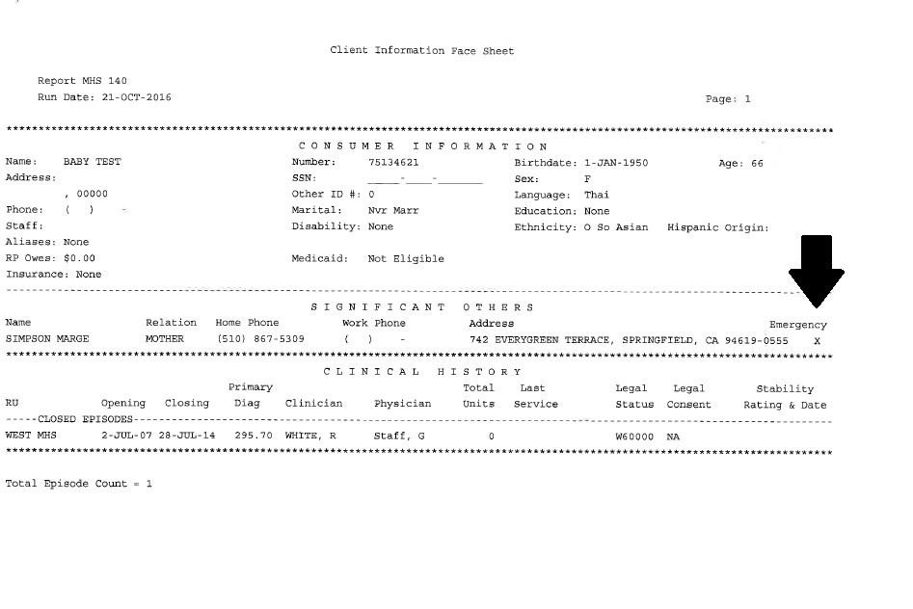
End Result Is a Face Sheet with Emergency Contact Info

Slide 141
Client Messages
The Client Messages screens allow staff to view and write messages pertaining to clients.
The messages are noted on the Locator and Client Message screens, and active Client Messages can be displayed on Morning Report, Report MHS 120 etc.

Slide 142
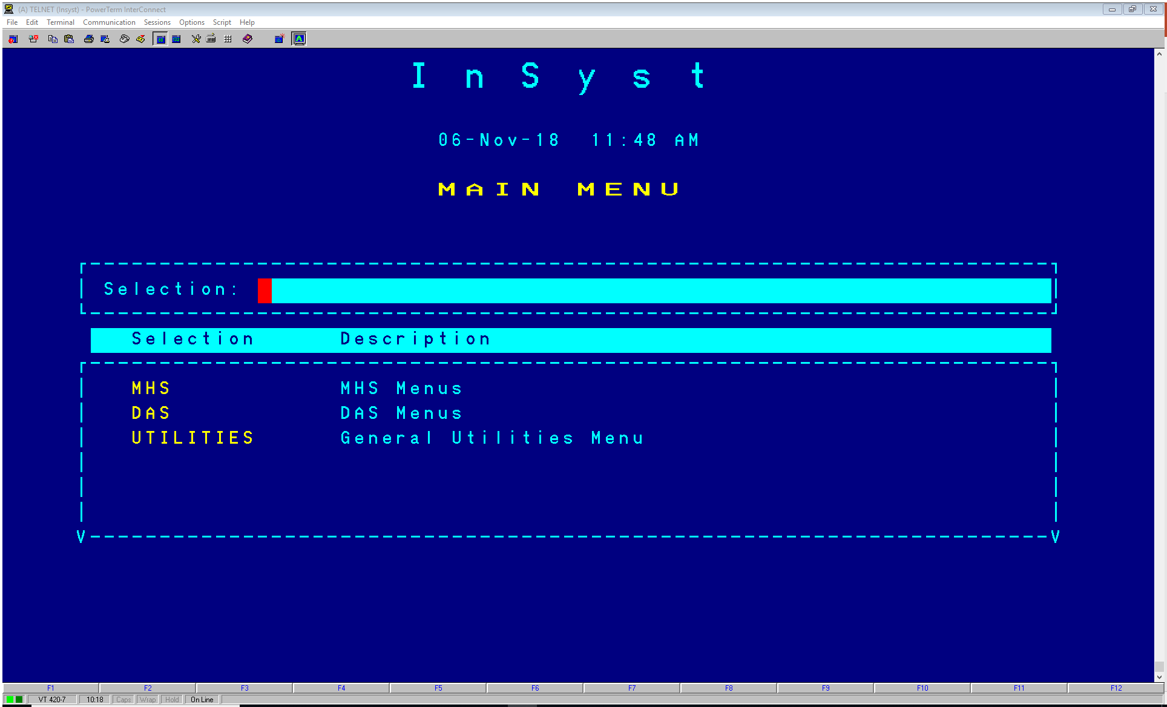
Client Messages
Select MHS or DAS

Slide 143
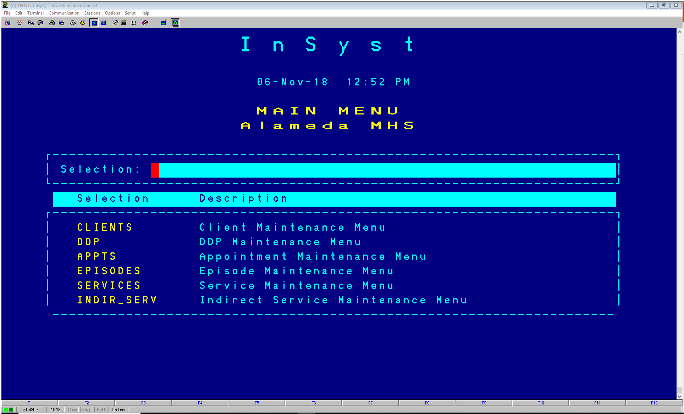
Client Messages
Select CLIENTS

Slide 144
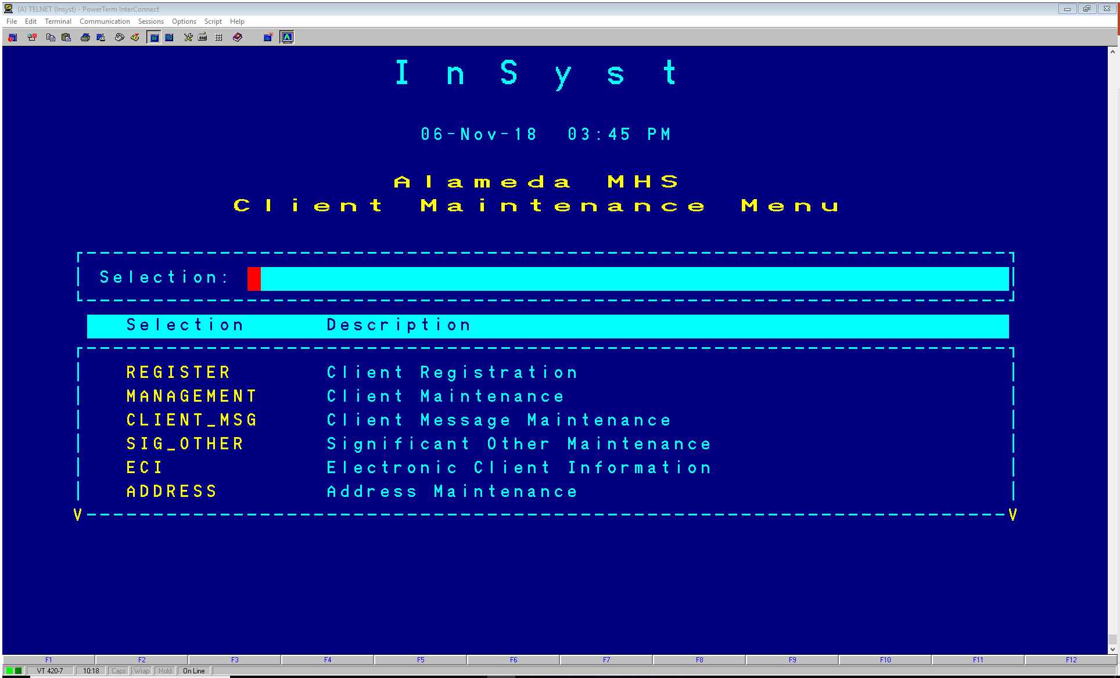
Client Messages
Select CLIENT-MSG

Slide 145
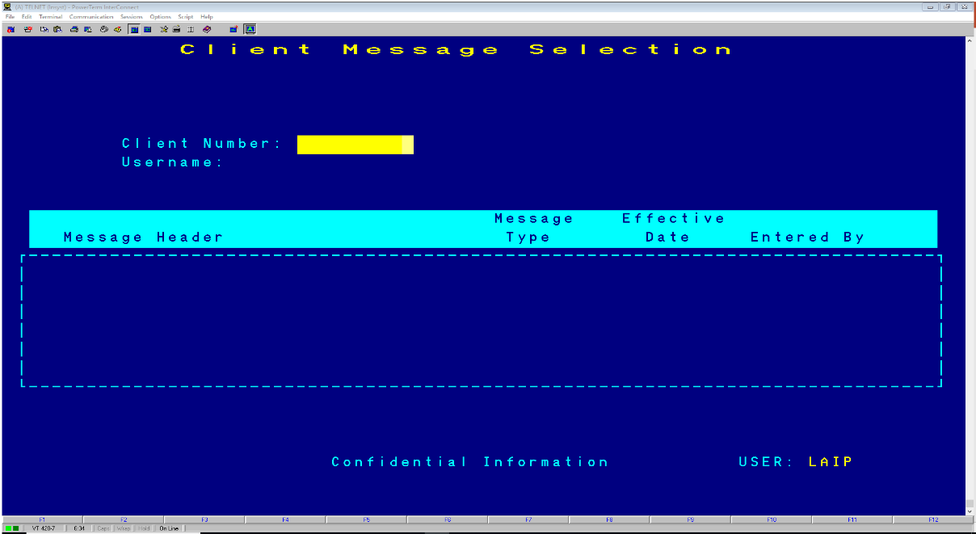
To View Client Messages
Choose CLINICAL from the Main Menu
Choose CLIENT_MSG from the Clinical Menu to display the Client Message Selection Screen

Slide 146
To Enter New Client Messages
When you’re at the Client Message Selection screen Press Num Lock(Gold)-I to insert new messages for a client.
You should see Client Message Insert screen
Enter the following data:
Client: Client number
Message Header: Title for the message
Author: Author of the message
Effective Date: The date the message will appear
Expiration Date: The date the message will no longer
appears as an active message in the Client Locator
Screen. Can blank the field for no expiration date.
Message Type: Type X to indicate the type of messages
(clinical, case management, incident, etc)

Slide 147
To Enter New Client Messages Cont.
Enter “Y” at the Form and OK prompt to record information about your message and to move to the Client Message text editor.
The text editor screen should have the Client Number and Message Header. Then proceed with typing your message. Do not press return at the end of the line, it will automatically move to the next line for you. Press Control/Z when you have completed your message. Press Return to save your message. If you do not want to save your message, erase the word EXIT and replace it with QUIT and press return.

Slide 148
Maintaining Client Messages
Choose CLINICAL from the Main Menu
Choose CLIENT_MSG from the Clinical Menu to display the Client Message Selection Screen
Enter Client Number and/or Username, then press Return
Move the cursor through the list of messages and select the ones you want to maintain by entering “L” (lookup), “U” (update), or “D” (delete) next to them. Then press Return

Slide 149
Message Lookup/Delete/Update
You can search by Client or by Username
Enter “L” and your screen should list: Client, Header, Author etc. Press return to display the message
Type Control/Z to move to the next message or return to the Client Message Selection Screen.
Enter “D” and then enter “Y” to delete the message.
(note: you may only delete your own messages)
Enter “U” and then press Return to display the message in the text editing screen to make changes. Type Control/Z and press Return to save the changes.

Slide 150
HIPAA Resources
42 USC 1395 US Department of Health and Human Services – www.hhs.gov
Office of Civil Rights (enforces HIPAA Privacy & Security Rules) – www.hhs.gov/ocr/privacy/index.html
CA Office of Health Information Integrity (CAL OHII) – www.Calohii.ca.gov
CA Hospital Association- www.calhospital.org (publications include the CHA California Health Information Privacy Manual-2013)
American Psychological Association http://apapracticecentral.org/business/hipaa/index.aspx
NASW: http://www.socialworkers.org/hipaa/
AAMFT: http://aamft.org/iMIS15/AAMFT/Content/Advocacy/HIPAA%20Resources.aspx
American Psychiatric Association: http://psychiatry.org/psychiatrists/practice/practice-management/hipaa
American Counseling Association: https://www.counseling.org/; http://www.counseling.org/docs/private-practice-pointers/meeting_hippa_requirements.pdf?sfvrsn=2

Slide 151
Contact Us:
Contact QA Department at (510)567- 8105 or QAOffice@acbhcs.org
If you feel that you are missing a procedure code that you are contracted for, that should be included in your RU, please call Provider Relations @ (800)878-1313.
For Clinicians Gateway questions, Please contact IS at (510)567-8181.
For questions regarding your agency contract, please contact the Network Office at (510) 567-8296

Slide 152
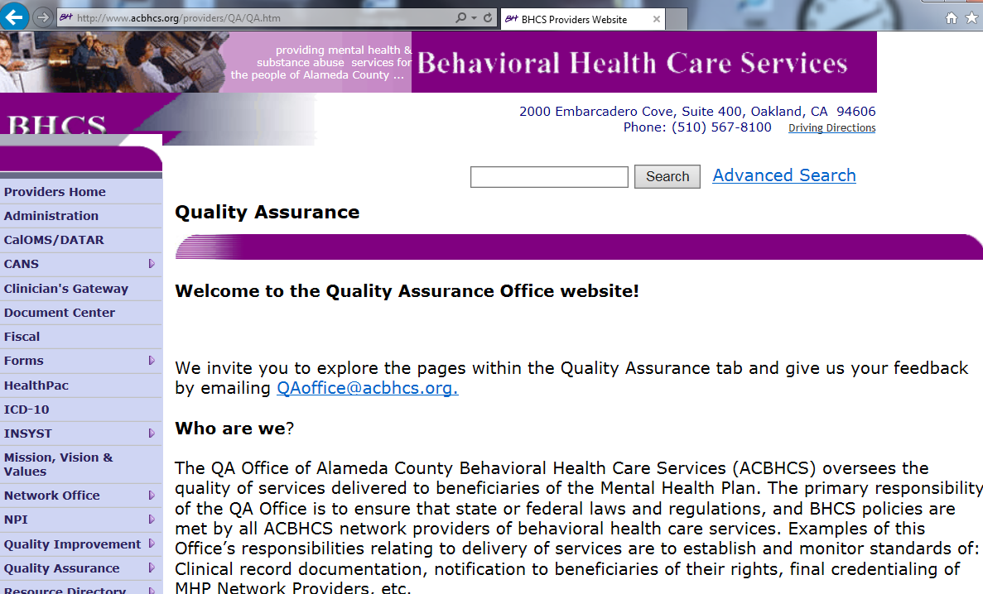
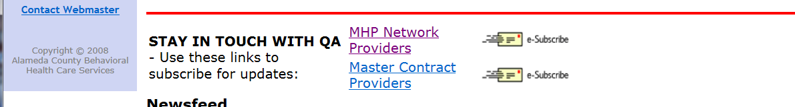

Sign-up for QA Provider Website Updates

Slide 153
Procedure Codes

Slide 154
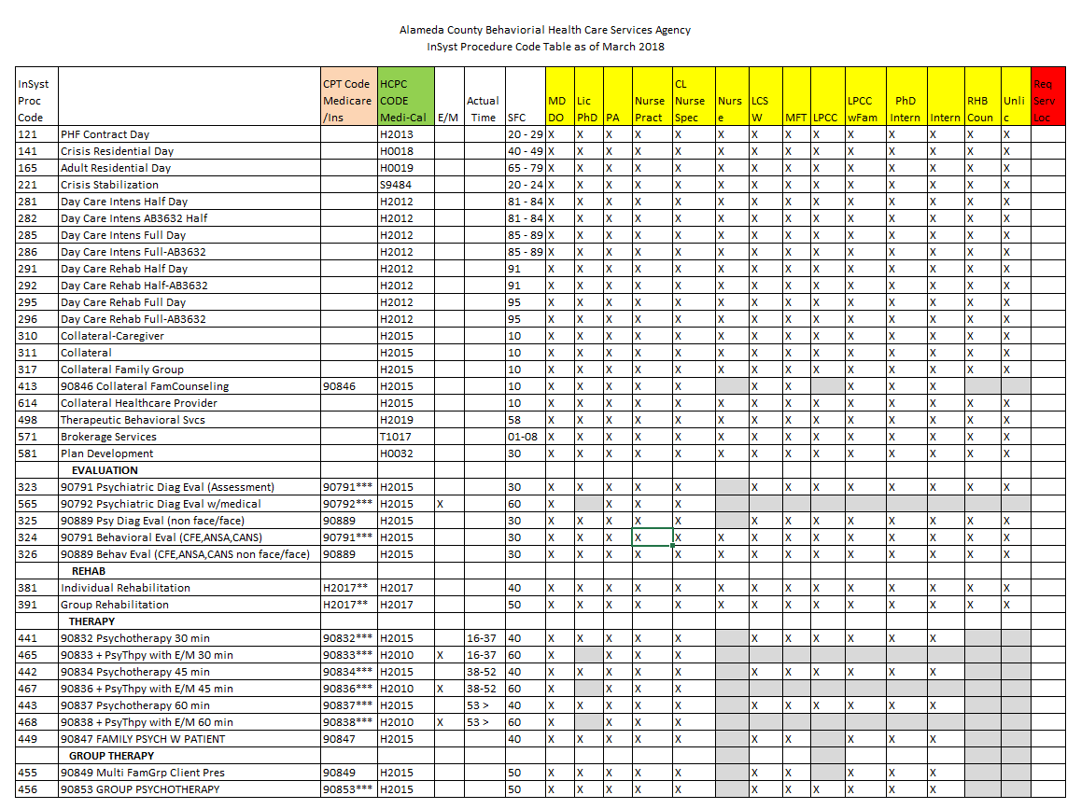

Slide 155
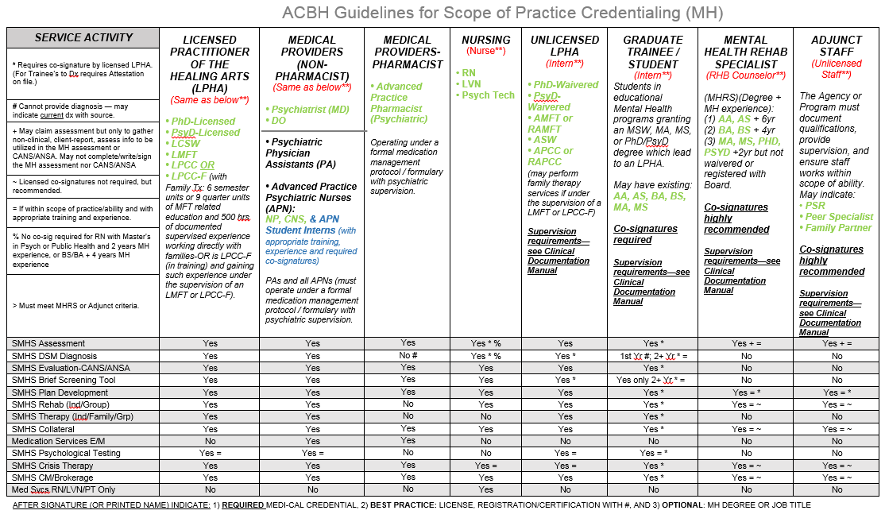

Slide 156
Choosing the Right Procedure Code
Consider whether the service is:
  planned or unplanned
  direct or indirect
Think about the ultimate purpose of the service:
  Discussing a change of mental status to decide whether the treatment plan needs to change (Plan Development)
  Skill building (Individual or Group Rehabilitation)
  Service linkage (Brokerage/Case Management)
Consider who was involved:
  Caregiver (Collateral Caregiver)
  Medical doctor (Collateral Healthcare)

Slide 157

Game Time!

Slide 158
Procedure Codes continued
Assessment Codes
Not a Planned Service—May be Provided when Needed
Evaluate current mental, emotional, or behavioral health. Includes but is not limited to:
  Mental Status, Clinical History, Relevant Cultural Issues, Diagnosis, Use of testing procedures for assessment purposes (i.e. Beck)
  323-90791 – Face to Face Psychiatric Diagnostic Evaluation
  565-90792 – Face to Face Psychiatric Diagnostic Evaluation above with Medical Component—only performed by Medical Providers (MD, DO, APN—CNS or NP, & PA)
  325-90889 Non Face to Face Psychiatric Diagnostic Eval with or without Medical Component
  324-90791 – Face to Face Behavioral Evaluation (Completion of CANS, ANSA-T, ANSA, or approved equivalent)
  326-90889 – Non Face to Face Behavioral Evaluation (CANS, ANSA, etc.)

Slide 159
Procedure Codes continued
Plan Development (581)
Not a Planned Service—May be Provided when Needed
Plan Development is defined as a service activity that consists of development of client plans (with client collaboration), and/or monitoring and recording of a client’s progress towards their mental health objectives.
  Writing Client Plan in Collaboration with Client.
  Plan Monitoring– when considering updating Client Plan given trigger event, change in functioning, etc.
  Meetings with other providers in which they discuss alternative treatments or changes in treatment for client can be billed as plan development.
  Note: Supervision is never a billable service.

Slide 160
Procedure Codes continued
Plan Development (581) Cont.
    Intra-agency/clinic Plan Development only occurs when the Plan is being reconsidered and the writer could not obtain the information from the written record.
    This is not done routinely in-house such as a Case Manager meeting with the MD after she sees the client, or the clinician meeting with the Family Partner after the Partner sees the client/family.
    For example, clinician becomes aware client went off their anti-psychotic medication (historically linked to decompensation and hospitalization) and clinician needs to meet with the psychiatrist to modify the plan to address the issue immediately.
      Both Staff can bill for the full time for these types of plan development meetings.

Slide 161
Procedure Codes continued
Individual (381) or Group Rehab (391)
PLANNED SERVICE—MUST BE IN CLIENT PLAN
Includes Improving, Maintaining, OR Restoring Functional skills, Daily Living skills, Social and Leisure Skills, Grooming and Personal Hygiene Skills, Meal Preparation skills, and Medication Education. The impairments targeted must be a DIRECT result of the included Dx signs, symptoms, or behaviors:
Allowed Example from DHCS:
  “The most common example would be a client with schizophrenia who has social skills deficits which are the direct result of the schizophrenic disorder. Training will focus on social skills development.”
  -John Griffith, PhD, DHCS Consulting Psychologist, email correspondence of 5/20/15

Slide 162
Procedure Codes continued
Individual (381) or Group Rehab (391) Cont.
PLANNED SERVICE—MUST BE IN CLIENT PLAN
Disallowed Example from DHCS:
  Client has Major Depression with symptoms of insomnia, depressed mood, anhedonia, indecisiveness, fatigue, feelings of worthlessness and psychomotor retardation.
  Clinician wishes to address an identified impairment (or skill deficit) of poor ADL’s.
  “In this example , the ‘deficit’—i.e., failure to perform ADLs—is not really a deficit at all. The client KNOWS how to bathe, brush teeth, comb hair, etc.”
  -John Griffith, PhD, DHCS Consulting Psychologist, email correspondence of 5/20/15
  Rehab services could be provided to address the deficits of Major Depression in the areas of: interest in life (anhedonia), self-worth (feelings of worthlessness) and energy (fatigue).

Slide 163
Procedure Codes continued
Collateral (311) *for family engagement use Code 310
MAY ONLY BE PROVIDED AFTER THE COMPLETION OF THE CLIENT PLAN
Services provided to Significant Support person
  Consultation, Training and Psychoeducation of significant support person in client’s life where the
    Focus is always in achieving mental health Objectives in Client Plan—If Plan is not completed, there is no way to do so.
    The provider may be receiving or providing information to the significant support person.
    The client may or may not be present for this service activity.
Definition—Supporting Client Plan by:
  Gathering information from, or
  Explaining results of psychiatric, other medical examinations and procedures, or other accumulated data to family or other responsible persons, or
  Advising them how to assist clients

Slide 164
Procedure Codes continued
Collateral (311) *for family engagement use Code 310
Intra-agency/clinic Collateral does not occur. If necessary, it is most likely Plan Development.
For example, family partner becomes aware client behavior at school has worsened and is at risk of suspension, and therefore needs to meet with the clinician to adapt interventions--possibly resulting in a change to the Plan to address the issue immediately.

Slide 165
Procedure Codes continued
Collateral Caregiver (310)
PLANNED SERVICE—MUST BE IN CLIENT PLAN
For the purpose of supporting and tracking family engagement in clients’/consumers’ treatment.
A service activity provided to a caregiver, parent, guardian or person acting in the capacity of a family member for the purpose of meeting the needs of the mental health objectives.
The client/consumer is generally not present for this service activity.
  If the client/consumer is present, and the service provider facilitates communication between the client/consumer and his/her caregiver(s), a family therapy procedure code is likely more appropriate (if within scope of practice of the provider—not MHRS or Adjunct Staff).
    If the client is present and the focus is on the significant other supporting the client’s MH Objectives—Collateral Caregiver may be used.
    If the focus is on the client’s skill building with caregiver present—Ind. Rehab. May be used.

Slide 166
Procedure Codes continued
Collateral—Family Counseling (413)
(without Client Present)
PLANNED SERVICE—MUST BE IN CLIENT PLAN
DHCS has clarified that Family Therapy can never be claimed if the client is not present.
A new code: Collateral - Family Counseling (413) has been created to use for the following situations:
  A Client fails to show to a scheduled Family Therapy appointment and collateral interventions are provided to the family instead.
  A client’s family needs to be seen (without client) and collateral interventions are provided to prepare them for participation in Family therapy.
  A Client’s family needs to be seen (without client) and collateral interventions are provided to help them participate in family therapy in a more positive manner.
(413) Has the same scope of practice requirements as therapy codes and should never be provided by MHRS or Adjunct staff.

Slide 167
Procedure Codes continued
Collateral Health Care Provider (614)
PLANNED SERVICE—MUST BE IN CLIENT PLAN
Provided to improve the health and wellness of the client through the coordination of care between the behavioral health care provider and the client’s health care provider(s) (physician, physician’s assistant/nurse practitioner, registered nurse, licensed vocational nurse, speech pathologist or audiologist, occupational or physical therapist). This Code should not be used for Coordination of care with psychiatrists (use Collateral 311 for such contact).
Goal of care coordination across healthcare disciplines must be to support the client/consumer in achieving the Mental Health objectives of the client’s/consumer’s Client Plan
Activities may include: gathering developmental and health information, consultation, care coordination, side effects of medication on behavior and/or prescription drug interactions. It may also be used to assess, in collaboration with the medical provider(s), the impact of the client’s chronic health conditions on the behavioral health of the client and their family.

Slide 168
Procedure Codes continued
Collateral Family Group (317)
PLANNED SERVICE—MUST BE IN CLIENT PLAN
Service activity provided in a group setting composed of two or more sets of family members, caretakers or significant support persons in the life of a client in treatment.
Collateral Family Group services may be used in providing psycho-education, resources and skills to family members/significant support persons to assist clients in gaining or re-gaining emotional equilibrium and community and family functioning.
Could be with or without client present.

Slide 169
Procedure Codes continued
Case Management/Brokerage (571)
UNPLANNED SERVICE – for linkage and referral ONLY
PLANNED SERVICE — for follow-up which MUST BE IN CLIENT PLAN
Help clients to access medical, educational, social, vocational, rehabilitative, or other community services that are identified in the Client Plan and Assessment.
Services activities may include, but are not limited to:
  Communication with client & other individuals.
  Coordination of care
  Referrals
  Monitoring service delivery to ensure client’s access to services.
  Monitoring client’s progress toward making use of services.
MH Plan must document need for case management due to severe impairment due to MH Dx that results in client being unable to make and maintain other community service referrals (Adult), or without such services Child’s MH Sx and Impairments would be exacerbated. Must also document, successful C/M is expected to decrease MH Sx’s and Impairments. See prior slides for these documentation requirements.

Slide 170
Procedure Codes continued
Katie A (578, 577, 557)
The 578 Code (CFT-ICC) is to be claimed by the clinician coordinating and leading the meeting for the amount of the meeting time only. (The coordinator should use the 577 Code for any time spent including planning, coordinating, plan monitoring, needs assessment, and preparing outside of the meeting time).
The 577 Code (ICC) is to be claimed for all other participants (other than the coordinator) for the time he or she contributed to the meeting, up to the length of the meeting, plus documentation and travel time.
The 557 Intensive Home Based Services (IHBS) are services that consist of skill-based interventions; development of functional skills; development of skills or replacement behaviors that are provided to child or youth that allow the child or youth to participate in the CFT.

Slide 171
Procedure Codes continued
Psychotherapy Codes
PLANNED SERVICE—MUST BE IN CLIENT PLAN
A psycho-therapeutic intervention that focuses primarily on symptom reduction/behavioral change as a means to improve functional impairments. May be delivered to an individual or group and may include family therapy.
Must be performed by Licensed/Registered/Waivered LPHA or MH Trainee
Individual: (441/442/443)
  May use +491-90785 for Interactive Complexity
Family: (449) (May only be WITH Client present.)
  NOTE: Prior Family Psychotherapy Without Client Present (413) is
    NOW Collateral—Family Counseling
Multi-Family Group: (455) (May only be WITH Client present.)
  provided to more than one family, each with at least one enrolled client present.
  Note: Multi-Family WITHOUT Client Present is now renamed as Collateral-Family Group
Group : (456)
  May use +491-90785 for Interactive Complexity

Slide 172
Individual Psychotherapy: Choosing the time based on
Face to Face Time Spent in Session
Always choose code based on the exact number of f-2-f minutes.
    Documentation time & Travel Time will be included in Total Time and therefore reimbursed.
    Contact with client’s by phone may be entered as face to face time, but the location of such service must be Location = phone. If any other location is claimed, the service will be disallowed during audit.

Slide 173
Selecting the Code for Individual Psychotherapy
Individual Psychotherapy:
Time Based Code: (441/442/443)
Code selected based on the time of the time spent with the client.
Procedure Code: Therapy | CPT Code | Typical Time Period (minutes) | Actual/F-F Time (minutes)
441 | 90832 | 30” Psychotherapy | 16-37”
442 | 90834 | 45” Psychotherapy | 38-52”
443 | 90837 | 60” Psychotherapy | 53”-beyond

Slide 174
Procedure Codes continued
Prorating Group Services
PLANNED SERVICE—MUST BE IN CLIENT PLAN (see exceptions in Clin Doc Manual)
Group Rehabilitation: 391, Collateral Family Group: 317 (usually provided by Family Partners),
Group Psychotherapy: 456,
& Multi-Family Group Psychotherapy With Client Present : 455
Prorated Requirement:
  When claiming for services in a group setting, time claimed must be prorated for each client represented within the Progress Note:
    List all staff present with justification for their presence
    List the number of clients present
    Include the number of all clients regardless of they are being claimed to ACBH/Medi-Cal/etc.
    List total time of group service, total documentation time, and total travel time. See specific examples for time breakdowns of different scenarios.
    INSYST will calculate the billable time per client

Slide 175
Prorating Group Services, Example 1
1 Clinician Provides Group therapy to 6 clients:
Suppose 1 clinician sees 6 clients (all Medi-cal eligible) in a group for 60 minutes. After the group it takes the clinician 10 minutes each to write 6 progress notes (1 for each client.)
  You must indicate in the PN: 6 group participants
The clinician would enter the following into a progress note.
Face to Face time: 60 Documentation time: 60 Total time: 120 Group count 6
INSYST will divide 120 (total staff time) by 6 (number of clients/charts) and pay you 20 minutes for each billing/progress note.
Once you do 6 billings/progress notes (1 for each client in the group) you are paid 20x6 = 120 minutes.
  Therefore, in the end, you get paid for the full amount of time that it took you to provide face to face service and complete the documentation.
Notice how in each progress note the documentation time is 60 minutes—not the 10 minutes doc time for that client. This is because that number will get divided by the number of clients in the group. So in this case you will get paid 10 minutes.

Slide 176
Prorating Group Services, Example 2a
2 Clinicians Provide Group therapy to 6 clients:
You have three options on how to bill/document this.
  Option 1: Both clinicians can do their own progress notes/billings for all clients.
    Each Clinician would write a progress note (PN indicates interventions that the writer did) and bill:
    Face to Face time: 60 Documentation time: 60 Total time: 120 Group count 6
    This is the easiest and suggested method for billing/documenting when more than one clinician is running a group.
    Each clinician would indicate their own interventions and need for a co-staff.
    Two separate entries into InSyst.

Slide 177
Prorating Group Services, Example 2b
2 Clinicians Provide Group therapy to 6 clients:
Option 2: One clinician can write the progress notes for all clients (in this case the writer indicates all group interventions—not just their own) and add a co-staff billing time to account for the other clinician’s time.
  The one clinician would write a progress note and bill for each client:
  Primary Staff: Face to Face time 60 Documentation time: 60 Total time (Primary Staff): 120
  For Co-staff group time indicate: 60 (The co-staff time field is not present in InSyst until the RU for the service is entered.)
  Group count 6
  Notice that the co-staff time did not get entered into Total time. The Co-staff time acts like a secondary total time field for the 2nd staff. Since the second staff didn’t do any progress notes, they only billed for their face to face time.
  When there is a second facilitator always indicate the clinical reason why such as: “A second clinician needed to address and individual client’s crisis outside of the group 1:1 while the other clinician continues with the group.”

Slide 178
Prorating Group Services, Example 2c
2 Clinicians Provide Group therapy to 6 clients:
Option 3: One clinician can write the progress notes for some of the clients and the co-staff writes the notes for the remainder of the clients. The other clinician would write a progress note for the remainder of the clients:
Staff 1 (writes PN for three of the clients):
  Primary Staff: Face to Face time 60, Documentation time: 30, Total time (Primary Staff): 90 (Only total time entered into InSyst).
  For Co-staff group time indicate: Face to Face time 60 Documentation time: 30 Total time (Co-Staff): 90 (Only total time entered into InSyst).
  Group count 6
Staff 1 (writes PN for the other three clients):
  Primary Staff: Face to Face time 60, Documentation time: 30, Total time (Primary Staff): 90 (Only total time entered into InSyst).
  For Co-staff group time indicate: Face to Face time 60 Documentation time: 30 Total time (Co-Staff): 90 (Only total time entered into InSyst).
  Group count 6
Note, data entry into InSyst for this process will soon be changing—watch for memo. However, there will be no change in the clinical documentation charting.

Slide 179
Add-On Codes (+)
Add-On (+) codes describe additional services provided within a service. They are added to select, primary codes and demonstrate an enhanced service.
Add-on (+) codes are never used as stand alone codes
Add-on codes are designated by a + sign
Added time increments (crisis therapy)
Added service (interactive complexity or psychotherapy)

Slide 180
Crisis Codes
Crisis Therapy (formerly, Crisis Intervention)
(May be performed for such crisis activities by staff that their training and experience allows.)
A service lasting no more than 8 hours (total for all providers) in a 24-hour period: Immediate response to client’s acute psychiatric symptoms in order to alleviate problems which, if untreated, would present an imminent threat to the client, others, or property.
Only use when the client is at imminent risk for danger to self/other and/or gravely disabled. The purpose is to stabilize the client.
Service activities include but are not limited to one or more of the following: Medication Support Services, Assessment, Collateral, and Therapy.

Slide 181
Crisis Add-on Codes: Time Ranges
Codes Used | Based on Face to Face time
377 | 30-75 minutes (Add Doc and Travel Time Here.)
377 + 378 | 76-105 minutes (60 + 16 – 45)
377 +378 +378 | 106-135 minutes (60 + 30 + 16 – 45)
377 +378 +378 + 378 | 136-165 minutes (60 + 30 + 30 + 16 – 45)
377 +378 +378 +378 +378 | 166-195 minutes (60 + 30 + 30 + 30 + 16 – 45)

Slide 182
Crisis Add-On Codes:
Additional Time Spent for Crisis Therapy.
  377-90839 is used for the first 30-75”
    Add all other time (documentation, travel, etc.) to the 377 code.
  378-90840 is used for each additional 16-45”
  If an additional 378 is needed the earlier 378 indicates 30” and the balance (16 – 45”) moves down to the next 378.
  The final 378 includes the actual remaining minutes of f-f time (if 16 minutes or greater).
    If 15 minutes or less—do not add another 378: just add it to the 30” of the final 378 code
Notes:
Look at Procedure code time period handout now

Slide 183
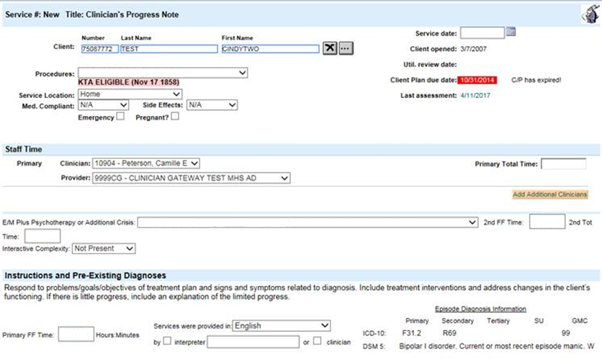
Crisis Therapy Add-On Code
Fill out applicable areas

Slide 184
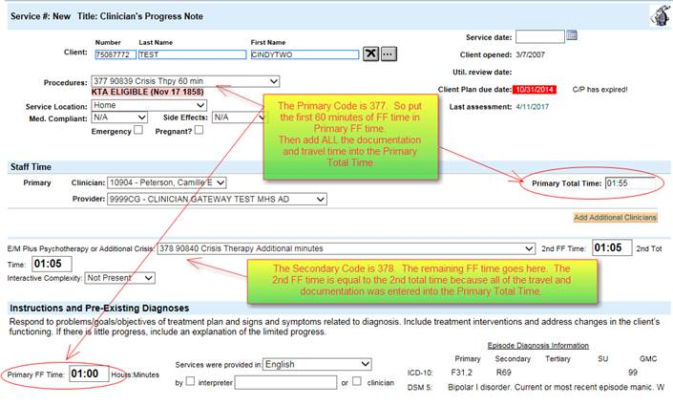
Add-On - Crisis Codes 377/378
For CG Users Example Explained
Notes:
The really tricky part is that they can use up to 75 FF minutes with code 377, but if they go beyond that, then the code 377 FF time must be dropped back to 60 minutes. Code 377 takes 31 – 75 minutes if it is used without any additional 378 time.

Slide 185
Add-On Code for Additional Service Provided: Interactive Complexity +491-90785
Refers to one or more, of 4 specific communication factors during a visit that complicate delivery of the primary psychiatric procedure (individual psychotherapy/group psychotherapy/assessment):
  The need to manage maladaptive communication.
  Caregiver emotions or behaviors that interfere with implementation of the treatment plan.
  Evidence or disclosure of a Sentinel Event and mandated reporting to a 3rd party with initiation of discussion of the event.
  Use of play equipment to overcome barriers to diagnostic or therapeutic interaction.
    This does not include routine play therapy

Slide 186
Add-On Code for Additional Service Provided:
Interactive Complexity +491-90785 cont.
Documentation Requirements:
  Indicate the specific type of communication complication (see four on previous slide).
  Document the specifics of the communication difficulty.
Can only be used with these codes:
  323-90791 & 565-90792 Psychiatric Diagnostic Evaluation.
  441-90832, 442-90834, 443-90837 Ind. Psychotherapy
  456-90853 Group Psychotherapy (for the specific client)
Cannot be used with Crisis Therapy, Family Therapy, or with E/M Codes.

Slide 187
Interactive Complexity (+) 491-90785
Add-on in InSyst & CG
Select primary procedure code and indicate minutes (into InSyst or Clinician’s Gateway) as previously described.
Select Interactive Complexity Add-on Code (no associated minutes).
  InSyst, Select code 491-90785 and enter one (1) minute
  Clinician’s Gateway, Select “Interactive Complexity: Present”

Slide 188
Medication Support Services
May be provided by Medical Providers (MD, DO, NP)
Medication Support Services may include, but are not limited to:
  Evaluation of the need for medication;
  Evaluation of clinical effectiveness and side effects;
  Obtaining informed consent;
  Medication Education
  Instruction in the use, risks, and benefits of and alternatives for medication;
  Assessment of the client
  Collateral and Plan development related to the delivery of the service and/or
  Prescribing, administering, dispensing and monitoring of psychiatric medications

Slide 189
Medication Support Services cont.
Contact and Site Requirements
  Medication Support Services may be either face-to-face or by telephone with the client or with significant support person(s)
  May be provided anywhere in the community
  469-90862 for Medication Management has been eliminated.

Slide 190
Evaluation and Management (E/M) Codes
Two Methodologies for charting:
  Coding by the Elements—see QA Training Website for resources.
  Counseling and Coordination of Care:
    Make up the great majority of client medication support services in Community Mental Health.
    See slides below and QA Training Website for additional resources.
Notes:
CPT codes rule the rest of the medical world

Slide 191
Evaluation and Management (E/M) Codes
When “Counseling & Coordination of Care” exceeds 50% of face-to-face time, the E/M Code is selected on the basis of the face-to-face service time.
If “Counseling & Coordination of Care” was less than 50% of the face-to-face time, the E/M Code must be selected based on the complexity of the visit.
  Refer to E/M Clinical Documentation Training
  E/M Training Materials:
    http://www.acbhcs.org/providers/QA/training.htm
    Scroll down to “Training Handouts & Resources”
Notes:
CPT codes rule the rest of the medical world

Slide 192
E/M Codes: when >50% of f-f time is Counseling & Coordination of Care
The majority of E/M services provided in Community Mental Health involve >50% of face-to-face time which is spent performing Counseling (aka in psychiatry as Supportive Psychotherapy) and Coordination of Care services.
    Especially extended visits such as 645—99214 & 646-99215
Psychiatrists often label what the CPT defines as “Counseling” as supportive psychotherapy.
The components of “Supportive Psychotherapy” are usually considered as overlapping with “Counseling” (as defined by CPT) and should not be claimed as E/M + Add-on Psychotherapy .
Such interventions are claimed as “Counseling and Coordination of Care” as part of the E/M visit. Claim E/M only.
Notes:
CPT codes rule the rest of the medical world

Slide 193
E/M Codes: when >50% of f-f time is Counseling & Coordination of Care
Documentation:
  Outpatient--Indicate Face-to-Face time (Inpatient—Indicate Unit Floor Time).
  Indicate Counseling and Coordination of Care time.
    Or at least statement: “Counseling and Coordination time was greater than 50% of face-to-face time.”
    Start and end times also recommended.
    Example:
      646-99215; F-F time = 50”: start 13:00 and end 13:50;
      Counseling and Coordination of Care time = 40”
      Doc time = 8”; Total time = 58”
  List the content topics of Counseling and Coordination of Care discussed & provide a detailed description of discussion of each content topic documented.
Notes:
CPT codes rule the rest of the medical world

Slide 194
E/M Codes: when >50% of f-f time is Counseling & Coordination of Care
Indicate Content Topics of Counseling
    Diagnostic results, prior studies, need for further testing
    Impressions
    Clinical course, prognosis
    Treatment options, medication issues, risks and benefits of management options
    Instructions for management and/or follow-up
    Importance of compliance/adherence with chosen management options
    Risk factor reduction
    Client education and instructions
Notes:
CPT codes rule the rest of the medical world

Slide 195
E/M Codes: when >50% of f-f time is Counseling & Coordination of Care
Coordination of Care:
    Services provided by the medical provider responsible for the direct care of a client when he or she coordinates or controls access to care or initiates or supervises other healthcare services needed by the client.
    outpatient coordination of care must be provided while face-to-face with the client (or family).
Provider must detail and thoroughly document what was discussed for each content topic covered
  E.g. for Compliance/Adherence discussion:
    “20 minutes of 25 minutes face-to-face time spent counseling re: the importance of medication compliance with mood stabilizer for bipolar disorder. Explored impact of when client went off her medications—including recent 5150 and involuntary hospitalizations…”
Notes:
CPT codes rule the rest of the medical world

Slide 196
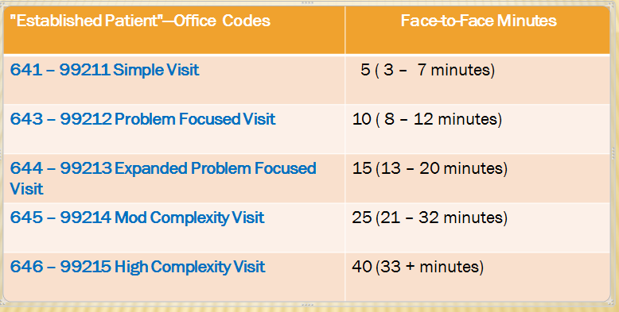
E/M Codes: when >50% of f-f time is Counseling & Coordination of Care
Notes:
CPT codes rule the rest of the medical world

Slide 197
Medication Support: RN/LVN/Psych Tech only (369)
This procedure code was developed for RN’s and LVN’s who provide medication management but who cannot bill Medicare. This code is for Medi-Cal billable only. Maximum claim limit of 4 hours (240 minutes) per day
  This code should be used when doing medication injections and providing medication support
    Face-to-Face and Non Face-to-Face
  The expectation is that time spent would be 15-30 minutes. If service is provided beyond 30 minutes, the documentation must support that level of service.
  RN, LVN, Psych Tech’s may exclusively use this code for all services they provide.

Slide 198
Medication Support: Medical Providers
(MD, DO, NP, PA, CNS)
367—Medication Training and Support
This procedure code was developed for non face-to-face Medication Services, and therefore is Not billable to Medicare
  Used ONLY for non face-to-face services
  MD, DO, NP, PA & CNS’s may exclusively use this code for all non-face-to-face services they provide.

Slide 199
Procedure Code/Services Review
Case Management vs. Plan Development vs. Collateral
  May Case Mgt, Plan Develop, or Collateral be provided across agencies (or in the same agency between RU’s that do not share a medical record)?
    YES — Coordination of Care is recommended.
  Which of these service types may be routinely provided within the same RU across staff, or between staff of different RU’s who share a chart?
    NONE

Slide 200
Procedure Code/Services Review
Case Management vs. Plan Development vs. Collateral
  Which service may be provided when needed between the staff of the same RU, or staff of different RU’s who share an agency chart?
    Plan Development
    For Example:
      Case Manager/Family Partner/Consumer Peer/Therapist meets with the client and finds they have discontinued their psychotropic medications prescribed by the MD (in the same clinic). Previously when this has occurred the client has rapidly decompensated and become hospitalized. The staff person then contacts the MD (claiming Plan Development) given this significant triggering event that may result in a change to the Client Plan.
      Even if a change does not occur—as long as the circumstances are documented in the PN that a Plan change was considered, claiming is appropriate.

Slide 201
Procedure Code/Services
Case Management vs. Plan Development vs. Collateral
  Another example of billable intra-agency Plan Development:
  The clinician writing an annual plan has read the medical record on an on-going basis. The clinician believes that coordinating with the MD and Family Partner to finalize the plan will facilitate the creation of MH Objectives that each of the providers are focusing on with the client.
Notes:
This is about plan development

Slide 202
Procedure Code/Services
Case Management vs. Plan Development vs. Collateral
  Examples of incorrectly claimed intra-agency activities as Plan Development.
  MH Trainee writes up monthly summary of client’s progress in psychotherapy and in a meeting distinct from weekly supervision shares this with the LPHA for collaboration and monitoring of client’s success towards meeting MH Objectives.
    Meeting with one’s clinical supervisor (such as when collecting hours toward licensure) for any activity may never be claimed.
    Meeting with an outside therapist around how to best proceed — with an eating disorders case you rarely have the opportunity to treat — is a consultation for professional development and never claimed.

Slide 203
Procedure Code/Services
Case Management vs. Plan Development vs. Collateral
  When is intra-agency staff claiming not allowed?
    When one provider may simply read the medical record without there being an unnecessary delay in treatment services.
      Correct procedure:
        In preparation for meeting with a client, the staff person reads the medical record entries from other staff since their last client intervention.
        Then they are up to date with the current status of the client’s MH Objectives.
Notes:
This is about plan development

Slide 204
Procedure Code/Services
Case Management vs. Plan Development vs. Collateral
  Examples of incorrectly claimed intra-agency activities as Collateral:
Clinician meets weekly with family partner after the home visits with parents of a child client to coordinate their services to better meet the client’s MH Objectives.
    In non-urgent situations, reading each others’ Progress Notes should be adequate. The above example is more like supervision.
Case Manager accompanies client to psychiatrist appointment to communicate updates in client’s progress with a medication trial.
    Again, reading each other’s notes is adequate unless an urgent matter arises that needs to be discussed promptly.
Notes:
Tony should review

Slide 205
Procedure Code/Services
Case Management vs. Plan Development vs. Collateral
Examples of incorrectly claimed intra-agency activities as Case Management:
  Adult Team Vocational Counselor and Case Manager meet monthly to coordinate client’s Vocational and MH Services.
  Case Manager meets with Nurse Practitioner to refer client for a medication evaluation. CM’s write up of last meeting with client that precipitated the referral with reasoning why should be adequate when routed to NP.
Notes:
Tony review

Slide 206
Procedure Code/Services
Individual Rehab (381) vs. Case Management/Brokerage (571)
How does individual Rehab differ from Case Management/Brokerage?
While monitoring client’s ability to access resources (Case Management) it is often necessary to teach client skills (Individual rehab) to help them overcome the barriers that are preventing them from succeeding in the linkage and follow through.
Case Management and Individual Rehab interventions are likely to often be done during the same session with a client. In these cases, the lowest paying code (Case Management) must be used; unless the services are separately claimed. No Case Management/Brokerage interventions can be described in a progress note if Individual rehab code is chosen.
If a staff helps assure successful linkage to an appointment/resource by going with client to the appointment they must document what interventions were done at each step and why it was clinically necessary for staff to assist client. Staff may not bill for any time in which they are not doing interventions (i.e. waiting for client, being present while another provider is providing services, etc.)
Notes:
Needs Tony approval.

Slide 207
Procedure Code/Services
Example: A client has depressive symptoms that prevent them from successfully going to the vocational office. Employment is expected to help improve client’s symptoms of depression and low self worth. You determine that client has few coping skills to manage these depressive symptoms that are impairing their ability to access these much needed services.
If staff provides a session in which skill building is provided for the purpose of helping client get connected to a community support resource, (where linking and monitoring is also provided) the staff should bill this as case management.
If staff provides a session in which only skill building is provided to client with the intent/expectation that these skills will help all areas of client’s impairment, the staff should bill individual rehab. No Case Management interventions should be provided during the same session in order to bill individual rehab.
Notes:
Tony Review

Slide 208
Procedure Code Review Questions
What codes now have distinct non f-f codes as well as f-f codes?
Assessment and CANS/ANSA Behav Eval Codes
What differentiates the two MH Assessment Codes 323-90791 & 565-90792
323 is for non-medical providers and 565 is for medical providers (MD, FNP, etc.)
What is the difference between Collateral Codes 310 and 311
310 is with a caregiver significant support person and 311 is with any other significant support person
What would happen if a PN is audited which had total time indicated but not f-f time for Psychotherapy and why?
Disallowed as Psychotherapy is a time-based code so it would not be known which code should have been selected.

Slide 209
Procedure Code Review Questions Cont.
1.) Which is the most prevalent type of E/M service provided and how must it be documented?
  Counseling & Coordination of Care was more than 50% of the f-f time, indicate topics of CCC, AND indicate discussion of each topic area.
2.) Interactive Complexity may be added to which 3 procedure codes?
  Assessment; & Group and Individual Psychotherapy
3.)What codes do RNs use?
  369 Medication Management
4.)What codes do medical providers (MD, NP) use for all services which are not f-f ?
  367 Med Training& Support for all other non f-f svcs.

Slide 210


with

