Slide 1
Clinical Documentation
(Non E/M) Training
Kyree Klimist, MFT,: QA Associate Administrator
Clinical Review Specialists:
Tony Sanders, PhD
Jennifer Fatzler, MFT
Donna Fone, MFT, LPCC
Michael De Vito, MFT, MPH
(See E/M Training Handout.)

Slide 2
Objectives
Discuss the core elements of Medical Necessity and the Clinical Loop aka Golden Thread
Strengthen the ability to assess and document client problem areas, symptoms, strengths, and impairments in an Assessment.
Improve the ability to develop client goals and mental health objectives in compliance with Medi-Cal/DHCS requirements.
Learn how to document Medi-Cal/DHCS Progress Notes.

Slide 3
Potential Audiences
(See Scope of Practice Handout)
LPHA—Licensed
LPHA—Registered or Waivered
_________________________________
MH Graduate Students
_________________________________
MHRS
_________________________________
Adjunct & Other Staff
  Consumer Workers
  Family Partners

Slide 4
Medical Necessity for Outpatient Specialty Mental Health Services
Medical Necessity criteria for outpatient Specialty Mental Health Services are set forth in the California Code of Regulations, Title 9, Section 1830.205, 1830.210, and 1830.205 (b)(2)-(3).
In order for outpatient Specialty Mental Health Services to be reimbursable through the Medi-Cal Program, all four of the required medical necessity elements must be applicable and be documented in the beneficiary’s record.

Slide 5
Medical Necessity Criteria
Must meet the following:
  An included diagnosis
  (See Medical Necessity for Specialty Mental Health Services handout.)
  A qualifying impairment (meets one of the following)
    A significant impairment in an important area of life functioning
    A reasonable probability of significant deterioration in an import area of life functioning (without treatment)
    A reasonable probability that a child will not progress developmentally as individually appropriate

Slide 6
Medical Necessity Criteria
A qualifying Intervention (meets all of the following)
  The focus of the intervention is to address the condition of the impairment resulting from the included diagnosis
  The expectation is that the proposed intervention will:
    Significantly diminish the impairment, or
    Prevent significant deterioration, or
    Allow the child to progress developmentally as individually appropriate, or
    For a child who meet EPSDT criteria meet the criteria of Section 1830.210
    The conditions would not be responsive to physical healthcare treatment.

Slide 7
Medical Necessity Criteria
It is very important to remember that the medical necessity criteria are INTERLOCKING.
Covered Diagnosis Qualifying Impairment(s)
The interventions/services which are billed to Medi-Cal must address the qualifying impairment(s) which result from the covered diagnosis.
Interventions or services which address the impairment resulting from non-covered diagnoses are not reimbursable. See slides # 45 – 55.

Slide 8
Medical Necessity Criteria
This means that ALL SERVICES AND INTERVENTIONS FOR WHICH MEDI-CAL REIMBURSEMENT IS REQUESTED MUST DO ONE OF THE FOLLOWING:
  Diminish impairment(s)
  Prevent significant deterioration
  Allow a child to progress developmentally as individually appropriate

Slide 9
Medical Necessity & Key Documents
The initial & ongoing Assessment documentation establishes Medical Necessity.
The Client Plans are based on the Initial Assessment and ongoing assessments.
Progress Notes must contain evidence that the services claimed for reimbursement meet Medical Necessity.

Slide 10
Included Diagnosis Continued
Having a diagnosis that is not “included” does not exclude a client from having his/her services reimbursed AS LONG AS
  They also have an “included” diagnosis as the primary (FOCUS OF TX) diagnosis, and services/interventions are directed toward the impairment resulting from an “included” diagnosis.
The primary diagnosis will be the diagnosis associated with a claim

Slide 11
Helping the Client Identify Impairments—Role Play
“You said you’ve been feeling very sad, anxious and irritable. How does this play out at home, at work, with friends?”
“What do you think is making it difficult for you to…
  do your work?”
  take care of things at home?”
  get along with others?”
  do the things/activities that you once enjoyed?”

Slide 12
Identifying Impairments
Role Play Continued
  How do your (depressive/anxious) symptoms impact your:
  (Social/family relationships)
  decreased contact with friends ?”
    loss of intimate relationships?”
    family relationships?”
  (Performance at work or school)
    avoidance of certain jobs?”
    being late to work due to depression?”
    decreased contact with co-workers?”
    failing grades due to depressive mood / poor concentration?”
  (Participation in hobbies, leisure activities)
    avoidance of certain leisure activities?”

Slide 13
The Golden Thread
Definition:
  The “Golden Thread” is the sequence of documentation that supports the demonstration of ongoing medical necessity and ensures all provided services are reimbursable.
  The sequence of documentation on which medical necessity requirements converge is:
        The Assessment
        The Client Plan
        The Progress Note

Slide 14
The Golden Thread
Medical Necessity:
  Completion of a Mental Health Assessment which documents:
      Symptoms/behaviors/impairments to determine a diagnosis
      Strengths/needs /barriers
  Carry Assessment information forward into the Client Plan which documents:
      Objectives linked to symptoms/behaviors/impairments
      Interventions to achieve the identified objectives
  Carry forward into the Progress Note which documents:
      Goal-based interventions provided to the client

Slide 15
MH Assessment
Step 1 of the Golden Thread
What is the purpose?
  Learn about client’s story
  Gather a lot of information about the client in a brief period of time in order to formulate a diagnosis, develop a conceptualization, and collaboratively create a treatment plan (acknowledged by client’s signature).
  Determine if the client meets medical necessity:
    (Does he/she have an “included” diagnosis and an impairment in life functioning due to his/her mental health symptoms?)

Slide 16
MH Assessment
Step 1 of the Golden Thread continued
Presenting Problems (symptoms/behaviors):
  Document the intensity, frequency, duration and onset of current symptoms/behaviors
Impairments in Life Functioning:
  Document the connection between impairments and their relationship to MH symptoms/behaviors of the diagnosis
    e.g., difficulty keeping a job due to his depressed mood, lack of energy, and difficulties concentrating, which are significantly interfering with his work performance.
  Best practice to document both the client’s activity level both prior to and at the onset of symptoms.

Slide 17
MH Assessment
Step 1 of the Golden Thread continued
Assess for Substance Use Disorders (SUD):
  Document past and current use in record.
  For children/adolescents document caregiver’s use and impact upon the client.
If appropriate establish SUD Diagnosis
  Cannot be primary (FOCUS OF TX) Diagnosis
  Include in Client Plan—by addressing the underlying MH Dx’s signs, Sx, and behaviors through the MH Objectives.

Slide 18
MH Assessment
Step 1 of the Golden Thread continued
Annual Assessments: As of 8/1/2014 full Assessments are required on an annual basis.
See 9/3/14 BHCS Memorandum handout.

Slide 19
MH Assessment
Step 1 of the Golden Thread continued
Initial Assessment must be completed within 30 days of the Episode Opening Date (EOD) based on a soft count.
Annual Assessments after that must be completed within the 30 day period prior to the first day of the Episode Opening Month (EOM).
  E.G. Episode Opening Date (EOD) 8/28/14 and Assessment due by 9/27/14.
  Annual Assessment must be completed in July 2015 and signed no later then 7/31/2015

Slide 20
MH Assessment
Step 1 of the Golden Thread continued
Who can: 1.) established a diagnosis, 2.) complete, & 3.) sign an Assessment?
  Licensed LPHA
Who can: 1.) complete, 2.) and sign an Assessment but not provide a Diagnosis?
  Graduate Students with a co-signature of a licensed LPHA
    Must indicate in the Assessment which licensed LPHA provided the Diagnosis and the date it was assigned.
Who can: 1.) complete and, 2.) sign an Assessment but requires a co-signature for the diagnosis given?
  Waivered LPHA, Registered LPHA
MHRS may ONLY gather demographic & client reported information.
  Enter information into progress note, not into the assessment

Slide 21
MH Assessment
Step 1 of the Golden Thread continued
  If all information for the Initial Assessment is gathered in one assessment contact
    Reference Initial Assessment completed in the Progress Note
      “Completed Initial Assessment (see Initial Assessment dated xx/xx/xx in clinical record)”
      Sign/date the Assessment as of the date of the assessment contact
  If information for the Initial Assessment is gathered in multiple assessment contacts,
      Reference sections of the Initial Assessment completed in each Progress Note
      Sign/date the Assessment as of the date of the last assessment contact

Slide 22
MH Assessment
Step 1 of the Golden Thread continued
If information is gathered AFTER the initial assessment has been completed, an Assessment Addendum MUST be used instead of adding to the original Assessment
    An Assessment Addendum should be used to update/confirm information on the original Assessment.

Slide 23
MH Assessment
Step 1 of the Golden Thread continued
Primary Diagnosis is the Medi-Cal Included diagnosis that is the PRIMARY FOCUS OF TREATMENT.
  The Primary diagnosis in the clinical record must match the primary diagnosis in INSYST to ensure an accurate clinical snapshot
  If the Diagnosis is revised you must update INSYST

Slide 24
Client Plan
Step 2 of the Golden Thread
What is the purpose?
  Ensures a client’s care is goal directed and purposeful
  Allows anyone involved in a client’s care to see, at a glance, what a client’s services are aimed at and directed toward
  Creates a “road map” for the client, family, and mental health / medical staff
  Lists markers of progress; “Is the client getting better?” “Is the client stabilizing?” “Is the client progressing developmentally as appropriate?”

Slide 25
Client Plan
Treatment Plan Cycle: As of (8/1/2014) treatments plans will only be required on an annual basis. The cycle must be kept in sync with the Episode Opening Date (EOD).
Every Treatment Plan after that would be due on a 12 month cycle, completed within the 30 day period prior to the first day of the EOD month.

Slide 26
Client Plan
Charts will enter the Annual cycle when they reach the anniversary of the episode opening date (EOD) month.
  A chart opened on 12/15/13 will convert to an Annual Cycle on 12/1/14. An Annual Assessment & Treatment Plan will be completed in November 2014.
      6-month Cycle: 12/15/13 – 5/31/14 & 6/1/14 – 11/30/14
      Annual Cycle: 12/1/14 -11/30/15
  A chart opened on 7/1/2014 will convert to an Annual Cycle on 7/1/15. A 6-month update will continue to be required in December. An Annual Assessment & Treatment Plan will be completed in June.
      6-month Cycle: 7/1/14 – 12/31/14 & 1/1/15 – 6/30/15
      Annual Cycle: 7/1/15 -6/30/15

Slide 27
Client Plan
  Providers MUST be attentive to the need to update changes in the treatment plan through-out the year. DHCS (and QA) will disallow notes if the treatment plan has not been updated to reflect new client goals, mental health objectives, and events in the client’s life.
    Examples of events requiring a change to the Treatment Plan include, but are not limited to: hospitalization, new thoughts or behaviors of self-harm or dangerousness to others, additions of new treatment modalities (i.e. case management or groups.)

Slide 28
Client Plan
In addition, it is strongly recommended that charts are reviewed at 60 days after the EOD to ensures that the Assessment and the Treatment Plan has been thoroughly completed with all signatures, and on time. (This is not necessarily a full Quality Review and is not triggered by the 485 InSyst report.)
If you skip this review and only do it annually and one of these items is missing, the financial repercussions can be heavy.

Slide 29
Client Plan
Step 2 of the Golden Thread continued
Must be completed:
  Within 60 days (actual day count starting on EOD.
      EOD 8/18/14, then the Plan is due: 10/16/14
      The 2nd treatment plan is due approximately 10 months after the first treatment plan during the month prior to the EOD. Every Treatment Plan after that would be on a 12 month cycle.
  A Client Plan is due annually before the first day of the first month of the EOD, and annually thereafter.

Slide 30
Client Plan
Step 2 of the Golden Thread continued
Goals
The Client Goals are the long-term hopes of the consumer and/or caregiver/parent . Goals should focus upon their personal vision of recovery, wellness, and the life they envision for themselves.
You may include Long Term Mental Health Goals which support the Client Life Goals (by linking them to the specific MH Objectives, see slides 46 – 57).
Invaluable for client engagement and buy-in to services.
Providers assist the client in developing the short term Mental Health objectives to his/her long term goal which are targets of interventions.

Slide 31
Client Plan
Step 2 of the Golden Thread continued
Mental Health Objectives
  A way to see if the CLIENT is improving
  Measurable change in helping the client achieve his/her long-term goals
    Can address symptoms, behaviors or impairments identified in the Assessment
    Strength based MH objectives replace problematic Sx with positive coping skills/behaviors/etc.
  Should be based upon the client’s abilities and be meaningful to the client
    What is he/she identifying as the problem? Why did he/she reach out for help?
  SMART (Specific, Measurable, Attainable, Realistic and Time-Bound)
  Important to look at how they might impact and build upon strengths and supports

Slide 32
Client Plan
Step 2 of the Golden Thread continued
Service Modalities
  Identify the proposed type(s) of service modalities to be provided along with a proposed frequency and duration.
    Example:
    Individual Psychotherapy 1x per week, or as needed, for 12 months;
    Case Management 1x per month, or as needed, for 12 months;
    Group Therapy 1x per week (“or as needed” probably not necessary here as all groups are scheduled), for 12 months.
    Adding “as needed” to the frequency of the service modality allows flexibility in the scheduling.

Slide 33
Client Plan
Step 2 of the Golden Thread continued
Interventions
For each service modality include a detailed description of interventions to be provided i.e. CBT, DBT, mindfulness/stress reduction, self-regulation skills
    Interventions must focus upon and address the identified functional impairments as a result of the mental disorder.
    Interventions must be consistent with the client plan mental health objectives and the qualifying diagnoses

Slide 34
Client Plan
Step 2 of the Golden Thread continued
Plans MUST be updated as client functioning improves or deteriorates. Events may trigger the need such as a psychiatric hospitalization.
  DHCS is now disallowing all claims after the date the Plan should have been updated.
All signatures are required on any addendum to a current Client Plan. (i.e. All required staff signatures & client signature)

Slide 35
Client Plan
Step 2 of the Golden Thread continued
If the client does not sign or refuses to sign the Client Plan, regular efforts must be attempted to obtain the client’s approval.
  Note the issue on the client signature line in the Client Plan with a reference to a Progress Note. Then elaborate in the Progress Note the rationale or reason why a signature was not obtained.
  DHCS is now disallowing all notes after date Plan should have been signed by the Client.

Slide 36
Client Plan
Step 2 of the Golden Thread continued
    Example - Symptoms / behaviors / impairments related to the primary diagnosis (from the Assessment)
  “For the past month, client has been experiencing depressed mood with a loss of energy, loss of interest or pleasure in almost all activities, and social withdrawal”
  “Depressive symptoms are significantly interfering with client’s academic/work performance, and impacting his social and family relationships”

Slide 37
Client Plan
Step 2 of the Golden Thread continued
Example – MH OBJECTIVE targeting symptoms
Client Goal:
  “I want to be able to go out do things with my family & friends, again”
Mental Health Objective:
  “To decrease depressive symptoms as evidenced by an increase in the # of social interactions from 0x to 3x per week in the next # weeks/months”
Service Modalities
  “Individual Rehabilitation (weekly or as needed), & Psychiatric Medication Services (monthly or as needed) over the next 12 months”
Detailed Clinical Interventions:
  “Assist the client in re-engaging in pleasant activities and learning new ways of dealing with distress”
  “Teach and reinforce active problem-solving skills in order to increase client’s self-efficacy and improve his/her mood.”
  “Help the client to identify early warning signs of relapse, review skills learned during therapy, and develop a plan for managing challenges in order to help prevent the relapse of depressive symptoms.”

Slide 38
Client Plan
Step 2 of the Golden Thread continued
Verb | Measure | Target Person | Client’s Behavior | Baseline Measure | Goal Measure | Time Frame
To Increase | # of min’s | Client | Engages in pleasurable activities (social, physical, pleasant) | From 0x/day | To 30’/day | Within 12 mos.
To Increase | # of times | Client | Uses active problem-solving Skills | From 0x/week | To 5x/week | Within 12 mos.
To Increase | # of times | Client | Uses relaxation skills | From 0/week | To 5x/week | Within 12 mos.

Slide 39
Client Plan
Step 2 of the Golden Thread continued
Exercise: Turn to the person sitting next to you and together create a scenario including the following: Included Dx; Signs, Sx and Bx of Dx; Impairments; and then write a SMART MH objectives such as:
Insomnia (Sx of depression)
  “Improved ability to fall asleep within 30 minutes of... going to bed from 0 times per week to 5 times per week within the next 12 months.”
  “Improved ability to stay asleep at least 6 hours once having fallen asleep from 0 times per week to 5 times per week within the next 12 months.”
Decreased Appetite (Sx of depression)
  “Improved appetite as evidence by eating two or three meals per day from 1 times per week to 5 times per week within the next 12 months.”
Anergy (Sx of depression)
  “Improved energy as evidenced by leaving the home for outside activities 3 or more times per week, from 1 time every two weeks, within the next 12 months.”
Poor self-care/ADL’s (Impairment of depression)
  “Improved ability to care for self by showering or bathing 3 – 4 times per week, from 1 time per week, within the next 12 months.”

Slide 40
Client Plan
Step 2 of the Golden Thread continued
Exercise: Break into groups and write SMART objectives:
Inability to maintain housing/placement (address underlying MH Sx’s)
Inability to (or maintain) study/work (behavior, attendance, achievement, functioning) (address underlying MH Sx’s)
Intrusive thoughts

Slide 41
Client Plan
Step 2 of the Golden Thread continued
Exercise: Break into groups and write SMART objectives:
Thoughts (or actions) of... self/other harm
Hallucinations (visual/auditory)
Phobia/Anxiety as evidence by… (or self-report of...)

Slide 42
Client Plan
Step 2 of the Golden Thread continued
Exercise: Break into groups and write SMART objectives:
7) Concentration as evidence by… (or self-report of...)
8) Inattention as evidence by… (or self-report of...)
9) Oppositional Behavior (provide example such as re compliance with authority)

Slide 43
Client Plan
Step 2 of the Golden Thread continued
Exercise: Break into groups and write SMART objectives:
Anger Control as evidence by …. (or self report of...)
Conduct/Anti-social Behaviors (shoplifting, lying, vandalism, cruelty to animals, etc.)
Behavioral Regression as evidenced by…. (or caretaker report of...…)

Slide 44
Client Plan
Step 2 of the Golden Thread continued
Exercise: Break into groups and write SMART objectives:
13) Legal Problems (Address underlying MH symptomology)
Family/Relationship Problems (Address underlying MH symptomology)
Substance use habits as evidence by… (Address underlying MH symptomology)

Slide 45
MH Plan Example #1:
Impairment: Inability to maintain housing/placement
Non-billable example:
Mental Health Objective: Client will obtain stable housing within 6 months; temporarily living with a friend.
Service Modality: Case management 1x/week or as needed for 1 year
Detailed Interventions: Case management - Case manager will work with client to apply for housing and assist client in filling out necessary forms.

Slide 46
MH Plan Example #1:
Impairment: Inability to maintain housing/placement cont.
Billable example:
Dx: Major Depressive DO (lack of interest in all areas of life, low energy, insomnia, indecisiveness, feelings of worthlessness, and poor self-care)
Goals: Client states: “I want my own place to live”. Long Term MH Goal: Decrease depression symptomology, and increase coping, so that client’s depressive signs and symptoms do not negatively impact his ability to obtain housing.

Slide 47
MH Plan Example #1:
Impairment: Inability to maintain housing/placement cont.
Billable example cont.:
Mental Health Objective(s):
-Client’s depressive symptoms are reduced as evidenced by an increase in sleep from 2-3 hours per night to 6-8 hours per night by 6 months; and an increase in energy from 0 energy now to 6-8 on a 0-10 scale (10 being high energy) per self-report by 6 months.
-Client is engaged and invested in his self-care as evidenced by increased # of showers per week from 0 to 2 or more; and increased brushing of teeth from 0x daily to once daily within the next 6 months.
-Client’s lack of interest and indecisiveness will decrease as evidenced by an increase in action steps taken by client towards obtaining stable housing from 0 to 4 or more action steps taken within the next 3 months.

Slide 48
MH Plan Example #1:
Impairment: Inability to maintain housing/placement cont.
Billable example cont.:
Service Modality: Psychotherapy 1x/week, or as needed, for 1 year; Case Management 1x/week, or as needed, for 1 year; Group Rehab 1x/week for 6 months
Detailed Interventions: Psychotherapy – CBT to help client link feelings of worthlessness to depressive symptoms, to explore roots of low self-esteem and areas of competence. Group Rehab – build client’s awareness to track and manage depressive symptoms, teach coping skills such as relaxation techniques, and build client’s self-care skills. Case Management – Link client to psychiatric services.

Slide 49
MH Plan Example #1: Impairment: Inability to maintain housing/placement cont.
Non-billable example:
Mental Health Objective: Client will obtain stable housing within 6 months; temporarily living with a friend.
Service Modality: Case management 1x/week or as needed for 1 year
Detailed Interventions: Case management - Case manager will work with client to apply for housing and assist client in filling out necessary forms.

Slide 50
MH Plan Example #2: Impairment: Inability to obtain/maintain employment: chronic periods of unemployment or underemployment cont.
Billable example:
Dx: Schizophrenia—Paranoid delusions, paranoid auditory hallucinations with negative symptoms of flat affect, poor planning and follow-through which results in: social withdrawal, lack of motivation (such as ability to attend desired vocational services) and neglect of personal hygiene.
Goal: Client states: “I want a job so that I can support myself”. Long Term MH Goal: Decrease positive and negative signs of schizophrenia so that they do not interfere with the client’s ability to obtain and maintain meaningful employment.

Slide 51
MH Plan Example #2: Impairment: Inability to obtain/maintain employment: chronic periods of unemployment or underemployment cont.
Billable example cont.:
Mental Health Objective(s):
-Client’s current symptoms of schizophrenia will decrease by 6 months as evidenced by increased motivation to attend desired appointments by client/other self report.
-Client will attend appointments with psychiatrist consistently (5 of 6 monthly times, now 1 of 6 monthly times by 6 months.
-Client will attend to daily hygiene (as evidenced by taking a shower and wearing clean clothes) 6 of 7 days/week (now 0) by 6 months.
-Client will identify the role of 6 of his symptoms of schizophrenia that result in employment difficulties from 0 now by 9 months.
-Client will take antipsychotic medications consistently as prescribed (25 of 30 days, now 5 – 10 of 30 days) by 12 months as evidenced by self or others report.
-Client will learn and implement 4 - 6 assertiveness and other communication skills (now 0) by 12 months.
-Client will identify and challenge 5 -10 (currently 0) delusional beliefs and generate 5 – 10 (currently 0) reality-based alternatives regarding barriers to employment by 12 months.

Slide 52
MH Plan Example #2: Impairment: Inability to obtain/maintain employment: chronic periods of unemployment or underemployment cont.
Billable example cont.:
Mental Health Objective(s):
Service Modality: Individual and group rehab 1x/week, or as needed, for 1 year; Case Management 1x/month, or as needed, for 1 year; Individual Psychotherapy 1x/week, or as needed, for 1 year; Medication Management 1x/month, or as needed, for 1 year.
Detailed Interventions: Psychotherapy – CBT to help identify paranoid thinking and to generate reality based alternatives. Individual & Group Rehab – build client’s awareness to track and manage psychotic symptoms, teach coping skills such as relaxation techniques, and build client’s self-care skills. Case Management – Link client to vocational services. Medication management strategies to engage client in collaboration to find anti-psychotic medications that he is able to tolerate without significant side-effects that have led him to discontinue medication regimen in the past.

Slide 53
MH Plan Example #2: Impairment: Inability to obtain/maintain employment: chronic periods of unemployment or underemployment cont.
Non-billable example.:
Mental Health Objective: Client will obtain stable employment within 6 months.
Service Modality: Case management 1x/week or as needed for 1 year
Detailed Interventions: Case management - Case manager will work with client to job search and assist client in filling out necessary applications.

Slide 54
MH Plan Example #3: Impairment: Cocaine dependence and abuse cont.
Billable example:
Included M/C Dx: Schizophrenia, Paranoid Type—Paranoid delusions, paranoid auditory hallucinations with negative symptoms of flat affect, poor planning and follow-through, social withdrawal, amotivational and neglect of personal hygiene.
Goal: Client states: “To stop using cocaine and landing in the hospital.” Long Term MH Goal: Prevent Psych Decompensation which usually leads to coping with paranoia by using cocaine, and has also resulted in psychiatric hospitalizations.

Slide 55
MH Plan Example #3: Impairment: Cocaine dependence and abuse cont.
Billable example cont.:
Mental Health Objectives:
– Client will identify paranoid ideation when it arises 3 out of 4 times/week (currently 0 of 4 x per week) over the next 3 months.
--Client will learn 3 – 4 alternative coping skills (currently 1) to manage paranoid symptoms when they arise over the next 6 months.
--Client will increase the number of times she uses the 3 – 4 learned alternative healthy coping skills in response to paranoid thoughts from 0 x per day to 3 x per day, as reported by client, within the next 6 months.

Slide 56
MH Plan Example #3: Impairment: Cocaine dependence and abuse cont.
Billable example cont.:
Service Modality: Individual Rehabilitation 1 time per week, or as needed, for the next 12 months and Group Rehabilitation 1x per week for the next 12 months.
Detailed Interventions: Utilize skill building to:
--Increase client’s reality testing by helping client identify paranoid thoughts and his reactions. –Assist client to identify behaviors that have led to hospitalization and teach client about alternative behaviors.
--Teach and practice with client relaxation techniques, social skills, and other alternative coping strategies to be used in response to paranoid thoughts.

Slide 57
MH Plan Example #3: Impairment: Cocaine dependence and abuse.
Non-billable example:
Mental Health Objective: Decrease client’s use of cocaine from daily to 0 xs per week as reported by client over the next 12 months.
Service Modality: Individual Rehabilitation
Detailed Interventions: Provide psycho-education on substance use. Teach relapse prevention techniques. Help client monitor use of cocaine.

Slide 58
Progress Notes
Step 3 of the Golden Thread continued
BIRP Format: (See Handout.)
  Behavior/Assessment,
  Intervention by Staff,
  Response of Client to Intervention, and
  Plan for future services.
What is the purpose?
  B = Documents what is presently going on with the client (brief narrative)
  I = Identifies what you did (i.e., what intervention was provided toward the mental health objectives)
  R = Identifies client’s response toward the interventions and progress toward his/her objectives
  P = Provides plan for continued services i.e. collaterals, coordination of care, continue with CBT techniques etc. Can include any follow up by the provider or client.

Slide 59
Progress Notes
Step 3 of the Golden Thread continued
Modifying the BIRP Format for a collateral/case mgt—when no Client Contact
What is the purpose?
  “B” = Documents what is presently going on with the client (brief narrative) that necessitated this service
  “I” = Identifies what you did (i.e., what intervention was provided toward the mental health objectives): provided or received info, etc.
  “R” = Identifies contact’s response toward the interventions and progress toward the purpose above “B”
  P = Provides plan for continued services as a result of this service: i.e. collaterals, coordination of care, etc. Can include any follow up by the provider or client.

Slide 60
Progress Notes
Step 3 of the Golden Thread continued
Ask yourself:
  “What did I do?”
  “What was the purpose of what I did?”
  “Why was the service provided?”
  “What benefit was provided to the client?”
  “Does the service/intervention match to a mental health objective on the Client Plan?”
Progress Notes must:
  Be linked/connected to a MH objective on the Client Plan
  Be completed within one working day.
    Any required co-signatures within 5 working days.
  Be done prior to submission of a claim
  May combine different types of services e.g., combining individual rehab and collateral in a single note (indicate service code for the predominant service)

Slide 61
Progress Notes
Step 3 of the Golden Thread continued
Progress Notes are used to document a reimbursable service.
If “YES” to the following, then you have a strong reimbursable Progress Note:
  Is it clear that I took some action that will help my client?
  Will the action work toward improving or maintaining my client’s mental health?
  Did the service I provided relate directly back to the identified MH needs /MH included diagnosis / MH objectives of my client?

Slide 62
Progress Notes
Step 3 of the Golden Thread continued
Progress Note Staff Interventions
All interventions must always link back to identified mental health need(s) of the client
  Decreasing symptoms or behaviors must always link back to the identified mental health need
  Increasing adaptive behaviors / skill development must always link back to the identified mental health need

Slide 63
Progress Notes
Step 3 of the Golden Thread continued
Examples
Engagement with Client at beginning of treatment
  “Engaged client to establish rapport, explain treatment rationale, clarify treatment process, and understand and address barriers to treatment to improve participation.”
Psycho-education with Client:
  “Introduced Problem Solving Treatment to the client, established link between client’s symptoms and depression, established the link between problems and depression, and facilitated a problem-solving orientation.”

Slide 64
Progress Notes
Step 3 of the Golden Thread continued
Quality of Writing
Concise
Clear
Cohesive
Reader-centered
Written in language anyone can understand
Legible
Only uses ACBHCS abbreviations
  (See ACBHCS Abbreviations Handout)
Always keep in mind that the Clinical Record
belongs to, and is about, the client!

Slide 65
Progress Notes
Step 3 of the Golden Thread continued
Key things to ask yourself
“What did you do? Why did you see the client? Is it reflected in the Progress Note?”
“Does the Progress Note clearly relate back to a mental health objective on the Client Plan?”
“Did you sign, write your credential that allows you to bill Medi-Cal, and date the Progress Note?”
“Can the Progress Note be read by someone else (legible)?”
“ “Did you complete and turn in your Progress Note to be filed (or file it yourself) prior to turning in the claim?”

Slide 66
Objective & Progress Note Exercise
(See Progress Note Exercise Handout.)
Objectives:
  Participants will be able to understand how to link Medical Necessity, Client Plan MH Objective, and Interventions in a Progress Note.
  Participants will be able to write a Progress Note which meets documentation standards.
Smaller groups will review a vignette (see attached training exercise)
  Each group will collectively compose 2 MH objectives
  Each group will collectively write a Progress Note based upon the BIRP model

Slide 67
Procedure Codes
Key things to ask yourself when
choosing a Procedure Code
(See ACBHCS Procedure Code Handout.)
“Does the Procedure Code reflect what is written in the Progress Note?”
“Who was the service directed to/at?”
  Directed at client means there will be face-to-face time (presence of client does not assume face-to-face time)
  Directed at inter-agency (not the same RU) such as collateral, assessment, and/or plan development.

Slide 68
Procedure Codes continued
323-90791– Psychiatric Diagnostic Evaluation (Initial & Reassessment)
Evaluate current mental, emotional, or behavioral health.
  Includes but is not limited to:
    Mental Status
    Clinical History
    Relevant cultural issues
    Diagnosis
    Use of Testing Procedures for assessment purposes
565-90792 – Psychiatric Diagnostic Evaluation w/ Medical Component—only performed by Medical Providers (MD, DO, APN—CNS or NP, & PA)
324-96151- Behavioral Evaluation (Completion of CFE or approved equivalent)

Slide 69
Psychiatric Diagnostic Evaluation Procedure Codes: 323—90791, 565—90792 Cont.
Reporting Psychiatric Diagnostic Procedures
  Each Psychiatric Diagnostic Codes may be reported only once per day (unless seeing the client and significant other separately).
  323-90791 Psych Diag Eval may be provided by a non-medical provider on the same day as 565-90792 Psych Diag Eval with Medical Component is provided by a medical provider (Psychiatrist/ANP/PA).
  Cannot be reported with an E/M code on same day by same individual provider.
  Cannot be reported with psychotherapy service code on same day by any provider.
  May be reported more than once for a client when separate diagnostic evaluations are conducted with the client and other collaterals (such as family members, guardians, and significant others).
    Diagnostic evaluation for child with child.
    Diagnostic evaluation for child with caretaker.
  Use the same codes, for later reassessment, as indicated.

Slide 70
Procedure Codes continued
Plan Development (581)
    Plan Development is defined as a service activity that consists of development of client plans, approval of client plans, and/or monitoring and recording of a client’s progress towards their mental health objectives.

Slide 71
Procedure Codes continued
Plan Development (581) cont.
A service meets the requirement for plan monitoring if it contains the following elements, which must be clearly documented in the client chart:
1. Document the event that triggered the clinical indication for monitoring e.g. change in behavior, symptoms, impairments, etc., or the circumstance, such as a child has a marked change in behavior at school and has become increasingly aggressive; or an adult client serviced by a clinical interdisciplinary team has recently been released from the hospital.
2. Document the progress of the client as it relates to the event or circumstance e.g. client’s behavior, symptoms, impairments are worse, better, no change – again, relating it back to the mental health objectives.
3. Document the outcome of the monitoring; that is, what will happen as a result of the service e.g. change to client plan, change in medications, no change, etc.
4. If the service is part of an interdisciplinary team meeting, document all participants present (therapist, case manager, psychiatrist, etc.) The corresponding progress note should clearly document how this activity is related to the client plan.

Slide 72
Procedure Codes continued
Plan Development (581) cont.
Notes:
o Monitoring a client’s progress must be related to the client’s mental health objectives except when the triggering event or circumstance represents a new clinical issue not yet included in the client plan. In this case, the client plan should be changed to include a related mental health objective, or, there should be documentation as to why no change to the plan was made.
o Monitoring the progress of a client is always a part of a regular service such as individual rehabilitation or psychotherapy i.e. a client’s progress note should always include a section on behavior or presentation for that day. If the client presents a significant clinical change, this may indicate a clinical need for a plan development service.
o Plan Development Services may now be billed within the same RU if a service meets the above criteria, with or without a change to the client plan.
o Supervision is never a plan development service.

Slide 73
Procedure Codes continued
Psychotherapy (441/442/443)
Group Psychotherapy: 456-90853
May use +491-90785 for Interactive Complexity
A therapeutic intervention
Focus primarily on symptom reduction
Can be provided as individual, family, or group

Slide 74
Procedure Codes continued
Individual (381) or Group Rehab (391)
Improving
Maintaining
Restoring
  Functional skills
  Daily living skills
  Social skills
  Leisure skills
  Grooming and Personal hygiene skills
  Obtaining support resources and obtaining medication education

Slide 75
Procedure Codes continued
Collateral (311) *for family engagement use Code 310
Services provided to Significant Support person
  Consultation and Training support person
  Focus is in achieving mental health Objectives in Client Plan
Never done within the same RU.
Definition:
  Gathering information from, or
  Explaining results of psychiatric, other medical examinations and procedures, or other accumulated data to family or other responsible persons, or
  Advising them how to assist clients

Slide 76
Procedure Codes continued
Collateral Caregiver
(310)
For the purpose of supporting and tracking family engagement in clients’/consumers’ treatment.
A service activity provided to a caregiver, parent, guardian or person acting in the capacity of a family member for the purpose of meeting the needs of the mental health objectives.
The client/consumer is generally not present for this service activity. If the client/consumer is present, and the service provider facilitates communication between the client/consumer and his/her caregiver(s), a family therapy procedure code is likely more appropriate.

Slide 77
Procedure Codes continued
Collateral Family Group
(317)
317 Collateral Family Group is defined as a service activity provided in a group setting composed of two or more sets of family members, caretakers or significant support persons in the life of a client in treatment.
Services may be provided by LPHA and/or MHRS level staff. Adjunct Staff, peers, and family partners may provide this service with documented evidence of ongoing supervision, education, and experience.
Collateral Family Group services may be used in providing psycho-education, resources and skills to family members/significant support persons to assist clients in gaining or re-gaining emotional equilibrium and community and family functioning.

Slide 78
Procedure Codes continued
Multi-Family Group Psychotherapy
(455)
455 Multi-Family Group Psychotherapy is defined as Psychotherapy delivered:
  to more than one family unit each with at least one enrolled client.
  Generally clients are in attendance.
Services may be provided by LPHA (licensed and registered/waivered) and MH Students/Trainees.

Slide 79
Procedure Codes continued
Prorating Group Services
Group Rehabilitation: 391, Collateral Family Group: 317 (usually provided by Family Partners),
Group Psychotherapy: 456,
& Multi-Family Group Psychotherapy : 455
Prorated Requirement:
  When claiming for services in a group setting, time claimed must be prorated for each child/youth represented.
    List all staff present with justification for their presence
    List the number of clients present
    List total time of group service, documentation time, and travel time
    INSYST will calculate the billable time per client

Slide 80
Procedure Codes continued
Case Management/Brokerage (571)
Help clients to access medical, educational, social, vocational, rehabilitative, or other community services that are identified in the Client Plan or Assessment.
Never done within the same RU.
Services activities may include, but are not limited to:
  Communication with client & significant support person.
  Coordination of care outside of agency/RU.
  Referrals.
  Monitoring service delivery to ensure client’s access to services.
  Monitoring client’s progress toward making use of services.

Slide 81
Non E/M Codes Psychotherapy based on Time Periods
  Choose the procedure code based on the Face-to-Face time spent in session (or contact time on phone—indicate phone in location field)
  Supporting Documentation & Travel Time will be included in Total Time

Slide 82
Choosing the non E/M Codes based on Face to Face Time Spent in Session
“A unit of time is attained when the mid-point of the time period is passed.” CPT Manual 2013 (See InSyst Procedure Code Handout)
Always choose code based on the exact number of f-2-f minutes. For non f-2-f [i.e. telephone] use client contact minutes and indicate “phone” in the “location” field.
Procedure Code: Therapy | CPT Code | Typical Time Period (minutes) | Actual/F-F Time (minutes)
441 | 90832 | 30” Psychotherapy | 16-37”
442 | 90834 | 45” Psychotherapy | 38-52”
443 | 90837 | 60” Psychotherapy | 53”-beyond

Slide 83
Claiming Face-to-Face Time and Total Time: Clinician’s Gateway
Psychotherapy: 36” f-f time, 10” doc. time, and 20” travel time. Total time = 66”. (1:06)
Choose code based on f-f time (or contact time for telephone) and enter that amount of time for that code:
441-90832 (Ind Psych 16-37 min.) enter:
  36” in “Primary F-F Time”
  Total time. Enter:
    66” (1:06) in: “Primary Clinician Time”
  Warning: To choose code based on total time would be considered Fraudulent by Medicare.
Notes:
Actual Time = Total Time

Slide 84
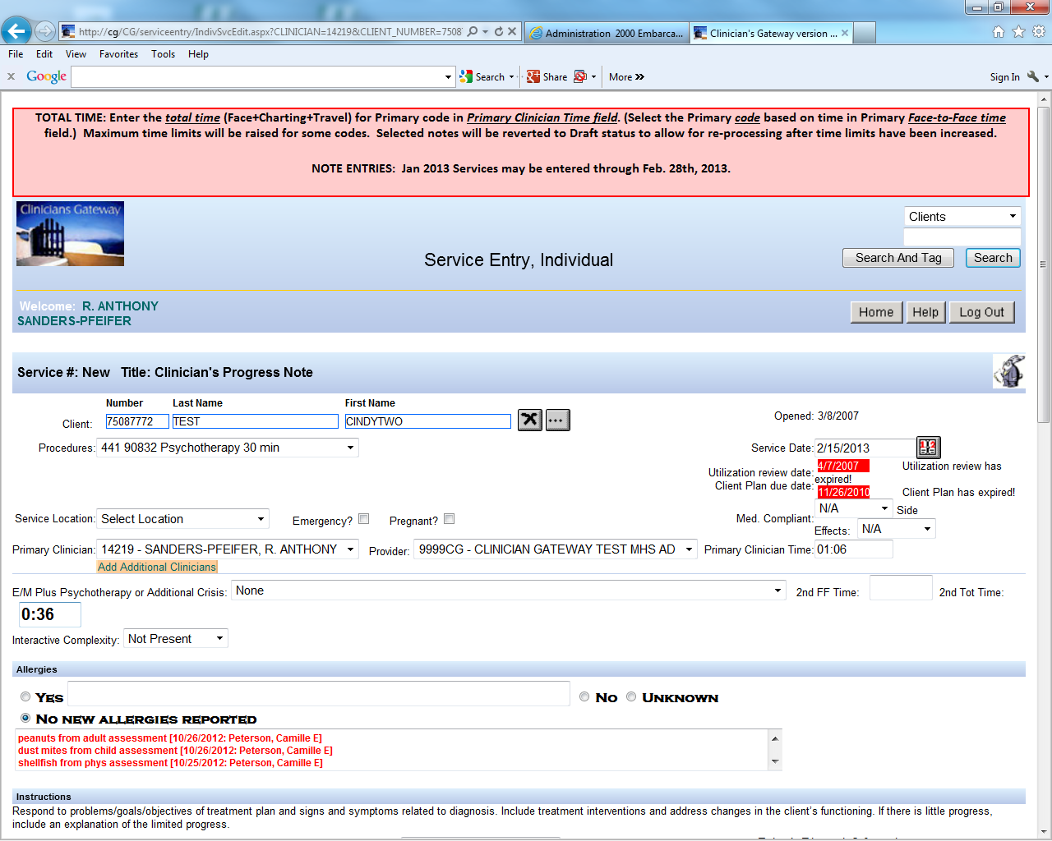

PSYCHOTHERAPY FACE TO FACE TIME = 36” (:36)
DOC/TRAVEL TIME = 30” (:30)
TOTAL TIME = 66” (1:06)
1
3
2

Slide 85
Claiming Face-to-Face Time and Total Time: InSyst Direct Entry
Psychotherapy: 45” f-f time, 10” doc. time, and 20” travel time. Total time = 75”
Choose code based on f-f time (if on the phone—base on contact time):
        442-90834 (Ind Psych 38-52 min.)
Enter Total Time:
  75”
  Warning: To choose code based on total time would be considered Fraudulent by Medicare.
Notes:
Actual Time = Total Time

Slide 86
Add-On Codes (+)
Add-On (+) codes describe additional services provided within a service. They are added to select, primary codes and demonstrate an enhanced service.
Added time increments (crisis therapy)
Added service (interactive complexity or psychotherapy)
Add-on (+) codes are never used as stand alone codes
Add-on codes are designated by a + sign

Slide 87
Add-On Codes continued:
Additional Time Spent: for Crisis Therapy—concept in general.
  377-90839 is used for the first 30-75”
  378-90840 is used for each additional 16-45”
  For paper charting: when you go beyond a 377 and use a 378--the 377 is indicated as 60” and the balance moves down to 378.
  If an additional 378 is needed the earlier 378 indicates 30” and the balance moves down to the next 378.
  The final 378 includes the actual remaining minutes of f-f time (if 16 minutes or greater).
    If 15 minutes or less—do not add another 378: just add it to the 30” of the final 378 code
Notes:
Look at Procedure code time period handout now

Slide 88
Procedure Codes continued
Crisis Therapy (formerly, Crisis Intervention)
337-90839 (First 60 Minutes of Face to Face Services)
+378-90840 (For each additional 16-30 Minutes of Face to Face Services)
A service lasting no more than 8 hours in a 24-hour period: Immediate response to client’s acute psychiatric symptoms in order to alleviate problems which, if untreated, would present an imminent threat to the client, others, or property.
Only use when the client is at imminent risk for danger to self/other and/or gravely disabled. The purpose is to stabilize the client.
Service activities include but are not limited to one or more of the following: Medication Support Services, Assessment, Evaluation, Collateral, and Therapy.

Slide 89
Crisis Code 377-90839 (Used Alone)
InSyst
  Crisis service lasting 45” f-f, + 15” doc/travel + 60” total
    Based on f-f time choose code 377-90839 (30-75”)
    Enter 60” (45” f-f + 15” doc/travel)
Clinician’s Gateway
  Crisis service lasting 45” f-f, 15” doc/travel
    Use code 377-90839 for the 45” f-f time.
      Enter 45” into “Primary f-f Time”
      Enter Total Time of 60” (1:00) (45” f-f + 15” doc/travel) into “Primary Clinician Time”
      See screen shot
For < 30 minutes can not use Crisis Code (if appropriate use and chart to a different code, e.g. individual psychotherapy, ind rehabilitation, etc.)

Slide 90
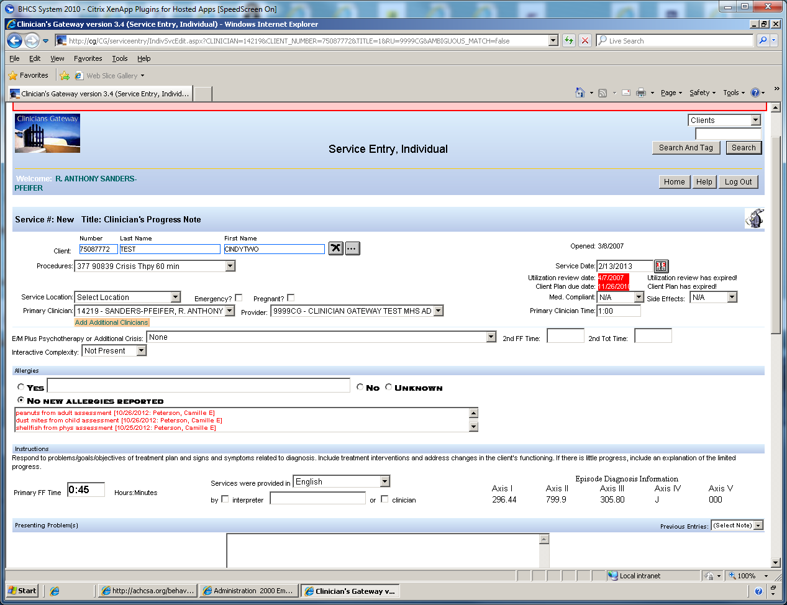

CRISIS THERAPY FACE TO FACE TIME = 45” (:45)
DOC/TRAVEL TIME = 15” (:15) TOTAL TIME = 60” (1:00)
1
3
2

Slide 91
Crisis Code 377-90839 + 378-90840
InSyst
  Crisis service: 115” F-F Time + 60” Travel/Doc Time = 175” Total Time
    Select Code 377-90839 for the 1st 60” F-F Time and enter 120” (60” F-F + 60” Travel/Doc
    Select Code 378-90840 for next 30” and enter: 30” time
    Select Code 378-90840 and enter 25” for the remaining F-F time
      If F-F time <16” do not add another 378: add it to the 378 code above
  In paper chart, indicate:
    “377-90839, +378-90840, +378-90840. F-F = 115”, Doc/Travel Time = 60” Total Time = 175”
Clinician’s Gateway:
  Crisis service: 115” (1:55) F-F Time + 60” (1:00) Travel/Doc Time = 175” (2:55) Total Time
    Select code 377-90839 and enter 60” (1:00) in “Primary FF Time” & 120” (2:00) into “Primary Clinician Time”. (The first 60” FF Time + Travel/Doc Time.)
    Select code 378-90840 and enter= 55 “in “Secondary FF Time” & 55” into “Secondary Total Time”.
    See Screen Shot

Slide 92
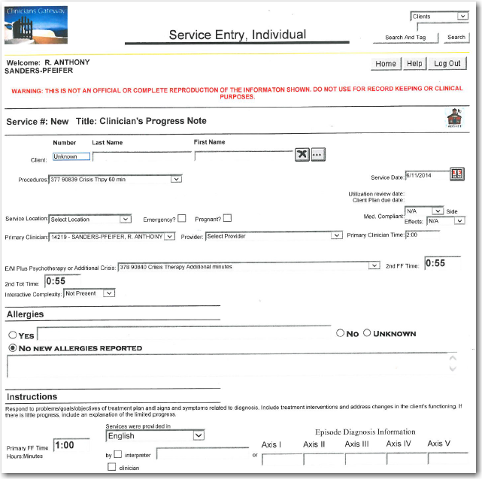
CRISIS THERAPY FACE TO FACE TIME = 115” (1:55)
DOC/TRAVEL TIME = 60” (1:00) TOTAL TIME = 175” (2:55)
1
3
6
4
5
2

Slide 93
Crisis Therapy:
154”f-f + 8”doc time
Paper Chart—InSyst entry
Clinicians Gateway entry
377-90839 is used for the first 60”
378-90840 is used for each additional 30”, AND the balance if it is less than 16” is added to the last 378-90840.
154” F2F Time and 8” Documentation Time.
    Select 377-90839: enter 68” (60” F-F + 8” Doc Time”
    Select +378-90804 (30”)
    Select +378-90804 (30”)
    Select +378-90804 (34”) (30” + 4” remaining F-F time when less than 16”)
Because the F2F Time is the deciding factor whether or not to use another 378-90840 (not the documentation time or the travel time) any F2F time less than 16” is included in the final 378-90840—do not add an additional 378 code.
Here is direction for entering into CG, using your first example of 154” (2:34) F2F Time & 8” (0:08)Documentation Time.
In the “Procedure” field, select 377-90839.
In the “Primary FF Time” field (lower left) enter (1:00).
Enter (1:08) in the “Primary Clinician Time” field. (60” FF time + 8” Doc/Travel time)
In the “E/M Plus Psychotherapy or Additional Crisis” field select 378-90840.
In the “2nd FF Time” field enter 1:34 (remainder of FF time)
In the “2nd Tot Time” field enter 1:34

Slide 94
Add-On Code for Additional Service Provided: Interactive Complexity
Refers to specific communication factors during a visit that complicate delivery of the primary psychiatric procedure:
Typical clients:
  Have others legally responsible for their care, such as minors or adults with guardians
  Request others to be involved in their care during the visit
  Require the involvement of other third parties, such as child welfare agencies, parole or probation officers, or schools

Slide 95
Procedure Codes continued
Interactive Complexity +491-90785
4 Specific communication factors during a visit that complicate delivery of the primary psychiatric procedure.
  The need to manage maladaptive communication.
  Caregiver emotions or behaviors that interfere with implementation of the treatment plan.
  Evidence or disclosure of a Sentinel Event and mandated reporting to a 3rd party with initiation of discussion of the event.
  Use of play equipment to overcome barriers to diagnostic or therapeutic interaction.

Slide 96
Add-On Code for Additional Service Provided: Interactive Complexity (491-90785) cont.
4 specific communication factors during a visit that complicate delivery of the primary psychiatric procedure:
  The need to manage maladaptive communication (related to e.g., high anxiety, high reactivity, repeated questions, or disagreement) among participants that complicates delivery of care.
    Vignette (reported with 442-90834, Psychotherapy 45 min)
      Psychotherapy for an older elementary school-aged child accompanied by divorced parents, reporting declining grades, temper outbursts, and bedtime difficulties. Parents are extremely anxious and repeatedly ask questions about the treatment process. Each parent continually challenges the other’s observations of the client.

Slide 97
Add-On Code for Additional Service Provided: Interactive Complexity (491-90785) cont.
4 specific communication factors during a visit that complicate delivery of the primary psychiatric procedure:
  Caregiver emotions or behaviors that interfere with implementation of the treatment plan
  Vignette (reported with 441-90832, psychotherapy 30 min)
    Psychotherapy for young elementary school-aged child. During the parent portion of the visit, mother has difficulty refocusing from verbalizing her own job stress to grasp the recommended behavioral interventions for her child.

Slide 98
Add-On Code for Additional Service Provided: Interactive Complexity (491-90785) cont.
4 specific communication factors during a visit that complicate delivery of the primary psychiatric procedure:
  Evidence or disclosure of a Sentinel Event and mandated reporting to a 3rd party (e.g., abuse or neglect with report to state agency) with initiation of discussion of the sentinel event and/or report with client and other visit participants
    Vignette (reported with 565-90792, psychiatric diagnostic evaluation with medical services)
      In the process of an evaluation, adolescent reports several episodes of sexual molestation by her older brother. The allegations are discussed with parents and report is made to state agency.
        Time completing a report outside of the session is not billable.

Slide 99
Add-On Code for Additional Service Provided: Interactive Complexity (491-90785) cont.
4 specific communication factors during a visit that complicate delivery of the primary psychiatric procedure:
  Use of play equipment, physical devices, interpreter or translator** to overcome barriers to diagnostic or therapeutic interaction with a client who is not fluent in the same language or who has not developed or lost expressive or receptive language skills to use or understand typical language.
    Vignette (reported with 456-90853, group psychotherapy)
      Group psychotherapy for a young child who requires play equipment to participate in the group therapeutic interaction
  **Per CMS, 491 should not be used to bill solely for translation or interpretation services as that may be a violation of federal statute.

Slide 100
Add-On (+) Procedure Code for Interactive Complexity
(+491-90785)
Can only be used with these codes:
  323-90791 & 565-90792 Psychiatric Diagnostic Evaluation.
  441-90832, 442-90834, 443-90837 Psychotherapy
  E/M with + Psychotherapy add-on
    E/M+465-90833, E/M+467-90836, E/M+468-90838
  456-90853 Group Psychotherapy
Cannot be used with Crisis Therapy, Family Therapy, or with other E/M codes when no psychotherapy was provided.
Notes:
Mention the handout for interactive complexity

Slide 101
Interactive Complexity (+) 491-90785 Add-on in InSyst & CG
Select primary procedure code and indicate minutes (into InSyst or Clinician’s Gateway) as previously described.
Select Interactive Complexity Add-on Code (no associated minutes).
  InSyst, Select code 491-90785 and enter one (1) minute
  Clinician’s Gateway, Select “Interactive Complexity: Present”

Slide 102
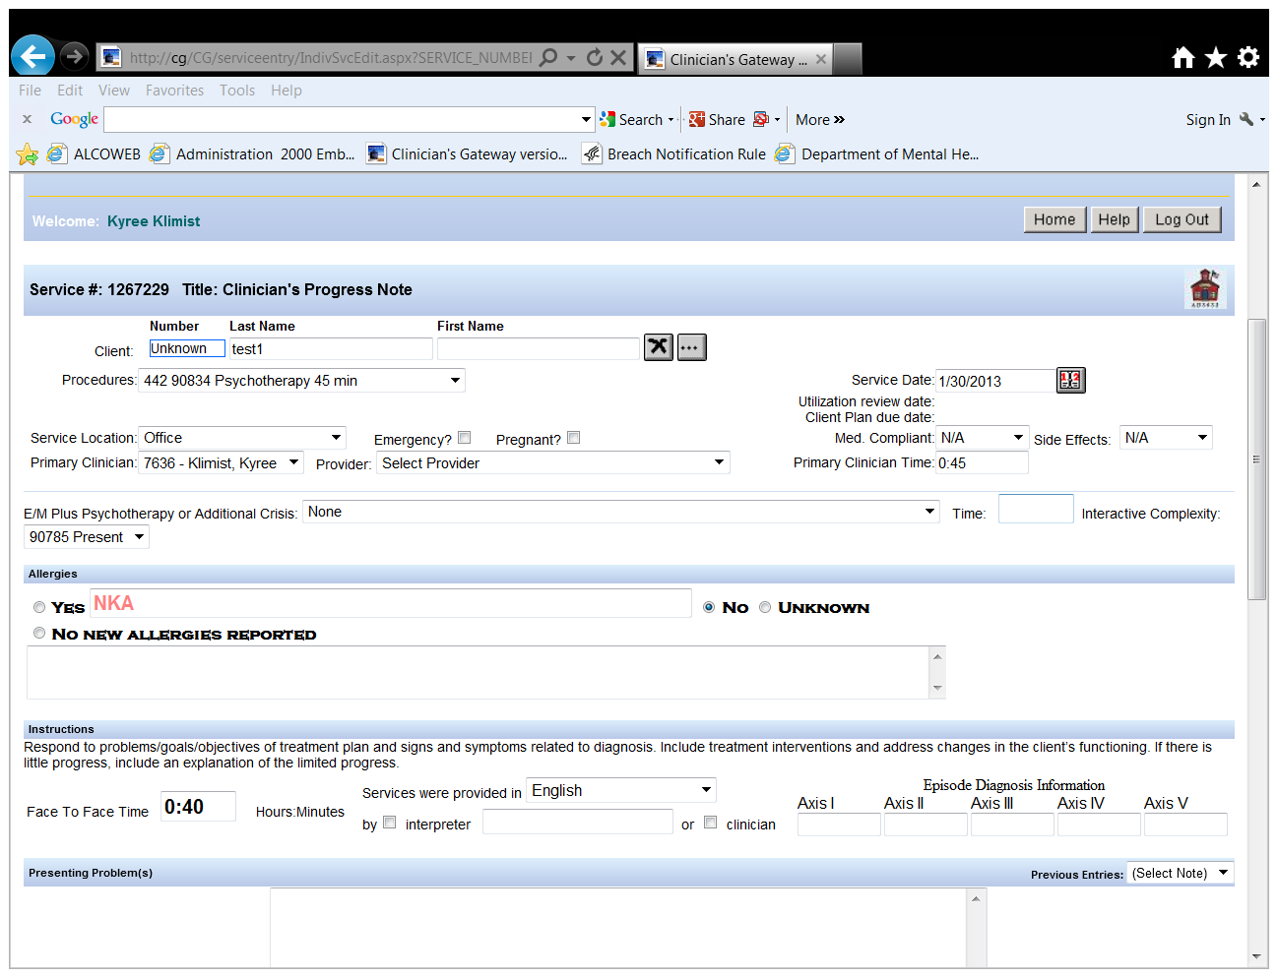
Interactive Complexity 491-90785 Add-on (+) in Clinician’s Gateway (CG) EHR

Slide 103
Documenting Add-On (+) Codes in Physical Chart’s Progress Notes
Medicare/CMS requires that each add-on code is indicated in the chart note.
  Example:
    377-90839 Crisis Therapy
    +378-90840 Crisis Therapy add-on
    +378-90840 Crisis Therapy add-on
When documenting for an add-on code, be sure that the note content reflects the service and/or time frame of the add-on.

Slide 104
Medication Support Services
Medication Support Services may include, but are not limited to:
  Evaluation of the need for medication;
  Evaluation of clinical effectiveness and side effects;
  Obtaining informed consent;
  Medication Education
  Instruction in the use, risks, and benefits of and alternatives for medication;
  Assessment of the client
  Collateral and Plan development related to the delivery of the service and/or
  Prescribing, administering, dispensing and monitoring of psychiatric medications

Slide 105
Medication Support Services
Contact and Site Requirements
  Medication Support Services may be either face-to-face or by telephone with the client or with significant support person(s)
  May be provided anywhere in the community
  469-90862 for Medication Management has been eliminated.

Slide 106
Evaluation and Management (E/M) Codes: 99###
Refer to E/M Clinical Documentation Training
E/M Training Materials:
http://www.acbhcs.org/providers/QA/training.htm
Scroll down to “Training Handouts & Resources”
Notes:
CPT codes rule the rest of the medical world

Slide 107
Medication Support: RN/LVN/Psych Tech only (Not an add-on)
369 Meds Management by RN/LVN/Psych Tech’s Only
This procedure code was developed for RN’s and LVN’s who provide medication management but who cannot bill Medicare. This is for Medi-Cal billable only.
  This code should be used when doing medication injections and providing medication support
    Face-to-Face and Non Face-to-Face
  The expectation is that time spent would be 15-30 minutes. If service is provided beyond 30 minutes, the documentation must support that level of service.

Slide 108
Medication Support: Medical Providers (MD, DO, NP, PA, CNS) (Not an add-on)
This procedure code was developed for non face-to-face Medication Services, and therefore is Not billable to Medicare, 367—Medication Training and Support
  Used ONLY for Non face-to-face services

Slide 109
Additional Handouts
Suicide/Homicide Risk Assessment
Medi-Cal Benefits Help Desk
Privacy Incident Report (PIR)

Slide 110

Claims
MH Services Lockouts (see handout)
“Lockouts” are services that cannot be reimbursed or claimed due to the potential duplication of claim (“double billing”) or ineligible billing site.
Mental Health Services Not Reimbursable:
  On days when Crisis Residential Treatment Services, Inpatient Psychiatric Services or Psychiatric Health Facility Services are reimbursed by Medi-Cal,
  except for the day of admission to the facility
On days when the client resided in a setting where the client was ineligible for Medi-Cal, e.g.,
  Institute for Mental Disease (IMD),
  Jail or Prison
  Juvenile hall, Unless…
    There is evidence of post-adjudication for placement, (i.e., the court has ordered suitable placement in a group home or other setting other than a correctional setting, jail and other similar settings)

Slide 111

Claims
Non-Reimbursable Services/Activities
No service provided: Missed appointment
Solely transportation of an individual to or from a service
Service provided solely payee related
Services provided was solely clerical
  Includes leaving or listening to voice mail.
Socialization Group
  which consists of generalized group activities that do not provide systematic individualized feedback to the specific targeted behaviors of the clients involved
Translation and/or interpretive services (including sign language)
Activities or interventions whose purpose is solely to provide vocational training, academic education or recreational activity are not reimbursable.
Completing CPS reports. Report writing is not a Mental Health intervention.
No claiming after client’s death.
No claiming for time spent in an IEP meeting.

Slide 112
Contact Us:
Contact QA Department at (510)567- 8105 or QAOffice@acbhcs.org
If you feel that you are missing a procedure code that you are contracted for, that should be included in your RU, please call Jackie Mortensen @ (800)878-1313.
For Clinicians Gateway questions, Please contact IS at (510)567-8181.
For questions regarding your agency contract, please contact the Network Office at (510) 567-8296

