Slide 1


Slide 2
Day Rehabilitation &
Day Treatment Intensive
Program standards & documentation
By dhcs and acbh
Notes:
This morning’s intentions are to: Review the program components that have been established by DHCS for DR/DTI programs which will set a context to discuss the documentations standards.

Slide 3
Introductions
Name, Agency, Role, population your program serves
What is one question that you would like answered today?
Housekeeping
  Location of bathrooms
  Discuss preferences for breaks

Slide 4
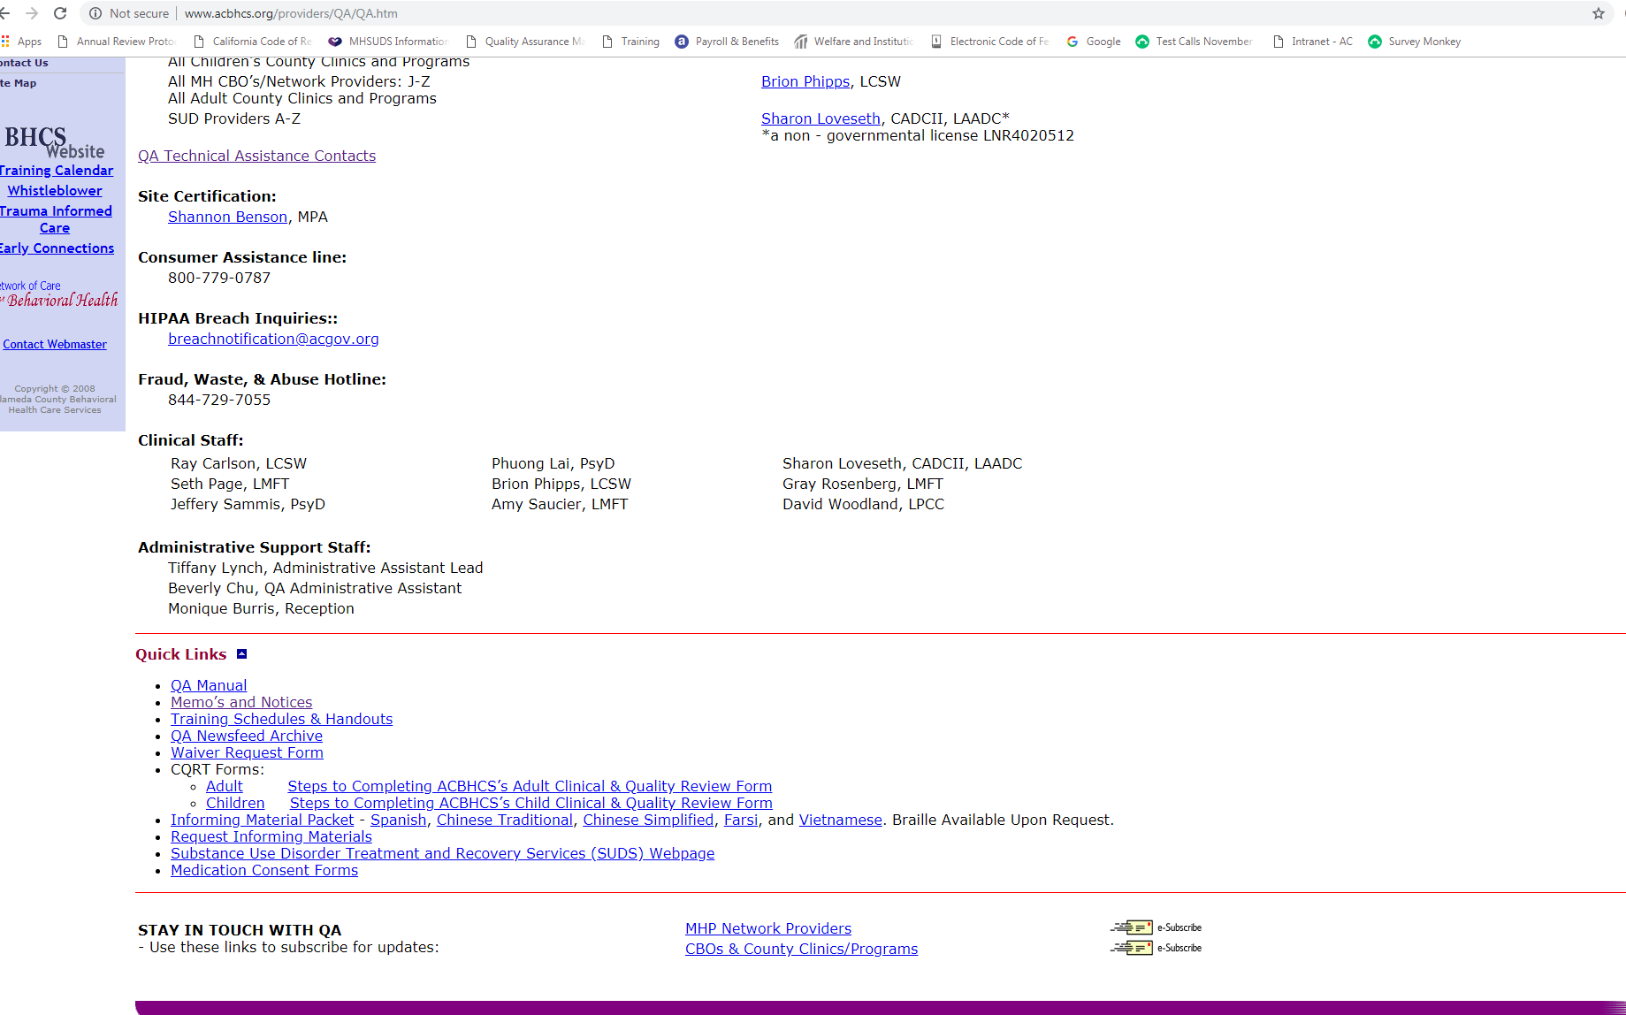
Sign-up for QA Provider Website Updates

Slide 5
Accessing the ACBH Provider’s Website
If you would like to begin receiving QA updates and notices:
  Go to www.acbhcs.org/providers
  Click on “Quality Assurance” from the menu options on the left of the screen – this should bring you to the QA home page.
  Scroll to the bottom of the page where it says “STAY IN TOUCH WITH QA”
  Click on the “e-Subscribe” link to begin receiving updates and notices

Slide 6
Program Definitions
  “Day Rehabilitation” means a structured program of rehabilitation and therapy to improve, maintain or restore personal independence and functioning, consistent with requirements for learning and development, which provides services to a distinct group of individuals.
  VS.
  “Day Treatment Intensive” means a structured, multi-disciplinary program of therapy which may be an alternative to hospitalization, and/or avoid placement in a more restrictive setting.
Notes:
What are we talking about today? We are talking about Day Rehab and Day Treatment Intensive programs. As you can see, there are some philosophical differences between these two types of programs. They each have their own purpose.

Slide 7
Authorization Requirements
Day Rehabilitation | Day Treatment Intensive
Must be authorized by ACBH every six months | Must be authorized by ACBH every three months
If additional mental health services are needed, prior authorization is required (on the same six month cycle) if they are to be provided on the same day as Day Rehabilitation.
If additional mental health services are needed, prior authorization is required (on the same three month cycle) if they are to be provided on the same day as Day Treatment Intensive.

Slide 8
Authorization Process
For Day Rehabilitation, both initial and continuation of service authorizations are completed by the ACBH Utilization Management (UM) Department.
  Complete the Clinical/Quality Review Request form and fax the form to UM. For initial authorization, the following timelines should be followed:
    For programs lasting 6 or more months – form must be faxed within 60 days of EOD
    For programs lasting less than 6 months – form must be faxed within 30 days of EOD
    For programs lasting less than 3 months – form must be faxed within 7 days of EOD
  UM staff will review the form to confirm that medical necessity is met for DR/DTI services.
  Once medical necessity is found, the authorization form will be faxed back within 14 calendar days.
New Programs will also participate in the ACBH supervised CQRT process until training is complete and agency is released to do internal CQRT(see CQRT manual on providers website).
For Day Treatment Intensive and all programs that are 6 or 7 days per week, contact ACBH Utilization Management Department.
If your contract with ACBH gives you different authorization requirements than are listed above, please follow those guidelines.
Notes:
These are all calendar days

Slide 9
Day Rehabilitation/Day
Treatment Intensive Services:
Required Service Components

Slide 10
Required Service Components
Day Rehabilitation | Day Treatment Intensive
Ratio of 1:10 (staff:clients) | Ratio of 1:8 (staff:clients)
Therapeutic Milieu | Therapeutic Milieu
Community Meetings | Community Meetings
Skill Building Groups | Skill Building Groups May also include Process Groups
Adjunctive Therapy Groups | Adjunctive Therapy Groups
Process Groups and/or Psychotherapy Groups | Psychotherapy
Notes:
There are also some similarities and commonalities.

Slide 11
Staff to Client Ratio – Day Treatment Intensive
At a minimum there must be at least one person from the following list providing Day Treatment Intensive services to eight beneficiaries or fewer clients in attendance during the period the program is open:
  Physicians
  Psychologists or related waivered/registered professionals
  Licensed Clinical Social Workers or related waivered/registered professionals
  Marriage and Family Therapists or related waivered/registered professionals
  Registered Nurses
  Licensed Vocational Nurses
  Psychiatric Technicians
  Occupational Therapists
  Mental Health Rehabilitation Specialists
When serving more than 12 clients, there must be one person from two of the above groups present.

Slide 12
Staff to Client Ratio – Day Rehabilitation
At a minimum there must be at least one person from the following list providing Day Rehabilitation services to ten beneficiaries or fewer clients in attendance during the period the program is open:
  Physicians
  Psychologists or related waivered/registered professionals
  Licensed Clinical Social Workers or related waivered/registered professionals
  Marriage and Family Therapists or related waivered/registered professionals
  Registered Nurses
  Licensed Vocational Nurses
  Psychiatric Technicians
  Occupational Therapists
  Mental Health Rehabilitation Specialist
When serving more than 12 clients, there must be one person from two of the above groups present.

Slide 13
Staff to Client Ratios Explained
Day Rehabilitation
Day Treatment Intensive
Ratio of 1:10 example
  If 1-10 clients: must have 1 staff on the list from previous slide
  If 11-20 clients: must have 2 staff from 2 different disciplines on the list from previous slide
  If 21-30 clients: must have 3 staff from 2 different disciplines on the list from previous slide
  Etc…
Ratio of 1:8 example
  If 1-8 clients: must have 1 staff on the list from previous slide
  If 9-16 clients: must have 2 staff from 2 different disciplines on the list from previous slide
  If 17-24 clients: must have 3 staff from 2 different disciplines on the list from previous slide
  Etc…

Slide 14
Therapeutic Milieu
Occurs for the continuous scheduled hours of operation for the program:
      Programs must be continuous except for lunch and short breaks; but these do not count in the program time.
        Must exceed four hours per day for full-day programs
        At least three hours per day for half-day program.
    There must be at least one staff person present and available in the milieu for all scheduled hours of operation, including lunch and breaks.
There is an expectation that clients are present for all scheduled hours of operation each day, with the exception of “unavoidable absences.”
  Unavoidable absence is defined as a crisis and/or illness
Notes:
Therapeutic Milieu is the social environment of the program. The culture, the philosophy, the feeling one gets when in the physical space of the program.
Milieu therapy seeks to control or manipulate the therapeutic environment in order to prevent self-destructive behavior.
What is a Therapeutic Milieu referring to?
- Provides the foundation for the provision of day treatment intensive and day rehabilitation and differentiates these services from other specialty mental health services
- Includes a therapeutic program that is structured by well-defined service components with specific activities being performed by identified staff.
- Creates a supportive and nurturing interpersonal environment that teaches, models, and reinforces constructive interaction.
- Supports peer/staff feedback to clients on strategies for symptom reduction, increasing adaptive behaviors, and reducing subjective distress.
- Empowers clients through involvement in the overall program (such as the opportunity to lead community meetings and to provide feedback to peers) and the opportunity for risk taking in a supportive environment.
- Supports behavior management interventions that focus on teaching self-management skills that children, youth, adults and older adults may use to control their own lives, to deal effectively with present and future problems, and to function well with minimal or no additional therapeutic intervention.

Slide 15
Community Meetings
  Occur a minimum of once per day, but may occur more frequently.
  Address issues pertinent to the continuity and effectiveness of the therapeutic milieu.
  May, but are not required to, be part of the continuous therapeutic milieu.
  Actively involve staff and clients

Slide 16
Community Meetings
  Include a staff person who is either a:
      Physician
      Licensed/waivered/registered psychologist
      LCSW/MFT/LPCC/registered intern
      Registered Nurse
      Psychiatric Technician
      Licensed Vocational Nurse, or
      Mental Health Rehabilitation Specialist
  Additionally, for Day Treatment Intensive must include a staff person whose scope of practice includes psychotherapy.

Slide 17
Community Meetings
Address relevant items including, but not limited to:
  the daily schedule
  current events
  individual issues that clients or staff wish to discuss to elicit support of the group milieu process and
  conflict resolution

Slide 18
Skill Building Groups
Staff help clients to identify barriers/obstacles related to their psychiatric/psychological experiences and, through the course of the group interaction, become better able to identify skills that address symptoms and behaviors and to increase adaptive behaviors.
Notes:
Audience engagement:
Can anyone share with me an example of a Skill Building Group that they are currently doing or might like to do at their program?

Slide 19
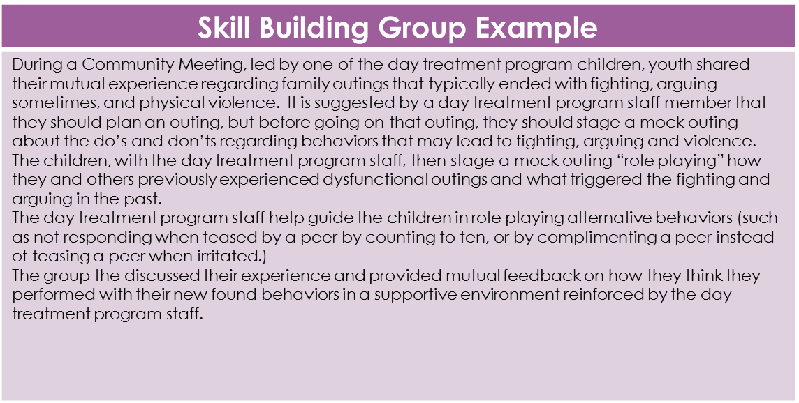

Slide 20
Adjunctive Therapy Groups
Staff and clients participate in non-traditional therapy that utilizes self-expression (art, recreation, dance, music, etc.) as the therapeutic intervention. Participants do not need to have any level of skill in the area of self-expression, but rather be able to utilize the modality to develop or enhance skills directed toward client plan goals.
Notes:
Audience engagement:
Can anyone share with me an example of an Adjunctive Therapy Group that they are currently doing or might like to do at their program?

Slide 21
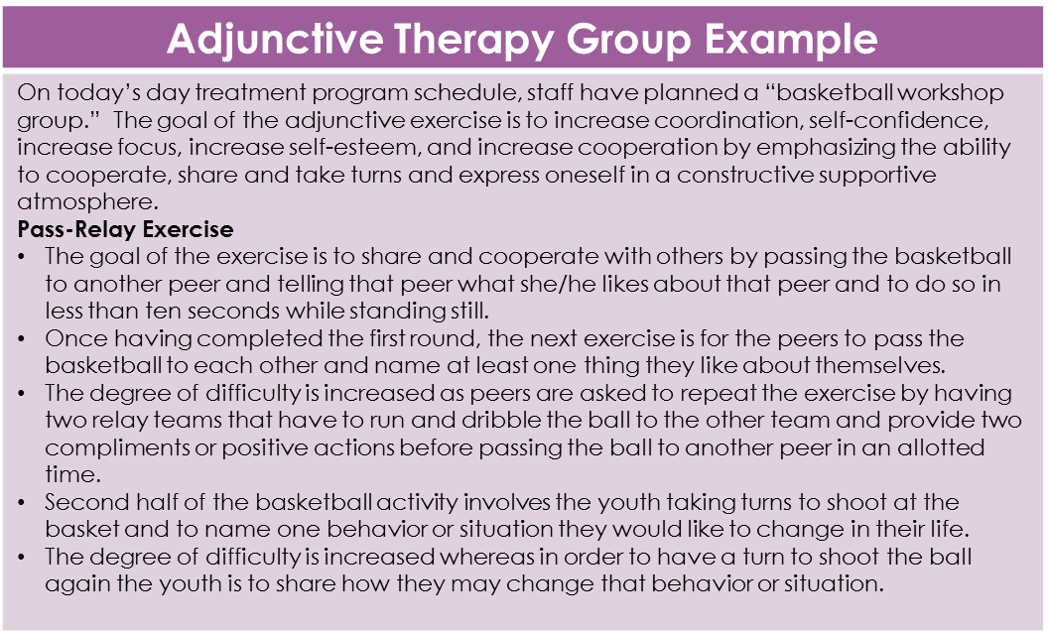

Slide 22
Process Groups
Staff facilitate these groups to help clients develop the skills necessary to deal with their individual problems/issues by using the group process to provide peer interaction and feedback in developing problem-solving strategies and to assist one another in resolving behavioral and emotional problems. Process groups are based on the premise that much of human behavior and feeling involves the individual’s adaptation and response to other people and that the group can assist individuals in making necessary changes by means of support, feedback and guidance.
Notes:
Process groups are focused on utilizing the group process to give feedback to group members in a way that empowers them to learn from each other.

Slide 23
Process Group Example
During the day treatment program’s regularly scheduled Process Group titled “Problem Solving”, the children democratically vote on one out of three staff prepared topics to tackle. The topic that received the most votes today was, “What my brother/sister does that drives me crazy!” The day treatment program staff assisted one child volunteer to write a list of sibling behaviors that drive them crazy on a whiteboard during an open sharing session. Once having formulated the list, the day treatment program staff helps another child “take a vote” from the list that most of the members of the group share in common. Next, the children share problem solving strategies on a whiteboard about what they had done to avoid a confrontation with their sibling or how they successfully handled a negative sibling behavior that drove them crazy.” Finally, the group votes and provides feedback on which strategy might be the best of the ones suggested by their peers with the idea that they would change a maladaptive behavior with this new strategy.
Notes:
Audience engagement:
Can anyone share with me an example of a Process Group that they are currently doing or might like to do at their program?
Facilitators of process groups should encourage the group (and group process) to be the tool of change and recovery. The facilitator is encouraging more group participation and ownership of the group process in order to increase client empowerment and a democratic learning environment.

Slide 24
Psychotherapy
Includes the use of psychosocial methods within a professional relationship to assist the client or clients to achieve a better psychosocial adaptation, to acquire greater human realization of psychosocial potential and adaptation, and/or to modify internal and external conditions that affect individuals, groups, or communities in respect to behavior, emotions and thinking, in respect to their intrapersonal and interpersonal processes. This service may only be provided by licensed, registered or waivered staff practicing within their scope of practice. Psychotherapy is a required component of Day Treatment Intensive programming and is optional for the Day Rehabilitation programs.

Slide 25
  Contact Requirements
At least one contact per month with a family member, caregiver or other significant support person identified by an adult client, or one contact per month with the legally responsible adult for a client who is a minor.
    Adult clients may choose to decline this service component. If so, it needs to continue to be explored with the client. These discussions need to be documented in a progress note.
    If unable to contact significant support person, attempts to do so should be documented in a progress note and at least three attempts should be made during the month (except not required for adults who have refused this service).
The contacts and involvement should focus on the role of the significant support person in supporting the client's community reintegration.
It is expected that this contact will occur outside hours of operation and outside the therapeutic program.
Notes:
If adult client declines this service component, that should be documented in a progress note. For adult clients, it would be best practice to continue to make attempts to engage the client’s support system if they initially decline and it seems clinically appropriate to do so.

Slide 26
Day Rehabilitation/Day Treatment Intensive Services:
Documentation Requirements

Slide 27
Timeliness For Submission of Clinical Documents
By day one (first billed day), an Interim Assessment and Client Plan must be in place.
A completed Full MH Assessment and Full Client Plan must be in place by day seven for both Day Rehabilitation and Day Treatment Intensive programs.

Slide 28
Timeliness For Submission of Clinical Documents
The CANS/ANSA form shall be administered on the following time frames for both DR and DTI:
  At Opening: The initial CANS/ANSA must be completed prior to the treatment plan completion and no later than 7 days from EOD. CANS/ANSA scores shall be used to inform the Initial Client Plan.
  At 6-month mark: A Re-assessment CANS/ANSA must be completed within the calendar month prior to the 6th month of the EOD.
  At 12 month mark: A Re-assessment CANS/ANSA must be completed prior to the treatment plan completion and during calendar month prior to the episode opening month.
  At Discharge: A CANS/ANSA must be completed prior to closing the case.

Slide 29
Documents for Auditing
Weekly Schedules
Proof of Staffing Ratios (usually included in Weekly Schedule and Group Sign-in Sheets)
Crisis Response Protocol
Program Description
Full Staff List including:
  Staff Names
  Staff Signatures
  Job Titles and credentials, (LPHA, MHRS, Adjunct staff, etc.)
  If the DR/DTI program uses staff who are also staff with other responsibilities (i.e.: as staff of a group home, a school, or another mental health treatment program), there must be documentation of the scope of responsibilities for these staff and the specific times in which DTI/DR activities are being performed exclusive of other activities.
  If MHRS staff, include copy of resume to demonstrate proof of experience congruent with definition of MHRS status.
Notes:
If you haven’t already, every program needs to develop these documents and be able to provide them to auditors for review during audits.

Slide 30
    Detailed Weekly Schedule
A detailed weekly schedule indicating when and where the service components will be provided and by whom:
    This includes:
      program and milieu staff list
      their qualifications/credentials
      group sub-type
      group leaders (with back-ups)
      staffing ratios
      their scope of responsibility
    The weekly schedule must be readily available to clients and, as appropriate, to their families, caregivers, or significant support persons.
Notes:
The schedule should be posted and/or shared so all clients may view it/have access to it.

Slide 31
Program Description
Providers are required to develop and maintain a written program description that describes the specific activities of the service reflecting the required service components.
  The program description must include a detailed list of all current groups being provided.

Slide 32
    Mental Health Crisis Protocol
The program must assure the availability of appropriately trained and qualified staff and include agreed upon procedures for addressing crisis situations.
The program services may include referrals for crisis intervention, crisis stabilization, or other specialty mental health services necessary to address the client’s urgent or emergency psychiatric condition.
If clients will be referred out for crisis services, the program must demonstrate that program staff have the capacity to handle the crisis until the client is linked to the outside service.

Slide 33
Key Service Documentation Requirements
Day Rehabilitation | Day Treatment Intensive
Weekly Note | Daily Progress Notes
 | Weekly Clinical Summary
Monthly contact with support person | Monthly contact with support person
Documentation of total number of minutes or hours attended. | Documentation of total number of minutes or hours attended.
Daily Attendance Logs | Daily Attendance Logs
Group Attendance Log with Name and duration of each group & client’s sign-in signature. | Group Attendance Log with Name and duration of each group & client’s sign-in signature.
Unavoidable Absences | Unavoidable Absences
Notes:
DTI: Must have a Weekly Clinical Summary reviewed and signed by a physician, a licensed/waivered/registered psychologist, clinical social worker, or marriage and family therapist; or a registered nurse who is either staff to the day treatment intensive program or the person directing the service.

Slide 34
Progress Note Requirements
When writing progress notes consider the image of a golden thread that ties the assessment, treatment plan, and progress notes together.
Document the following elements:
  The relevant aspects of client care directly related to:
    medical necessity and the included diagnosis in the Assessment, and
    How the services provided:
      reduced impairment,
      restored functioning, and/or
      prevented significant deterioration in an area of life functioning as identified in the Client Plan goals and objectives.
Notes:
Brief discussion of medical necessity

Slide 35
Progress Note Requirements
In each Progress note, you must document:
  proof of client encounters:
    including relevant clinical decisions;
    when decisions are made; and
    alternative approaches for future interventions.
  the interventions applied and the client’s response to those interventions.
  referrals to community resources/other agencies, follow-up care, and discharge summaries when relevant.

Slide 36
Progress Note Requirements
Must also contain:
  The date(s) of service
  The signature of the person providing the service, the person’s credentials*, and date of signature;
  The date the documentation was entered in the beneficiary’s record; and
        The total number of hours and minutes the beneficiary actually attended the program (not percentages).
Notes:
*Discuss Scope of Practice Grid handout

Slide 37
Progress Note Requirements
    DR Weekly Note requires details of daily attendance (total number of minutes and hours attended), participation, absences, all groups attended, presenting problem, interventions, contacts with significant person(s), and any skill development learned.
    DTI Weekly Clinical Summary requires all of the above, AND details of Psychotherapy/Family Psychotherapy received, Crisis Interventions, and other significant issues.
    Progress Note Timeliness:
      DTI daily Progress Notes are due within one working day of client’s day of service/scheduled attendance, and after 5 business days are considered a “late note” and must be documented as such.
      DTI & DR Weekly Summary are due within one working day of client’s last treatment day of scheduled attendance and after 5 business days are considered a “late note” and must be documented as such.
      For Clinician’s Gateway users – for claiming purposes, a daily note must be completed that simply references the date of the “weekly” summary note. This means that the weekly summary note must be completed on the referenced date listed in the daily notes.
Notes:
Discuss Timeliness; give examples

Slide 38
Weekly Clinical Summary Requirements
Must be reviewed and signed by one of the following:
  Physician,
  Licensed/Waivered/Registered Psychologist
  Licensed/Waivered/Registered Social Worker,
  Licensed/Waivered/Registered Marriage and Family Therapist.
  A Registered Nurse who is ether staff to the DTI program or the person directing the service.

Slide 39
Verification of Group Attendance
The DHCS requires that clients participation in groups must be verified/documented.
All programs must comply with this requirement through:
  a Daily Attendance Log for each client per day whereby clients sign-in at their arrival time to the program and sign-out at their departure time from the program.
    &
  a Group Attendance Log for each group for clients to sign-in.
  Per HIPPA, these logs must be filed separately from the client’s chart, and for DHCS audit purposes must be kept as long as medical records must be kept by regulation (ACBH recommends 15 years) in chronological order.
Notes:
Example of Client Log.

Slide 40
Documentation of Unavoidable Absence Requirements
An unavoidable absence is defined as a crisis and/or illness and is infrequent.
  Examples may include:
    Family Emergency
    Client Illness
    Court appearance
    Appointment that cannot be rescheduled (note needs to explain why an appointment cannot be rescheduled). Medical appointments do not meet this criteria unless documented that this was the only available appointment within the needed treatment timeframe.
    Family Event (e.g., funeral, wedding)
    Transportation Issues
Unavoidable Absences must be documented only when the client has attended 50 percent of scheduled day but less than a full day.
  Unavoidable Absence note must be a separate entry in the chart and include:
      the reason for the absence and
      the total minutes/hours of actual attendance.
  In cases where absences are frequent, it is the responsibility of the MHP to ensure that the provider re-evaluates the beneficiary’s need for DR/DTI program and take appropriate action such as a referral to another form of treatment program.
Notes:
Unavoidable absences are documented when you plan on billing for that day. This can only happen when the client has attended at least 50% of the scheduled day, but less than a full day.

Slide 41
Lockouts
DR/DTI are not reimbursable when Crisis Residential Treatment Services, Psychiatric Inpatient Hospital Services, Psychiatric Health Facility Services, or Psychiatric Nursing Facility Services are reimbursed, except for the day of admission to those services.
Two half-day programs may not be provided to the same beneficiary on the same day.
Notes:
DR/DTI are not reimbursable under the following circumstances, except on the day of admission to these services.

Slide 42
Contact Us:
Contact QA Department at (510)567- 8105 or QAOffice@acgov.org
If you feel that you are missing a procedure code that you are contracted for, that should be included in your RU, please call Jackie Mortensen @ (800)878- 1313.
For Clinicians Gateway questions, Please contact IS at (510)567-8181.
For questions regarding your agency contract, please contact the Network Office at (510) 567-8296
For all other questions related to Day Rehabilitation or Day Treatment Intensive Program Standards and Documentation, contact Deanna Kolda @ (510)383-1538 or deanna.kolda@acgov.org.

Slide 43
References
FAQs from SMART – State Management Advisory and Response Team, Medi-Cal Day Treatment
  http://www.dhcs.ca.gov/services/mh/Pages/SMART.aspx
Title 9, California Code of Regulations
DHCS Letter No.: 03-03
SD/MC Provider Certification & Re-Certification Protocol – Lockouts (DHCS)
SD/MC Provider Certification & Re-Certification Protocol (DHCS)
Exhibit A – Attachment 2 DHCS Contract

