Slide 1
Clinicians Gateway-SmartCare / CalAIM implementation
July 1, 2023

Slide 2
Topics
Logging In
Facesheet
Terminology-Programs
Staff IDs
Service Procedure Codes
Service Time Reporting
Service Diagnosis
Service Rejections
Schedule of Uploads

Slide 3
New Clinicians Gateway-SmartCare apps are coming on July 1, 2023.
Due to the transition to SmartCare on 7/1/2023, and new billing rules from CalAIM, new instances of Clinicians Gateway (CG) are required.
We have kept changes as minimal as possible.
The look and feel of the new CG-SmartCare will be very familiar to current CG users.

Slide 4
Logging IN
Two new instances of Clinicians Gateway will used with services dated July 1, 2023 and later
Clinicians Gateway MHS – SmartCare
Clinicians Gateway SUD – SmartCare
Existing instances of Clinicians Gateway will be used with services dated June 30, 2023 and earlier
Clinicians Gateway MHS – InSyst
Clinicians Gateway SUD – InSyst

Slide 5
For Citrix Users:
Citrix icons will be made available on 7/1/23. Note the InSyst version and the SmartCare version.
MHS and SUD are still separate applications.

Slide 6
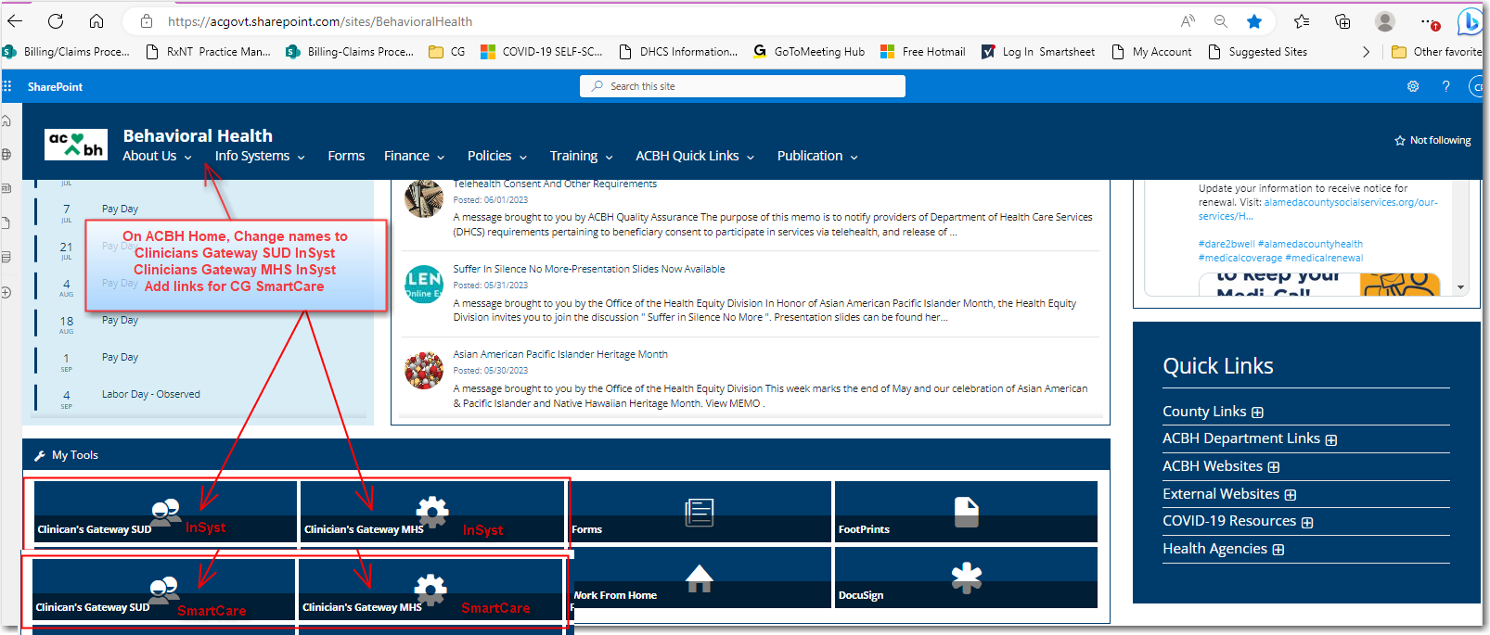
For Internal Users:
On the ACBH Home Screen, we will update the existing links to include “InSyst” in the name. On 7/1/23, we will add the links to
CG MHS SmartCare and CG SUD SmartCare.

Slide 7
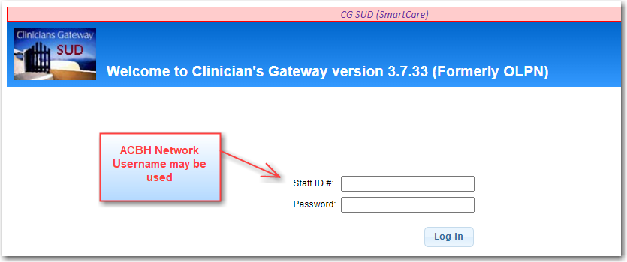
ACBH Network Login Username may be used for logging in. The royal blue header alerts to CG-SmartCare

Slide 8
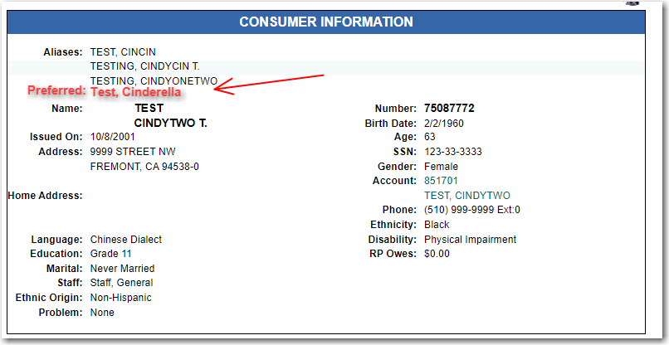
facesheet
Preferred name will be imported into CG when designated in SmartCare

Slide 9
Terminology
Say goodbye to Reporting Units and InSyst Episodes

Slide 10
InSyst Reporting Units SmartCare Programs
InSyst Episodes Program Enrollments/Admissions
Diagnoses will be associated with the program enrollment
In SmartCare “Episode” is a term for an umbrella ‘episode of care’ within SmartCare. We will not use the SmartCare Episode in relation to our program enrollments/admissions.

Slide 11
Staff ids
Clinicians Gateway will retain the InSyst Staff ID #s
SmartCare will display staff by name

Slide 12
*Staff will be identified in SC by name. SC ID # is in the background only. *Within CG-SC, existing InSyst Staff ID #s will remain the same. They will be mapped to their corresponding SC ID # *Staff who were end-dated in InSyst were not migrated to SC *New and non-migrated staff will receive new SC Staff ID #s starting at 200,000 when newly created in SC

Slide 13
Services – procedure codes
Refer to guidance from ACBH BBS and QA for specific details

Slide 14
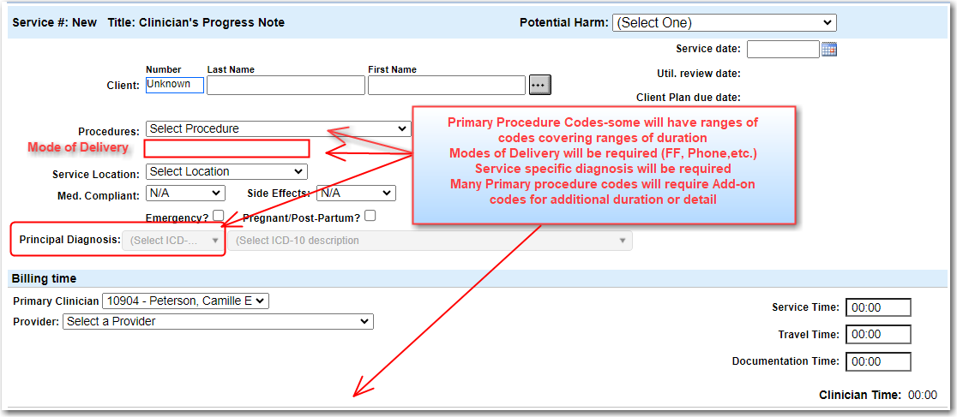

Slide 15
Services – Procedure codes – refer to guidance from ACBH BBS and QA
Many codes will have time ranges which are shown in their description
* SC will assign the correct code according to the duration
Many Primary codes will need Add-on codes to report additional time or complexity
Some codes will be locked out when in combination with others on the same day.
Duplicate override codes will still be requested by the system when necessary
Mode of Delivery is now required (Face to Face, Telephone, Video… ) in addition to Location.
Clinicians Gateway will incorporate permissions and restrictions to aid in correct choices

Slide 16
Services – Time Reporting

Slide 17
Services – Time Reporting
Start Time for Service (hh:mm AM/PM)
Separate time fields for Service, Travel, and Documentation durations
Service time and Add-on time used for claiming
Total Clinician time reported on Individual Staff Log
Add-On code requires its own Service Time
Time reporting will not change for Indirect Service notes

Slide 18
Services Service specific Diagnosis

Slide 19
Service Diagnosis – Please refer to guidance from ACBH QA
A service specific diagnosis is required with each note
The diagnosis will be sent with the claim line
Claimable diagnoses are required after the assessment period
Diagnoses from the SmartCare program enrollment will be offered at the top of the drop-down list
Diagnoses outside of program enrollment diagnoses will be offered, according to scope of practice of author of note, in the drop down.

Slide 20
Services rejections
Rejected during Service Upload nightly process

Slide 21
Clinicians will be able to correct rejected notes and resubmit through CG
Finalized services will be uploaded nightly from Clinicians Gateway to SmartCare
Some services may be rejected by SmartCare
Rejected services will be returned to the user’s Pending Services list
Rejected services status will be changed from Finalized to Draft
Rejected services will have an Error indicator in the “Sort” column

Slide 22
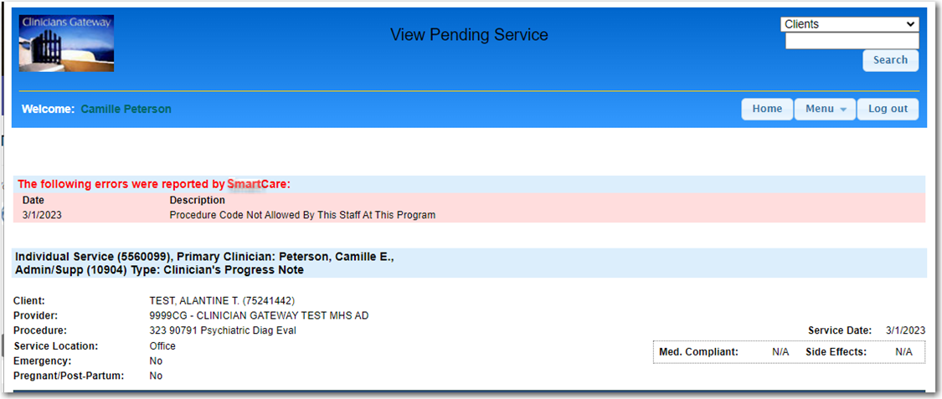
The Error reason is provided in red at the top of the View Service screen
The clinician can make corrections to resolve the error and re-finalize the note.
Corrections needed may be within the note or in SmartCare
Reprint Individual Staff Log to reflect the changes

Slide 23
Schedule of Uploads
Job | Frequency
New Clients to CG | Every 15 minutes
New Program Enrollments to CG | Every 15 minutes
Updates of Clients to CG | Nightly
Updates of Enrollments to CG | Nightly
Services to SmartCare | Nightly

Slide 24
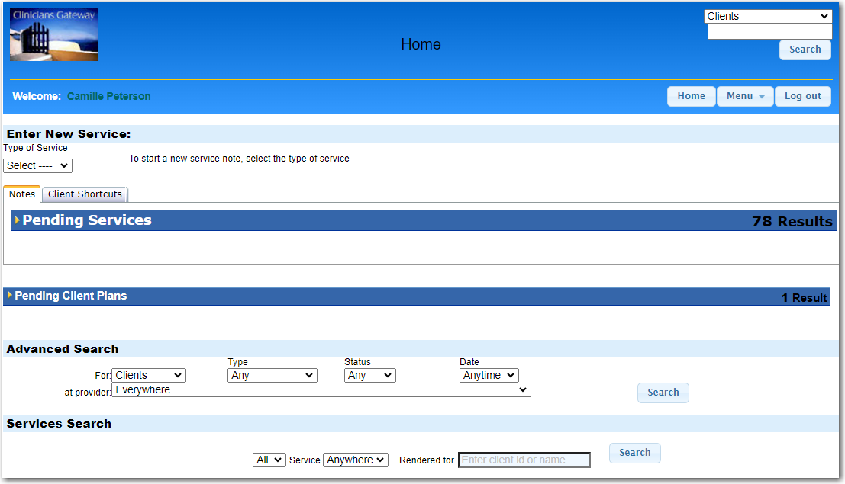
Questions?

Slide 25
Best Wishes
We hope these changes to adapt Clinicians Gateway to SmartCare and CalAIM requirements are easy for current users.
We will continue to add features to integrate CG with SC.
For questions, please contact
IS Support: his@acgov.org or 510-567-8181
ACBH QA: qata@acgov.org or _____________
ACBH BBS: _______________________
ACBH QA will be offering Office Hours 3:30 – 5 PM
From July 3 – July ??????

Slide 26
Thank you
ACBH IS System Support
his@acgov.org
510-567-8181

