Slide 1
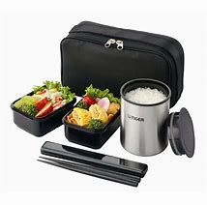
ACBH QA Substance Use Disorder Brown bag
ACBH providers, Quality Assurance Lead Staff, Directors, Managers and Supervisors are welcome to join QA for a question and answer session!
Technical Assistance for Substance Use Providers
Open lunch forum to discuss billing and clinical documentation technical questions related to Medi-Cal
All sessions occur 12-1 pm on the respective Friday
Join in person: 2000 Embarcadero Cove, Oakland CA 94607, Suite 305 in our Joaquin Miller Conference Room
or
Join by phone: 877-336-1828/Passcode:8298628
QA SUD Brown Bag 2020 Schedule
January 16th, 2020 | July 16th, 2020
February 20th, 2020 | August 20th, 2020
March 19th 2020 | September 17th, 2020
April 16th, 2020 | October 15th, 2020
May 21st, 2020 | November 19th, 2020
June 18th, 2020 | December 17th, 2020

