Slide 1
Mental Health Fee for Service Provider Clinical Documentation Training
Amy Saucier, LMFT Clinical Review Specialist Supervisor
Tony Sanders, PhD, Clinical Psychologist, Interim Associate Administrator
Quality Assurance Department

Slide 2
Introductions
What is your name?
Are you in the right training?
What type of Mental Health Fee for Service Provider are you? (formerly known as Level III Network)
Individual, Group, or Organization
Notes:
Are you in the right training? Yes. If you claim with the CMS 1500 form. Form is red and white when printed in color.

Slide 3
Psychological Testing
Assessment and treatment plans are not required for psych testing only cases.
Progress notes should detail which psychological tests were administered at each session.
Time spent writing report is claimable and this should be documented within progress notes.
If you only conduct psychological testing, the rest of this training will not be relevant to you. If you would like to leave at this time you may. Thank you for all of the great work you do for our consumers.

Slide 4

Fee For Service Providers
This training is for mental health providers contracted by Alameda County who claim via paper form CMS 1500.
These providers are individual therapists, groups of therapists,
and Organizations (Non-Master Contract Organizations).
There are some documentation related differences between
these providers that will be described in this training.

Slide 5
Agenda 6/24/20 9:00 am – 4:00 pm
TIME | TOPIC
9:00am – 9:30am | Introductions, Logistics, Training Objectives, News & Updates
9:30 am – 10:30 am | Initial Timelines and Processes 6 month and 1 year Timelines and Processes
10:30 am – 10:45 am | Break
10:45 am – 12:15 pm | Audit Highlights Medical Necessity Pre-Assessment & Assessment Requirements Documentation Requirements (including SO/GIE data) Plan Documentation Requirements
12:15 pm – 1:15 pm | Lunch
1:15 pm – 1:45 pm | Plan Documentation Requirements continued Progress Note Documentation Requirements
1:45 pm – 2:00pm | Break
2:00 pm – 3:00 pm | Procedure Codes Documentation Requirements
3:00 pm – 4:00 pm | Questions, Post Test, & Course Evaluation

Slide 6

News and Updates
See provider website: http://www.acbhcs.org/providers/Main/Index.htm
qa section & sign up for updates: http://www.acbhcs.org/providers/QA/QA.htm
Audit notices, reports & tools: http://www.acbhcs.org/providers/QA/QA.htm

Slide 7
Training Objectives
Review Initial Approval & 6 month and 1 year Processes
Understand Package of Services
Review Clinical Documentation Requirements
Discuss the core elements of Medical Necessity and the Clinical Loop aka Golden Thread
Strengthen the ability to assess and document client problem areas, symptoms, strengths, and impairments in an Assessment.
Improve the ability to develop client goals and mental health objectives in compliance with Medi-Cal/DHCS requirements
Learn how to document Medi-Cal/DHCS Progress Notes

Slide 8



MHP FFS Provider Types - Outpatient
All claims must be made with form CMS 1500
Individual Clinician
Licensed master’s level (or greater) therapist, psychiatrist, or psychologist
Only Licensed LPHAs can provide services
Group of Clinicians
Group of 2+ individual clinicians
Licensed master’s level (or greater) therapist, psychiatrist, or psychologist
Only Licensed LPHAs can provide services
Master Contract Organizations – CMS HCFA 1500
Both Licensed and Board Registered or Waivered LPHAs may provide services (with Assessment and Plan restrictions and per your contract)

Slide 9
Documentation Training Requirements
Providers are expected to attend a minimum of one ACBH clinical documentation training every three years, as well as any additional ACBH required trainings.
The expectation is for providers to keep up to date with all current policies, procedures and regulations.

Slide 10
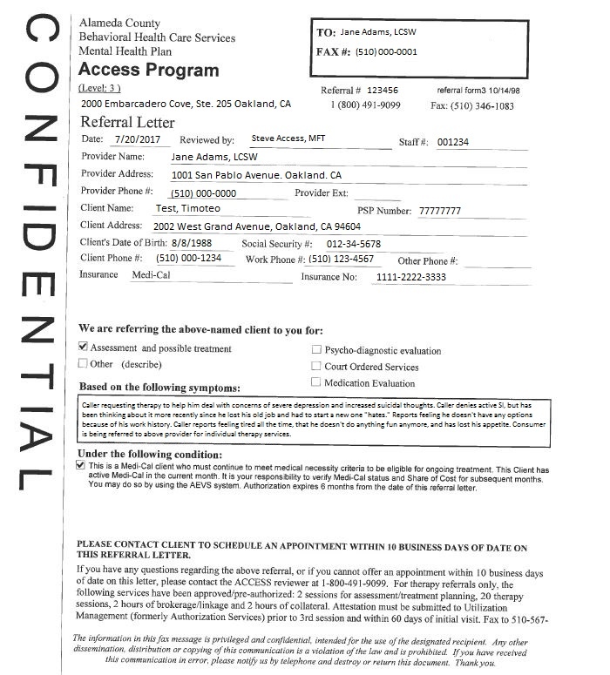
ACCESS Referral Letter
The Referral Letter Date marks the start of services. Providers reassess for continued services every 6 months.
The provider must offer an appointment date within 10 business days of the Referral Letter Date. If this is not possible, consult with the ACCESS line on how to proceed.

Slide 11
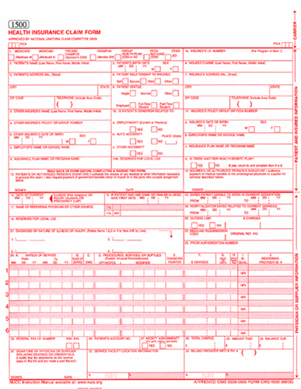
CMS 1500 Claiming Rates & Codes
See July 1, 2016 Specialty Mental Health Rate sheets
Organization, Community Clinic, and Multidisciplinary Group (MHP FFS Orgs) Rates
Physician Rates
LCSW, MFT, LPCC Rates
PhD Rates (includes psychological testing)
Remember to refer to the Rate/Code sheet for your license.

Slide 12
Important Forms
Attestation form:
http://www.acbhcs.org/providers/Forms/Forms.htm#UM
Medi-Cal compliant Assessment and Client Plan forms:
http://www.acbhcs.org/providers/Forms/ProviderNetwork.htm
Request for Continued Services (RCS) form:
http://www.acbhcs.org/providers/Forms/Forms.htm#UM

Slide 13
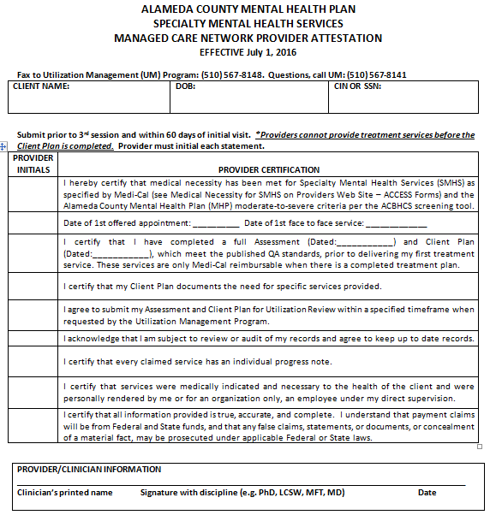
Attestation Form
Follow all of the instructions on this form. The Attestation Form must be completed and submitted to UM prior to the third unit of service. Assessment codes are used for the first two units of service.
By completing this form, the provider attests that they have completed and will continue to complete the required documentation to claim for services through Medi-Cal.
Attestation must also be completed annually by the same referral date cycle.

Slide 14
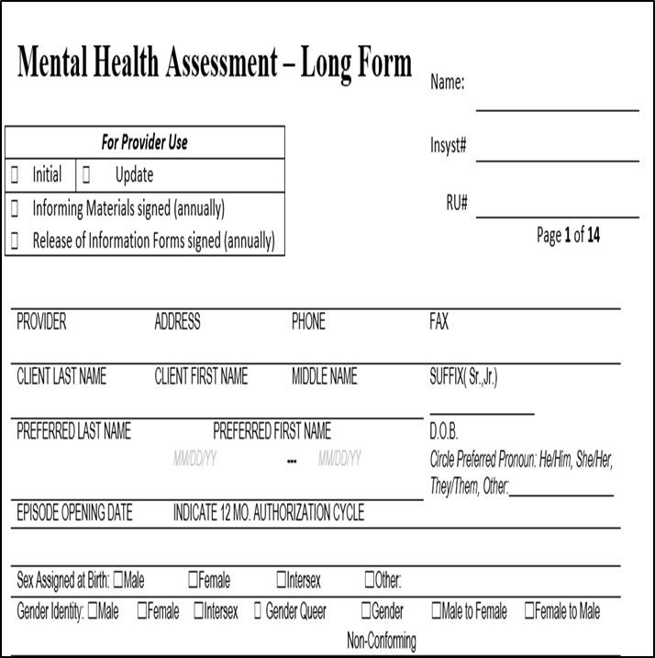
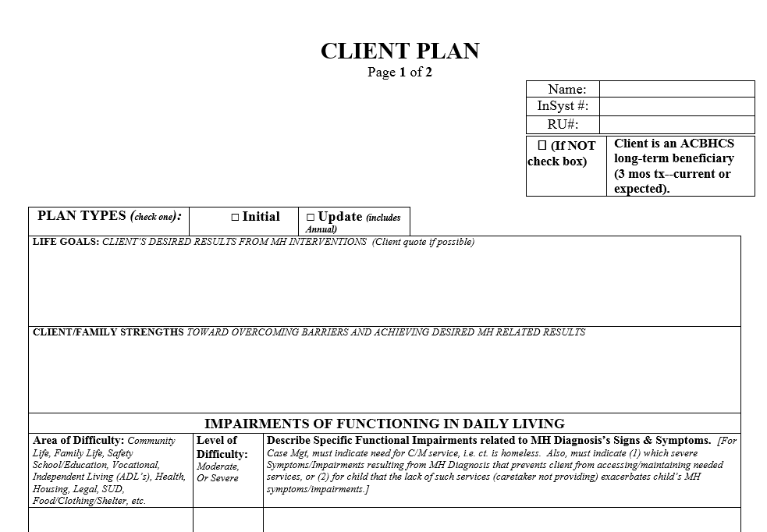
Assessment—Long Form and Client Plan
Assessment TEMPLATE
Client plan template

Slide 15
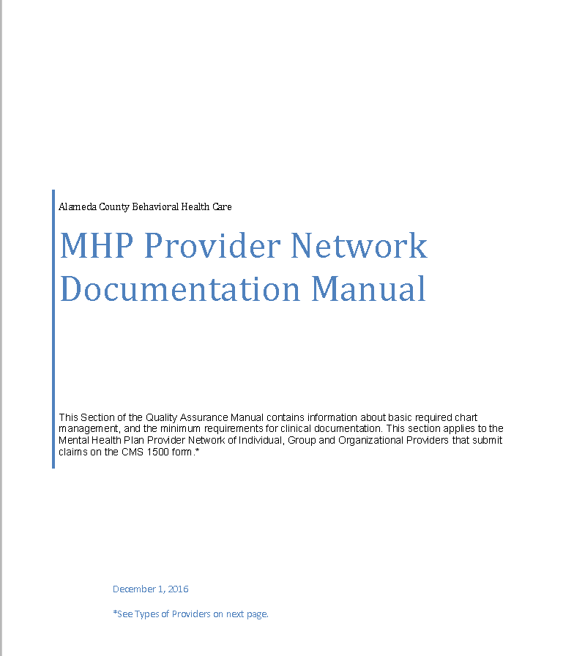
ACBH Clinical Documentation Standards Manual for Network Providers
http://www.acbhcs.org/providers/QA/docs/qa_manual/7-2_MHP_NETWK_PROVIDER_DOC_STANDARDS.pdf
Documentation Standards manual for all providers that claim using the form CMS 1500

Slide 16
Insurance Eligibility Verification
Payment of claims is dependent on continued insurance eligibility, medical necessity, and timeliness of claim submission.
It is the provider’s responsibility to check insurance eligibility monthly and understand medical necessity criteria for SMHS. Remember to verify eligibility prior to initially providing services and then on the first of each calendar month.
If Medi-Cal has been discontinued, alert the beneficiary to follow-up with the Medi-Cal Office so that hopefully their benefit will be reinstated (usually retroactively if alerted same/next month from discontinuation).
It is strongly recommended for the provider to know each of their beneficiary’s Medi-Cal Managed Care Plan (MCP) to help ensure continuity of care as a beneficiary's condition improves from moderate-to-severe to mild-to-moderate.
See MHP FFS Documentation Standards Manual for more information.

Slide 17
Insurance Eligibility Verification—cont.
In the event the provider and client are needing additional assistance, the provider can contact ACBH Help Desk (888-346-0605) which has HIT staff available to assist with the renewal or application process.
The client will need to sign the MC382 form which assigns ACBH as their authorized representative in order for HIT staff to submit an application on their behalf.

Slide 18
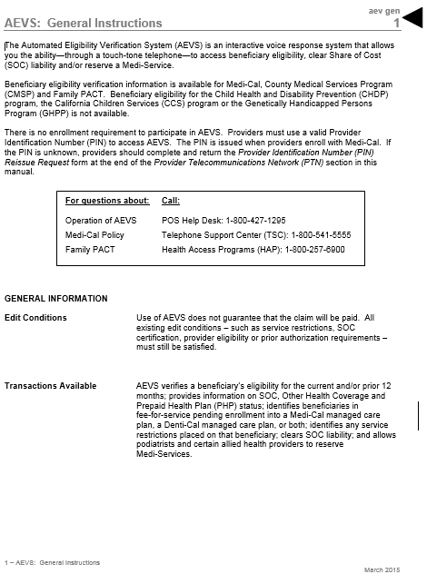

Insurance Eligibility Verification
DHCS provides several options to verify Medi-Cal eligibility
Automatic Eligibility Verification System (AEVS):
https://files.medi-cal.ca.gov/pubsdoco/AEVS_home.asp
Or call 1-800-427-1295 and enter your PIN
Or using the online DHCS system:
https://www.medi-cal.ca.gov/eligibility/login.asp
Use the AEVS system provider number that you were assigned. Contact your QA Technical Assistance contact if you need help.
Notes:
Michiko provides the pin numbers

Slide 19
MHP FFS Overview – For outpatient services
ACCESS
Approves the initial package of services (6 months)
UM
Approves the Annual Package of Services (6 month)
Provider Relations
Providers submit claims within 60 days of the end of the service date month
BHCS remits payment to provider

Slide 20
Documentation Timeline
Access approves the Initial package of Service.
Provider offers client an appointment date within 10 business days of referral letter date
Provider completes Initial Assessment by the 3rd unit of service.
Provider completes Client Plan prior to the 3rd unit of service
Provider must update client plan the next session after continuing services beyond 6 months. No additional services can be provided until plan is updated.
UM approves or denies Annual Package of Service
Provider submits RCS Form to UM for any subsequent services requests 2 weeks prior to current expiration
Provider completes Medical Necessity Attestation Form and faxes to UM prior to providing the 3rd unit of service.

Slide 21
Initial Approval & 6 month and 1 year Continuation of Services

Slide 22
Initial/Annual Package of Services
Two units of service to complete both the Assessment and Plan (code 90791)
Assessment must be completed before the 3rd unit of service
Plan must be completed before the 3rd unit of service
Providers may not provide therapy services before the initial/annual assessment and client plan are completed
Short-form assessment template may be used for your initial assessment; however, the long-form is required for your annual assessments.
Attestation must be submitted to Utilization Management (UM) before the 3rd unit of service. FAX to 1-888-860-8068.
Call UM if medical necessity requires additional assessment/plan services.
Notes:
Cannot bill for documentation, Session 1 – ct visit FtF, Session 2 no ct write up A & P, Session 3 ct signed first then start tx

Slide 23
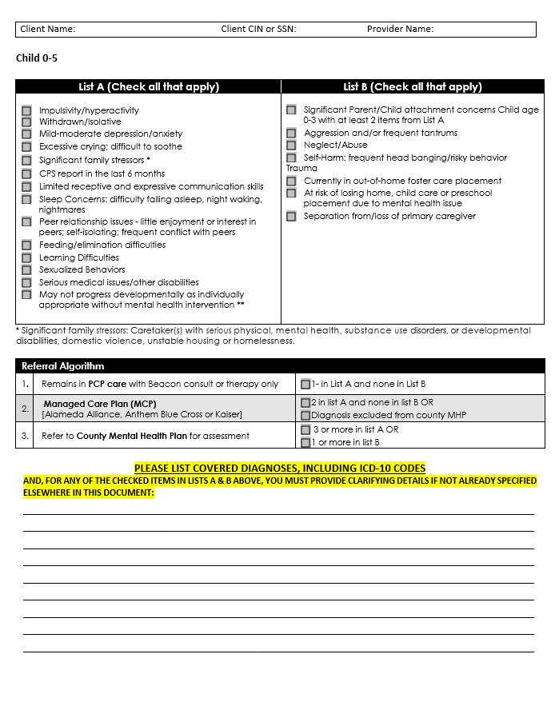
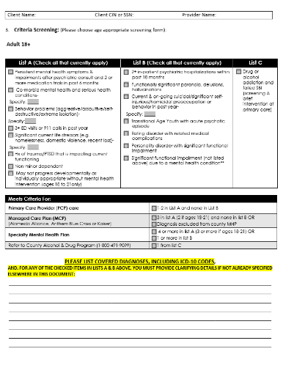
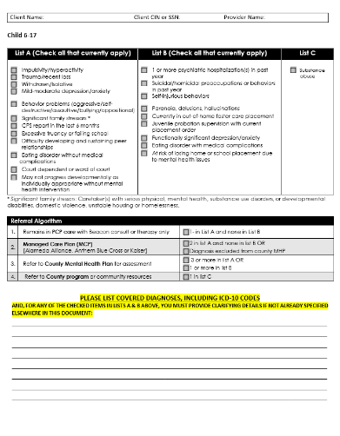
ACBH Brief Screening Tool
For every new client, the ACBH Screening Tool is required, regardless if ACCESS has included a completed screening tool or not.
An abbreviated version of these tools are embedded in the RCS form and are required upon continuation of services.
A copy of these forms must be kept in the chart.
There are three (3) age specific versions for this tool; 0-5, 6-17, and Adult. Choose the one for the age of the client. If a client is determined to have mild-moderate severity or lower, they must be referred to a lower level of care.
See slide #34 if client’s Screening Tool indicates a Mild-Moderate level of service is indicated.

Slide 24
Initial/Annual Package of Services
The package of 26 services (over a 6 month period) consists of:
20 therapy sessions (combination of Individual, Family &/or Group Therapy)
Individual Therapy - indicate: 90832-30”, 90834-60”, or 90837-90”(contact UM if 90 minute sessions are needed)
Code Crisis Therapy (additional visit) as Individual Therapy—call UM if additional sessions required.
Family Therapy - indicate: 90846-60” or X9510-90”
Group Therapy - indicate: 90853-60” or Y9506-90”
Each session regardless of length (30, 60, or 90) = 1 of 20 allowed sessions
PLUS
*Up to 120 minutes of Brokerage/Linkage in increments of 30” or 60”. Up to 120 minutes of Collateral in increments of 10” (90887-10”) or 45” (90888-45”).
Notes:
15-44 is billed a 30 min session
45-74 is billed a 60 min session
Any session over 74 would bill 90 but needs UM approval

Slide 25
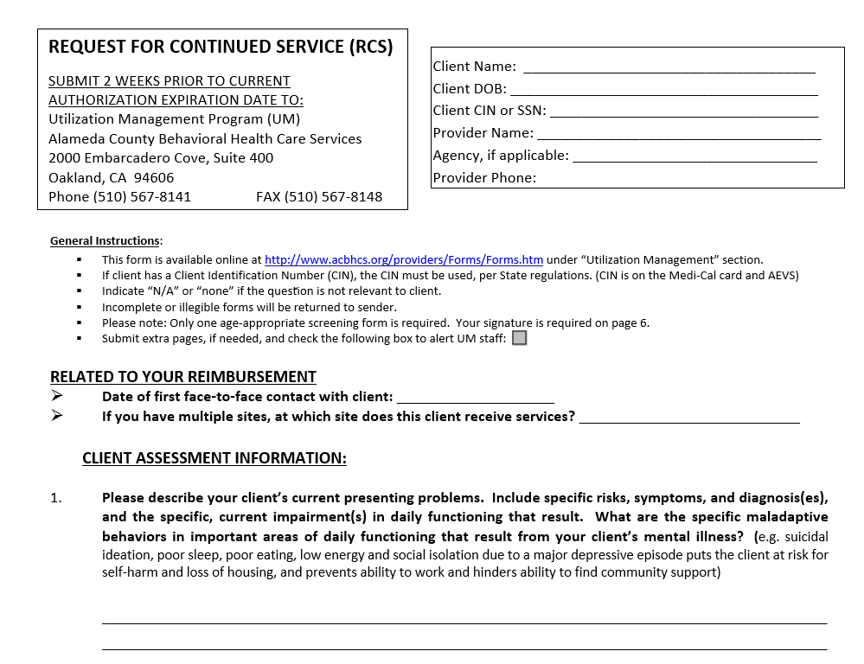
Request for Continued Services (RCS)
This form is required whenever an extension of services is being requested.
The RCS can be submitted up to 2 weeks before the 6 months from the Referral Letter Date.
Follow the instructions on the form and submit to Utilization Management FAX: (888) 860-8068
If no extension is requested or approved, all remaining services will expire 6 months from Referral Letter Date (even if not all the sessions were used).
All pages of the packet are required to be faxed.

Slide 26
Medical Necessity for Continued Services
Therapy will continue for our beneficiaries as long as:
Meets the moderate-severe medical necessity criteria
Beneficiary is benefiting from therapy
The appropriate documentation is in place demonstrating continued need for therapy.
When outpatient therapy is no longer clinically warranted the beneficiary will be referred to a higher or lower level of care.
ACBH wants to ensure that beneficiaries remain stable in the community.
There are no length of stay limits; everything is tied to medical necessity.

Slide 27
Request for Continued Service (RCS)
In response to the RCS, providers will receive a letter of approval or denial by a UM Clinical Review Specialist (CRS). Notification will also be sent to the beneficiary. Service approval is usually for a 6 month time span unless otherwise specified.
A UM CRS may request responses for additional information that does not impact the current services, such as “For beneficiary’s current medications, please list dosage and frequency.” These requests will be highlighted in yellow on the approval letter; responses expected on the next RCS.
A Provider may receive a phone call requesting case consultation if continued need for services is not clearly documented on the RCS.
If, by the 14th calendar day, the Provider fails to respond to a telephone request to help determine medical necessity, the RCS will be considered withdrawn and no approval will be processed. This will most likely result in returned claims.

Slide 28
Continued Service Package
Providers have one unit of service to complete the updated Client Plan (use Psychiatric Diagnostic Eval code)
A new client plan must be completed in the first session after extension.
For next six months:
20 Therapy sessions – Any combination of Individual, Family &/or Group Therapy as long as the modality is specified in the plan.
Individual (30, 60, 90 minutes – if approved by UM)
Code Crisis Therapy (additional visit) as Individual Therapy—call UM if additional sessions required.
Family Therapy (60 or 90 minutes)
Group Therapy (90 minutes)
3 hours - Brokerage/Linkage (30 and 60 minutes increments)
2 hours – Collateral (10 and 45 minutes increments)
Call UM if medical necessity requires additional services.

Slide 29
Crisis Services
This modality does not need to be in the treatment plan as crises are by definition not planned.
Utilize Individual Therapy Code and indicate in PN that there was a crisis intervention.
Relevant clinical details leading to the crisis
The identified crisis must be the client’s crisis, not a significant support person’s crisis. ^{(CCR24)}
The urgency & immediacy of the situation must be clearly documented and describe each of the following medical necessity requirements: ^{(CCR06) (CCR10) (CCR15)}
How the crisis is related to a mental health condition
How the client is imminently or currently a danger to self or to others or is gravely disabled
Why the client either requires psychiatric inpatient hospitalization or psychiatric health facility services or that without timely intervention, why the client is highly likely to develop an immediate emergency psychiatric condition.
Interventions done to decrease or eliminate or alleviate danger, reduce trauma and/or ameliorate the crisis.
The aftercare safety plan.
Collateral and community contacts that will participate in follow-up.
Providers should be tracking how often crisis services are being utilized and assessing whether a higher level of care is indicated.
*There is no need to get crisis services authorized by Utilization Management.
Call UM if medical necessity requires additional assessment/plan services.

Slide 30
Recommended Procedure for Completing Initial Assessment/Plan with one client visit
Unit 1
Use first unit of service and meet with client face-to-face for 45 minutes focused on Assessment and developing Plan. Spend 15-30 minutes writing Assessment/Plan. If you don’t complete Assessment or Plan in the first session, document in the session’s Progress Note that you, “completed pages 1 & 2 in Plan” or “completed sections X, Y, & Z of Assessment.” Claim one unit of 90791.
Unit 2
Without client present, complete assessment and plan. Claim a unit of 90791. Document that the client will sign the plan at the next visit.

Slide 31
Recommended Procedure for Completing Initial Assessment/Plan in two visits with client present
Unit 1
Use one unit of service to meet with client face-to-face for 45 minutes focused on Assessment and developing Plan. Spend 15-45 minutes completing the Assessment and Plan without client present. Claim one unit of 90791. Obtain verbal consent and document this in the session’s progress note.
Unit 2
Use second unit of service to meet with client face-to-face for 60 minutes doing collaborative documentation and complete the Assessment and Plan. Obtain client’s approval and signature on client plan at end of session. Claim one unit of 90791.

Slide 32
Assessment and Plan Due Dates
At every 6 months
At every Annual
Make sure RCS is submitted in time to ensure continued services are granted. RCS can be submitted up to two (2) weeks prior to 6 months from referral letter date.
New Plan with client and signature
New Assessment is not required
Make sure RCS is submitted in time to ensure continued services are granted. RCS can be submitted up to two (2) weeks prior to 6 months from start date.
New Plan with client and signature
ACBH Long Form Assessment REQUIRED

Slide 33
Specialty Services
Psychological Testing
Any provider may request psychological testing for beneficiaries by contacting ACCESS
Children and Family Services and Customized Services
Child Welfare Worker (CWW) initiates referral to ACCESS
For Customized Services, CWW must obtain supervisor approval
Providers must submit progress reports or treatment summaries to assigned CWW once every six months or upon request. Use approved code for claiming this activity.
Probation and CalWorks recipients
All referrals come through ACCESS and use assigned CalWorks codes.

Slide 34



Mild-moderate impairment
If a Provider is interested in continuing to work with a beneficiary whose condition improves to mild-to-moderate impairment, it is recommended that the Provider become a Beacon and/or Anthem Blue Cross provider. If you choose not to join their panel, you could request a single case agreement to serve a particular client in need for continuity of care. If this is not successful, you will need to refer out to their provider panel.
Beacon Health Options (855) 856-0577
Anthem Blue Cross (888) 831-2246
Kaiser Permanente (510) 752-1075

Slide 35
Audits

Slide 36
Auditing of Charts
To assure compliance with documentation and treatment planning requirements, ACBH will occasionally request treatment documentation for claims review.
When ACBH contacts you please submit the requested documents promptly.

Slide 37
Assessment

Slide 38
Brief Screening Tool (BST)
The Brief Screening Tool must be administered in order to determine eligibility for SMHS
This must be done before any services can be claimed and with every request for continued services
For Individual and Group Providers the Brief Screening Tool must be administered by a Licensed LPHA.
For Organizations a Waivered/Registered LPHA with a Licensed LPHA co-signature may also complete the BST.
Completion of Request for Continued Services is not billable. An informational/non-billable progress note should be completed.
Client must continue to meet criteria for Moderate – Severe to be eligible for Specialty Mental Health Services.

Slide 39

Informing Materials
ACBH Informing Materials (IM) must be reviewed with and signed by the beneficiary in their preferred threshold language
Before services are provided
If unable to cover IM in 30 days after the referral letter date contact Quality Assurance.
Annually
All areas must be addressed
This service is claimed as part of the MH Assessment process.
Need to have all languages of informing materials in the lobby.

Slide 40
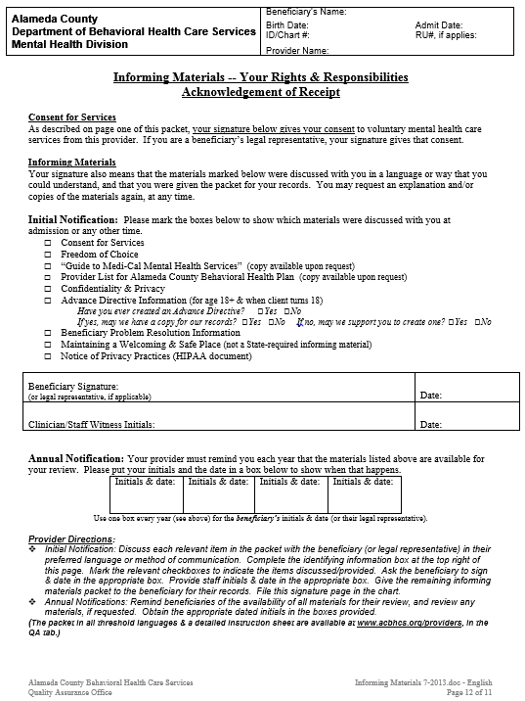
Pre-Assessment – Informing Materials
Forms are located on Provider Website > Quality Assurance > Informing Materials
http://www.acbhcs.org/providers/QA/General/informing.htm
The beneficiary must check all of these boxes, indicating that these materials were discussed.
Retain this signature page in the client record and give the beneficiary the rest of the Informing Materials packet.
The beneficiary then signs and dates here

Slide 41
Pre-Assessment – Releases of Information
Must be signed by client
Not required for other Health Care Services Providers for treatment purposes—but recommended
Not required to simply facilitate treatment referral to other Health Care Providers—but highly recommended
Releases are valid for as long as the client indicates, if no date indicated, default is 12 months.
An actual date is recommended rather than an event such as “until the end of treatment.”

Slide 42
Medical Necessity

Slide 43

The Golden Thread
The “Golden Thread” is the sequence of documentation that supports the demonstration of ongoing medical necessity and ensures all provided services are reimbursable.
The sequence of documentation on which medical necessity requirements converge is:
The Assessment
The Client Plan
The Progress Note

Slide 44
Part 1 – Included Diagnosis
DSM-5 diagnosis must be current (not historical)
For Individual and Group Providers the diagnosis must be established by Licensed LPHA
See scope of practice grid for approved list of LPHAs
For Organizations, if established by Waivered/Registered LPHA, the diagnosis must be co-signed by a Licensed LPHA.
If required co-signature is missing, then multiple claims would be disallowed until compliant.

Slide 45
Part 1 – Included Diagnosis
See Lists & Crosswalk – http://www.acbhcs.org/providers/QA/audit.htm
MH Outpatient M/C Included Dx List—Alpha
MH Outpatient M/C Included Dx List—Numeric
MH M/C Included Dx Crosswalk: DSM-IV to DSM-5
General Medical Codes List
Psychosocial Conditions List (may use any present in DSM-5).

Slide 46
Part 2 – Qualifying Impairment
A Qualifying Impairment (meets one of the following):
A significant impairment in an important area of life functioning
A reasonable probability of significant deterioration in an important area of life functioning (without treatment)
For EPSDT (children < 21 yrs): a reasonable probability that a child will not progress developmentally as individually appropriate
Indicate the most severe one on the MH Assessment (listed A-B in order of descending severity). Ex. 1: If A & B—then indicate A;
Ex. 2: If B & C—then indicate B.

Slide 47
Part 2 – Qualifying Impairment
If the client has had recent (within the last 3 months of indication) HI/SI (no plans or means required), or other high risk conditions:
A comprehensive Risk Assessment and a formalized, and written Safety Plan – must be created for treatment purposes.
See the BHCS Provider website for resources:
http://www.acbhcs.org/providers/QA/docs/2013/TR_Suicide-Homicide_Risk_Assesment.pdf

Slide 48
Part 3 – Treatment will address impairments
The focus of treatment are the signs/Sx's of the Included Dx’s and address the following:
Decrease the significant impairment in an important area of life functioning
Prevent the probability of significant deterioration in an important area of life functioning
(For Children - EPSDT) Will allow the child to progress developmentally as individually appropriate.
Indicate the most severe one on the MH Assessment (listed A-B in order of descending severity). Ex. 1: If A & B—then indicate A;
Ex. 2: If B & C—then indicate B.

Slide 49
Assessment

Slide 50
Who can create and complete an Assessment?
For Individual and Group providers, Assessment must be completed by a Licensed LPHA.
Non-Master Contract Organization claiming through a CMS 1500 paper form:
Licensed LPHAs OR Waivered/Registered therapists with Licensed LPHA co-signature.

Slide 51
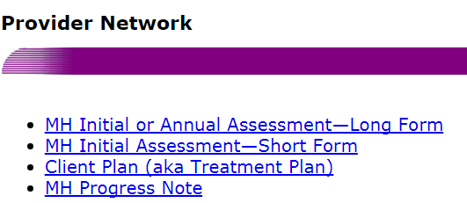
Assessment Templates
MHP FFS Individual, Group and Organizations that Claim with a CMS 1500 paper form must use Clinical Templates found on BHCS Provider Website:
http://www.acbhcs.org/providers/Forms/ProviderNetwork.htm

Slide 52
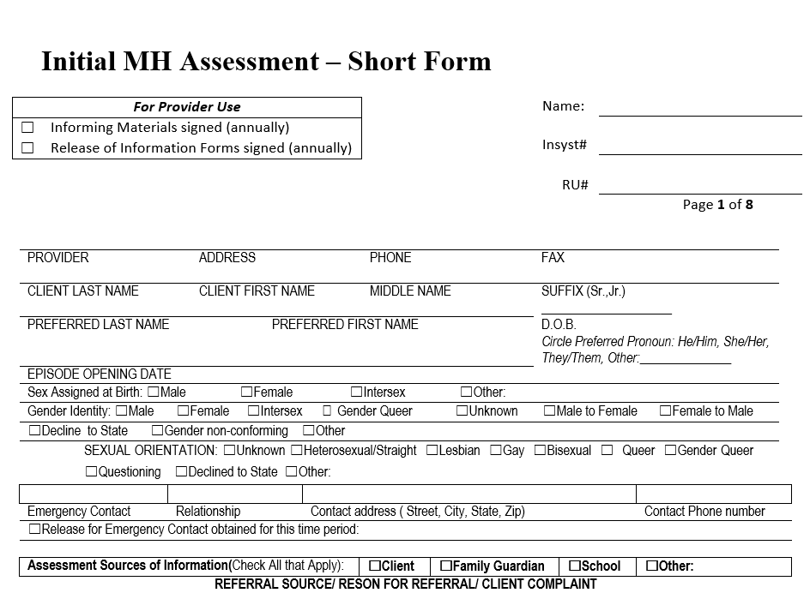
Assessment Template – Short Form
May use for Short or Long Form for the Initial Assessment

Slide 53
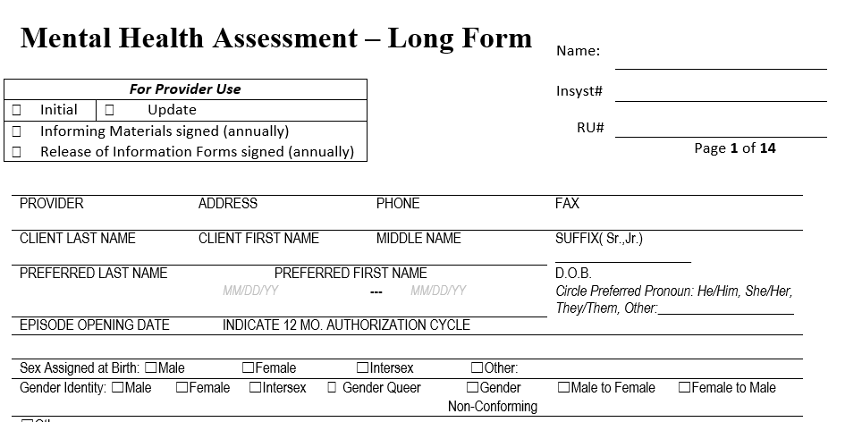
Assessment Template – Long Form
May be used for the initial assessment, but is optional.
The Assessment Long Form is required for 12 month/Annual Assessment
Both the Long and Short forms capture the same information, the long form has additional prompts for the assessor.

Slide 54

Discussing SOGIE Sensitively
What’s in a Word?
Policy Focus: Why Gather Data on SO and GI in Clinical Settings; The Fenway Institute
http://www.lgbthealtheducation.org/

Slide 55
Discussing SOGIE Sensitively
The Data collection will serve to identify LGBTQQI2-S populations which have historically been underserved as well as to assist the provider in providing culturally sensitive & responsive services.
Gathering such data in clinical settings will allow providers to better understand and treat their clients, and to compare their clients’ health outcomes with national samples of LGB or LGBT people from health surveys.

Slide 56
Why are we collecting this information?
Social determinants affecting the health of LGBTQ individuals largely relate to systemic oppression and discrimination.
Lesbian, gay, bisexual, and transgender (LGBT) clients have unique health needs and experience numerous health disparities
They are an underserved population that is largely invisible in the health care system
Routine and standardized collection of sexual orientation and gender identity (SOGIE) information in medical and electronic health records (EHRs) will help assess access, satisfaction with, quality of care, inform the delivery of appropriate health services, and begin to address health disparities

Slide 57

Why are we collecting this information?
National Resource Center for Youth Development - Fact Sheet & Healthy People 2020:
LGBT youth are 2 to 3 times more likely to attempt suicide. LGBT youth are more likely to be homeless. Transgender individuals have a high prevalence of HIV/STIs, victimization, mental health issues, suicide and are less likely to have health insurance than heterosexual or LGB individuals.
70% report being harassed at school
90% report feeling unsafe at school
Elderly LGBT individuals face additional barriers to health because of isolation and a lack of social services and culturally competent providers. LGBT populations have the highest rates of tobacco, alcohol, and other drug use.

Slide 58
Discussing SOGIE Sensitively
Recommendations for Assessment Clinician—Confidentiality & Privacy
LGBT clients may be hesitant to disclose information about their sexual orientation or gender identity due to fears about confidentiality and privacy.
These fears may have to do with not knowing what will happen with this information
Clients may be reluctant to provide such personal information to office staff in a waiting room, because it feels less private than answering the question of a provider in a private office.
During provider-client interaction there are several potential barriers to gathering this information.
Providers may not be comfortable asking these questions, or lack knowledge on how to elicit this information.
Some worry LGBT people will be reluctant to disclose due to anti-LGBT stigma and prejudice.
This may be true, and as a result not all LGBT clients will disclose their sexual or gender identity.

Slide 59
Discussing SOGIE Sensitively
Questions recommended by national LGBTQ organizations include:
Two-step sex/gender question
What is your current gender identity: male, female, transgender, or other? (For written—select from list.)
What was your sex at birth: male or female? (For written—select from list.)
And
A sexual orientation question
How do you identify?
Who are you attracted to?

Slide 60
Discussing SOGIE Sensitively
Recommendations for Assessment Clinician—Language and Client Choice to Disclose:
Providers can also use inclusive or neutral language, such as “Do you have a partner?” instead of asking “Are you married?” which to most people still refers to heterosexual relationships
Providers should ask permission to include information about a client’s sexual orientation and gender identity in the medical record, and assure confidentiality.
If self-disclosure does not come up in response to general questions such as those proposed above, further questions can be embedded in the sexual history. Such a history should address sexual risk behavior as well as sexual health, sexual orientation (including identity, behavior, and attraction), and gender identity.
I.e. Many men may disclose they have sex with a man but not identify as LGBTQ.

Slide 61
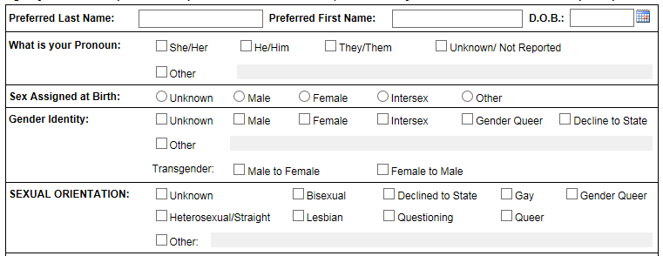
Client Information & SOGIE (Sexual Orientation and Gender Identity Expression)
For Gender Identity, Sexual Orientation and “My Pronoun” select all that apply.
When collecting “caretaker/guardian” information—use that label rather than mother/father (may be same-sex household), parent (may be extended family members), etc. Only exception would be biological parents if genetic information is needed.
If spouse is being requested: indicate “spouse or significant-other”.

Slide 62
SOGIE Resources and Suggested Email Signature
www.EastBayPride.com
Symbols of LGBTQQI2-S Support such as email signature line with pronouns:
Thank you,
Tony
Tony Sanders, PhD
Pronouns: He/Him/His (What is this?)
“What is this” link: https://www.mypronouns.org/

Slide 63
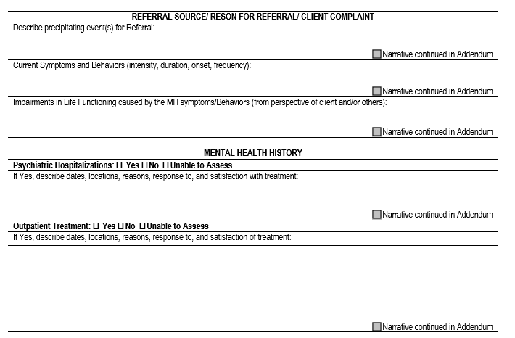
Referral Source, Mental Health History

Slide 64
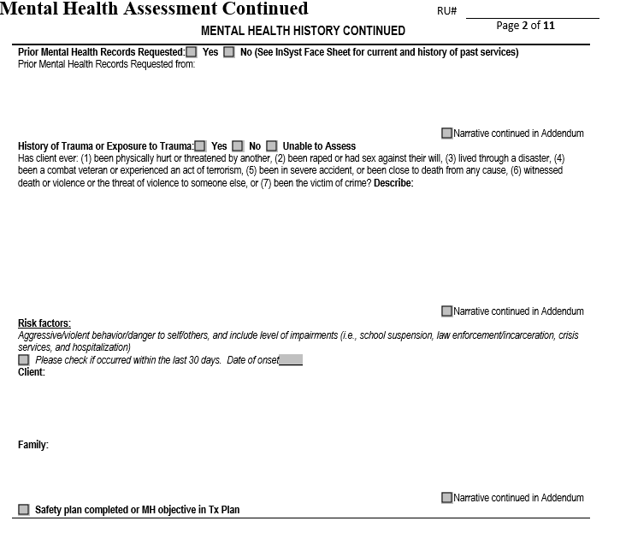
Mental Health History, Risk Factors (including reminder about Safety Plan)

Slide 65
Risk Assessment & Safety Plan
If suicidal, homicidal or other significant risk is found during the assessment and occurred within the last 90 days, both a comprehensive risk assessment and a formal written safety plan must be developed in coordination with the client.
Beyond 90 days of suicidal, homicidal or other significant risk ideation, if it is determined that a Comprehensive Risk Assessment and formal written Safety Plan are not indicated, document the clinical reasoning for this decision.

Slide 66
Risk Assessment & Safety Plan
Comprehensive Risk Assessment (must be documented in Clinical Record):
Reason for Comprehensive Assessment
Current Episode: Current Intent (Subjective Reports & Objective Signs); Plans; Access to Means; and Ideation (Frequency, Intensity & Duration)
History of Risks and Attempts (Self-Harm, Risk to Others, & Hospitalizations related to Risk)
Risk Factors (Internal, & Environmental)
Protective Factors (Internal, & Environmental)
Focused Symptom Severity (Depression, Anxiety, Anger, Agitation, Insomnia, Hopelessness, Perceived Burdensomeness, Impulsivity/Self Control, Chronic Risk, Therapeutic Alliance, and Current Level)
Status of Crisis Safety Plan
Comprehensive Risk Assessment Resource:
http://www.acbhcs.org/providers/QA/docs/2013/TR_Suicide-Homicide_Risk_Assesment.pdf

Slide 67
Risk Assessment & Safety Plan
Formal Crisis Safety Plan (written from client’s perspective as their plan).
What are my Warning Signs (Thoughts, Images, Thinking Processes, Mood & Behavior)?
What Are My Triggers?
What Internal Coping Strategies may I Use (Identification of, Likelihood of Use, Barriers and Problems Solving)?
What Social Contacts May I Use (For Distraction &/or for Support—multiple people in multiple settings)?
When Will I contact my Family Members and/or Friends to Assist in the Resolution of the Crisis?
Which, and When Will I Contact, Professionals and Agencies for Assistance (Priority & Expectations)?
How May I Reduce the Potential for Use of Lethal Means?
The Implementation of Safety Plan (Likelihood of Use and Problem Solve if Obstacles; Regular Review)
Resource: www.mentalhealth.va.gov/docs/VA_Safety_planning_manual.doc

Slide 68
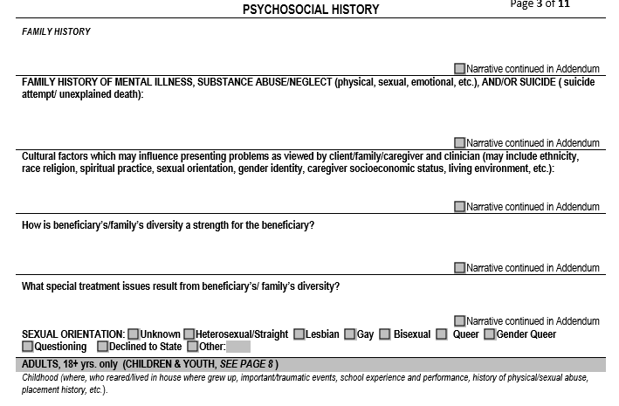
Psychosocial History

Slide 69
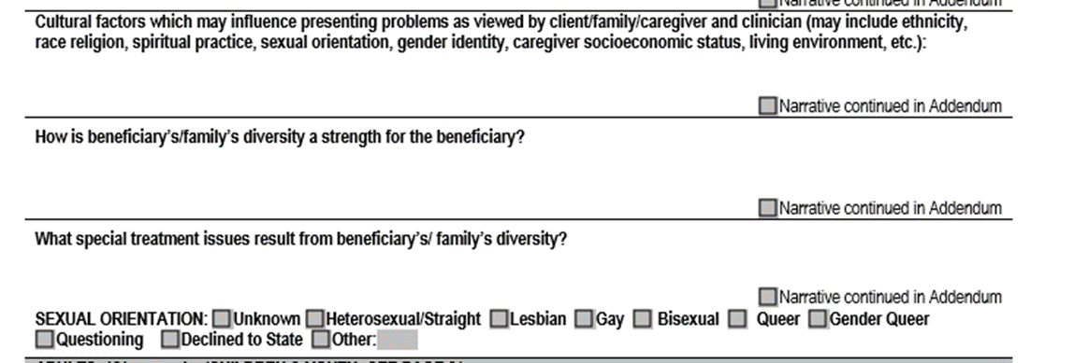
Cultural Considerations

Slide 70
Cultural Considerations
Identified during the Assessment Process and addressed in the Plan if appropriate
Language & Physical Limitations
If a client or family member requires an Interpreter—call the ACCESS line for authorization.
Race, Ethnicity, Socio-Economic Status, Class, Religion, Immigration status/Citizenship, Geography,
Assessment template forms now include SO/GIE (Sexual Orientation/Gender Identity/Expression) fields

Slide 71
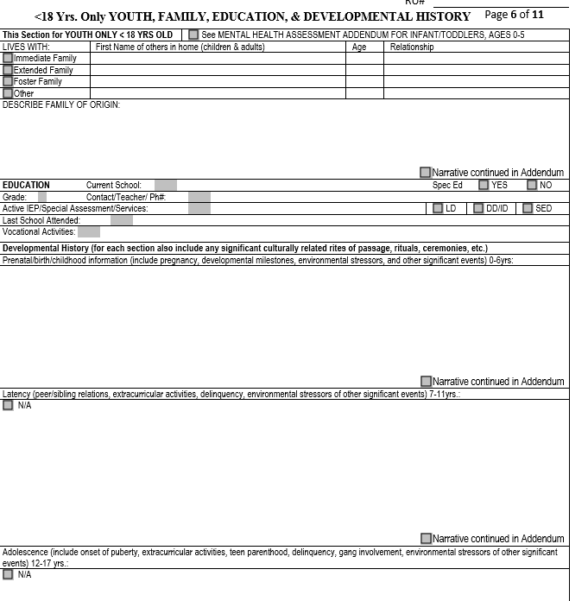
Developmental History (Child, Youth only)

Slide 72
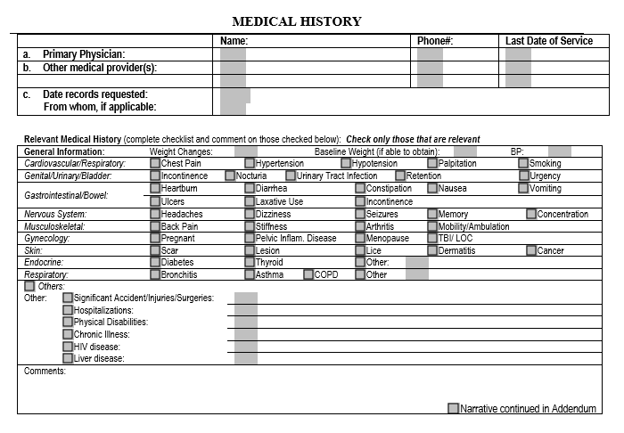
Medical History

Slide 73
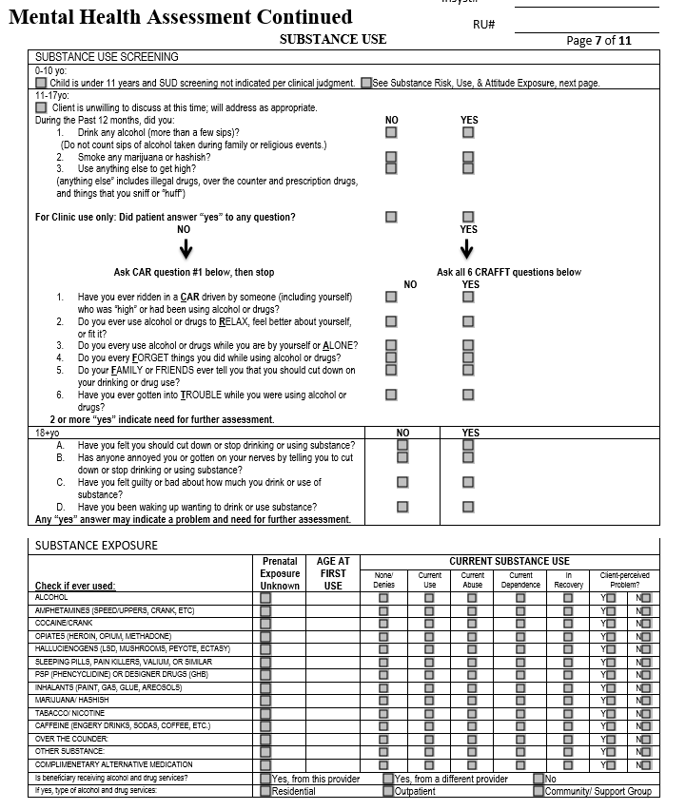
Substance Use

Slide 74
Substance Use Considerations
Must Assess for Substance Use in 7 Areas:
Tobacco, Alcohol (ETOH), Caffeine, Complimentary Alternative Medicine (CAM), Prescription (Rx), Over The Counter (OTC), and Illicit Drugs
Assess for Substance Use Disorders (SUD):
Document past and current use in record
For children/adolescents also document the caregivers’ use and impact upon the client
If appropriate establish SUD Diagnosis
Cannot be primary (FOCUS OF TX) Diagnosis
Best to also include in Client Plan. However, this is only done so by addressing the underlying MH Dx’s signs, Sx, and behaviors through the MH Objectives.
Refer to substance use treatment services through the Substance Use Access and Referral Helpline at 1-844-682-7215 x2

Slide 75
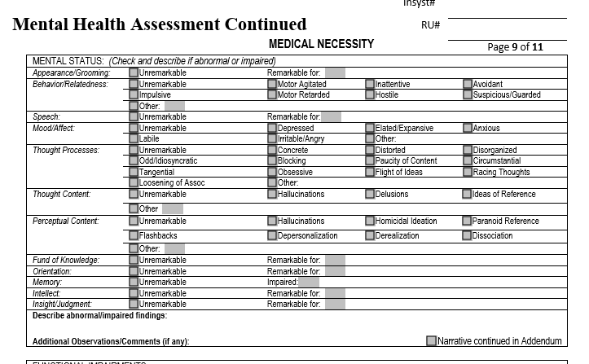
Medical Necessity Mental Status Exam (MSE)

Slide 76
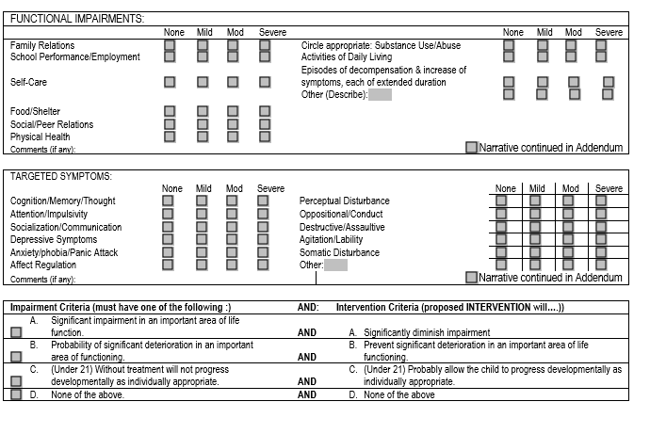
Medical Necessity Functional Impairments

Slide 77
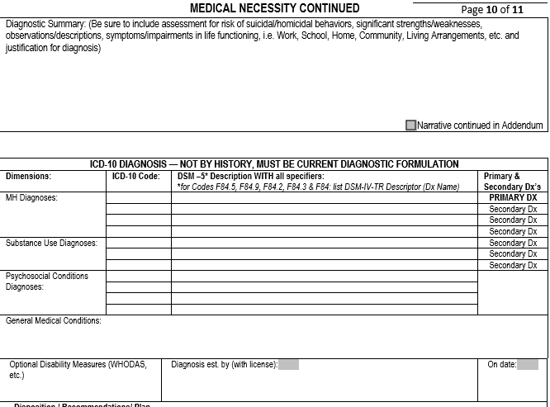
Medical Necessity Diagnostic Summary and ICD 10/DSM 5 Dx

Slide 78
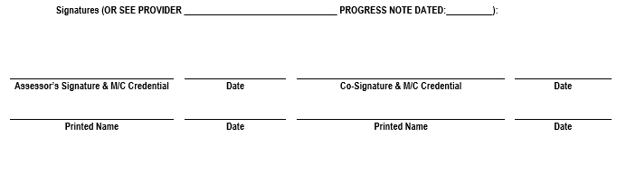
Assessment Signatures

Slide 79
No Planned Services Before Assessment and Plan Are Complete
May be claimed
May be Not Be claimed*
MH Assessment/Plan Development Services
Crisis Intervention (must be at immediate risk of hospitalization due to danger to self, danger to others or grave disability.) MHP FFS Providers use Individual Therapy code.
Medical Providers - prescribers (as needed may prescribe while claiming Psychiatric MH Assessment if PN indicates “urgent” need)
Case Management – Linkage Only
Psychotherapy (Individual or Group)
Rehabilitative Services (Individual or Group)
Collateral
Case Management - Monitoring
Non-urgent medication services
*list not exhaustive

Slide 80
Medication Services—Prescribers Only
For children who are wards or dependents of the juvenile court and living in an out-of-home placement or in foster care prescribers are required request permission from the court before any psychotropic medications are administered.
See http://www.courts.ca.gov/documents/jv217info.pdf for more specific information about JV-220 requirements.
In addition to a completed JV-220, prescribers must also complete medication consent forms, as described on the following slide.

Slide 81
Medication Services—Prescribers Only cont.
Medication Consent Forms
Required for all medications prescribed by Medical Provider
ACBH Medication Consent Forms Required—or equivalent—all sections completed. http://www.acbhcs.org/providers/Forms/Forms.htm#Med_consent
Additional Medication Information Sheets are available online.
If client’s preferred language is other than English use the translated Medication Consent Form that is available in all threshold languages.
Always offer to provide interpretation of the information contained in the Medication Consent Form in their preferred language if client speaks a language other than threshold languages—document this in the progress note.

Slide 82
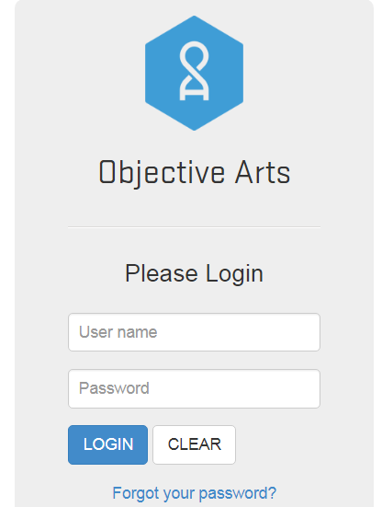



CANS / ANSA
is not & are not required at this time.

Slide 83
Assessment Finalization Timelines
The Initial Assessment – Short or Long form - is due prior to the client’s 3rd unit of service.
If client is seen for more than 12 months, the Annual Assessment – Long Form is required and must be completed within the first two units of service.

Slide 84
Client Plans

Slide 85
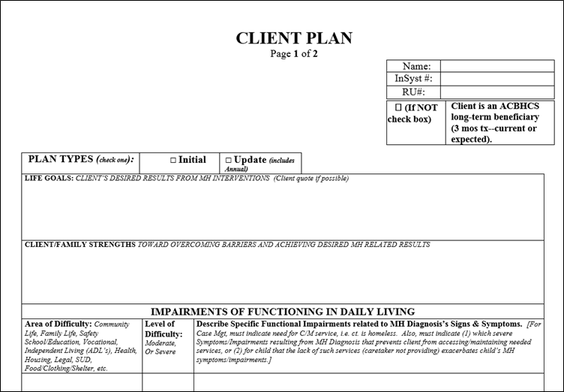
Client Plans

Slide 86
Getting Ready to Write Plan with Client
Established Medical Necessity
Completed Assessment (with required co-signatures if applicable)
Documented the need for case management in the Assessment if considering providing case management services
Have conducted a Risk Assessment and developed & written a Safety Plan if you have assessed any risk factors within the past 90 days and including an objective related to containment.
Consider addressing any cultural, linguistic, physical limitations in Plan

Slide 87
Who can create and complete Plans?
Individual or Group of Providers
Licensed LPHAs only
Organizations
Licensed LPHAs OR Waivered/Registered Interns

Slide 88
Plan Finalization Timelines
The Initial Client Plan is due within 60 days of the referral letter date AND prior to the 3rd unit of service.
If a case is closed before the third unit of service, a completed plan is NOT required.
Client plan must be updated immediately following any extension and annual update
Six month plan updates are due before the 2nd unit of service after the 6 month RCS approval.
Annual/Yearly plans are due by anniversary of the referral letter date. How is this if they are given longer time for the Annual Assessment—see slide #83 “within the first two service units of renewal date”
Once the client signs the plan no changes can be made to that plan.
Client’s/Representative approval and signature must be obtained each time plan is updated.

Slide 89
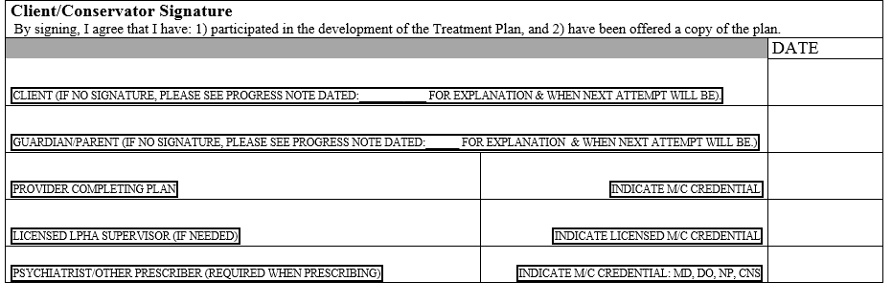
Plan Signatures
The Plan finalization date is the when the licensed LPHA signs
and is not considered completed until the
Client/Representative signs—or indicates why not.

Slide 90
What if I can’t obtain the client’s signature?
If you are unable to obtain a client’s signature, you must document either by writing on the plan or in a progress note the reasons why you cannot obtain client’s signature and that you will attempt again at the next face to face session (or clinical reason why contraindicated).
“Client agreed verbally to Client Plan formulation at last visit. Client no showed for today’s session. Will review plan and obtain written signature at next session.”
“Due to client’s paranoia, client gave verbal consent, but refused to sign plan. Clinician will attempt to obtain signature within next three months.

Slide 91
What if I still can’t obtain client’s signature?
If the client does not sign or refuses to sign the Client Plan, regular efforts should be attempted and documented to obtain the client’s approval. If client was simply unavailable—then must attempt at next scheduled appointment.
If not fully documented per instructions above, DHCS/ACBH QA will disallow all claims made after the date the Plan should have been signed by the client and until all required signatures are obtained.

Slide 92
Additional Client Plan Updates
Providers must update the treatment plan through-out the year when clinical changes occur. DHCS (and QA) will disallow notes if the treatment plan has not been updated to reflect new client goals, mental health objectives, and events in the client’s life.
Examples of events requiring a consideration of change to the Plan be documented in the PN include, but are not limited to:
Hospitalization, new thoughts or behaviors of self-harm or dangerousness to others, additions of new service modalities (i.e. medication services, case management, group rehab, individual therapy, etc.), school suspension, placement risk, etc.
As needed plan updates are claimed as an Individual Therapy session and each counts as one of the allotted therapy sessions.
Remember, with every plan update, Brief Screening Tool and new plan signatures are needed

Slide 93
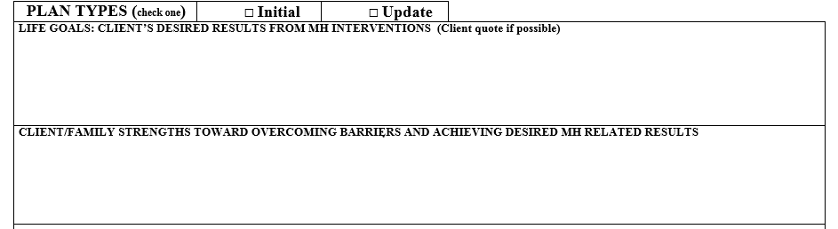
Client’s Life Goals Section

Slide 94
Client Goals
The Client Goals are the long-term hopes of the consumer and/or caregiver/parent. Goals…
Should focus upon their personal vision of recovery, wellness, and the life they envision for themselves
Can be in the client’s own words
Increase client engagement and buy-in to services
With the client’s goals in mind, providers assist the client by “translating” their goals into short term Mental Health objectives.
Client says, “I want to live on my own someday.” or “I want to have a better relationship with my family.”
To identify what mental health goals to work on, providers can ask “What gets in the way of you achieving these goals?”

Slide 95
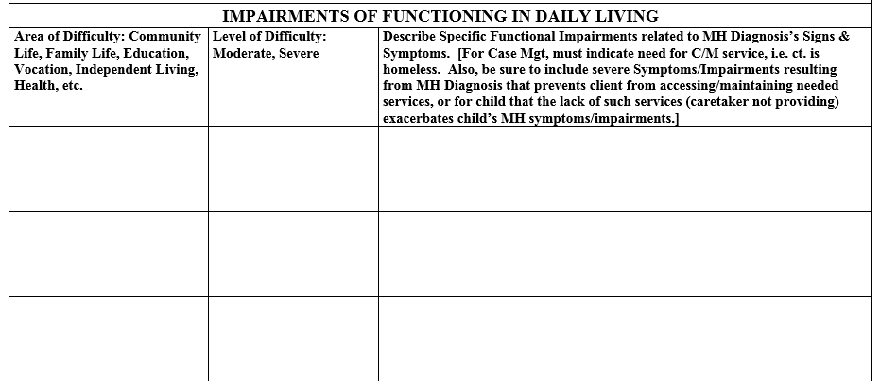
Impairments / Area of Challenges

Slide 96
Impairments / Area of Challenges
Indicate Area of Challenges: Community Life, Family Life, Safety School/Education, Vocational, Independent Living (ADL’s), Health, Housing, Legal, SUD, Food/Clothing/Shelter, etc.
Indicate Level of Challenges
Moderate or Severe (remember to rate accordingly—severe—if documenting to a Significant Impairment in an Important Area of Life Functioning for Medical Necessity).
Describe Specific Functional Impairments related to MH Diagnosis’s Signs & Symptoms.
For Case Mgt, it is best to indicate the need for C/M service, i.e. ct. is homeless. Also, to indicate: (1) which severe Symptoms/Impairments resulting from MH Diagnosis that prevent client from accessing/maintaining needed services, or (2) for child that the lack of such services (caretaker not providing) exacerbates child’s MH symptoms/impairments.

Slide 97
Discharge Plan
Estimated treatment plan duration, describe criteria (readiness) that would indicate client could successfully transition to a lower level of care with possible referrals and discharge plan.
“Long Term Client w/o Discharge Expected”
Is never a discharge plan

Slide 98
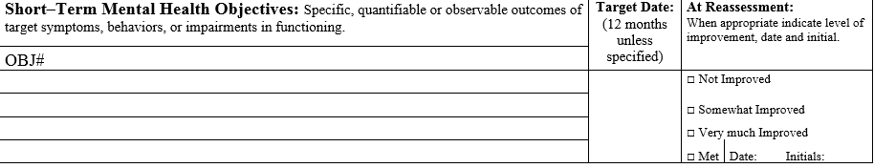
Mental Health Objectives
Note that the ACBH Treatment Plan Template prompts for a 12 month Objective Target Date, however as treatment plans are required to be updated every 6 months, most objectives will need modification at 6 months.

Slide 99
Mental Health Objectives
All Objectives must directly address the client’s mental health Sx's and cannot focus on finding housing, getting a job, providing SUD counseling, etc.
A way to see if the client (not caregiver) is improving
Measurable change in helping the client achieve their long-term goals
Can address MENTAL HEALTH symptoms, behaviors or impairments identified in the Assessment
OR
Be Strength-Based mental health objectives replace problematic Sx with positive MENTAL HEALTH coping skills/behaviors/etc.
Should be based upon the client’s abilities and be meaningful to the client
What are they identifying as the problem? Why did they reach out for help?

Slide 100
SMART Objectives
SMART (Specific, Measurable, Attainable, Realistic and Time-Bound)
Important to look at how they might impact and build upon strengths and supports
Must include duration: at least 6 months
Special note about duration: At least one mental health objective must be valid for 6 months or the plan will need to be updated due to not having any current objectives after the last stated duration (such as only having a MH Objective with a 3 month duration).

Slide 101
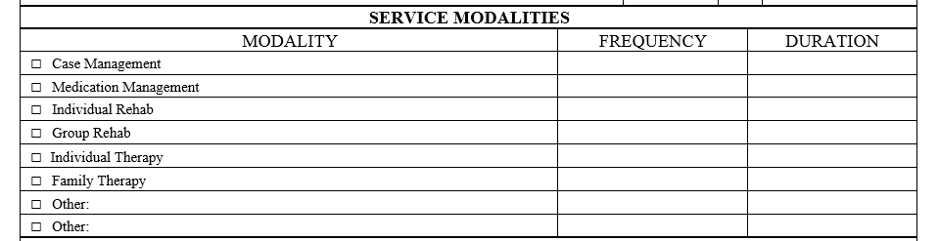
Service Modality
Note: Individual Rehab and Group Rehab are NOT available AND Individual Therapy is available.
Also, Other can include Collateral

Slide 102
Service Modalities
Identify the proposed type(s) of service modalities to be provided along with a proposed frequency and duration.
If the planned service modality for a claimed service is not in the client plan it MAY NOT BE CLAIMED and MUST be disallowed if it is claimed. This includes Case Management and Collateral.
Don’t include Assessment/Plan Development/Crisis modalities in the plan.

Slide 103
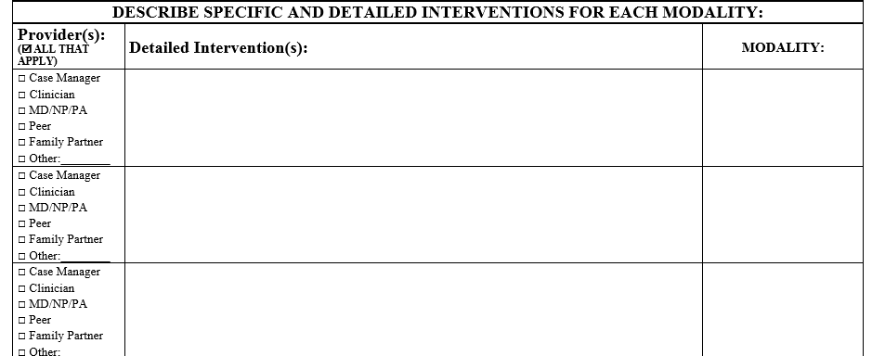
Detailed Interventions
Detailed Interventions are required for each Modality

Slide 104
Detailed Interventions
For each service modality include a detailed description of interventions to be provided. Interventions must focus upon and address the identified functional impairments as a result of the mental disorder.
Interventions must be consistent with the client plan mental health objectives and the qualifying diagnoses.
Interventions for Collateral should include listing significant others (by names and/or roles) for whom contact is planned and indicating “and others as needed.”
Detailed Interventions for Case Management would best indicate that successful C/M (linkage and monitoring) will result in the client’s MH Symptoms being reduced (i.e. achievement of Client’s MH Objectives).

Slide 105
Detailed Interventions - Examples
Detailed Interventions should be general and also specific to client’s mental health needs
Examples:
Individual Therapy
Use CBT techniques to help client identify triggering thoughts that lead to client’s aggressive behaviors and replace with prosocial behaviors and other positive activities.
Collateral
Provide psychoeducation to significant support persons of client including parents, teachers, and school counselor (others as needed) to assist client in his/her MH Goals and Objectives of x, y & z.
Med Services
Medication management strategies to engage client in collaboration to find, and optimize the dosage for effective anti-depressive medications.

Slide 106
Plan Example #1: Client with Moderate/Severe Symptoms
Billable example: Treatment Plan Goal
Dx: Generalized Anxiety DO (Excessive worry that is persistent throughout the day regarding most situations, which occurs every day. Low energy, difficulty in concentration, feels irritable and tense.)
Impairments: Relationship difficulty with partner (frequent arguments), difficulty completing work assignments, loss of enjoyment in daily activities (“polluted” by worry).
Goals: Client states: “I don’t want to feel this way…like something is wrong all the time.”
(Optional) Long Term MH Goal: Learn to control worrisome thoughts and feelings and increase positive relationship with partner (gain more patience/less irritability).
Notes:
Group activity
One vignette – diagnosis, impairments and client goal
Choose out of the fishbowl which section
Objective, intervention, service modality and detailed interventions, discharge plan

Slide 107
Plan Example #1 Continued: Client with Moderate/Severe Symptoms
Billable example cont.:
Mental Health Objective(s):
#1) # of times client has arguments with family, friends, co-workers will decrease from 10 times per week to 3 or less per week as evidenced by partner and client report for the next 6 months.
#2) Increase the number of daily activities in which client feels they are able to control anxious feelings from 1-2 times per day (currently) to 5 times per day or more as evidenced by self report for the next 6 months.
#3) Client will increase the number of times they use coping skills learned in therapy to manage anxiety from (0 times per day) to 10 or more per day as evidenced by journal keeping for the next 6 months.

Slide 108
Plan Example #1 Continued: Client with Moderate/Severe Symptoms
Billable example cont.:
Service Modality:
Psychotherapy 1x/week, and as needed, for 20 sessions for 6 months.
Case Management 2 sessions in next 6 months
Collateral 2 sessions in next 6 months
Detailed Interventions:
Individual Psychotherapy – psychodynamic therapy to help client process through past traumatic events that precipitated the onset of anxious feelings. CBT therapy to help teach client coping skills to manage symptoms as they arise.
Case Management – Successful linkage of client to primary care provider/psychiatrist to discuss possible medication options for client. This is expected to decrease the client’s irritability and to increase their energy and concentration.
Collateral – Will provide psychoeducation to client’s partner regarding client’s symptoms and how to best support client in managing anxiety.

Slide 109
Plan Example #2: Client with Severe Symptoms
Billable example: Treatment Plan Goal
Dx: Major Depressive Disorder (lack of interest in all areas of life, low energy, insomnia, indecisiveness, feelings of worthlessness, and poor self-care)
Impairments include Client’s difficulty in maintaining employment, having positive social interactions, completing daily tasks, maintaining independent housing, and accessing resources in the community.
Goals: Client states: “I want my own place to live.”
(Optional) Long Term MH Goal: Decrease depression and increase coping skills, so that client’s depressive signs and symptoms do not negatively impact his ability to meet his life goals.

Slide 110
Plan Example #2 Continued: Client with Severe Symptoms
Billable example cont.:
Mental Health Objective(s):
#1) Client’s depressive symptoms are reduced as evidenced by an increase in energy from “1-2” energy level (current) to 6-8 on a 0-10 scale (10 being high energy) per self-report by 6-12 months.
#2) Client is engaged and invested in his self-care as evidenced by increased # of showers per week from 0 to 2 or more; and increased brushing of teeth from 0x daily to once daily within the next 6-12 months.
#3) Client will increase daily living activities and demonstrate successful self-identified task(s) completion 3 – 4 x’s/week (now 0/week) for the next 3 – 12 months.

Slide 111
Plan Example #2 Continued: Client with Severe Symptoms
Billable example cont.:
Service Modality:
Psychotherapy 1x/week, and as needed, for 20 sessions for 6 months.
Case Management 2 sessions, in next 6 months.
Collateral 2 sessions in next 6 months.
Detailed Interventions:
Psychotherapy – CBT to help client link feelings of worthlessness to depressive symptoms, to explore roots of low self-esteem and areas of competence.
Case Management – Successful linkage of client to housing resources in community. Connecting client to resources is expected to decrease client’s sadness and depression.
Collateral – Will provide psychoeducation to client’s mother regarding client’s symptoms and how to best support client in managing his depression.

Slide 112
Progress Notes

Slide 113
Claiming to Medi-Cal
Every claim made to Medi-Cal must have a corresponding progress note in the client’s chart
All assessment and plan development sessions require progress notes in order to be claimed. The assessment and plan are not enough to complete the claiming process. Use the appropriate Assessment / Psychiatric Diagnostic Evaluation Codes to claim for these services.
When writing notes documenting the Assessment and Plan sessions, if each are completed in one session, the progress note may include a reference to the completed form. For example, “This therapist gathered information to complete the Assessment. See Assessment dated…”
If the Assessment or Plan spans multiple sessions, then the progress note may reference completed sections in the assessment or plan, as long as what sections were completed in that session are specified.
If it is not possible to reference specific sections of the assessment or plan, then the content of the session must be included in the progress note.

Slide 114
Progress Notes Must…
Progress Notes must contain:
Procedure Code of service provided to client
Date of Service
Indicate what language the service was provided (unless English Speaking client and in the MH Assessment it indicates: “English speaking client and all services will be provided in English”).
Legible Provider Signature with Medi-Cal credential and date signed (not date of service) unless written and finalized with signature on the same day.
Only use ACBH approved abbreviations—if you use an additional abbreviation, or acronym, the first time it is used in each PN it must be spelled out.

Slide 115
Progress Notes Must…
Indicate code and exact minutes designated from Code/Rate Sheet.
Default to the code closest (rounding up and down) to the minutes it took for f-f or phone contact time and documentation time.
Do not put the actual total minutes or break down face-to-face and doc time for example.
e.g. 60 minute Ind. Psychotherapy with 10 minutes documentation should be documented as 90834-60”.
90 minute Psychotherapy requires provider to call UM to confirm medical necessity is met for providing this service at Network Provider level of care.

Slide 116
B/PIRP Format – Progress, Not Process
Behavior/Assessment, Purpose/Problem =documents what is presently going on with the client (brief narrative), especially in terms of progress towards MH goals and objectives
Intervention by Staff =Identifies what you did today (i.e., what specific intervention was provided toward the mental health objectives). Cut and paste interventions from previous session may result in a disallowance.
Response of Client to Intervention = Identifies client’s response today toward the interventions and impact/progress toward their MH objectives
Plan for future services = Provides plan for continued services i.e. collaterals, coordination of care, continue with CBT techniques etc. Can include any follow up by the provider or client—not simply and always: “next session on mm/dd/yy”
Always indicate which MH Objective (restate or reference # of Objective in Plan) is being addressed

Slide 117
Modifying Progress Notes for Case Management Services
“B/P” Problem: “Client reports they were evicted over the weekend. Clients symptoms of depressed mood & fatigue prevents client from contact the shelter for assistance in spite of desire to do so”
“I” = Identifies what you did (i.e., what intervention was provided toward the mental health objectives): provided or received info, etc. (i.e. with client present, I called the shelter with a referral and made appointment for the client at 4pm today.)
“R” = Identifies contact’s response toward the interventions and progress toward the purpose above “B” (i.e. client agreed to make the shelter appointment as scheduled and to report back to this provider of how it was going at our next scheduled appointment.)
P = Provides plan for continued services as a result of this service: i.e. collaterals, coordination of care, etc. Can include any follow up by the provider or client. (Successful housing of the client through case management is expected to result in the client of meeting their MH goals of reducing depression and associated fatigue”)

Slide 118
Progress Notes FAQs
Can I combine different types of services in one progress note?
No, claim separately even if provided on the same date of service.
Can I combine two of the same services on the same day, for example two collateral phone calls to different people?
Yes, but it may be clearer to the auditor to claim separately if talking to different people. Most likely these discussions will have different purposes.
Can I combine two 10 minute collateral services with the same person together for one 20 minute collateral service?
Yes, you would put two 10 min. collateral codes on form CMS 1500 and document this in one progress note for the chart.

Slide 119
Non-Billable Services
Travel time may not be incorporated for claiming purposes
Voice mail, Email, Text messages (leaving or receiving)
Faxing
Non-Treatment related report writing (i.e. disability report for SSA or Abuse/Neglect reporting—phone or written)
Scheduling
No shows/ Missed Appointment
Lock-outs
Transporting the client
Completing the Brief Screening Tool
Non-SMHS services such as vocational, housing, payee.
If any part of the note includes such activities without indicating “did not claim for the time it took to do that activity,” the claim will be disallowed.

Slide 120
Non-Billable Services
Payee related (Indicate payee portion of visit in a separate—non-billable service note.)
Socialization Group, which consists of generalized group activities that do not provide systematic individualized feedback to the specific targeted behaviors of the clients involved
Translation and/or interpretive services, including sign language
Activities or interventions whose purpose includes providing vocational training, academic education or recreational activity
After client’s death
If any part of the note includes such activities without indicating “did not claim for the time it took to do that activity,” the claim will be disallowed.

Slide 121
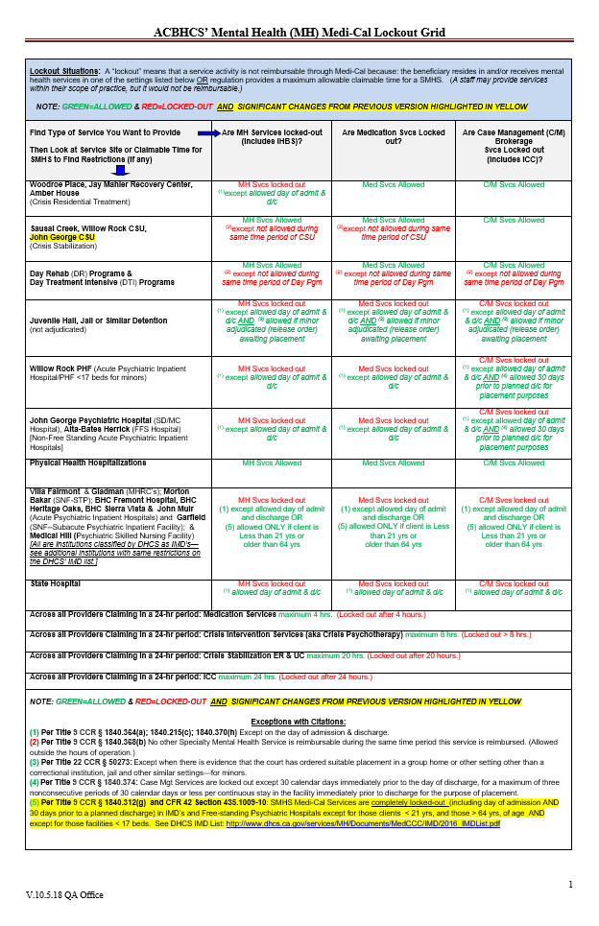
Mental Health Services Lockout
Lockouts” are services that cannot be reimbursed or claimed due to the potential duplication of claim (“double billing”) or ineligible billing site.
http://www.acbhcs.org/providers/QA/docs/training/MH_Lockout_Grid.pdf

Slide 122

Group Exercise: Putting on an Auditor’s Hat
Read note together
Look for ‘questionable’ issues
Group discussion

Slide 123

Final Considerations
Always keep in mind that the Clinical Record belongs to, and is about, the client. Write as if the client will be reading it and it will be therapeutic to do so.

Slide 124
Procedure Codes

Slide 125
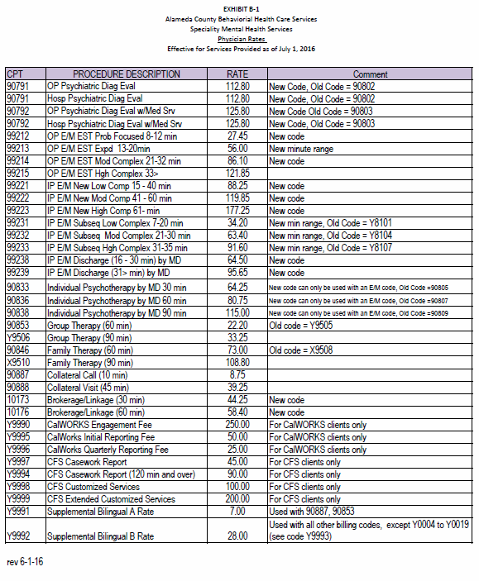
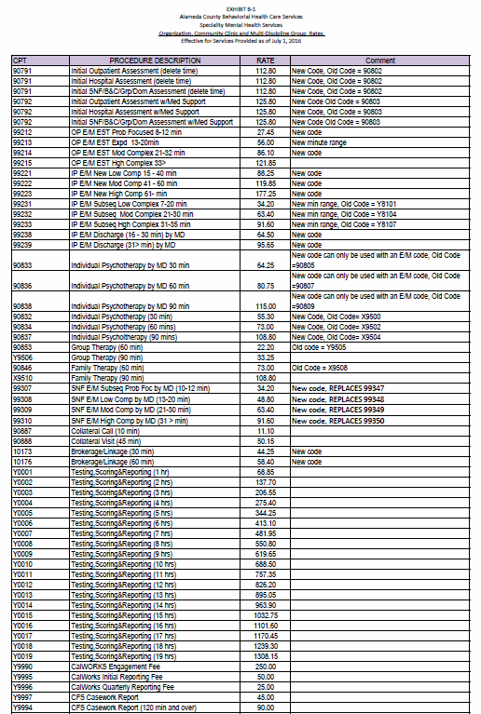
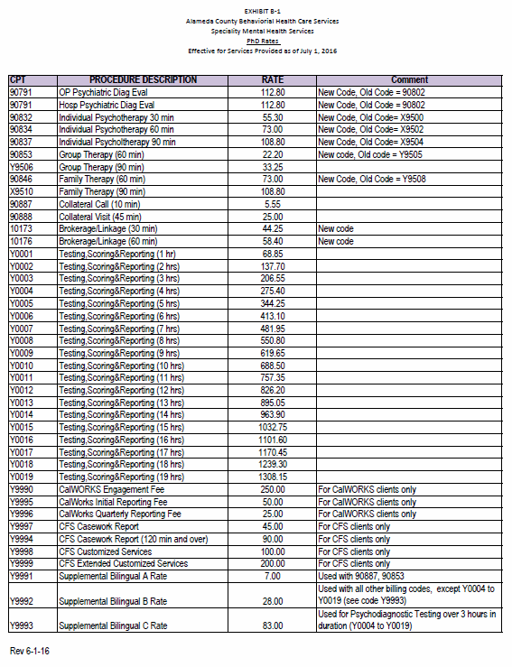
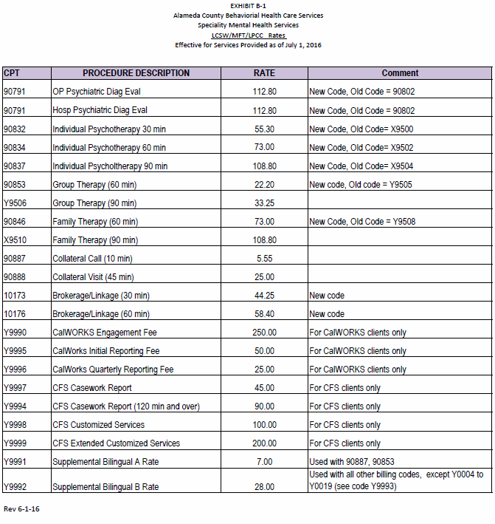
MHP FFS Procedure Codes
Choose the right one for your license:

Slide 126
Procedure Code/Services
Assessment and Plan Development
Use the same code for both assessment and plan development
Most likely this will be OP Psychiatric Diagnostic Eval (90791) or, for prescribers, OP Psychiatric Diagnostic Eval w/Med Srv (90792).
Indicate code and actual minutes
Using these codes counts towards the two allotted initial Assessment/Plan Development units of service initially and annually.
At 6 month extension, one unit of service is available for plan development.

Slide 127
Procedure Code/Services
Individual Psychotherapy
A therapeutic intervention
Focus primarily on symptom reduction
Individual Psychotherapy modality must be in the plan to claim for these services
See rate sheet for specific codes
Example: A 60 minute Individual Psychotherapy session by a LPHA with a client at a private practice office would be coded as 90834-60”

Slide 128

Procedure Code/Services
Family Therapy
Client must be present during the session.
Interventions should address client’s presenting problems in the context of the family system.
Interventions must focus on reducing the client’s mental health symptoms. Client’s response to treatment must be documented accordingly.
Family Therapy must be a modality in the client plan.
Example: A 90 minute Family Therapy session by an LPHA is coded as X9510
Notes:
No couple’s therapy!

Slide 129
Procedure Code/Services
Group Therapy
One facilitator can reasonably facilitate a group of up to six clients. For multiple facilitators, only one unit of group service is claimed for each client.
One group therapy session counts as one session from client’s package.
Group Therapy must be a modality in the treatment plan.
For example: A 90 minute Group Therapy session facilitated by a Ph.D. would use code Y9506-90”.

Slide 130
Claiming Group Therapy
Group therapy modality must be listed in the treatment plan
For each group member, attending group counts as one session
Facilitator must write individual progress notes for each group member
Each group service for each client is claimed as 90853—60” or Y9506—90”

Slide 131

Crisis Services
Use Individual Psychotherapy codes
This modality does not need to be in the treatment plan as crises are by definition not planned.
Relevant clinical details leading to the crisis
The identified crisis must be the client’s crisis, not a significant support person’s crisis. ^{(CCR24)}
The urgency & immediacy of the situation must be clearly documented and describe each of the following medical necessity requirements: ^{(CCR06) (CCR10) (CCR15)}
How the crisis is related to a mental health condition
How the client is imminently or currently a danger to self or to others or is gravely disabled
Why the client either requires psychiatric inpatient hospitalization or psychiatric health facility services or that without timely intervention, why the client is highly likely to develop an immediate emergency psychiatric condition.
Interventions done to decrease or eliminate or alleviate danger, reduce trauma and/or ameliorate the crisis.
The aftercare safety plan.
Collateral and community contacts that will participate in follow-up. its of service.
If utilization of Individual Services is needed for Crisis Services, you may contact UM to provide medical necessity for additional therapy sessions.

Slide 132
Procedure Code/Services
Collateral
Modality must be in the treatment plan to claim.
Collateral services are to support the Client Plan by:
Gathering information from any significant support persons
Explaining results of psychiatric, other medical examinations and procedures, or other accumulated data to family or other responsible persons, or
Advising significant support persons how to assist client(s) in order for client to accomplish MH Objectives
Consultation, Training and Psychoeducation of significant support person in client’s life where the focus is always in achieving mental health Objectives in Client Plan—If Plan is not completed, there is no way to do so.
Maximum of 120 minutes TOTAL every 6 months
Collateral Call 90887-10” or Collateral Visit 90888-45” (round to closest). Must use code/minutes as approved—cannot combine or separate into smaller units.
If more sessions are needed, contact UM to provide medical necessity for additional services.

Slide 133
Procedure Code/Services
Brokerage / Case Management
UNPLANNED SERVICE – for linkage and referral ONLY
PLANNED SERVICE — for follow-up which MUST BE IN CLIENT PLAN
Help clients to access medical, educational, social, vocational, rehabilitative, or other community services that are identified in the Client Plan and Assessment.
Service activities may include, but are not limited to:
Communication with client & other individuals
Coordination of care
Referrals
Monitoring service delivery to ensure client’s access to services.
Monitoring client’s progress toward making use of services.
Must meet documentation requirements in earlier slides to claim
MH Plan – best to document need for case management due to severe impairment due to MH Dx that results in client being unable to make and maintain other community service referrals (Adult), or without such services Child’s MH Sx and Impairments would be exacerbated. Best to also also document, successful C/M is expected to decrease MH Sx’s and Impairments.
Case Management/Brokerage: 10173-30” or 10176-60” (round up or down to the closest time);
30 or 60 minute increments
Maximum TOTAL time is 120 minutes initial/annual and 180 mins. at 6 month reauthorization.
If more sessions are needed, contact UM to provide medical necessity for additional services.

Slide 134
Psychological Testing Codes
Providers can refer a client for psychological testing after 3 months of treatment, if believe an earlier referral meets medical necessity—contact ACCESS to consult.
Psychological Test Authorization Request (PTAR) is required to be submitted to and approved by ACCESS.
Includes Testing, Scoring, Reporting activities (1 – 19 hours total).

Slide 135
Other Procedure Codes
Not common and must be specified in Provider contract before they can be used
CFS Casework Report (Y9997)
CFS Customized Services
CalWorks related codes
E/M Codes

Slide 136

What is the procedure code?

Slide 137
You’ve been referred a client from ACCESS for family therapy. In the second session you finish the Assessment and start discussing the client plan. The session ends before you have a chance to write up the plan and get client’s signature.
What should you do?
This session counts as one of the assessment/plan development sessions. The time the therapist spends writing up the plan is included in the Psychiatric Diagnostic Evaluation rate. The therapist needs to get the plan signed at the beginning of the next session. The next session would be billed as Family Therapy.
Notes:
Group activity

Slide 138
You’re meeting with a client who suffers from severe anxiety for an individual therapy session when they disclose that they use prescription painkillers regularly. They share that they were initially prescribed them after a car accident, but they help the client feel less anxious. They discuss how that their doctor won’t prescribe them any more but they still, “need them to take the edge off.” They tell you they have “a guy” who helps them get some, but they’re starting to need more and more and it’s getting very expensive. The “guy” has suggested they try a more potent version he has that’s cheaper, but the client is concerned what that might mean.
What should you do?
Bill this service as Individual Therapy. Client should be assessed for the need for substance use services. If the plan is updated then it would still be coded as individual therapy and this would count as one of the individual therapy sessions. Make sure to refer the client to substance use services. In the body of the PN indicate Crisis Intervention service provided.

Slide 139
ACBH FAQs: Clinical Documentation Updates
During the Nationwide Public Health Emergency
June 1, 2020
All of these FAQs apply to both Mental Health (MH) and Substance Use Disorder (SUD) Services during the COVID emergency period, unless otherwise indicated.
For Questions & Technical Assistance, contact: QATA@ACgov.org
Principles:
ACBH recognizes that COVID-19 presents a myriad of challenges. ACBH is working
collaboratively with Department of Healthcare Services (DHCS), providers, and other stakeholders to ensure we continue to protect access to care and services, while also minimizing COVID-19 spread.

Slide 140
Q1: May providers claim for telephone and telehealth services?
Yes, both SMHS and SUD services may be provided via telehealth. Please refer to the following ACBH and DHCS resources:
1. Leveraging Technology to Meet Client Needs – New Guidance from DHHS-OCR (issued on March 18, 2020)
2. Leveraging Technology to Meet Client Needs – Non-Licensed Staff Update (issued on March 19, 2020)
3. Specific guidance for providers regarding HIPAA and telehealth is available from the external resources listed on DHCS’ Telehealth Resources page.
Q2: May providers claim for services provided via text messaging to clients during the COVID-19 emergency?
No. We have now received updated guidance from DHCS that there is no claiming for texting clients at this time. Texting is only allowed for scheduling appointments with clients. DHCS Legal is vetting any additional use of texting.

Slide 141
Q3: May providers claim for services provided via email messaging to clients during the COVID-19 emergency?
No. At this time, DHCS has not given permission for claiming for email communication. When a beneficiary consents to the use of email communication, and that consent has been documented, counties may send SMHS and SUD notices via email. Providers must remain HIPAA and 42 CFR Part 2 compliant.
Q4: May a LPHA provider whose license has expired continue to provide services if they are unable to renew their credential with their licensing board at this time?
Yes. for additional information, please see below:
1. Order Waiving License Renewal Requirements: https://www.dca.ca.gov/licensees/continuing_ed.pdf
2. Order Waiving License Reactivation or Restoration Requirements: https://www.dca.ca.gov/licensees/reinstate_licensure.pdf

Slide 142
Q5: Will late signatures (Informing Materials Consents, Client Plan and Medication Consents) be accepted as compliant for claiming purposes if verbal consent is provided?
Yes, for those documents listed above—but not for Release of Information forms (ROI). In the session’s progress note, explain specifically what information was shared with the client, that the client verbally consented to the information provided, and that due to the COVID-19 emergency the client was unable to meet in-person and sign the document. As well, during this public health crisis ACBH has temporarily suspended the requirement for client signature for receipt of psychiatric medication during this time of emergency (Cal. Code. Regs. tit. 9 § 852).
Q6. May the platform DocuSign be utilized to obtain electronic signatures?
Yes, during the COVID emergency, HIPAA-compliant electronic signature platforms such as DocuSign may be used for both staff and client electronic signatures. However, a Business Associate Agreement must be in place with the electronic signature vendor in order to utilize HIPAA-compliant platforms.

Slide 143
Q7. When the emergency ends, does ACBH expect that providers will go back and obtain treatment or client plan signatures for clients that are still in treatment?
No, Providers are not expected to get signatures from beneficiaries who receive Specialty Mental Health Services and SUD services during the time period of the COVID-19 public health emergency. When the public emergency ends, providers shall resume compliance with all documentation and signature requirements and update all clinical records on a “go-forward” basis.
Q8: Can the client provide verbal consent for a Release of Information (ROI)?
No. The U.S. Department of Health and Human Services has not waived the signature requirements of written authorizations for client releases of information. You may discuss the release of information with the client and mail the forms to them for their signature (it is
suggested you enclose a self-addressed stamped return envelope as well). A copy, fax, or photo sent by email or text will be acceptable for a signed ROI. A witness signature is not required on the ROI form.

Slide 144
Q9: (MH only) Under what circumstances could a provider disclose PHI to a family member, relative, close friend, or other person identified by the individual without an ROI?
A provider may disclose PHI to a family member, relative, close friend, or other person identified by the MH (not SUD) client as responsible for their care without an ROI under the following circumstances when the client is NOT present:
The family member, relative, close friend, or other person has already been identified by the client as responsible for their care;
The PHI is used to notify or assist in the notification of (i.e. identifying/locating) this family member/person responsible for the client's care of the client's location, general condition or death;
The provider determines in their professional judgment that the disclosure is in the best interest of the client; AND
4. The provider discloses ONLY the PHI directly relevant to the person's involvement with the client's care or payment related to the client's care or for notification (i.e. minimum necessary).
5. For example, the provider may infer that it is in the client's best interest to allow the other person to act on behalf of the client in picking up filled prescriptions, medical supplies, or other similar forms of PHI 6. See 45 CFR 164.510(b)(3)). https://www.law.cornell.edu/cfr/text/45/164.510

Slide 145
Q10: If a provider has lost contact with the client during the COVID-19 emergency, may they contact a family member (or another person) without a signed Release of Information in order to locate the client? Yes, but only if they do not disclose any PHI to the person with whom they are speaking. This includes NOT disclosing that the caller works for a behavioral health services provider.
Q11: Has ACBH issued any additional guidance on Telehealth and HIPAA privacy and security?
Yes, the Alameda County Health Services Agency Office of Compliance Services issued the following guidance: 1. Remote Work and HIPAA Privacy and Security: March 2020 COVID-10 Remote Work and HIPAA Privacy & Security Guidelines for HCSA Staff. 2. Telehealth and HIPAA Privacy and Security: March 2020 FAQs: COVID-19 Telehealth and HIPAA Privacy & Security

Slide 146
Q12: Are there any exceptions to obtaining client written consent before disclosing Protected Health Information (PHI)?
1. Specialty Mental Health Services (SMHS): Yes, a MH provider may disclose PHI to another HIPAA- covered health care professional (mental and/or physical health) for the purpose of treatment, and for health care operations activities including care coordination (e.g. referrals) for mutual clients
Q13: During the COVID-19 emergency many of our clients desperately need case management services to link them with critical community services. If I am unable to meet with the client in person to obtain a written ROI, how can I advocate on their behalf for services that do not meet the above exceptions?
If you are speaking with the client on the telephone or via telehealth, you may ask their consent to add another service provider to a multiparty conference call. An ROI is not required in this situation because the client is on the original phone call, implying consent.

Slide 147
Q15: Are written Telehealth Consents required before Telehealth Services begin?
No, during the emergency period, the requirement for written or verbal consent is suspended for Telehealth Services. The requirement for written consents for Telehealth Services will resume after the emergency ends. (See Executive Order N43-20.)
Q16: Is there an ACBH required Telehealth Consent form to use?
No. ACBH is in the process of developing a Telehealth Consent Form for future use.
Q17: During the COVID-19 emergency has there been any changes to the NOABD and State Fair Hearing Appeal process?
Yes, from March 1, 2020 through the conclusion of the COVID-19 emergency clients will have 240 days (rather than 120 days) to file for a State Fair Hearing when their Appeal is denied by ACBH. When NOABD’s are issued to the client—an additional insert must be added. See: ACBH Grievance System
Q18: Where can I find COVID testing resources?
http://www.acphd.org/2019-ncov/testing.aspx
http://www.acphd.org/media/571443/alameda-county-covid-testing.pdf

Slide 148
Q22: Can group counseling services be conducted via telehealth and telephone
Yes. Group Counseling services may be provided for SUD and Specialty Mental Health Services
Q23: How can providers ensure their patients do not run out of medications?
1. Medi-Cal allows patients to fill up to 100 days of non-controlled medications. Narcotic treatment programs can receive exemptions to provide take-home medications for patients who are sick or quarantined. See DHCS COVID-19 FAQ: Narcotic Treatment Programs for more detail. Patients receiving buprenorphine products can currently receive 30-day supplies on Medi-Cal. 2. Utilization limits on quantity, frequency, and duration of medications may be waived by means of an approved Treatment Authorization Request (TAR) if there is a documented medical necessity to do so. See DHCS pharmacy guidance.

Slide 149
Q25: Does ACBH have specific expectations for documentation of services delivered by telephone or telehealth? Providers may indicate that telephone and telehealth services were provided in lieu of in-person services due to COVID-19 social distancing practices and continue following current documentation requirements.
Q27: Are facilities able to provide treatment or recovery services outside the facility service location if there are concerns about providing treatment at the location due to COVID-19? In some circumstances, DHCS shall consider and may allow facilities to provide treatment or recovery services off-site for any concerns related to COVID-19. Providers should contact their Licensing Analyst for questions. See COVID-19 Response website for information notices for treatment facilities.
Q28: (MH only) Can a licensed mental health professional provide direction to a Therapeutic Foster Care (TFC) parent through telehealth rather than in person? Yes. Telehealth and telephone may be used by licensed mental health professionals to provide direction to TFC parents during the emergency.

Slide 150
Q35: How do providers access federal grant opportunities?
1. Providers should stay updated by regularly checking the federal websites for grant opportunities. DHCS has a web page that reflects a compilation of websites that may be followed to search for grant funding opportunities. These links can provide more information on the following opportunities: provider relief fund; Grants.gov; telehealth; small business loans; and SAMHSA grant announcements
2. The Small Business Administration recently issued two interim final rules to supplement previously posted interim final rules on the Paycheck Protection Program (PPP) with additional guidance regarding disbursements, as well as guidance on the amount of PPP loans that any single corporate group may receive and criteria for non-bank lender participation in the PPP.

Slide 151
Q36: Where are up-to-date resources on COVID-19?
1. California Department of Public Health – COVID-19 Updates CDPH
2. Gathering/Meeting Guidance
3. CDC COVID-19 webpage
4. Guidance for the Elderly
5. Guidance for Employers
6. What to do if you are sick
7. Guidance for Workplace/School/Home Document
8. Steps to Prevent Illness
9. Guidance for use of Certain Industrial Respirators by Health Care Personnel Medicaid.gov, COVID-19 resource page
10. CMS: Emergency Medical Treatment and Labor Act (EMTALA) Requirements and Implications
11. Governor Newsom’s 3/12/20 Order 12. CDPH: For Individuals with Access and Functional Needs
Q37: Does DHCS provide an outreach letter to Medi-Cal Beneficiaries regarding COVID-19?
Yes, see https://www.dhcs.ca.gov/Documents/Beneficiary-Outreach-Letter.pdf This is an excellent resource to provide to clients during the COVID emergency.
Q38: Are there COVID resources for Spanish speaking individuals?
Yes. MUA Publishes a COVID19 Resource Guide for the Immigrant Community https://bit.ly/MUAGuiaCOVID19

Slide 152
Q39: Are there support resources for staff and providers during the COVID emergency?
Yes. See local staff COVID support resources below.
1. In collaboration with Alameda County Psychological Association (ACPA), Crisis Support Services of Alameda County (CSS) is rolling out the Staying Strong Against COVID19 Support Line for Bay Area Workers in Healthcare Settings. It's Okay to Vent: 510-420-3222
2. The COVID19 Pro Bono Counseling Project is an organization offering free video and phone therapy to front-line healthcare workers in the Bay Area during the COVID19 crisis. See: https://sites.google.com/view/cpbc-proj/home and https://www.youtube.com/watch?v=5rgI5T1Vxgo&feature=youtu.be
Q40: How should behavioral health programs reduce transmission of COVID-19?
The CDC has provided interim infection prevention and control recommendations in health care settings. As well, all providers are now required to wear facial coverings inside their programs and sites.
Q41: How should behavioral health providers manage clients presenting with upper respiratory symptoms?
ACBH strongly encourages use of telehealth or telephone services to minimize infection spread. Programs should follow infection prevention and control recommendations in health care settings published by the CDC (please see Q35 for more details).
Q42: When should programs refer a patient to medical care?
See CDC guidelines for health care professionals on when patients with suspected COVID-19 should seek medical care.

Slide 153
Q44: If a former client is later found to have been diagnosed with COVID-19, what action should be taken?
1. Staff should inform individuals of possible exposure but must do so in a way that protects and maintains the other clients’ confidentiality as required by law. Clients exposed to a person with confirmed COVID-19 should refer to CDC guidance on how to address their potential exposure, as recommendations are evolving over time.
2. It is the duty of every health care provider, knowing of or in attendance on a case or suspected case of any of the diseases to report to the local health officer (17 CCR § 2500 (b)). For COVID-19, immediate reporting by phone (17 CCR § 2500 (b)). 3. Inpatient and residential facilities must also report to DHCS, within one (1) working day, any events identified in California Code of Regulations Title 9 Chapter 5 Section 10561(b)(1), which would include cases of communicable diseases such as COVID- 19.
Q46: What else can behavioral health programs do to prepare for or respond to COVID-19?
DHCS encourages providers to adhere to the CDC’s and CDPH’s recommendations to prepare for COVID-19.

Slide 154
Q47: How can behavioral health providers obtain personal protective equipment (PPE)?
Resources on infection mitigation in behavioral health facilities are as follows:
1. California Department of Public Health (CDPH) Health Care System Mitigation Playbook which provides helpful information to medical facilities on infection control and mitigation, and has useful information for BH facilities as well.
2. ASAM’s, Infection Mitigation in Residential Treatment Facilities which provides helpful information on the same, designed for SUD residential treatment.
3. National Council on Behavioral Health COVID-19 guidance for behavioral health facilities

Slide 155

At the start of an individual therapy session, your client looks severely agitated. When you ask the client they report feeling suicidal. You start to assess the client for self-harm they abruptly get up and leave your office. You call their phone, but there is no answer. You don’t have any emergency contacts listed on file. You are concerned that client has a high risk for self-harm and contact the police to request a safety check. In total you spent 45 minutes for this service.
What should you do?
Bill this session as Individual Therapy. At your next session, you would develop a safety plan with the client and discuss whether any changes to the treatment plan are necessary. All of these service activities would be billed as individual therapy.
Notes:
MHP FFS – Indiv. Therapy
Both would count off of their individual therapy sessions services

Slide 156
Reminders
Providers are expected to carry a minimum caseload of three (3) MHP FFS Provider Network clients (some exceptions apply.)
Because our beneficiaries typically benefit from connection to additional community resources, providers are expected to use the “Brokerage/Linkage” billable service for assisting clients in connecting with community resources such as primary care physician, housing resources and social services.
Organizational Providers must comply with the OIG and Other Exclusion List Monitoring, Oversite and Reporting Policy

Slide 157

Who you gonna call….
ACCESS for referral questions, (510) 346-1010
Utilization Management Program Daily Coordinator for RCS & Attestation questions, (510) 567-8141
Provider Relations for claims processing questions, (800) 878-1313
Network Office for contract questions, (510) 567-8296
Quality Assurance for documentation questions, (510) 567-8105
QATA@acgov.org

Slide 158

To stay up to date with Quality Assurance announcements: Sign up for QA updates at:
http://www.acbhcs.org/providers/QA/QA.htm
Scroll down to “stay in touch with QA”, click on “e-subscribe” and enter your email contact information.

Slide 159

Thank you for coming!

