Slide 1

Notices of adverse benefit determination (noabd) for medi-cal beneficiaries
      Alameda County Behavioral Health
      Mental health & substance use services.

Slide 2
Learning Objectives
Obtain Knowledge of:
what notices of adverse benefit determinations (NOABD) arE
when a NOABD is required
which noabd template to use
how to fill OUT a NOABD template
Noabd timeliness standards
Noabd record keeping and submission to ACBH

Slide 3
Authority and references
CMS Medicaid and CHIP Managed Care Final Rule (Final Rule)
CMS Medicaid Mental Health Parity Final Rule (Parity Rule)
Title 42, Code of Federal Regulations (CFR), Part 438, Subpart F. Grievance and Appeal System
Title 22, California Code of Regulations (CCR), §51014.1. Fair Hearings Related to Denial, Termination or Reduction in Medical Services
Title 22, CCR, §51014.2. Medical Assistance Pending Fair Hearing Decision
Title 9, CCR, §1810.200. Action
Title 9, CCR, §1850.210. Provision of Notice of Action
Alameda County’s MHP Contract #17-94572 with the California State Department of Health Care Services (DHCS)
Alameda County’s Intergovernmental Agreement (IA) #17-94062 (G) (2-8) with the DHCS
MHSUDS Information Notice No: 18-010. Federal Grievance and Appeal System Requirements with Revised Beneficiary Notice Templates
ACBH Policy No: 300-2. Notices of Adverse Benefit Determination for Medi-Cal Beneficiaries (2/15/19)

Slide 4
Background and Purpose OF noabd
BACKGROUND:
Notices of Adverse Benefit Determination (NOABD) supplant previous Notices of Action (NOA).
The Centers for Medicare and Medicaid Services (CMS) Managed Care Final Rule (Final Rule) aligns the Medicaid managed care program with other health insurance coverage programs and was put into effect July 5, 2016, with phased implementation over several years.
The CMS Medicaid Mental Health Parity Final Rule (Parity Rule), issued on March 29, 2016, is intended to create consistency between the commercial and Medicaid markets, strengthen access to mental health and substance use disorder services for Medicaid beneficiaries, and ensure restrictions or limits are not more substantially applied to the aforementioned services as compared to medical surgical services.
PURPOSE:
Provide Medicaid (Medi-Cal) beneficiaries timely and understandable written notification when an adverse benefit determination for specialty mental health (SMHS) or substance use disorder (SUD) services is made; notification inclusive of beneficiary rights, such as the right to appeal.

Slide 5
DEFINITION: ADVERSE BENEFIT DETERMINATION
Any of the following actions taken by the Behavioral Health Plan (BHP), which includes Alameda County Behavioral Health (ACBH) and ACBH-contracted providers:
The denial or limited authorization of a requested service, including determinations based on the type or level of service, medical necessity, appropriateness, setting, or effectiveness of a covered benefit;
The reduction, suspension, or termination of a previously authorized service;
The denial, in whole or in part, of payment for a service;
The failure to provide services in a timely manner;
The failure to act within the required timeframes for standard resolution of grievances and appeals; or
The denial of a beneficiary’s request to dispute financial liability.

Slide 6
Notices of adverse benefit determination (noabd)
A NOABD is written notification of when an adverse benefit determination is made, and the BHP is required to issue to Medi-Cal beneficiaries.
NOABD REQUIRED CONTENT:
The adverse benefit determination the BHP has made or intends to make;
A clear and concise explanation of the reason(s) for the decision. For determinations based on medical necessity criteria, the notice must include the clinical reasons for the decision. The BHP shall explicitly state why the beneficiary’s condition does not meet SMHS and/or DMC-ODS medical necessity criteria;
A description of the criteria used. This includes medical necessity criteria, level of care criteria, and any processes, strategies, or evidentiary standards used in making such determinations;
The beneficiary’s right to be provided upon request and free of charge, reasonable access to and copies of all documents, records, and other information relevant to the beneficiary’s adverse benefit determination.

Slide 7
Noabd templates
NOABD- Denial (of authorization)
Noabd- payment denial
Noabd- delivery system
Noabd- modification
Noabd-termination ¹
Noabd- Authorization delay
Noabd- timely access ¹
Noabd-Financial liability
Noabd- grievance & appeal timely resolution ¹
NOTE: NOABD TEMPLATEs typically ISSUED BY acbh AND acbh-CONTRACTED SMHS adult PROVIDERS 1

Slide 8
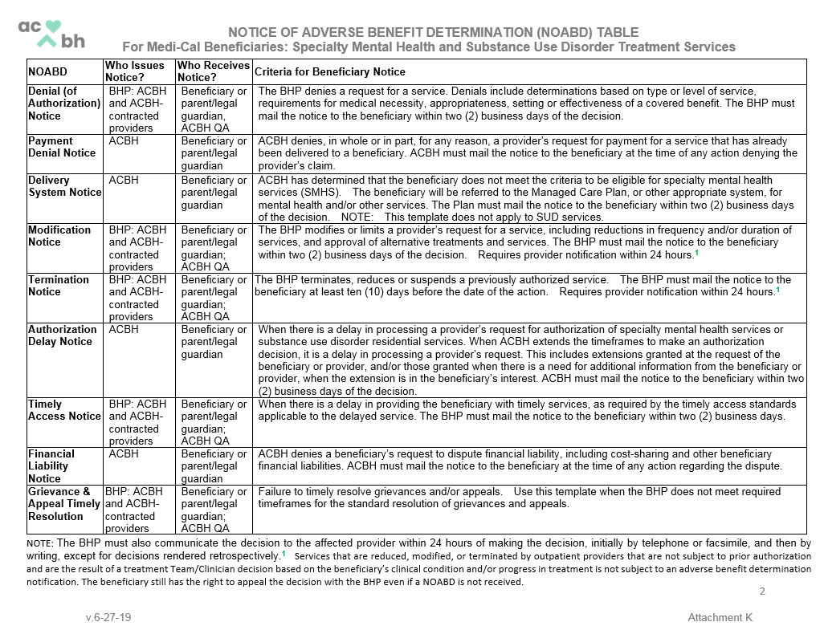
NOABD TABLE

Slide 9
NOAbd- termination
ISSUED BY bhp: acbh AND ACBH-CONTRACTED PROVIDERS
Use this template when the BHP terminates, reduces or suspends a previously authorized service.
RESPONSIBLE BHP PROVIDERS AND EXAMPLES OF WHEN TO ISSUE THE NOABD-TERMINATION
ACBH departments/units that authorize SMHS or DMC-ODS services
  ACBH Utilization Management Program (UM) uses this template when DMC-ODS residential treatment or SMHS Fee-for-Service (FFS) Network or AB1299/SB785 services that were previously authorized are terminated (e.g. SMHS FFS Network provider given initial authorization and requests reauthorization, but UM denies).
ACBH-Contracted providers that authorize SMHS or DMC-ODS services
  When a beneficiary has lost contact with a Tx Provider and the Tx Provider is not able to contact/locate the beneficiary and closes the episode.
  When a beneficiary is discharged for non-compliance.
NOABD-Termination Timeliness Standards: BHP must mail the notice to the beneficiary at least ten (10) days before the date of the action, except as permitted under 42 CFR 431.213 and 431.214 (e.g. <10 days if the safety or health of individuals in the facility is endangered due to the clinical or behavioral status of the resident). Requires provider notification within 24 hours.
NOTE: Services that are reduced, modified, or terminated by outpatient providers that are not subject to prior authorization and are the result of a treatment Team/Clinician decision based on the beneficiary’s clinical condition and/or progress in treatment is not subject to issuance of a NOABD.

Slide 10
NOABD- Timely Access
ISSUED BY bhp: acbh AND ACBH-CONTRACTED PROVIDERS
Use this template when there is a delay in providing the beneficiary with timely services, as required by the timely access standards applicable to the delayed service.
RESPONSIBLE BHP PROVIDERS AND EXAMPLES OF WHEN TO ISSUE THE NOABD-TIMELY ACCESS
ACBH SMHS and DMC-ODS “front door” service providers and delivery system entry points
  ACBH ACCESS uses this template when a beneficiary has requested SMHS service(s) and the first known available/offered appointment is outside of timely access standards (e.g. beneficiary request for outpatient psychiatry and is not offered an appointment within 15 business days).
ACBH-Contracted SMHS and DMC-ODS “front door” service providers and delivery system entry points
  ACBH-Contracted 24/7 SUD Helpline uses this template when a beneficiary has requested a SUD treatment service and the first available/offered appointment is outside of timely access standards (e.g. beneficiary request for Outpatient Services (OS) and is not offered an appointment within 10 business days).
  ACBH Treatment Providers use this template when they cannot offer the initial appointment within the timely access standards (SMHS - the date at the top of the ACCESS referral letter sent to the provider is the date of the beneficiary’s initial request for services.
NOABD-Timely Access Timeliness Standard: The BHP must mail the notice to the beneficiary within two (2) business days.

Slide 11
NOABD-grievance & appeal timely resolution
ISSUED BY bhp: acbh AND ACBH-CONTRACTED PROVIDERS
Use this template when the BHP does not meet required timeframes for the standard resolution of grievances and/or appeals
RESPONSIBLE BHP PROVIDERS AND EXAMPLES OF WHEN TO ISSUE THE NOABD-GRIEVANCE & APPEAL TIMELY RESOLUTION
ACBH
  ACBH Quality Assurance (QA) uses this template when the required applicable timeframe for standard resolution of grievances and/or appeals is not met.
ACBH-Contracted SMHS and DMC-ODS service providers
  ACBH-Contracted service provider uses this template when the required applicable timeframe for standard resolution of grievances is not met.

Slide 12
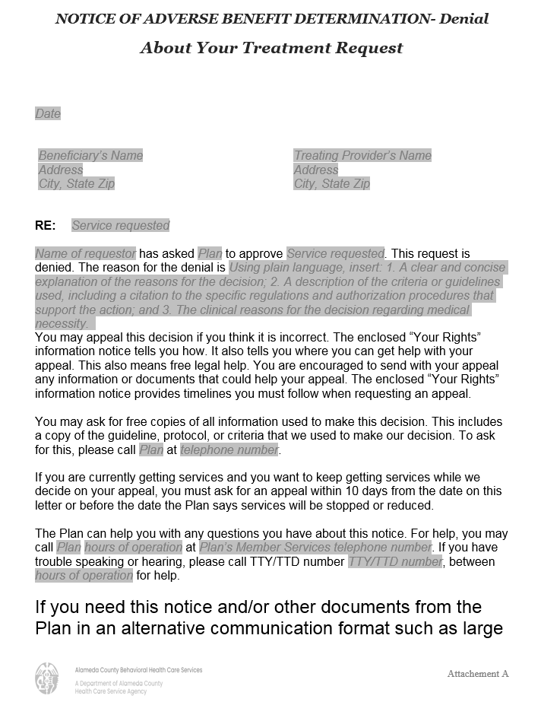
How to complete a NOABD
Complete gray italicized areas
Insert in plain language the adverse benefit determination, the clinical reason(s), and the criteria or guidelines used, including citations to the specific regulations.
NOABD-DENIAL EXAMPLE:
Beneficiary A has asked ACBH to approve specialty mental health individual therapy services. This request is denied. The reason for the denial is 1. Your current condition does not meet specialty mental health service criteria. Symptoms and impairment described appear to be related to substance abuse only; 2. medical necessity criteria, in accordance with Title 9, CCR, §1830.205, does not include substance-related disorders for specialty mental health service eligibility; and 3. the focus of the proposed intervention would not appropriately address your condition.
C. Template and enclosure sections that indicate “The Plan/Plan,” insert your program/department name and phone number.

Slide 13
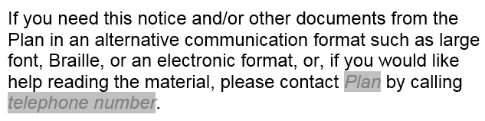
Making a written noabd accessible to beneficiaries with disabilities and language needs
For “Plan” and “telephone number” insert:
Your program/department name and phone number.
For beneficiaries with visual impairments or upon request for large font, please increase the letter font of the NOABD to 18-point font. You may send the notice to the beneficiary electronically via your providers’ secure e-mail. Upon request for Braille or audio files, please contact the QA office informing materials number 510-567-8233.
For beneficiaries with reading difficulties and language needs or upon request, please offer to read the NOABD material to the beneficiary. If needed, contact the language line vendor for interpretation services. For translation of written NOABD materials, please contact the QA office informing materials number 510-567-8233.
For beneficiaries who have hearing difficulties, please contact 711 or include the 711 phone number in the TTY sections of the NOABD. Please contact the language line vendor for translation language services.

Slide 14
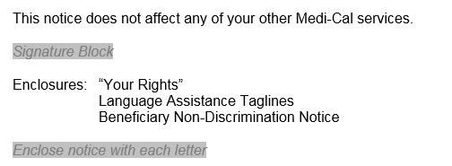
HOW to complete a Noabd, continued
For “Signature Block” and “telephone number” insert:
Name of issuer/decision-maker
Direct telephone number or extension of the decision-maker
The indicated Enclosures are required to be sent with all issued NOABDs.

Slide 15
NOABD Record keeping and submission
ACBH departments/units who issue NOABDs shall internally maintain records and notate in applicable ACBH data system(s).
ACBH-Contracted providers who issue NOABDs shall:
Retain copies of NOABDs and place in beneficiary’s chart, if applicable;
Immediately submit copies of all issued NOABDs to the:
ACBH Quality Assurance (QA) Office:
US Mail: 2000 Embarcadero, Suite 400
Oakland, CA94606
or
Fax: 510-639-1346

