Slide 1
Alameda County Behavioral Health
Mental Health & Substance Use Services
Substance Use Disorder (SUD) Documentation Training
Opioid Treatment Providers
July 30, 2019
9am to 4:30pm

Slide 2
ACBH Quality Assurance (QA) Staff
Rudy arrieta, msw
Quality management program director
Kim Coady, LCSW
Interim Quality Assurance Administrator
Tony Sanders, Ph.D, LAADC
Interim Quality assurance ASSOCIATE ADMINISTRATOR
JEFF SAMMIS, PSY.D
Clinical Review Specialist Supervisor
Sharon Loveseth, CADCII, LAADC
SUD Program specialist
Brion Phipps, LCSW
Clinical Review Specialist
CAMMIE DUVALL, LMFT
QA CLINICIAN

Slide 3
Quality Assurance ACBH Contacts
SUD Technical Assistance | Sharon Loveseth, LAADC nr; SUD Program Specialist Sharon.Loveseth@acgov.org
SUD Auditing, CQRT | Brion Phipps, LCSW; Clinical Review Specialist Brion.Phipps@acgov.org
Interim QA Associate Administrator | Tony Sanders, PhD, Clinical Psychologist, MFT, LAADCC Tony.Sanders@acgov.org

Slide 4
Agenda
Today’s Topics of Discussion
Overview of Training / Recommended Workflows
Informing Materials and Clinical Intake and Assessment(s)
ASAM Level of Care (ALOC) and Medical Necessity
Client Plans
Case Management and Progress Notes
Discharge Plan, Discharge Summary and Wrap-Up

Slide 5
Break Schedule
Approximate Time | Break Schedule
10:00 to 10:10 am | Break #1
11:00 to 11:10 am | Break #2
12:00 to 12:30 pm | Lunch
1:30 to 1:40 pm | Break #3
2:40 to 2:50 pm | Break #4

Slide 6
Introductions
What agency/program are you with?
What is your role/professional credential?
What is one question you have about OTP documentation you would like answered today?
Notes:
Ask audience to answer the following questions:
Raise hands if you are LPHA, Medical Staff, Counselor, Peers
Is this your first time attending on these trainings?

Slide 7
ACBH Audit Info & SUD Claims
CY 2018-2019 SUD SOC Audit is currently underway. Results will be forthcoming.
Disallowances associated with fraud, waste, and abuse may result in recoupment of service amounts

Slide 8
Technical Assistance Feedback
Alameda County Behavioral Health
Mental Health & Substance Use Services
DHCS and other entities are conducting technical assistance and monitoring independent of ACBH
Please let Sharon know if DHCS or another agency contacts your agency to conduct a review
This will assist us in providing accurate, consistent technical assistance to all of our providers

Slide 9
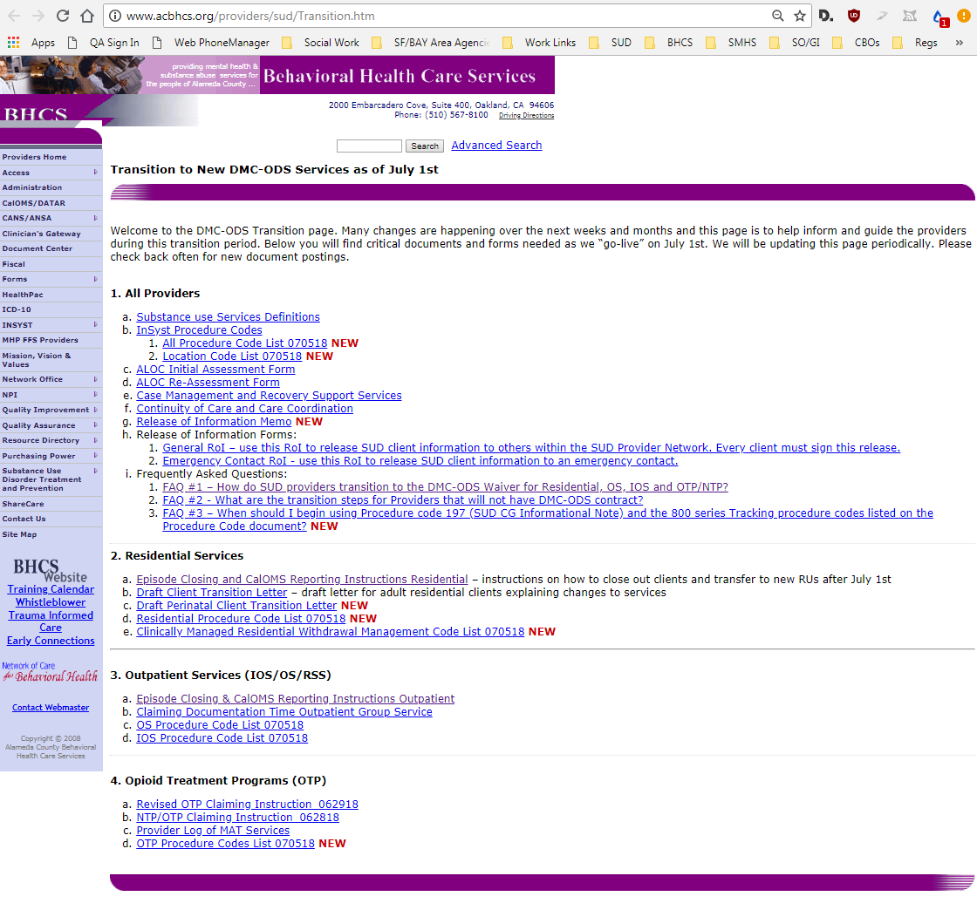
ACBH SUD DMC-ODS Transition Website http://www.ACBH.org/providers/sud/Transition.htm

Slide 10
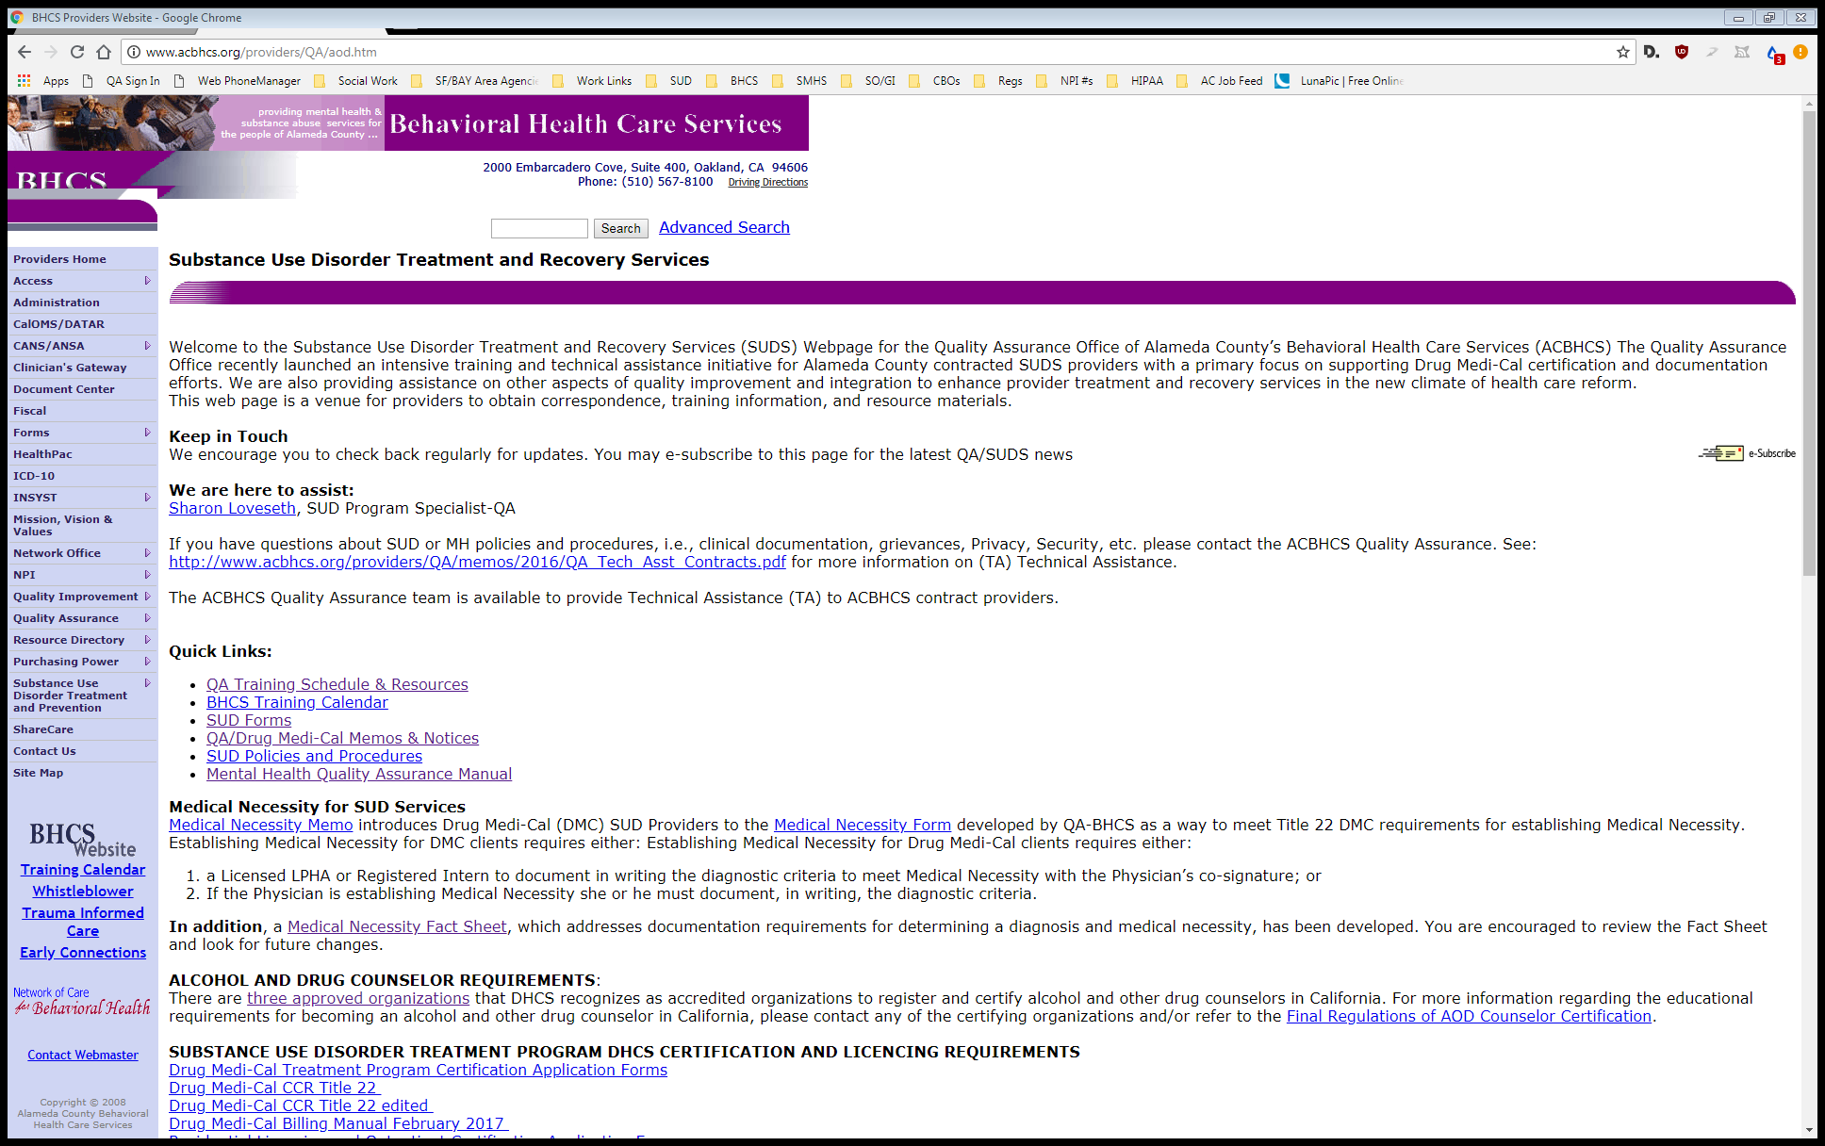
ACBH SUD QA Webpage http://www.ACBH.org/providers/QA/aod.htm
To subscribe to ACBH email lists, click on this icon

Slide 11
Who is this training for?
All Alameda County subcontracted Opioid Treatment Programs
Both in and out of county
ACBH staff
Please alert trainer if you are not employed at one of these entities
Notes:
Is this slide even necessary?

Slide 12
Some things to keep in mind…
Regardless of program certification standards or contract, all subcontracted SUD providers will be audited to ACBH QA clinical documentation standards
ACBH may have additional standards not specified in associated regulations
All days indicated in this training are to be considered calendar days, unless specifically noted otherwise

Slide 13
Alameda County SUD System Overview

Slide 14
What is the DMC-ODS Waiver?
The Drug Medi-Cal Organized Delivery System (DMC-ODS) provides a continuum of care modeled after the American Society of Addiction Medicine (ASAM) Criteria for substance use disorder treatment services, enables more local control and accountability, provides greater administrative oversight, creates utilization controls to improve care and efficient use of resources, implements evidenced based practices in substance abuse treatment, and coordinates with other systems of care.
This approach provides the beneficiary with access to the care and system interaction needed in order to achieve sustainable recovery. DMC-ODS will demonstrate how organized substance use disorder care increases the success of DMC beneficiaries while decreasing other system health care costs.

Slide 15
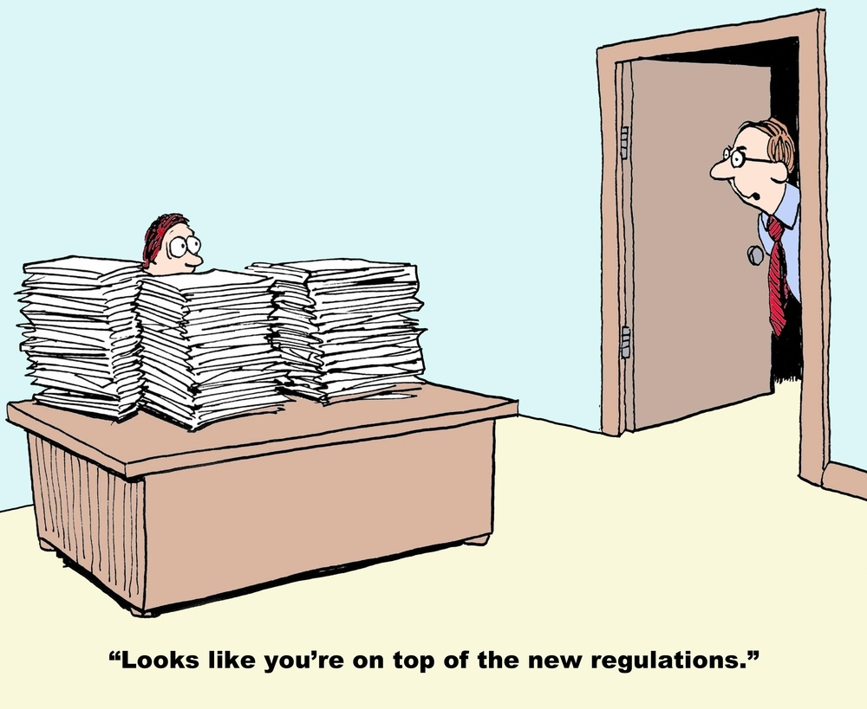
Applicable Regulations and Standards Covered in this Training (others may apply)
DMC-ODS Intergovernmental Agreement (Exhibit A, Attachment I)
Centers For Medicare & Medicaid Services, Special Terms and Conditions
Note: Refer to pages 96-127 and 376-407 for the DMC-ODS system. (Updated June 7, 2018)
Title 9 CCR, Ch. 4 and 42 CFR Part 8 - MAT for Opioid Use Disorders
Health & Safety Code, Division 10.5, Part 2, Chapter 10
CA Alcohol and/or Other Drug Program Certification Standards (AOD) (Program Licensing required for Residential)
Alameda County Behavioral Health Plan / ACBH QA Clinical Doc Standards
ACBH SUD DMC-ODS RFP
ACBH SUD DMC-ODS Implementation Plan
Individual provider contracts
42 CFR, Part 2, HIPAA (PUBLIC LAW 104-191), HITECH
SABG (SAPT/SAMHSA Block Grant Funds)
Additional regulations may apply
Remember providers must always follow the highest standard / regulation.

Slide 16
The IA, STCs, Title 22, and Title 9
By implementing the DMC-ODS Waiver, SUD services from 7/1/18 are regulated by the DMC-ODS Intergovernmental Agreement and the CMS Special Terms and Conditions. Title 22 § 51341.1 is no longer applicable for DMC-ODS counties.
For OTPs, Title 9, Ch. 4 and Health & Safety Code, Division 10.5, Part 2, Chapter 10 still apply, however when the IA or another regulation has a higher standard, the higher standard must be followed.
Additional requirements may be indicated in ACBH SUD RFP Specifications, ACBH SUD DMC-ODS Implementation Plan, and individual contracts.
DHCS has stated that the broad standards outlined in the IA are intended as a minimum standard of care. Counties have been told encouraged and are expected to set higher standards of care depending on specific county needs. In all areas, SUD Providers must follow the ACBH Guidelines described herein.

Slide 17
AOD Certification / License Standards
DHCS Alcohol and/or Other Drug Program Certification Standards updated 5/2017:
http://www.dhcs.ca.gov/provgovpart/Documents/DHCS_AOD_Certification_Standards_5_._30_._17.pdf
All residential programs, including WM 3.2, are required to have AOD Certification Standard License
At this time, OTPs and outpatient SUD providers are not required to have an AOD Certification or License
Regardless, if an agency has an active AOD Certification / License, then that agency is required to follow those standards (if different or higher)
ACBH will be requesting evidence of AOD Certification / License at the time of audits

Slide 18
Early Intervention Services (ASAM Level 0.5) – contracted out services (not ODS claiming-a separate contract is required)
Services include: screenings, brief treatment as medically necessary, and, when indicated, a referral to treatment with a formal linkage.
Individuals, other than at-risk youth, refer to other prevention services in the community.
Some types of Early Intervention Services include: Educational programs for DUI, Employee Assistance Programs, community based services, Transition to Treatment, primary prevention service providers
Bridge to Treatment - For adolescents at risk of developing a substance use disorder or those with an existing substance use disorder.
Transition to Treatment – For adults (and their families) experiencing problems related to substance use and who need treatment services but have not yet engaged in those services
Early Interventions Services must be specified in your contract in order to be claimed
IA.III.N

Slide 19
Outpatient Services (OS) (ASAM Level 1.0) – outpatient contracts
Outpatient treatment services using recovery or motivational enhancement therapies and strategies. ASAM Level 1 encompasses organized services that may be delivered in a wide variety of settings. A detailed description begins on page 184 of The ASAM Criteria: Treatment Criteria for Addictive, Substance-Related, and Co-Occurring Conditions (2013)
Adults = Up to 9 hours of medically necessary services
Adolescents = Less than 6 hours of medically necessary services
Not limited to DMC certified sites (e.g. special population contracts – older adults, youth prevention)
Services can be provided in-person, by telephone, by telehealth (except group), and in any appropriate setting in the community.
IA.III.O

Slide 20
Opioid Treatment Programs (OTPs) ASAM Level OTP 1
Under DMC-ODS OTPs are required to have methadone, buprenorphine, disulfiram, naloxone available.
Note that licensed OTPs may prescribe other non-controlled medications approved by the FDA for MAT (e.g. Naltrexone and Acamprosate).
Medications approved by the FDA in the future would also be allowed to be utilized by OTPs.
Services include methadone dosing, buprenorphine dosing, disulfiram dosing, and naloxone dispensing along with counseling services to beneficiaries diagnosed with an Opioid Use Disorder
Between 50 and 200 minutes of counseling services must be provided each calendar month. Additional counseling services may be provided when medically necessary.
When included in the provider contract, Case Management Services may also be provided
Health and Safety Code Section 11839.2

Slide 21
Opioid Treatment Programs (OTPs) ASAM Level OTP 1
Citizens of Alameda County have access to a comprehensive range of opioid specific treatment services:
Medi-Cal / DMC Clients
Detoxification Treatment < 21 days
Maintenance Treatment > 21 days
Non-Medi-Cal Clients
Non-DMC Opioid Treatment Services
9 CCR, Ch. 4
ACBH OTP Contracts

Slide 22
Opioid Treatment Programs (OTPs) Detoxification Treatment
Detoxification Treatment is the dispensing of an opioid agonist treatment medication in decreasing doses to an individual to alleviate adverse physical or psychological effects related to withdrawal from the continuous or sustained use of an opioid drug and as a method of bringing the individual to a drug-free state within a period of not more than 21 days.
The goal of Detoxification Treatment is to reduce or eliminate opiate addiction
Counseling and Case Management Services may be provided during the detoxification episode
Clients with two or more unsuccessful detoxification episodes within a 12-month period must be assessed by the OTP physician for other forms of treatment. A program may not admit a client for more than two detoxification treatment episodes in one year.
Currently must claim 21-day detoxification services in Maintenance RUs, this may be changing with FY 19-20 contracts
42 CFR § 8.2
42 CFR § 8.12.e.4

Slide 23
Opioid Treatment Programs (OTPs) Maintenance Treatment
Maintenance Treatment is a treatment modality whereby replacement narcotic therapy is used in sustained, stable, medically determined dosage levels for a period in excess of 21 days, to reduce or eliminate chronic opiate addiction, while the client is provided a comprehensive range of treatment services.
42 CFR § 8.2

Slide 24
Opioid Treatment Programs (OTPs) ASAM Level OTP 1
Non-Medi-Cal Clients
Non-DMC Opioid Treatment Services
Determined by contract. More information to follow.
Currently these are the OTP Detoxification RUs, these names may be changing
9 CCR, Ch. 4
ACBH OTP Contracts

Slide 25
OTP workflow

Slide 26
Intensive outpatient Services (IOS) ASAM Level 2.1
ASAM Level 2.1 encompasses services that are capable of meeting the complex needs of people with addiction and co-occurring conditions. It is an organized outpatient service that delivers treatment services during the day, before or after work or school, in the evening, and/or on weekends. A detailed description begins on page 198 of The ASAM Criteria: Treatment Criteria for Addictive, Substance-Related, and Co-Occurring Conditions (2013)
Adults = min. of 9 hours, max. of 19 hours per week of medically necessary services
Adolescents = min. of 6 hours, max. of 19 hours per week of medically necessary services
More than 19 hours per week may be provided when medically necessary. LPHA must document clinical reasoning in the chart and the client plan must be updated to reflect the need for expanded IOS hours. In these cases, if ALOC indicates a higher level of care, then the ALOC and/or progress noted must describe the clinical reason why the beneficiary is receiving services at a lower level of care.
Services can be provided in-person, by telephone, by telehealth (except group), and in any appropriate setting in the community.
IA.III.P
IA.V.H.1.i

Slide 27
Components of OS/IOS Services Allowable Services
Intake/Assessment
Treatment Planning
Individual and Group Counseling
Patient Education (Ind. or Group)
Family Therapy (LPHAs only)
Medication Services
(Medical Providers MD, DO, NP, PA ONLY)
More information available later in the presentation
Case Management
Physician Consultation
Collateral Services
Crisis intervention services
Discharge planning and coordination

Slide 28
Recovery Support Services (RSS)
Only may be provided at OS or IOS providers
Beneficiary must be in remission and have a SUD remission diagnosis
Are available after the beneficiary has completed a course of treatment and is in remission.
Recovery Support Services emphasize the client’s central role in managing their health, use effective self-management support strategies, and organize internal and community resources to provide ongoing self-management support to clients.
Current RSS documentation follows stated standards for OS
ACBH is currently updating RSS standards
IA.III.T

Slide 29
Components of Recovery Support Services
Individual and group counseling, assessment, treatment planning, and:
Recovery Monitoring: Recovery coaching, monitoring via telephone and internet.
Substance Abuse Assistance: Peer-to-peer services and relapse prevention.
Education and Job Skills: Linkages to life skills, employment services, job training, and education services.
Family Support: Linkages to childcare, parent education, child development support services, family/marriage education.
Support Groups: Linkages to self-help and support, spiritual and faith-based support.
Ancillary Services: Linkages to housing assistance, transportation, case management, individual services coordination.
IA.III.T

Slide 30
Recovery Support Services Requirements
Providers must attempt one (1) contact every 30 days unless LPHA clinically justifies reduced contact (in-person, telephone, or telehealth). Document this contact or attempt in the medical record.
Medical Necessity shall be reassessed between 5-6 months from RSS episode opening date (EOD) or most recent Medical Necessity. The beneficiary must meet criteria for medical necessity to qualify for continuing services.
Services may be delivered by an approved certified Peer Specialist (for substance abuse assistance services only) or SUD Counselor / LPHA
Peers may not be concurrently receiving and providing SAA RSS
IA.III.T

Slide 32
Level 3.2-WM - Clinically Managed Residential Withdrawal Management - Currently Cherry Hill
Services delivered by appropriately trained staff, who provide 24 –hour supervision, observation, and support for clients who are intoxicated or experiencing withdrawal.
WM 3.2 is characterized by its emphasis on peer and social support rather than medical and nursing care. This level provides care for clients whose intoxication/withdrawal signs and symptoms are sufficiently severe to require 24-hour structure and support.
Individuals enter Withdrawal Management Services (Cherry Hill Detox) through the Sobering Center and may stay very briefly or as long as a few days.
During the first 24-48 hours at Cherry Hill Detox, a assessment is completed addressing the six ASAM dimensions, and a withdrawal management plan is developed with the client. The plan addresses both withdrawal management considerations, and case management interventions for pre-discharge planning. Clients tend to stay in withdrawal management for an average of 4 days.
Upon discharge, when determined by the ALOC, clients should be referred to an appropriate LOC within the SUD system of care
IA.III.U

Slide 33
Withdrawal Management Components of Services
Intake/Treatment Planning: The process of admitting a beneficiary into a substance use disorder treatment program. Intake includes the evaluation or analysis of substance use disorders; the diagnosis of substance use disorders; and the assessment of treatment needs to provide medically necessary services. Intake may include a physical examination and laboratory testing necessary for substance use disorder treatment.
Observation/Monitoring: The process of monitoring the beneficiary’s course of withdrawal. To be conducted as frequently as deemed appropriate for the beneficiary and the level of care the beneficiary is receiving. This may include but is not limited to observation of the beneficiary’s health status.
Medication Services: The prescription or administration related to substance use disorder treatment services, or the assessment of the side effects or results of that medication, conducted by staff lawfully authorized to provide such services within their scope of practice or license.
Case Management/Care Coordination: See CM slides.
Physician Consultation: Physician consultation between agency MD and ACBH approved addiction medicine physicians, addiction psychiatrists, or clinical pharmacists. Must be claimed separately in order to be reimbursed.
Discharge/Transition Services: The process to prepare the beneficiary for referral into another level of care, post treatment return or reentry into the community, and/or the linkage of the individual to essential community treatment, housing and human services.
STCs.X.139.a

Slide 34
Cherry Hill Workflow

Slide 35
Clinical Quality Review Team (CQRT)
CQRT has two components:
Services authorization (for OS/IOS/RSS) ← For RES auth. fax to UM
Chart review (for IOS/OS/RSS/RES)
CQRT is required for all IOS/OS/RSS/RES SUD providers and is part of Alameda County’s service authorization process
Providers will be trained by ACBH QA staff on CQRT procedure and will participate in ACBH QA facilitated CQRT meetings
Providers are required to participate in ACBH led CQRT
Providers should send at least one Licensed LPHA, additional staff may be Registered/Waivered LPHA, Certified SUD Counselors, and with QA ACBH approval Registered Counselors who meet ACBH requirements to conduct Intake/Assessment/ASAM.

Slide 36
Residential Services
Open to all populations per contract
Based on assessed ASAM Level of Care (ALOC)
There are limitations on length of stay
Prior authorization required
Referral from portal
UM must authorize within 5 days from admission
24-hour structure
7 days a week
IA, III.Q

Slide 37
Referrals to Residential
Beneficiaries must be referred to a residential facility through one of the SUD portals
CenterPoint aka Call Center → (844) 682-7215
CenterPoint AB109 Criminal Justice Case Management Program
Cherry Hill
Drug Court
The ASAM Level of Care (ALOC) screening is completed at one of the portals and referral information securely sent to the referred provider
Portals may also refer to other levels of care
IA, III.F.3.iii

Slide 39
Recovery Residences
Are abstinence-based, peer supported housing with concurrent Alameda County SUD outpatient treatment
Based on recommended CCAAP Recovery Residence models
Short-term housing (6 month maximum) based on ACBH criteria
Beneficiaries must be actively participating in OS/IOS/RSS Treatment in order to be eligible for Recovery Residence services.

Slide 40
Medical Record Requirements

Slide 41
Charting Requirements Individual Client Record
Each client must have an individual record that meets 42 CFR, Part 2 Final Rule, HIPAA, & HITECH requirements → whichever is stricter
NO other client identifying information is allowed in another client’s record
In past audits, services were disallowed because they contained multiple client PHI information, often in the form of combined group notes or group sign-in sheets
As a result, the medical record was not considered unique
References to other clients should happen only when absolutely necessary and done anonymously (e.g. “another client”)
Never use other clients’ initials, names, nicknames, etc.
IA.III.PP.9, 42 CFR § 2, & HIPAA (P.L. 104-191)

Slide 42
Content of Client Records 1
A unique identifier (e.g. name, client number, InSyst ID)
Date of admission and other admission data
Personal Information:
• Date of birth • Assigned gender at birth
• Telephone number (or indicate “none”) • Preferred pronoun
• Gender identity/expression • Race, cultural, and/or ethnic information
• Address (or indicate “homeless”) • Next of kin or emergency contact (with ROI)
• Preferred name • Sexual orientation
• Other pertinent personal information
IA.III.PP.9
9 CCR § 10165

Slide 43
Content of Client Records 2
All treatment records also must include documentation of sessions, services, and treatment provided, as well as progress notes signed by the physician, nurse, or counselor, test or analysis results for illicit drug use.
Documentation of services and treatment provided includes, but is not limited to, such documentation as:
Informing Materials/Consent signature page
ASAMs
Assessments
Medical necessity documents
Treatment plans
Progress/Counseling notes
Continuing services justifications
Discharge plan/summary
Prior addiction and treatment failure
ROIs and ROI tracker Log
Physical examinations
Laboratory test orders and results
Referrals
Reasons for med. changes
CQRT and authorization forms
Any other information relating to the treatment services rendered to the beneficiary
9 CCR § 10165
IA.III.PP.9

Slide 44
Content of Client Records 3 Additional Requirements for OTPs
Program’s response to a test or analysis for illicit drug use which disclose the absence of both methadone and its primary metabolite (when prescribed by the medical director and program physician)
Documentation of approval or denial of any granted exceptions to required practices
Documentation of the reasons for changes in medications and dosage levels, when applicable
Documentation that the beneficiary received a copy of the program rules and instructions prior to admission
CURES verifications
9 CCR § 10165
9 CCR § 10170

Slide 45
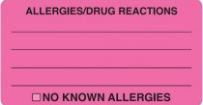
Emergency Contact and Allergy Information
Emergency contact and allergy information must be posted in a prominent location in the medical that is easily located during an emergency situation
Allergy Information Requirements:
Many providers use allergy stickers on the front of the chart
If no allergies indicate, No Known Allergies or NKA
Emergency Contact Information Requirements:
It’s impossible to predict an emergency situation so it’s best to get emergency contact information at the beginning of treatment and then update periodically
Also have beneficiary sign an ROI for the contact and update this when the contact changes
InSyst must be updated with the current Emergency Contact information (see slides at the end of this presentation for instructions)
ACBH Requirement

Slide 46
ACBH Medical Record Retention Policy
Providers must maintain client records following discharge/termination with the following considerations:
For all clients, records (paper and electronic) must be maintained for a minimum of: 10 years after the last service OR 10 years after their 18 birthday, whichever is later.
Records must be retained until audit findings are resolved, potentially longer than 10 years from the last date of service
Records must also be retained until DHCS/ACBH finalizes cost settlement for the year in which the last service occurred
All records must be maintained through the end of the MHP contract in place 10 years from the date of the last service
Also, consider that different disciplines have different record retention requirements and providers must adhere to the strictest standard
For these reasons ACBH recommends providers maintain all records for at least 15 years from the last date of service, or the client’s 18th birthday, whichever is later.
Many hospitals and other medical services store records indefinitely

Slide 47
SUD Personnel

Slide 48
OTP Licensing Requirements
All OTP Programs operating in the State of California must be licensed by the California Department of Health Care Services (DHCS).
Medication Units are required to additionally have approval from the FDA
All OTP programs must renew their DHCS Narcotic Treatment Programs operating license annually. In order to complete the license renewal process the Alameda County AOD Administrator is required to complete and submit a Certification of Need for Continued Services and a recommendation of license renewal.
A renewal application must be submitted to ACBH AOD Administrator and DHCS advance of license expiration as this process can take up to 3 months once all of the required elements are submitted to DHCS. It is imperative that OTP providers submit these documents in a timely manner as no services may be provided on an inactive license; regardless of when application documents were submitted. Note that DHCS assesses license fees in order to complete the license application and renewal process, applications without the required fee will be terminated.
Additional licenses, accreditation may be required (COA, CARF, Joint Commission, DEA, NCQA, URAC, ACHC, etc.)
9 CCR § 10055, 9 CCR § 10020, 9 CCR § 10010

Slide 49
SUD Agency Responsibilities
It is you and your staffs’ responsibility to know and follow ALL applicable regulations
Employ qualified staff and ensure staff work within their scope of practice!
Develop and document procedures for admission
Ensure medical necessity is documented in beneficiary records
Complete a personal, medical, and substance use history upon admission
Ensure that client’s challenges identified are addressed in treatment plan and progress notes
Complete discharge summary upon discharge
OTP Treatment MUST be provided under the direction of a Licensed Physician

Slide 50
Requirements for SUD Medical Director
Must be physician who is licensed by the Medical Board of California or the Osteopathic Medical Board of California
Must not be excluded from participation in any State or Federal Medicare or Medicaid program
Must be enrolled in Medi-Cal as a substance use disorder medical director
Must be acting in compliance with all laws and requirements of the Medi-Cal program
22 CCR § 51000.24.4,
22 CCR § 51000.70

Slide 51
SUD Medical Director Responsibilities 1
Each program must have a medical director who is a licensed physician in the State of California. The medical director may also serve as the program director. The medical director shall assume the medical responsibility for all program clients by:
Signing client record notes (have asked the state for clarification)
Placing clients in treatment
Initiating, altering and terminating replacement narcotic therapy medications and dosage amounts
Supervising the administration and dispensing of medications
Planning and supervising provision of treatment including regular review and notes in the clients' records.
Other duties and responsibilities of the medical director shall be set forth in the protocol.
The medical director may delegate duties as prescribed in the program protocol to another licensed program physician(s) but may not delegate his/her responsibility in above to physician extenders.
9 CCR § 10110

Slide 52
SUD Medical Director Responsibilities 2
The substance use disorder medical director may delegate their responsibilities to a physician consistent with the provider's medical policies and standards; however, the substance use disorder medical director shall remain responsible for ensuring all delegated duties are properly performed.
Ensure that medical care provided by physicians, registered nurse practitioners, and physician assistants meets the applicable standard of care
Ensure that physicians do not delegate their duties to non- physician personnel
Develop and implement medical policies and standards for the provider. MD P&P must be signed by the current Medical Director.
Ensure that physicians, registered nurse practitioners, and physician assistants follow the provider's medical policies and standards
Ensure that the medical decisions made by physicians are not influenced by fiscal considerations.
Ensure that provider's physicians and LPHAs are adequately trained to perform diagnosis of substance use disorders for beneficiaries, determine the medical necessity of treatment for beneficiaries
Ensure that provider's physicians are adequately trained to perform other physician duties, as outlined in this section
IA, III.PP.5.i,
9 CCR § 10110

Slide 53
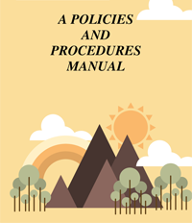
SUD Medical Policy and Standards 1 AKA Program Protocol
Is written document which sets forth a program's treatment concept, organization, and operational procedures
The Medical Director is required to develop program and/or agency policy and procedures
These are common policies and procedures to guide on-site medical and related requirements. → Must be updated as necessary
The content of the P&P is a combination required elements and elements as determined by the Medical Director
Much of the content will be specific application of the regulations to the specific program
Current Medical Director signature must be present on the P&P

Slide 54
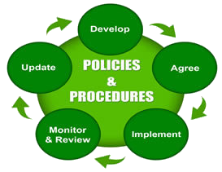
SUD Medical Policy and Standards 2 AKA Program Protocol
Some required elements include:
Medication Protocols, Plan for evaluating effectiveness of the program, Program administration, medical director duties/delegation of duties (physicians, physician extenders), caseload Information, multiple registration policies, program rules, emergency/disaster plan, client Identification, admission criteria, body specimen collection requirements, dosing policies, take home privileges policies, discharge/termination policies, fair hearing policies.
Additional sections recommended by DHCS for inclusion are:
Disease prevention, on-site injury response, on-site injury prevention, medication dosing procedures, emergency protocols, OD procedure, medical emergency procedure, infectious disease protocols (e.g. TB, lice, MRSA, scabies, etc), requirements for physical exam, procedure for when the client is under the influence, and more…
9 CCR, Ch. 4
IA.III.PP.5.i

Slide 55
Staff Personnel Records Must include:
Opioid Treatment Programs employ a range of staff, each with distinct and overlapping responsibilities. This section provides and overview of providers, their roles, and responsibilities. Agencies must maintain personnel records for all staff that includes at least the following information:
Name, address, telephone number, position, duties, and date of employment
Resumes, applications, and/or transcripts documenting work experience and/or education used to meet the requirements of regulations
When applicable copies of licensure, certification, or registration to obtain certification for all staff who provide treatment services (including medical staff who administer medications) covering the duration of employment
Staff who provide counseling services must also include a copy of the code of conduct of the registrant's or certified AOD counselor's certifying organization
9 CCR § 10125.d
9 CCR § 13005

Slide 56
Physicians
A program physician may delegate his/her duties under this subchapter to other appropriately licensed personnel who are members of the program staff.
The nature and extent of such delegation of duties shall be set forth in the protocol
Physicians must have Drug Addiction Treatment Act of 2000 (DATA 2000) waiver in order to prescribe or dispense buprenorphine
Practitioners who administer and dispense approved Schedule II controlled substances (that is, methadone) for maintenance and detoxification treatment must obtain a DEA registration
Other certifications, licenses, waivers may apply and must be followed
9 CCR § 10115, 9 CCR § 10120,
DATA 2000

Slide 57
Physician Extenders
The term “physician extender” refers to registered nurse practitioners and physicians' assistants only
The protocol shall contain documentation satisfactory to the Department verifying that:
Nurse practitioners are used as physician extenders in compliance with the licensing and scope of practice requirements listed in article 8 (commencing with section 2834), chapter 6, division 2, of the Business and Professions Code and corresponding regulations adopted by the Board of Registered Nurses, and
Physicians' assistants are used as physician extenders in compliance with the licensing and scope of practice requirements listed in chapter 7.7 (commencing with section 3500), division 2, of the Business and Professions Code and corresponding regulations adopted by the Medical Board of California.
9 CCR § 10120

Slide 58
Other Medical Staff May work under physician surgeon supervision
Registered Nurses
Licensed Vocational Nurses
Pharmacists
Psychiatric Technician
Must work within their scope of practice and in accordance with regulations
HSC § 11215

Slide 59
Licensed Practitioners of the Healing Arts (LPHAs)
LPHAs include:
Physicians
Nurse Practitioners
Physician Assistants
Registered Nurses
Registered Pharmacists (May not diagnose or conduct MSE as it is not within their scope of practice)
Licensed Clinical Psychologists
Licensed Clinical Social Worker
Licensed Professional Clinical Counselor
Licensed Marriage and Family Therapists
License Eligible Practitioners (Registered/Waivered) working under the supervision of licensed clinicians
Co-signatures required by licensed LPHA on diagnoses
IA.III.A.1.i.a

Slide 60
Counseling Services
All program staff who provide counseling services must be licensed, certified or registered to obtain certification or licensure from their respective California licensing board (e.g. Board of Behavioral Sciences, Board of Psychology, California Board of Registered Nursing, Board of Vocational Nursing and Psychiatric Technicians) when providing the service.
Staff who may provide counseling services are nurses, psychologists, social workers, psychiatric technicians, trained counselors, or others as long as they have training or experience in treating persons with an opiate addiction.
9 CCR § 10125

Slide 61
SUD Counselor/LPHA Responsibilities
LPHA and Certified Counselors may conduct these.
Registered Counselors with appropriate training and experience may complete Intake/Assessment and ALOCs. (See additional slides for specific training and experience requirements.)
Also, see co-signature requirements for Intake/Assessment for all SUD Counselors.
Each client must be assigned to a counselor
Assessment (Intake and ongoing as medically necessary)
ASAM/ALOC (LPHAs and Certified Counselors only)
Collaborating with the client to develop Initial & Updated Treatment Plans
Facilitating Individual & Group Counseling Sessions
Completing and Monitoring Sign-In Sheets
Providing Crisis Intervention Services
Providing Collateral Services
Documenting Services in Progress Notes
Providing Case Management Services
Discharge Planning
IA.III.PP.9.ii,
9 CCR § 10125

Slide 62
SUD Counselors Code of Conduct Requirements
Program staff that provide counseling services are required to have a signed copy of their certifying organization’s Code of Conduct in their personnel file. At a minimum, that Code of Conduct must prohibit counselors from:
Providing counseling services, attending any program services or activities, or being present on program premises while under the influence of any amount of alcohol or illicit drugs. Drugs or medications prescribed by a physician or other person authorized to prescribe drugs, and over-the-counter medications, used in the dosage and frequency indicated, are exempt from this prohibition.
Providing services beyond the scope of their license, registration, or certification
Discriminating against program participants, clients, residents, or other staff members, based on race, religion, age, gender, disability, national ancestry, sexual orientation, or economic condition;
Engaging in social or business relationships for personal gain with program participants, clients, or residents, their family members or other persons who are significant to them;
Engaging in sexual conduct with current participants, clients, residents, their family members, or other persons who are significant to them;
Verbally, physically, or sexually harassing, threatening, or abusing any participant, client, resident, their family members, other persons who are significant to them, or other staff members.
9 CCR § 13060

Slide 63
SUD Counselor Certification Organizations
SUD Counselors are required to have an active certification or registration with a DHCS approved Counselor Certification Organization when providing the service. DHCS maintains a website of the current accepted Certification Organizations:
https://www.dhcs.ca.gov/provgovpart/Pages/CounselorCertificationOrganizations.aspx
As of this training these are:
California Association of DUI Treatment Programs (CADTP)
http://www.cadtp.org/
Email: info@cadtp.org
California Consortium of Addiction Programs and Professionals (CCAPP)
https://www.ccapp.us/
Email: office@ccapp.us
California Association for Drug/Alcohol Educators (CAADE) (As of 3/11/19)
https://dev.caade.org/
Email: office@accbc.org

Slide 64
Training Requirements
All LPHAs, including the SUD Medical Director, must receive a minimum of five (5) hours of continuing education related to addiction medicine each year
All staff who provide ANY treatment services must keep up with their respective board or credentialing requirements and have an active credential at the time the service is provided. Any service provided by a staff without an active credential at the time of the service is not a valid service. This includes claiming and non-claiming related treatment activities.
Registered and certified SUD counselors must adhere to all requirements in CCR Title 9, Chapter 8
For ASAM, at a minimum all e-modules or equivalent in-person ASAM trainings are required.
Each contracted agency must have at least one representative attend every ACBH QA training
IA.III.A.1.iv,
IA.III.GG.3.ii
9 CCR § 10105

Slide 65
Temporary Exceptions to OTP Regulations

Slide 66
Temporary Exceptions to OTP Regulations 1
DHCS may grant temporary exceptions to Title 9, Ch. 4 requirements if it determines that such action is justified and would improve treatment services or afford greater protections to the health, safety or welfare of clients, the community, or the general public. No exception may be granted if it is contrary to or less stringent than the federal laws and regulations which govern narcotic treatment programs.
9 CCR § 10425

Slide 67
Temporary Exceptions to OTP Regulations 2
Exceptions are subject to all of the following requirements:
Such exceptions shall be limited to program licensees operating in compliance with applicable laws and regulations
Requests for exceptions shall be formally submitted in writing to DHCS
Exceptions are limited to a one-year period unless an extension is formally granted by DHCS
No exception may be granted until DHCS has requested and evaluated a recommendation from the applicable County Drug Program Administrator and all applicable fees have been received
The program applicant shall comply with all Departmental requirements for maintaining appropriate records or otherwise documenting and reporting activity
The formal approval by DHCS must contain an accurate description of the exception(s) granted and the terms and conditions to be observed by the licensee
Exception(s) shall be voided if the licensee fails to maintain compliance with this section or other applicable laws and regulations that govern narcotic treatment programs
9 CCR § 10425

Slide 68
Temporary Exceptions to OTP Regulations 3
The content of this training is based on the codified regulations, specific agency and individual client requirements may differ
Providers must be able to provide proof of all exceptions and are required for review at the time of audits or other monitoring activities
There are two types of Exceptions to Title 9, Ch. 4 Regulations:
Agency level exceptions
Individual client exceptions (keep DHCS exception documents in the client’s record)
According to DHCS exception requests must be submitted to DHCS and SAMHSA via the SAMHSA/CSAT Opioid Treatment Program Extranet
https://otp-extranet.samhsa.gov/login.aspx?ReturnUrl=%2f
9 CCR § 10425

Slide 69
OTP Admission Process
Day one admission requirements

Slide 70
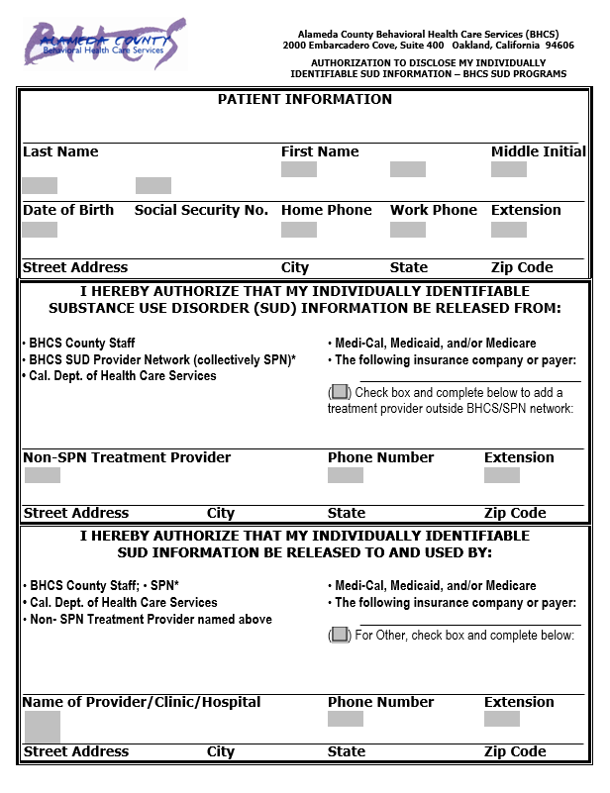
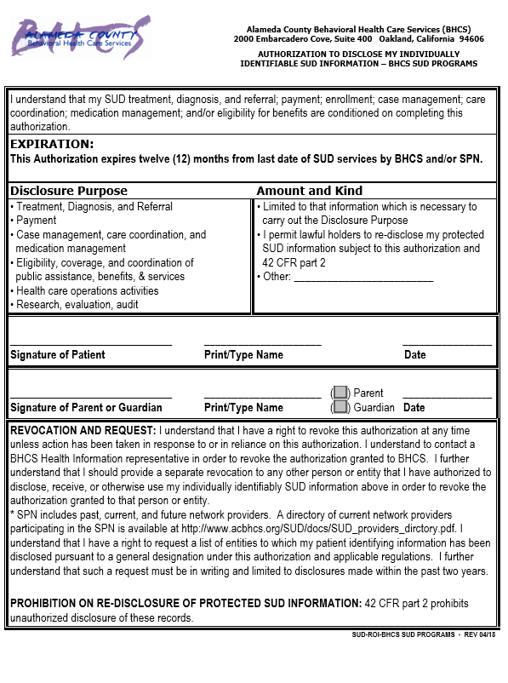
ACBH SUD Programs ROI
ACBH SUD Programs ROI is required for all ACBH contracted SUD providers and must be signed prior to entering any information into Clinician’s Gateway/InSyst and releasing any information to the ACBH SUD Provider Network (SPN).
When the beneficiary signs the ACBH SUD Programs ROI, this allows communication between ACBH contracted SUD programs (collectively the SPN)
Regardless best practice remains to discuss and have client sign a specific ROI whenever releasing information outside of your agency
Use the ACBH SUD Provider Directory to determine which agencies are covered by the ACBH SUD Programs release:
http://www.ACBH.org/SUD/docs/SUD_providers_dirctory.pdf
If the beneficiary declines to sign the required SUD Programs ROI, DO NOT OPEN EPISODE IN INSYST or CG. Indicate on ROI and consult with ACBH immediately.

Slide 71
ACBH SUD Program ROI Screenshot
SUD Programs ROI is required on day one before any beneficiary information may be inputted in to Clinician’s Gateway and InSyst

Slide 72
OTP Admission/client Selection Admission Components
Admission to opioid treatment consists of four core elements:
Determination of physical fitness to receive medication
Determination of physical addiction/dependence to opiates
Informed consent for medication assisted SUD treatment
Prevention of multiple registrations
Dosing may not occur until the client is admitted to treatment
9 CCR § 10270.a

Slide 73
OTP Admission/client Selection 1. Determination of physical fitness
While helpful for pain management, opioid use can have devastating side effects and are highly addictive substances. Both opioids and the medications used for treating them are powerful substances. Also, for a variety of reasons, individuals who are physically dependent on opioids, can have significant physical health related concerns. Moreover, some individuals who are addicted to opioids use other medications and street drugs. All of these factors need to be assessed and taken into consideration before a practitioner can prescribe MAT.
As a result, the regulations require that, prior to admission, a medical evaluation containing at a minimum the following components must be completed:
A medical history which includes the applicant's history of illicit drug use
Laboratory tests for determination of narcotic drug use, tuberculosis, and syphilis
A physical examination (See physical examination slide for specific requirements)
9 CCR § 10270.a

Slide 74
OTP Admission/client Selection Physical Examination Requirements
The physical examination must at minimum contain:
An evaluation of the applicant's organ systems for possibility of infectious diseases; pulmonary, liver, or cardiac abnormalities; and dermatologic sequelae of addiction;
A record of the applicant's vital signs (temperature, pulse, blood pressure, and respiratory rate);
An examination of the applicant's head, ears, eyes, nose, throat (thyroid), chest (including heart, lungs, and breasts), abdomen, extremities, skin, and general appearance;
An assessment of the applicant's neurological system; and
A record of an overall impression which identifies any medical condition or health problem for which treatment is warranted.
9 CCR § 10270

Slide 75
OTP Admission/client Selection 2. Determination of physical addiction/dependence to opiates
Observed signs of physical dependence, must be clearly and specifically noted in the client's record
Some of the common withdrawal effects associated with stopping the use of opioids include:
Physical and psychological cravings
Nausea
Stomach/Abdominal pain
Cold sweat / Sweating
Chills
Vomiting
Diarrhea
Dilated pupils
Runny nose
Increased tearing
Agitation
Anxiety
Muscle tension
Shaking or quivering
Trouble sleeping
Enlarged pupils
Pain in the bones
Goose bumps
Yawning
9 CCR § 10270

Slide 76
OTP Admission/client Selection Which staff can determine admission to OTP?
Medical Director
Physician
Physician’s Assistant
Nurse Practitioner
Before admitting a client to treatment, the medical director must document the required elements of client selection in the medical record.
If a physician’s assistant or nurse practitioner completes the medical evaluation and other requirements of admission, the medical director must also document their review and concurrence in the client’s medical record.
Also known as Physician Extenders
9 CCR § 10270.a

Slide 77
OTP Admission/client Selection Maintenance Admission Requirements 1
Confirmed documented history of at least two years of addiction to opiates
With prior DHCS approval, the program may make an exception to this requirement only if the program physician determines, based on their medical training and expertise, that withholding treatment constitutes a life- or health-endangering situation
Confirmed history of two or more unsuccessful attempts in withdrawal treatment with subsequent relapse to illicit opiate use
At least seven days shall have elapsed since completion of the immediately preceding episode of withdrawal treatment if it is to be used to satisfy this subsection
State regulations do not allow maintenance treatment for individuals who are under 18 years of age. DHCS will review temporary exceptions to this rule with or without written consent of their parent(s) or guardian. See Minor Consent slide for additional info.
Certification by a physician of fitness for replacement narcotic therapy based upon physical examination, medical history, and indicated laboratory findings. Plans for correction of existing medical problems should be indicated.
Evidence of observed signs of physical dependence
9 CCR § 10270.d
IN 18-061
Notes:
Looking through title 9, I did not see anything specific to a narrative evaluation. Will we still want this to apply to OTP as well?

Slide 78
OTP Admission/client Selection Maintenance Admission Requirements 2
Allowed exceptions when medically justified by the medical director or physician:
An applicant who has resided in a penal or chronic care institution for one month or longer may be admitted to treatment within one month of release without documented evidence of physical dependence, provided the person would have been eligible for admission before incarceration or institutionalization.
Previously treated clients who voluntarily detoxified from maintenance treatment may be admitted to treatment without documentation of current physical dependence within six months after discharge, if the program is able to document prior maintenance treatment of 6+ months. At the discretion of the medical director or physician may be granted the same take-home step level they were on at the time of discharge.
Pregnant clients who are currently physically dependent on opiates and have had a documented history of addition to opiates in the past may be admitted to maintenance treatment without documentation of a two-year addiction history or two prior treatment failures.
9 CCR § 10270.d.5/6
Notes:
Looking through title 9, I did not see anything specific to a narrative evaluation. Will we still want this to apply to OTP as well?

Slide 79
OTP Admission/client Selection Detoxification Admission Requirements 1
Determination by a program physician that the client is currently physically dependent on opiates. Evidence of current physical dependence shall include:
Observed signs of physical dependence, which must be clearly and specifically noted in the client's record.
Results of an initial test or analysis for illicit drug use shall be used to aid in determining current physical dependence, and must be noted in the client's record. Results of the initial test or analysis may be obtained after commencement of detoxification treatment.
9 CCR § 10270.d.5/6

Slide 80
OTP Admission/client Selection Detoxification Admission Requirements 2
Detoxification treatment for individuals who are under 18 years of age requires written consent of their parent(s) or guardian prior to the administration of the first medication dose. OTPs may seek an exception to this requirement on an individual client basis by submitting a temporary exception request to DHCS. (see Minor Consent slide for additional information)
At least seven days shall have elapsed since termination of the immediately preceding episode of detoxification treatment. A program may not knowingly admit a client who does not satisfy this requirement.
The client's signed statement that at least seven days have elapsed since termination of the immediately preceding episode of detoxification treatment may, if reliable, be acceptable.
The applicant is not in the last trimester of pregnancy.
9 CCR § 10270.d.5,6
9 CCR § 10270.c.3
MHSUDS IN 18-061

Slide 81
Establishing an Included Diagnosis Diagnosis/Symptoms/Impairments
Under DMC-ODS establishing a diagnosis is part of determining medical necessity
The beneficiary must meet criteria for at least one included DSM-5 opioid diagnosis
Beneficiaries may be treated for multiple included SUD diagnoses. All SUD diagnoses to be treated must be fully established in the medical record.
The opioid SUD diagnosis must occur prior to admission by the individual conducting the medical evaluation
The written basis for the diagnosis must be indicated in the medical record
Must include specific, individualized signs and symptoms for each diagnosis, including timeframes
To be given a diagnosis, the beneficiary must meet the criteria as specified in the DSM-5 for each diagnosis given. ACBH does not determine criteria for diagnoses.
A good rule of thumb is that an individual reviewing the diagnosis should be able to determine the diagnosis from the written narrative alone.
IA.III.PP.10

Slide 82
Included SUD Diagnoses
Diagnoses that are treatable through DMC-ODS SUD treatment are indicated on the Alameda County SUD Diagnoses Included List
Must use the most recent list published by ACBH
Only the DSM-5 diagnoses on this list may be treated through SUD services
Beneficiaries receiving OTP services must have at least one opioid SUD diagnosis that is being treated
Include both the ICD-10 code and DSM-5 name (including specifier)
e.g. In Early Remission, In Sustained Remission, In a Controlled Environment
Differential diagnoses must be considered and documented as relevant

Slide 83
ACBH SUD Included Diagnosis List
Last updated on 11/1/2018 to include both DSM-5/APA coding updates and DHCS included diagnoses updates. The DSM-5 update added additional codes for remission SUD diagnoses. Alameda County’s list update includes both these additional codes and all possible specifiers for all SUD included diagnoses.
Specifiers must be used accurately
Alameda County SUD providers may only provide treatment for the DSM-5 diagnoses on this list.

Slide 84
OTP Admission/client Selection 3. Informed Consent 1
Each client shall attest to voluntary participation in a program by providing written documentation of his/her informed consent.
The program shall ensure that the client reads and understands the consent form, explain program rules, and supply the client with copies of the consent form and program rules.
If a client is admitted to a new treatment episode after a previous episode of treatment was terminated by the program physician and the discharge was noted in the client's record, the program shall reissue rules and instructions to the client and require that the client resign the consent form.
9 CCR § 10290

Slide 85
OTP Admission/client Selection 3. Informed Consent 2
The addicting nature of medications used in replacement narcotic therapy
The hazards and risks involved in replacement narcotic therapy
The client's responsibility to the program
The program's responsibility to the client
The client's participation in the program is wholly voluntary and the client may terminate their participation in the program at any time without penalty
The client will be tested for evidence of use of opiates and other illicit drugs
The client's medically determined dosage level may be adjusted without the client's knowledge, and at some later point the client's dose may contain no medications used in replacement narcotic therapy
Take-home medication which may be dispensed to the client is only for the client's personal use
Misuse of medications will result in specified penalties within the program and may also result in criminal prosecution
The client has a right to a humane procedure of withdrawal from medications used in replacement narcotic therapy and a procedure for gradual withdrawal is available
Possible adverse effects of abrupt withdrawal from medications used in replacement narcotic therapy
Protection under the confidentiality requirements
9 CCR § 10280

Slide 86
OTP Admission/client Selection 3. Informed Consent 3
Ind. of childbearing age (~12-51 yrs)
Knowledge of the effects of medications used in replacement narcotic therapy on pregnant individuals and their unborn children is presently inadequate to guarantee that these medications may not produce significant or serious side effects.
These medications are transmitted to the unborn child and may cause physical dependence.
Abrupt withdrawal from these medications may adversely affect the unborn child.
The use of other medications or illicit drugs in addition to medications used in replacement narcotic therapy may harm the client and/or unborn child.
The client should consult with a physician before nursing.
The child may show irritability or other ill effects from the client's use of these medications for a brief period following birth.
9 CCR § 10285

Slide 87
Additional Detoxification Admission Requirements 2
Unless legally emancipated, clients under the age of 18 must have the written consent of their parent/guardian prior to the administration of the first detoxification medication dose
clients must not have previously had detoxification services in the past seven days. A written/signed client’s statement, if deemed reliable, may be used to meet this requirement
Pregnant individuals in the last trimester are not eligible for detoxification services

Slide 88
OTP Admission/client Selection 4. Prevention of Multiple Registrations 1
Clients may only be enrolled/registered at one OTP at a time. Providers must not provide OTP services if a client has open services at another OTP
The only exception to this is if the client has had prior approval from their primary treatment provider to receive services on a temporary basis.
Both providers involved in visiting client services must follow all requirements, prior to visiting services being provided. See this slide for more specific information on this subject. (9 CCR § 10295)
9 CCR § 10205
9 CCR § 10295

Slide 89
OTP Admission/client Selection 4. Prevention of Multiple Registrations 2
Prior to admission (including first dose), providers must complete the following tasks and document these in the chart
Notify all clients that they cannot receive replacement narcotic treatment at multiple providers
Require that the client sign a written attestation they are not receiving any other replacement narcotic treatment (If the client refuses to sign this attestation, they cannot be admitted into the program)
Require the client provide the following demographic information: Full name and any aliases, DOB, mother's maiden name, sex, race, height, weight, color of hair, color of eyes, distinguishing markings (such as scars or tattoos).
Request that the client provide their Social Security number to aid in multiple registration checks
Request that the client sign a ROI, allowing the OTP to contact other OTPs in a 50 mile radius to complete multiple registration checks
9 CCR § 10210

Slide 90
OTP Admission/client Selection 4. Prevention of Multiple Registrations 3
Prior to admission, a specimen must be collected for drug testing. Often these results may not be available for a few days after admission. However, when the client's initial drug analysis tests positive for Methadone or its metabolite, the program must take steps to determine the methadone’s source:
Discuss the results with the client: Have they received Methadone from another OTP or inclient hospital (likely within the 72 hours prior to the sample collection date)?
If the client identifies a specific OTP or inclient hospital, have the client sign an ROI and verify that the client is no longer receiving OTP services from that program
OTPs must coordinate with each other to ensure only one is providing treatment
Clients receiving replacement therapy at another OTP must be discharged at the other OTP prior to being admitted for treatment (unless visiting client requirements are met) (see Visiting Client slides)
If the client does not identify a specific OTP, inclient hospital, or other entity as the source of the methadone, have them sign ROIs to allow the OTP to contact all OTPs in a 50 mile radius
Clients who refuses to sign any of the ROIs indicated on this slide have to be discharged immediately as there is a risk of simultaneous OTP services. No additional dosing services may be provided.
9 CCR § 10215
9 CCR § 10310

Slide 91
OTP Admission/client Selection 4. Prevention of Multiple Registrations - Ongoing
To help prevent multiple registrations, DHCS has a client data system that alerts providers of potential multiple OTP registrations
Providers report admission and discharge data to DHCS by the sixth working day of the month following the month in which the program admits or discharges a client
DHCS will notify each program when multiple client registrations are found.
When a program receives multiple registrations notification, they must do the following:
If they are still providing services, they must immediately coordinate with the other identified programs to determine the sole treating provider
If they are no longer providing services, the provider must notify DHCS and close any open services
DHCS may need to help resolve situations when it is not clear who is the treatment provider
9 CCR § 10220
9 CCR § 10225

Slide 92
Additional Physical Examination Info
An agency’s Medical Policies and Procedures (as determined by the Medical Director), indicate the necessary components for a valid physical examination
When the beneficiary's physical examination indicates a beneficiary has a significant medical illness, the client plan must include a goal that the beneficiary obtain appropriate treatment for the illness.

Slide 93
Alameda County SUD Providers’
OTP Intake and Assessment Process

Slide 94
Components of Informing Materials
Consent for Services
Freedom of Choice
Confidentiality & Privacy
Maintaining a Welcoming & Safe Place (not a State-required informing material)
“Guide to Medi-Cal Mental Health Services” OR “Guide to Drug Medi-Cal Services”
Provider Directory for Alameda County Behavioral Health Plan
Beneficiary Problem Resolution Information
Advance Directive Information (for age 18+ and when client turns 18)
Notice of Information 42 CFR PART 2: Information on Drug and Alcohol client Disclosure (for clients receiving Substance Use Treatment services only)
Medi-Cal Requirement

Slide 95
Informing Materials / Admission Criteria: Informing Materials, Incidental Disclosure, ROIs, and Payment Provisions
All ACBH contracted treatment providers are required to review ACBH Informing Materials (aka Consent to Services and Acknowledgments) packet with the beneficiary (client) prior to signing the signature page. All are available in Alameda County threshold languages.
http://www.acbhcs.org/providers/QA/General/informing.htm
Providers may not remove, modify, or contradict any components of the ACBH form
OTP providers may have additional privacy notices, sliding scale, informing forms, etc. (see following slides for additional specific information)
Discussions around informed consent should begin at admission and clients must sign the Informing Materials by the Assessment due date. Providers must retain the signature page in the beneficiary’s medical record. This must be completed initially and then reviewed annually.
Having the Informing Materials’ signature page signed does not relieve the provider of their duties to have the Incidental Disclosure Acknowledgement, ROIs, Sliding Scale/Payment Provisions, etc. acknowledged (signed & dated) and in place as required by regulations

Slide 96
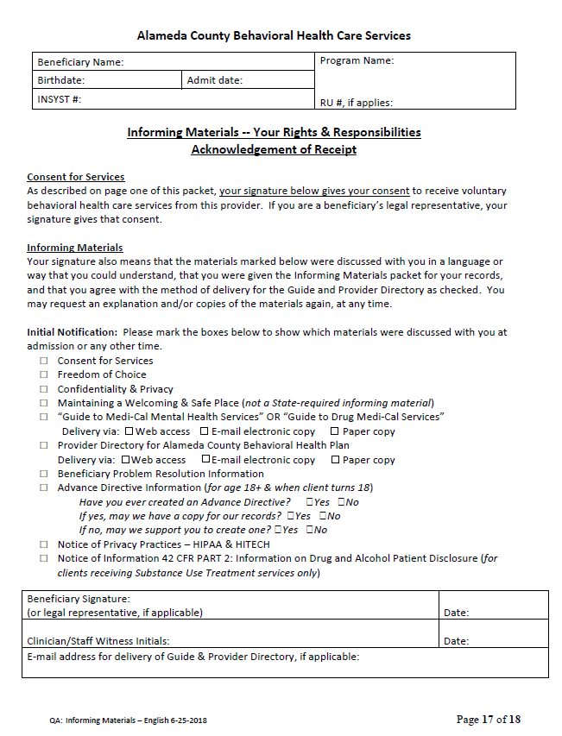
ACBH Informing Materials
File the signature page in the chart and give the beneficiary the rest of the handbook for their reference
Give packet to client
Retain sig. page in chart
Must review all of these items with the client and check these boxes
Beneficiary signs here

Slide 97
Medication Consent Requirements
TBD have asked DHCS

Slide 98
Incidental Disclosures
42 CFR, Part 2 does not allow providers to unintentionally disclose PHI (called incidental disclosures) that may occur through conversations with their co-workers in such places as hallways or breakrooms.
Beneficiaries may unintentionally disclose personal information during casual conversations, “free talk,” with other beneficiaries (clients) outside of the treatment room or provider environment. 42 CFR, Part 2 does not regulate beneficiaries’ conversations. However, the Incidental Disclosure Information form reminds clients about the importance of privacy for others and promotes respect and confidentiality. The Incidental Disclosure form must be reviewed upon admission and be completed for each beneficiary.
These documents shall be in the beneficiary’s chart and ACBH will be auditing to this standard.
42 CFR, Part 2
DHCS DMC FAQ

Slide 99
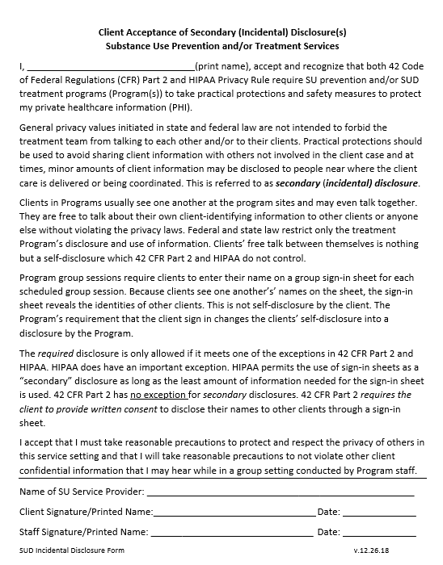
Incidental Disclosures Form
This additional disclosure is required by ACBH and must be maintained in client’s chart

Slide 100
Controlled Substance Utilization Review and Evaluation System
CURES 2.0 (Controlled Substance Utilization Review and Evaluation System) is a database of Schedule II, III and IV controlled substance prescriptions dispensed in California serving the public health, regulatory oversight agencies, and law enforcement. CURES 2.0 is committed to the reduction of prescription drug abuse and diversion without affecting legitimate medical practice or client care.
For OTPs CURES check is required before prescribing and then every four months thereafter
https://oag.ca.gov/cures
HSC 111165.4 (a)(1)(A)(i)

Slide 101
Releases of Information (ROIs)
Health Information is protected by law; Protected Health Information (PHI)
Must include 42 CFR, Part 2 Final Rule, HIPAA, HITECH requirements
Best practice is to get a ROI even if contact with an external individual is allowed by law
ROIs protect both the beneficiary and the agency
ROIs are valid for dates specified
Statements such as, “to the end of treatment” are not
considered specific dates
It is highly recommended that specific expiration dates be indicated
ROIs with non-specific end dates automatically expire after 12 months

Slide 102
Releases of Information (ROIs), Cont.
Required for any contact outside of your agency
Required ACBH ROIs have been approved by Alameda County Counsel
ACBH currently has three approved versions of this two page form:
SUD Programs ROI
Emergency Contact ROI
Criminal Justice ROI

Slide 103
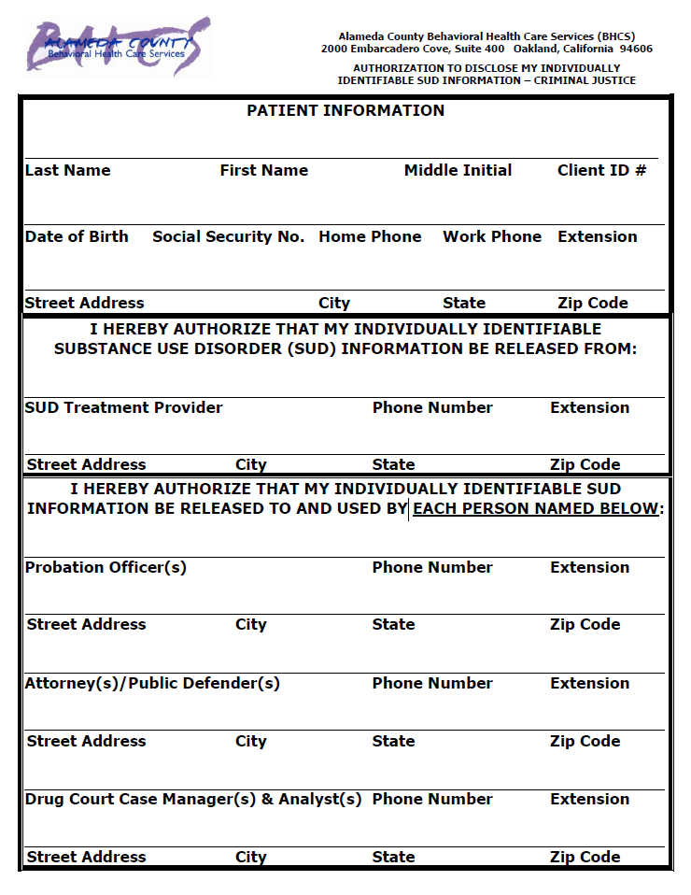
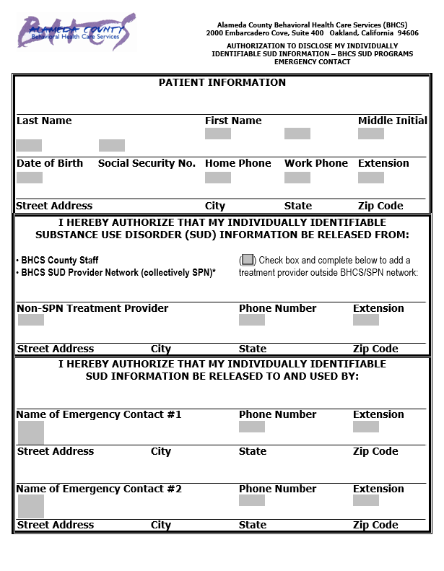
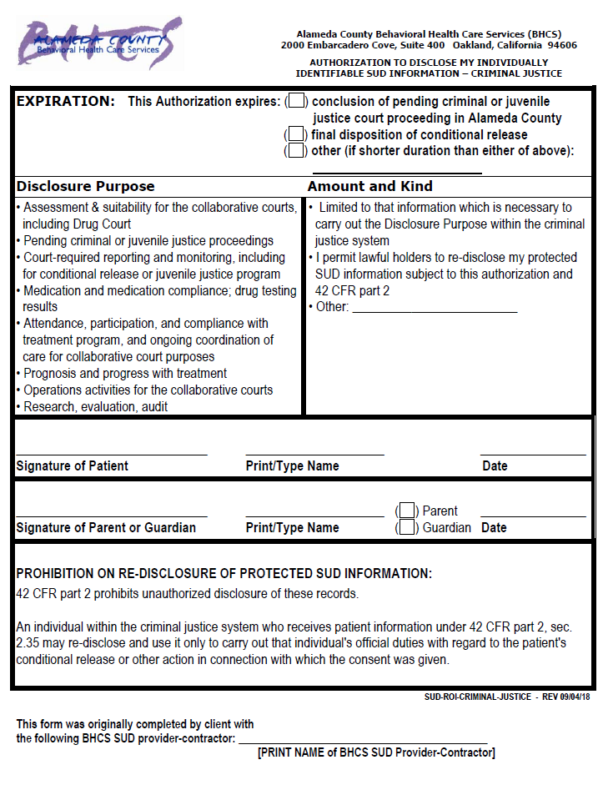
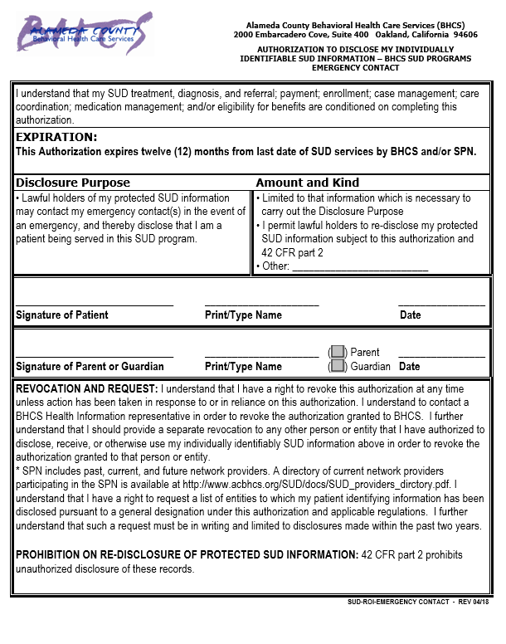
ACBH ROI Screenshots
QA highly recommends ROIs are printed as double sided. There is a high risk that the second page will get separated and/or be unclear as to which ROI it applies
SUD Programs ROI
Criminal Justice ROI
Emergency Contact ROI

Slide 104
ROI Tracker Log Requirements
With some exceptions, an individual has a right to receive an accounting of disclosures of protected health information made by a covered entity in the six years prior to the date on which the accounting is requested.
Required components:
The date of the disclosure
The name of the entity or person who received the protected health information and, if known, the address of such entity or person
A brief description of the protected health information disclosed
A brief statement of the purpose of the disclosure that reasonably informs the individual of the basis for the disclosure
For multiple disclosures to the same entity, the frequency, periodicity, or number of the disclosures made during the accounting period and the date of the last such disclosure during the accounting period are required
45 CFR 164.528

Slide 105
ACBH ROI Tracker Log Meets HIPAA Disclosure Tracking Requirements
Tracker log will be requested for audits
45 CFR 164.528

Slide 106
Physical Health and SUD Treatment

Slide 107
Physical Health Considerations
Clients who request DMC-ODS services may have significant physical health issues
Coordination with physical health providers is required to meet the physical health needs of our clients
When identified physical health issues must be included in plan goals/action steps whenever possible

Slide 108
Health Screening / Questionnaire Highly recommended for all programs
AOD Certified/Licensed programs may use DHCS Form 5103 for the health questionnaire or may develop their own health questionnaire provided it contains, at a minimum, the information in DHCS Form 5103
The health questionnaire is a client's self-assessment of their current health status. The health questionnaire is completed and signed prior to the client's admission and retained in the file. Program staff must review each completed health questionnaire. When appropriate, the client must be referred to licensed medical professionals for physical, psychiatric, and laboratory examinations
Unless the client needs assistance, this is a questionnaire for them to complete independently
Health Questionnaire requirement is intended to be a client self-report document that provides information for the treatment staff conducting the intake assessment. It is not a medical history screening or assessment.
Client’s self-report is used to determine if client has immediate medical needs that would impact their ability to safely participate in SUD Treatment. Non-AOD certified/licensed providers are recommended to have the client self-report their medical history using DHCS 5103 in addition to gathering required medical history
AOD Certification Standards (05/17)

Slide 109
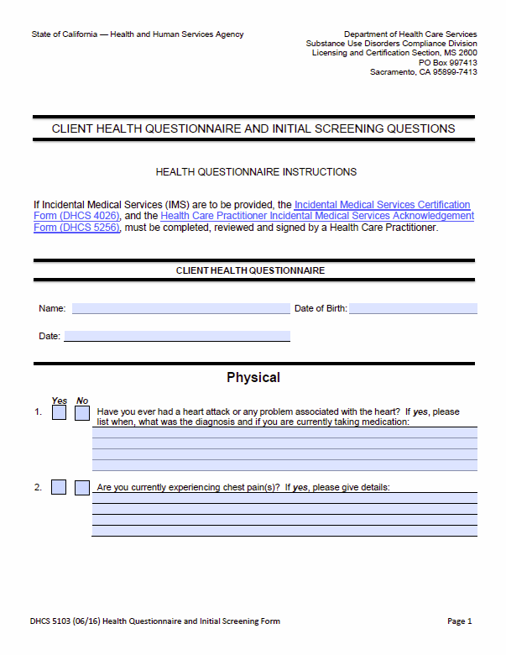
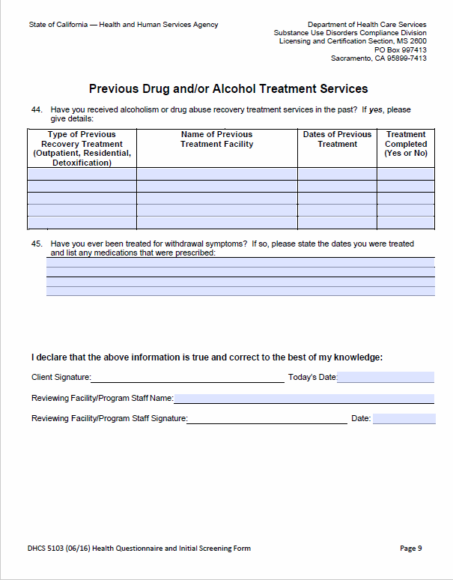
DHCS Form 5103 Health Screening Questionnaire
Meets requirements AOD Alcohol And Drug Certification Standards Section 12020
DHCS Form 5103, Version (06/16) this is a 10 page form:
http://www.dhcs.ca.gov/provgovpart/Documents/DHCS_5103.pdf
Available in handout section!

Slide 110
OTP Assessment Requirements
Part of the Golden Thread

Slide 111
Assessments: The Foundation of Treatment
The assessment process is the a key element in the development of a trusting, helping relationship with the beneficiary
As the assessment process unfolds, important areas will need to be explored in-depth. Document specific information in the assessment document
It is expected that the assessment process can take several sessions to complete
The problems or challenges identified during the assessment process are used to inform the client’s plan
This will be explored more extensively in the client plan section of this training
Detailed comments are required for each assessed component
If comment sections and/or checkboxes are left blank, it cannot be determined if that section was assessed and no credit will be given. When it is not clinically appropriate to assess a particular component, indicate the reason why. As treatment progresses, update the assessment information as necessary.

Slide 112
OTP Maintenance Treatment Assessment Required Assessment Components 1
Within 28 days of admission and prior to the treatment plan being completed, all clients receiving maintenance treatment must receive a comprehensive needs assessment. The following elements must be included in the assessment:
These items will likely be part of the day 1 admission assessment requirements, but should be expanded upon if necessary
Health care as recorded within the overall impression portion of the physical examination
Drug/Alcohol use history / Prior addiction history
Previous SUD treatment history / Prior treatment failure
Medical history
Family history
Psychiatric/psychological history
Social/recreational history
Financial status/Economic history
Educational/Vocational/Rehabilitation
Employment history
Criminal history, legal status
IA.III.PP.8.a
9 CCR § 10305.d
9 CCR § 10165

Slide 113
OTP Maintenance Treatment Assessment Required Assessment Components 2
The needs assessment must include a narrative evaluation or analysis of the client and their functioning, including a summary of the client's psychological and sociological background.
Areas identified as significant to the client must be comprehensively explored and documented in the assessment.
The needs assessment must be completed by a treatment staff (SUD Counselor, LPHA) working within their training and scope of practice. This is an assessment document and not a questionnaire the client completes.
IA.IV.45
9 CCR § 10305.d.1

Slide 114
Additional Perinatal Assessment Items Required for all LOCs
Mother/child habilitative and rehabilitative service needs (i.e., development of parenting skills, training in child development, which may include the provision of cooperative child care pursuant to Health and Safety Code Section 1596.792)
Service access needs (i.e., provision of or arrangement for transportation to and from medically necessary treatment)
Need for education to reduce harmful effects of alcohol and drugs on the mother and fetus or the mother and infant
Needs related to coordination of ancillary services (i.e., assistance in accessing and completing dental services, social services, community services, educational/vocational training and other services which are medically necessary to prevent risk to fetus or infant).
If any of these items are endorsed by the client, then it must be indicated in the client plan.
Must provide transportation when needed (i.e. client cannot access transportation). Indicate reason
IA, III.PP.2.ii

Slide 115
Intake Assessment Review Due Dates For Maintenance Treatment
The needs assessment must be completed within 28 days from admission
As indicated by the complete signature of the LPHA or Counselor who conducted the assessment
The supervising counselor and medical director must review and approve the Needs Assessment document within 14 days from the document’s author’s signature date
If during their review, the medical director or supervising counselor determines that the assessment is incomplete or needs additional information then the assessment must be revised. The completion date on the assessment will be the date when all required signatures are present.
Revisions do not change the assessment due date
IA.V.B.2.b.i.1

Slide 116
OTP Detoxification Treatment Assessment Required Assessment Components
For Detoxification services, Title 9 regulations do not specify additional assessment requirements beyond what is required prior to admission
When medically necessary and indicated, a needs assessment may be completed
IA.III.PP.8.a
9 CCR § 10305.b

Slide 117
Claiming for Completing the Assessment
If an assessment is completed in one session, both the gathering of assessment information and completion of the assessment form, one progress note may document the claim. In the progress note, make reference to the assessment form (“see assessment form dated xx/xx/xx”). It is not necessary to repeat all gathered information in both the note and form. The progress note documentation time includes both the time writing the Assessment form and completing the progress note.
If an assessment is completed over multiple sessions, each progress note must clearly indicate what information was gathered in each session. The Information gathered in each session must be indicated in the progress note, or the progress note must link to specific sections of the assessment. Time spent completing the assessment form may be spread out over each session, or at the last assessment session.
An auditor or other individual reviewing the note/claim must be able to determine precisely what information was gathered for each claimed service
Intake/Assessment may be claimed for face-to-face services plus documentation time OR only for documentation time when completing the assessment form
All activities (face-to-face, PN documentation, completing the form, etc.), require start and end times.
IA.III.PP.17

Slide 118
ASAM LOC Assessments
An essential component of establishing medical necessity

Slide 119
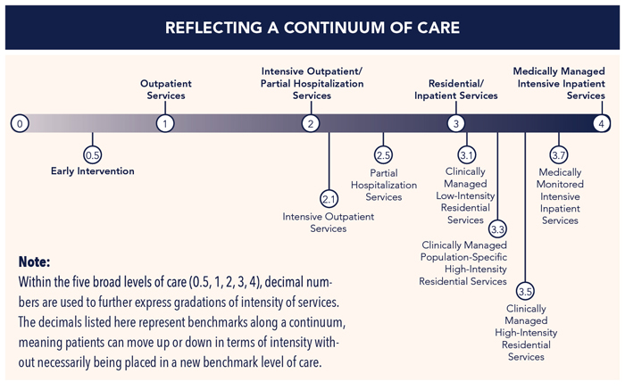
IA.V.B.ii.b.i.2

Slide 120
ASAM LOC Assessments (ALOCs)
Under the IA, the ALOC assessment is a core component of establishment of medical necessity in the SUD system
It is vital that providers use the ALOC accurately and correctly. Issues with the level of care assessment can cause full chart disallowances as medical necessity would not be established.
ALOCs must be consistent with the client’s functioning and presentation and include all LOCs the client meets criteria for.
Providers must complete the ASAM Level of Care (ALOC) accurately to the client’s needs, We are finding that often the ALOC confirms the level of care of the provider (e.g. IOS providers determine client needs ASAM 2.1) and is not consistent with the individual’s documented presentation and assessment. ACBH will be monitoring ALOCs closely for accuracy.
IA.V.B.ii.b.i.2

Slide 121
ASAM Level of Care (ALOC)
If the beneficiary is referred to SUD services through one of the portals, a brief ALOC screening will have been completed
Often the portals’ screening will have incomplete information
May have been a phone screening
Providers must complete the full ALOC within established medical necessity timelines
IA.V.B.ii.b.i.2

Slide 122
ASAM Levels of Care
The ASAM Criteria describes treatment as a continuum marked by four broad levels of service and an early intervention level. Within the five broad levels of care, decimal numbers are used to further express gradations of intensity of services.
The levels of care provide a standard nomenclature for describing the continuum of recovery-oriented addiction services. Using the ASAM assessment clinicians are able to conduct a multidimensional assessment that explores individual risks and needs, as well as strengths, skills and resources.
IA.V.B.ii.b.i.2

Slide 123
ASAM Level of Care (ALOC), Cont.
Portals – Use ASAM ALOC Screening Form
All other providers use ASAM Level of Care Assessment (ALOC)
ALOC Initial
ALOC Review
These forms are identical and have different names for tracking purposes
Using identical ALOCs allows for direct comparison across treatment time frames
IA.V.B.ii.b.i.2

Slide 124
Alameda County Residential ASAM LOCs
ASAM LOC | Service Name | Description of Care
3.1 | Clinically Managed Low-Intensity Residential Services | 24-hour structure with available trained personnel; at least 5 hours of clinical service per week and preparation for outpatient treatment.
3.2 | Withdrawal Management (clinically-managed) residential withdrawal management | 24 –hour supervision, observation, and support for clients who are intoxicated or experiencing withdrawal.
3.3 | Clinically Managed Population-Specific High-Intensity Residential Services | 24-hour care with trained counselors to stabilize multidimensional imminent danger. Less intense milieu and group treatment for those with cognitive or other impairments unable to use the full active milieu or therapeutic community and preparation for outpatient treatment. (Note: This level is not designated for adolescents). (Currently in development)
3.5 | Clinically Managed High-Intensity Residential Services | 24-hour care with trained counselors to stabilize multidimensional imminent danger and preparation for outpatient treatment. Able to tolerate and use the full milieu or therapeutic community.
3.7 (referral) | Medically Monitored Intensive Inclient Services | 24-hour nursing care with physician availability for significant problems. 16 hour/day counselor availability. (N/A to this training)
4 (referral) | Medically Managed Intensive Inclient Services | 24-hour nursing care with daily physician care for severe, unstable problems. Counseling available to engage client in treatment. (N/A to this training)
IA.V.B.ii.b.i.2

Slide 125
ASAM Dimensions
Each of the six (6) ASAM dimensions require assessment
For each dimension that is not No Risk/Stable, a written descriptive comment is required
Depending on how the intake is completed, information from the Assessment is used to inform the ASAM and vice versa
Regardless there must be a congruence between the intake assessment documents, medical necessity, and ASAM
IA.V.B.ii.b.i.2

Slide 126
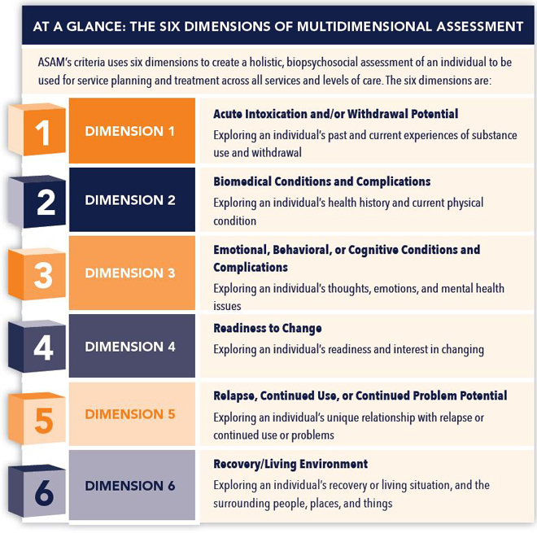
ASAM Dimensions
IA.V.B.ii.b.i.2

Slide 127
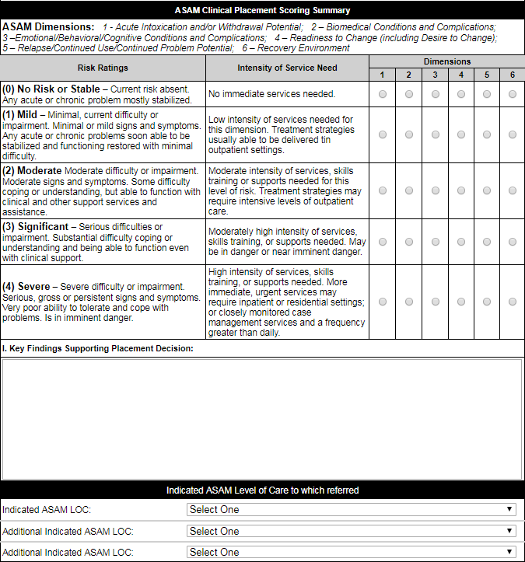
ASAM Clinical Placement Scoring Summary
Be mindful that only one Risk Rating is required for each dimension (score one row per column)
A detailed narrative written description is required to explain the Key Findings Supporting the Placement Decision
Refer to ASAM training materials and guidance to assist in determining the Level of Care accurately and consistently
IA.V.B.ii.b.i.2

Slide 128
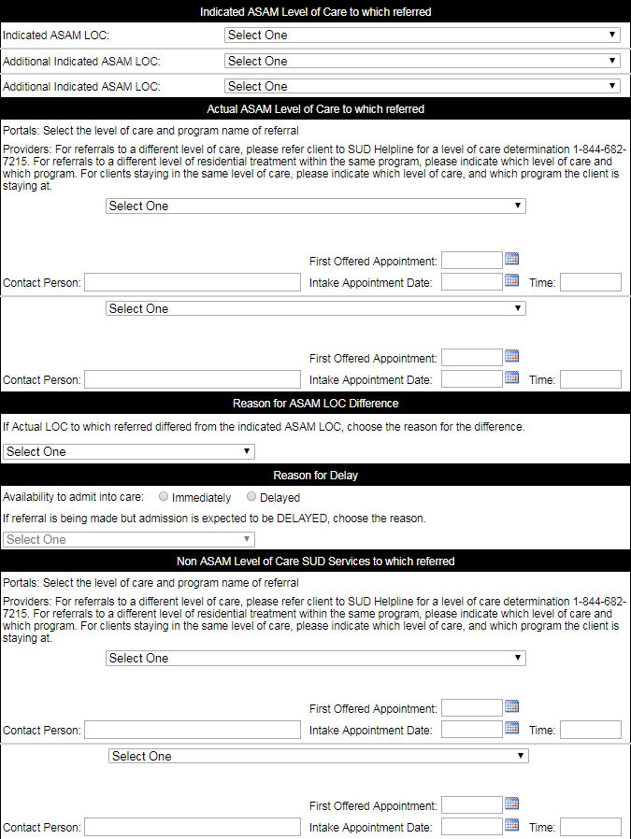
ASAM LOC (ALOC)
The Indicated ASAM LOC is the beneficiary’s presentation at the time of assessment
When the Indicated ASAM LOC differs from the Actual ASAM Level of Care to which referred, choose a reason from the dropdown menu. A more detailed explanation is required in the comment field.
Beneficiaries may have up to 3 possible ASAM LOCs
For example:
Indicated: OTP
Additional Indicated: OS/IOS
Additional Indicated: Recovery Residence
IA.V.B.ii.b.i.2

Slide 129
ALOC Due Dates
ALOCs are due prior to every plan or plan update and whenever clinically indicated
ALOCs completed within 45 days of plan date may be used to meet this requirement, if there are clinical changes then the ALOC must be redone.
OTP – Due within 28 days from date of admission and then every 90 days from date of previous ALOC
IA.V.B.ii.b.i.2

Slide 130
CG ALOC Data Entry Instructions 1
OTPs are allowed to have data entry staff input data from completed ALOCs into Clinician’s Gateway
The Counselor/LPHA completes the ALOC, then data entry staff enter the information into CG exactly as written on the completed ALOC form. The ALOC in CG must be identical to the completed ALOC.
When creating the ALOC in CG the data entry staff must change the ownership of the ALOC to the treatment staff who completed/signed the ALOC. → For instructions, see next slide
The assessment staff who completed the form, must then go into CG, review the form and confirm it’s accuracy, then sign the ALOC. The ALOC form in CG must be signed/finalized by a staff with the training and credentials to do so.
If your agency uses this option, it is highly recommended that your confirm your data entry process with QA like to explore this option, contact ACBH SUD TA for guidance on developing the required validation checks.

Slide 131
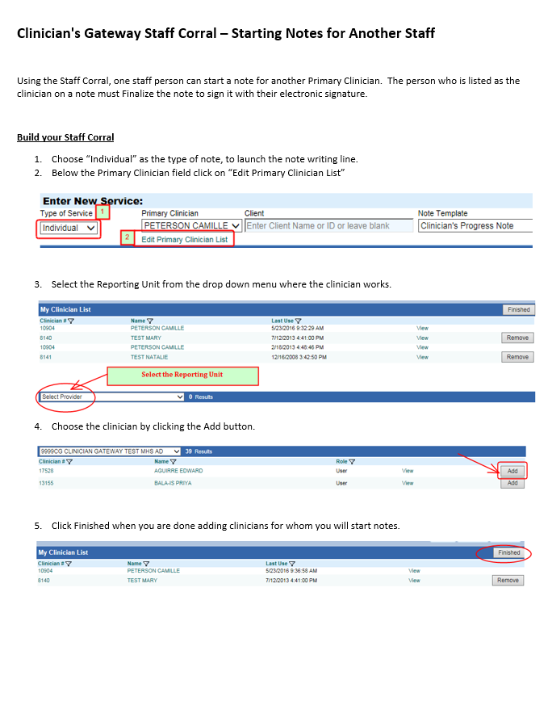
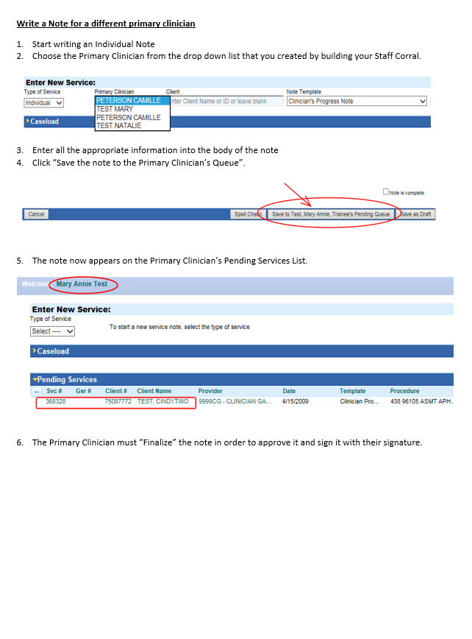
CG ALOC Data Entry Instructions 2 See handouts

Slide 132
Transitioning between Levels of Care OTP ←→ Other SUD LOCs
Once an ALOC indicates an additional or different level of care than is currently being provided, providers have 10 days to assist the beneficiary’s connection with the new LOC
When transitioning between LOCs the client must be closed in the previous RU and opened in the new RU
Certain services may be provided simultaneously, such as OTP and OS, or OS and RES
Client records must be opened as if a new client for this type of transition
IA.V.D.2.i.b

Slide 133
Medical Necessity Criteria Youth/Adolescents
Youth under 21 may be assessed to be at-risk for developing a SUD, and if applicable, must meet the ASAM adolescent treatment criteria.
Youth with a DSM-5 SUD diagnosis → refer using ASAM
Youth at-risk for SUD (ASAM 0.5) → refer to early intervention, primary physician, or MH provider
Youth under age 21 are eligible for EPSDT services, which includes SUD prevention treatment, if medically necessary
IA.III.B.2.ii.b

Slide 134
Initial Medical Necessity Form
Requirements

Slide 135
Initial Medical Necessity Form Highly recommended for OTPs
May only be completed by an LPHA
If the LPHA is registered/waivered, then a licensed LPHA review and co-signature within due date of medical necessity is required
This form documents the basis for SUD diagnosis in the client’s individual medical record
The IMN must include complete signatures (printed name, credentials, date, and signature) of the LPHA(s) required on the document
Completing the IMN (or CSJ) inputs the diagnosis into CG, without this complete the diagnosis will not be auto populated on the client plan document
Medical necessity elements on the IMN must be established prior to completion of the treatment plan

Slide 136
Diagnosis requirements for OTPs
Under DMC-ODS, OTPs are required to document the signs and symptoms for at least one included diagnosis that will be the primary focus of treatment
For OTPs, beneficiaries must be diagnosed with at least one included Opioid Use Disorder diagnosis
IA.III.PP.10

Slide 137
Additional Medical Necessity Requirements
Health care services…which are reasonable and necessary to protect life, to prevent significant illness or significant disability, or to alleviate severe pain through the diagnosis or treatment of disease, illness or injury are covered by the Medi-Cal program, subject to utilization controls…
22 CCR § 51303
22 CCR § 51340.1

Slide 138
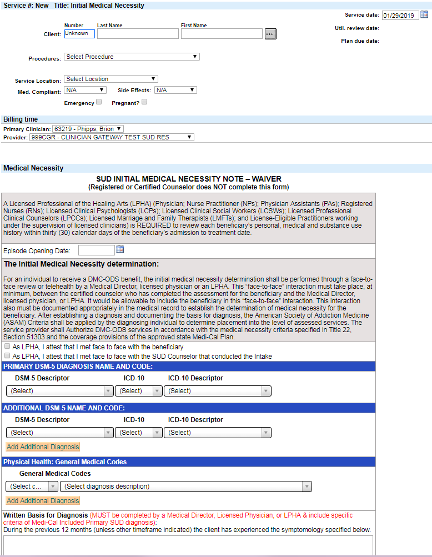
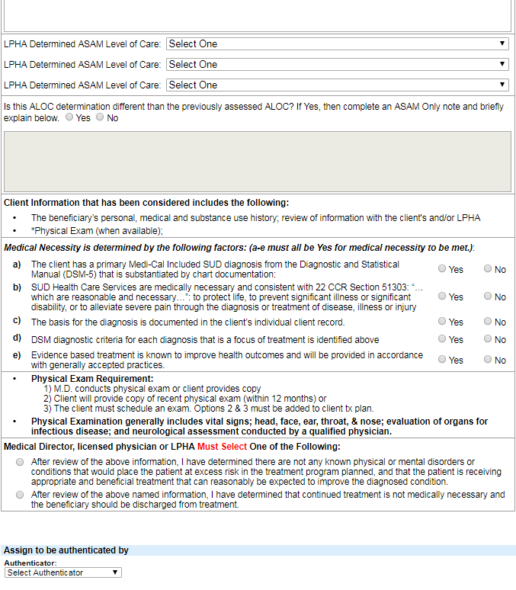
Initial Medical Necessity Form Covers the additional SUD Med. Nec. requirements
LPHA must enter all ASAM levels of care here (up to 3)
The LPHA indicates here if they met face-to-face with the beneficiary or the SUD Counselor who conducted the assessment
All must be determined as ‘Yes’ in order for medical necessity to be established.
IMN may only be completed by an LPHA. If LPHA is registered or waivered, then a licensed LPHA must review and co-sign the form
If not, medical necessity will not have been established and claims will be disallowed
LPHA must include the written basis for each treated diagnosis. DSM-5 criteria must be individualized and include specific signs and symptoms for each SUD diagnosis.
Up to 9 diagnoses may be added to the beneficiary’s medical record

Slide 139
Levels of Care on IMN
As part of establishing medical necessity the LPHA must review and approve the ASAM
The LPHA may require that the ALOC be redone if they feel it is not accurate or is missing elements
The LOC information from the ALOC is included in the IMN and indicates the LPHA concurs with the ALOC findings.
By signing the IMN, the LPHA is attesting that medical necessity is met and they have reviewed the required components of the intake to inform their decision.

Slide 140
Initial Medical Necessity (IMN) Form Due Dates
Required for all treatment modalities and it must be completed prior to the initial treatment plan
IOS/OS/RSS – Initial plan is due within 30 days of date of admission
RES – Initial plan is due within 5 days of date of admission
Part of pre-authorization packet required by ACBH UM
WM RES (ASAM 3.2) – Initial plan is due within 24-48 hours of admission (24 hours highly recommended due to short length of stay)
OTPs - Initial plan is due within 28 days of date of admission
OTPs must have documentation of all of the elements on the form by this due date

Slide 141
A few review questions are coming up, we know the answers are in your handout, they’re right there on the next page. Please don’t look so we can all figure them out together.

Slide 142
Medical Necessity & Assessment Review Questions
What are the requirements to establish Medical Necessity for SUD services?
A DHCS included SUD diagnosis which is the Primary Focus of Treatment
Appropriate ASAM LOC (ALOC)
Initial Medical Necessity Form or for OTPs prior admission med. necessity documents
Who may establish a diagnosis?
LPHA (with co-signatures if registered/waivered LPHA). At OTPs diagnoses will probably be established prior to admission by a physician
Who may complete the ASAM?
LPHA, certified SUD Counselor. Registered SUD Counselor if they meet knowledge, experience, and ASAM training requirements
Who MAY NOT formulate a diagnosis?
Certified/Registered SUD Counselor
Does a checkbox list or simply restating the DSM-5 criteria for a SUD diagnosis suffice as a written basis for the diagnosis?
No. The written basis for the diagnosis completed by an LPHA must be individualized with timeframes indicated for all criteria.

Slide 143
Medical Necessity & Assessment Review Cont. All are reasons for full chart non-compliance from the date of non-compliance until completed
What is the timeline for establishing medical necessity and on-going treatment for ACBH SUD programs?
OS/IOS within 30 days, Residential within 5 days of the date of admission, 24-48 hours for WM RES (Cherry Hill)
Between 5 and 6 months (from the Initial Medical Necessity or Last Justification for Continuing Treatment) the Justification for Continuing Tx must be established by the LPHA with determination of Medical Necessity and with a written recommendation from the counselor/LPHA to continue treatment. Registered/Waivered LPHAs require licensed LPHA co-signature.
For OTPs medical necessity must be established prior to admission/initial dose and then annually thereafter.
Why would a medical necessity form need a co-signature?
If the LPHA completing the form was registered or waivered with their respective board

Slide 144
Who may complete an Intake Assessment and ASAM, and Participate in ACBH CQRT?
ACBH highly recommends that the Intake Assessment and ALOC are completed by LPHAs and Certified SUD Counselors ONLY
When there is no other option, Registered SUD Counselors may do so with the minimum training and experience:
Required ASAM e-modules training
Registered SUD Counselors who ,have one year full time equivalent SUD treatment experience; OR
Registered SUD Counselors who have completed the following hours towards their certified credential (essentially the equivalent of half of CCAPP CADC-I requirement):
158 hours of approved education
127 practicum hours (internship experience)
1500 hours of supervised work experience (includes practicum hours)
AND Supervisor must provide an attestation of experience and knowledge to conduct Intake Assessments, ALOC ← Maintain in employee’s personnel file. This will be requested during an audit.

Slide 145
Client Plans
Part of the Golden Thread

Slide 146
We are so in sync
Client Plans & Documentation

Slide 147
“We are so *NSync”
Client Plans & Documentation

Slide 148
SUD Client Plans 1
Each person admitted to treatment services must have an individually prepared client plan
The development of the client plan should be, as much as possible, a collaborative process between the primary SUD Counselor/LPHA and the beneficiary
The LPHA or SUD Counselor must attempt to engage the beneficiary to meaningfully participate in the preparation of the initial client plan and updated client plans.
Plans should be specific and written in language the beneficiary understands (not overly clinical or with acronyms)
IA.III.PP.12
9 CCR § 10305

Slide 149
SUD Client Plans 2 Required components (except Detoxification OTP)
A statement of problems identified through the ASAM, other assessment tool(s) or intake documentation
Goals to be reached which address each problem
Action steps that will be taken by the provider and/or beneficiary to accomplish identified goals
Target dates for the accomplishment of action steps and goals
A description of the services, including the type of counseling, to be provided and the frequency thereof
The assignment of a primary therapist or counselor
The beneficiary's DSM-5 diagnosis as documented by the Medical Director or LPHA
If a beneficiary has not had a physical examination within the 12-month period prior to the beneficiary's admission to treatment date, a goal that the beneficiary have a physical examination
If documentation of a beneficiary's physical examination, which was performed during the prior twelve months, indicates a beneficiary has a significant medical illness, a goal that the beneficiary obtain appropriate treatment for the illness
IA.III.PP.12
9 CCR § 10305

Slide 150
SUD Client Plans 3 Additional OTP Maintenance Requirements
Goals to be achieved by the client based on the needs identified during the assessment process and with estimated target dates for attainment in accordance with the following:
Short-term goals are those which are estimated to require ninety (90) days or less for the client to achieve; and
Long-term goals are those which are estimated to require a specified time exceeding ninety (90) days for the client to achieve.
9 CCR § 10305

Slide 151
SUD Client Plans 4 OTP Detoxification Services Plan Requirements
Provisions to assist the client to understand illicit drug addictions and how to deal with them
Provisions for furnishing services to the client as needed when the period of detoxification treatment is completed
The treatment services required and a description of the role they play in achieving the stated goals
The type and frequency of scheduled counseling services
IA.III.PP.12
9 CCR § 10305.b

Slide 152
SUD Client Plans 5
On the client plan, providers should attempt to link identified needs to the corresponding ASAM Dimension:
1) Acute Intoxication and/or Withdrawal Potential
2) Biomedical Conditions/Complications
3) Emotional/Behavioral/Cognitive Conditions/Complications
4) Readiness to Change
5) Relapse/Continued Use/Continued Problem Potential
6) Recovery Environment
IA.III.PP.12

Slide 153
SUD Client Plans 6 Client Plan Goals
Goals must be established collaboratively with the client that addresses each active problem (not deferred)
Goals may focus on the client’s personal vision of recovery, wellness, and the life they envision for themselves
ACBH recommends providers use S.M.A.R.T. (Specific, Measurable, Attainable, Realistic, and Time Bound) style goals
Measurable and attainable goals create opportunity for success
IA.III.PP.12
9 CCR § 10305

Slide 154
SUD Client Plans 7 Deferring Client Plan Goals
If a challenge is not going to be addressed during the plan period it may be deferred
Must indicate reason for each deferral on the plan
Name a few reasons why a goal is deferred…
IA.III.PP.12

Slide 155
SUD Client Plans 8 Action Steps
Steps that will be taken by the provider and/or beneficiary to accomplish identified goals.
During the plan development process providers assist the client in developing the short-term action steps related his/her identified goal(s)
Instead of indicating that the client will participate in groups or treatment, indicate what will be the expected benefit to client.
IA.III.PP.12.i.a.i.3

Slide 156
SUD Client Plans 9 Action Steps Continued
Provider Action Steps must focus on helping the client achieve their treatment goals
Interventions for Collateral (see prior slides) should include listing significant others by their names and roles (professional relationships do not qualify for Collateral services) for whom contact is planned and indicating “others as needed”
Only approved ACBH abbreviations (acronyms) may be used in the Medical Record—see website for list
IA, III.PP.12

Slide 157
SUD Client Plans 9 Action Steps Continued
Use This:
Client will be able to identify 5 personal relapse prevention skills.
Client will develop a safety plan and learn the three states of the domestic violence cycle of abuse.
Not This:
Client will attend Relapse Prevention Group
Client will participate in individual counseling every week.
IA, III.PP.12

Slide 158
SUD Client Plans 10 Frequency of Services
Use specific expected frequency of services (e.g. 1x/week and as needed)
The frequency of services indicated in the plan must match the frequency of services provided
The Client Plan should be updated if the planned frequency doesn’t correspond with the beneficiary’s actual use of services
ACBH will be checking this in upcoming audits
IA, III.PP.12

Slide 159
SUD Client Plans 11a Description of Services OTPs
The following services types need to be identified in OTP plans:
Best practice is to include a brief description of the type of services
Intake, treatment planning, physician consultation, crisis, and discharge planning do not need to be in the plan.
520 OTP-NTP MAT Buprenorphine
521 OTP-NTP MAT Buprenorphine Brand
522 OTP-NTP MAT Disulfiram Generic
523 OTP-NTP MAT Disulfiram Brand
524 OTP-NTP MAT Naloxone Generic
525 OTP-NTP MAT Naloxone Brand
526 OTP-NTP MAT Bupr-Nalox Gen
527 OTP-NTP MAT Bupr-Nalox Brand
455 OTP-NTP-NTP Individual Counsel
474 OTP-NTP-NTP Collateral
479 OTP-NTP-NTP Medical PsychoTX
483 OTP-NTP Patient Education
486 OTP-NTP Medication Services
506 OTP-NTP Group Counsel
519 OTP-NTP Methadone Dosing
IA, III.PP.12

Slide 160
SUD Client Plan 12 Additional Requirements
Plan must indicate the primary SUD Counselor/LPHA. If this changes, indicate the change in a progress note and update on the next plan.
If a beneficiary has not had a physical examination within the twelve month period prior to beneficiary‘s admission to treatment date, a goal that the beneficiary have a physical examination—if goal is carried over to the following Tx Plan, the current barriers and needed Action Steps must be indicated.
If a beneficiary has a significant medical illness, the plan must contain a goal to obtain appropriate treatment for the illness
DSM-5 SUD Diagnosis (both code and name with specifiers are required)
IA, III.PP.12

Slide 161
Updating SUD Client Plans Additional OTP Maintenance Plan Requirements
Updates occur whenever medically necessary or at least once every three months from the date of admission
A summary of the client's progress or lack of progress toward each goal identified on the previous treatment plan.
New goals and behavioral tasks for any newly identified needs, and related changes in the type and frequency of counseling services
IA, III.PP.12
9 CCR § 10305.f

Slide 162
Signature Requirements Reminder
All treatment staff signatures in SUD must include the printed name, credentials, legible signature, and date signed.
In CG this should be done automatically when signatures are finalized. Non-finalized signatures are not considered complete. Also verify your name and credentials are correct in CG.
When beneficiaries are required to sign documents, ask that they print their name, sign legibly, and include that day’s date. If they have difficulty with this, note this on the progress note documenting the service.
One of the most common causes of non-compliance is due to incomplete signatures that did not contain all three above requirements – Will cause claims disallowances.

Slide 163
Client Plan Signatures For Initial Plan
Due by the initial plan’s due date
The SUD Counselor or LPHA who completes the plan
Beneficiary’s signature (see following slide for specific requirements)
IA, III.PP.12

Slide 164
Client Plan Co-Signatures For Initial Plan
If required, the LPHA co-signature is due 15 days from the date the SUD Counselor or LPHA completes the plan
Note that CG does not allow the client signature to occur after the LPHA signature
For clients in OTP Maintenance, both the supervising counselor and Medical Director/Physician must review and co-sign the plan within 14 days from the plan’s effective date
IA, III.PP.12

Slide 165
Client Plan Signatures For Plan Updates
The SUD Counselor or LPHA who completes the plan must sign the plan by the due date
If a SUD Counselor completes the plan, the required LPHA co-signature is due within 15 days of the SUD Counselor’s signature. (14 days for OTPs)
The beneficiary signature on the plan update is 15 days from the date the SUD Counselor/LPHA completed the plan
Note that CG does not allow the client signature to occur after the LPHA signature
For clients in OTP Maintenance, both the supervising counselor and Medical Director/Physician must review and co-sign the plan update within 14 days from the plan’s effective date
IA, III.PP.12

Slide 166
What if the beneficiary is unwilling or unable to sign the plan or plan update?
The beneficiary’s signature is required on the plan and plan update. It is the formal attestation that the beneficiary has participated in the plan development and their agreement to the specifics of treatment.
If the beneficiary refuses to sign the plan, the provider must document the reason for refusal and the provider's strategy to engage the beneficiary to participate in treatment – if not may cause multiple claims disallowances
A beneficiary not being available to sign the plan or the provider forgetting to have the beneficiary sign are not valid reasons for non-signature on the plan or plan update.

Slide 167
OTP Client Plan Due Dates
Initial plan is due within 28 days of date of admission
OTP plans are due at least every 3 months from the date of admission, and then every 3 months thereafter (windows)
Plans may need to be updated more frequently based on beneficiary status/functioning
IA.III.PP.12
9 CCR § 10305

Slide 168
Services required to be listed in the Plan
What are unplanned services?
These are services that do not need to be included in the client plan in order to be provided
The only unplanned services are: Intake/Assessment, Treatment Planning, Crisis, Discharge, and Physician Consultation
Dosing before completion of the Assessment and Plan 28 day due date.
What are planned services?
Services that are required to be identified in the plan in order to be provided
Planned Services may be provided prior to the initial plan due date, if the initial plan has not yet been completed.
Once an initial plan is completed, regardless of the plan due date, only services identified in the plan may be provided
Residential programs (including WM RES) must indicate the LOC as the plan service modality
See next slide for planned services
IA.III.PP.12

Slide 169
Planned Services Types for OTPs
Individual Counseling
Group Counseling
Collateral
Medical Psychotherapy
Patient Education
Medication Services
Methadone Dosing
OTP/NTP MAT Codes
e.g. Naloxone Generic
Case Management
Service Coordination
Care Coordination

Slide 170
Potential Client Plan Issues Non-Compliance
Services may be disallowed when:
Plan signatures are missing or incomplete
The additional Perinatal Assessment items were not addressed on the plan. (See Perinatal Slides)
Plan is not individualized
What are some common reasons for client plan non-compliance?
Primary SUD Counselor/LPHA not identified in the plan
Target Dates of Goals/Action Steps not indicated or expired
Frequency and Type of Services (modalities) not specified
Goals, Objectives and Measurable Action Steps are missing or vague
Plan was not completed on time
DSM-5 diagnosis is not on the plan
IA.III.PP.12

Slide 171
Perinatal Client Plans
Additional requirements for perinatal beneficiaries:
Prenatal exposure to substances harms developing fetuses. If this is identified as a need in the assessment there must be a goal to provide education to the mother, action steps, and target date must be included in the plan to address this problem.
Does the mother need assistance in accessing ancillary services (dental, social, community, educational/vocational, and other services that are medically necessary to prevent risk to the fetus)?
If yes, the plan must include a goal, action steps, and target date to accomplish this goal
IA.III.PP.2

Slide 172
Perinatal Client Plans, cont.
Was a need for mother/child habilitative services identified in the assessment?
If yes, the plan must include a goal, action steps, and target date to accomplish this goal
Were sexual or physical abuse issues identified in the assessment?
If yes, the plan must include a goal, action steps, and target date to accomplish this goal
Are there service access needs (i.e. transportation, financial, other barriers) identified in the assessment?
If yes, the plan must include a goal, action steps, and target date to accomplish this goal
IA.III.PP.2

Slide 173
How to claim for writing the Client Plan 1
If the plan is completed in one session (both face-to-face collaboration with the client) and writing the plan, it may be documented as one treatment planning session. Start and stop times for each component must be clearly documented.
Example:
Interventions: Counselor and client met to discuss plan goals and action steps (60 minutes). Following the session, counselor used information gathered in the session to develop and write client plan (50 minutes). See plan dated 11/10/18. Counselor and client sign the plan at the next face-to-face meeting.

Slide 174
How to claim for writing the Client Plan 2
If the development of the plan took place over several sessions, document each session separately.
For the treatment planning sessions, indicate the sections of plan template that were completed in the progress note or write data in the note.
After the last session, on the same day that the note is written for that service, also write the plan. Include the time (including date, start and end times) spent doing each activity: Session time, PN documentation, plan writing, travel time, etc.

Slide 175
A few review questions are coming up, we know the answers are in your handout, they’re right there on the next page. Please don’t look so we can all figure them out together.

Slide 176
Client Plan Review Questions
If a service type or modality is not listed in the plan can those services be claimed?
Unplanned services (intake/assessment, treatment planning, crisis, physician consultation, discharge) may be provided at anytime, and do not need to be listed in the plan.
Planned services (group, individual, case management, medication, collateral, patient education, dosing after 28 days etc) may only be provided when included in the plan and after the initial plan due date. Planned services may be provided prior to the plan due date.
When is a plan update due for a person receiving OTP Detoxification services?
Due to the short-term nature of OTP Detox, it is unlikely a client would need a plan update
What part of the diagnosis needs to be listed on the plan?
The ICD-10 code and DSM-5 name

Slide 177
Client Plan Review Questions
When does the plan need to be updated?
Due to the short-term nature of WM 3.2 services, plan updates are highly unlikely. OTP Maintenance treatment requires plan updates once every 3 months from EOD (in the 3 month window)
Can the time I spent writing the plan be claimed?
For outpatient services, yes the time spent documenting is claimed along with the treatment plan services. For RES providers, this time is included in the day rate.

Slide 178
Progress Notes
Part of the Golden Thread

Slide 179
Claiming using ACBH Notes
In order to claim for all services except dispensing, a progress note is required
Forms such as the Client Plan are not for claiming
For example, if a OS SUD Counselor and a beneficiary meet to develop the client plan, the SUD Counselor might meet with the beneficiary to discuss plan goals, then later that day or the next day the SUD Counselor sits down to write the plan. The SUD Counselor would document that this way:
Possible to write one note
Document the face-to-face session with dates and times of service
Include documentation date/time for writing the progress note and writing the plan

Slide 180
OTP Counseling Progress Notes 1
Required for each claim for each unique service made for SUD services
For example, two groups on the same day require separate group notes – two (2) notes on that day
Must be completed by the staff that provided the service within 7 calendar days of the service (the date of service is day 1)
Providers must enter the actual time and minutes on the service note, InSyst will calculate correct claiming
IA.III.PP.14
9 CCR § 10345

Slide 181
OTP Counseling Progress Notes 2
Progress notes are individual narrative summaries and must include all of the following:
The topic of the session or purpose of the service
Type of counseling format (i.e., individual, group, or medical psychotherapy) – Must either be the exact code Name or code.
Recommend that providers use the Procedure Code and Name on notes
Information on the beneficiary's attendance, including the date, start and end times of each individual and group counseling session or treatment service.
Identify if services were provided in- person, by telephone, or by telehealth.
If services were provided in the community, identify the location and how the provider ensured confidentiality.
IA.III.PP.14
9 CCR § 10345

Slide 182
OTP Counseling Progress Notes 3
A description of the beneficiary's progress on the treatment plan problems, goals, action steps, objectives, and/or referrals, including
Response to a drug-screening specimen which is positive for illicit drugs or is negative for the replacement narcotic therapy medication dispensed by the program.
New issue or problem that affects the client's treatment.
Nature of prenatal support provided by the program or other appropriate health care provider.
Goal and/or purpose of the group session, the subjects discussed, and a brief summary of the client's participation.
IA.III.PP.14
9 CCR § 10345

Slide 183
OTP Group Claiming Using ACBH Template As An Example
How are OTPs currently claiming for group services?

Slide 184
Reimbursement of Documentation Time 1
The Medical Director, LPHA, or counselor who provided the service may claim for time spent documenting that service
Documentation time related to dosing activities is not claimable
Reimbursable documentation activities include:
Time spent completing progress notes, client plans, continuing services justification, and discharge documentation is reimbursable
Typical time spent documenting a 50 minute service is 10 minutes, but the content of the note must substantiate the time claimed for documentation
Writing of the Assessment, IMN/CSJ, Client Plans, etc. may take longer than 20% of total face-to-face and doc time.
Documentation alone is not reimbursable, there must be a claimed contact service
Must include date and start/end times for all claimed time, including documentation times, an auditor must be able to reconstruct all of the claimed time by reading the note
IA.III.PP.17

Slide 185
Reimbursement of Documentation Time 2
For OTPs who have technological/EHR limitations that do not allow for non-continuous claiming, a second note that claims for service documentation time may claimed and included in the medical record.
In these situations, two notes are required. One to claim for the service, the other to claim for the documentation time.
The progress note for the service (e.g. Ind. Counseling) must include the documentation time in the body of the note, but this time is not included in the claimed time.
The documentation time note may be brief but must clearly indicate what note the documentation time refers to.
For example, “Claiming 10 minutes to document 5/14/19 Individual Counseling service, see 5/14/19 progress note.”
IA.III.PP.17

Slide 186
Documenting Case Management and Physician Consultation
FOR ALL SUD PROVIDERS: Case Management and Physician Consultation are separate services and need to be claimed and documented separately
For residential programs these services must be documented separately from the daily required progress note
The time spent providing Case Management and Physician Consultation services do not count towards minimum or maximum service requirements as they are separate services.
For example, at OTPs, time spent providing Case Management services does not count towards the 50 minute minimum monthly counseling service requirement
Providers must use the single service progress note to separately document these services

Slide 187
Requirements for Physician Consultation Notes
Physician Consultation notes must include all of the following:
Beneficiary’s name
The purpose of the service
Date, start and end times of each service
Identify if services were provided face-to-face, by telephone or by telehealth
ACBH Consultants name and discipline. e.g. Charles, Smith, PharmD
The physician completing the note must sign their name and include their printed name, credentials, and date signed
The progress note must be completed within seven (7) calendar days of the service

Slide 188
Case Management Services Available at all LOCs
To assist a beneficiary in being able to access medical, educational, social, prevocational, vocational, rehabilitative, and community services.
Focus on coordination of SUD care and integration centered around primary care especially with beneficiaries with chronic SUD issues
Interaction with the criminal justice system allowed, if needed
Case management services may be provided face-to-face, by telephone, or by telehealth with the beneficiary and may be provided anywhere in the community.
Case management services may be provided by a LPHA or Registered/Certified SUD Counselor
Case management services must be provided when transitioning beneficiaries between levels of care.
IA.III.R

Slide 189
Case Management Services, Cont.
Care Coordination
Bringing together various providers and information systems to coordinate health services, client needs, and information to help better achieve the goals of treatment and care.
Service Coordination
A service to assist clients in accessing needed medical, educational, social, prevocational, vocational, rehabilitative, and/or other community services. Its is a collaborative process of assessment, planning, facilitation, care coordination, evaluation, and advocacy for options and services to meet an individual's and family's comprehensive health needs through communication and available resources to promote quality, cost effective outcomes. In order to link client with services and resources (e.g., financial, medical, or community services), case managers must have a working knowledge of the appropriate service needed for the client to optimize care through effective, relevant networks of support.
IA.III.R

Slide 190
Requirements for Case Management Notes
Case Management progress notes must include all of the following:
Beneficiary’s name
The purpose of the service
A description of how the service relates to the beneficiary's client plan problems, goals, action steps, objectives, and/or referrals
Date, start and end times of each service
Identify if services were provided in-person, by telephone, or by telehealth
If services were provided in the community, identify the location and how the provider ensured confidentiality.
The SUD Counselor or LPHA completing the note must sign their name and include their printed name, credentials, and date signed
The progress note must be completed within seven (7) calendar days of the service

Slide 191
Clinician’s Gateway Screenshot: SUD Information Only Note
Use this note for recording information that is not billable but needs to be documented in the client’s medical record.

Slide 192
Transportation vs. Travel Time
Transportation is when a staff transports a beneficiary to an off-site location. It may be to an appointment, a community resource, to pick up their medications, or any number of other off-site activities. Time transporting clients is not reimbursable, except at SUD RES programs (where it counts towards the required 20 hours of structured therapeutic activities per week).
A staff providing counseling or other treatment interventions while going 1:1 off-site with a beneficiary may claim only the actual time providing the treatment service. This must be documented clearly and be a medically necessary service.
Travel Time is the time a treatment staff spends traveling (one-way or round trip) to meet the beneficiary at their home and in the community. The beneficiary is not with the staff during time claimed as Travel Time.

Slide 193
SUD Group Treatment Requirements

Slide 194
OTP Counseling Groups
OTP counseling may only be between 4 and 10 participants regardless of staffing — reason for non-compliance
OTP Counseling Groups larger than 10 participants must be divided into separate groups with different group facilitators (counselors/LPHAs)
Groups with more than 10 participants may not be claimed for any of the participants. Instead, a non-billable note would be completed for each group participant.
A client that is 17 years of age or younger may not participate in group counseling with any participants who are 18 years of age or older — reason for non-compliance for all group members.
However, a client who is 17 years of age or younger may participate in group counseling with participants who are 18 years of age or older when the counseling is at a provider's Medi-Cal certified school site.
IA.III.PP.13
IA.IV.42
9 CCR § 10345.b.3.B

Slide 195
Claiming in InSyst for Co-Staffing
Each staff claiming for group services must have separate claim lines in InSyst in order to comply with DHCS and OIG enforcement of 42 CFR Regulations.

Slide 196
Group Sign-In Sheets Improper handling of group sign-in sheets was a frequent cause of non-compliance during prior SUD audits
For each group counseling session a sign-in sheet must be completed with these items:
Date of the group session
Topic of the group
Start and End time for the group
If an individual’s start and end time is different, note that as well
A typed or legibly printed list of participants’ names attending the group (pre-typed ok)
Signature of each participant who attended the session (must be clear that it matches the name — if not legible due to client’s writing inability, counselor must indicate)
Legibly printed name and signature of LPHA(s)/counselor(s)
Certifies it is accurate and complete
Group Sign-in sheets must be kept separate from the chart as it contains multiple clients’ PHI and provided to ACBH whenever a chart is audited
IA.III.PP.13

Slide 197
Group Sign-In Sheets
Make sure members print their names legibly (pre-typed lists ok).
All facilitators must sign, attesting that the information on the sign-in sheet is accurate
For each group member attending, they must sign their name, indicating they attended the group. If the time they attended is different than above, this must noted in the two right columns.
Keep sign-in sheets separately from the chart in order to maintain confidentiality
When charts are requested for audit, remember to provide all corresponding sign-in sheets, otherwise the auditor is unable to confirm group compliance.
For Residential providers who use non-treatment staff to input data for daily notes, there are ADMIN columns to document their inputting of this data into the daily note and that the treatment staff who sign the note also confirms this information. Sees slide on transcribing requirements for additional information

Slide 198
Dispensing Requirements
For controlled narcotic medications

Slide 199
Administering Narcotic Controlled Substances
Every person or entity that handles controlled substances must be registered with DEA or be exempt by regulation from registration.
Controlled narcotic substances used for treatment at OTPs may ONLY be administered by the following individuals (licenses pursuant to B&PC):
Physicians/Surgeons
Registered Nurses acting under the instruction of a physician/surgeon
Physician Assistants acting under the client-specific authority of a physician/surgeon supervisor
When acting under the direction of a physician/surgeon, the following individuals may also administer narcotic controlled substances orally (licenses pursuant to B&PC):
Psychiatric Technicians
Vocational Nurses
Pharmacists
9 CCR § 10260
HSC § 11215
DEA Practitioners Manual

Slide 200
Dosing/Dispensing Log Requirements
Each program must maintain accurate records of medications used in replacement narcotic therapy traceable to specific clients, showing dates, quantity, and batch code marks of the medications.
These records must be maintained by a physician, pharmacist, or health professional authorized to compound, administer or dispense medications used in replacement narcotic therapy.
The staff who administers the dose must initial the corresponding entry
These records must be retained for a period of three years and be available at the time of an audit
9 CCR § 10255

Slide 201
Claiming for Dosing/Dispensing
Providers must use the corresponding procedure code for the medication being administered
The medical staff who dispensed the medication to the client, must be the staff entered into InSyst for claiming
These codes are only used when dispensing or administering and when the OTP provides the medication for allowable take home services:
519 OTP-NTP Methadone Dosing
520 OTP-NTP MAT Buprenorphine
521 OTP-NTP MAT Buprenorphine Brand
522 OTP-NTP MAT Disulfiram Generic
523 OTP-NTP MAT Disulfiram Brand
524 OTP-NTP MAT Naloxone Generic
525 OTP-NTP MAT Naloxone Brand
526 OTP-NTP MAT Bupr-Nalox Gen
527 OTP-NTP MAT Bupr-Nalox Brand

Slide 202
Take Home Medications
Rules, Requirements, and Exceptions

Slide 203
Take Home Medication Procedures 1
The medical director or physician will determine the quantity of take-home medications
The program must instruct the client of their obligation to safeguard the medications
The program must label each take-home dosage container per 9 CCR § 10365.d requirements
Clients on a daily dose of methadone above 100 milligrams are required to attend the program at least six days per week for observed ingestion unless the program has received prior written approval from the Department.
9 CCR § 10365

Slide 204
Take Home Medication Procedures 2
Self-administered take-home medication can only be provided to a client if the medical director or program physician has determined, in their clinical judgment, that the client is responsible in handling narcotic medications, and has documented his or her rationale in the client's record. The rationale must be based on consideration of the following criteria:
Absence of use of illicit drugs and abuse of other substances, including alcohol
Regularity of program attendance for replacement narcotic therapy and counseling services
Absence of serious behavioral problems while at the program
Absence of known criminal activity, including the selling or distributing of illicit drugs
Stability of the client's home environment and social relationships
Length of time in maintenance treatment
Assurance that take-home medication can be safely stored within the client's home
Whether the rehabilitative benefit to the client derived from decreasing the frequency of program attendance outweighs the potential risks of diversion
9 CCR § 10365

Slide 205
Take Home Medication Procedures 3 Criteria for Take-Home Medications
The medical director or program physician may place a client on one of the six take-home medication schedules, only when at least the additional following criteria have been met:
Documentation in the client's record that the client is participating in gainful vocational, educational, or responsible homemaking (i.e., primary care giver, retiree with household responsibilities, or volunteer helping others) activity and the client's daily attendance at the program would be incompatible with such activity;
Documentation in the client's record that the current monthly body specimen collected from the client is both negative for illicit drugs and positive for the narcotic medication administered or dispensed by the program; and
No other evidence in the client's record that he or she has used illicit drugs, abused alcohol, or engaged in criminal activity within the last 30 days (for Steps I-V) and the last year for Step VI
9 CCR § 10370

Slide 206
Take Home Medication Procedures 4 Take-Home Step Levels
Step I Level → After 3 months continuous treatment = 1 day take home supply & OTP observed ingestion 6 days a week
Step II Level → After 6 months continuous treatment = 2 days take home supply & OTP observed ingestion 5 days a week
Step III Level → After 9 months continuous treatment = 3 days take home supply & OTP observed ingestion 4 days a week
Step IV Level → After 12 months continuous treatment = 4 days take home supply & OTP observed ingestion 3 days a week
Step V Level → After 2 years continuous treatment = 5 days take home supply & OTP observed ingestion 2 days a week
Step VI Level → After 3 years continuous treatment = 6 days take home supply & OTP observed ingestion 1 day a week
9 CCR § 10375

Slide 207
Take Home Medication Procedures 5 Exceptions to Take-Home Privileges
The medical director or program physician may grant an exception to take-home medication criteria and dosage schedules for any of the following reasons:
The client has a physical disability or chronic, acute, or terminal illness that makes daily attendance at the program a hardship. The program must verify the client's physical disability or illness, and include medical documentation of the disability or illness in the client's record. The client shall not be given at any one time, more than a two-week take-home supply of medication.
The client has an exceptional circumstance, such as a personal or family crisis, that makes daily attendance at the program a hardship. When the client must travel out of the program area, the program shall attempt to arrange for the client to receive his or her medication at a program in the client's travel area. The program shall document such attempts in the client's record. The client shall not be given at any one time, more than a one-week take-home supply of medication.
The client would benefit, as determined by the medical director or program physician, from receiving his or her medication in two split doses, with one portion dispensed as a take-home dose, when the medical director or program physician has determined that split doses would be more effective in blocking opiate abstinence symptoms that an increased dosage level.
The medical director or program physician must document in the client's record the granting of any exception and the facts justifying the exception.
DHCS may grant temporary exceptions allowing at most up to a month supply for clients with over two years of continuous treatment. Clients are required to attend the program at least once each month.
9 CCR § 10385
42 CFR 8.12

Slide 208
Take Home Medication Procedures 6 Restricting Take-Home Privileges
The medical director or program physician must restrict a client's take-home medication privileges by moving the client back at least one step level on the take-home medication schedule for any of the following reasons:
Clients on step level schedules I through V who have submitted at least two consecutive monthly body specimens which have tested positive for illicit drugs and/or negative for the narcotic medication administered or dispensed by the program, unless the program physician invalidates the accuracy of the test results.
Clients on step level schedule VI who have submitted at least two monthly body specimens within the last four consecutive months which have tested positive for illicit drugs and/or negative for the narcotic medication administered or dispensed by the program, unless the program physician invalidates the accuracy of the test results.
Clients, after receiving a supply of take-home medication, are inexcusably absent from or miss a scheduled appointment with the program without authorization from the program staff.
The client is no longer a suitable candidate for take-home medication privileges as presently scheduled, based on take home requirements.
Regardless, a medical director or physician may revoke take-home privileges for any reason, including:
The client is sharing, giving away, selling, or trading the medication administered or dispensed by the program.
The client attempts to register in another narcotic treatment program.
The client alters or attempts to alter a test or analysis for illicit drug use.
The medical director or program physician shall order the restriction or revocation within fifteen (15) days from the date the program has obtained evidence for any of the reasons identified.
9 CCR § 10390

Slide 209
Take Home Medication Procedures 7 Restoring Take-Home Medication Privileges
The medical director or program physician, when restoring each step of a client's restricted take-home medication privileges, must:
Determine that the client is responsible for handling narcotic medications per take-home medication requirements
Ensure that the client has completed at least a 30-day restriction, and the most recent monthly body specimen collected from the client is both negative for illicit drugs and positive for the narcotic medication administered or dispensed by the program when restoring the following:
Step level schedules I through V which were restricted due to drug-screening test or analysis results
Ensure that at least the previous three (3) consecutive monthly body specimens collected from the client are both negative for illicit drugs and positive for the narcotic medication administered or dispensed by the program when restoring the following:
Step level schedule VI which was restricted due to drug-screening test or analysis results
Any step which was restricted due to an unexcused absence after receiving a supply of take-home medication
Restoring take home medication privileges may not circumvent take-home requirements
Clients cannot advance to a step level they have not previously satisfied the requirements for that level
9 CCR § 10400

Slide 210
Service Types
Including InSyst Procedure Codes

Slide 211
Intake/Assessment 465 OTP-NTP Intake/Assessment
Intake/Assessment services consist of the evaluation or analysis of substance use disorders; the diagnosis of substance use disorders; and the assessment of treatment needs to provide medically necessary services.
Intake/Assessment procedure codes at OTPs should be used for services related to completing the Intake Needs Assessment and other related assessment services
Intake/Assessment does not need to be in the plan in order to be provided
May be provided by SUD Counselors and LPHAs
Documentation time may be claimed for completing the needs assessment document as long as it
For OTPs Intake/Assessment services cannot be claimed on the first day of services, as those services are considered pre-admission services to determine medical necessity and are included in the first dosing claim.
STC.X.135

Slide 212
Treatment Planning 496 OTP-NTP Treatment Planning
For each beneficiary the provider must prepare an individualized written client plan, based upon information obtained in the intake and assessment process. OTP plan are required to be completed within the first 28 days of intake, and then within every 3 months thereafter or whenever there is a change in treatment modality or significant event that would then require a new plan.
This code is used to claim for services related to developing, updating, or otherwise related to the client plan.
May be provided by SUD Counselors and LPHAs with required co-signatures.
9 CCR § 10305

Slide 213
Types of Counseling Services available at OTPs
Individual Counseling
Group Counseling
Medical Psychotherapy
Treatment staff who provide these services must operate within their scope of practice and training and have valid credentials at the time the service is provided.
IA.IV.44
9 CCR § 10345

Slide 214
Counseling Services The following does not qualify as a counseling session
Interactions conducted with program staff in conjunction with dosage administration.
Self-help meetings, including the 12-step programs of Narcotics Anonymous, Methadone Anonymous, Cocaine Anonymous, and Alcoholics Anonymous.
Educational sessions, including client orientation sessions
Administrative intervention regarding payment of fees.
IA.IV.44
9 CCR § 10345.c

Slide 215
Individual Counseling
Services are conducted in a confidential setting so that individuals not participating in the counseling session cannot hear the comments of the beneficiary, SUD counselor or LPHA.
Individual counseling focuses on reducing or stopping substance use, skill building, adherence to a recovery plan, and social, family, and professional/educational outcomes.
IA.IV.44
9 CCR § 10345.c

Slide 216
Individual Counseling 455 OTP-NTP Individual Counsel
Session between a beneficiary and a LPHA or SUD counselor
Individual Counseling must be indicated in Client Plan with frequency (e.g. 1x/week)
Services are provided in-person, by telephone or by telehealth qualify as Medi-Cal reimbursable units of service, and are reimbursed without distinction.
May be provided by SUD Counselors and LPHAs
IA.IV.44

Slide 217
Group Counseling 506 OTP NTP Group Counsel
Group counseling services provided by 1-2 treatment staff, with a minimum of four clients and no more than ten clients and having a clear goal and/or purpose that is a common issue identified in the treatment plans of all participating clients.
Group Counseling must be indicated in Client Plan with frequency (e.g. 3x/week)
A beneficiary that is 17 years of age or younger shall not participate in-group counseling with any participants who are 18 years of age or older. However, a beneficiary who is 17 years of age or younger may participate in group counseling with participants who are 18 years of age or older when the counseling is at a provider's certified school site.
May be provided by SUD Counselors and LPHAs
IA.IV.42
9 CCR § 10345

Slide 218
OTP Medical Psychotherapy 479 OTP-NTP MedicalPsychoTX
Medical psychotherapy session, with face-to-face discussion conducted by the medical director (or delegated physician) on a one-on-one basis with the client, on issues identified in the client's treatment plan.
May only be provided by a M.D.
IA.IV.42
9 CCR § 10345

Slide 219
Collateral 474 OTP NTP Collateral
Sessions with LPHAs or counselors and significant persons in the life of a beneficiary, focused on the treatment needs of the beneficiary in terms of supporting the achievement of the beneficiary's treatment goals.
Significant persons are individuals that have a personal relationship (family member, non-paid advocate, sponsor, etc.), AND not an official or professional relationship (CWW, Probation Office, Teacher, etc.) with the beneficiary.
Teachers, outside therapists, probation workers, CWWs, etc. are considered professional relationships and cannot be claimed as collateral. Case Management may apply.
Releases of Information are required for collateral contacts
Collateral must be indicated in Client Plan with frequency (e.g. 2x/month)
May be provided by SUD Counselors and LPHAs
IA.IV.14

Slide 220
Crisis Intervention 491 OTP-NTP Crisis Intervention
“Crisis intervention” is a face-to-face contact between a beneficiary who is at risk for imminent threat of relapse and a LPHA or counselor
“Crisis” for SUD means an actual relapse or an unforeseen event or circumstance which presents to the beneficiary an imminent threat of relapse. Crisis intervention services shall be limited to stabilization of the beneficiary's emergency situation.
Services shall focus on alleviating crisis problems
Not required to be in the plan as crises by definition are unplanned events
As crises can happen anytime, and by definition are unexpected, it’s good practice to have signed ROIs in place in case of emergency
May be provided by SUD Counselors and LPHAs
IA.IV.20

Slide 221
Patient Education 483 OTP-NTP Patient Education
Means providing research based education on addiction, treatment, recovery and associated health risks
May be provided as an individual or group service (group client ed. code coming soon)
When documenting a Patient Education group (a non-clinical service), at a minimum, the service note for group patient education must always relate back to the individualized client plan.
Patient Education must be indicated in Client Plan with frequency (e.g. 2x/month)
Patient Education groups may only have 2-12 participants per group
May be provided by SUD Counselors and LPHAs
IA.IV.70

Slide 222
Physician Consultation Code TBD
Are services to support DMC physicians with complex cases, which may address medication selection, dosing, side effect management, adherence, drug-drug interactions, or level of care considerations.
Physician Consultation Services include DMC physicians’ consulting with addiction medicine physicians, addiction psychiatrists or clinical pharmacists. Physician consultation services are designed to assist DMC physicians by allowing them to seek expert advice when developing treatment plans for DMC-ODS beneficiaries with complex cases.
Physician consultation services may address medication selection, dosing, side effect management, adherence, drug-to-drug interactions, or level of care considerations.
ACBH is working to contract with one or more physicians or pharmacists in order to provide consultation services. Until then this service may not be claimed.
IA.III.S
IA.IV.76

Slide 223
Medication Services and Medication Assisted Treatment (MAT)
Only OTP/NTPs provide medication services for Opioid Use Disorders
Methadone treatment is only allowed at OTP/NTPs
OTP/NTPs are required to provide access to Buprenorphine, Naloxone, and Disulfiram
Additional MAT may be provided at OTP/NTPs if the client meets OTP/NTP admission requirements
OS/IOS/RES prescribers may claim for medication services if within their scope of practice and training. The prescribed medication needs to be picked up by the client at a local pharmacy
Prescribed medication may not be methadone, buprenorphine, naloxone, and disulfiram for opioid treatment
RES also requires IMS Certification to provide medication services
Beneficiaries may also be referred to their primary care physician for medication services
MAT is not available through Recovery Support Services programs, they may receive MAT elsewhere
IA, III.AA.3.11

Slide 224
Medication Services Allowed for all LOCs when specified in contract
Definition: The prescription or administration of medication related to substance use treatment services, or the assessment of the side effects or results of that medication
May only be conducted by staff lawfully authorized to provide such services and/or order laboratory testing within their scope of practice, licensure, training, and experience
OS/IOS/RES providers may prescribe if within their scope of practice and training. The prescribed medication needs to be picked up by the client at a local pharmacy
Prescribed medication currently may not be any medication for opioid treatment
RES requires IMS Certification
Prescription and administration of medications may occur at the following locations:
NTP/OTPs (only certain medications)
Fee-for-service primary care physicians
Medication Services must be indicated in Client Plan with frequency (e.g. 2x/month)
STC.X.135.a.f

Slide 225
Medication Services 486 OTP-NTP Medication Services
Prescribing?
STC.X.135.a.f

Slide 226
OTP Medication Services InSyst Procedure Codes
519 OTP-NTP Methadone Dosing
520 OTP-NTP MAT Buprenorphine
521 OTP-NTP MAT Buprenorphine Brand
522 OTP-NTP MAT Disulfiram Generic
523 OTP-NTP MAT Disulfiram Brand
524 OTP-NTP MAT Naloxone Generic
525 OTP-NTP MAT Naloxone Brand
526 OTP-NTP MAT Bupr-Nalox Gen
527 OTP-NTP MAT Bupr-Nalox Brand

Slide 227
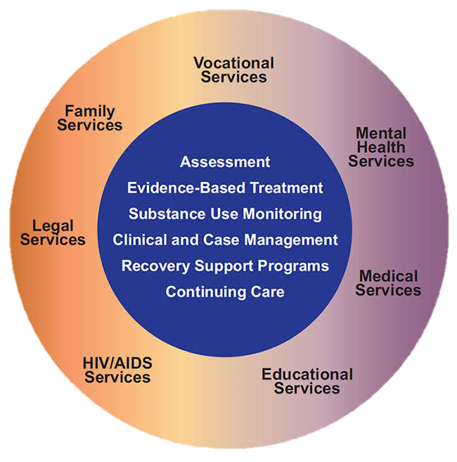
Case Management Services InSyst Procedure Codes
For OTPs, Case Management codes are being added to the InSyst Procedure Code lists.
Case Management Services do not count towards the Counseling services requirement

Slide 228
Discharge Planning 501 OTP-NTP Discharge Planning
Process to prepare the beneficiary for referral into another level of care, post treatment return or reentry into the community, and/or the linkage of the individual to essential community treatment, housing and human services
Discharge Services are not required to be in the plan in order to be claimed
IA.IV.24

Slide 229
Tracking Codes Exist for each program type
On the procedure code table there are several “Tracking Codes”
These are not codes for billing and have no claim associations
Tracking codes are required by CG on forms only, they should automatically populate in the corresponding form

Slide 230
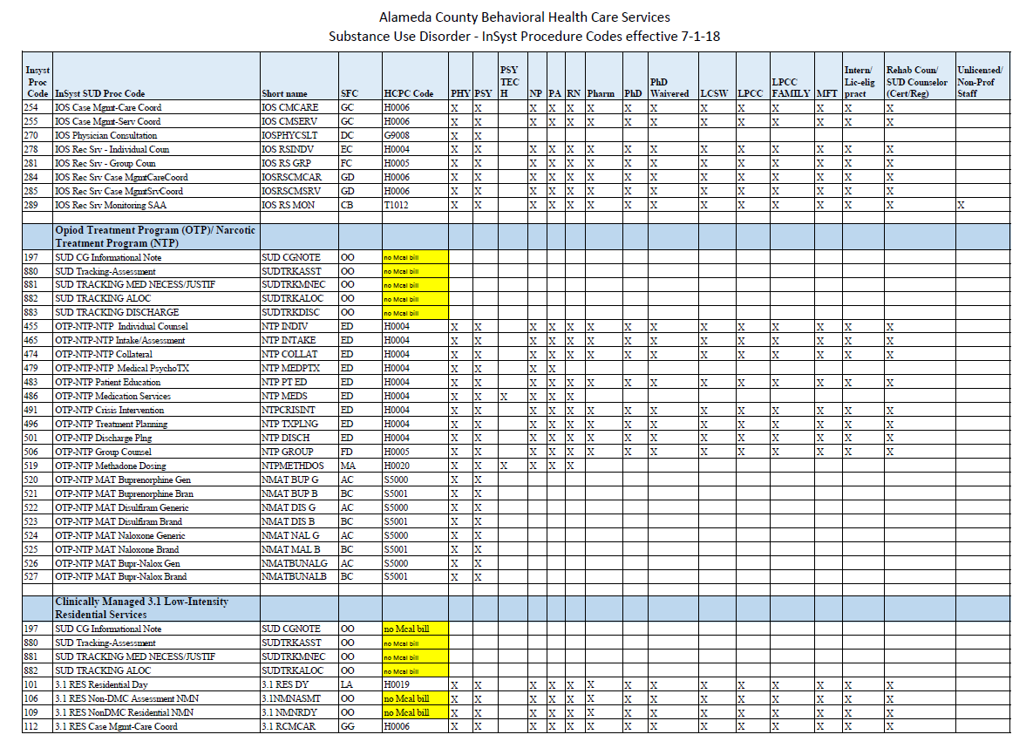
SUD InSyst Procedure Code Table

Slide 231
Continuing SUD Services
Beyond 6 months from date of admission

Slide 232
Continuing SUD Services 1 Requirements in the Regulations
In order to continue treatment, Title 9, Ch. 4 requires the medical director or physician to document the following in the chart:
At least annually, the medical director or physician must complete a periodic review or evaluation
Annually, after two continuous years of treatment, the medical director or physician, must document an evaluation that includes:
Evaluation of the client's progress, or lack of progress in achieving their treatment goals
Determination, in their clinical judgment that the client's status indicates that such treatment should be continued for a longer period of time because discontinuance from treatment would lead to a return to opiate addiction.
The IA requires continued services justifications every 5-6 months, that includes:
Primary Counselor/LPHA recommendation
LPHA determination of medical necessity for continuation of services
IA.III.PP.13
9 CCR § 10165
9 CCR § 10410

Slide 233
Continuing SUD Services 2 OTP Maintenance Treatment Requirements
Due to the significant differences between these requirements ACBH has asked DHCS for further clarification. We will let you know as soon as we have clarified this question.
Until DHCS provides clarification, OTPs should complete a primary counselor/LPHA recommendation in addition Title 9 requirements. Both must be done annually.
IA.III.PP.15
9 CCR § 10410.b
9 CCR § 10165.c.2

Slide 234
Continuing SUD Services 3 Counselor Recommendation Requirements
The Primary SUD Counselor/LPHA must review the beneficiary's progress and eligibility to continue to receive treatment services, and recommend whether the beneficiary should or should not continue to receive treatment services at the same level of care.
This recommendation must be completed by the Primary SUD Counselor/LPHA prior to the LPHA completing the Continuing Services Justification
IA.III.PP.15
9 CCR § 10410.b
9 CCR § 10165.c.2

Slide 235
Discharges from OTP Services

Slide 236
Treatment Termination Procedures
A client may voluntarily terminate participation in a program even though termination may be against the advice of the medical director or program physician
If the medical director or program director determines that the client's continued participation in the program creates a physically threatening situation for staff or other clients, the client's participation may be terminated immediately
A client's participation in a program may be involuntarily terminated by the medical director or program physician for cause
When discharge occurs on an involuntary basis, the provider must notify the beneficiary according to ACBH NOABD Policy
IA.III.PP.13
9 CCR § 10415

Slide 237
Treatment Termination Procedures
If a program utilizes disciplinary proceedings which include involuntary termination for cause, the program must include in its protocol reasons and procedures for involuntarily terminating a client's participation in the program. The procedures shall provide for:
Explanation to the client of when participation may be terminated for cause
Client notification of termination
Client's right to hearing
Client’s right to representation
If the program elects not to terminate for cause, the protocol must state that clients shall not be involuntarily terminated for cause except for safety reasons
IA.III.PP.13
9 CCR § 10415

Slide 238
Treatment Termination Procedures
Except for safety reasons, either voluntary or involuntary termination must be individualized, under the direction of the medical director or program physician, and take place over a period of time not less than 15 days, unless:
The medical director or program physician deems it clinically necessary to terminate participation sooner and documents why in the client's record
The client requests in writing a shorter termination period
The client is currently within a 21-day detoxification treatment episode
IA.III.PP.13
9 CCR § 10415

Slide 239
Discharge Summary or Discharge Plan?
Depending on the circumstances of the discharge, either a Discharge Plan or Discharge Summary must be completed
A discharge summary is a summary of treatment services, progress, and prognosis — it is only used when contact with the client is lost, all other discharges require a discharge plan
Must be completed within 30 days of last face-to-face service
A discharge plan is a plan to support client’s discharge from the program
A plan is developed in conjunction with the client and is intended to transition client from treatment services
Can be claimed when completed face-to-face with client
In order to be claimed, discharge plans must be prepared (discussed and signed with client) within 30 days prior to the last face-to-face treatment
IA.III.PP.13
9 CCR § 10415

Slide 240
Discharge Plan
Discharge Plans MUST include:
The date of discharge
The reason for the discharge
A summary of the client's progress during treatment
Description of each client’s triggers and a plan to assist the client to avoid relapse when confronted with triggers
A support plan
Complete signature of LPHA or counselor
Client’s legibly printed name, date, and signature
Must document that client was provided (or offered and reason for refusal) a copy of their discharge plan at the last face-to-face.
“Client discharged from the program” is not a discharge plan!
IA.III.PP.13
9 CCR § 10415

Slide 241
Discharge Summary Required when client contact is lost
The discharge summary must be completed within 30 calendar days of the last face-to-face contact with the beneficiary
Discharge Summary MUST include:
The client's name
Date of discharge
Duration of treatment (admission date to date of last service)
Reason for discharge and if discharge was involuntary or successful completion of SUD services
A narrative summary of the treatment episode
The client’s prognosis
A Discharge Summary is required (whenever contact is lost with a beneficiary) but it is not a claimable activity.
IA.III.PP.13
9 CCR § 10415

Slide 242
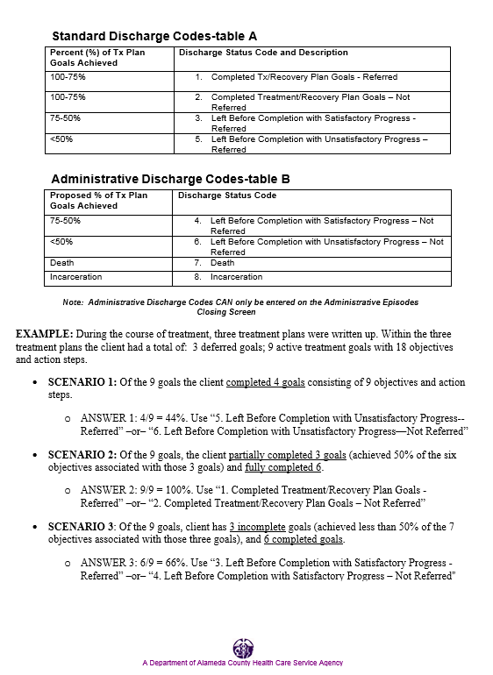
Discharge Codes California Outcome Measurements (CalOMS)
IA.III.FF.3

Slide 243
Discharge Codes California Outcome Measurements (CalOMS)
Standard Discharge Codes-table A
Percent (%) of Tx Plan Goals Achieved | Discharge Status Code and Description
100-75% | Completed Tx/Recovery Plan Goals - Referred
100-75% | Completed Treatment/Recovery Plan Goals – Not Referred
75-50% | Left Before Completion with Satisfactory Progress - Referred
<50% | Left Before Completion with Unsatisfactory Progress – Referred
Administrative Discharge Codes-table B
Proposed % of Tx Plan Goals Achieved | Discharge Status Code
75-50% | Left Before Completion with Satisfactory Progress – Not Referred
<50% | Left Before Completion with Unsatisfactory Progress – Not Referred
Death | Death
Incarceration | Incarceration
IA.III.FF.3

Slide 244
NOABDs, Grievances, Appeals, Fair Hearings

Slide 245
Notice of Adverse Benefit Determination NOABD
ACBH has recently updated it’s NOABD policy
Please refer to ACBH NOABD training materials and policy updates from Summer 2019
IA.II.G.2

Slide 246
What is a “grievance”?
Is an expression of dissatisfaction about any matter other than an adverse benefit determination.
Grievances may include, but are not limited to, the quality of care or services provided, and aspects of interpersonal relationships such as rudeness of a provider or employee, or failure to respect the enrollee's rights regardless of whether remedial action is requested.
Grievance includes an enrollee's right to dispute an extension of time proposed by the MCO, PIHP or PAHP to make an authorization decision.

Slide 247
Grievances
Grievances may be filed by a consumer or their designated representative to ACBH as follows:
By phone: (800) 779-0787 Consumer Assistance Line
Via US mail:
2000 Embarcadero Cove, Suite 400
Oakland, CA 94606
In person:
By visiting the provider site to obtain forms and assistance
By visiting Consumer Assistance at Mental Health Association, 954-60th Street, Suite 10, Oakland, CA 94608

Slide 248
Grievances, cont.
Draft ACBH P&P is in the handouts provided or on the providers’ website
ACBH encourages providers to utilize the ACBH grievance process instead of an internal grievance process

Slide 249
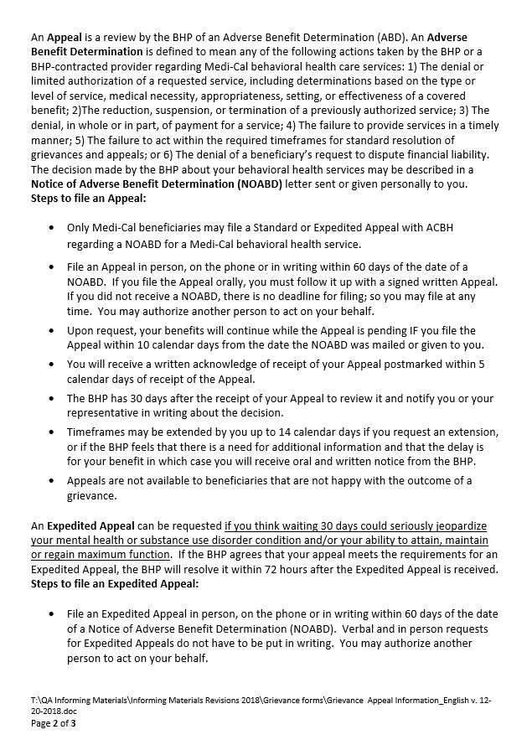
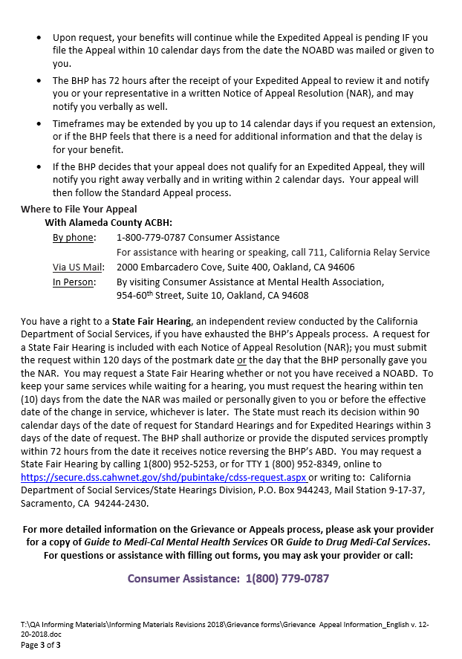
Grievance & Appeal Process

Slide 250
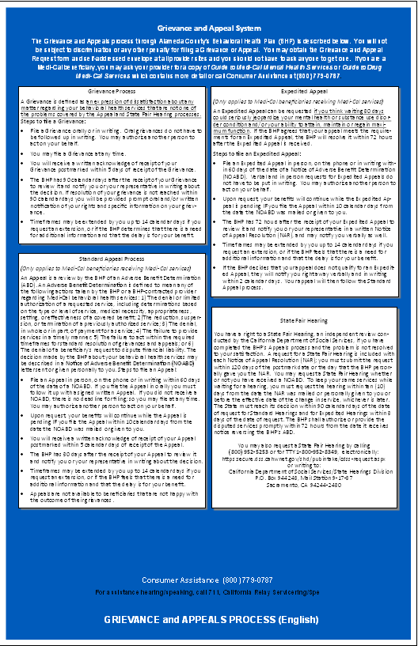
Grievances
All of the following ACBH Grievance materials must be posted and available in the lobby:
Poster
Forms
Envelopes
Beneficiaries with Grievances & Complaints of any type must be referred to the ACBH Grievance Line, see poster for more information

Slide 251
Miscellaneous Items

Slide 252
Visiting or Courtesy Dosing Requirements
A client must report to the same program to which he or she was admitted unless prior approval is obtained from the client's medical director or program physician to receive services on a temporary basis from another narcotic treatment program. The approval mustbe noted in the client's record and shall include the following documentation:
The client's signed and dated consent for disclosing identifying information to the program which will provide services on a temporary basis;
A medication change order by the referring medical director or program physician permitting the client to receive services on a temporary basis from the other program for a length of time not to exceed 30 days; and
Evidence that the medical director or program physician for the program contacted to provide services on a temporary basis has accepted responsibility to treat the visiting client, concurs with his or her dosage schedule, and supervises the administration of the medication, subject to Section 10210(d).
9 CCR § 10295

Slide 253
Visiting or Courtesy Dosing Requirements Billing Challenges
Billing for courtesy dosing has significant challenges, especially when the client’s Medi-Cal is from another county (out-of-county).
9 CCR § 10295

Slide 254
Visiting or Courtesy Dosing Requirements Admission and Documentation Requirements
Admission requirements do not change for visiting clients. Visiting clients’ services are considered temporary and may not exceed 30 days of services.
In most cases the assessment and treatment plan is unlikely to be required, as the due date for those documents is within 28 days from admission.
9 CCR § 10295

Slide 255
Minor Consent for SUD Services
Family Code § 6929 allows for minors aged 12 – 17 to consent for services related to the treatment of a drug or alcohol related disorder
Medication services and other types of treatment services that pose a higher client risk are typically not allowed without parental/guardian consent
DHCS has provided guidance that in order for Medi-Cal to be claimed for services where the minor has consented to treatment, the Medi-Cal Minor Consent Program must be used.
Remember children under 12 years old are NOT eligible for Minor Consent related to drug or alcohol abuse, a sexually transmitted disease or for outpatient mental health care.
Cal. Family Code § 6929, MHSUDS IN 14-002,
MHSUDS IN 18-061,
22 CCR § 50147.1,
22 CCR § 51473.2,

Slide 256
OTP Treatment of Minors
Detoxification treatment for individuals who are under 18 years of age requires written consent of their parent(s) or guardian prior to the administration of the first medication dose
State regulations do not allow maintenance treatment for individuals who are under 18 years of age. DHCS will review temporary exceptions to this rule with or without written consent of their parent(s) or guardian.
OTPs may seek exceptions to these requirement on an individual client basis by submitting a temporary exception request to DHCS.
Licensed OTPs may submit exception requests using Form SMA-168: Exception Request and Record of Justification. This form must be submitted to DHCS and the Substance Abuse and Mental Health Services Administration (SAMHSA) via the SAMHSA OTP Extranet website. In order to access Form SMA-168, OTPs must be logged into the Extranet website.
9 CCR § 10270
MHSUDS IN 18-061

Slide 257
SUD Lockouts
Beneficiaries with Medi-Cal and Medicare (Medi-Medi) are not eligible to receive SUD services. Refer the individual to their Medicare or primary care provider.
If a Medi-Cal beneficiary is incarcerated, claiming is not allowed on the days of incarceration
Services are allowed for adjudicated adolescents
Claiming is locked out after 60 days from EOD if out-of-county Medi-Cal has not transferred to Alameda County
SUD services additionally may not be allowed, due to duplication of service and same day billing considerations
SUD services are not locked out if the beneficiary is receiving mental health services, as long as there is not a duplication of services and the services provided remain medically necessary
DHCS MHSUDS 17-023
DHCS DMC Billing Manual 2017

Slide 258
DMC-OS Same Day Billing Matrix
(updated 5/25/2017)
DHCS MHSUDS 17-023
DHCS DMC Billing Manual 2017

Slide 259
Drug Medi-Cal Eligibility
Check Medi-Cal Eligibility at intake and the first week of each month (if any services are being claimed to Medi-Cal)
If client loses Medi-Cal eligibility, the provider should assist the beneficiary in regaining Medi-Cal.
If a beneficiary has out-of-county Medi-Cal but has moved to Alameda County, providers may begin SUD treatment but must immediately begin to work with the beneficiary to have their Medi-Cal switched to Alameda County.
The ACBH Network office can assist with this process → Contact ASAP after determination
No services can be claimed over 60 days for out-of-county Medi-Cal and all such services may not exceed the dollar amount indicated in the provider contract
ACBH Requirement

Slide 260
Other Insurance or Private Pay
If a beneficiary has another insurance, private pay, or funding source not directly or indirectly paid by Alameda County funds then those services are not subject to Alameda County SUD requirements.
These services may have other requirements and providers will need to check with the funding source for those specific requirements.
For questions, or to determine funding sources in complicated cases, contact ACBH (e.g. Kaiser Medi-Cal)

Slide 261
Drug Screening Requirements 1
All OTP clients are required to submit body specimens for testing
For clients receiving Detoxification treatment, drug tests are required prior to the first dose and any other time deemed necessary by the attending physician
For clients receiving Maintenance treatment drug tests or analyses are required prior to the first dose and then at least monthly
Providers may claim for time spent collecting of urine samples when deemed “medically indicated” and it is part of the intake or individual session
The provider must establish procedures which protect against falsification and/or contamination of the sample
Document the results in the file and if part of an individual session, may claim documentation time for this.
UA lab fees are not reimbursable by Drug Medi-Cal. Medi-Cal (physical health) may be an option for coverage of lab services.
IA.III.PP.7.viii
9 CCR § 10310

Slide 262
Drug Screening Requirements 2
What happens when there is a positive drug test?
9 CCR § 10310

Slide 263
InSyst
All staff who will be claiming to DMC need to be enrolled in InSyst
Registered and Certified counselors must have their InSyst Staff Mask indicate “Rehab Counselor” not “Unlicensed Staff”
Please refer to IS page on the ACBH provider website for more information about upcoming InSyst trainings and resources
http://www.ACBH.org/providers/Insyst/Insyst.htm

Slide 264
Backing out Claims in CG/InSyst
The process to back out claims depends on when the claim in question occurred
When a service has already been claimed, follow the Claims Correction instructions from ACBH Finance. Typically progress notes in CG must remain in the EHR as part of the evidentiary trail. → http://www.acbhcs.org/providers/Forms/Forms.htm#CCF
For backed out notes add an addendum to the note explaining the situation and the solution (i.e. service was replaced, or disallowed, etc.).
Always follow instructions from the IS, Network Office, or Finance regarding CG/InSyst. QA may not always have the most current information about InSyst/CG procedures.
When in doubt contact IS, Network Office, or Finance

Slide 265
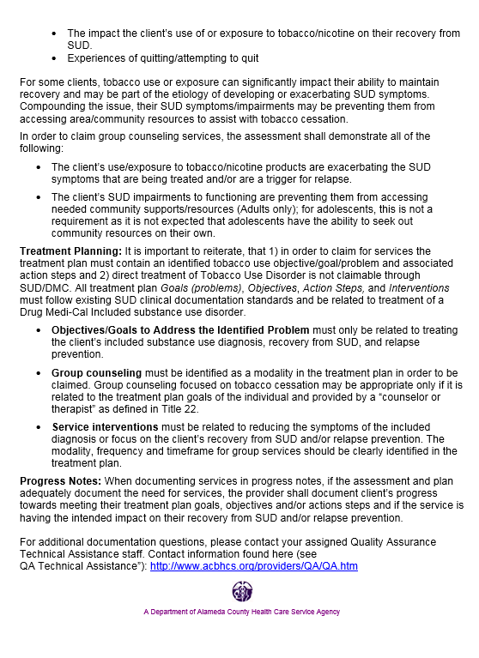
Tobacco Guidelines for SUD Providers
ACBH released a memo on 1/12/18 outlining treatment options for SUD beneficiaries who use, or whose lives are impacted by, tobacco products

Slide 266
Sources / Resources
DHCS INs: http://www.dhcs.ca.gov/formsandpubs/Documents/Info%20Notice%202015/Enclosure%204_15_30.pdf
42 CFR §: http://www.ecfr.gov/cgi-bin/text-idx?rgn=div5;node=42%3A1.0.1.1.2
IA: http://www.dhcs.ca.gov/provgovpart/Documents/DMC-ODS_Waiver/DMC-ODS_ExhibitA_AttachmentI_Boilerplate.pdf
CMS STC: http://www.dhcs.ca.gov/provgovpart/Documents/CAMedi-Cal2020STCsAmended04052018.pdf
Want to learn more about the DMC-ODS Waiver?
http://www.dhcs.ca.gov/provgovpart/Documents/11.10.15_Revised_DMC_ODS_FACT_SHEET.pdf
http://www.ACBH.org/providers/SUD/medi-cal.htm

Slide 267
42 CFR, Part 2 Final Rule Sources
42 CFR Part 2, Final Rule is effective as of February 2, 2018. Some resources are provided below:
https://www.federalregister.gov/documents/2018/01/03/2017-28400/confidentiality-of-substance-use-disorder-client-records
https://lac.org/wp-content/uploads/2018/01/Jan-2018-Final-Rule-Synopsis.pdf
https://lac.org/samhsa-revises-42-cfr-part-2-new-final-rule-confidentiality-substance-use-disorder-treatment-information/
https://www.psychiatry.org/psychiatrists/practice/practice-management/hipaa/42-cfr-part-2
https://www.asam.org/advocacy/issues/confidentiality-(42-cfr-part-2)

Slide 268
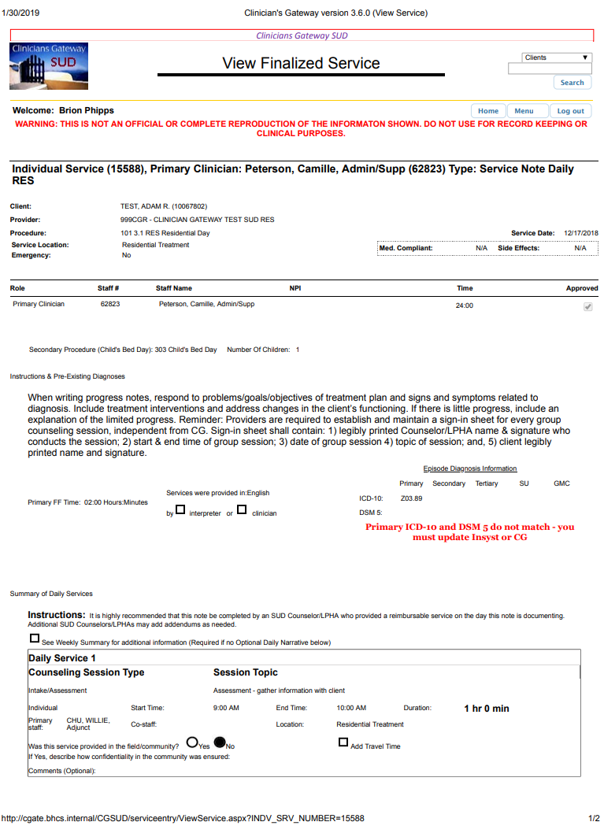
Printing in CG
If you see this warning on printed CG notes, the note was not printed correctly and is not a valid clinical document
When printing documents in Clinician’s Gateway for CQRT or audit purposes, you must print using the proper print method.
There is a PRINT button at the bottom of the screen
Or you can search and tag
Both of these methods essentially download the requested documents as PDF and then they can be printed as official documents.
If printed using CTRL-P or the browser’s print dialogue a notification will be printed in red on the top of documents printed this way indicating they are not valid.

Slide 269
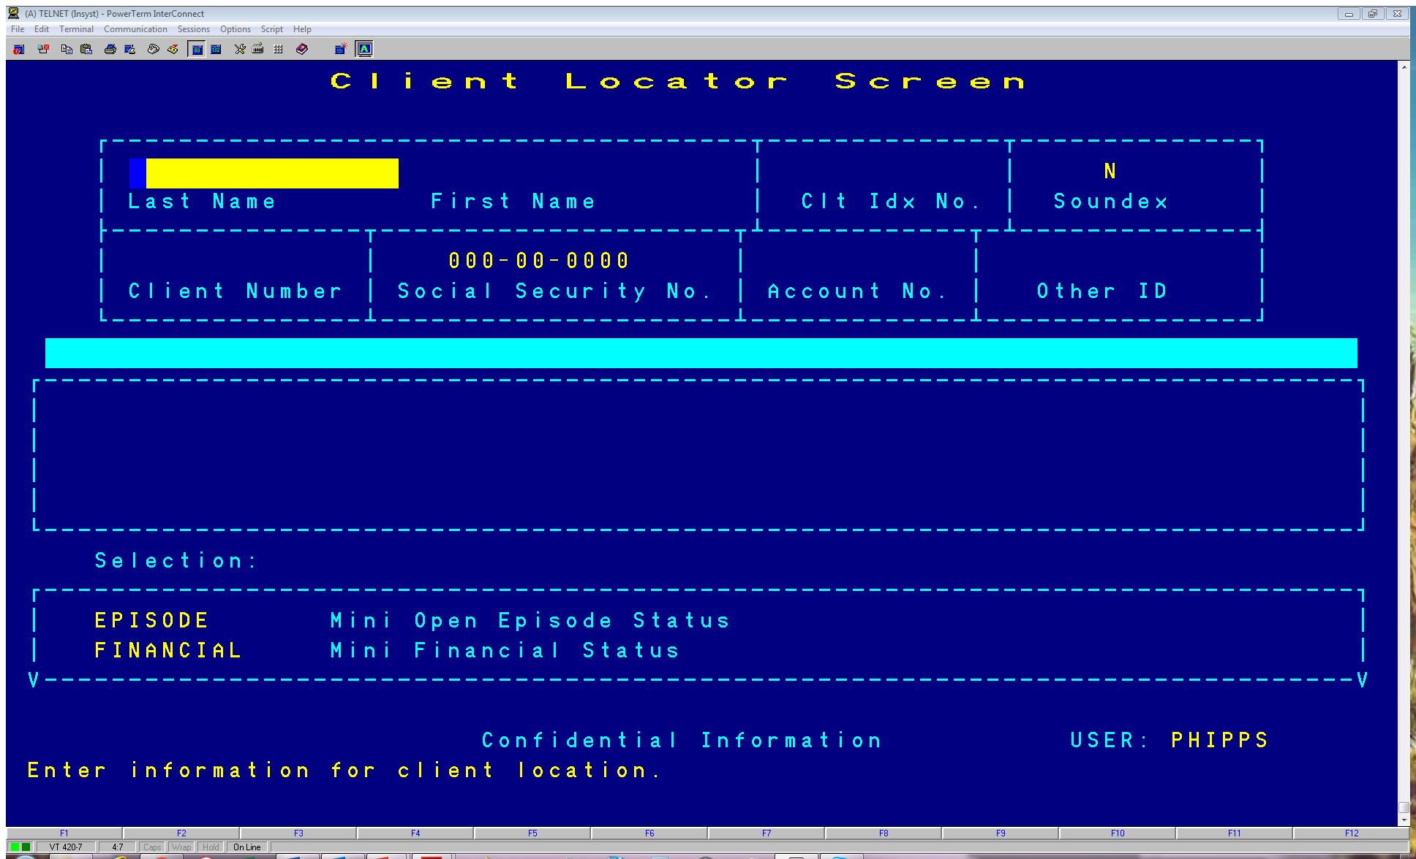
How to Print InSyst Face Sheet
Navigate to the InSyst Client Locator Screen (1,7 from main menu)
With the client’s information on the InSyst Client Locator Screen press Num-Lock + F, then press F6
This will print the client’s InSyst Face Sheet to the designated printer
These instructions are also in the InSyst Mini-Manual

Slide 270
How to Update Emergency Contact Information

Slide 271
How to Update Emergency Contact Information

Slide 272
How to Update Emergency Contact Information

Slide 273
Inserting Significant Other Info if None was Entered at Episode Opening

Slide 274
Updating Significant Other Information that has already been entered

Slide 275
How to Update Emergency Contact Information

Slide 276
Face Sheet with Emergency Contact Info

