Slide 1
INSYST Update for MH and SUD Clients
Effective: 03/22/2017
Client Registration
  New MHS field: Veteran Status
Episode Open and Closing:
  MHS & SUD- Ability to enter ICD-10 Diagnosis Codes
  MHS – New Field for General Medical Code (GMC)
  MHS – Nurse Practitioner allowed in the Physicians field
MHS – Only a selected group of Programs will be using the new PEI (Prevention and Early Intervention) screens.

Slide 2
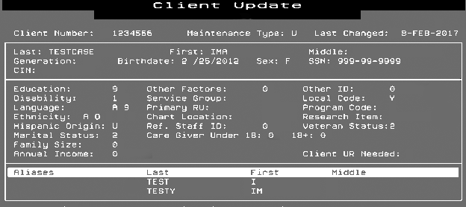
Mental Health Clients’ Registration
New mandatory MHS fields are included during the Client registration
VETERANS STATUS:
  Valid values are numeric:
    1 - Yes
    2 – No
    3 - Declined to answer.

Slide 3
Episode Open and Closing:
MHS & SUD- Ability to enter ICD-10 Diagnosis Codes
Continue to use DSM-IV to crosswalk the primary diagnosis to the ICD-10 diagnosis code through March 31, 2017.
Effective April 1, 2017, begin using the new ICD-10 InSyst fields according to information stated in the Quality Assurance Memos dated 3-22-17.
  See QA Memo: Final ACBHCS DSM-5 and ICD-10 Implementation rev. 3.22.17:
  located on the Providers Website under the Quality Assurance / Memos and Notices

Slide 4
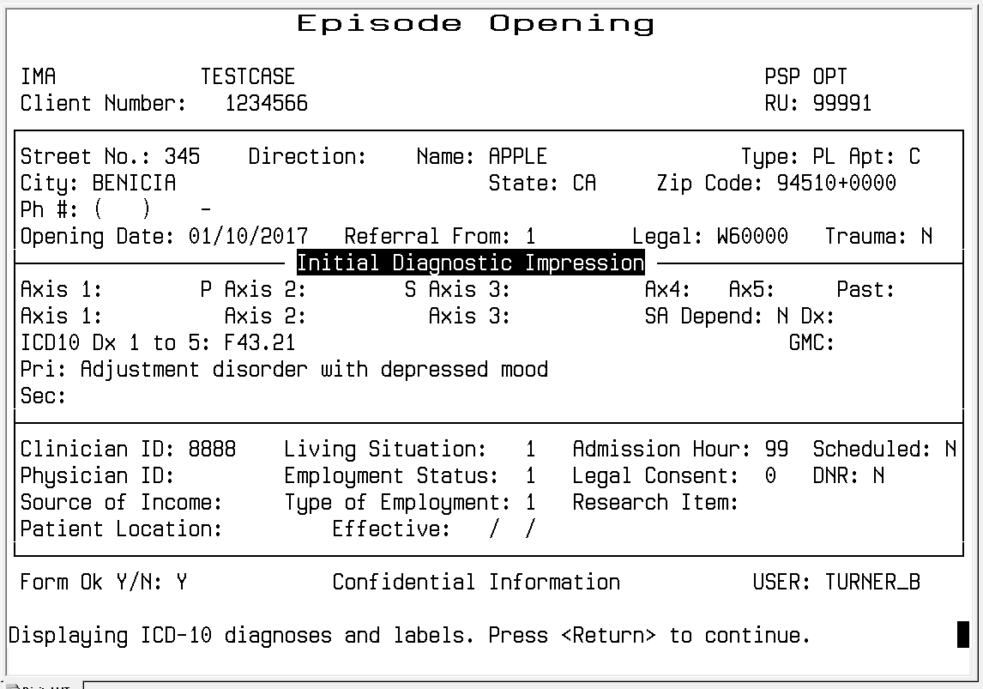
Mental Health Clients’ Episode Open / Closing:
MH - Ability to enter ICD-10 Diagnosis Codes
New ICD10 diagnoses codes fields-Dx #1, Dx #2, Dx #3, Dx #4 & Dx #5:
Primary (Dx-1) and Secondary (Dx-2) fields accept Included ICD-10 Mental Health (“F” series as well as “No Diagnosis” = z03.89 or “Deferred Diagnosis” = R69) diagnosis codes.
The Third (Dx-3), Fourth (Dx-4), and Fifth (Dx-5) fields accept Included Mental Health or Physical Health diagnosis codes.
The ICD-10 Diagnosis description (name) will auto populate from the Primary (Dx-1) and Secondary (Dx-2) ICD-10 diagnosis code value.

Slide 5
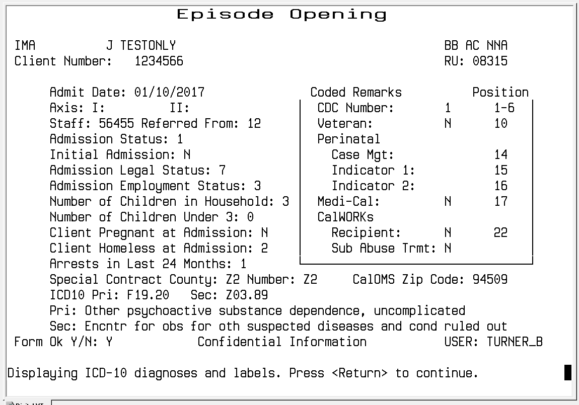
SUD Clients’ Episode Open and Closing:
SUD - Ability to enter ICD-10 Diagnosis Codes
New ICD10 diagnoses codes fields:
Primary and Secondary fields accept valid ICD-10 diagnosis codes (F10-F19)
The ICD-10 Diagnosis description will auto populate from the Primary (Prim) and Secondary (Sec) ICD-10 diagnosis code value.

Slide 6
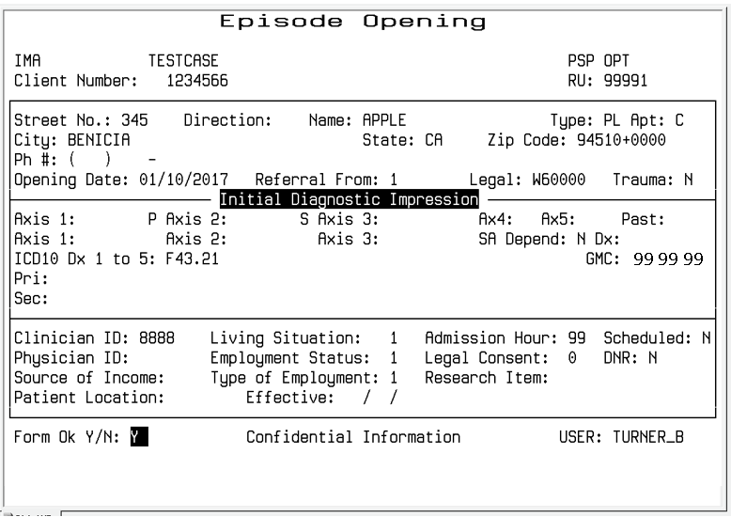
  Mental Health Clients’ Episode Open /Closing:
  New Field for General Medical Code (GMC)
New GMC codes fields (enter up to 3)
  Standard GMC codes still apply
GMC code values located on the Providers Website under the InSyst Menu / Forms.
Link to the General Medical Condition Summary Codes displayed by code
Axis 3 is no longer available - do not enter GMC Codes here
Axis 4 and Axis 5 fields are no longer used (no input required).
SA Depend: Y or N Dx:_____ (F10-F19)
  Y = Yes requires Dx
  N = No Dx

Slide 7
Mental Health Clients’ Episode Open / Closing:
Nurse Practitioner allowed in the Physicians field
Nurse Practitioner allowed in the Physicians field

Slide 8
Mental Health PEI Screens
Training will be provided at a later date for the Programs that will be using this new screens to collect PEI data as required by the State.
If you wish further information regarding the PEI screen please contact the Help Desk at (510) 567-8181

Slide 9
Contact Information
Information Systems Help Desk:
InSyst Data Entry/ Staff # Assistance
InSyst Reports
(510) 567-8181
InSyst Data Entry Training:
Helpdesk (510) 567-8181
Willie Chu (510) 383-1591
Quality Assurance:
DSM-5 & ICD-10 related questions
(510) 567-8105 QAOffice@acbhcs.org

